Slide 1

Face Recognition: A Comparison of Appearance-Based Approaches
Thomas Heseltine
Advanced Computer Architecture Group
Department of Computer Science - University of York
www.cs.york.ac.uk/~tomh
tom.heseltine@cs.york.ac.uk

Slide 2
Introduction
Growing interest in biometric authentication
  National ID cards, Airport security (MRPs), Surveillance.
  Fingerprint, iris, hand geometry, gait, voice, vein and face.
Face recognition offers several advantages over other biometrics:
  Covert operation.
  Human readable media.
  Public acceptance.
  Data required is easily obtained and readily available.
Approaches include:
  Feature analysis, Graph matching, Appearance-Based.

Slide 3
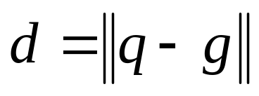
Direct Correlation
A facial image of 65 by 82 pixels contains 5330 intensity values, describing a point in image space.
Similar face images are close in image space, whereas different faces are far apart.
The similarity of any two face images can be measured by the Euclidean distance between the two faces in image space.
An acceptance / rejection decision can then be made by applying a threshold to this distance measure.
.

Slide 4






Eigenfaces
PCA is applied to a training set of 60 facial images and the top 59 eigenvectors with the highest eigenvalues taken to represent face space.
Any face image can then be projected into face space as a vector of 59 coefficients, indicating the ‘contribution’ of each corresponding eigenface.
Face images are compared by calculating the Euclidean distance between eigenvector coefficients.
Each eigenvector can be displayed as an image and due to the likeness to faces, Turk and Pentland refer to these vectors as eigenfaces.

Slide 5





Fisherfaces
Similar to the eigenface approach, yet able to account for variations between multiple images of the same person.
Utilises a larger training set containing multiple images of each person.
The ratio of between-class and within-class scatter matrices is calculated.
The eigenvectors of this matrix are then taken to formulate the projection matrix.
The low dimensional sub-space created maximises between-class scatter, while minimising within-class scatter.

Slide 6
Limitations
System effectiveness is highly dependant on image capture conditions.
Variations in lighting conditions.
  Different lighting conditions for enrolment and query.
  Bright light causing image saturation.
Differences in pose – Head orientation.
  2D feature distances appear to distort.
Image quality.
  CCTV, Web-cams etc. are often not good enough.
Expression (change in feature location and shape).
Partial occlusion (Hats, scarves, glasses etc.).
Meaning face recognition systems are usually not as accurate as other biometrics, producing error rates that are too high for many of the applications in mind.

Slide 7
Possible Solution
There are many image representations and filtering techniques that reduce the effect of lighting conditions and improve image quality
        Colour normalisation
        Histogram equalisation.
        Edge detection.
        Noise reduction.
Such methods are known to improve face recognition systems.
However, it is not known how these improvements vary between different approaches.
Is there a universal filter that improves all face recognition methods?

Slide 8
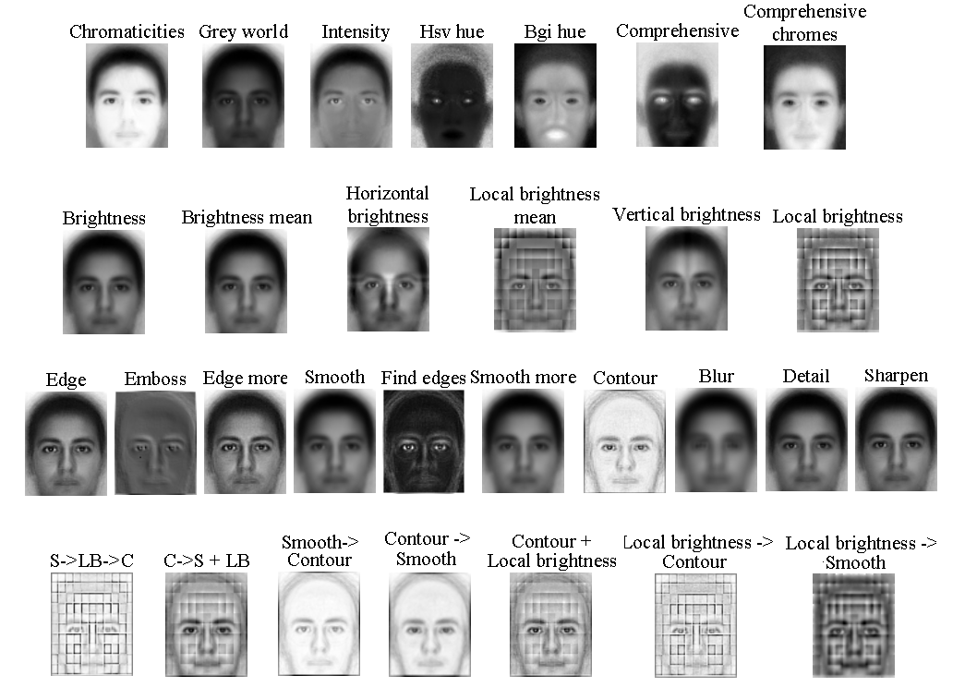

Slide 9






Test Database
960 bitmap images of 120 individuals (60 male, 60 female) extracted from the AR Face Database provided by Martinez and Benavente [10]. All images are translated, rotated and scaled, such that the centres of the eyes are aligned.
The database is separated into two disjoint sets:
  The training set, (240 images: 4 images of 60 different people, captured under a variety of lighting conditions with various facial expressions).
  The test set, (720 images: 12 images of 60 people, captured under a variety of conditions, captured under a variety of lighting conditions with various facial expressions).
Test image conditions repeated on two separate days

Slide 10
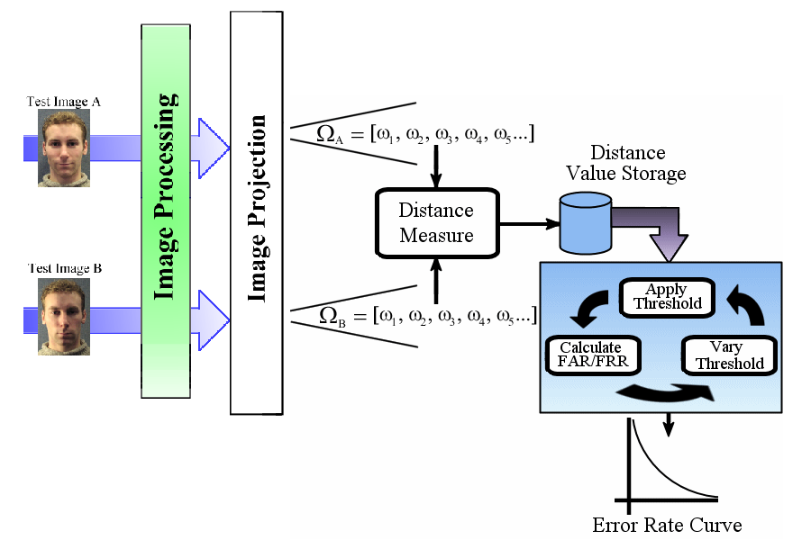
Test Procedure
  Comparing every image with every other image provides 258,840 verification operations to calculate false rejection rates and false acceptance rates.

Slide 11
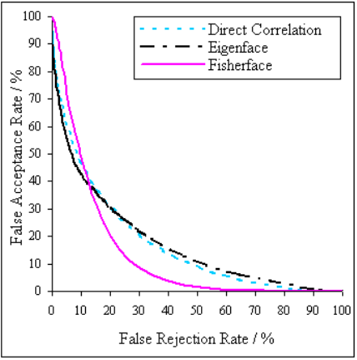
Output
FAR
The percentage of incorrect acceptances - distance measures below the threshold, when images of different people are being compared.
FRR
The percentage of incorrect rejections - distance measures above the threshold when images of the same person are being compared.
By varying the threshold we obtain error rate pairs describing a curve.
The EER is used to compare pre-processing techniques.
However, it should not be used as a guideline to the system performance in a real world situation.

Slide 12
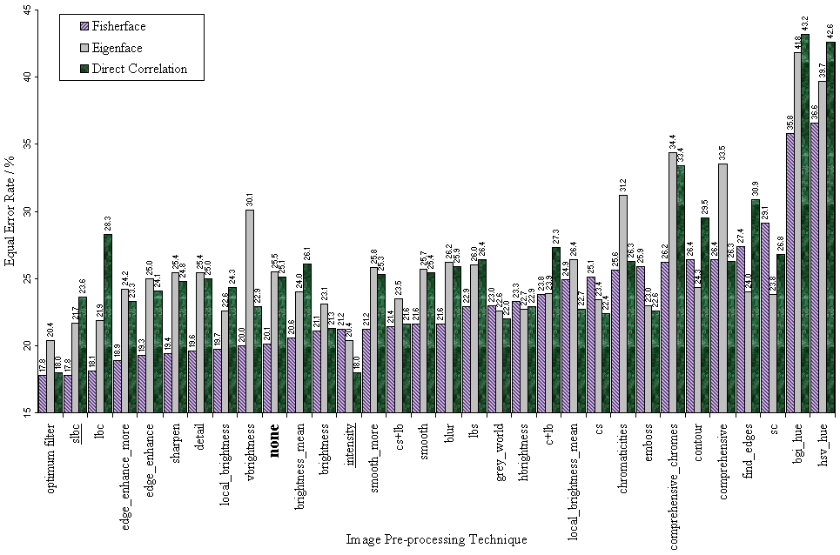
Equal Error Rates

Slide 13
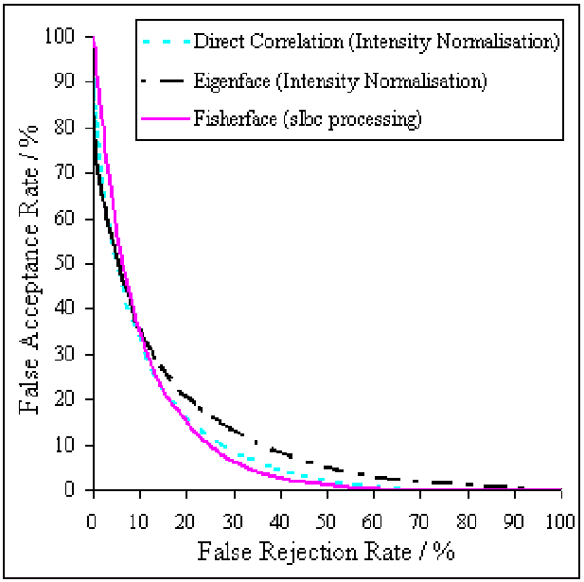


Optimum Systems
Fisherface - 17.8% EER
slbc processing
Direct Correlation - 18.0% EER
Intensity Normalisation
Eigenface 20.4% - EER
Intensity Normalisation

Slide 14
Conclusion
All three of the systems tested are improved significantly by application of image pre-processing techniques.
In general the fisherface method produces the lowest error rates.
Each system is affected differently by different pre-processing techniques. Some techniques may improve one system while having a detrimental effect on another.
The most effective system uses “slbc” pre-processing technique, when applied to the fisherface method of face recognition.
However, this is only marginally better than the direct correlation method.

Slide 15
References
1. Brunelli, R., Poggio, T.: Face Recognition: Features versus Templates. IEEE Transactions on Pattern Analysis and Machine Intelligence 15 (1993) 1042-1052
2. Turk, M., Pentland, A.: Eignefaces for Recognition. Journal of Cognitive Neuroscience, Vol.3, (1991) 72-86
3. Turk, M., Pentland, A.: Face Recognition Using Eignefaces. In Proc. IEEE Conf. On Computer Vision and Pattern Recognition. (1991) 586-591
4. Belhumeur, P., Hespanha, J., Kriegman, D.: Eigenfaces vs. Fisherfaces: Face Recognition using class specific linear projection. In Proc. ECCV, (1996) 45-58
5. Heseltine, T., Pears, N., Austin, J.: Evaluation of image pre-processing techniques for eigenface based face recognition. In Proc. of the Second International Conference on Image and Graphics, SPIE vol. 4875, (2002) 677-685
6 Marcialis, G., Roli, F.: Fusion of LDA and PCA for Face Recognition. Department of Electrical and Electronic Engineering, University of Cagliari, Piazza d’Armi
7. Finlayson, G., Schaefer, G.: Hue that is Invariant to Brightness and Gamma. BMVC01, Session 3: Colour & Systems, (2001)
8. Finlayson, G., Schiele, B., Crowley, J.: Comprehensive Colour Image Normalisation. In Proc. ECCV '98, LNCS 1406, Springer, (1998) 475-490
9. Martinez, A., Benavente, R.: The AR Face Database. CVC Technical Report #24, (1998)

