Slide 1
Eigenface for Face Recognition
Presenter: Trần Đức Minh

Slide 2
Outline
Overview
Eigenfaces for Recognition
Conclusion

Slide 3
Overview
Face Representation
  Template-based approaches
  Feature-based approaches
  Appearance-based approaches
Face Detection
  Utilization of elliptical shape of human head (applicable only to front views ☹) [5]
  Manipulation of images in “face space” [1]
Face Identification
  Performance affected by scale, pose, illumination, facial expression, and disguise, etc.

Slide 4
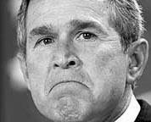
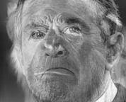
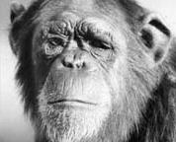
Face space
=
+
An image is a point in a high dimensional space
  An N x M image is a point in R^{NM}
  We can define vectors in this space as we did in the 2D case

Slide 5
Outline
Overview
Eigenfaces for Recognition
Conclusion

Slide 6
Eigenfaces Approach
In the language of information theory……
  Efficient encoding followed by comparing one face encoding with a database of models encoded similarly

Slide 7
Eigenfaces Approach (Contd.)
In mathematical terms…….
  Find the principal components of the face distribution, or the eigenvectors of the covariance matrix of the set of face images, called eigenfaces
  Eigenfaces are a set of features that characterize the variation between face images
  Each training face image can be represented in terms of a linear combination of the eigenfaces, so can the new input image
  Compare the feature weights of the new input image with those of the known individuals

Slide 8
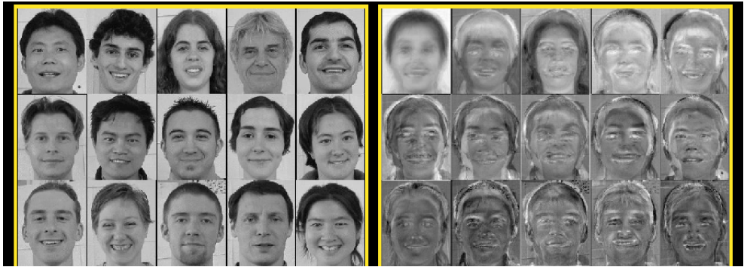
Example for eigenface
Eigenfaces look somewhat like generic faces.

Slide 9
Major Steps
Initialization: acquire the training set of face images and calculate the eigenfaces, which define the face space
Given an image to be recognized, calculate a set of weights of the M eigenfaces by projecting it onto each of the eigenfaces
Determine if the image is a face at all by checking if the image is sufficiently close to the face space
If it is a face, classify the weight pattern as either a known person of as unknown
(Optional) If the same unknown face is seen several times, update the eigenfaces / weight patterns, calculate its characteristic weight pattern and incorporate into the known faces

Slide 10



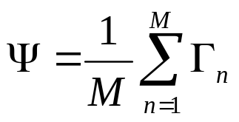




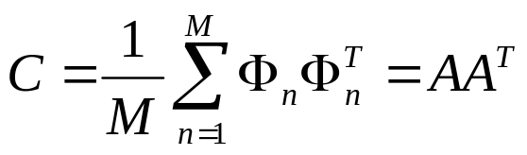



Calculating Eigenfaces
Set of training images ( is a column vector of size )
Average face of the training set:
Each training image differs from the average face by:
A total number of pairs of eigenvectors and eigenvalues of the covariance matrix
(C: matrix) Eq. (1)
where (A: matrix)
Computationally Intractable☹!

Slide 11








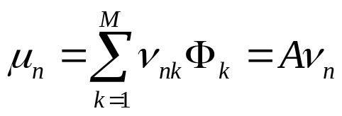
Calculating Eigenfaces
For Computational Feasibility
Only M - 1 eigenvectors are meaningful ( )
Eigenvectors and associated eigenvalues of :
Eq. (2)
Therefore, are the eigenvalues of , are the associated eigenvalues
Eq. (3)
The associated eigenvalues allow us to rank the eigenvectors according to their usefulness in characterizing the variation among the images

Slide 12



Using Eigenfaces for Identification
Construction of Known Individuals’ Face Classes
-- Images of known individuals are projected onto “face space” by a simple operation , where i=1, 2, ……, M represents the ith individual, and k =1, 2, ……, M’ represents the weight coefficient of eigenvector . The pattern vector of the ith individual
-- If an individual has more than one image, take the average of the pattern vectors of this person

Slide 13


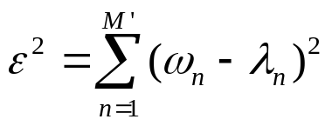





Using Eigenfaces for Identification (Contd.)
Given a new image
-- Project onto face space, and get its pattern vector
-- Determine whether is a face image: Eq. (4)
If < a predefined threshold , it is a face image; otherwise, not
-- Classify either as a known individual or as unknown:
Eq. (5)
If < a predefined threshold , is identified as the k’th face class; otherwise, it is identified as unknown

Slide 14
Outline
Overview
Eigenfaces for Recognition
Conclusion

Slide 15
Advantages
Ease of implementation
No knowledge of geometry or specific feature of the face required
Little preprocessing work

Slide 16
Limitations
Sensitive to head scale
Applicable only to front view
Good performance only under controlled background (not including natural scenes)

Slide 17
Reference
“Eigenfaces for recognition”, M. Turk and A. Pentland, Journal of Cognitive Neuroscience, vol.3, No.1, 1991
“Face recognition using eigenfaces”, M. Turk and A. Pentland, Proc. IEEE Conf. on Computer Vision and Pattern Recognition, pages 586-591, 1991
Lindsay. I. Smith. A tutorial on principal components analysis, February 2002
Ilker Atalay M.Sc Thesis: Face Recognition Using Eigenfaces Istanbul Technical University – January 1996
Dimitri Pissarenko, Eigenface-based facial recognition, Feb 06, 2003

Slide 18
Demo

Slide 19
Thank you

