Slide 1
COMP 5527
Mobile Computing and Data Management
Lab One
2012.2.15

Slide 2
Outline
MVC Architecture
Objective-C Language
iOS Application Development
slide <number>

Slide 3
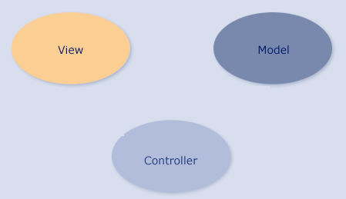


MVC
“Model, View, Controller” (MVC) is prevalent in iPhone programming
  Model: the abstract data about your problem space
  View: the visual elements of the application
  Controller: code that glues the model and view together
slide <number>

Slide 4
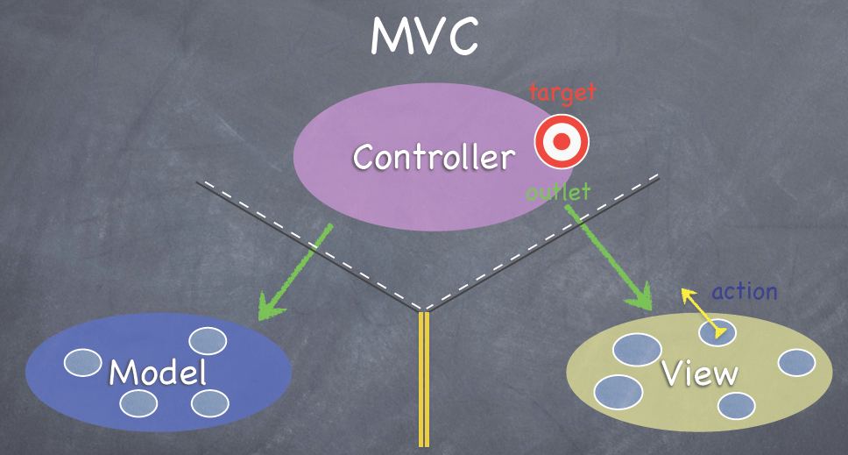
Communication in MVC
The controller can always talk directly to the Model.
The controller can also talk directly to the View.
The view can send a action to a target in the Model.
slide <number>

Slide 5
Objective-C language
Class Declaring and Implementation
Method Declaring and Calling
Variable Type
slide <number>

Slide 6
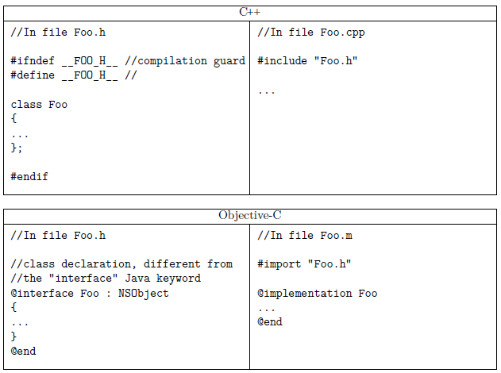
Organization of source code
slide <number>

Slide 7
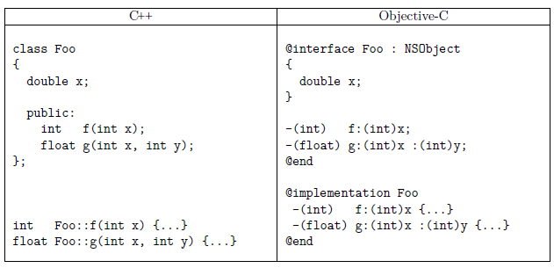
Class Declaration
slide <number>

Slide 8
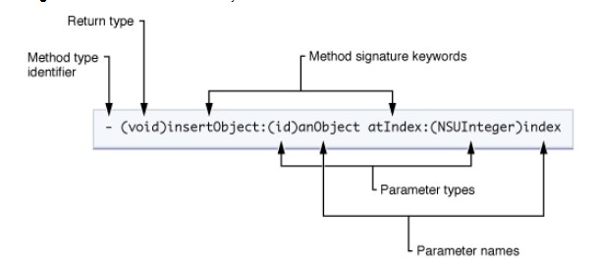
Method Declaration
void inserObjectatIndex (id anObject, NSUInteger index)
slide <number>

Slide 9
Messaging vs Method Call
Methods are called using message communication
Method calling can be nested
  Objective C
  [Caculator setOperand:[DataGenerator generateRandomDigit]]
  C++
  Caculator.setOperand(DataGenerator.generateRandomDigit())
C++ format | Objective C format
object.doSomething() | [object doSomething]
object.doSomething(var1) | [object doSomething:var1]
object.doSomething(var1, var2) | [object doSomething:var1:var2 ]
slide <number>

Slide 10
Variable Type
Variable type “id”
  The “id” is a generic type that Objective-C uses to represent an arbitrary object.
  All objects therefore are of type “id”.
  Use it conveniently and cast it to real type later
  eg: -(IBAction)sayHello:(id) sender;
slide <number>

Slide 11
iOS Application Development
Develop an application “Hello World”
slide <number>

Slide 12
Thank You!!
slide <number>

