Slide 1
1. Service Design – Overview

Slide 2
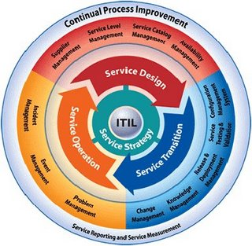
Recap on ITIL Service Cycle

Slide 3
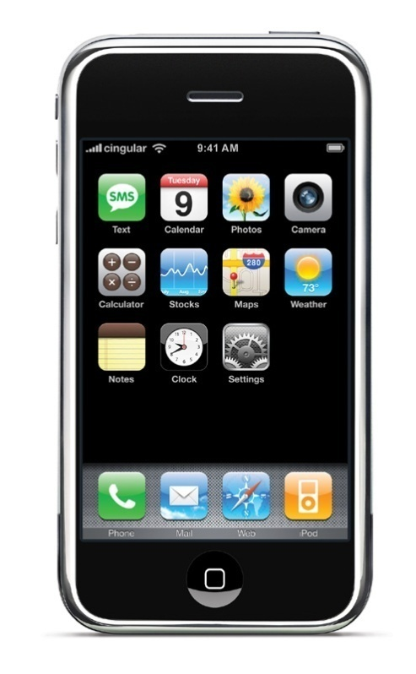

Product vs Service
Good Product Design?
Good Service Design?

Slide 4
What makes a good business process? ( Davis R. 2009 )
Effective ( can achieve its objective? )
Relevant ( crucial to the business )
Efficient ( no waste, unnecessary steps, multiple handover )
Usable ( Is it practical ?)
Reused ( modularity )
Managed ( process owner ? )
Measured ( process metrics )

Slide 5
2. Service Design Principles
Goals
Identifying service requirements
Design activities
Design aspects
Service Design models

Slide 6
Goal of Service Design
The design of appropriate and innovative IT services, including their architectures, processes, policies and documentation, to meet current and future agreed business requirements

Slide 7
Design process activities
Requirements collection, analysis and engineering
Design of appropriate services, technology, processes and process measurement
Production and maintenance of IT policies and design documents
Plan for the deployment and implementation of IT strategies using roadmaps, programmes
Risk assessment

Slide 8
Service Design Aspects
Design of the services (requirement, resources, capacities )
Design of the management system and tools
Technology architectures design
Design of the processes and roles
Design of the measurement methods and metrics of the services

Slide 9
Design Aspects for Incident Management
Collect requirements to set up a service desk, examine required resources and capabilities
Management system: e.g. need a knowledge database, escalation matrix, service level
Technology architecture: solicit service management software, monitoring tools
The process flow, e.g. process lifecycle from incident opening to closure
Measurement: How to measure service level

Slide 10
Main Service Delivery Strategy
In-sourcing
Outsourcing
Co-sourcing
Partnership ( multi-sourcing )
Business Process Outsourcing (BPO), e.g. outsourcing whole data centre
Application Service Provision ( utility service model )
Knowledge Process Outsourcing ( e.g. outsource R&D)

Slide 11
4 Ps for good IT service design
People ( skills and competencies )
Products ( Technology and management systems employed in IT service delivery)
Processes (Processes, Roles and Activities)
Partners(Vendors, Manufacturers and Suppliers)

Slide 12
Service Design Processes
Service Catalogue Management (SCM)
Service Level Management (SLM)
Availability Management
Capacity Management
IT Service Continuity Management
Information Security Management
Supplier Management

Slide 13
3. Service Design –
Service Catalogue Management & Service Level Management
By Dr. Franklin Leung

Slide 14
What is a Service Catalog?
A Service Catalog provides a clear description of all services offered and includes details about each service, e.g. who is able to use the service, who to contact for support, services hours and location, etc.

Slide 15
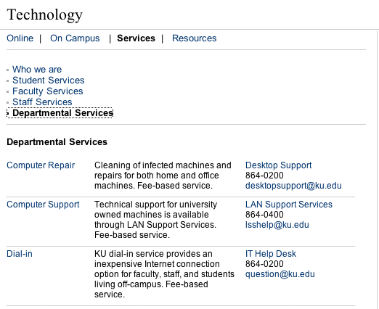
How about a better alternative?

Slide 16
Components of a Service Catalog
Service
Listing
Service
Details
Service
Level
Agreement

Slide 17
Service details
Service details contains items such as:
Description (what service is this?)
Main users (who use this service?)
Functionality (what does this service provide?)
Availability (when is this service available?)
User support (when and from who is support available?)
Any associated costs

Slide 18
Simple example of a Service Catalogue
Service | Customer | Accounts | Legal | Sales | HR | Retail
Payroll |  | X | X
E-mail |  | X | X | X | X | X
Invoicing |  | X |  | X |  | X
Internet |  | X | X | X | X
Intranet |  | X | X | X | X | X

Slide 19
Service Catalog Project Highlights
Create service details for all currently displayed services.
Create Service Level Agreements for all services
Gather information on other services not currently listed.
Promote, revise, and improve.

Slide 20
Service Level Management
Service Level Management (SLM) is an IT “best practice” process that includes an ongoing review of services.
SLM includes agreeing, monitoring , measuring, reporting, and reviewing services.
Service Level is customer-centric ( user-centric ) and users should be able to understand the service level metrics ( that is, the metrics should not be technical )

Slide 21
Example of Service Level
Time periods when service is available
Response time provided by a computer system
Turnaround time from order to delivery after placing an order request for computer equipment
Number of rings ( or number of seconds) within which the call for service desk will be picked
Recovery time for critical failure

Slide 22
Goals of Service Level Management
Maintain & improve IT Service Quality, through a constant cycle of agreeing, monitoring & reporting upon IT Service achievement & instigation of actions to eradicate poor service

Slide 23
Components of SLM
( Service Level Management )
Service
Catalog
Service
Level
Agreements
Operational
Level
Agreements
Underpinning
Contracts

Slide 24
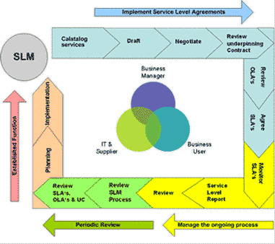

Slide 25
Scope of Service Level Management
SLAs should be established for all IT Services being provided. Underpinning Contracts & Operational Level Agreements ( OLAs ) should also be in place with all those suppliers upon who the delivery of service is dependent

Slide 26
What is a Service Level Agreement
An SLA is a formal negotiated agreement that defines in quantitative terms the service being offered to a customer. Any metrics included should be capable of being measured on a regular basis. SLAs should be renegotiated whenever a business service is subject to change.

Slide 27
Components (Cont’d)
Service Level Agreements (SLA) – established between users and IT service provider
Operational Level Agreement (OLA) – established between the Service Manager and internal teams within IT ( e.g. Network Team agrees to provide networks service at a defined service level, Database Team agrees to provide database service at a defined level
Underpinning Contracts (OC) – established between Service Provider and External Vendors

Slide 28
Accenture Case
A new initiative for IT Department to provide clear and verifiable service levels for each of the IT Products and Services offered. The optimal service levels would be determined by what users require.

Slide 29
SLM Key Concepts
Planning the Process
Implementing the Process
Ongoing Process

Slide 30
SLM – Planning the process
Initial planning activities
Plan monitoring activites
Establish perception of the services
Underpinning contacts and OLAs

Slide 31
SLM – Implementing the Process
Managing the expectation of the customer
Seeking agreement on the service level
SLA structures
- Service based
- Customer based
- Multi-level SLAs

Slide 32
Multi-Level SLAs Structure
Corporate Level SLA ( covering generic SLM issues appropriate to every customers )
  Customer Level SLA ( covering all SLM issues relevant to a particular customer )
    Service Level SLA ( Covering all SML issues relevant to the specific service )

Slide 33
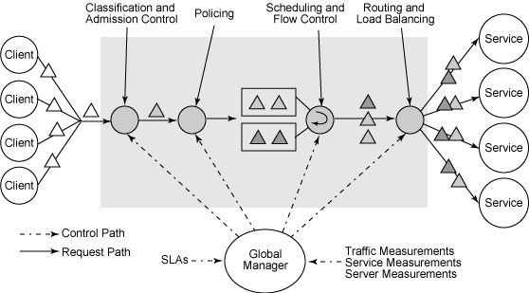

Slide 34
SLM – Implementing the Process
SLRs – Service Level Requirements & draft SLA ( interactive process )
Wording of SLAs ( terminology, style & culture)
Seek agreement ( with the owner & negotiate )
Establish monitoring capabilities ( if you can’t measure it, don’t put it in )

Slide 35
SLM – Implementing the Process ( Cont’d)
Review underpinning contracts ( agreements with external suppliers )
Review OLAs – Operational Level Agreements ( agreements with internal support groups )
Define reporting & review procedures (agreed with customer)

Slide 36
Examples of SLA Content
Service Description
Introduction & Administration
Service Hours
List of Services and expected performance levels (Throughput, availability & reliability)
Transaction responses times & batch turnaround time
Change Procedures
Charging

Slide 37
Examples of SLA content (Cont’d)
Roles and responsibilities clearly defined (both client and service providers )
Pricing and performance based incentives and penalties
Security, Service Continuity ( e.g. backup data centre ) and Intellectual Property Ownership
Frequency of performance reporting and review
Clearly defined processes for changes to SLA
Terms of voiding and termination of agreement

Slide 38
Awareness campaign
Existence of new SLA must be advertised
Service Desk & support groups must receive details of when new SLAs become operational
Display tables of key targets for support areas
Customers must also be included in the awareness campaign

Slide 39
SLM – Ongoing Process
Monitoring SLAs (Automated tools can include thresholds to allow alerts & escalations)
Reporting SLAs
Service Review Meetings
Maintenance of SLAs, contracts & OLAs

Slide 40
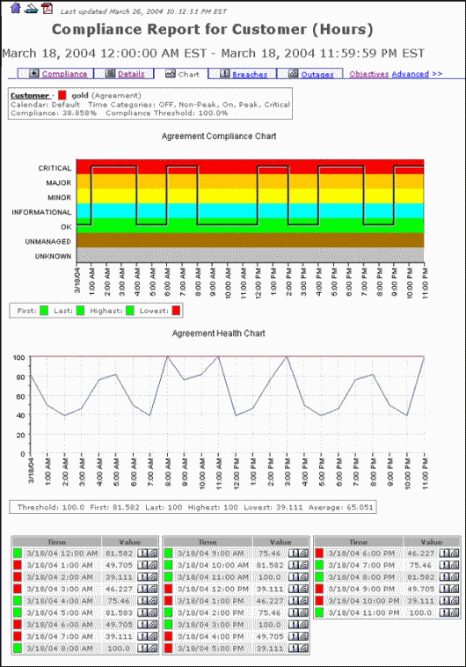

Slide 41
Metrics
( Key Performance Indicator KPI )
Percentage reduction in SLA targets missed
Percentage increase in customer perception and satisfaction of SLA achievements, via service reviews and Customer Satisfaction Survey
Percentage reduction in SLA breaches caused because of third-party support contracts ( underpinning contracts )
Total number and percentage increase in fully documented SLAs in place
Percentage reduction in the costs associated with service provision

Slide 42
SLM Benefits
Improvement in Service Quality
Improved relationships including relationship building
Clearer views of roles & responsibilities
Clear & Consistent expectation of the level of service required
Measurable targets

Slide 43
SLM – Possible Problems
No monitoring of pre-SLA achievements
Does not ensure ( verify ) that targets are achievable before committing to them
Inadequate focus, resources, time & seniority/authorityToo technical or lengthy & not properly communicated

Slide 44
4. Service Design
- Availability Management
By Dr. Franklin Leung

Slide 45
4.1 Availability Management – General Concepts

Slide 46
Examples of reasons for system down
Service Operational errors ( e.g. type in wrong command, execute wrong program )
Inadequate change management ( e.g. migrate the wrong program to production environment, unauthorized change, unexpected impact due to lack of planning and communication )
Inadequate capacity management ( running of disk space, insufficient bandwidth)
Hardware failures (network, server, storage)
External factors ( e.g. slow Internet due to damage of cross-continent cables)

Slide 47
Unavailability
Availability does not come free
Unavailability also has a cost…therefore, is not free either
Consider the cost of failure of a highly critical business system
Cost of failure can be measured against the VBF (Vital Business Function)

Slide 48
Unavailability
Tangible costs include lost revenue, overtime payments, loss of IT staff productivity etc.
Intangible costs include loss of customer goodwill due to dissatisfaction, loss of customer, reputation, staff morale

Slide 49
Objectives of Availability Management
Provides a point of a focus and management for all availability-related issues, relating to services, components and resources
Ensuring that availability targets in all areas are measured and monitored, and that they match or exceed the current and future agreed needs of the business in a cost-effective manner
Continually optimize and proactively improve the availability of the IT infrastructure

Slide 50
Reactive vs Proactive
Reactive activities of availability management
  Monitoring, measuring, analyzing, reporting and reviewing all aspects of component and service availability
Proactive activities of availability management
  Producing recommendations, plans and documents on design guidelines and criteria for new and changed services, and the continual improvement of service and reduction of risk in existing services

Slide 51
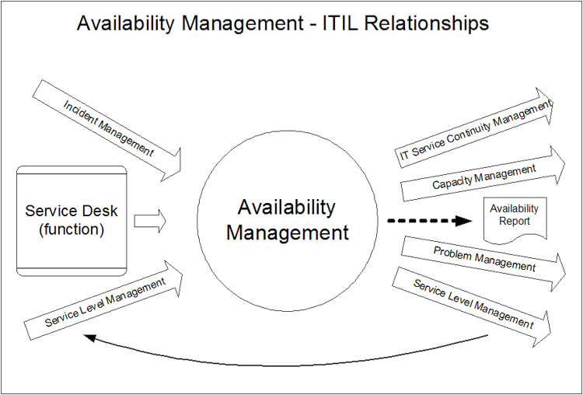
AM’s relationship with other processes

Slide 52
5 key elements
Availability
Reliability
Maintainability
Serviceability
Security
Plus – Vital Business Functions (VBF )

Slide 53
Availability
The ability of an IT service or component to perform its required function at a stated instant or over a stated period of time
Availability is underpinned by the reliability and maintainability of the IT infrastructure & the effectiveness of IT support
Availability is expressed as a percentage

Slide 54
Calculating Availability
Availability = (AST – DT )x 100/AST
  = service or component availability (%)
  Where
  AST = Agreed Service Time
  DT = Actual downtime during agreed service time

Slide 55
Example
Agreed Service Time Period:
  Monday to Saturday , 24 hours
Scheduled down time: Sunday ( 24 hours )
Down time this week: 3 hours
Availability this week = ( 6 x 24 - 3 ) / ( 6 x 24 ) = 97.9%

Slide 56
5 key elements - reliability
The reliability of an IT service can be qualitatively stated as freedom from operational failure
The reliability of each component & the level of resilience designed and built into the IT infrastructure will determine the reliability
Reliability is measured as MTBSI ( Mean Time between Service Incidents ) or MTBF ( Mean Time between Failures )

Slide 57
Availability versus Reliability
Do “availability” and “reliability” mean the same?
Any differences between “ a boss who is available” and “a boss who is reliable”?
Think of your boyfriend/girlfriend:
“Is he/she highly available to you” (can he/she spend a lot of time with you? )
vs
“Is he/she reliable”( Will he/she suddenly disappear for short periods frequently?)

Slide 58
5 key elements - Maintainability
Maintainability refers to the ability of an IT Infrastructure component to be retained in, or restored to, an operational state
Maintainability is measured as MTRS ( Mean time to Restore Service ) or MTTR ( Mean Time to Repair)
It is sometimes ambiguous as the time to repair a system may not be the same as the time to recover the service
ITIL recommends the use of MTRS which covers the time to repair, the time to resolve, the time to recover.

Slide 59
Formula
Reliability ( MTBSI in hours ) =
Agreed Service Time / number of incidents
( breaks )
Reliability ( MTFB in hours )
= ( Agreed Service Time – Down Time )/
number of incidents
Maintainability ( MTRS in hours )
= Total Down Time / number of incidents

Slide 60
Availability, Reliability, Maintainability
Reliability reflects the frequency of failures ( the more failures, the lower reliability )
Maintainability reflects how long the service is down for each incident
Availability reflects both reliability and maintainability as it measures the total uptime again the agreed service period.

Slide 61
5 key elements - Serviceability
Serviceability
  Serviceability describes the contractual arrangements made with Third Party IT Service Providers for Availability
  There is no specific metric for Serviceability. The Availability, reliability & maintainability of IT service & components under their care is measured.

Slide 62
5 key elements - Security
Security
  Security is the Confidentiality, Integrity & Availability (CIA) of the data associated with a service
  It is an aspect of overall availability

Slide 63
5 key elements ( cont’d )
Vital business functions (VBF) is the term used to reflect the business critical elements of the business process supported by an IT service
  e.g. ATM dispenses cash & receipts, dispensing cash would be considered the Vital Business Function of the ATM service

Slide 64
Supplier & Maintainer relationship
The required levels of Availability for the IT services should be documented within a formal SLA ( Service Level Agreement )
The IT provider needs to formally agree with each Infrastructure supplier & maintainer the appropriate conditions & controls for the SLA to be met ( Underpinning Contract)

Slide 65
IT availability Metrics Model
Measurements need to be meaningful & add value if availability measurements & reporting are to ultimately deliver benefit to the IT & business organisation
This is influenced strongly by the combination of ‘what you measure’ & ‘how you report it’

Slide 66
Metrics Tree
Based on balanced scorecard
Business Metrics -> IT metrics -> service & customer metrics -> individual process metrics -> individual component metrics

Slide 67
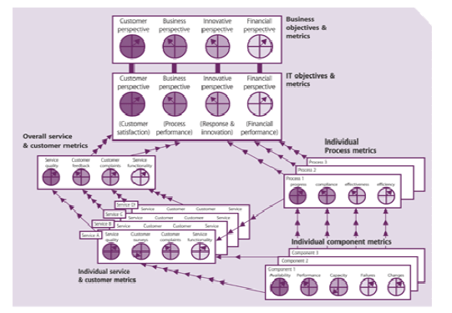

Slide 68
Availability Plan
Availability plan should have aims, objectives & deliverables
It considers the wider issues of people, process, tools & techniques
Is “technology focused” ( versus “user focused in service level management” )

Slide 69
4.2 Increase availability in the scenario of hardware failure

Slide 70
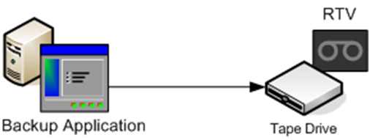
Background information on backup ( making copies of data )
Tape Drive is attached to a machine
The simplest picture is that data in the hard disk of the computer is backed up to a tape drive

Slide 71
Tape Library
Since we have to do daily/weekly backup and sometimes over one tape is needed for each backup, a tape library is needed. It also saves the routine task of changing tape daily as the machine will switch to use a new tape within the library automatically.

Slide 72
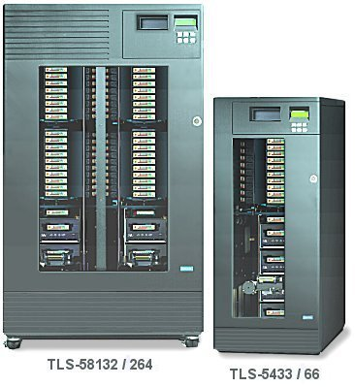

Slide 73
Recovery Options and High Availability Design
Modes: Cold Standby ( Recovery ), Warm Standby, Hot Standby
Challenges:
  Time for Recovery ( great impact to availability )
  Manual versus automatic invocation
  Data and Parameters Integrity ( for database server, what happens if the database is being updated during the time of failure? Will the update become effective or not after recovery? )
  Network routing ( traffic may have to be re-routed to backup machines )

Slide 74
Cold Standby
Database: A separate standby machine is idle. During failure of the primary machine, the content stored in backup media ( e.g. tape ) are restored from the primary machine to the standby machine.
Others ( e.g. web server, firewall, router ): A separate standby machine with equivalent parameters is idle and ready. During failure of the primary machine, the standby machine will take over through manual invocation.

Slide 75
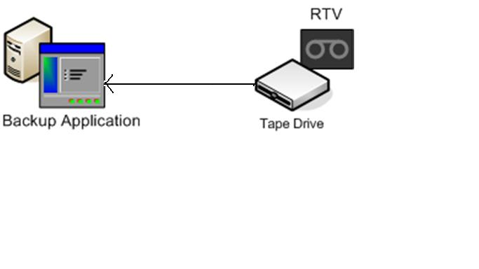
Primary machine fails, data restored to Standby machine via tape
Primary
Server
Standby Server

Slide 76
Warm Standby
Database: The change log of the primary machine is copied regularly to the standby machine. The standby machine also have a static copy of database in the beginning. In case of machine failure, the database in the standby machine will be brought back to the image just to the point before failure by executing the changes in the change log.
Others: Real-time monitoring of the primary machine allows automatic failover to the backup machine ( i.e. backup machine can take up automatically )

Slide 77
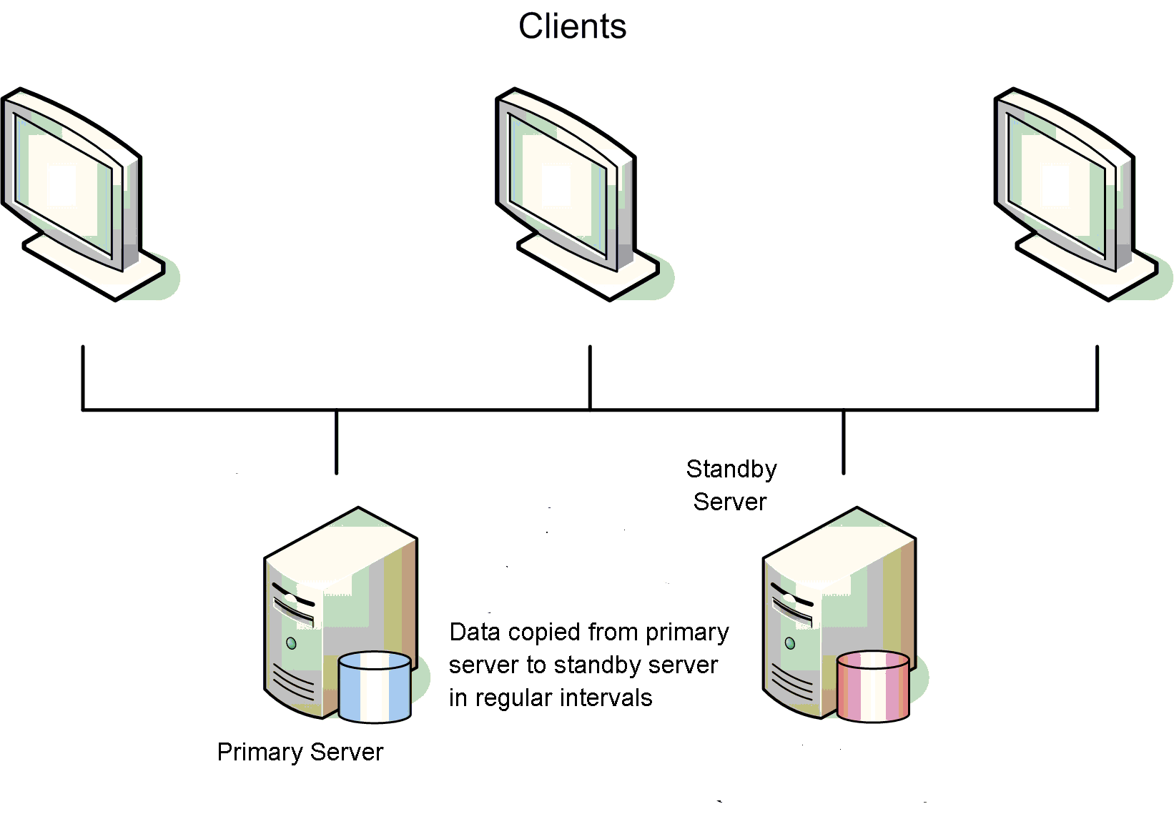
Warm Standby – Data copied from primary to standby machine regularly

Slide 78
Warm Standby – If primary server is down, standby server will take over.

Slide 79
Hot Standby ( High Availability )
high-availability configuration : two same-function components to form a cluster; in case one fails, another can continue to function as normal so that the system will not be down )
Router, firewalls, file server, database servers can all have high availability configuration

Slide 80

High Availability as in airplane engine configuration

Slide 81
Hot Standby ( Cont’d)
Database: The database image is mirrored on real-time from primary to stand-by machine or both primary and stand-by machine share the same storage. In case of primary machine failure, the stand-by machine can become active and provide the services as if uninterrupted.
Others: (Active-Active mode for router, firewall, web server) Both the primary and backup servers are actively running during normal operation. If the primary fails, the service is uninterrupted as the requests will be handled by backup machines as usual.

Slide 82
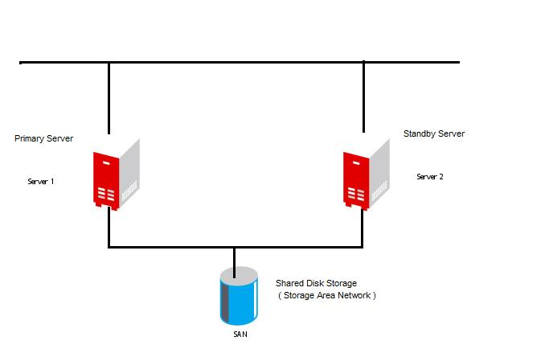
Normal operation – request is handled by primary server and data update is sent to the shared storage

Slide 83
When primary server ( or network to primary server fails ), standby server can take over and uses the same data storage

Slide 84
4.3 Component Failure Impact Analysis ( CFIA )

Slide 85
Component Failure Impact Analysis
Used to predict and evaluate the impact arising from component failures
Devised by IBM in the early 1970s , originally on hardware design but can be used in wider context covering the full IT infrastructure

Slide 86
CFIA steps
Create a grid with CI ( Configuration Item) on one axis and the IT services on the other;
Populate the grid as follows:
  Leave a blank when the failure of the CI does not impact the service
  Insert an ‘X’ when the failure of the CI causes the IT service to be inoperative
  Insert an ‘A’ when there is an alternative CI to provide the service
  Insert an ‘M’ when there is an alternative CI but requires manual intervention to recover

Slide 87
CFIA ( Cont’d )
Having built the grid, CIs that have a large number of Xs are critical to many services and can result in high impact should the CI fail
Equally, IT services have high count of Xs are complex and vulnerable to failure.

Slide 88
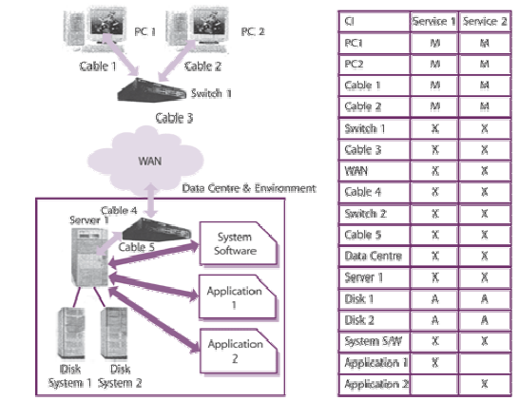

Slide 89
Advanced CFIA
The matrix can be expanded with additional fields such as
  Component availability weighting
  Probability of failure
  Recovery time
  Recovery procedures

Slide 90
Advanced CFIA –
Calculating End-to-End Availability

Slide 91
Two levels of Availability Management
Service Availability ( including all aspects of service availability )
Component Availability ( individual components)

Slide 92
End-to-End Availability
That is, from the user-end all the way to the end of the chain of the components providing the service.
For example, an online securities trading system may involve a router, firewall, web server and database server. Either component fails will lead to unavailability of the service.
End-to-end availability measures the availability of the whole service, comprising all the components

Slide 93
Availability for a network with multiple components
Question:
If a network has a router and a firewall, the router has availability 99% ( i.e. 0.99 ) and the firewall has availability 98% ( i.e. 0.98 ), what the overall availability for the whole network?
( Hints: if either component fails, the whole network fails. )

Slide 94
Availability for a network with multiple components
Answer:
( 0.99 + 0.98 ) / 2
0.99 x 0.98
1 – ( 0.99 x 0.98 )
1 – ( 1 – 0.99 ) x ( 1 – 0.98 )

Slide 95
Question
If you have a high availability (hot standby) configuration for a firewall and each firewall component has availability of 99% ( 0.99 ), what is the overall availability for this HA firewall configuration?
(Hints : This is different from last question. The firewall will fail if both its firewall components fail - double failure. If just one of the firewall component fails, the firewall as a whole is still functioning )

Slide 96
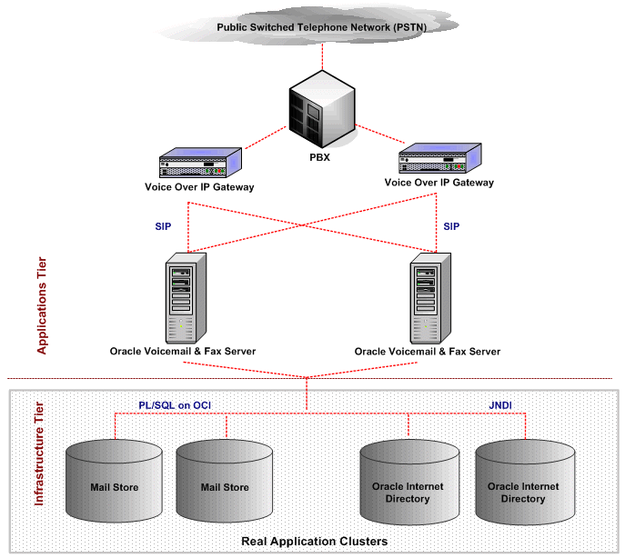
High Availability
Configuration Example

Slide 97
Answer
(a) 0.99
(b) 0.99 x 0.99
(c) 1 – ( 0.99 x 0.99 )
(d) 1 – ( 1 – 0.99 ) x ( 1 – 0.99 )

Slide 98
4.4 Availability Management – Benefits and Problems

Slide 99
Availability Manager
Responsible for ensuring that the monitoring and reporting mechanism is in place
Responsible for ensuring that escalation is made when services do not meet their agreed availability targets.
If the targets are not met, will Availability Manager carry all the responsibilities? Not necessarily as the service down may have many reasons ( e.g. inadequate capacity management, operational errors ). However, availability management is primarily responsible to ensure that availability is measured and provide a point of focus for management.

Slide 100
Availability Management Benefits
Single point of accountability via process owner – Someone is accountable for measuring and monitoring the system !!!

Slide 101
Benefits
The frequency & duration of IT service failures is reduced over time
Possible Problems
Lack of tools to underpin & support the process

Slide 102
Reference
Davis, R. (2009 ), “What makes a good process”, BP Trend, November 2009
itSMF (2007), An Introductory Overview of ITIL V.3, itSMF
itSMF(2007), ITIL V3 – Service Design, itSMF

