Slide 1
Services Science Management
COMP5138

Slide 2
Contents
Quality Management
The Six Sigma
Defining, Measuring and Controlling
Analyzing and Improving

Slide 3
Quality Management

Slide 4
Development of
Quality Management
Six Sigma
ISO9000 / Total Quality Management
Total Quality Control
Statistical Process Control
1950s
1960s
1970s
1980s
1990s

Slide 5
Process Improvement
Plan:
Choosing control subjects
and setting goals
Do:
Running the process
Check:
Sensing and monitoring
Act:
Take corrective actions
Plan Do
Act Check
Quality level
Time
Edward Deming PDCA Cycle

Slide 6
Deming’s 14-Point Program
Create constancy of purpose for improvement of product and service
Adopt the new philosophy
Cease dependence on mass inspection
End the practice of awarding business on price tag alone
Constantly and forever improve the system of production and service
Institute modern methods of training on the job
Institute modern methods of supervising
Drive out fear
Break down barriers between departments
Eliminate numerical goals for the workforce
Eliminate work standards and numerical quotas
Remove barriers that hinder hourly workers
Institute a vigorous program of education and training
Create a structure in top management that will push everyday on the above 13 points

Slide 7
Foundations for Continuous Improvement
Individual development – ensure that job skills are taught in a consistent manner
Management training – different levels of management are continuously reminded for the process
Human resources planning – employee selection and performance review
Standards of performance – instructions to employees specifying their performance
Career progression – job advancement to stimulate conformance
Opinion surveys – customer and colleague opinions as a source of monitoring

Slide 8
The Six Sigma

Slide 9
The Six Sigma
A business improvement concept that is built upon a well-defined and robust infrastructure which directly involves personnel from several management levels targeting quality and process improvement projects to drive a company’s continual improvement efforts
Sigma (σ) is used to represent the standard deviation of a statistical population. The term "six sigma process" comes from the notion that if one has six standard deviations between the process mean and the nearest specification limit, there will be practically no items that fail to meet specifications

Slide 10
Main Characteristics of the Six Sigma Methodology
Strategic alignment
Top down approach
Customer focus
Management and staff involvement
Project management
Measurement and improvement

Slide 11
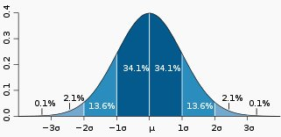
Statistical Process Control
Statistical process control (SPC) involves using statistical techniques to measure and analyze the variation in processes. Most often used for manufacturing processes, the intent of SPC is to monitor product quality and maintain processes to fixed targets.
The Six Sigma method strengthened the traditional 3 sigma control limit (about 99% within quality standards) to 6 sigma control limit (about 99.9997%)
Lower Control Limit
(LCL)
Upper Control Limit
(UCL)
Traditional 3 sigma control limits

Slide 12
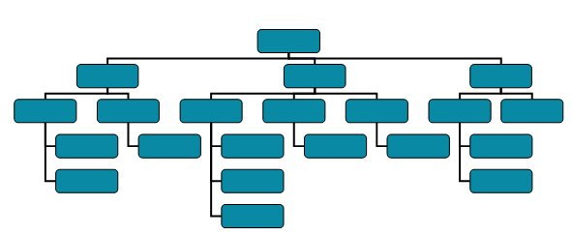
Multi-levels Alignments
The Six Sigma method stresses the involvements of different levels of management to involve within a quality improvement team
Executive Management
Senior Management
Middle Management
Departmental Staff
A Six Sigma Team

Slide 13
Six Sigma Belt System and their Roles
Six Sigma Role | Position | Main responsibilities
Executive Champion | CEO/Managing Director | Decision making
Champion | GM/Directors | Implementation within division
Master Black Belt | Process improvement specialist | Coaching, consulting, training and support
Black Belt | Managers | Project management
Green Belt | Assistant Managers | Process improvement

Slide 14
Reasons to implement the Six Sigma
Reduce cost and waste
Improve productivity
Transform and drive the organization to a new direction
Response to competitive pressure
Benchmarking with other market leaders
Pressure from customers to improve the quality of products and services

Slide 15
The Six Sigma Method
The DMAIC Approach
  Define high-level project goals and the current process
  Measure key aspects of the current process and collect relevant data
  Analyze the data to verify cause-and-effect relationships
  Improve or optimize the process based upon data analysis
  Control to ensure that any deviations from target are corrected before they result in defects. Set up pilot runs to establish process capability

Slide 16
A Typical DMAIC
Six Sigma Project
Voice of Customer (VOC)
Strategic Analysis
Voice of Business (VOB)
Define
Critical to Quality (CTQ)
CTQ Priorization
Project
Voice of Process (VOP)
Measure and
Analyze
Process CTQs
Improve and
Control
Optimization
Control

Slide 17
Defining , Measuring and Controlling

Slide 18
Quality Tools for
Defining and Controlling
Cause-and-Effect Diagram
Check Sheet
Run Chart
Histogram
Pareto Chart
Scatter Diagram
Quality Function Deployment

Slide 19
Cause-and-Effect Diagram
(Fish Bone Diagram)
Equipment
Personnel
  Gate agents cannot process passengers quickly enough
Aircraft late to gate
Too few agents
Late arrival
Agents undertrained
Gate occupied
Agents under-motivated
Other
Mechanical failures
Agents arrive at gate late
Weather
Late pushback tug
Late cabin cleaners
Late or unavailable cabin crews
Air traffic
Late or unavailable cockpit crews
Delayed
Flight
Departure
Poor announcement of departures
Weight and balance sheet late
Late baggage to aircraft
Delayed checkin procedure
Late fuel
Confused seat selection
Late food service
Passengers bypass checkin counter
Checking oversize baggage
Issuance of boarding pass
Acceptance of late passengers
Cutoff too close to departure time
Material
Desire to protect late passengers
Desire to help company’s income
Poor gate locations
Procedure

Slide 20
Check Sheet
A check sheet is a historical record of observations and source of data for problem identifications.
Month Lost Departure Mechanical Overbooked Other Luggage Delay
January 1 2 3 3 1
February 3 3 0 1 0
March 2 5 3 2 3
April 5 4 4 0 2
May 4 7 2 3 0
June 3 8 1 1 1
July 6 6 3 0 2
August 7 9 0 3 0
September 4 7 3 0 2
October 3 11 2 3 0
November 2 10 1 0 0
December 4 12 2 0 1
Total 44 84 24 16 12

Slide 21
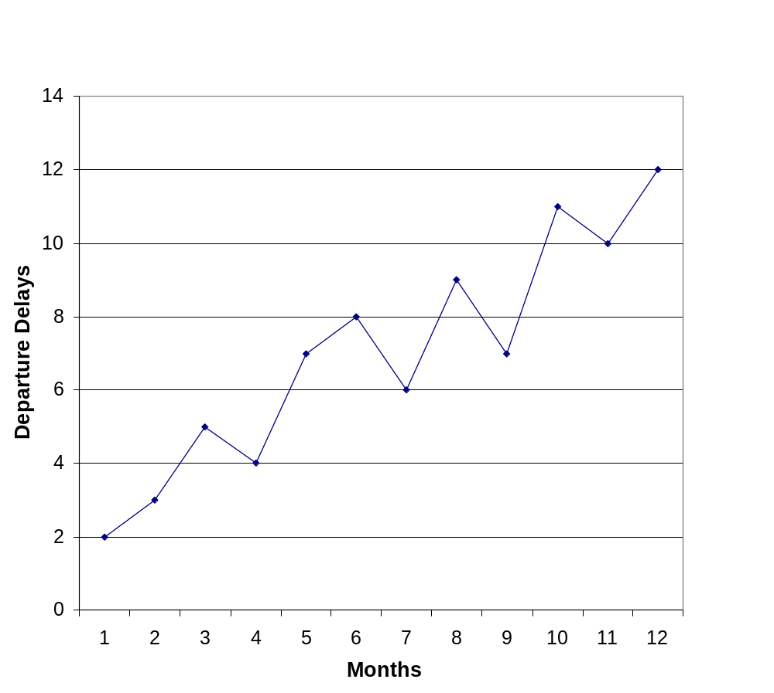
Run Chart
A run chart tracks changes in a important process variable over time to
detect trends or cycles in performance.

Slide 22
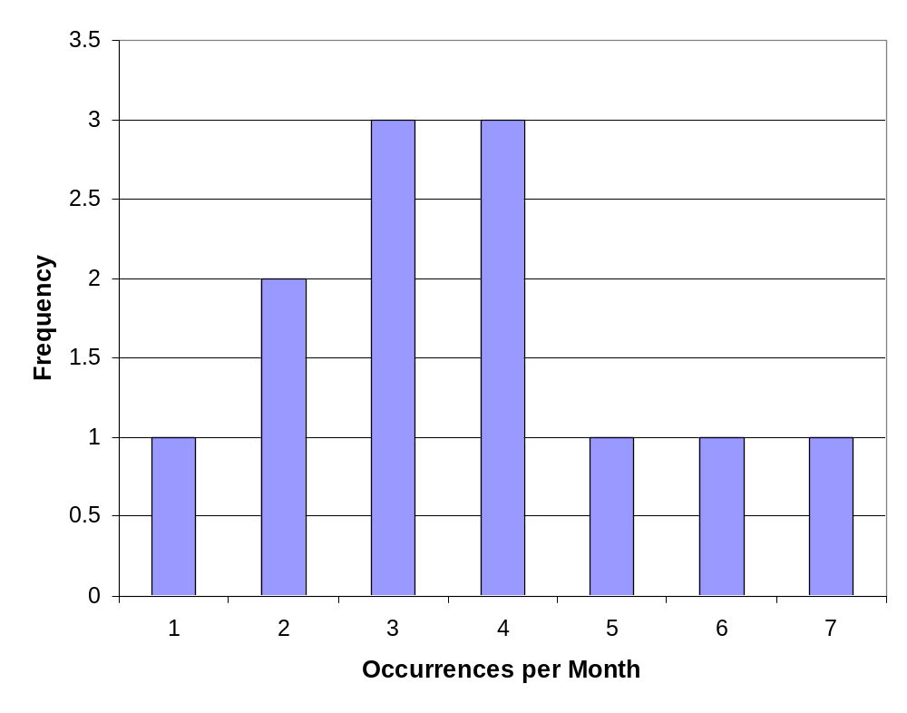
Histogram
A histogram presents data collected over a period of time as
a frequency distribution so that unusual features become obvious.

Slide 23
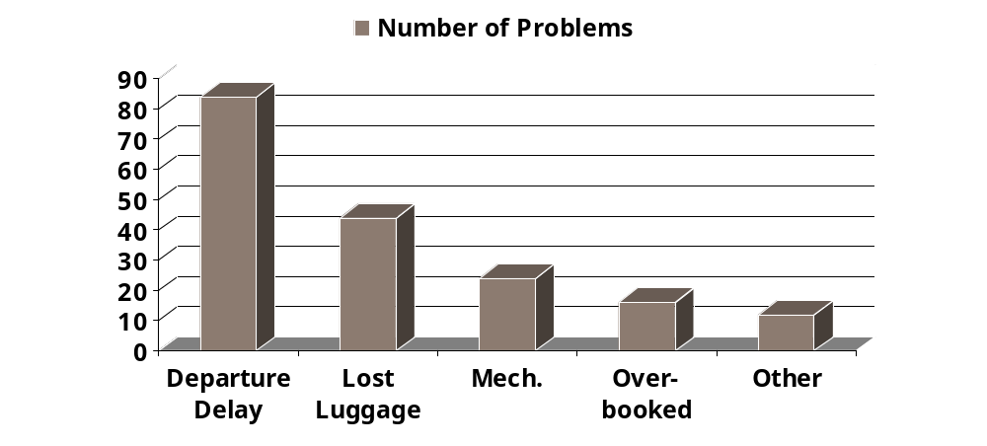
Pareto Chart
A Pareto chart orders problems by their relative frequencies so as
to spot the greatest potential for improvement. It is commonly found
that 80% of the problems are just contributed by the top 20% of frequently
happened errors. Pareto chart prompt attentions for high frequency events.

Slide 24
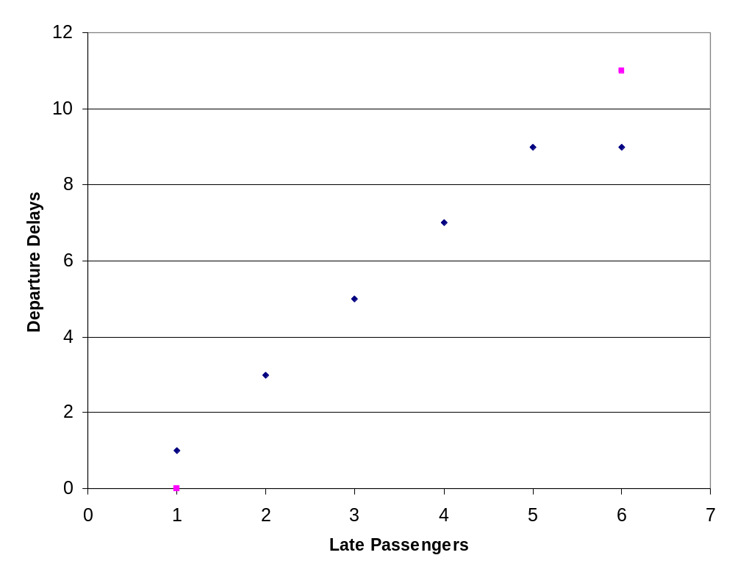
Scatter Diagram
A scatter diagram visually shows the relationship between two variables so
that correlations between problems can be identified.

Slide 25
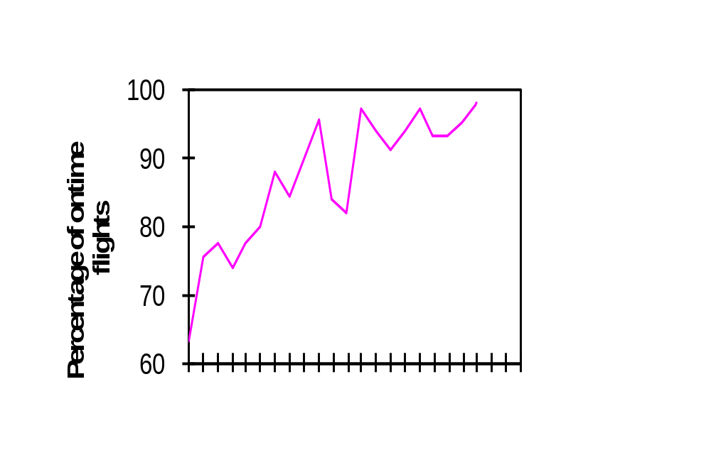
Control Chart
Control chart uses to monitor processes that are under performance.
expected
Problems
Lower Control Limit
1998
1999

Slide 26
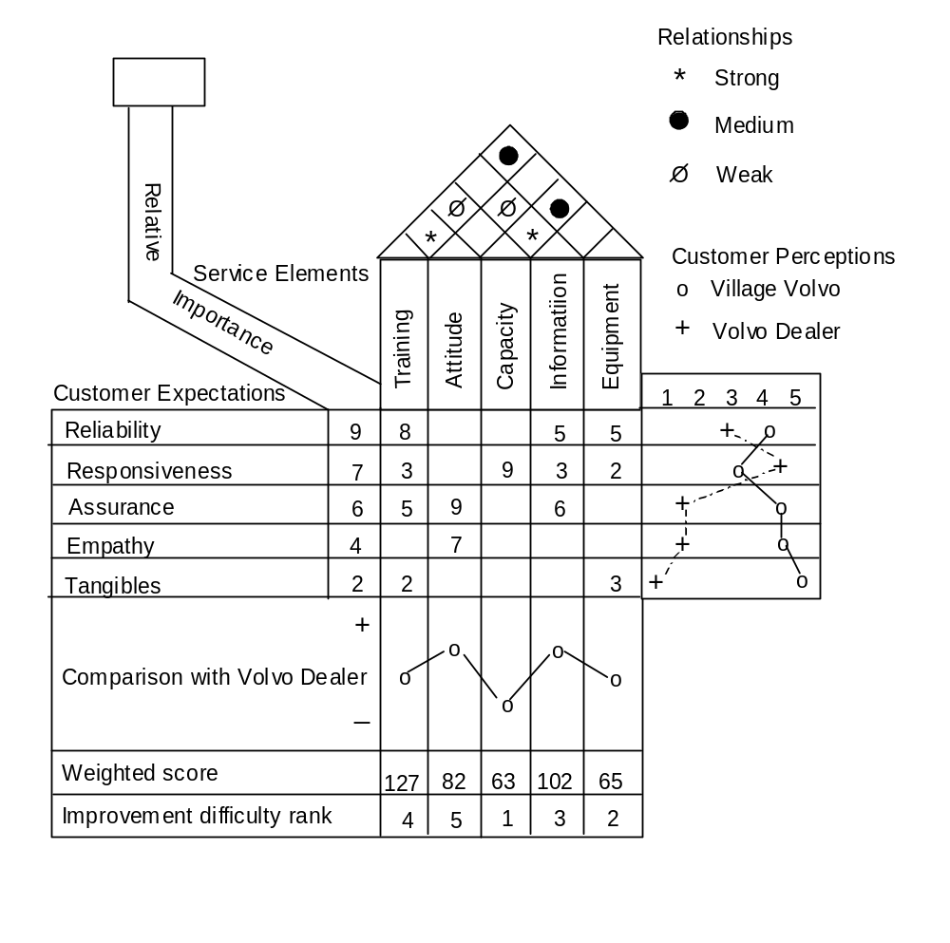
Quality Function Deployment
(House of Quality)
VOP
VOC
VOB

Slide 27
Analyzing and Improving

Slide 28
Tools for Analyzing and Improving Problems
Project Design and Management
  The Gantt Chart
  Critical Path Method (CPM)
Process Analysis
  Customer Contacts
  Service Encounters
  Blueprinting
  Process Flow Chart
  Process Allocation

Slide 29
Analyzing and Improving:
Project Design and Management

Slide 30
Project Design
Project can vary widely in their complexity, resource requirements, time needed for completion, and risk. Common project varies across different issues:
  Characteristics of Projects: purpose, life cycle, interdependencies, uniqueness, and conflict.
  Project Management Process: planning (work breakdown structure), scheduling, and controlling.
  Selecting the Project Manager: credibility, sensitivity, ability to handle stress, and leadership.
  Building the Project Team: Forming, Storming, Norming, and Performing.
  Principles of Effective Project Management: direct people individually and as a team, reinforce excitement, keep everyone informed, manage healthy conflict, empower team, encourage risk taking and creativity.
  Project Metrics: Cost, Time, Performance

Slide 31
Techniques for
Project Management
The Gantt Charts
  By breaking down the project into distinct activities, the
  Gantt chart establish the time line for each project activities against a calendar view
Critical Path Method (CPM)
  A mathematical modeling method that tries to optimize the starting and finishing time of different activities of a project. The common method for the optimization process is presented in form of a PERT diagram (Program Evaluation & Review Technique)
Both methods can adopt probabilistic measures in minimizing the influences of unexpected problems

Slide 32
The Gantt Chart
ID Activity Days Day of Project Schedule
1 2 3 4 5 6 7 8 9 10 11 12 13 14 15 16 17 18 19 20
A Negotiate for 2
Location
B Contact Seeded 8
Players
C Plan Promotion 3
D Locate Officials 2
E Send RSVP 10
Invitations
F Sign Player 4
Contracts
G Purchase Balls 4
and Trophies
H Negotiate 1
Catering
I Prepare Location 3
J Tournament 2
Personnel Required 2 2 2 2 2 3 3 3 3 3 3 2 1 1 1 2 1 1 1 1
Critical Path Activities
Activities with Slack

Slide 33
The PERT Diagram
TS – Total Slack
ES – Earliest Start
EF – Earliest Finish
LS – Latest Start
LF – Latest Finish
2
2
2
5
3 6
6 10
10 14
14 18
5 8
8 12
12 16
19 23
TS
0
ES
EF
0 3
A₂
C₃
D₂
G₄
5
6
LS
LF
0 3
10 12
18 23
16 18
23 28
START
E₁₀
I₃
J₂
0
B₈
F₄
H₁
28 32
28 32
0
0
0
3 12
12 18
18 28
3 12
12 18
18 28

Slide 34
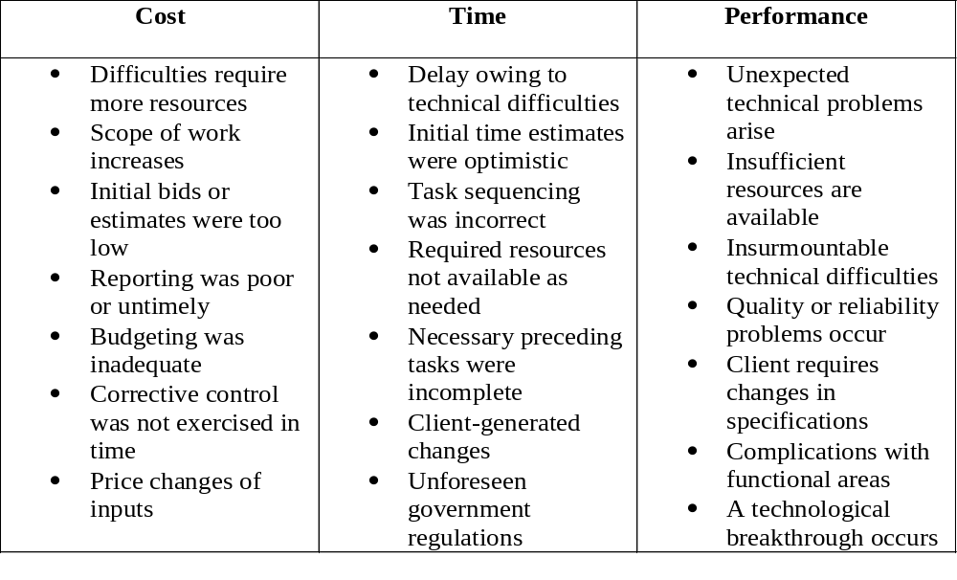
Projects Requiring Probabilistic Measures

Slide 35
Analyzing and Improving:
Process Analysis

Slide 36
Process Analysis
Process analysis tries to identify bottleneck operations, determines the system capacity that are fundamental in the service operations and making improvement on the overall process
Key focus on improvements are:
  Bottlenecks of the operations
  Total slacks available in the process
  Consolidation of activities

Slide 37
Process Design
Business strategy development or review
New service strategy development
Idea generation
  Screen ideas against new service strategy
Concept development and evaluation
  Test concept with customers and employees
Business analysis
  Test for profitability and feasibility
Service development and testing
  Conduct service prototype test
Market testing
  Test service and other marketing-mix elements
Commercialization
Post introduction evaluation
Front-end Planning
Implementation

Slide 38
Service Blueprinting
A tool for simultaneously depicting the service process, the points of customer contact, and the evidence of service from the customer’s point of view
Step 1
Step 2
Step 3
Step 4
Step 5
Step 6
Identify the process to be blueprinted
Identify the customer or customer segment
Map the process from the customer’s point of view
Map contact employee actions, onstage, backstage,
technology
Link contact activities to needed support functions
Add evidence of service at each customer action step

Slide 39
Service Blueprint Components
- Define standards for front-stage activities
- Specify physical evidence
- Identify principal customer actions
Customer Actions
line of interaction (customers and front-stage personnel)
“Onstage” Contact Employee Actions
line of visibility (between frontstage and backstage)
“Backstage” Contact Employee Actions
line of internal interaction (between backstage and other Department)
Support Processes
- Support processes involving other service personnel
- Support processes involving IT
*** Where appropriate, show fail points and risk of excessive waits ***

Slide 40
Process Blueprinting
Front Stage
Make
Arrive
Check-in
Go to
room
Customer
reservation
at reception
Line of
Interaction
Employee
Face-to-face
Doorman greets, takes baggage
Receptionist
verifies, gives
key to room
Phone
Contact
Rep. records, confirms
Backstage
Line of
Visibility
Bellboy
Baggage
To room
Baggage arrived
Enter
data
Register
guest data
Line of
Internal Interaction
Marketing
Database

Slide 41
Process Flow Diagram
Property Survey
CT=90 min.
Yes
Final Approval
CT=15 min.
Mortgage
Applications
Completed
Applications
Approved Mortgages
Credit Report
CT=45 min.
Title Search
CT=30 min.
No
CT – Cycle Time
Unapproved Mortgages
An Mortgage Approval Example

Slide 42
Process Allocation
Automobile Driver’s License Office
Review Payment Violations Eye Test Photograph Issue
1
240
15
2
120
30
3
60
60
4
90
40
5
180
20
6
120
30
In
Out
Activity
Number(s)
Capacity
per hour
Cycle Time
in seconds

Slide 43
Improved Process
  In
1,4
65
55
3
60
60
2
120
30
5
180
20
6
120
30
Out
In
1,4
65
55
3
60
60

Slide 44
Analyzing and Improving:
Facilities Management

Slide 45
Facility Layouts
Service operations can be directly affected by the design of the facility. The facility layouts represent the supporting component of the service package and it should be convenient to both the customers and the service provider.

Slide 46
The Service Environment
Servicescape – The man-made, built surroundings
of a service environment
Interior
Exterior
Other Tangibles
Interior design
Equipment
Signage
Layout
Air quality
Temperature
Business cards
Stationary
Billing statements
Reports
Employee dress
Uniforms
Brochures
Web pages
Virtual web pages
Exterior design
Signage
Parking
Landscape
Surrounding
environment

Slide 47
Roles of the Servicescape
Package
  conveys expectations
  influences perceptions
Facilitator
  facilitates the flow of the service delivery process
  provides information
Socializer
  facilitates interaction between:
    customers and employees
    customers and fellow customers
Differentiator
  sets provider apart from competition in the mind of the consumer
Notes:
Dental laser “drill”

Slide 48




The Russell Model of Affect
Arousing
Distressing
Exciting
Unpleasant
Pleasant
Boring
Relaxing
Sleepy

Slide 49
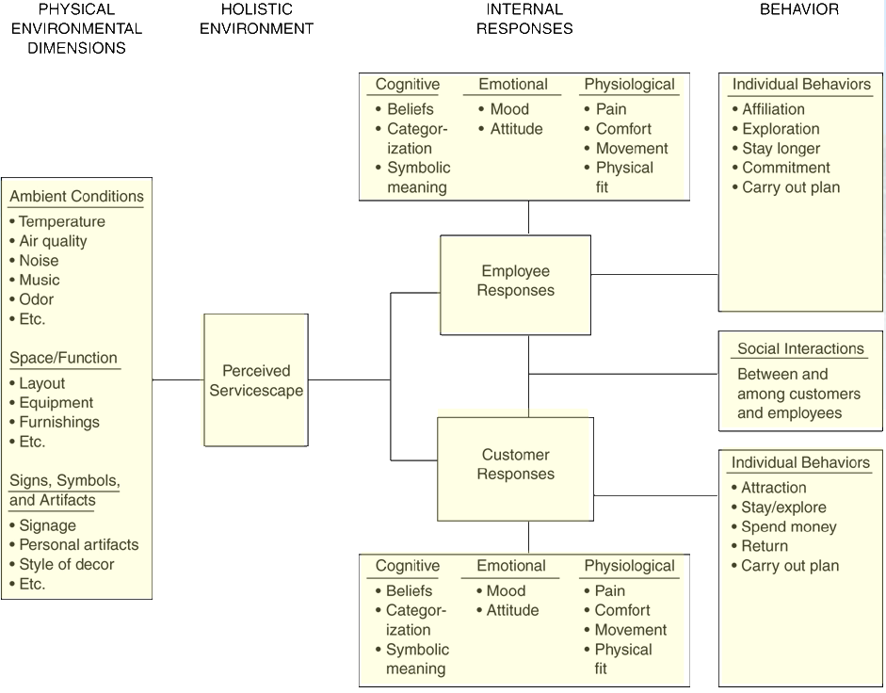
Bitner’s ServiceScape Model

Slide 50
Dimensions in the
Servicescape Model
Ambient Conditions
  Ambient conditions refer to those characteristics of the environment pertaining to our five senses
Spatial Layout and Functionality
  Layout refers to size and shape of furnishings and the way it is arranged
  Functionality is the ability of those items to facilitate performance
Signs, Symbols and Artifact
  Explicit or implicit signals to communicate the firm’s image, help consumers find their way and to convey the rules of behavior

Slide 51

The Impact of
Ambient Conditions
The ambient environment composed of literally hundreds of design elements and details in the service environment
Ambient conditions include:
  Lighting and color schemes
  Size and shape perceptions
  Sounds such as noise and music
  Temperature
  Scents
These conditions can elicit desired
behavioral responses among consumers

Slide 52
The Impact of Music
Music can have a powerful effect on perceptions and behaviors, even if played at barely audible volumes
The various structural characteristics of music such as tempo, volume, and harmony are perceived holistically, and their effect on internal and behavioral responses is moderated by respondent characteristics
  Fast tempo music and high volume music
  increases arousal levels
  People tend to adjust their pace, either
  voluntarily or involuntarily, to match the tempo
  of music

Slide 53

The Impact of Scent
An ambient smell is one that pervades an environment
  May or may not be consciously perceived by customers
  Not related to any particular product
The presence of scent can have a strong impact on mood, affective and evaluative responses, and even purchase intentions and in-store behaviors
Suitable and approximate scents can enhance employee productivity

Slide 54
The Impact of Color
Colors have a strong impact on people’s feelings
Color is stimulating, calming, expressive, disturbing, impressional, cultural, exuberant, symbolic
People are generally drawn to warm color (red, orange and yellow) environments
Warm colors encourage fast decisions making for low-involvement decisions or impulse purchases
Cool colors (blue and green) are favored when consumers need time to make high-involvement purchases

Slide 55

The Impact of
Signs and Symbols
Use signs, symbols and artifacts to guide customers clearly through the process of service delivery
  Customers (especially first time ones) will automatically try to draw meaning from the signs, symbols and artifacts to guide them through the service environment and service process
  Unclear signals from a servicescape can result in anxiety and uncertainty about how to proceed and obtain the desired service

Slide 56

Elements of
Environmental Design
There is a multitude of research on the perception and impact of environmental stimuli on behaviour, including:
  People density, crowding
  Lighting
  Sound/noise
  Scents and odours
  Queues
No standard formula to designing the perfect combination of these elements
Design from the customer’s perspective!

Slide 57
Tools to Guide in
Servicescape Design
Keen Observation of Customer Behavior and Responses to the service environment by management, supervisors, branch managers, and frontline staff
Feedback and Ideas from Frontline Staff and Customers using a broad array of research tools ranging from suggestion boxes to focus groups and surveys.
Field Experiments can be used to manipulate specific dimensions in an environment and the effects observed.
Blueprinting or Service Mapping – extended to include the physical evidence in the environment

Slide 58
References
Akpolat, H., Six Sigma in Transactional and Service Environments, Gower, 2004.
Fitzsimmons, J. and Fitzsimmons M., Service Management: Operations, Strategy, Information Technology, McGraw-Hill/Irwin, 6th edition, 2008.
Juran, J.M., Juran’s Quality Handbook (5th Edition), McGraw-Hill, 1999.
Winston, W.L., Operations Research: applications and Algotithms, Duxbury, 1994.
Zeithaml, V.A., Bitner, M.J., and Gremler, D.D., Services Marketing: Integrating Customer Focus across the Firm, 5th edition, McGraw-Hill, 2008.

