Slide 1
Services Science Management
COMP5138

Slide 2
Contents
Service Capacity Planning
Managing Queues
Course Review
Exam. Questions Review

Slide 3
Service Capacity Planning

Slide 4
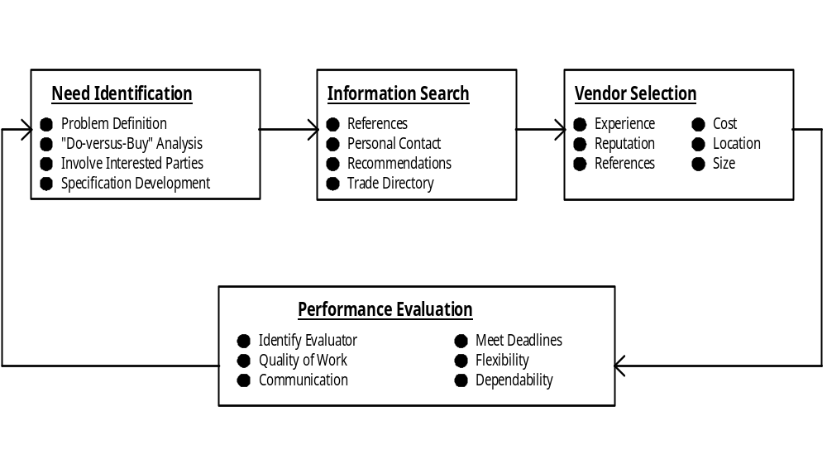
Outsourcing Process
Outsourcing: to hire the services of another company to manage all or parts of
the services that otherwise would be rendered by a functional unit of the
organization. Outsourcing provides additional capacity to an organization.

Slide 5
Outsourcing Services
Benefits
• Allows the firm to focus on its core competence
• Service is cheaper to outsource than perform in-
house
• Provides access to latest technology
• Leverage benefits of supplier economy of scale
Risks
• Loss of direct control of quality
• Jeopardizes employee loyalty
• Exposure to data security and customer privacy
• Dependence on one supplier compromises
future negotiation leverage
• Additional coordination expense and delays
• Atrophy of in-house capability to perform service

Slide 6
Outsourcing Considerations
Focus on Physical
  Facility support service
    Low cost
    Identify responsible party to evaluate performance
    Precise specifications can be written
  Equipment support service
    Experience and reputation of vendor
    Availability of vendor for emergency response
    Designate person to make service call and to check that service is satisfactory

Slide 7
Outsourcing Considerations
Focus on People
  Employee support service
    Contact vendor clients for references
    Specifications prepared with end user input
    Evaluate performance on a periodic basis
  Employee development service
    Experience with particular industry important
    Involve high levels of management in vendor identification and selection
    Contact vendor clients for references
    Use employees to evaluate vendor performance

Slide 8
Outsourcing Considerations
Focus on Process
  Facilitator service
    Knowledge of alternate vendors important
    Involve end user in vendor identification
    References or third party evaluations are useful
    Have user writing detailed specifications
  Professional service
    Involve high level management in vendor identification and selection
    Reputation and experience very important
    Performance evaluation by top management

Slide 9

Balancing Utilization and Financial Return
Yield Management
  Actual Return
  Potential Return
Challenges and Risks
  Loss of competitive focus
  Customer alienation
  Employee morale problems
  Incompatible incentive and reward systems
  Lack of employee training
  Inappropriate organization of the yield management function

Slide 10
Yield Management
Yield management is an approach aimed at minimizing wastages due to idle facilities in an attempt to maximize profitability. Followings are common characteristics that lead to the application of yield management:
  Relatively Fixed Capacity
  Ability to Segment Markets
  Perishable Inventory
  Product Sold in Advance
  Fluctuating Demand
  Low Marginal Sales Cost and High Capacity Change Cost

Slide 11
Seasonal Allocation of Facilities
First class
Standard
Budget
20%
20%
20%
30%
50%
30%
50%
60%
Percentage of capacity allocated
to different service classes
50%
30%
30%
10%
Peak Shoulder Off-peak Shoulder
(30%) (20%) (40%) (10%)
Summer Fall Winter Spring
Percentage of capacity allocated to different seasons
Optimal allocation of Rooms for a Hotel

Slide 12
Inventory in Services
Role of Inventory
  Decoupling inventories
  Seasonal inventories
  Speculative inventories
  Cyclical inventories
  In-transit inventories
  Safety stocks
Considerations in Inventory Systems
  Type of customer demand
  Planning time horizon
  Replenishment lead time
  Constraints and relevant costs

Slide 13
Inventory Models
Economic Order Quantity (EOQ)
Special Inventory Models
With Quantity Discounts
Planned Shortages
Demand Uncertainty
    Safety Stocks
Inventory Control Systems
Continuous-Review
Periodic-Review

Slide 14
Inventory Levels For
EOQ Model
Units on Hand
Q
0
Q
Time
D

Slide 15
Managing Queues

Slide 16

Inventorying of Demand
Services, being performances, normally cannot be stored for later use
In businesses where demand regularly exceeds supply, managers can often take steps to inventoried demand
  By asking customers to wait in line, usually on a first-come, first-served basis
  By offering customers the opportunity of reserving or booking space in advance

Slide 17
Essential Features of
Queuing Systems
Renege
Arrival
process
Queue
discipline
Departure
Calling
population
Queue
configuration
Service
process
Balk
No future
need for
service

Slide 18
Alternative Queuing Configurations
Single line, single server, single stage
Single line, single servers at sequential stages
Parallel lines to multiple servers
Designated lines to designated servers
Single line to multiple servers (“snake”)
28
29
21
“Take a number” (single or multiple servers)
25
20
30
26
24
31
32
27
23

Slide 19

Tailoring Queuing Systems
Urgency of job
  Emergencies vs.
  Non-emergencies
Duration of service transaction
  Number of items to transact
  Complexity of task
Payment of premium price
  First class vs. Economy class
Importance of customer
  Frequent and loyal customers vs. others

Slide 20
Avoiding Burdensome
Waiting Time
Add extra capacity so that demand can be met at most times
Rethink design of queuing system to give priority to certain customers or transactions
Redesign processes to shorten transaction time
Manage customer behavior and perceptions of wait
Install a reservations system

Slide 21
Minimizing Perception of
Waiting Time
1. Unoccupied time feels longer
2. Pre-process/post-process wait feels longer than in-process
3. Anxiety makes waiting seem longer
4. Uncertain waiting is longer than known, finite waiting
5. Unexplained waiting seems longer
6. Unfair waiting is longer than equitable waiting
7. People will wait longer for more valuable services
8. Waiting alone feels longer than in groups
9. Physically uncomfortable wait feels longer
10. Waiting seems longer to new or occasional users

Slide 22
Effective Reservation System
Reservations are supposed to guarantee that service will be available when the customer wants it
A reservation system offers many benefits for firms
  Enables management to keep free some time for handling emergency jobs that carry a premium price
  Pre-sells service
  Controls and smoothes demand in a more manageable way
  Informs and educates customers in advance of arrival
  Customers avoid waiting in line for service (if service times are honored)
  Data capture helps organizations prepare financial projections
The challenge in designing reservation systems is to make them fast and user-friendly for both staff and customers

Slide 23

Well-Designed Reservations Systems
Fast and user friendly for customers and staff
Can answer customer questions
Offers options for self service (e.g. Web)
Accommodates preferences (e.g., room with view)
Deflects demand from unavailable first choices to alternative times and locations
Includes strategies for no-shows and overbooking
  Requiring deposits to discourage no-shows
  Canceling unpaid bookings after designated time
  Compensating victims of over-booking
Maximize yield through accurate demand projection

Slide 24
References
Fitzsimmons, J. and Fitzsimmons M., Service Management: Operations, Strategy, Information Technology, McGraw-Hill/Irwin, 6th edition, 2008.
Juran, J.M., Juran’s Quality Handbook (5th Edition), McGraw-Hill, 1999.
Winston, W.L., Operations Research: applications and Algotithms, Duxbury, 1994.

Slide 25
Course Review

Slide 26
Functional Processes Along the Service Triangle
Marketing
Service Marketers
  creating realistic customer expectations:
    service system design
    promotion
Operations Management
  rendering the service as promised:
    managing fail points
    training systems
    quality control
Human Resources Management
  empowering the human element:
    job descriptions
    selection criteria
    appraisal systems
System Technology
  providing necessary tools:
    system specifications
    personal preference databases
Technology
Human Resources
Operations

Slide 27
Service Evaluation
Service characteristics
  Intangible, Inseparable, Inconsistent, Inventory
Service management
  People, Process, Physical
Expectation and Perception
  Disconfirmation
    Zone of tolerance bounded by desire and adequate service
  Service quality
    The five Servqual dimensions (RATER)
  E-S-Qual
    The seven online service quality dimensions
Technology Adoptions
  DeLone and McLean Model
  Technology Acceptance Model

Slide 28
Services Marketing
Gaps Model of Service Quality
  Customer Gap (Source of customer dissatisfaction)
    Differences between expectation and perception
  Provider Gap (Ideas to close the customer gap)
    Gap 1
      Knowledge of customers
    Gap 2
      Design of standards
    Gap 3
      Performance
    Gap 4
      Communication

Slide 29
Development of
Quality Management
Six Sigma
Top down approach
Project management
Customer focus
ISO9000 / Total Quality Management
Total Quality Control
Statistical Process Control
1950s
1960s
1970s
1980s
1990s
Statistical Oriented
Continuous improvement
and management involvement

Slide 30
Services Management
Six Sigma
  Define
  Measure
  Analyze
  Improve
  Control
Different operational tools for different stages

Slide 31
Comparisons of
Service Management Frameworks
Service Concepts
  - 4Is
  - 3Ps
  Service quality evaluation
  5 dimensions
    Responsiveness
    Assurance
    Tangibles
    Empathy
    Reliability
Gaps Model
  Gap 1: Knowledge
  Gap 2: Design
  Gap 3: Performance
  Gap 4: Communicate
Six Sigma
  Define
  Measure
  Analyze
  Improvement
  Control
ITIL
  Improvement
  Strategy
  Transition
  Design
  Operation
Steps for problem design:
Analyze a problem with general service concepts
Identify the key problem of the service process (e.g. Responsiveness)
Go through the Gaps Model and identify key gap issue (e.g. Gap 2,
poor service design)
Go through 6 Sigma stages and focus on key issue (e.g. Analyze,
Blueprint and process allocation)
Go through ITIL lifecycle and focus on key issue (e.g. Design,
Service Level Management, Availability Management)

Slide 32
Scope of Different Frameworks
Gaps Model attempts to identify a general customer problem that creates customer dissatisfaction. The analysis try to direct attention of managers to a specific ‘service process’ that created by one of the provider’s gap (Step 1. Marketing management).
Six Sigma attempts to improve on the general problem identified in the above. Linkages of internal process to the customer process will provide ideas for redesign and improvements (Step 2. Operations Management).
ITIL will just focus on the IT improvement involved in the previous steps of a specific service process (Step 3. IT Management).

Slide 33
Process Blueprinting
Step 1.
Analyse the problem from the Customer’s perspective (Marketing, Gaps Model)
Front Stage
Make
Arrive
Check-in
Go to
room
Customer
reservation
at reception
Line of
Interaction
Employee
Face-to-face
Doorman greets, takes baggage
Receptionist
verifies, gives
key to room
Step 2.
Analyse the problem in terms of a critical incident that would need improvement on the provider’s process (Operations, Six Sigma)
Phone
Contact
Rep. records, confirms
Backstage
Line of
Visibility
Bellboy
Baggage
To room
Baggage arrived
Enter
data
Register
guest data
Line of
Internal Interaction
Step 3.
Focus on an IT improvement that could fit in the redesigned process (IT Management, ITIL)
Marketing
Database
Marketing
Database

Slide 34
Exam. Questions Review

Slide 35
Q.1
a) Explain the key differences of the Six Sigma methodology as compare to traditional quality management techniques such as statistical process control and total quality management (6%);
b) Briefly describe the DMAIC approach and operational tools applied in each of the Six Sigma stages. Illustrate two of the tools along the Define stage with examples (8%);
c) Compare and contrast the Six Sigma Method with the Gaps Model of Service Quality in services quality improvement approaches (6%).

Slide 36
Q.1 Answer
2a) Students are expected to describe the development of quality management in the past few decades starting with the statistical process control and total quality control that focused on statistical methods, total quality management that focused on continuous improvements and management involvement, and finally Six Sigma that focus on top-down project management approach;
2b) The DMAIC should be explained and relevant tools should be summarized in each of the stages. Two relevant tools in Define stage such as Cause-and-Effect diagrams, different graphical methods, services research and service recovery techniques could be illustrated in details.
2c) Brief comparisons on different stages of the Six Sigma (DMAIC) and the Gaps Model in relation to the operations and marketing management are expected. In particular, the student should be able to map different gaps in the Gaps Model with corresponding stages in the Six Sigma wherever relevant.

Slide 37
Q.2
a) Illustrate the concept service encounter with a customer going to a bank depositing money over a cashier counter. (10%)
b) What are the implications to different management functions over the service encounter? (8%)
c) What could be the role of IT management in terms of the above service encounters? (7%)

Slide 38
Q.2 Answer
a) The answer should illustrate different service processes which can be seen by the customer. Explanation should be given in terms of the moments of truth, critical incidents and the drama approach roles and scripts in the design of the service process
b) Different functions will be responsible for different process: marketing management will try to create realistic customer expectations along the line of interaction and visibility; operations management will try to render the service as promised along the line of interaction and visibility; human resources management will try to empower the human elements; IT management will try to provide the necessary tools along different lines of interaction;
c) IT will have a supporting role for automation of the process along the service encounter. It could make the process more responsive, reliable, tangible and more consistent. But on the other hand, designers have to aware that IT could lower the empathy and consider the role of customers in automation projects.

Slide 39
Q.3
a) Illustrate the concept of service encounters in mapping the customer experience in food purchase with a fast food restaurant (with no more than 10 contacts); (5%)
b) Describe different components of a blueprint and illustrate how the customer experience is connecting with different functional operations in light of the services triangle and service encounters (2a in the above). Illustrate the concepts with a blueprint diagram; (10%)
c) Critically evaluate the role of blueprinting along with the Six Sigma and the Gaps Model of Service Quality (10%).

Slide 40
Q.3 Answer
a) The process between customer and the service organization should be described in terms of customer contact, moments of truth, critical encounters. Alternative descriptions of the process with a drama approach (roles and scripts) are also acceptable
b) A blueprint integrates the service encounters in the above is expected. Different processes should be linking with each of the customer service encounters across the line of interactions, visibility, and internal interaction. In addition, the service triangle should highlight the roles of marketing, operations, human resources, and IT functions in providing a customer service. The role of different functional units along different lines of interactions should also be explained. E.g. Marketing function deals with issues above the line of interactions; HR and Operation functions deal with below the line of interactions and above the line of internal interactions; IT function deals with issues below the line of internal interactions
c) Describe different stages of the Six Sigma (DMAIC) and the Gaps Model in relation to the operations and marketing management are expected. In particular, the student should be able to identify and explain how blueprinting fit into the ‘Analyse’ stage of the Six Sigma and ‘Gap 2’ of the Gaps Model

Slide 41
Q.4
a) Define the concept of service encounter and the drama approach with example of a customer checking into a hotel room service (10%).
b) Define the concept of blueprinting by extending the service encounter in the above question and explain its implications for service design for different functional units (15%).

Slide 42
Q.4 Answer
a) The process between customer and the service organization should be described in terms of customer contact, moments of truth, and critical encounters (5%). Descriptions of the process with a drama approach including roles, scripts and role congruence (5%).
b) The answer should illustrate different service processes involved along the line of interaction, line of visibility, and the line of internal interaction. A flowchart should be drawn to include different service employees, processes, and relationships between different processes (7%). Different functional units will be responsible for different processes: marketing management will try to create realistic customer expectations along the line of interaction and visibility; operations management will try to render the service as promised along the line of interaction and visibility; human resources management will try to empower the human elements; and IT management will try to provide the necessary tools along different lines of interaction (8%).

