Slide 1
1. Service Design –
Service Continuity Management
Dr. Franklin Leung

Slide 2

Many financial companies lost their data centres in 9/11.

Slide 3
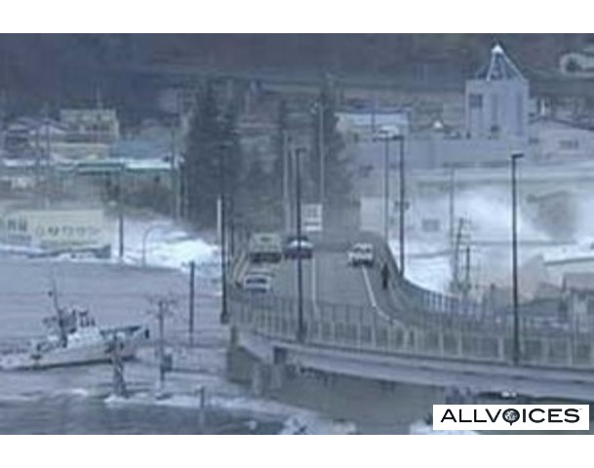
You may anticipate the disaster, but the disaster doesn’t happen in the way you expect.

Slide 4
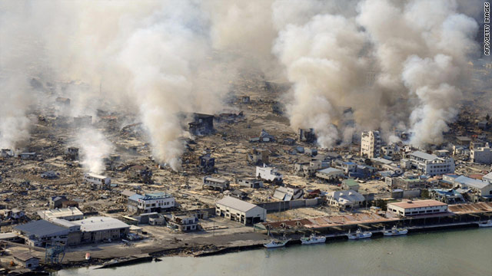
Not well prepared for a disaster, a company may go bankrupt.

Slide 5
IT Service Continuity Management(ITSCM)
Definition
ITSCM is the process responsible for the technology element of Business Continuity Management. It assesses & manages risks to IT services by examining CI values, threats & vulnerabilities弱点, developing appropriate countermeasures, creating an IT Service Continuity Plan & Managing any disaster situations that occur.

Slide 6
ITSCM
Goal
To support the overall Business Continuity Management process by ensuring that the required IT technical & services facilities ( including computer systems, networks, applications, telecommunications, technical support & service desk) can be recovered within required and agreed business timescales.

Slide 7
ITSCM versus BCM
ITSCM ( or Disaster Recovery Management ) is focused on the continuity of IT Services for the business. BCM ( Business Continuity Management ) is concerned with the management of Business Continuity that incorporates all services upon which the business depends, one of which is IT.

Slide 8
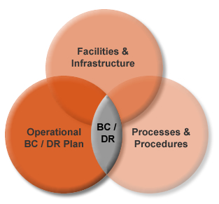
Business Continuity
/Disaster Recovery

Slide 9
Key ITSCM processes
Stage 1 : Initiation
Stage 2: Requirements & Strategy
Stage 3: Implementation
Stage 4: Operational Management

Slide 10
1.1 ITSCM Stage 1 Initiation
A well planned project initiation enables ITSCM work to proceed with the necessary sponsorship, buy-in & awareness, with all contributing members of the organisation aware of their responsibilities & commitment.

Slide 11
ITSCM Stage 1 Initiation
The initiation process covers the whole of the organisation & consists of the following 5 activities
  Policy setting
  Specify Terms of Reference (TOR) & scope
  Allocate resources
  Define the project organisation & control structure
  Agree project & quality plans

Slide 12
1.2 ITSCM Stage 2
Requirements & Strategy
Business Impact Analysis (quantify the impact loss of IT service)
Risk Assessment (risk identification and risk assessment to identify potential threats to continuity )
Business Continuity strategy

Slide 13
ITSCM Stage 2 Requirements & Strategy (Cont’d )
Options need to be considered
  People & communication
  IT systems, network & processes
  Critical services such as power, water, post etc.
  Critical assets such as records, reference material

Slide 14
ITSCM Stage 2 Requirements & Strategy
Specific IT recovery options
  Do nothing
  Manual work-arounds
  Reciprocal互惠arragements
  Graduate recovery ‘Cold Standby’
  Intermediate recovery ‘Warm Standby’
  Immediate recovery ‘hot standby’

Slide 15
Cold Standby
Data restored from tape to standby machines in the backup site
No significant cost in the telecommunication line between the primary and the backup site.
Cost : Low
Risk of data loss: High
Recovery timeframe: Long

Slide 16
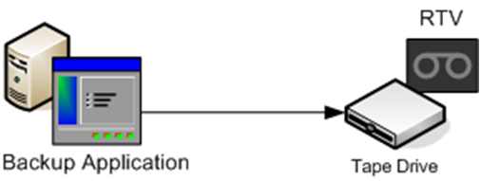
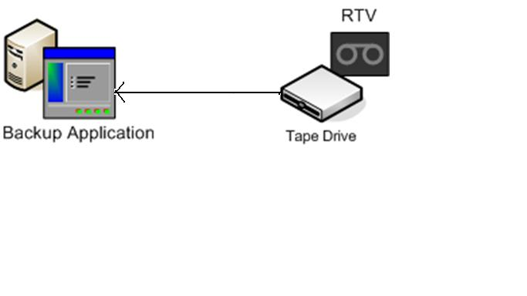
Primary machine fails, data restored to Standby machine via tape
Primary
Server
PRIMARY
SITE
BACKUP
SITE
Standby Server

Slide 17
Warm Standby
Asynchronous data replication/log copying across sites
A low-medium speed linking the primary site and backup site
Cost : medium
Risk of data loss: medium
Recovery timeframe: medium

Slide 18
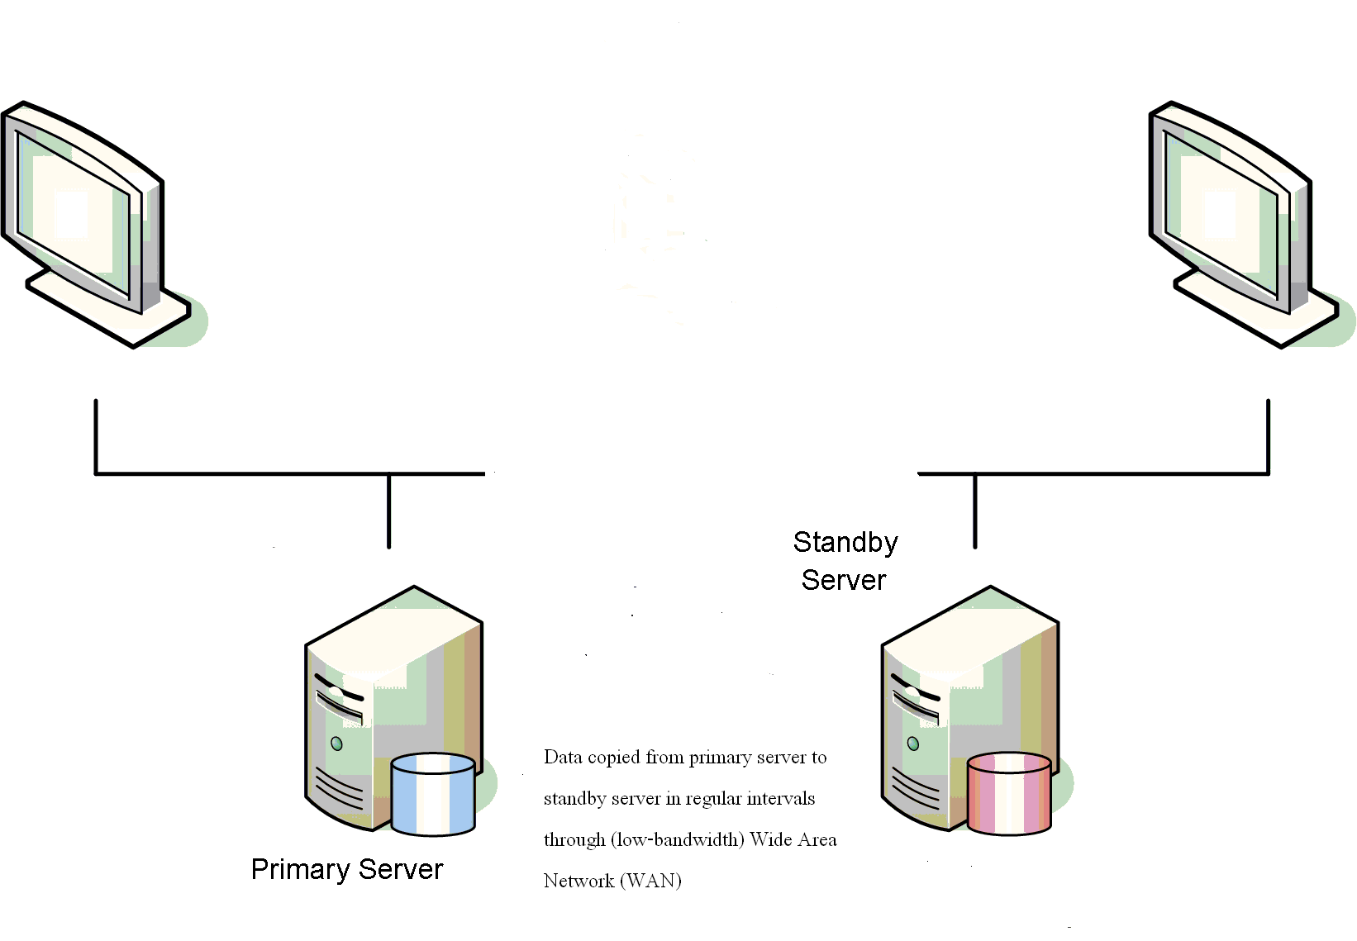
Warm Standby – Data copied from primary to standby machine regularly
PRIMARY SITE
BACKUP SITE

Slide 19
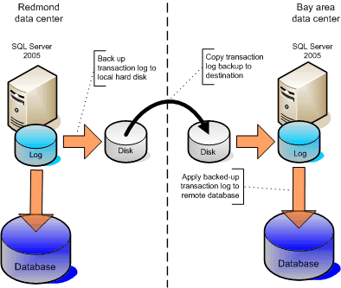
Sample Warm Standby scenario

Slide 20
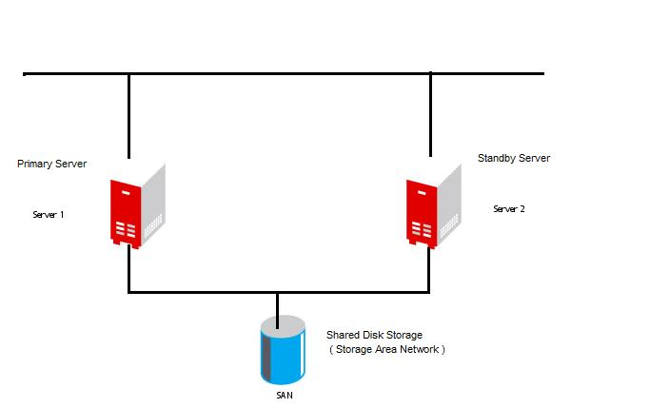

Hot Standby - Shared Storage cannot be employed in disaster recovery and sharing storage across different sites is not practicable.
BACKUP SITE
PRIMARY SITE

Slide 21
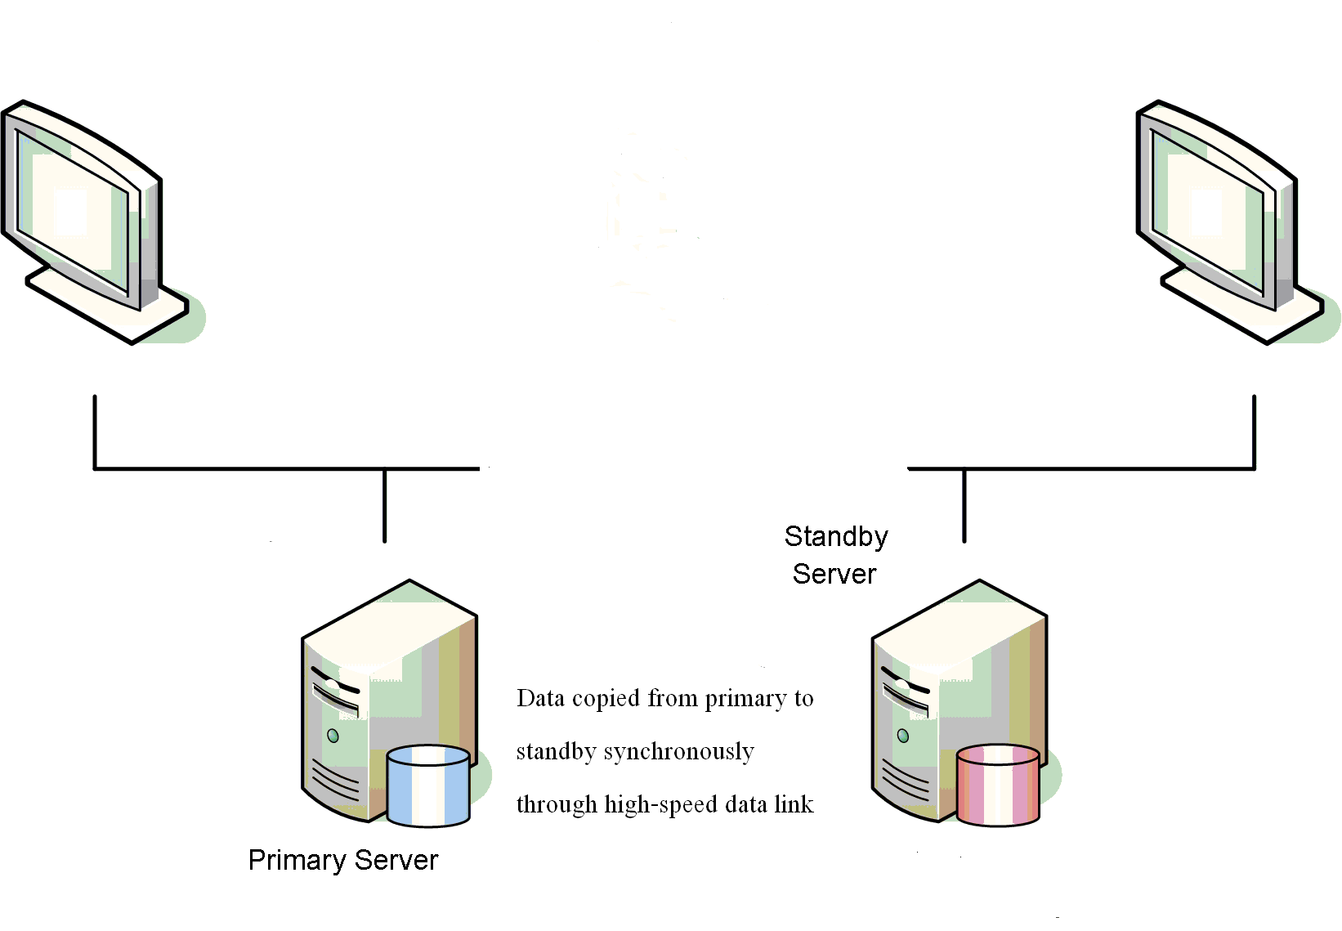
Hot Standby – Adopt similar Warm Standby scenario but use special storage system supporting synchronous data replication across high speed links
PRIMARY SITE
BACKUP SITE

Slide 22
Hot Standby
Like a hot standby recovery across sites
Synchronous data replication
High-speed link ( usually fiber network link ) linking primary and backup sites
Cost : high
Risk of data loss: low
Recovery timeframe: short

Slide 23
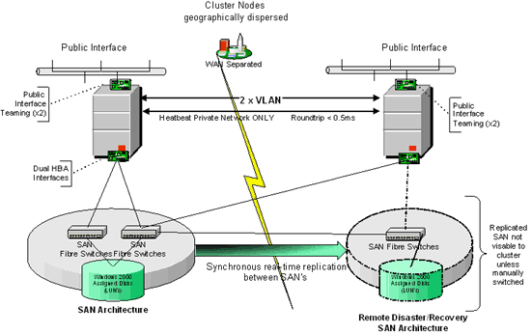
Hot standby Sample DR scenario

Slide 24
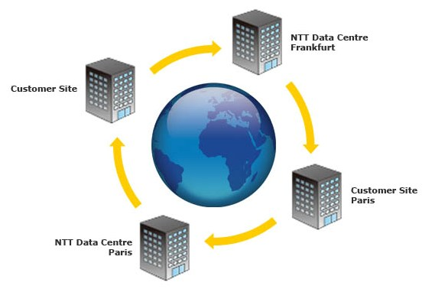
And, of course, locating primary and backup data centres should be located far apart

Slide 25
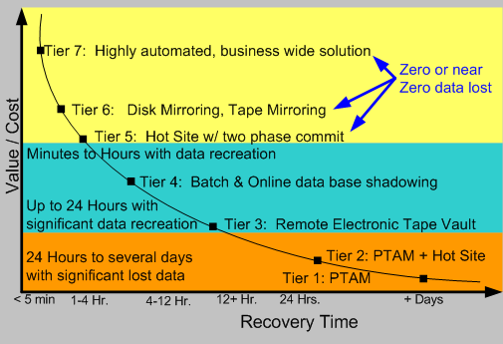
Cost versus Recovery Time

Slide 26
1.3 ITSCM Stage 3 Implementation
Organisation & Implementation planning
Develop ( recovery ) ITSCM plans
Develop procedures
Initial Testing
  Testing is a critical part of ITSCM & is the only way of ensuring that stand-by arangements and business recovery plans will work in practice

Slide 27
1.4 ITSCM Stage 4
Operational Management
Invocation
Education & Awareness
Review & Audit
Testing ( Regular testing after initial testing )
Change Control
Assurance

Slide 28
ITSCM –
Invocation启动& Responsibilities
Invocation is the ultimate test of the Business Continuity & ITSCM plans
Decision to invoke by the Crisis危机Management team
Consider the cost & disruption to the business
Plans available in the office & at home
Summary list available at all times the location of the plans, the associated key action & decision points, contact details of the crisis management team
Once the recovery has been completed, the business should be able to operate from the recovery site at the level determined & agreed in the BCM strategy

Slide 29
ITSCM
Generating Awareness引起体认
Awareness & commitment from the board & senior management, fully endorsed & sponsored required
The best & most effective way to raise senior management awareness is to highlight the potential risks & business impacts facing an organisation in terms of business failure to meet key performance indicators
Initial awareness for buy-in
Ongoing awareness (training)

Slide 30
ITSCM benefits
Potential lower insurance保险premiums
Management of risk & the consequent reduction of the impact of failure
Ability to meet regulatory监管or mandatory requirements

Slide 31
ITSCM Possible Problems
Gaining buy-in & assistance from the business
Availability of components, resources & data to test the IT recovery & BCM plans
Overlooking critical components, applications & dependencies & misinterpreting business impacts

Slide 32
ITSCM benefits
Business can survive a disaster
Opportunity to compete for business, increased customer confidence & organisational credibility
Reduced business disruption干扰in the event of a disaster, with ability to recover services efficiently

Slide 33
2. Service Design –
Capacity Management
Dr. Franklin Leung

Slide 34
Definition
Capacity Management is the process responsible for ensuring that IT processing and storage capacity provision match the evolving demands of the business in a cost effective & timely manner.
Examples: Management on CPU capacity, memory capacity, disk storage capacity, bandwidth

Slide 35
Goal
To understand the future business requirements ( the required service delivery ), the organisation’s operation (the current service delivery), the IT infrastructure (the means of service delivery) & ensure that all current & future capacity & performance aspect of the business requirements are provided cost effectively.

Slide 36
Scope
The scope includes all hardware, networking equipment, peripherals and software for both the operational & development environments & is the focal point for all IT performance & capacity issues.

Slide 37
3 key elements
Business Capacity Management (BCM)
  Trend, forecast, model, size & document future business requirements
Service Capacity Management (SCM)
  Monitor, analyze and report on service performance; establish baseline & profiles
Resource Capacity Management (RCM)
  Monitor, analyze and report on the utilisation of components, establish baselines & profiles

Slide 38
Examples of Capacity Data
Processor Utilization
Memory Utilization
Per cent processor per transaction type
IO (input-output) rates and device utilization
Disk Utilization
Transaction rates
Network traffic rates (bandwidth utilization)
Batch Duration

Slide 39
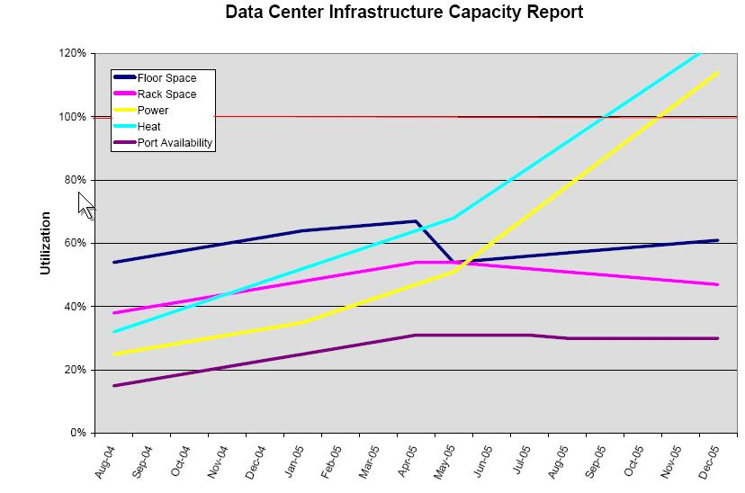

Slide 40
Key activities
Monitoring
Analysis
Tuning
Implementation
Modeling
Application sizing

Slide 41
Capacity database
Inputs: business data, service data, technical data, financial data, utilization data
Storage: Capacity database
Outputs: Service & Component based reports, exception reports, capacity plan & forecasts

Slide 42
Roles & Responsibilities
Ensuring adequate IT capacity to meet required levels of service
Ensure optimized use of existing capacity
Responsible for advising the SLM process about appropriate service levels
Assesses new technology & its relevance to the organization
Recommend resolutions to performance related incidents

Slide 43
Benefits
Increased efficiency & cost savings resulting in more economic provision of IT services
Planned buying & panic buying
Reduced risks of performance problems & failures

Slide 44
Possible problems
Customer expectations exceed technical capacity or are not prepared to pay
Over expectation of the benefits to be gained from tuning/upgrade
Unrealistic & unachievable performance figures from equipment suppliers & manufacturers
Unreliable & inaccurate business forecasts & information

Slide 45
3. System Design – Other processes

Slide 46
Other processes
Information Security Management
Supplier Management

Slide 47
Other activities in Service Design
Organizing for Service Design
  Activity Analysis
  Skills
  Roles and responsibilities
    Service Design Manager
    IT Designer/Architect
    Service Level Manager
    Availability Manager
    IT Service Continuity Manager
    Capacity Manager

Slide 48
4 Service Transition
- Change Management
By Dr. Franklin Leung

Slide 49
Change Management
Definition
The process of controlling Changes to the infrastructure or any aspect of services, in a controlled manner, enabling approved Changes within minimum disruption.
Goal
Ensuring that changes are recorded, evaluated, authorized, prioritized, planned, tested, implemented, documented and reviewed in a controlled manner.

Slide 50
Goal of Change Management
To ensure that standardised methods & procedures are used for efficient & prompt handling of all Changes, in order to minimise the impact of change-related Incidents upon service quality & consequently to improve the day-to-day operations of the organisation
Examples: large-scale desktop PC installation, operating system upgrade, adding additional CPU or hard disk storage, router configuration, firewall rules change, database scheme modification

Slide 51
Change Management
That means we want to:
Reduce unplanned outages
Improve service availability
Reduce unnecessary urgent changes

Slide 52
Change Management
Scope
Change management is responsible for managing Change processes involving hardware, software, communications equipment, system software, ‘live’ application software, & all documentation & procedures associated with the running, support & maintenance of live systems.

Slide 53
Challenges of Change Management
Test before Implement ( Availability of Testing Environment )
Documentation of Changes
Interrelated components ( e.g. compatibility issue such as “Can the existing database version run on new operating system? Can new operating system run on existing hardware? Can existing application run on the new platform? )
Limited Time Window for carrying out changes

Slide 54
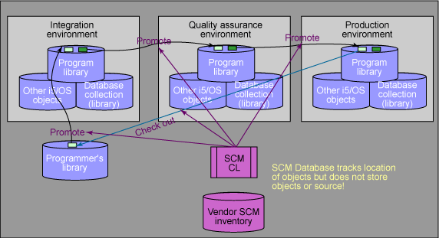
Three environments:
(a) Development/System Integration Env. (b) Quality Assurance or User Acceptance Env. (c ) Production Env.

Slide 55
Terms
Change Request – Request to make a change to a particular system and service
Change Manager - The person who makes sure that the change management process is followed
Change Advisory Board (CAB) – The group that reviews and approves (or rejects) change requests
RFC ( Request for Change )

Slide 56
Change Management - RFCs
A request for Change ( RFC ) is a form or screen used to record details of a request for a Change for any CI within an infrastructure or to procedures & items associated with the infrastructure
An incident is not a change
Customers/support staff can raise an RFC

Slide 57
RFC
RFC can be raised
  To apply the fix for an Incident or Problem
  The proposed purchase of a CI
  The removal of a CI
  Proposed Upgrade of a CI
  Location change
  Product or service changes from vendors or contractors

Slide 58
Change Advisory Board (CAB)
The change advisory board is a group of people who can give expert advice to Change Management on the implementation of changes. This Board is likely to be made up of senior representatives from all areas within IT ( e.g, network, server, application ) and , sometimes, senior representatives from business units.

Slide 59
Key activities
Change logging & filtering
Allocation of priorities ( immediate, high, medium, low )
Change categorisation ( minor, significant, major impact )
CAB meetings
Impact & resource assessment
Approving & scheduling of RFCs
Building, testing & implementing RFCs
Change Review

Slide 60
A Good Change
Must have
Impact statement
Business justification
Approvals
Test plan
Implementation plan
Fallback plan
Useful and meaningful information

Slide 61
Segregation of duties
Due to security considerations, no single party has the full authority and access rights to change the system
For example, technical support engineers do not have the super-user ( administrator ) rights to critical servers because the administrator can have the rights to even erase audit trail.

Slide 62
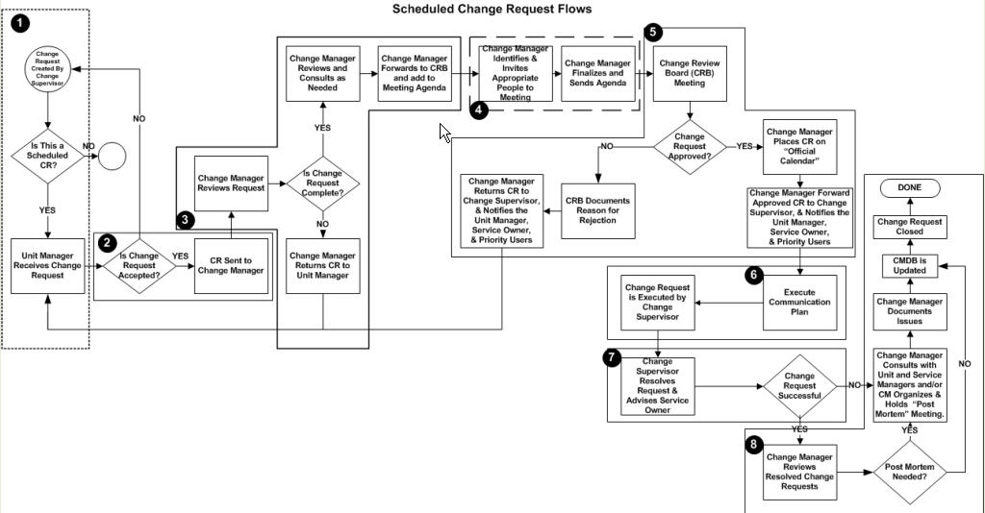
Scheduled Change Flow

Slide 63
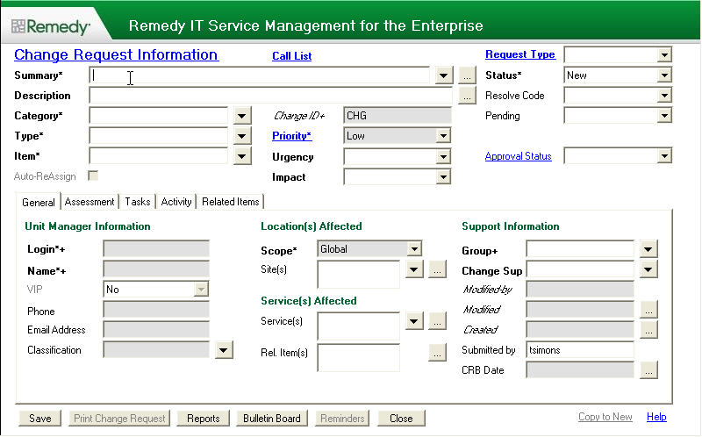
Remedy Change Request

Slide 64
Change Management
Benefits
Minimize the impact of change-related incidents upon service quality
Increase productivity by reducing disruptions for both users and IT staff
Improve communication with affected Service Owners, support staff and users
Improve risk assessment – balance need for Change against impact of the Change

Slide 65
Change Management
Possible Problems
Non-adherence to CM procedures
Implementing CM control of ‘all’ Cis & versions ( i.e. level too low/detailed)
Lack of control over urgent changes
Lack of accurate CMDB
Detection of unauthorized changes

Slide 66
Case on Service Transition - Change Management

Slide 67
Case Background
A local sizable company’s ITD does not have much change control. Log is entered voluntarily by system administrator and no supervisor approval is needed. For major changes, review by peers is needed.
Changes carried out sometime have an unanticipated impact on the network environment, e.g. changing firewall rules once led to the disconnection of the whole network.
Hire an external consultant to review the process

Slide 68
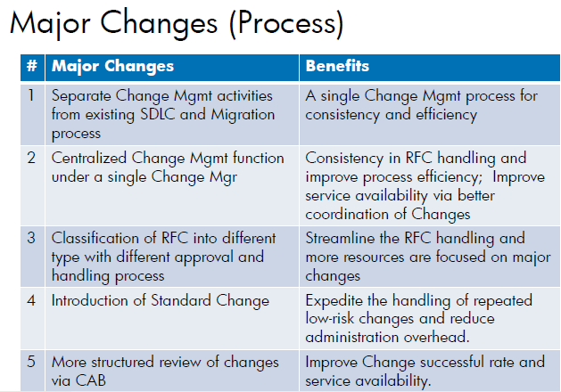

Slide 69
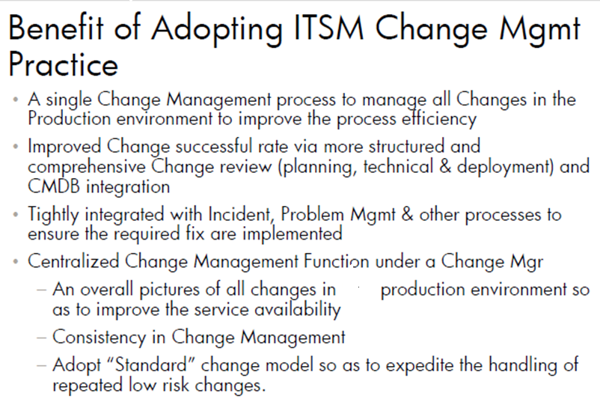

Slide 70
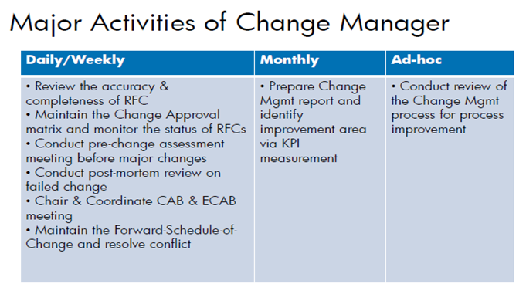

Slide 71
5. Service Transition –
Release and Deployment Management

Slide 72
Definition of Release Management
The process of designing and implementing efficient procedures for the distribution & installation of Changes to IT systems into the live system

Slide 73
Goal of Release Management
To take a holistic view of a Change to an IT Service & ensure that all aspects of a Release, both technical & non-technical, are considered together.

Slide 74
Scope of Release Management
To undertake the planning, design, build, configuration & testing of hardware & software to create a set of Release components for a live environments. Activities also cover the planning, preparation & scheduling of a Release

Slide 75
6. Service Transition –
Service Asset and Configuration Management
Dr. Franklin Leung

Slide 76
Configuration Management
Definition
The process of identifying & defining Configuration Items (CIs) in a system, recording & reporting the status of CIs & requests for changes, & verifying the completeness & correctness of CIs.

Slide 77
Configuration Management
Goal
To provide a logical model of the IT&T infrastructure or a service by identifying, controlling, maintaining & verifying the versions of configuration items in existence.

Slide 78
Configuration Management
Scope
The identification, recording & reporting of IT&T components, including their versions, constituent components & relationships are part of the scope of Configuration Management. Items include hardware, software & associated documentation.

Slide 79
Challenges in
Configuration Management
Does your company have a whole picture of the configuration of all the PCs ( e.g. how many are running Microsoft XP, how many PCs are running Microsoft 2003 etc. )?
Is the configuration record accurate? ( how to check the accuracy without involving significant manpower )?

Slide 80
Challenges in Asset Management
Is the company’s asset record accurate? (will any PC go missing but the asset record fails to record this?)
Does a company establish the mechanism to detect and prevent the installation of unauthorized software ( unlicensed software)?

Slide 81
Configuration management & Asset Management
Not the same but related
Asset Management is an accounting process that includes depreciation & details above a certain value
Configuration Management also maintains the relationships between assets
Many organisations start with Asset Management & then move to Configuration Management

Slide 82
5 key elements
Planning
Identification
Control
Status Accounting
Verification & audit

Slide 83
CMDB
The CMDB ( Configuration management database ) should hold all relevant system component details & the relationships between all system components, including incidents, problems, known errors, changes & releases. The CMDB also contains information & corporate data about employees, suppliers, locations & business units
A configuration is anything that needs to be controlled

Slide 84
CMDB ( Cont’d)
CIs – a component within a configuration (hardware, software, documentation, staff)
Attributes – describes a CI (name, version number, serial number, status )
Naming conventions – should be unique & consider existing name structures ( e.g. file server names )
Baselines – the configuration at a specific point in time ( snapshot )
Labeling CIs – for easy identification

Slide 85
Configuration Management Tools
Support more effective configuration management
Easy addition & deletion of new & old Cis
Maintenance of a history of all CIs
Support for the use of baselines
Good reporting facilities including inventory reports for audits, impact analysis, trend analysis & hierarchy relationships

Slide 86
Configuration Management
Benefits
Providing accurate information on CIs & their documentation
Making software changes visible
Contributing to contingency planning
Enabling the organisation to reduce the use of unauthorised software
Providing problem management with data on trends

Slide 87
The People, the Process or the Technology? Using the ACE framework to make tradeoffs in Service Delivery Improvement - Ramanathan et. Al.(2009)
Research Paper on Configuration Management

Slide 88
Service Delivery Improvement
Example case: PC Build and Install
100 requests for PC orders were received every month
Request on standard configuration mixed with non-standard configuration
Separate teams work together to provide the following services: help desk, request management, inventory management, approvals, billing, deployment, assembly/

Slide 89
Service Improvement Challenge
Reduce the PC deployment time
Develop a repeatable and scalable methodology that enabled continuous improvement through a monitoring and management framework
Show “Return on the Investment” in best practices (ITIL) training and adoption of a CMDB

Slide 90
Service Analysis
“As-is” versus “to-be” process
Reference framework: ITIL, SCOR(plan-source-make-deliver), ACE(adaptive Complex Enterprise)
“As-is” process study: adopt time-and-motion study, detailed time analysis for PC installation, site survey, cabling, approval, inventory etc ( queue time, execution time)

Slide 91
“To-be” process
Prioritizing those 80% standard configuration requests
Eliminate the approval step for standard config PC request
Maintain a up-to-date CMDB
Optimize the assembly step by keeping an inventory of pre-imaged PCs

