Slide 1
1. Continuous Service Improvement

Slide 2
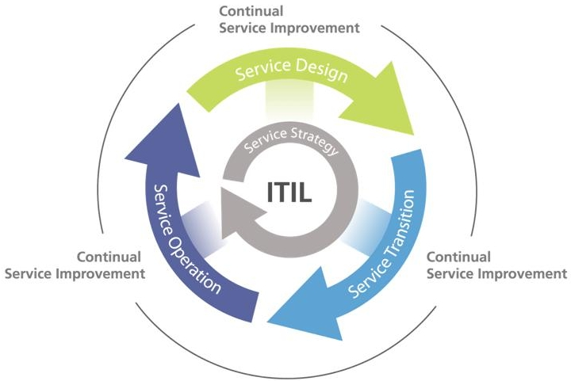
Recap of ITIL cycle

Slide 3
Continual Service Improvement (CSI)
Continually align and re-align IT services to the changing business needs by identifying and implementing improvements to IT services that support business improvements.

Slide 4
Service Metric
Schedule
Costs
Defects
Productivity
Customer Satisfaction
( Baselines are established as markers or starting points for later comparison. )

Slide 5
7-step Improvement Process
Define what you should measure
Define what you can measure
Gather the data
Process Data ( Reporting )
Analyze the data
Present the information
Implement Corrective Action
Monitoring and data collection through the service life cycle

Slide 6
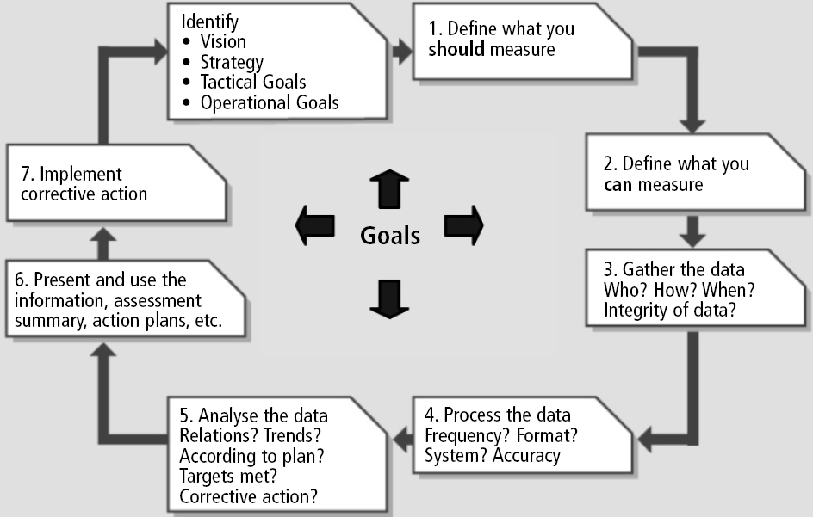

Slide 7
Underlying critical activities
Service Measurement
  Don’t just measure at the component level; measure at the service level
Service Reporting
  Reporting should not be just for technical people, should be of real interest and importance to the business people
  E.g. how IT works to improve service or innovate service; a means for IT to market its offering

Slide 8
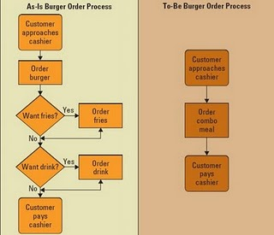

Slide 9
2. Applying ITIL
– Cloud Computing as an example

Slide 10
Why is ITSM(Service Management) Needed in the Cloud?
It is remote, requires best practice adoption
  Focuses on service provisioning and satisfies business needs
  Ensures high quality, more cost effectiveness and customer experience
ITSM ensures business-IT alignment in a cloud remote paradigm
  Utilizes cloud computing as a way to improve a current service or implement a new service
  CSF’s, KPI’s and CSI required for continued service

Slide 11
Service Strategy in the Cloud
Portfolio management, demand management, and financial management
  Portfolio management describes the cloud candidate
  Demand Management for workload calculation
  Financial management for costs calculation to meet workload demand
Potential problems: inefficient service delivery, and/or ineffective charging algorithm

Slide 12
Service Design in the Cloud
Services are designed based on what will best deliver on Service Strategy
Services in the Cloud are:
  Delivered remotely
  Focus is typically on service level contracts
SLAs are required
  Service deliverables are understood by all parties
Suppliers have to be identified and selected
Availability and capacity to ensure services described in the portfolio and specified in the SLAs can be delivered by cloud computing suppliers
IT service continuity management and information security management must be in place before the service goes “live”

Slide 13
Service Operation in the Cloud
Service Operation requires service monitoring
  Ensures the delivery of defined and agreed to service levels specified in SLAs
Role/ownership of Service Operation processes or support points must be clearly defined and monitored
  Service desks may share primary focus from incident resolution and rapid response to problem management
Access management is critical to maintain security and satisfy any customer trust requirements

Slide 14
Service Transition in the Cloud
Governance issues may need to be dealt with who owns change management
  Internal IT or the cloud suppliers
  Who will own and manage changes in the future
Release and deployment management is required as Service is rolled out to ensure it is successful
Underpinning service transition are service asset and configuration management which will detail exactly who owns the responsibility for the devices and software required to provide the new service

Slide 15
Continuous Service Improvement in the Cloud
Cloud Computing requires CSI for agility, adaptability in responding quickly and effectively to changes in business condition
  Identifying, qualifying and reporting on service success factors is mandatory for both the customer and the service provider
  Continuous service improvement ensures the focus stays on services, business/IT alignment and measurement in a cloud remote paradigam

Slide 16
3. ITIL in real life

Slide 17
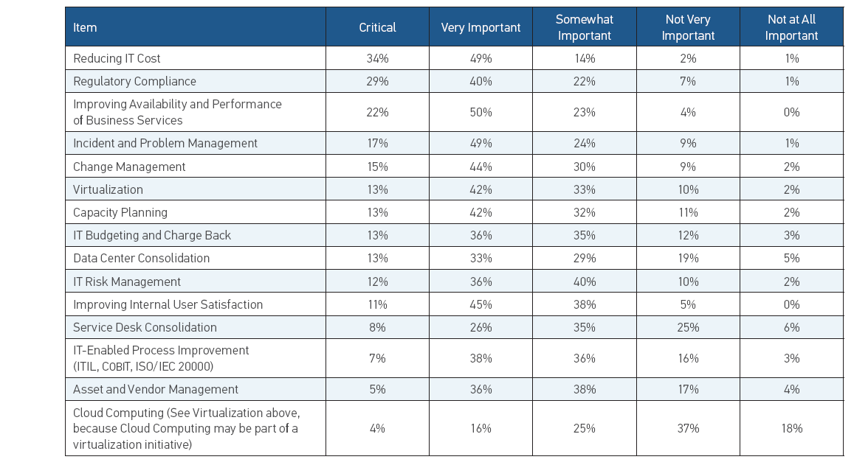
2010 – BMC Survey IT priorities

Slide 18
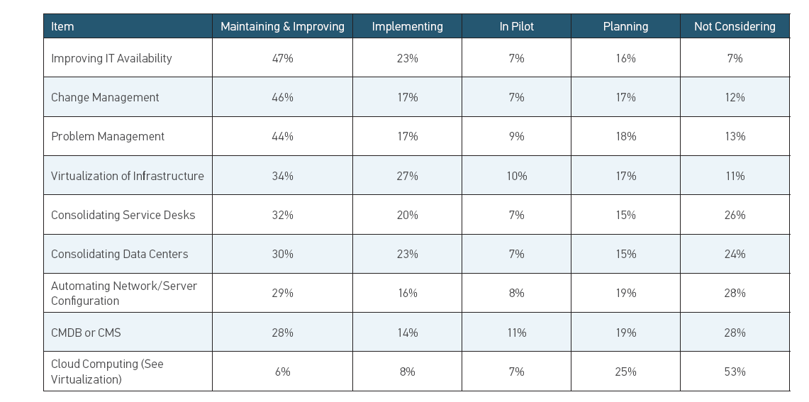

Slide 19
2009 ITIL survey
The 2009 “ITIL and Business Performance Management” was targeted at EMEA (Europe, Middle East and Africa) companies
26 questions
Carried out between November and December 2009
20 countries are contacted (Middle East counts as one)
17 countries participated
70 persons from 11 countries answered
  38 from France
  8 from Austria
  5 from Norway

Slide 20
Five Areas
History and Investment (2 questions)
    “What is the length of investment in ITIL practices?”
Customers and Services (3 questions)
    “What is the level of customer relations management between the IT Department and its internal customers?”
Organization and Processes (5 questions)
    “What is the current positioning of ITIL projects in the IT Department”
Industrial Integration (6 questions)
    “What is the maturity of the IT Service Management?”
Performance Management (10 questions)
    “What is the maturity of IT Performance Management?”

Slide 21
History and Investment
The question of investment is important because it’s the first maturity indicator of companies about the best practices ITIL.

Slide 22
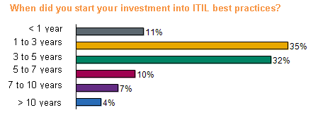
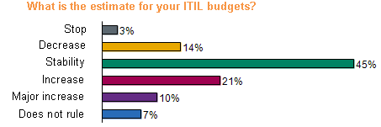
History and Investment
The average time of investment in ITIL is 3.5 years in 2009 against 2.9 years in 2008
Since 2007, ITIL budgets, for the most part, have either remained stable or have grown.

Slide 23
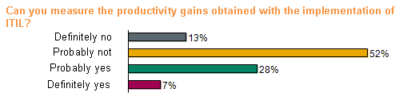
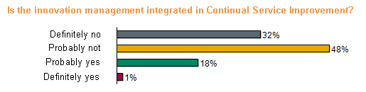
Performance Management
It’s still difficult to measure the contribution of these practices about the productivity.
The innovation isn’t integrated in the CSI.

Slide 24
Conclusion
The survey confirm :
  ITIL implementation with the Request Fulfillment Management, the service contract and service portal
  Harmonization of processes and rationalization of tools
  A pragmatical implementation of ITIL v3
To ensure an optimal QoS, IT departments invest :
  To rationalize their functioning using ITIL
  To evaluate their performance using KPI
The 2 key factors for deploying ITIL are:
  organizational change management
  sponsorship of managers

Slide 25
4. Other than ITIL –
Service Science Research Perspective

Slide 26
Limitations of ITIL
IT services delivered through a mix of structured and unstructured work activities
ITIL focus on standardized processes ( e.g. capacity management, availability management ) to provide high quality IT services
ITIL may be over-killing for small-to-medium enterprises
Focusing only on standardization without considering support for unstructured activities misses the opportunity for vast improvement in efficiency and quality of IT service delivery

Slide 27
Presence of Unstructured Activities in IT services
( Bailey et.al. 2007)
Dynamic processing
Knowledge intensive
Customization
Ad-hoc collaborations with colleagues

Slide 28
Examples of unstructured activities
Seeking information from external sources
Writing customer scripts
Troubleshooting
Discovering change impacts
Sharing information on Demand

Slide 29
Challenges in modeling and designing IT services
(Ramanathan et.al. 2009)
Unstructured ad-hoc processes
Knowledge-intensive
Global processes co-ordination
Shared services between multiple customers
Mixed-mode services ( e.g. delivery of PC and then installation of software )
Many-to-many customer-provider relationship

Slide 30
Activity Analysis
Challenges: record and analyze unstructured activities
Need tools to record human interaction, tool usage ( maybe online chat, discussion forum, collaborative workflow can be used to record human interaction )
Efficiency, quality and cost analyses
Analyses can be used to build models which can be used in cost/activity planning and forecasting

Slide 31
5. IT Service Management and ITIL Revision

Slide 32
Strategy -> Operation
Business Strategy
Business
Service Strategy
IT Service Strategy
Business Services
IT Services

Slide 33
Four Perspectives of the
Balanced Scorecard
Financial
Budget
Objective
Measure
Target
Initi
Customers
Internal Business
Processes
Customers/Citizens
Objective
Measure
Target
Initiative
Strategy
Objective
Measure
Target
Initi
Learning & Growth
Learning & Growth
Objective
Measure
Target
Initi
Source: Kaplan and Norton

Slide 34
Business Balanced Scorecard vs IT Services Balanced Scorecard
Perspective | Business Balanced Scorecard | IT services Scorecard
Customer | External customer satisfaction | External/Internal Customer Satisfaction
Financial | Revenue, Income, Profit | Cost
Internal business processes | Efficiency/reliability/ compliance of service workflow | Efficiency/reliability/ compliance of IT service workflow
Learning & Growth | Professional knowledge, Company culture | IT knowledge and certifications, IT culture

Slide 35
Metrics Tree
Based on balanced scorecard
Business Metrics -> IT metrics -> service & customer metrics -> individual process metrics -> individual component metrics

Slide 36
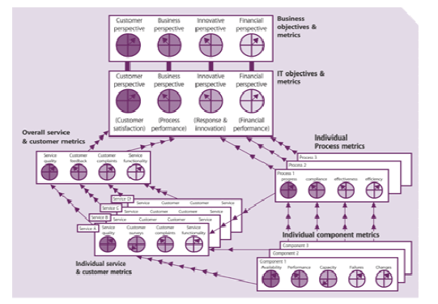

Slide 37
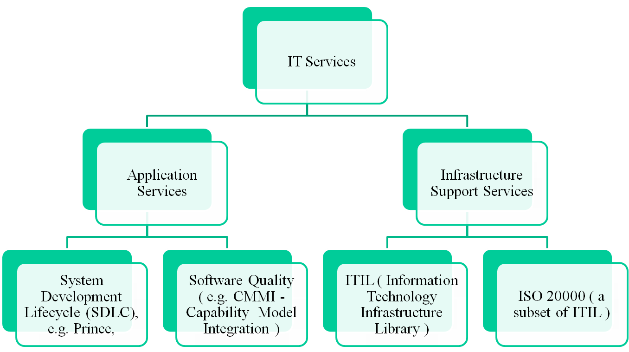
Priority in incident management refers to priority of the incidents related to infrastructure support services ( e.g. hardware, user support ) but not on the priority of service requests ( e.g. application development ).
Focus of this course COMP5138
I

Slide 38
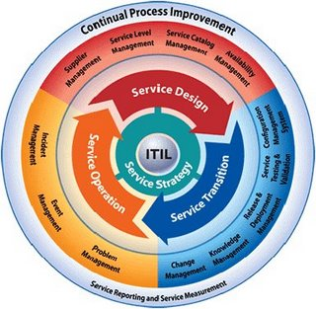
Service LifeCycle (ITIL V3 )

Slide 39
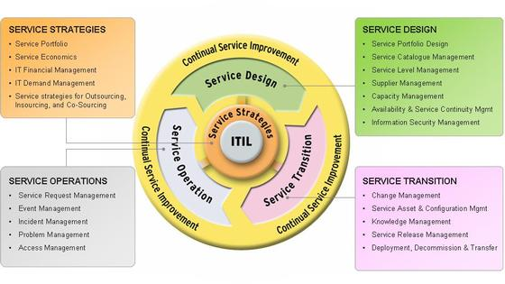

Slide 40
IT Strategies
IT governance
  Alignment with Business Strategy, IT Steering Committee
  KPI ( Key Performance Indicator ) in IT services linked IT performance to business Strategy , e.g. IT services scorecard
  Centralized/decentralized decision making
Financial Management ( such as internal charge-back, budgeting/accounting process )
Demand Management
Strategies on Service Provisioning

Slide 41
Service Provider Types
Type 1: Internal Service Provider
Type 2: Shared Service Provider
Type 3: External Service Provider

Slide 42
Delivery model Option
/Service Delivery Strategy
In-sourcing,
Out-sourcing
Co-sourcing
Partnership or multi-sourcing

Slide 43
Service Operation
Incident Management
Problem Management
Event Management
Service Request Management
Access Management

Slide 44
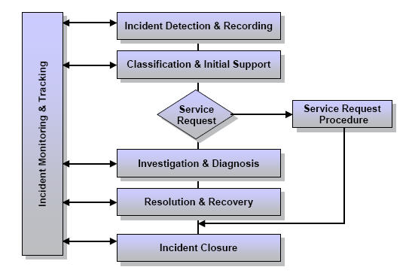
Incident Lifecycle

Slide 45
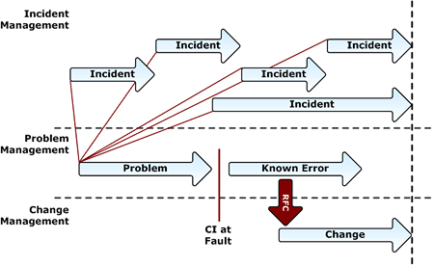

Slide 46
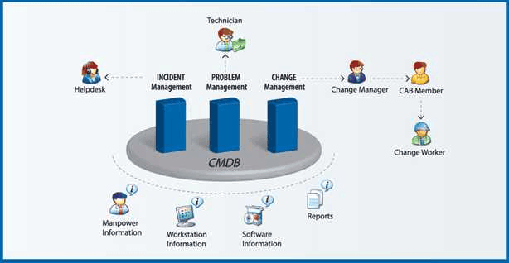

Slide 47
IT Operation Management Role
Operations Control ( Console Management, Job Scheduling, Backup and Restore , Print & Output Management, Maintenance Activities)
Facilities Management

Slide 48
Service Design
Service Catalog/Service Portfolio and Service Level Management
Availability Management
Capacity Management
IT Service Continuity Management
Information Security Management
Supplier Management

Slide 49
Service Design Aspects
Design of the services (requirement, resources, capacities )
Design of the management system and tools
Design of the processes for IT service design, operation, transition management
Design of the measurement methods, metrics of the services, architecture

Slide 50
Design process activities
Requirements collection, analysis and engineering
Design of appropriate services, technology, processes and process measurement
Production and maintenance of IT policies and design documents
Plan for the deployment and implementation of IT strategies using roadmaps, programmes
Risk assessment

Slide 51
Simple example of a Service Catalogue
Service | Customer | Accounts | Legal | Sales | HR | Retail
Payroll |  | X | X
E-mail |  | X | X | X | X | X
Invoicing |  | X |  | X |  | X
Internet |  | X | X | X | X
Intranet |  | X | X | X | X | X

Slide 52
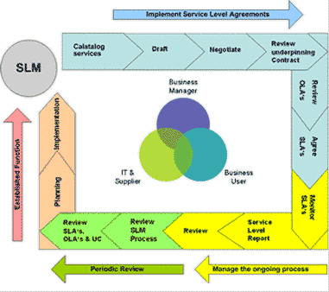

Slide 53
5 key elements of
Availability Management
Availability
Reliability
Maintainability
Serviceability
Security
Plus – Vital Business Functions (VBF )

Slide 54
Calculating Availability
Availability = (AST – DT )x 100/AST
  = service or component availability (%)
  Where
  AST = Agreed Service Time
  DT = Actual downtime during agreed service time

Slide 55
Formula
Reliability ( MTBSI in hours ) =
Agreed Service Time / number of incidents
( breaks )
Reliability ( MTFB in hours )
= ( Agreed Service Time – Down Time )/
number of incidents
Maintainability ( MTRS in hours )
= Total Down Time / number of incidents

Slide 56
Availability Management
Distinguish availability from reliability and maintainability
Distinguish component availability from service availability (end-to-end availability)
Calculation of end-to-end availability

Slide 57
Availability for a network with multiple components
Question:
If a network has a router and a firewall, the router has availability 99% ( i.e. 0.99 ) and the firewall has availability 98% ( i.e. 0.98 ), what the overall availability for the whole network?
( Hints: if either component fails, the whole network fails. )

Slide 58
Availability for a network with multiple components
Answer:
( 0.99 + 0.98 ) / 2
0.99 x 0.98
1 – ( 0.99 x 0.98 )
1 – ( 1 – 0.99 ) x ( 1 – 0.98 )

Slide 59
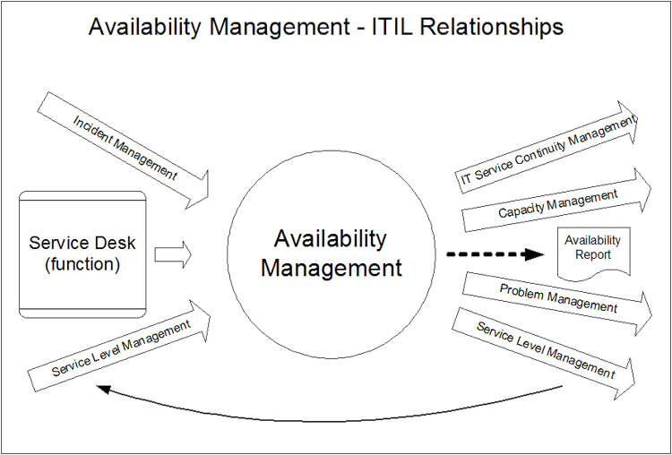
AM’s relationship with other processes

Slide 60
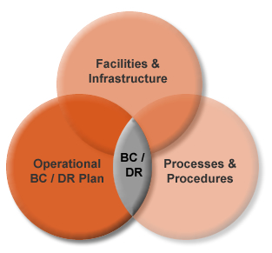
Business Continuity
/Disaster Recovery

Slide 61
Key Processes of IT Service Continuity Management
Business Continuity Management & ITSCM
Stage 1 : Initiation
  Management sponsorship, working committee
Stage 2: Requirements & Strategy
  Vital Business Function; Recovery Option
Stage 3: Implementation
Stage 4: Operational Management
  Drill; Education; invocation

Slide 62
Recovery Options
Do nothing
Manual Workaround
Graduate Recovery(Cold Standby)
Intermediate Recovery(Warm Standby)
Fast/Immediate Recovery(Hot Standby)

Slide 63
3 key elements of
Capacity Management
Business Capacity Management (BCM)
  Trend, forecast, model, size & document future business requirements
Service Capacity Management (SCM)
  Monitor, analyze and report on service performance; establish baseline & profiles
Resource Capacity Management (RCM)
  Monitor, analyze and report on the utilisation of components, establish baselines & profiles

Slide 64
Service Transition
Change Management
Release Management
Asset Management
Configuration Management
(Knowledge Management)

Slide 65
Change Management
Definition
The process of controlling Changes to the infrastructure or any aspect of services, in a controlled manner, enabling approved Changes within minimum disruption.
Goal
Ensuring that changes are recorded, evaluated, authorized, prioritized, planned, tested, implemented, documented and reviewed in a controlled manner.

Slide 66
Continual Service Improvement
7-step improvement process
Service measurement
Service Reporting

Slide 68
You should learn how to apply ITIL and conduct gap analysis

Slide 69
Gap Analysis against ITIL
- Service Operation ( example )
Is there a service desk as a central contact point for reporting incidents?
Is there a software system logging and keeping track of all incidents?
Is the log analyzed and common underlying cause for multiple incidents is analyzed? ( problem management )
Are there metrics and measurement for incident management ( e.g. measuring the total time to resolve incidents )?

Slide 70
Gap Analysis
Are Known Errors/issues Database established with workaround documented?
Are incidents categorized?
Is priority assigned to incidents according to its impact and urgency?
Are incidents properly closed ( e.g. confirmation of the resolution with the originator)?
Is the owner of a reported incident identified?

Slide 71
Gap analysis
You should be able to demonstrate that you know the key processes and conduct gap analysis, e.g. for
  Availability management
  Service Level Management
  IT service continuity management
  Continuous service improvement

Slide 72
IT transforming business organizations
IBM Global Business Services recommends a combination of
  CMMI (Capability Maturity Model Integration) : primarily for software development process )
  ITIL ( Information Technology Infrastructure Library ) : for infrastructure support service
  Six Sigma: for general quality management
Others: “Aligning COBIT, ITIL and ISO17799 for Business Benefits” by ISACA

Slide 73
What you should have learned
Besides building quality application systems, it is also important to plan and management infrastructure and support services.
ITIL provide a framework for infrastructure and support services
SSME (Service Science, Management and Engineering)– research studies on IT service management are ongoing; “best practices” may evolve.

Slide 74
Reference
Bailey, Kandogan, Haber & Maglio (2007), Activity-based Management of IT Service Delivery, CHIMIT 07, ACM.
Ramanathan, Ramnath & Glassgow (2009), The People, the Process or the Technology? Using the ACE Framework to make tradeoffs in Service Delivery Improvement, SAC 09, ACM.

