Slide 1

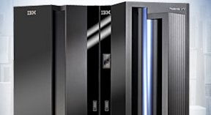
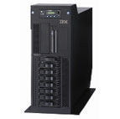


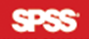
IBM on Service Transformation
1960s Mainframe Computer Specialist
1980s Smaller scale computers and servers
1990s Acquiring software developer
Service Orientation
2005s Drop out of PC Market
2010 Acquire SPSS

Slide 2
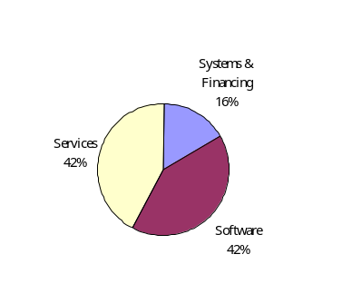
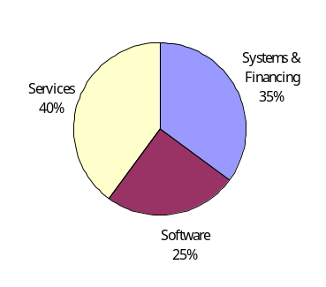
IBM Pre-tax Income
2000
2009
Source: IBM. (2010). 2009 Annual Report, [Online] Available at
http://www.ibm.com/annualreport/2009/ [Accessed Date 6 June, 2010].

Slide 3
Service Transformation
Different economies are evolving from agricultural to industrial, and industrial to service concentration
IBM is a famous computer hardware designer and manufacturer since 1950s
After sales customer service differentiated IBM from other competitors since the earlier days
IBM continues to develop its services since 1990s and gradually focus on software services and consultancy services in the last two decades
IBM reduces its scale on manufacturing and eventually sold out its profit making personal computer division in order to maximize its return on investment by concentrating on services industry
In 2008, 90% of incomes comes from service-related products.

