Slide 1
Services Science Management
COMP5138

Slide 2
Contents
1
Service Quality
2
Expectation and Perception
3
Technology in Services
4
Online Service Quality
5
Information Systems Success

Slide 3
Service Quality

Slide 4
Service Quality
Customers consume services according to their needs. Because of the characteristics of services, the decisions for service consumption are different from those in products
Since quality determines the value that a customer could received after a purchase, the quality of service becomes a key determinant for consumer’s behavior
Service quality defines what customers are looking for and how they evaluate service firms. Companies can measure and adjust their services in fulfilling customers’ needs

Slide 5
Service Quality Perception
Service quality evaluation is different from product quality; service quality is subjective to individual customer, contains psychological feelings, extends beyond immediate encounter, and has impact on future quality evaluation. Therefore, service quality is difficult to measure and control.
Service quality usually reflect the immediate feeling after a service counter.
Service quality is important because it will affect the overall customer satisfaction towards a service organization.

Slide 6
Measuring Service Quality
Servqual Questionnaires developed by Parasuraman, Bitner, & Zeithaml in 1988
  Based on the Gaps Model of Service Quality
  Defining actual service quality as the discrepancies between customer expectation and perception
  Refined into 5 measurement dimensions
  Improvements on service quality can be achieved by way of manipulating different dimensions
  22 questions for expectations and 22 questions for perceptions

Slide 7
Dimensions of Service Quality
Reliability
  Perform promised service dependably and accurately
Assurance
  Ability to convey trust and confidence
Tangibles
  Appearance of physical facilities and quality of facilitating goods
Empathy
  Approachability, caring and sympathy shown during service encounters
Responsiveness
  Willingness to help customers promptly

Slide 8
SERVQUAL
Expectation Section (Examples):
  They should have up-to-date equipment
  Their physical facilities should be visually appealing
  Their employees should be well dressed and appear neat
  The appearance of the physical facilities of these firms should be in keeping with the type of services provided
Perception Section (Examples):
  ABC has up-to-date equipment
  ABC’s physical facilities are visually appealing
  ABC’s employees are well dressed and appear neat
  The appearance of the physical facilities of ABC is keeping with the type of services provided

Slide 9
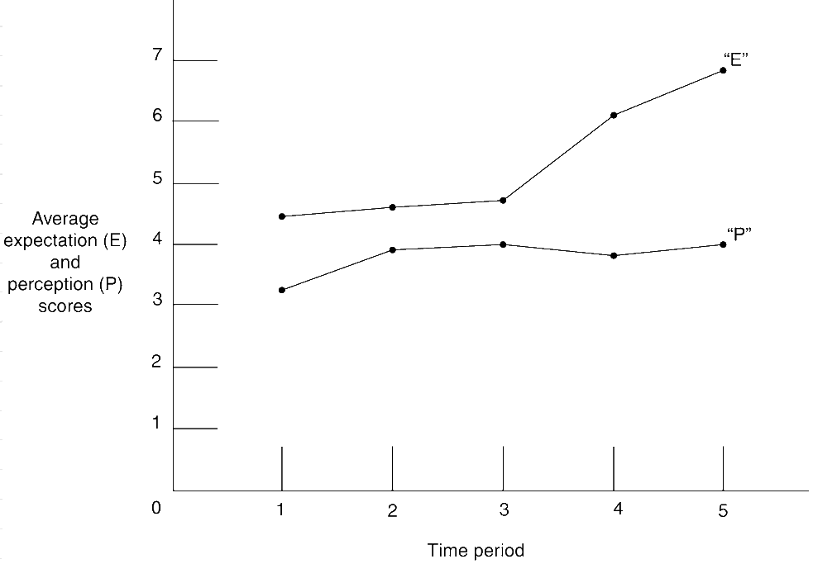
Tracking Expectations and Perceptions for Reliability

Slide 10
Service Equal Profits
?
Service
Profits
Would higher service quality always equal to more profit?

Slide 11
Customer Value Equation
Explicit Service
Implicit Service
(Results Produced) + (Process Quality)
Value =
(Price) + (Costs of Acquiring the Service)

Slide 12
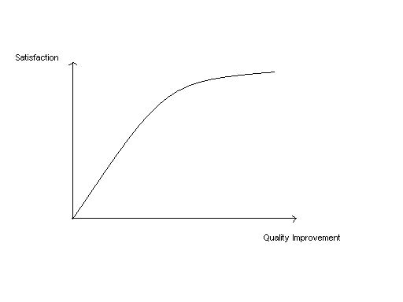
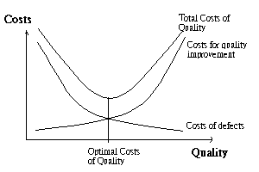
The Cost of Quality
Factors affecting profitability of quality improvement
  Marginal return of satisfaction, Costs structure for quality, improvement, Economy, Competitors, Customer segments, Company resources

Slide 13
The Return on Quality Approach
Full Implementation
Financial projection on results
Limited testing of effectiveness
Pilot testing of quality improvement programs
In order to assure a positive quality and profitability linkage.
Identification of opportunities
Preliminary Information Gathering
Source: Rust, R. T., Zahorik, A.J., & Keiningham, T.L. (1995). "Return on quality
(ROQ) - making service quality financially accountable." Journal of Marketing 59(2):58-70.

Slide 14
The Balanced Scorecard
Financial data reports only historical results
Budgets would help to predict future performance but only limited to the monetary terms
The Balanced Scorecard approach (Kaplan and Norton, 1996) measures different activities of an organization in order to project the relative future opportunities
The measurements integrate financial data with the internal and external environment in an attempt to align operations to strategies of an organization
Most of the Fortune 500 companies report their performance in terms of the Balanced Scorecard approach nowadays

Slide 15
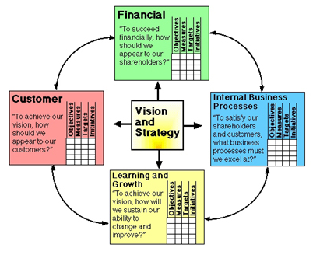
The Balanced Scorecard Approach
Different facets of the Balanced Scorecard in aligning vision and strategy of an organization
Source: http://www.balancedscorecard.org/BSCResources/AbouttheBalancedScorecard
/tabid/55/Default.aspx. [accessed 31 May, 2008] Balance Scorecard Institute.

Slide 16




The Balanced Scorecard Measurements
Financial Measures
Operational Measures
Price premium
Volume increases
Life value of customers
Process quality
Reduction in waste
Standards-conformance
Transaction time
Responsiveness
Right on time
Profitability
Customers’ Views
Innovativeness
Customer Satisfaction
% loyalty
% Intent to switch
Customer referrals
Cross selling
Number of new services
Return from new services
Employee skills
Time to market

Slide 17
Expectations and Perceptions

Slide 18
Expectations and Perceptions
Customer expectations
  beliefs about service delivery that serve as standards or reference points against which performance is judged
Customer perceptions
  subjective assessments of the actual service experiences

Slide 19
Dual Customer Expectation Levels
Level of
Expectation
Desired Service
Desired Service
Zone of Tolerance
Zone of Tolerance
A range of service performance that could satisfy a customer
Adequate Service
Desired Service
Zone of Tolerance
Adequate Service
Adequate Service
Responsiveness
Reliability
Tangibles

Slide 20
Factors That Influence
Desired Service
Lasting Service Intensifiers
  Personal philosophy that adjusts the level of desired service
Personal needs
  Physical or psychological requirements as desired by the customer at particular time

Slide 21
Factors That Influence
Adequate Service
Temporary service intensifiers
  Short term or emergency needs
Perceived service alternatives
  Acceptable alternate service providers
Self-perceived service role
  Customer’s self confidence in performing his/her role during the service
Situational factors
  Confidence in service provider under particular situation
Predicted service
  Beliefs about the level of service likely to receive base on past experience, word of mouth, and implicit services

Slide 22
Disconfirmation of Satisfaction
Measuring the differences between expectation and perception
Satisfaction
  Perception = Expectation (within the zone of tolerance)
Dissatisfaction (negative confirmation)
  Perception < Expectation
Delight (positive confirmation)
  Perception > Expectation

Slide 23
Perception and Satisfaction
Level of
Expectation
Delight
Desired Service
Zone of Tolerance
Satisfaction
Adequate Service
Dissatisfaction

Slide 24

Outcomes of
Customer Satisfaction
Increased customer loyalty
Positive word-of-mouth communications
Increased revenues and profits

Slide 25
Tracking the Zones of Tolerance for Service Quality
9
8
7
6
5
4
3
2
1
0
O
O
O
O
O
Reliability Responsiveness Assurance Empathy Tangibles
Retail Chain
O
= Zone of Tolerance = Service Quality Perception

Slide 26
Technology in Service

Slide 27
Role of Technology in the Service
Technology
Technology
Technology
Customer
Server
Customer
Server
Customer
Server
A. Technology-Free
Service
B. Technology-Assisted
Service
C. Technology-Facilitated
Service
Technology
Technology
Customer
Server
Customer
Server
D. Technology-Mediated
Service
E. Technology-Generated
Service

Slide 28
Service and Technology
Internet as a service
Potential for new service offerings
New ways to deliver service
Enabling both customers and employees
Extending the global reach of services

Slide 29
Economics of e-Business
Sources of Revenue:
- Transaction fees
- Information and advice
- Fees for services and commissions
- Advertising and listing fees
Ownership
- Customer relationship
- Customer data
- Customer transaction

Slide 30
Pros and Cons of SST on Services
Advantages of applying technology
  Provide alternative choices for customers
  Higher consistency than interpersonal alternative
  Significantly added values for customers
Disadvantages of applying technology
  Poor design and difficult to use
  Customers could not fulfill their roles
  Deferred service recovery

Slide 31
Internet as a Key SST Channel
The relative importance of internet for an organization still largely depends on the nature of its products, services, and buyer behavior of its target audience
Consumer who already has knowledge of a company is more likely to trust the company’s online presence
Loyalty can decrease because customers can easily access and trial the offerings by other competitors on the internet

Slide 32
Mixed-mode Service Delivery
Online and offline interaction in completing a service
Industry restructuring through collaboration of intermediaries across a wide geographic presence either through disintermediation or reintermediation

Slide 33
Managing Online Services

Slide 34
People
How an organization’s staff interact with customers via online options
  Auto-responding notifications
  Frequently asked questions
  On-site search engines
  Virtual assistants
  Online chat
  Staff callback
  Staff visit

Slide 35
Physical & Process
Physical Evidence
  Appearance
  Navigations
  Availability
  Performance
Process
  Integration of other Ps
  Method of service delivery
  Integration of online and offline process

Slide 36
Evaluation of Online Services
Fulfillment/reliability
  on-time and accurate delivery, accurate product representation, and technical reliability
Privacy/security
  protection of personal information and risk of fraud and financial loss
Information availability and content
Ease of use or usability
Graphic style
  color, layout, print size and type, number of photographs and graphics, and animation.

Slide 37
E-S-Qual Dimensions
E-S-Qual is an extension of the Servqual and further elaborate on the characteristics of online environment into 2 sections containing 7 dimensions:
  Core perception dimensions
    Efficiency
      ability of the customers to get to the Web site
    Reliability
      technical functioning of the site
    Fulfillment
      accuracy of service promises
    Privacy
      assurance that shopping behavior data are secured
  Recovery dimensions
    Responsiveness
      appropriate information to customers when a problem occurs
    Compensation
      money back and returning shipping and handling costs
    Contact
      the need of customers to be able to speak to a live customer service agent

Slide 38
Implications of the
E-S-Qual
Efficiency and fulfillment dimensions are the most critical dimensions in assessing online services
System availability is also important but might not be totally controlled by the services organization due to ownership of equipment by end-users
The importance of privacy varies but usually exhibit to be less important for most end-users
The involvement of physical goods will also impact on the overall online service quality evaluation

Slide 39
Information Systems
Success Model

Slide 40
Success with Technologies
In order to raise the effectiveness of information systems and to predict individual adoption and use of new IT systems, different models are developed to determine the success factors of new technology.
  DeLone and McLean Model (1992)
    The model synthesized different research on technology communications and adoptions and summarizing the key success factors of an information system
  Technology Acceptance Model (TAM, 1989)
    TAM was developed in view that individuals’ behavioral intention to use an IT is determined by two beliefs: perceived usefulness and perceived ease of use. Both beliefs defined the degree to which a person believes that using an IT will be free of effort

Slide 41
The DeLone & McLean Model
Service Quality
Service Quality
Service Quality
Service Quality
Intention to Use
Intention to Use
Intention to Use
Intention to Use
Intention to Use
System Quality
System Quality
System Quality
Net Benefits
User Satisfaction
User Satisfaction
User Satisfaction
User Satisfaction
User Satisfaction
Information
Quality
Information
Quality

Slide 42
Dimensions of D & M Model
Service Quality
  Overall support by the service providers including but not limited to IS department
System Quality
  Usability, availability, reliability, adaptability, response time
Information Quality
  Web content should be personalized, complete, relevant, easy to understand and secure
Intention to Use
  Ease to use and accuracy of transaction
User Satisfaction
  Overall customer experience
Net benefits
  Contributions to personal and organization impact

Slide 43
Technology Acceptance Model
Individual
Differences
Perceived
Usefulness
Service Quality
Service Quality
Service Quality
System
Characteristics
Behavioral
Intention
Use Behavior
System Quality
System Quality
Social Influence
Perceived
Ease of Use
Information
Quality
Facilitating
Conditions

Slide 44
Towards e-Business Success
The design of online services should:
  Consider characteristics and backgrounds of targeted customers
  Focus of the values and benefits propositions towards customers
  Evaluate viable online business model for service implementations in conjunction with the offline offerings
  Continuous monitoring of the service quality

Slide 45
References
Davis, F. D., ‘Perceived usefulness, perceived ease of use, and user acceptance of information technology’. MIS Quarterly, 13, 319–340, 1989.
DeLone, W.H. and McLean, E.R., ‘The DeLone and McLean Model of Information Systems Success: a Ten-Year Update’, Journal of Management Information Systems, Spring, 19/4, p.9-30, 2003.
Fitzsimmons, J. and Fitzsimmons M., Service Management: Operations, Strategy, Information Technology, McGraw-Hill/Irwin, 6th edition, 2008.
Parasuraman, A., Zeithaml, V.A., and Berry, L.L., ‘Servqual: A Multiple-Item Scale for Measuring Consumer Perception,’ Journal of Retailing, 64(1), 12-41, 1988.
Parasuraman, A., Zeithaml, V.A., Malhotra, A., ‘E-S-QUAL: A Multiple-Item Scale for Assessing Electronic Service Quality’, Journal of Service Research, Feb., 7/3, p. 213-233, 2005.
Yang, Z., Jun, M., Peterson, R.T. ‘Measuring customer perceived online service quality: Scale development and managerial implications’, International Journal of Operations & Production Management, 24/11/12, p. 1149-1174, 2004.
Zeithaml, V.A., Bitner, M.J., and Gremler, D.D., Services Marketing: Integrating Customer Focus across the Firm, 5th edition, McGraw-Hill, 2008.

