Slide 1
Course Lecturer
(Dr. Franklin Leung)
M.Sc. & Doctor of Business Administration from Hong Kong Polytechnic, M. Sc. In computer science from the University of British Columbia ( Canada ), B.A. in Computer science and Psychology from Southern Illinois University, USA

Slide 2
Visiting Lecturer (Dr. Franklin Leung)
Financial Risk Manager (FRM), Certified Information Security Professional (CISSP), Certified Information Systems Auditor (CISA), 20 years of experience in information technology, recent 5 years in business process re-engineering, risk management, compliance and operations
Thesis Supervisor for University of Warwick Master programme in project management
IT Specialist in Hong Kong Council of Accreditation, Panel member conducting course validation

Slide 3
1. From Business to IT Services
– An overview of frameworks
by Dr. Franklin Leung

Slide 4
Strategy -> Operation
Business Strategy
Business
Service Strategy
IT Service Strategy
Business Services
IT Services

Slide 5
Business Service vs IT Service
External customer
ServQual in external customer gap analysis
Balanced Scorecard
Service design and management
Service vs Product
Internal Customer
Use of ServQual in internal customer gap analysis
IT Service Scorecard
IT Service Design and Management
IT Service versus IT Product

Slide 6
Business Service vs IT Service
Design/Standards/ Performance/ Communication Gap
Customer Relationship Program
Service Capacity/Demand Management
Gap Analysis against best practice framework (e.g.ITIL)
Build up IT/User relationship
IT Service Capacity/Demand Management

Slide 7
Business Service vs IT Service
Manage external customer expectation
Service Quality Management
Process blueprinting/analysis
Service outsourcing
Manage external & internal customer expectation
Incident/Problem Management
IT process analysis and benchmarking
Data centre outsourcing

Slide 8
Definition of Service
(ITIL definition)
A ‘service’ is a means of delivering value to customers by facilitating outcomes want to achieve without the ownership of specific costs and risks.

Slide 9
Frameworks
Business Strategy – Balanced Scorecard,
IT Service Strategy – (a) IT Services Scorecard (b) ITIL Service Strategy
IT Services
  Application Services ( Capability Maturity Model Integration )
  IT Infrastructure Services ( ITIL framework on service design, operation, delivery; certification awarded to individuals )
Research on Services : Services Science

Slide 10
Business Strategy and
IT Service Strategy Framework

Slide 11
MISSION
To provide acquisition and assistance services to
support accomplishment of the Department's
programmatic goals and objectives.
VISION
To deliver on a timely basis the best value product
or service to our customers while maintaining
the public's trust and fulfilling public policy
objectives.
STRATEGY
To change the present system's culture, management
systems, and line processes consistent with the
principles of Quality Management, in order to
establish and maintain: a customer focus, a sense of
urgency, continuous and breakthrough process
improvement, and an emphasis on results.

Slide 12
Four Perspectives of the
Balanced Scorecard
Financial
Budget
Objective
Measure
Target
Initiative
Customers
Internal Business
Processes
Customers/Citizens
Objective
Measure
Target
Initiative
Strategy
Objective
Measure
Target
Initiative
Learning & Growth
Learning & Growth
Objective
Measure
Target
Initiative
Source: Kaplan and Norton

Slide 13
What is the Balanced Scorecard (BSC)?
The balanced scorecard is a management system (not only a measurement system) that enables organizations to clarify their vision and strategy and translate them into action.
It provides feedback around both the internal business processes and external outcomes in order to continuously improve strategic performance and results.
When fully deployed, the balanced scorecard transforms strategic planning from an academic exercise into the nerve center of an enterprise.

Slide 14
Items under each perspective
Objectives of initiatives
Measurement method
Target

Slide 15
Measurement in Scorecard
“How to measure anything: finding the values of intangibles in business” by Douglas Hubbard – “Anything can be measured”
“If you can’t measure it, you can’t manage it” from Peter Drucker
“Data beats opinion”
Measurement is the start of science; process measurement is the start of scientific management.

Slide 16
Measurement (Cont’d )
Measure customer satisfaction by (a) doing customer survey (b) categorizing and counting number of complaints
Measure operational efficiency through (a) turnaround time (b) resource utilization (c ) idle time

Slide 17
Marketing Measurements
“Marketing Metrics: the definitive guide to Measuring Marketing Performance” by Farris, Bendle, Pffeifer & Reibstein (2010)
“For years, corporate markets have walked into budget meetings… They couldn’t always justify how well they spent..or what different it all made.. They just wanted more money..”
“The challenge, of course, is knowing what to measure and exactly how to measure it, e.g. the number of customers
Over 100 metrics mentioned in the book

Slide 18

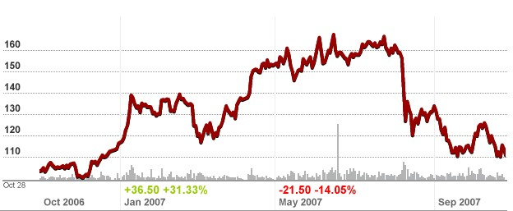
Things can’t be measured?
Love ( Intensity of Love )
  Psychologist develops metrics to measure “love”
Uncertainty ( uncertainty of stock measure )
  Risk Management uses standard deviation of stock return to measure stock volatility ( Harry Markowitz introduced this concept in 1952 and won Nobel Prize )

Slide 19
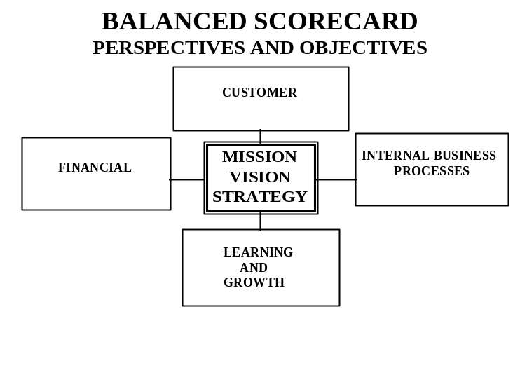
CUSTOMER PERSPECTIVE
CUSTOMER
- Customer Satisfaction
A-6

Slide 20

INTERNAL BUSINESS PROCESS PERSPECTIVE
INTERNAL BUSINESS
PROCESSES
-Effective Internal Controls
-Effective Supplier Management
-Effective Utilization of Alternate
Procurerment Approaches
-Streamlined Processes
-Acquisition Process
-Good Corporate Citizenship through
Purchasing
A-13

Slide 21
INTERNAL BUSINESS
PROCESSES PERSPECTIVE
OBJECTIVE MEASURE TARGET
Effective Internal Controls
Transactional review
of purchasing files, review boards and
Local Purchasing Information
Systems (LPIS)
Effective Supplier Management
Effective Utilization of Alternate
Procurement Approaches
Core:
% of systems in full compliance with
stakeholder requirements (e.g., applicable
laws, regulations, terms and conditions of
contracts, ethics, etc.) based on self-assessment
and subject to fatal flaw considerations
Core:
% Delivery on-time
Optional:
Supplier Satisfaction
Core:
% of RFPs over $100K issued electronically
A-14
Meets or exceeds expectations
85% on-time delivery (includes JIT)

Slide 22

LEARNING AND GROWTH PERSPECTIVE
LEARNING AND GROWTH
- Employee Satisfaction
- Employee Alignment
-Information Availability
A-21

Slide 23
LEARNING AND GROWTH PERSPECTIVE
OBJECTIVE MEASURE TARGET
Employee Satisfaction
Self-Assessments and Site Visit
Evaluations
Employee Alignment
Employee Performance
Appraisals
Information Availability
Establish Intranet and Knowledge
Portal
Core:
Employee Satisfaction Index
Employee Satisfaction Index includes data
from employee survey, focus groups,
absenteeism, and voluntary terminations
Core:
Employee Alignment % of employees
whose actual performance is aligned with
Key Success Factors
Core:
Information Availability Measure
This is a measure of useful information
(e.g., policies, procedures, operational
reports) available to employees
(Appropriate targets will be negotiated
between the Cognizant DOE Contracting
Officer and the contractor purchasing
organization.)
90% aligned
90% of work groups have the data
they need to do their jobs
A-22

Slide 24

FINANCIAL PERSPECTIVE
FINANCIAL
- Optimum Cost Efficiency of
Purchasing Operations
A-27

Slide 25
Initiatives Examples
Perspective | Objectives /Initiatives | Measurement | Target
Customer | Enhance customer satisfaction through service manners | No. of complaints | < 20 each year
Financial | Cost reduction | Cost to Income Ratio | < 40%
Internal Business Processes | Reduce turnaround time for invoice payment approval | Turnaround time for invoice payment approval | Cut down payment settlement time from 15 days to 10 days

Slide 26
Initiatives Examples ( Cont’d)
Learning & Growth perspective deals with the employee satisfaction, company culture, knowledge management, training ,
Perspective | Objectives /Initatives | Measurement | Target
Learning & Growth | Enhance English speaking ability of staff through training sponsorship | No. of training hours in English speaking for each employee | > 16 hours each year per employee

Slide 27
Distinction between Customer and Internal Business Operation
Customer initiatives will directly affect customer satisfaction ( e.g. service manner, service/product quality, front-end )
Internal business operation initiatives will directly increase effectiveness, reduce cost and may indirectly contribute to customer satisfaction ( e.g. back-office operation, supply chain logistics )

Slide 28
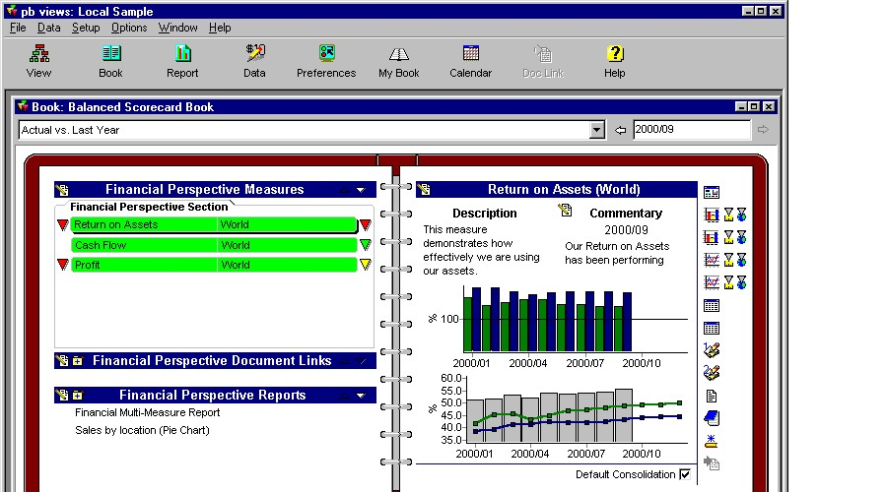

Example: Performance Views (dashboard )

Slide 29
Business Operation -> IT Service
Business Strategy
Business
Service Strategy
IT Service Strategy
Business Operation
IT Operation

Slide 30
Business Balanced Scorecard as Business Strategy Implementation Framework
Balanced Scorecard is for implementation of business strategy, not for IT services strategy. The objectives and measurements may be or may not be related to IT at all.
Instead, IT Balanced Scorecard is for implementation of IT Service Strategy. The objectives

Slide 31
IT Service Strategy Framework
– IT Balanced Scorecard
Perspective | Business Scorecard | IT services Scorecard
Customer | External customer satisfaction | External/Internal Customer Satisfaction
Financial | Revenue, Income, Profit | Cost
Internal business processes | Efficiency/reliability/ compliance of service workflow | Efficiency/reliability/ compliance of IT service workflow
Learning & Growth | Professional knowledge, Company culture | IT knowledge and certifications, IT culture

Slide 32
Measurement of IT services
Software quality
Security
Total Cost of Ownership
Availability
Turnaround time in producing report
Productivity of system administrator
Business Value

Slide 33
Customer Perspective
IT services may be further categorized under services provided to external customers and internal customers.
External Customer
  e.g. Establish e-commerce website for customers self-help and self-use
  e.g. Increase reliability of e-commerce website
Internal Customer
  e.g. Shorten turnaround time in responding to urgent cases in help desk

Slide 34
Financial Perspective
For IT services provided to external customers, it will focus both on revenue and cost; For IT services provided to internal customers, it will focus on cost.
Examples
  Increase revenue by 10% through e-commerce internal trading web site;
  Decrease cost by 10% through server consolidation

Slide 35
Internal IT Operation Perspective
It focus on IT operation ( rather than business operation which may contain manual work )
Examples of Initiatives:
  Reduce downtime through better capacity planning
  Shorten backup time through the use of disk rather than tape

Slide 36
Learning and Growth Perspective
e.g. provide technical training to administrators
Measurement: Number of certified database administrator

Slide 37
2. IT Infrastructure
Technology Overview

Slide 38






CPU & PRIMARY STORAGE
PRIMARY
STORAGE
CPU
DATA BUS
ADDRESS BUS
CONTROL BUS
INPUT
DEVICES
OUTPUT
DEVICES
SECONDARY
STORAGE

Slide 39

SECONDARY STORAGE
DISK
TAPE
OPTICAL STORAGE
*

Slide 40
SOFTWARE
APPLICATION SOFTWARE
OPERATING SYSTEM:
SCHEDULED COMPUTER EVENTS
ALLOCATES COMPUTER RESOURCES MONITORS EVENTS
LANGUAGE TRANSLATORS:
INTERPRETERS
COMPILERS
UTILITY PROGRAMS:
ROUTINE OPERATIONSMANAGE DATA
SYSTEM SOFTWARE
HARDWARE
PROGRAMMING LANGUAGES:
ASSEMBLY LANGUAGE; FORTRAN; COBOL; PL / 1; QBASIC; PASCAL; C; C++; FOURTH GENERATION LANGUAGES

Slide 41
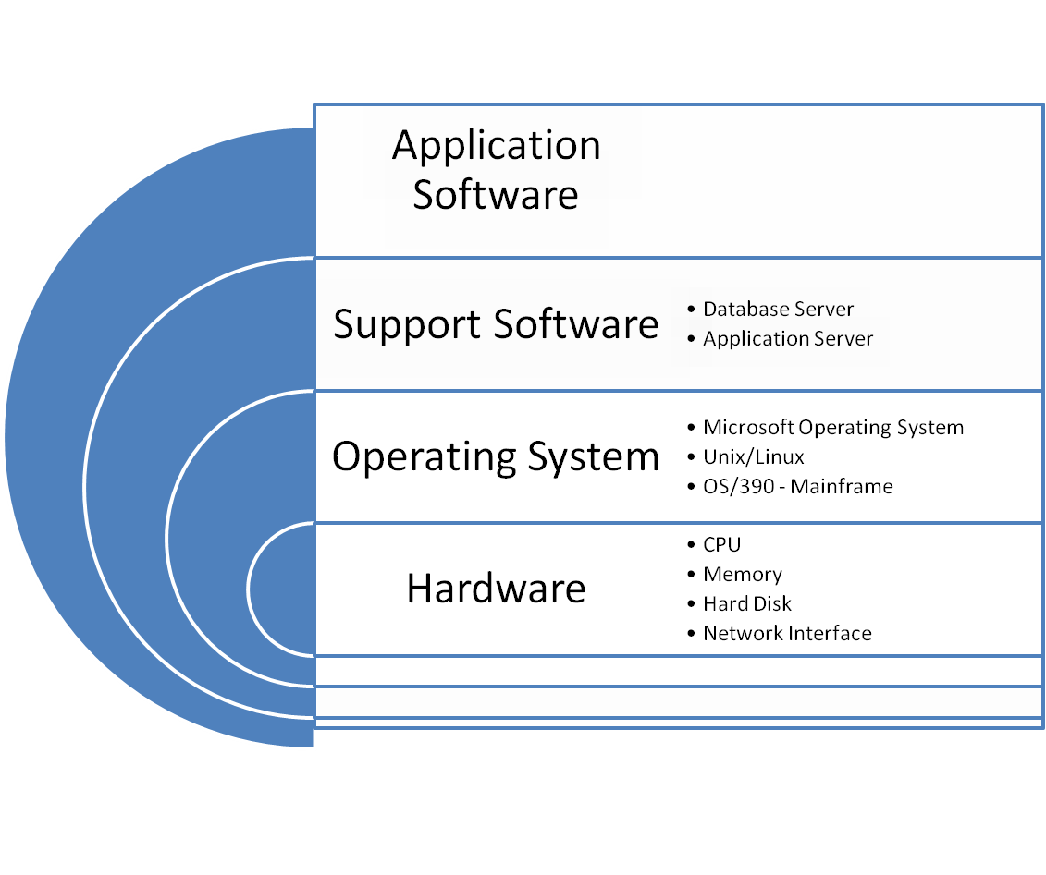

Slide 42
Types of System Software Running on Operating System
Application Server ( IBM Websphere, Oracle Application Server )
File Server ( Microsoft Servers )
Database Server ( Oracle, Microsoft SQL servers, Sybase )
Gateway to mainframe

Slide 43

MAINFRAME
d
LARGEST ENTERPRISE COMPUTER
COMMERCIAL, SCIENTIFIC, MILITARY APPLICATIONS
MASSIVE DATA
Applications running on mainframe may be used for long time, often referred to as Legacy System
IBM/Hitachi
*

Slide 44


MIDRANGE/MINICOMPUTER
MIDDLE-RANGE
UNIVERSITIES, LARGE CORPORATES, SME, FACTORIES, LABS
Usually run Unix Operating System
IBM, HP, SUN ( Sun acquired by Oracle )
*

Slide 45
MICROCOMPUTER
DESKTOP OR PORTABLE
PERSONAL OR BUSINESS COMPUTERS
AFFORDABLE
MANY AVAILABLE COMPONENTS
CAN BE NETWORKED
LENOVO/HP

Slide 46
DOWNSIZING
TRANSFER APPLICATIONS FROM LARGE COMPUTERS TO SMALL/MEDIUM COMPUTERS
REDUCES COST
SPEEDS RESULTS TO USER
FROM THIN CLIENT ( TERMINAL ) TO CLIENT/SERVER CODE ( CLIENT CONNECTING TO SERVER )
COOPERATIVE PROCESSING
*

Slide 47

STORAGE AREA NETWORK (SAN)
HIGH-SPEED NETWORK
CONNECTS VARIOUS STORAGE DEVICES
  TAPE LIBRARIES
  DISK ARRAYS
STORAGE SERVICE PROVIDER:
3rd party rents storage space
*

Slide 48
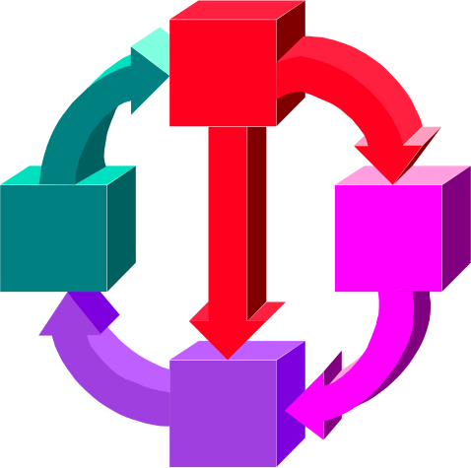
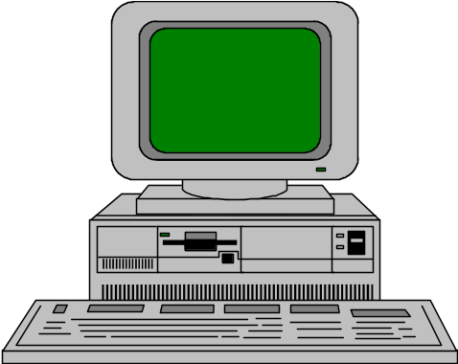
CLIENT / SERVER
CLIENT SERVER
REQUESTS
DATA, SERVICE
USER INTERFACE
APPLICATION
FUNCTION
DATA
APPLICATION FUNCTION
NETWORK RESOURCES

Slide 49
MIDDLEWARE
SOFTWARE ALLOWS DIFFERENT APPLICATIONS TO EXCHANGE DATA ( e.g. IBM MQ Series )
*
APPLICATION A
APPLICATION B
DATA
MIDDLE WARE

Slide 50
INTERNETWORKING
LINK NETWORKS
EACH RETAINS IDENTITY
INTO INTERCONNECTED NETWORK
*
NETWORK C
NETWORK A
NETWORK B

Slide 51
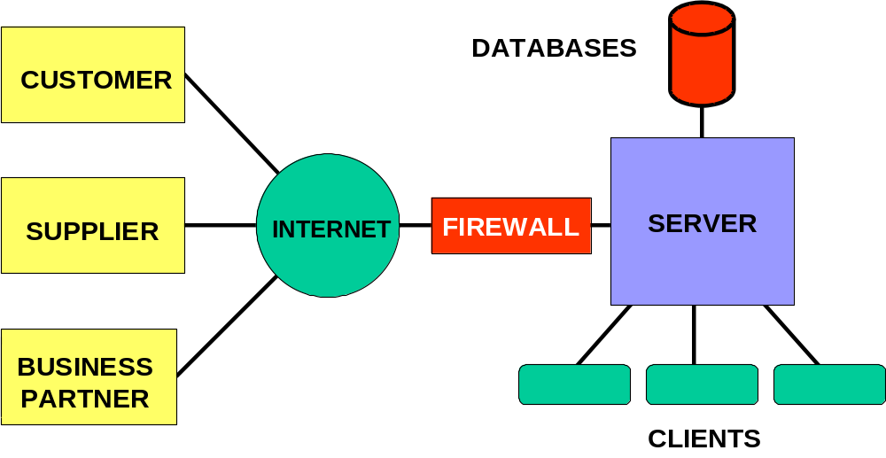
EXTRANET

Slide 52
LOCAL AREA NETWORK (LAN)
GATEWAY: Connection to other networks
ROUTER: Forwards data to other networks (e.g. CISCO routers )
NETWORK OPERATING SYSTEM (NOS): Manages file server; routes communications on network ( e.g. Linux, Microsoft Operating System )
*

Slide 53
WIDE - AREA NETWORK (WAN)
Network spans large geographic distances. Can include cable, satellite, microwave
SHARED LINES: Route determined by current traffic
DEDICATED LINES: Constantly
available for high-volume traffic
VPN ( Virtual Private Network )
over Internet
SPEED: Mbps/Gbps
*

Slide 54
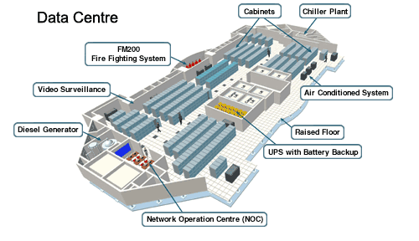
Data Centre Overview

Slide 55
Data Centre Environment
Security ( video surveillance )
Air conditioned system
Raised Floor ( wiring ) and Cabinets
HA configuration ( high availability )
UPS ( Uninterrupted Power Supply ) – Consider Electricity Generator – esp. in China
Business Continuity(Back-up data centre)

Slide 56
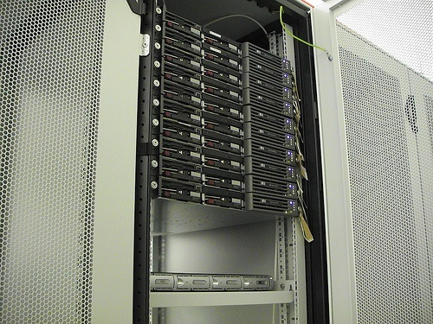
Rack-Mounted Server

Slide 57
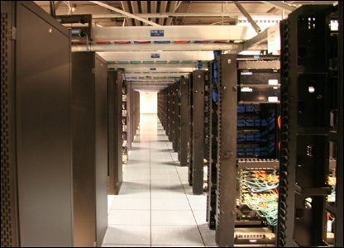
Cabinets in Data Centre

Slide 58
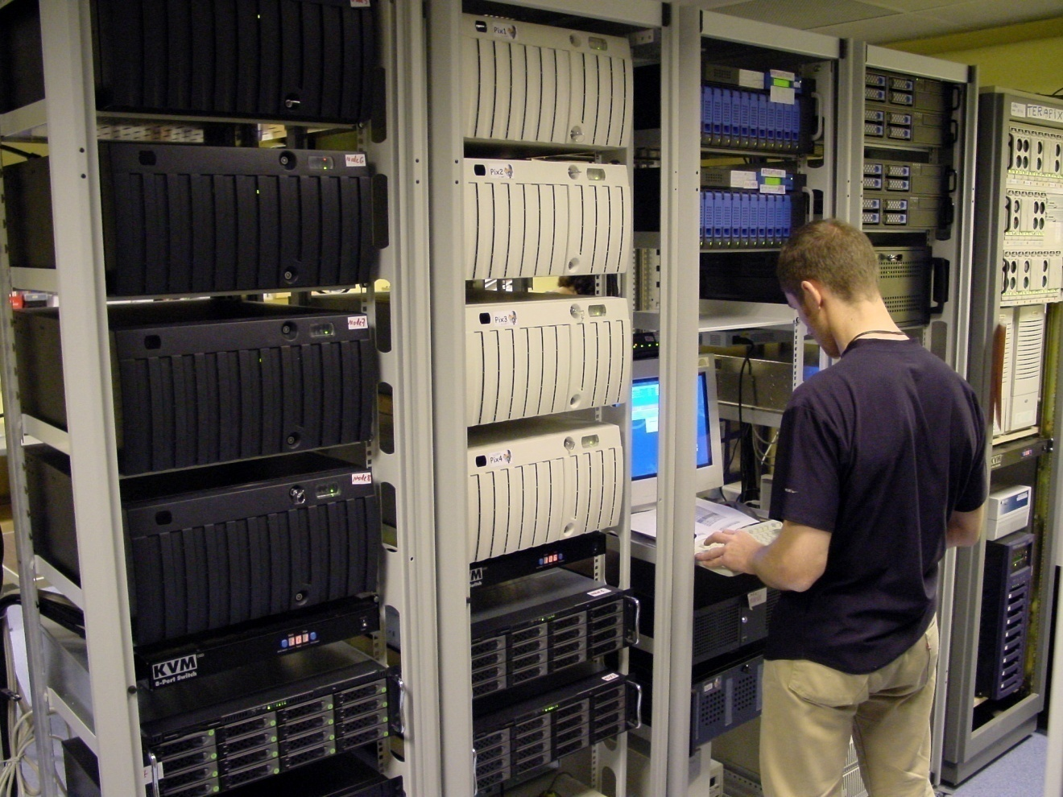
Shared console for multiple servers

Slide 59
High Availability
HA configuration for firewall, application server, database server
Redundant hardware/software component for real-time backup

Slide 60
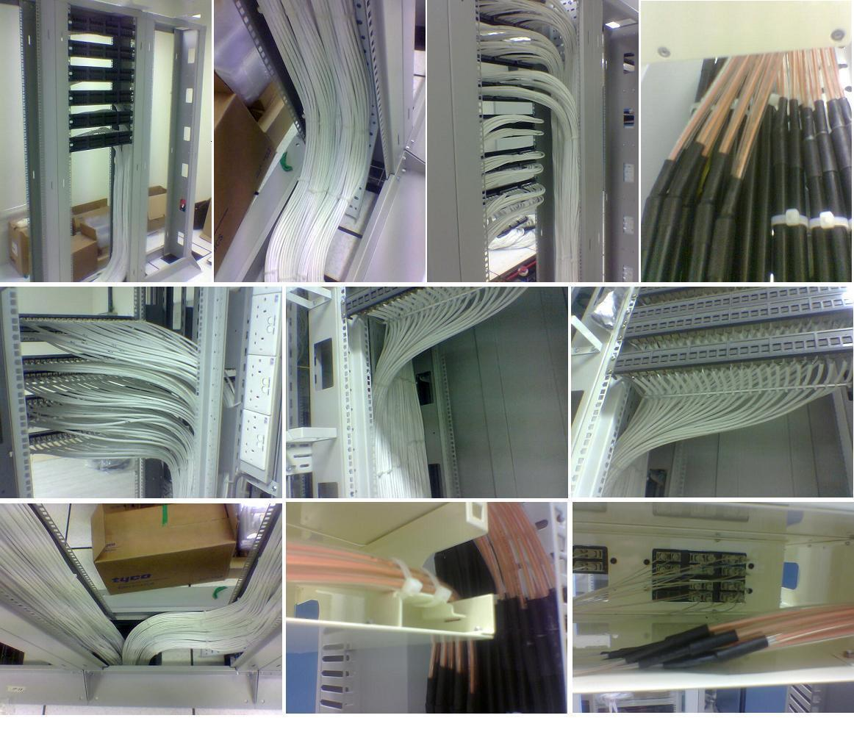
Wiring ( e.g. unshielded twisted pair (UTP), fiber optics cable )

Slide 61
Data Centre Infrastructure
Hetereogeneous Computing Environment
Multiple dedicated servers ( boxes )
Client Server + middleware + gateway
LAN/WAN/Internet/Firewall
Primary/Backup Data Centre ( Consider 9/11 attacks at the buildings with data centre inside )
Location of Data Centre/Data Centre consolidation

Slide 62
Challenges for system administrator
Monitor performance for CPU, Memory, Disk
Capacity planning and upgrade for different components
Interconnected network makes troubleshooting difficult; placing the blame on the scapegoat often happens
Expertise for different areas
Architecture planning is challenging

Slide 63
3. IT Services Overview

Slide 64
Infrastructure versus Application
Application systems are collection of programs running on system infrastructure
Infrastructure refers generally to network infrastructure, server infrastructure, data infrastructure, PC/desktop infrastructure, middleware infrastructure, office automation infrastructure ( e.g. e-mail )

Slide 65
IT Infrastructure Support Services versus IT application Services
 | IT application | IT Infrastructure Support services
Technology | Computer Program | Hardware (PC/Unix/mainframe) , Software(Office automation, database), Network(routers, firewall)
People | Project Manager, Systems Analyst, Programmers | Technical support manager, database/network/security administrator, help desk administrator, architect,
Processes | Program development, System testing, Application architecture | Server/Operational Management( capacity, performance, availability), Help desk support, security policy, technical infrastructure, procurement

Slide 66
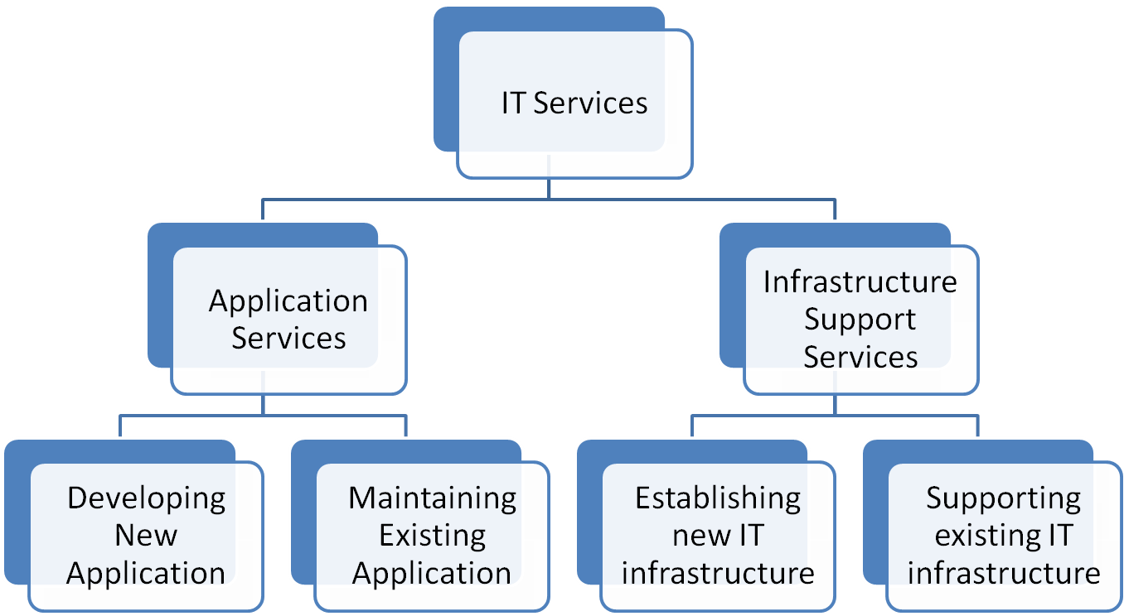
Hierarchy of IT Services

Slide 67
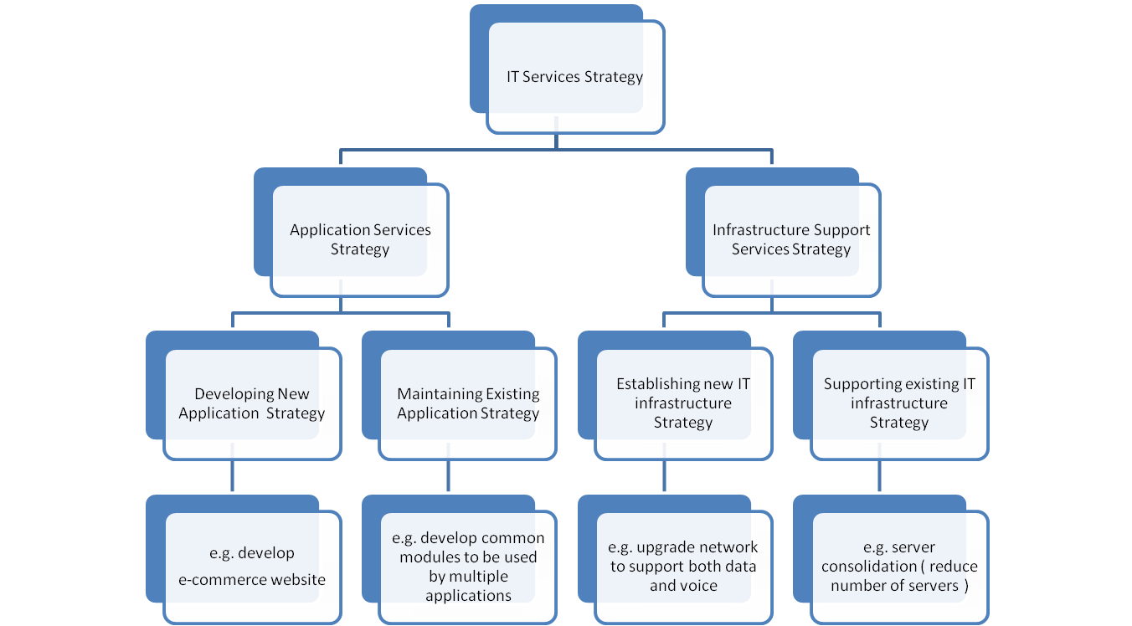
Breakdown of IT Service Strategy

Slide 68
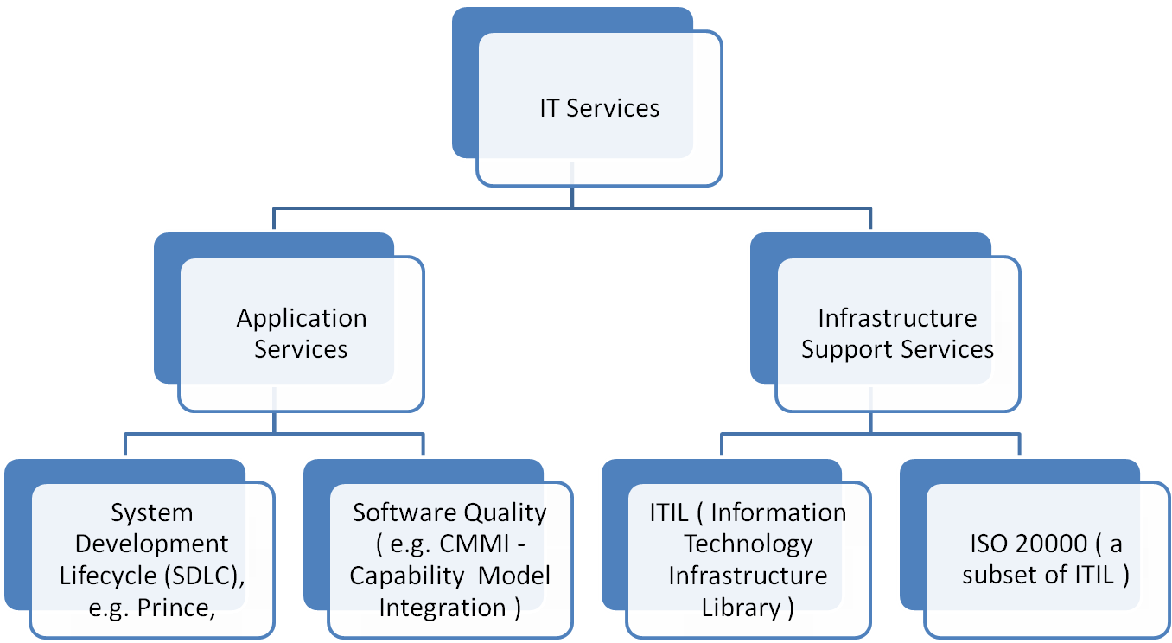
IT Service Processes Framework
Focus of this course COMP5138
I

Slide 69
Process Frameworks
Infrastructure Support Services
  ISO/IEC20000: IT Service Management (certification awarded to company) – aligned with ITIL
  Control Objectives for Information and Related Technology (COBIT) – related to IT Audit
Others
  Project Management Body of Knowledge (PMBOK)
  Six Sigma

Slide 70
Focus of IT Service Standard
/Best Practice
Process-focused ( that is, it is not focusing on people or technology )
It is vendor-neutral
Provides a documentation of recommended processes
Provides certification in most cases

Slide 71
IT Service Process Life Cycle
Install
Support
Procure
Manage
Dispose
Move/
Change

Slide 72
Examples of Managed Services
Asset
Management
Services
Procurement
Services
Security
Services
Help Desk
Service
Services
Management
Network
Monitoring &
Administration
Services
Hardware/
Software
Support
Services

Slide 73
Routine jobs in IT service
Operators take care of the regular operation of the computer system, e.g. report printing, doing back-ups, running scheduled jobs at night
Help desk staff take care of calls from end-user

Slide 74
Routine jobs in IT service
Network administrators take care of network devices, network routing design and change, network devices version upgrade
Server administrators take care of storage planning and management, server performance tuning, fix application, server version upgrade, capacity upgrade

Slide 75
Routine jobs in IT service
E-mail administrators take care of e-mail userid creation, e-mail routing configuration
Security administrators take care of user id creation, assignment of access rights to user id

Slide 76
IT Services versus IT products
IBM transforms itself successfully from selling products to selling IT Services ( e.g. customized solution, data centre outsourcing )
Services involve customization, integration, business consulting.

