Slide 1
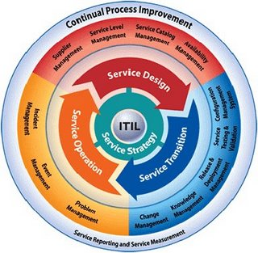
Recap on ITIL Service Cycle

Slide 2
ITIL - Service Strategy
1. Service Strategy Principles
2. Strategy and Organization
3. Service Economics
- Financial Management
- Demand Management

Slide 3
Service Management
Service Management is a set of specialization organizational capabilities for providing value to customer in the form of services. The capabilities take the form of functions and processes for managing service over a lifecycle, with specializations in strategy, design, transition, operation, and continual improvement.

Slide 4
Service
A service is a means of delivering value to customers by facilitating outcomes customers want to achieve without the ownership of specific costs and risks.

Slide 5
Business Unit vs Service Unit
A business unit is simply a bundle of assets meant to create value for customers in the form of goods and services ( simply speaking, front-end units )
Service units are like service units but they provide services to business units ( simply speaking, middle-office or back-office units )

Slide 6
Process
A process is a set of coordinated activities combining and implementing resources and capabilities in order to produce an outcome, which, directly or indirectly, creates value for an external customer or stakeholder
Processes are strategic assets when they create competitive advantage and market differentiation.

Slide 7
Functions vs Processes
Functions are units of organizations specialized to perform certain types of work and be responsible for specific outcomes ( e.g. departments/teams ). Processes involves activities which transform inputs into outputs.
For example, change is a process but service desk is a function. Processes can span across different functional units.

Slide 8
Case
A large internet service provider switched its internet service offerings from variable pricing to all-you-can-use fixed pricing. The strategic intent was to differentiate from competitor services through superior pricing plans. The service strategy worked exceedingly well – customers flocked to sign up. The outcomes, however, included large numbers of customers facing congestion or the inability to log on. Why was there such a disconnection between the strategy and operation?

Slide 9
1. Service Strategy Principles

Slide 10
Service Strategy Issues
What services should be offered to whom?
How do we differentiate ourselves from competitors?
How do we truly create value for our stakeholders?
How can financial management provide visibility and control over value creations?
How should we define service quality?
How do we resolve conflicting demands for shared resources?

Slide 11
Building a Clear Service Strategy
Define the market ( understanding the customers and opportunities )
Develop the offerings (What services should be offered )
Develop strategic assets ( Service Management as a strategic asset )
Prepare for execution

Slide 12
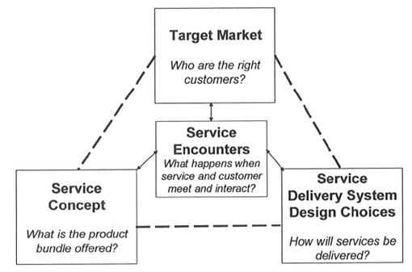

Slide 13
Four Ps of Strategy
Perspective: the distinctive vision and direction
Position : the basis on which the provider will compete ( e.g. compete on the basis of value or low cost )
Plan: how provide will achieve their vision
Pattern: fundamental way of doing things (consistent decisions and actions over time, e.g. adopting “high-end” service strategy )

Slide 14
Strategy Example (Standardization)
“We had seven deposit systems, five wire systems, five cash management systems, two capital market systems… We had Windows 98, Windows 2000, Windows NT, multiple programs… Of course our margins were half of the industry’s.. Maybe less than half”
- Jamie Dimon recalled in 2002 presentation, ticking off the problems he found at Bank One
- from “The House of Dimon – How Jamie Dimon Rose to the Top of the Financial World”

Slide 15
Service Provider Types
Type 1: Internal Service Provider
  exists within an organization solely to deliver service to one specific business unit
Type 2: Shared Service Provider
  services multiple business units in the same organization
Type 3: External Service Provider
  operates as an external service provider serving multiple external customers

Slide 16
Service Value
Service Utility
  What the customer gets in term of outcomes supported and/or constraints removed ( i.e. what the customer gets from the service )
Service Warranty
  How the service is delivered and its fitness for use, in terms of availability, capacity, continuity and security ( i.e. how the service is delivered )

Slide 17
Utility vs Warranty
The customer may be satisfied with the utility ( what ) but not satisfied with the warranty ( how )
For example, a customer may be satisfied with the functionality of online storage (what) but is concerned with confidentiality, integrity and availability of data ( how the service is delivered ).
A customer may be satisfied with the hotel rooms ( what ) but not satisfied with the room service ( e.g. cleaning, responding to calls )

Slide 18
Service Portfolios
Description
Value Proposition
Business Cases
Priorities
Risks
Offering and Packages
Cost and Pricing

Slide 19
2. Service Strategy
- Strategy and Organization

Slide 20
Strategy and Organization
Organization design ( e.g. centralized versus de-centralized, hierarchical versus matrix )
Organization Change
Organization Culture ( seniority versus competence, position versus knowledge )

Slide 21
IT Governance )
Management deals with making decisions and executing processes. Governance sets the framework of decision rights that encourage desired behaviours in the organization
A governance body ( e.g. IT steering committee )
Governance domains ( e.g. on service delivery, source strategy, contract management )

Slide 22
IT Governance
A Governance Body ( IT Steering Committee )
  Comprising IT and business leaders, chaired by executives of a level above CIO ( Chief Information Officer )
For example, in the Accenture assignment case, an IT steering committee is chaired by CIO and COO at every line of business. Formal process is established to present an IT project to the steering committee.

Slide 23
Sourcing Strategies
What to source (application/infrastructure/PC support)?
How to source (sourcing structure )
Guidelines and reference points for sourcing ( Service Provider Interfaces SIP )
Sourcing Governance
Implementation, monitoring and dispute resolution

Slide 24
Service Sourcing Structure
Internal (Type 1 )
  Provision and delivery of services by internal staff, as a cost centre ( cost is not recovered, i.e. no chargeback )
Shared Services ( Type 2 )
  IT as an internal business unit with its own profit and loss with a chargeback mechanism
Full Service Outsourcing
  A single contract with a single service provider, typically involve significant asset transfer ( e.g. data centre outsourcing )

Slide 25
Service Sourcing Structure
Prime
  A single contract with a single service provider who manages service delivery but engages multiple providers to do so
Consortium
  A collection of service providers explicitly selected by the service recipient. All providers are required to come together and present a unified management interface
Select Outsourcing
  A collection of service providers explicitly selected by the service recipient but the service recipient is the service integrator, responsible for cross-provider disputes

Slide 26
Dairy Farm case
Dairy Farm operates supermarkets, health and beauty stores, convenience stores, restaurants, home furnishing stores
Application that contribute business value: loyalty systems to support customer relationships
Applications for operation: HKMS(Hong Kong Merchandise system）, SAP
Infrastructure strategy: common systems, shared services

Slide 27
Dairy Farm – Sourcing Strategies
Operation: Adopts multi-sourcing strategies. JOS provides desktop support, internal IT performs quality control
60% of IT operations are outsourced
Service vendors with certifications: ISO20000 (ITIL certification for corporate), ISO 9000 (quality certification), ISO27001 (information security)

Slide 28
Service Provisioning
Traditional ( thick client, dedicated server, charging based on user seats/per CPU/per server)
Utility Services
  provided on the basis of how much, how often and when is required by each customer ( The future of IT service provision may be like provision of electricity in cloud computing )
Virtualization ( running multiple logical server instances on one physical server )

Slide 29
More on Utility Service
Computing service as utility ( like electricity as utility )
Utility – charged on usage; very easy to adopt service
Cloud computing is an example of computing service as utility

Slide 30
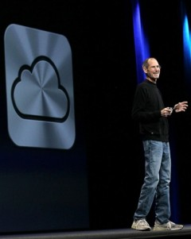
iPod Cloud Computing
On 6 June 2011, Apple CEO Steven Jobs introduced iCloud services
Files ( songs ) will be stored online, so you can access anywhere from any device

Slide 31
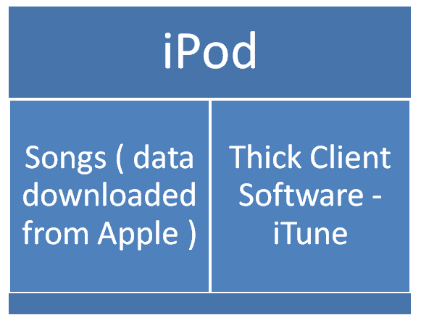
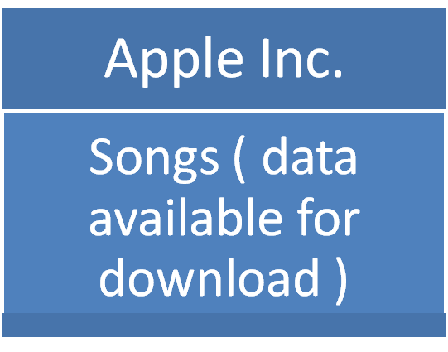
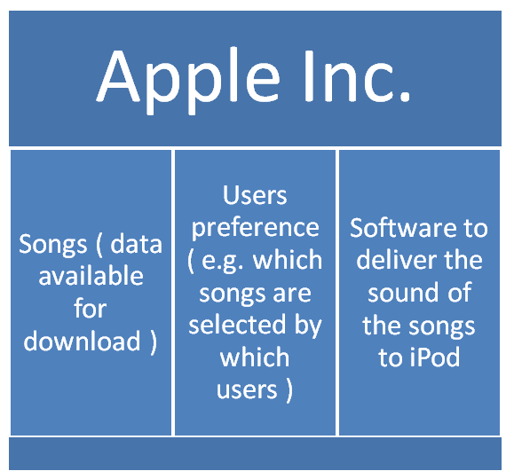
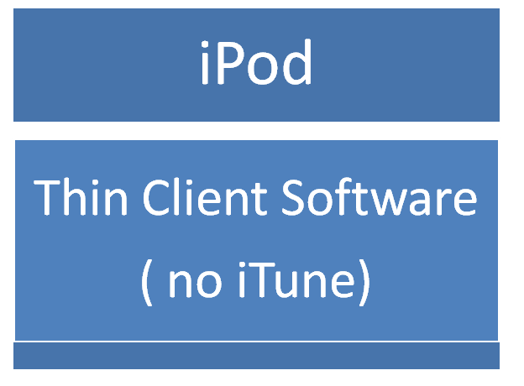
OLD
NEW

Slide 32
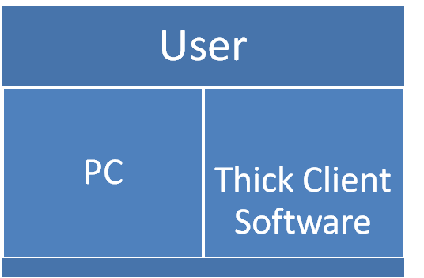
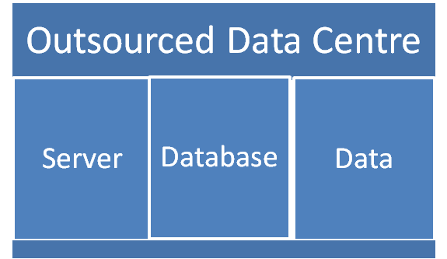
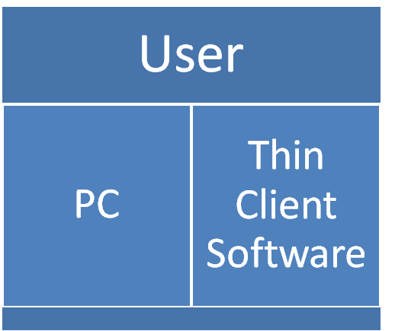
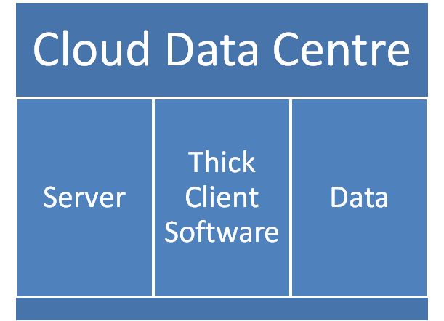
Data Centre Outsourcing
Cloud Computing – SaaS
(Software as a Service )

Slide 33
Research studies on outsourcing
Park & Kin (2005) conducted survey on 28 organizations with 107 responses.
Significant differences in service quality between in-sourced and outsourced systems
Outsourcing might not always be the correct choice for reducing costs and increasing efficiency.

Slide 34
JP Morgan Chase Case
Jamie Dimon cut the $5 billion outsourcing contract to IBM when he became CEO at 2005. Instead, JP Morgan Chase switched to provide such services within itself.

Slide 35
3. Service Economics
3.1 Financial Management

Slide 36
Definition for Financial Management
The process responsible for providing the essential financial management information to ensure services are run efficiently, economically & cost effectively through
  budgeting
  accounting
  charging

Slide 37
Goal for Financial Management
Provide cost-effective stewardship of the IT assets & resources used in providing IT services ( If IT services are provided to external customers, the goals will reflect profit making & marketing aims )

Slide 38
Financial Management Issues
How is the budget approved?
How is the money spent?
Is it centralized/decentralized? ( e.g. can a country or division make its own decision for its own IT budget? )
Do users pay for the support ( that is, is there a charge-back to the users? )
  If there is a charge-back, how is the price determined for the service?
How to reduce cost?

Slide 39
Budgeting
The process of predicting and controlling the spending of money & consists of a periodic negotiation cycle to set budgets & the day to day monitoring of current budgets

Slide 40
IT accounting
Set of processes enabling IT to account fully for the way its money is spent, particularly identifying costs by customer, by service, and by activity
Service Oriented Accounting using financial management to understand services in terms of consumption and provisioning (e.g. activity-based costing)
Charging ( optional )
The process required to bill the customers for the services applied

Slide 41
IT accounting
Calculate the cost of providing IT services to both internal & external customer
Perform cost-benefit or ROI (Return of Investment ) analysis

Slide 42
Major Cost Elements
Hardware | CPUs, LANs, disk storage peripherals, WANs, PCs, laptops, servers, mainframes
Software | Operating systems, applications, database, monitoring & management tools
People | Payroll costs, benefits, relocation costs, expenses, overtime, consultancy
Accommodation | Offices, storage, secure areas, utilities ( electricity )
External service | Security services, DR services, outsourcing services
Transfer | Internal charges from other cost centres within the organisation

Slide 43
Types of Cost
Fixed costs(salaries) vs Variable costs(overtime)
Depreciation methods
Unabsorbed costs
- any indirect costs that cannot be apportioned to a set of customers are recovered from all customers in as fair a way possible, usually by ‘uplifting’ the costs calculated so far by a set amount

Slide 44
Depreciation
Straight-line method or others
If a computer equipment is purchased for HKD 10,000 and its useful life is 4 years, there is a depreciation cost of HKD 2,500 per year ( that is, the book value of the equipment is reduced by HKD 2,500 ).

Slide 45
Question
Can the software development cost ( say. HKD 1M ) be capitalized?
  If not, all the expense will be accounted this year.
  If yes ( e.g. like a package acquired from an external vendor), then the cost can be depreciated each year, say, by HKD 1M for the coming five years )
 | Year 1 | Year 2 | Year 3 | Year 4 | Year 5
Expense | 1M | ---- | ----- | ----- | ------
Capitalized | 200K | 200K | 200K | 200K | 200K

Slide 46
(Internal ) Chargeback
Charging enables cost recovery
Recovers the cost of the IT services from the internal customers
Operate the IT organization as a business unit
Influence customer behaviour
Charging is optional
The decision to charge is made by board members of the organization

Slide 47
Charging (Cont’d )
Unless IT has the support of the whole company in introducing Charging, it will fail
It must be simple
It must be fair
It must be realistic

Slide 48
Accenture Case
Users paying support on a transaction basis ( i.e. paying for support call, rather than paying a fixed fee for IT support, P.4 in case )
E-mail services offered in three varieties (50/150/500MB) of e-mail storage per user and the services are priced (charged back to user) incrementally.

Slide 49
Charging
Methods of charging ( pricing methods )
  Cost
  cost-plus
  Going rate/Market Rate
But first you need to know the actual costs of providing the services

Slide 50
Charging vs Accounting
Charging is concerned with the recovery of the cost of IT services expenditures in a simple, fair & affordable way
IT accounting is concerned with providing detailed information on where & for what reason expenditure is incurred within IT services & is inward-looking

Slide 51
Discussion
Which charging method will you prefer (cost/cost plus or market rate or fixed rate) for internal charging?
For example, if your company has also done some application outsourcing (e.g. HKD 3000/per man day ) and also charged back the internally developed application to users (e.g. average HKD 1000/per man day), how should IT charge back to users for internally developed application? HKD1000? HKD3000? Or an amount in between?

Slide 52
Benefits of chargeback
Accurate cost information for determining cost of ownership for ongoing services
More business like decision making on IT services
Recovering IT costs in a fair manner, related to usage
Influencing (internal) customers

Slide 53
Possible Problems
Senior business managers may not recognize the benefits of IT accounting & charging & may reset the admin overheads
Combined: accountancy & IT skills are rare, so key activities may go to staff who don’t see them as their priority
Processes are so elaborate that the cost of running the financial management system exceeds the value of the information produced
If charges are seen excessive, customers may go elsewhere

Slide 54
3. Service Economics
3.2 Demand Management

Slide 55
Demand Management
Uncertainty in demand is a source of risk
Service output cannot be stored as inventories
Excess capacity generates excess cost
The purpose of demand management is to understand and influence customer demand for services and the provision of capacity
e.g. frozen period of change requests before implementation of large-scale project
e.g. Differential charging to encourage customers to use IT services at less busy time

Slide 56
References
itSMF: An Introductory Overview of ITIL V3, itSMF (2007)
itSMF: ITIL V3 Service Strategy
The impact of IS outsourcing type on service quality and maintenance effects, J. Y. Park & S. Kin (2005), Information & Management, Vol. 42

