Slide 1
Service Strategy - Recap

Slide 2
Main Issues
IT Governance
Financial Management
Sourcing Structures
Demand Management

Slide 3
Gap Analysis on
Service Strategy against ITIL
Any IT Steering Committee to advise on the direction and help prioritize projects?
Is budgeting process centralized/de-centralized? Any mechanism to align the budget with business needs?
Accounting of IT services ( e.g. know the expense by user groups, by projects and even by activities )

Slide 4
Gap Analysis ( Cont’d )
Service Accounting issues: e.g. how much spent on providing help desk/application development/infrastructure support, which department consumes a lot of IT resources) Accounting policies
Documented Service Policies ( e.g. Security Policy)
Charge-back to users on selected service ( if there is no charge-back and the services are free to users, are there strategies to manage the demand? )
Clear and appropriate strategy on sourcing structure

Slide 5
Clarification on ITIL framework
ITIL framework introduces some new roles such as incident manager, availability manager etc.
It should be clarified that these roles are more on the co-ordination. So incident manager ensures that the incidents are handled and escalated according to procedures. Availability manager ensures that system availability is properly monitored and deviation cases are escalated properly. It doesn’t mean that availability manager will be held responsible for all incidents failing to meet the availability requirements set in the service level agreement.

Slide 6
1. Service Operation Overview
By Dr. Franklin Leung

Slide 7
Achieving Balance in
Service Operation
Internal IT view versus External business view
Stability versus Responsiveness
Quality of service versus Cost of service
Reactive versus proactive

Slide 8
Common Service Operation Activities
IT Operations (Console Management, Job scheduling, Backup and Restore, Desktop Support, Server Management, Network Management, Database Management, Facilities Management, Information Security Management )
Monitoring and Control

Slide 9
2. Service Operation
- Event Management

Slide 10
Event Management
An event is a change of state that has significance for the management of a configuration item or IT service ( just like an alarm ). An event may indicate that something is not functioning correctly.
Event Management is the ability to detect events, make sense of them and determine the appropriate control action.

Slide 11
Event Management (Cont’d)
Effective service operation is dependent on knowing the status of the infrastructure and detecting any deviation from normal operation via good monitoring systems ( active or passive monitoring tools )
Event management depends on monitoring by generating notifications ( alarms ) for abnormal state, e.g. server running out storage space, network is slow

Slide 12
Event Management (Cont’d)
Event management usually employs monitoring system which has a central console and has software agents installed in servers and network equipment to generate alarms when necessary. BMC, HP, CA are selling such monitoring software.

Slide 13
3. Service Operation –
Incident Management

Slide 14
Goal of Service Operation
Deliver agreed levels of service to internal and external customers, and to manage the applications, technology and infrastructure that support delivery of the services.
Service Operation staff ensure that value to the business is delivered

Slide 15
Definitions of Incident Management
An incident is any event which is not part of the standard operation of a service & which causes, or may cause, an interruption to, or a reduction in quality of that service.
The process responsible for managing an incident throughout its lifecycle is Incident Management.

Slide 16
Incident Management
Goal
Restore normal service operation ( as outlined in the SLA ) as quickly as possible and minimize adverse impact on business operations, thus ensuring that the best possible levels of service quality & availability are maintained
Basically this means using all available resources to get the user back to a productive state as quickly as possible

Slide 17
Incident Management
Benefits
Minimize the disruption and downtime for our users
Maintain a record during the entire Incident life-cycle. (This allows any member of the service team to obtain or provide an up-to-date progress report)
Building knowledgebase of known issues to allow quicker resolution of frequent Incidents
Notes:
Building knowledgebase – workarounds, service that doesn’t work with IE7 create a solution indicating the compatible browsers that do work with the service.

Slide 18
Terminology
Incident - any event which is not part of the standard operation of a service and which causes, or may cause, an interruption to, or a reduction in, the quality of that service
Service Request - request for increased functionality for new services, not a failure in the IT infrastructure.
Major Incident – an Incident for which the degree of impact on the User community is extreme, and which requires a response that is above and beyond that given to normal incidents.
Problem - A condition identified by multiple incidents exhibiting common symptoms, or from one single significant incident, indicative of a single error, for which the cause is unknown
Known Error – A problem that is successfully diagnosed & for which a work-around is known
RFC - A Request for Change to any component of an IT infrastructure or to any impact of IT services

Slide 19
Scope of Incident Management
Categories of Tasks to be handled by Service desk
  Application ( Incident )
  Hardware ( Incident )
  Service Request
A request for new or additional service is not an Incident but a Request for Change
Handling of both failures in the infrastructure & of service requests are similar & are sometimes ( but not always ) both handled by Service Desk.

Slide 20
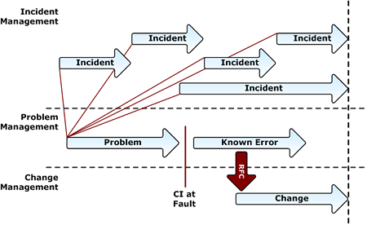

Slide 21
Role of Service Desk
The Service Desk will usually play the key role in the Incident Management process, recording & monitoring the progress of incidents & retaining ownership of them.

Slide 22
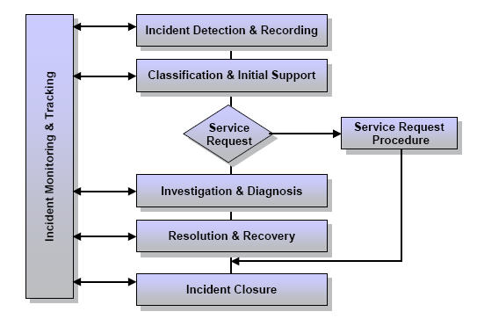
Incident Lifecycle

Slide 23
Incident Management Activities
Incident detection & recording
  Record basic details
  Link to CI ( Configuration Item ) in CMDB ( Configuration Management Database )
Classification & Initial Support
  Assign classification code
  Match against known errors and problems
  Assign impact & urgency thereby defining priority
  Provide initial support

Slide 24
Incident Management Activities ( Con’td)
Investigation & diagnosis ( interactive process )
  Offer a temporary work-around ( service desk )
  Collection & analysis of all related information
Resolution & recovery
  Incident resolved using the solutions or Work-around or raise an RFC

Slide 25
Incident Management Activities (Cont’d)
Incident Closure
  Confirmation of the resolution with the originator
  ‘Close’ category
  Check all actions taken are concise & readable
Incident ownership, monitoring, tracking & communication
  Monitor & Escalate Incident & Inform orginator

Slide 26
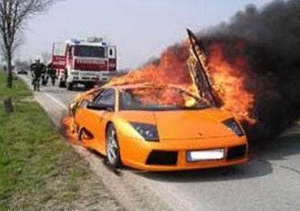
If you work in 999 call centre, what will you ask if someone reports a traffic accident?

Slide 27
I+U=P
Impact + Urgency = Priority
 | LOW URGENCY | MEDIUM URGENCY | HIGH URGENCY
LOW IMPACT | LOW PRIORITY | LOW PRIORITY | MEDIUM PRIORITY
MEDIUM IMPACT | LOW PRIORITY | MEDIUM PRIORITY | HIGH PRIORITY
HIG H IMPACT | LOW PRIORITY | HIGH PRIORITY | HIGH PRIORITY

Slide 28
I+U=P
Impact is defined as the number of people
affected by a service outage.
Low Impact: One customer affected, where no executive or executive staff are involved.
Medium Impact: Several customers are affected, or an executive or executive staff are involved.
High Impact: Whole organization, complete department or building affected, or revenue/financial systems affected.

Slide 29
I+U=P
Urgency is defined as the affect of the event on a customer’s ability to work. This is not to be confused with how urgent the requestor believes the incident to be.
Low Urgency: Ability not impaired, the customer is requesting extra or additional functions or services (a service request).
Medium Urgency: Abilities are partially impaired, and customers cannot use certain functions or services.
High Urgency: Abilities are completely impaired and customers cannot work.

Slide 30
I+U=P
Priority based on Impact and Urgency
Low Priority: Work to be completed in 4 business days.
Medium Priority: Work to be completed in 2 business days.
High Priority: Work to be completed in 4 hours.
Urgent Priority: Work to be completed in 2 hours.

Slide 31
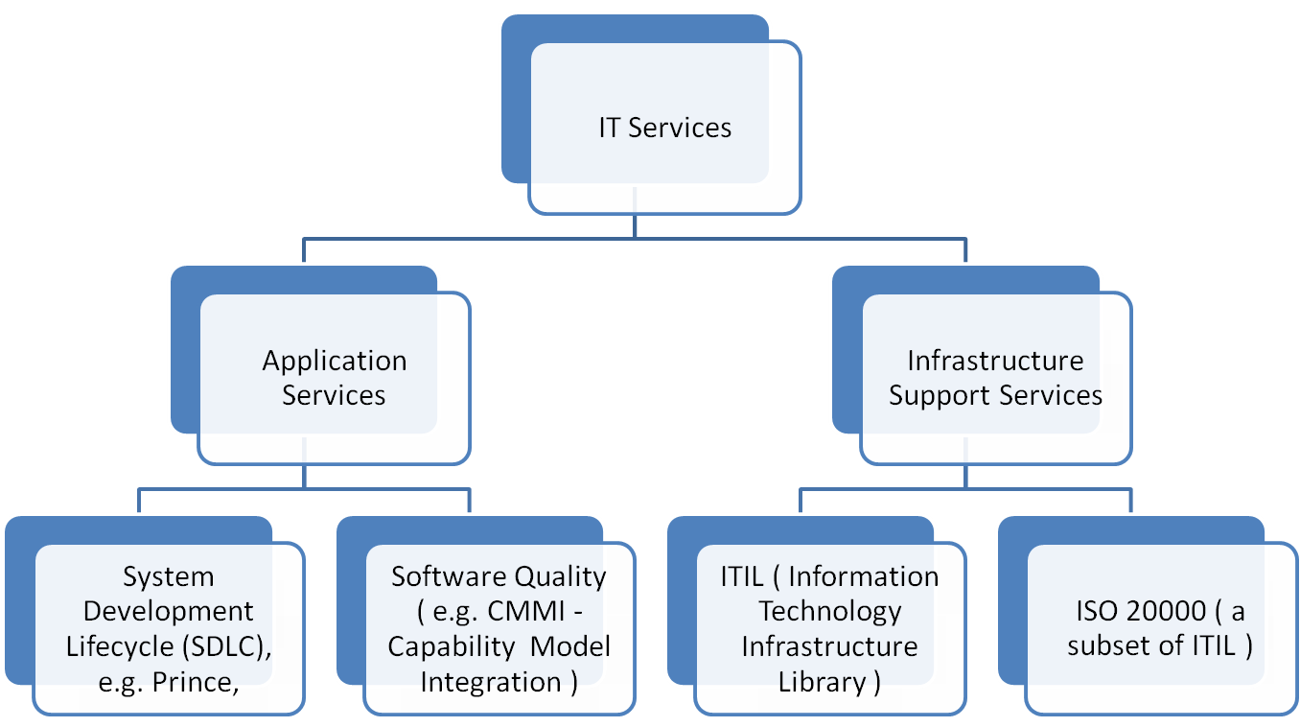
Priority in incident management refers to priority of the incidents related to infrastructure support services ( e.g. hardware, user support ) but not on the priority of service requests ( e.g. application development ).
Focus of this course COMP5138
I

Slide 32
Major Incident
the highest category of impact for an incident which results in significant disruption to our business
Major Incident Manager may be appointed to manage such major incidents

Slide 33
Support & Escalation
1st line support – Service Desk
2nd & 3rd line support & beyond
  Specialist support groups
  More time
  More resources
  May be external supplier
Escalation – may take place during every activity in the resolution process
Functional escalation – ( allocation )
Hierarchical escalation – ( organization hierarchy)

Slide 34
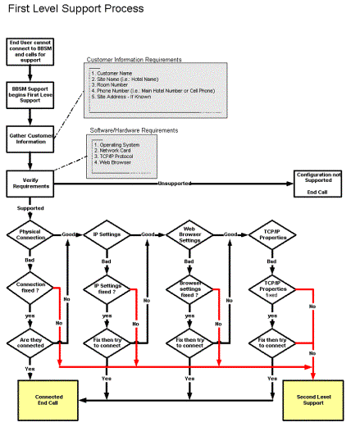

Slide 35
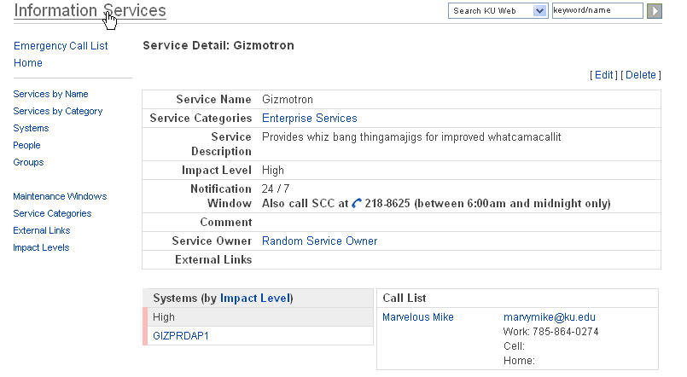
Call List

Slide 36
Metrics
Total number of incidents
Breakdown of incidents at each stage (e.g logged, work-in-progress, closed etc. )
Number and percentage of major incidents
Percentage of incidents handled within agreed response time
Average cost per incident
Number of incidents reopened as a percentage of the total

Slide 37
Incident Management Benefits
Reduced business impact of incidents by timely resolution
Proactive identification of beneficial enhancements
Improved monitoring of performance against SLAs

Slide 38
4. Service Operation
- Problem Management

Slide 39
Problem Management
Goal
To minimize the adverse impact of incidents and problems that are caused by errors in the IT Infrastructure
Benefits
Detection of the underlying causes of a recurring Incident and subsequent resolution and prevention
Reduce both the number and severity of Incidents and Problems on the business

Slide 40
Terms ( re-cap )
Incident – something that used to work doesn’t work now.
Major Incident – an Incident with a high impact on the campus community, and which requires a response above and beyond that given to normal incidents.
Workaround – Method of avoiding an incident or problem--a temporary fix to get the customer back up and running.

Slide 41
Terms
Problem – A condition identified by multiple incidents exhibiting common symptoms, or from one single significant incident, indicative of a single error, for which the cause is unknown.
Root cause – the underlying cause of the problem.
Known error – A condition identified by successful diagnosis of the root cause of a problem, when it is confirmed which Configuration Item is at fault and a workaround has been identified.

Slide 42
Problem Management process
Problem identification
Problem Manager or Service Owner
Multiple incidents exhibiting common symptoms
Or a single significant incident for which the cause is unknown.
Assemble problem team
Identify who needs to be involved
Ask all managers for input about possible related issues
Schedule meeting(s)
Follow Problem Analysis model to identify root cause
Implementation
Implement solutions
Document solutions

Slide 43
Problem Solving Flow（？！）
Does the damn
thing work?
NO
YES
Don’t mess
with it
Did you
mess
with it?
YES
YES
You Idiot!
Does anyone
Know?
NO
NO
Will you
catch Hell?
YES
You Poor
Soul
Hide it
NO
NO
Can you blame
Someone else?
Ditch it
YES
No Problem!

Slide 44
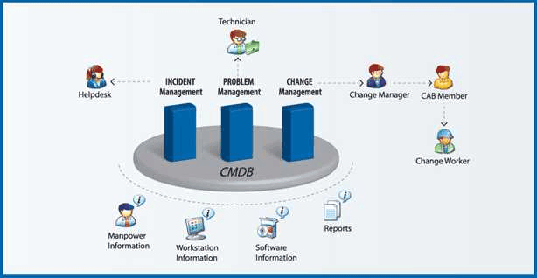
Integration of incident/problem management with other processes

Slide 45
5. Service Operation
- Request Fulfillment

Slide 46
Request Fulfillment
Management of customer/user requests that are not generated as an incident from an unexpected service delay or disruption
An incident is an unplanned event while service request is a planned event
Some organizations may choose to handle service requests as a ‘category’ of incidents via Incident Management System. However, it becomes more popular to handle requests separately via the Request Fulfillment Process.

Slide 47
ITIL Case Study
– Service Request Management

Slide 48
Case Background
A company is running a service desk and handle IT service requests ( e.g. installation of software ) from users ( internal customers). However, users can only call service desk on IT services incident reporting but users cannot submit the reporting online and hence cannot view the most updated status online.
Users submit application change request to IT department via hardcopies. It is difficult for the IT Dept. Head to keep track of change requests and ensure the requests are followed up properly.

Slide 49
ITIL implementation
A computer consulting company is engaged to advise on ITIL implementation.
The company also provides a computer system for service management.

Slide 50
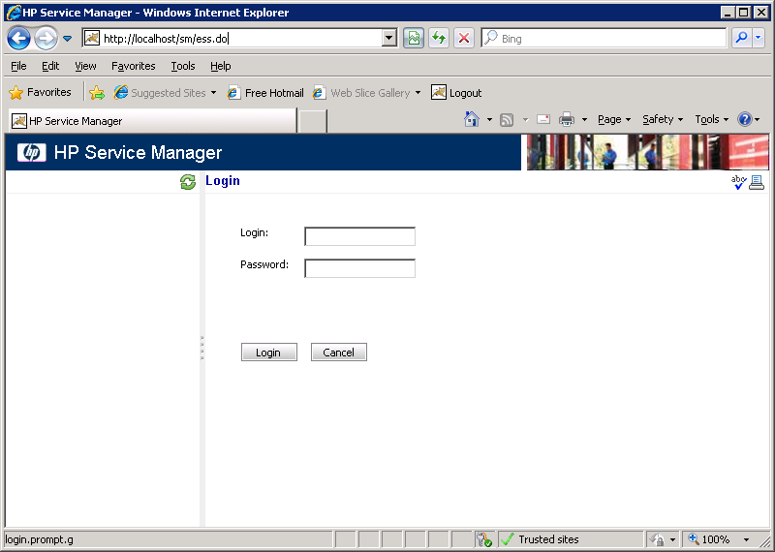
Service Manager Software

Slide 51
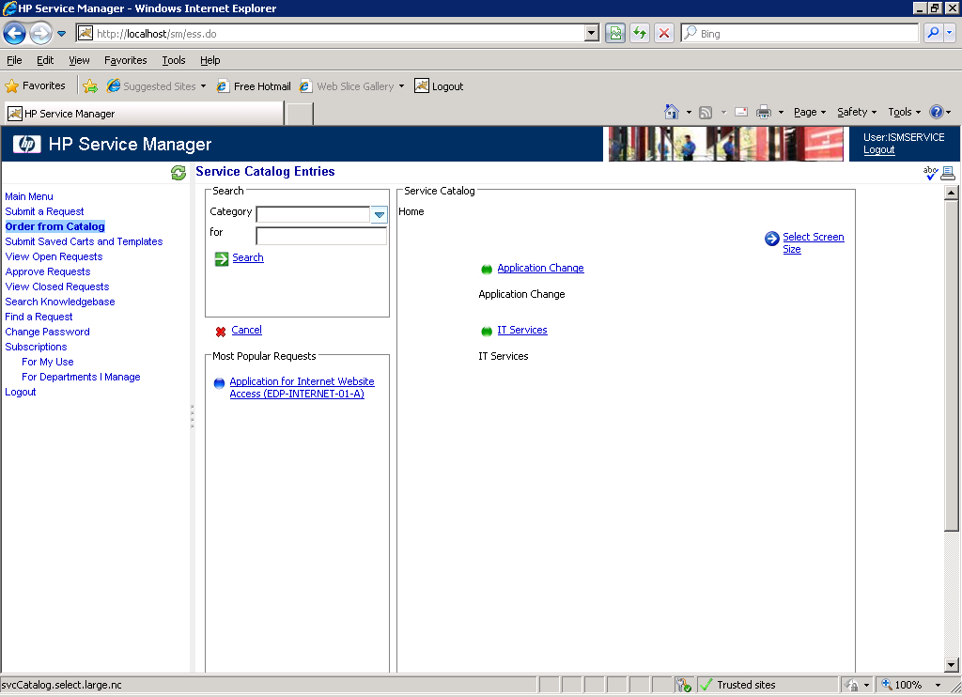
Handles IT Services and Application Change Request

Slide 52
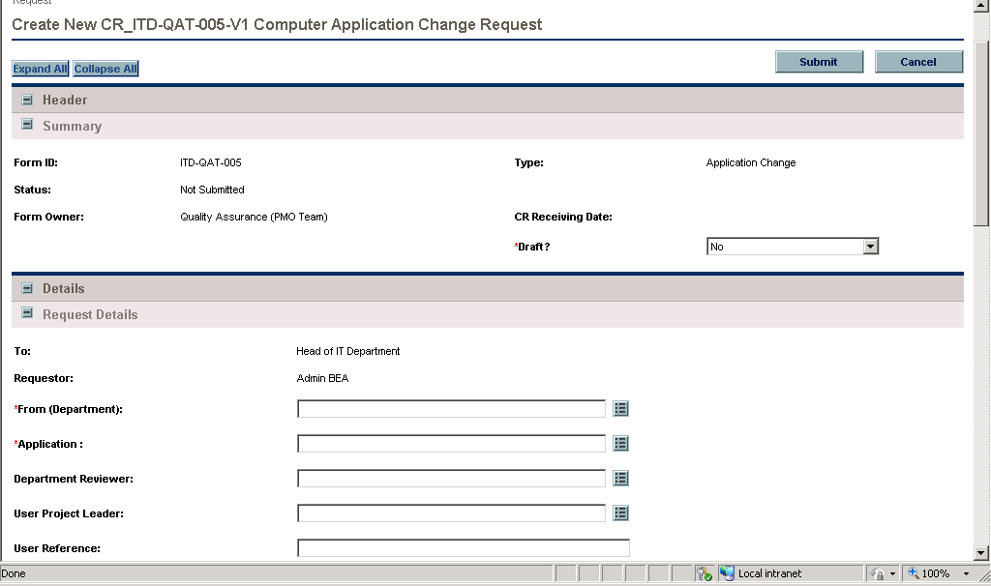
Creates New Application
Change Request

Slide 53
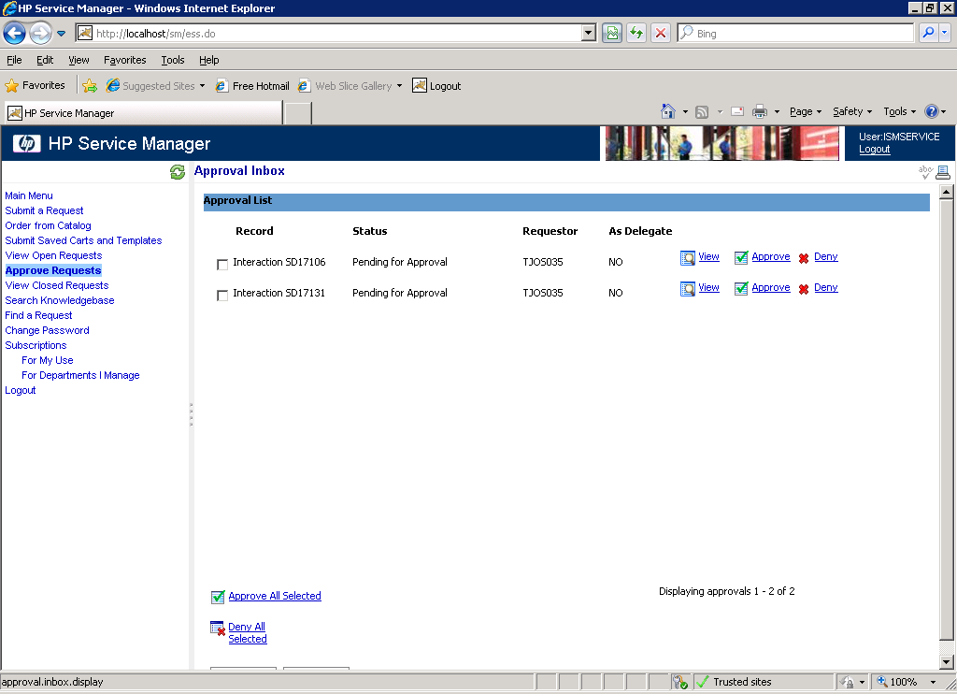
Service request submission needs to be approved by supervisors in user department.

Slide 54
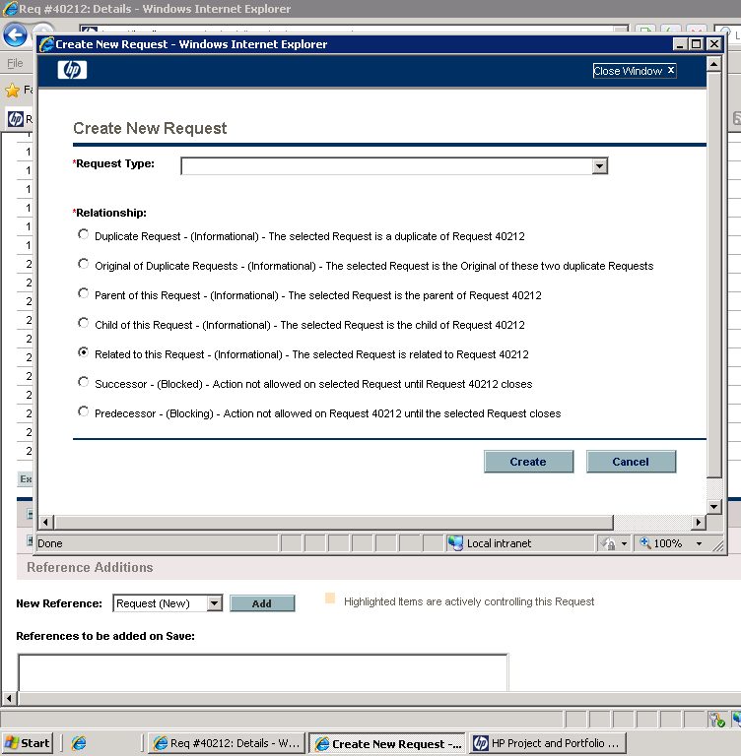
Relationship between multiple requests

Slide 55
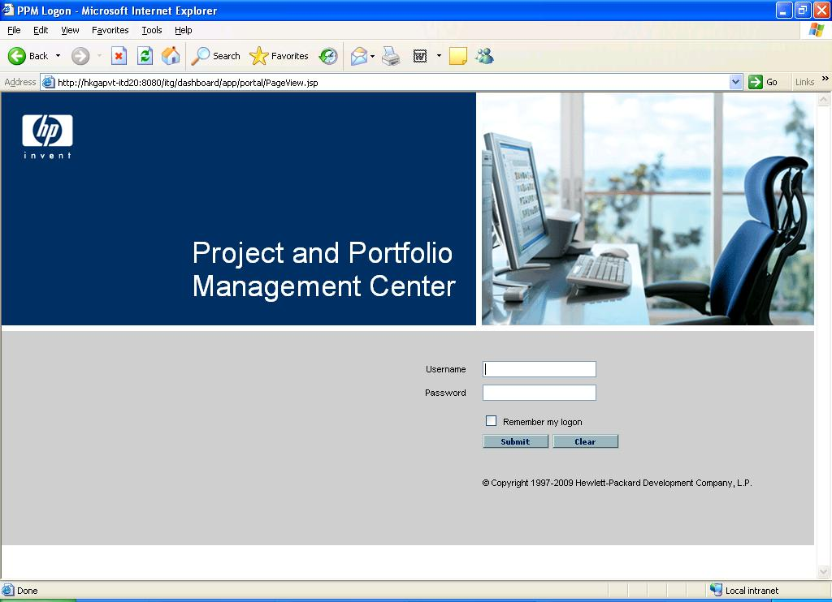
IT staff manage the requests in Project and Portfolio Management Centre

Slide 56
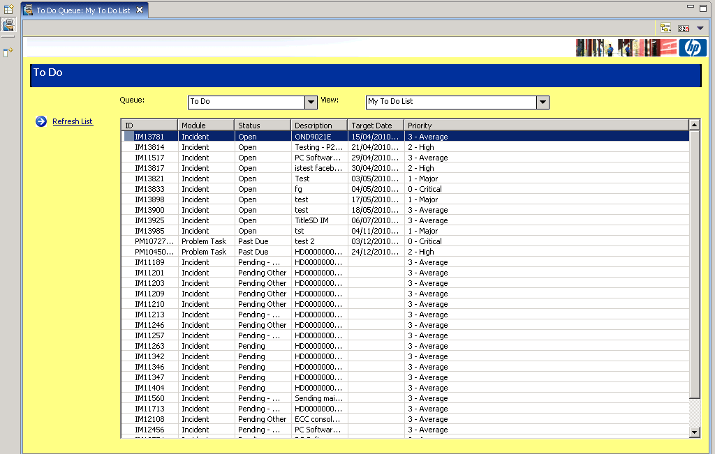
IT staff can see a list of outstanding requests

Slide 57
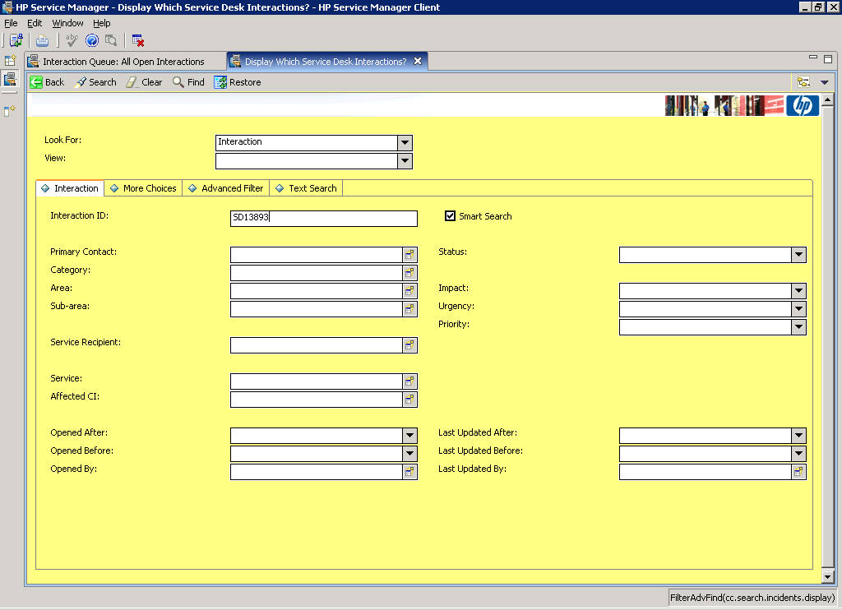
Priority Assignment: Impact x Urgency

Slide 58
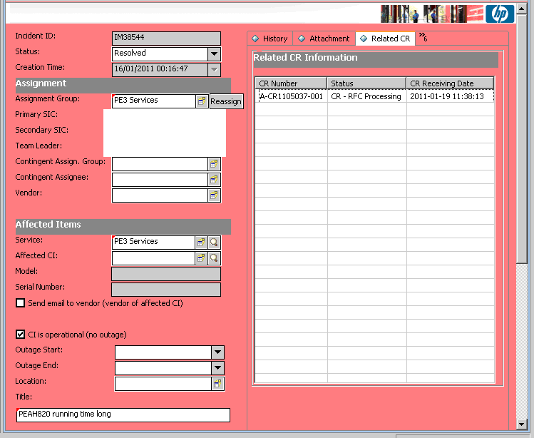
Service desk staff view the details of the incident and assign system-in-charge (SIC) to follow up.

Slide 59
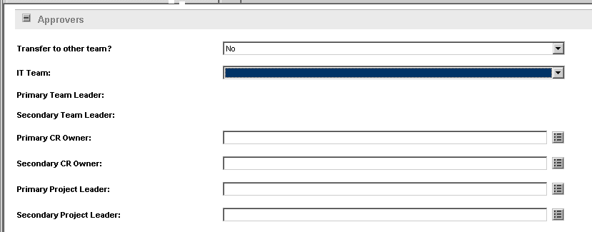
Service request/incidents can be transferred among teams and such transfer needs to be approved by service desk

Slide 60
6. Service Operation
- Access Management

Slide 61
Access Management
The process of granting authorized users the right to use a system, while preventing access to unauthorized users

Slide 62
7. Service Operation
- Technology Considerations

Slide 63
IT Service Management (ITSM) Technology
Self-help capabilities to users
Workflow engine ( for control of incident lifecycle, request fulfillment )
Integrated Configuration Management System
Discovery/Deployment/Licensing Technology
Remote Control (take control of the user’s desk-top)
Reporting

Slide 64
8. Gap Analysis on Service Operation against
ITIL Framework

Slide 65
Gap Analysis on Service Operation Against ITIL
Is there a service desk as a central contact point for reporting incidents?
Is there a software system logging and keeping track of all incidents?
Is the log analyzed and common underlying cause for multiple incidents is analyzed? ( problem management )
Are there metrics and measurement for incident management ( e.g. measuring the total time to resolve incidents )?

Slide 66
Gap Analysis
Are Known Errors/issues Database established with workaround documented?
Are incidents categorized?
Is priority assigned to incidents according to its impact and urgency?
Are incidents properly closed ( e.g. confirmation of the resolution with the originator)?
Is the owner of a reported incident identified?

Slide 67
Improvement of
Operational Activities
Automation of manual tasks
Renewing makeshift ( ad-hoc designed ) activities or procedures
Operational audits
Using incident management and problem management
Communication
Education and Training

Slide 68
9 Procter & Gamble ITIL Implementation Case

Slide 69
Proctor & Gamble
Streamlined ITIL processes within ITIL from 1998 to 2002
Saved around $500 Million
“When IT processes are done by 5,000 people consistently across one company, service management can deliver tremendous saving.” ( Muton Cohen, P&G )

Slide 70
Proctor & Gamble ( Cont’d)
Implemented ITIL “follow-the-sun” process which entails staffing data and operation centres around the world according to the time zone and provides 7x24 non-stop service
“ITIL is about having process in place that enable the people, software and hardware you do have to work better..” ( Gleen O’Donnel, Meta Computer )

