Slide 1
COMP5121
Data Warehousing & Data Mining
Keith C.C. Chan
Department of Computing
The Hong Kong Polytechnic University

Slide 2
Class Schedule
Lectures:
  9:30am to 12:30pm, Tuesdays, Y402
Tutorials
  Whenever needed during lecture time.
  Extra tutorial sessions held whenever necessary.
Labs
  Total of at least 7 lab sessions to be held on Saturdays at the labs on 6/F of PQ.
  PASW 13 & Oracle OWB.
  Additional lab sessions whenever needed.

Slide 3
Instructor
Keith C.C. Chan, Department of Computing
  Office: R1010/PQ812
  Phone: 3400 2602/2766 7282
  Fax:2170 0106
  Email: cskcchan@comp.polyu.edu.hk.
Consultation Hours:
  By appointment via Dean of Students’ Assistant at 3400 2602
  Or via email.

Slide 4
Assessment
Coursework and tests*:
  2 individual assignments (30-40%).
  1 mini group project (15-20%).
  0 mid-term test (0%).
  1 final examination (45%).
  Total (100%).
*Subject to changes.

Slide 5
Text and References
Chan, K.C.C., Course Notes on Data Mining & Data Warehousing, Department of Computing, The Hong Kong Polytechnic University, Hung Hom, Kowloon, Hong Kong, 2011.
Inmon, W.H., Building the Data Warehouse, 2nd Edition, J. Wliley & Sons, New York, NY, 1996.
Whitehorn, M., Business Intelligence: the IBM Solution: Datawarehousing and OLAP, Springer, London, 1999.
Han, J., and Kamber, M., Data Mining: Concepts and Techniques, 2nd Edition, Morgan Kaufmann, San Francisco, CA, 2006.
Syvajarvi , A., and Stenvall, J (Eds.), Data Mining in Public and Private Sectors, Information Science Refence, Hershey, PA, 2010.
Shmueli, G., Patel, N.R., Bruce, P.C., Data Mining for Business Intelligenec: Concepts, Techniques, and Applications in Microsoft Office Excel with XLMiner, Wiley, NY, 2010.
Berry, M.J.A. and Linoff, G.S., Data Mining Techniques for Marketing, Sales and Customer Relationship Management, Wilery, New York NY, 2004.
Witten, I.H., Frank, E., and Hall, M.A., Data Mining: Practical Machine Learning Tools and Techniques, 3rd Edition, Mlrgan Kaufmann, San Francisco, CA, 2011.
Harrison, J, Jr., Clinical Data Mining and Warehousing, An Issue of Clinics in Laboratory Medicine, Saunders, Amsterdam, 2008.
Stackowiak, R., Rayman, J., and Greenwald, R., Oracle Data Warehousing and Business Intelligence Solutions, Wiley, NY, 2007.
Soares, C., Peng, Y., Meng, J., Washio, T., and Zhou, Z.H., Applications of Data Mining in E-Business and Finance, IOS Press, 2008.

Slide 6
Course Outline (1)
Data Mining
  From data warehousing to data mining.
  Data pre-processing and data mining life-cycle.
  Association and sequence analysis; classification and clustering.
  Fuzzy Logic, Neural Networks, and Genetic Algorithms.
  Mining Complex Data.
    OLAP mining; spatial data mining; text mining; time-series data mining; web mining; visual data mining.

Slide 7
Course Outline (2)
Data warehousing.
  Introduction; basic concepts of data warehousing; data warehouse vs. Operational DB; data warehouse and the industry.
  Architecture and design; two-tier and three-tier architecture; star schema and snowflake schema; data capturing, replication, transformation and cleansing.
  Data characteristics; metadata; static and dynamic data; derived data.
  Data Marts; OLAP; data mining; data warehouse administration.

Slide 8
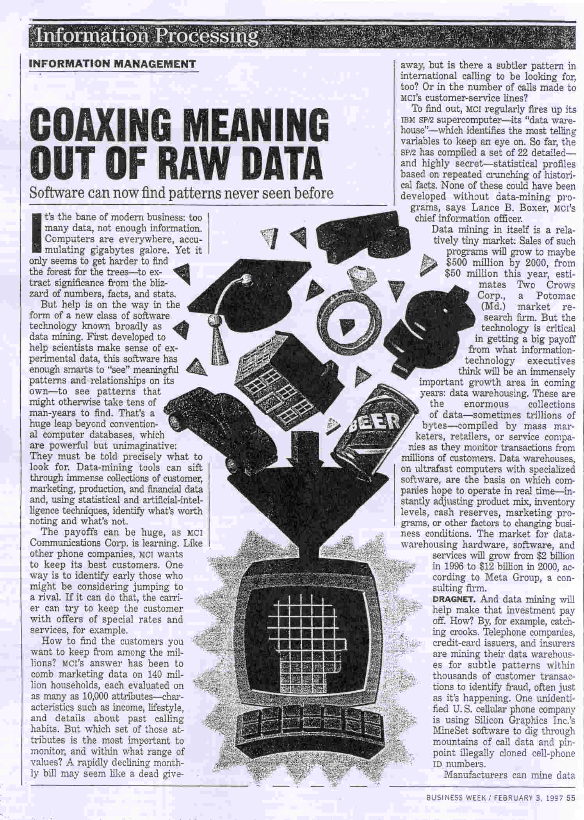
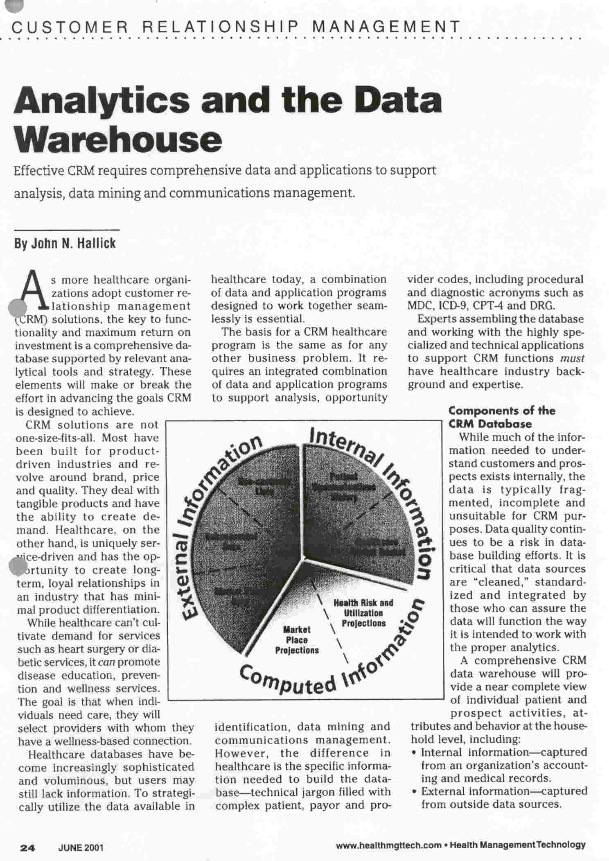
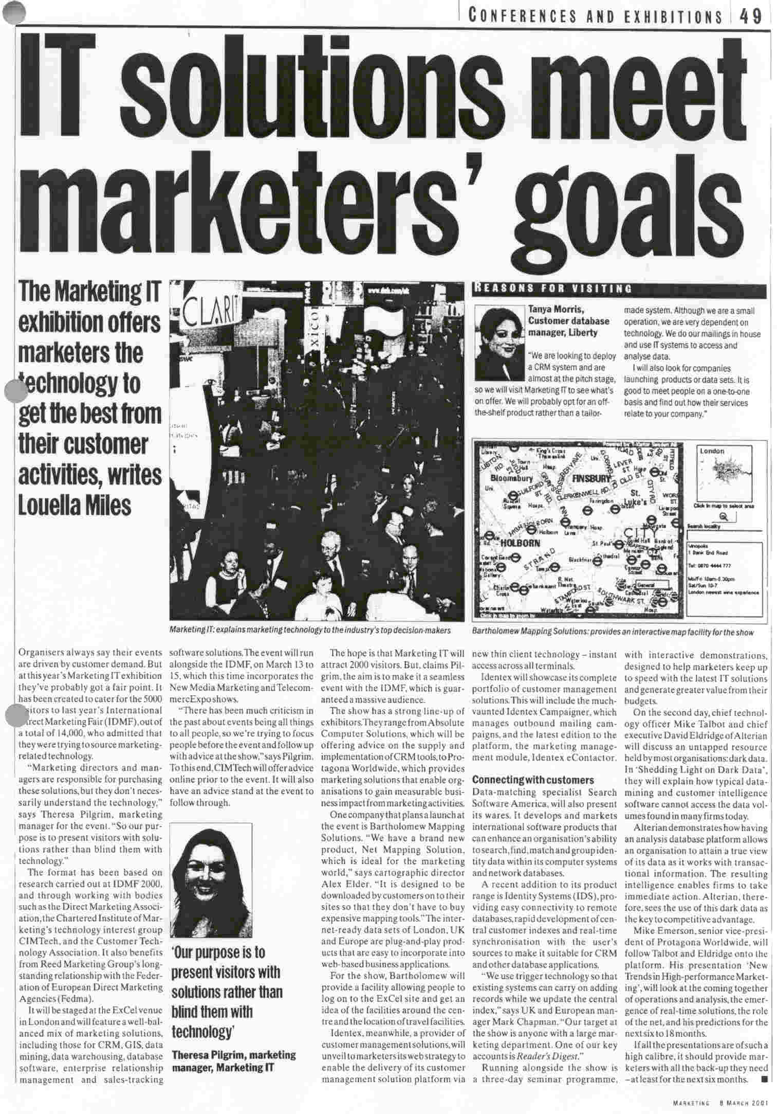
Aims and Objectives
The hype about data warehousing and data mining.
Better understand tools by IBM, Microsoft, Oracle, SAS, SPSS.
Job mobility and prospects.
Projects and research thesis.

Slide 9
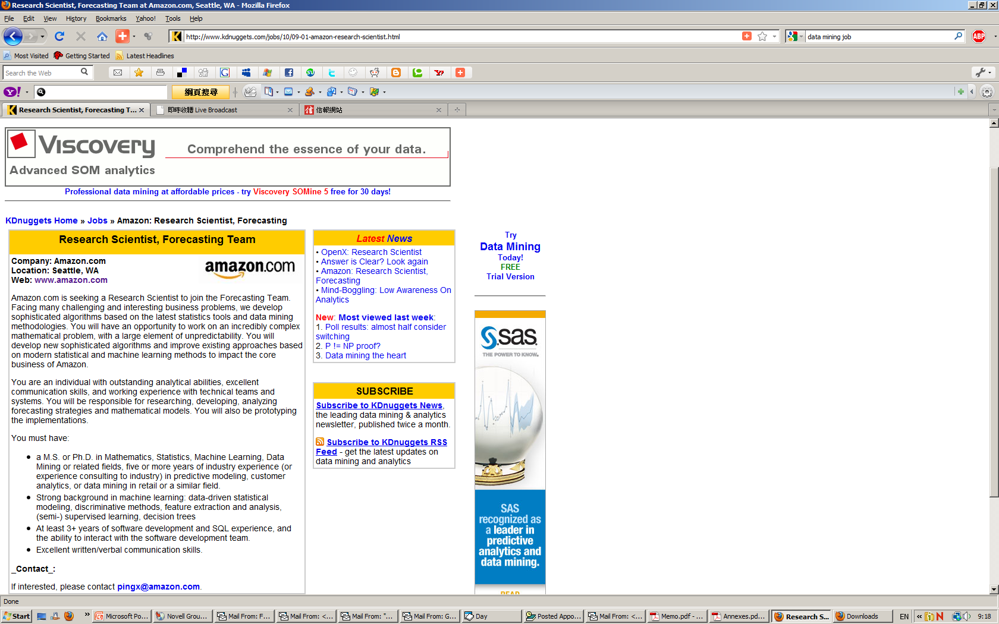


Slide 10
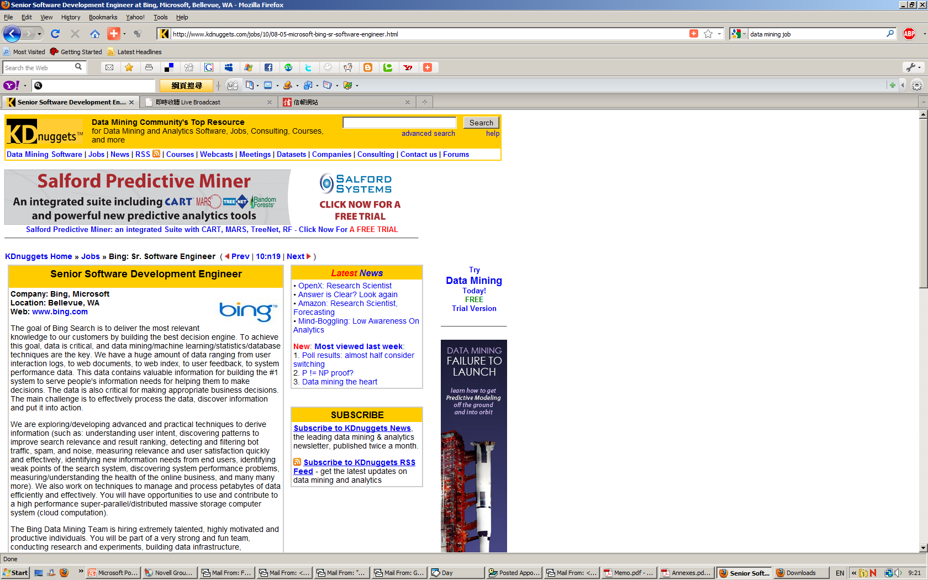

Slide 11
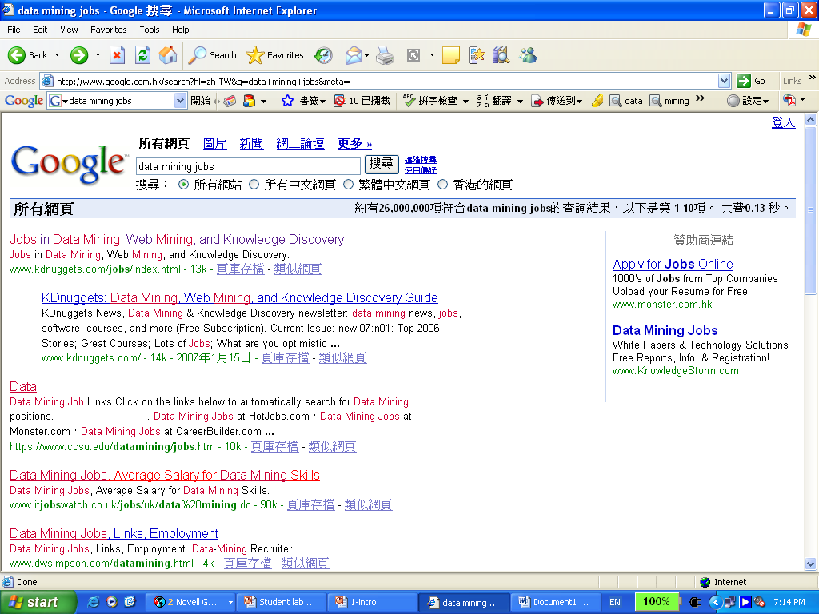

Slide 12
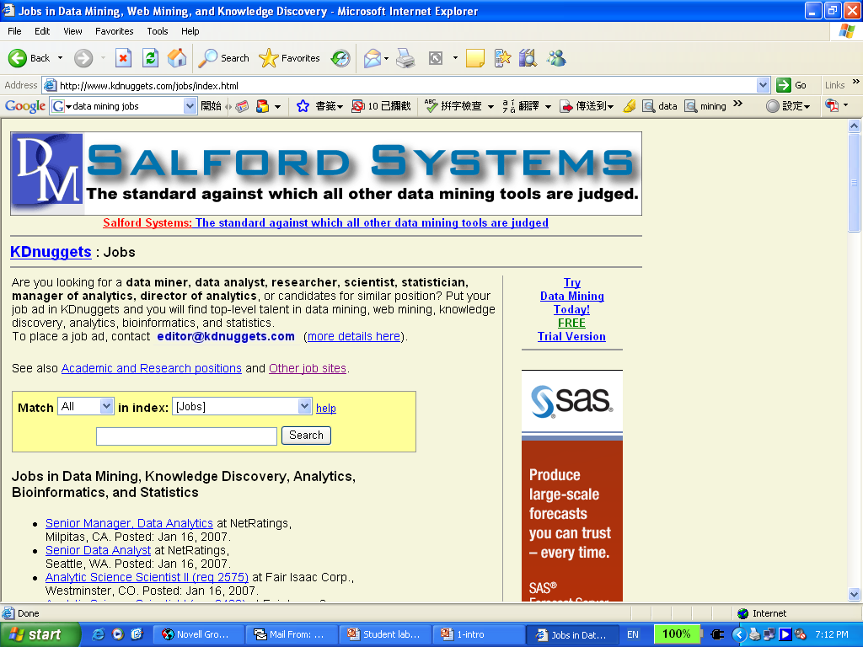

Slide 13
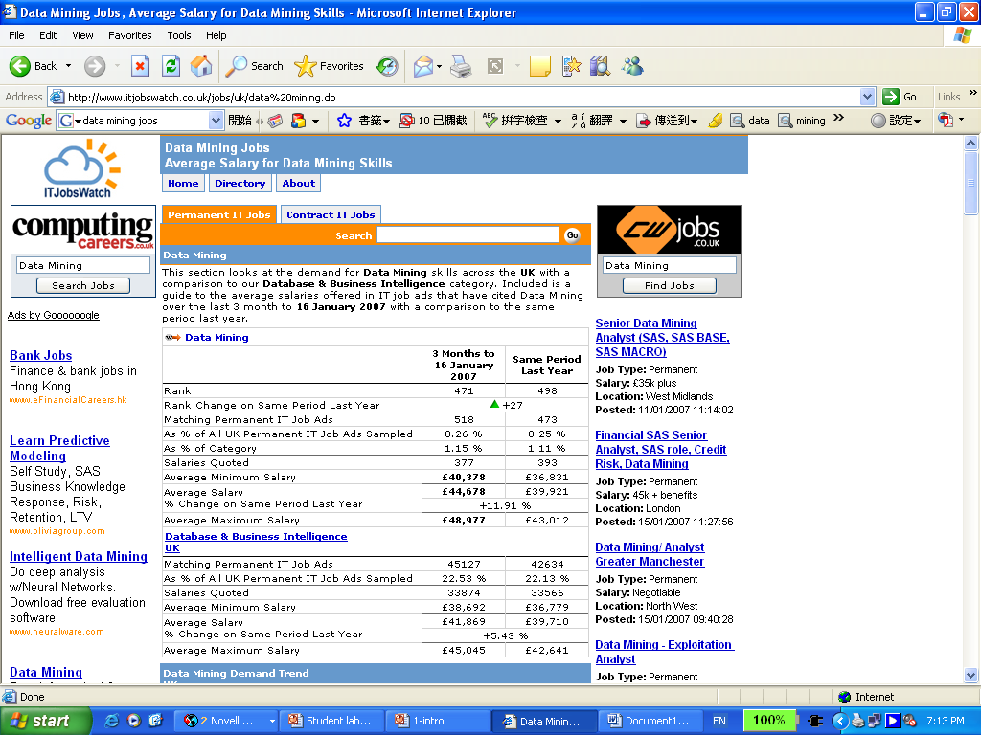

Slide 14
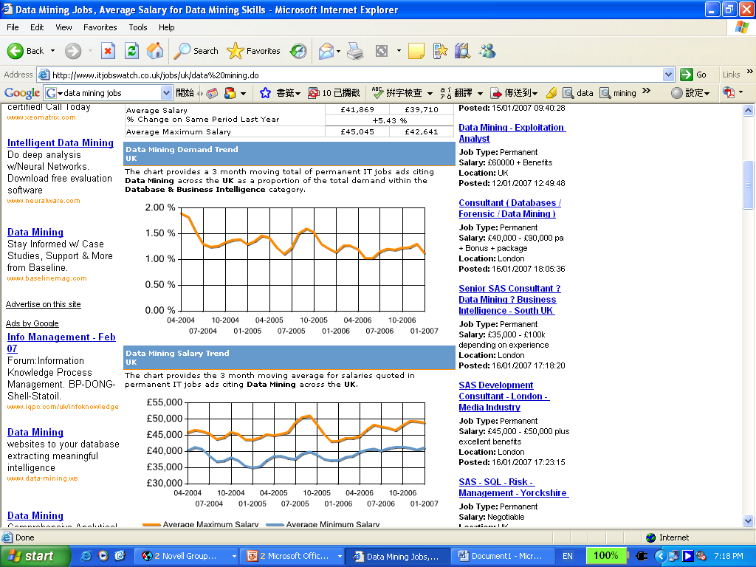

Slide 15
Data Warehousing and Industry
One of the hottest topic in IS.
Over 90% of larger companies starting or have DW.
Over $200 billion 1999-2004 [Meta-group].
US Federal government spending on DW projects from $579 million in 1999 to $911 million in 2004.
US State and local government spending grow from $550 million in 1999 to about $1.1 billion by 2004.
Worldwide DW market grow at 43%, reaching $148 billion by 2003.
US market alone will account for $72.7 billion by 2003 while growing at 41% annually.
Need of DW solutions in Japan and Europe and grow by 50% and 38% respectively.

Slide 16
Data Warehousing and Industry (2)
A 1996 study of 62 data warehousing projects showed:
  An average return on investment of 321%, with an average payback period of 2.73 years.
WalMart has largest warehouse
  900-CPU, 2,700 disk, 23 TB Teradata system
  ~7TB in warehouse
  40-50GB per day

Slide 17
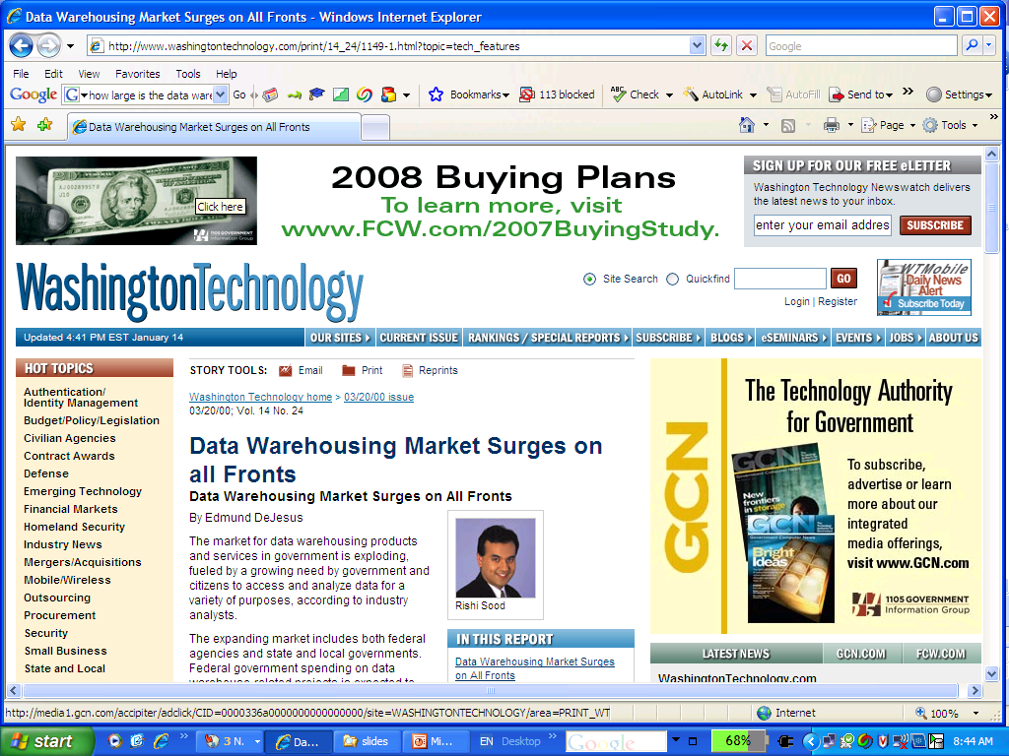

Slide 18
What is a Data Warehouse?
Defined in many different ways non-rigorously.
  A DB for decision support.
  Maintained separately from an organization’s operational database.
A data warehouse is a subject-oriented, integrated, time-variant, and nonvolatile collection of data in support of management’s decision-making process.— W. H. Inmon
Data warehousing:
  The process of constructing and using data warehouses

Slide 19
Why Data Warehousing?
Advance of information technology.
Data collected in huge amounts.
Need to make good use of data?
Architecture and tools to
  Bring together scattered information from multiple sources to provide consistent data source for decision support.
  Support information processing by providing a solid platform of consolidated, historical data for analysis.

Slide 20
What is Data Mining? (1)
Knowledge Discovery in Databases (KDD).
Discover useful patterns from large data warehouses.
Nontrivial extraction of implicit, previously unknown, and potentially useful information from data
  95% of the salesperson, male or female, that are located in Toronto and are over 6 feet in height and unable to speak French make over 1 million in sales every year for the last 5 years

Slide 21

What is Data Mining (2)
Data
Mining
Data
Warehouse
Data
Sources
Knowledge
Base
Data Warehosuing and Data Mining

Slide 22
Why Data Mining?
Data explosion problem:
  Automated data collection tools and mature database technology.
  Leading to tremendous amounts of data stored in databases, data warehouses and other information repositories.
We are drowning in data, but starving for knowledge!

Slide 23
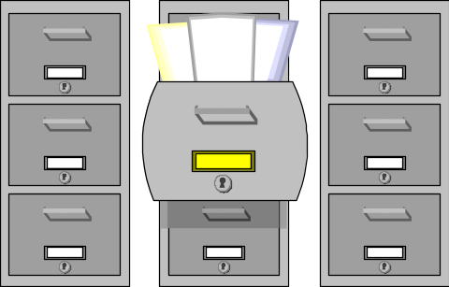


Data Rich but Information Poor
Databases are too big
Data Mining can help discover knowledge
Terrorbytes

Slide 24
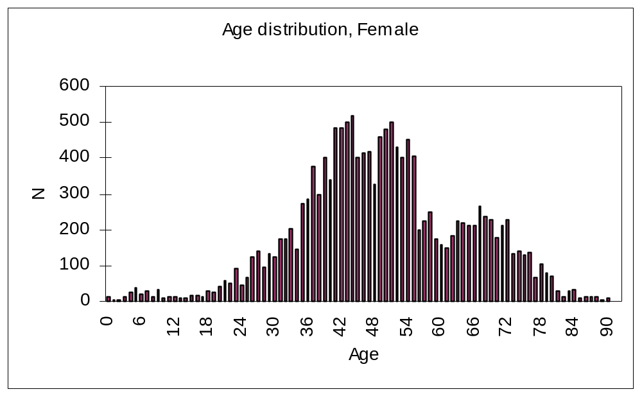
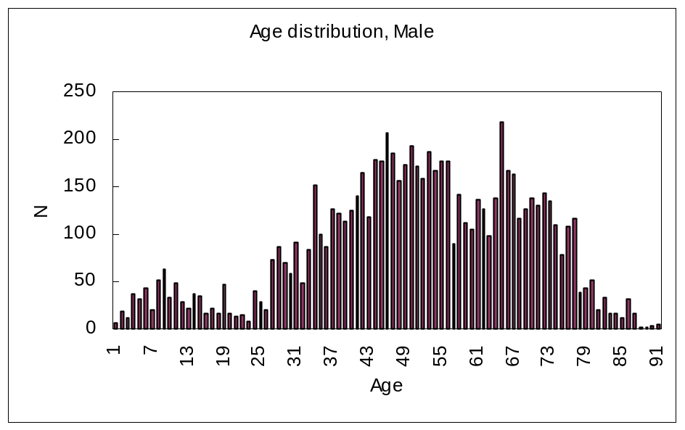
Data Mining vs. Statistical Inference
Female Age Distribution
Can you tell the
differences?
Male Age Distribution

Slide 25
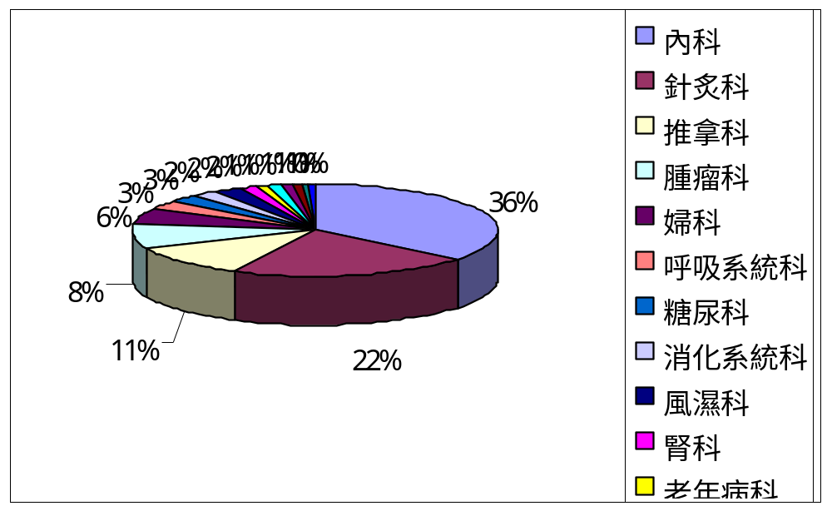
Data Mining vs. Statistical Inference (2)

Slide 26
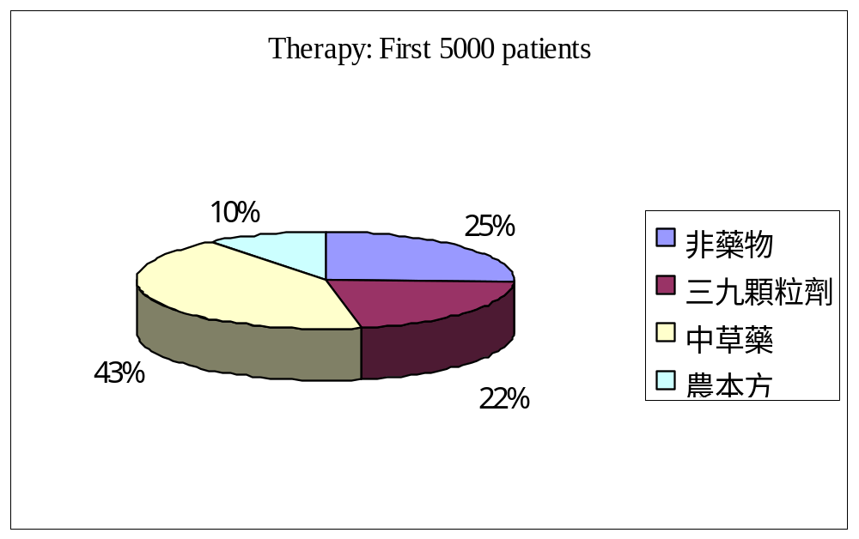
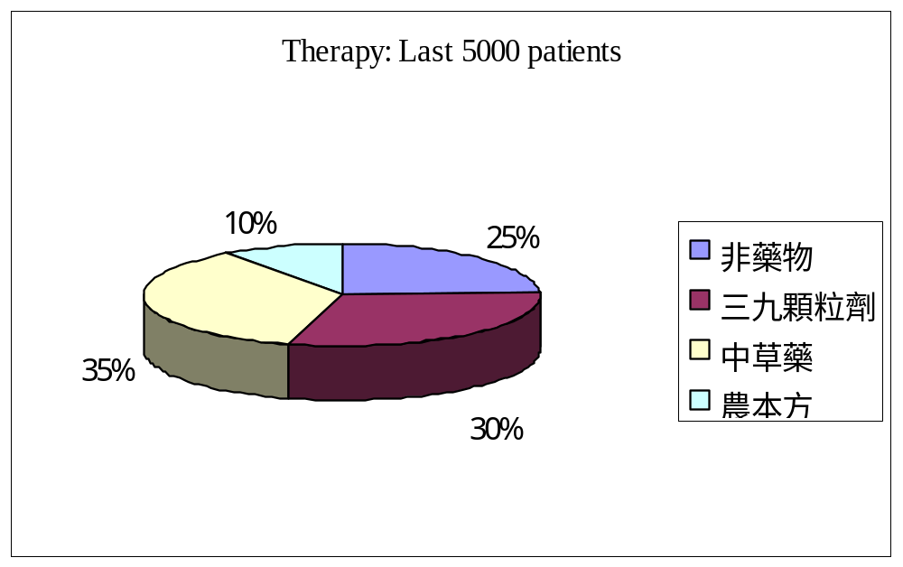
Data Mining vs. Statistical Inference (3)

Slide 27
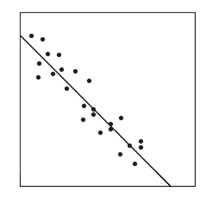
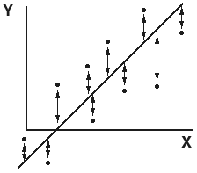
Data Mining vs. Linear Regression

Slide 28
Mining for Patterns/Knowledge
Knowledge/Patterns in the form of rules
  If <condition_1>&<condition_2>& …&<condition_n> Then <conclusion>
Types of knowledge/Patterns
  Association
    Presence of one set of items/attributes implies presence of another set.
  Classification
    Given examples of objects belonging to different groups, develop profile of each group in terms of attributes of the objects.
  Clustering.
    Unsupervised grouping of similar records based on attributes.
  Sequential analysis (temporal and spatial).
    Historical records collected at fixed period of time.

Slide 29
Mining Association Rules
The presence of one set of items in a transaction implies the presence of another set of items
  30% of people who buy diapers also buy beer.
The presence of an attribute value in a record implies the presence of another
  60% of patients with these symptoms also have that symptom.

Slide 30
An Example Association Rule
Mobile Telecom Data
  Provided by a Malaysian telecom company.
  Over 200 relational tables and transactional data of over 300,000 records.
  Example of a discovered association rules
    60% who call from Kula Lumper call to Penang.
    77% whose average call duration is greater than 5 minutes make an average of over 80 phone calls per month.

Slide 31
Mining Classification Rules
Customer Records
Demographic Data, Loan Data
Good Customer
Bad Customer
Good?
Bad?

Slide 32
An Example Classification
Airline data
  200,000 questionnaires.
  flight information such as flight date and distance.
Example of rules discovered
  Classify according to level of satisfaction:
    IF Race = Chinese & Movie = Not interested
    THEN Overall satisfaction = Not satisfactory (65%)
    IF Race = Japanese & Lunch = Japanese & Lunch = not satisfactory
    THEN Overall satisfaction = Not satisfactory (70%)
    IF Race = Turkish
    THEN Overall satisfaction = Very satisfactory (90%)

Slide 33
An Example of Classification (2)
Credit card data
  Each transaction contains transaction date, amount, and a set of items purchased, etc.
  Each customer record contains gender, age, education background, etc.
Example of rules discovered:
  IF e-mail address = no & use of card >= 9 months continuously & no. of transaction <= 2 THEN Cash Advance = Yes. (78%)
Actionable item:
  Promote credit services to potential customers who requires cash advance.

Slide 34
An Example of Classification (3)
Traditional Chinese Medicine (TCM) data
Age
District
CSSA
Tongue_Color Tongure_Appearance
Tongure_Coating_Color
Tongure_Coating_Texture
Left pulse
Right pulse
Disease groups
1. 血瘀
2. 經脈絡
3. 氣陰
4. 氣虛
5. …….
Total of 11,699 patients, 1,387 different disease signs.
Example of discovered rules.
  If Pulse = ‘緩’ & Tongue_color = ‘淡白’ Then ‘寒濕’ (77.1%).

Slide 35
An Example of Classification (4)
Traditional Chinese Medicine (TCM) data
Age
District
CSSA
Tongue_Color Tongure_Appearance
Tongure_Coating_Color
Tongure_Coating_Texture
Left pulse
Right pulse
Disease groups
1. 血瘀
2. 經脈絡
3. 氣陰
4. 氣虛
5. …….
Predicting herbs doctors prescribe based on tongue characteristics and pulse signs:
  甘草,白芍,柴胡,茯苓,丹參,法半夏,麥冬,黃芩,知母,桔梗.

Slide 36

Discovering Clusters
Dividing them up into groups according to similarity

Slide 37


Slide 38
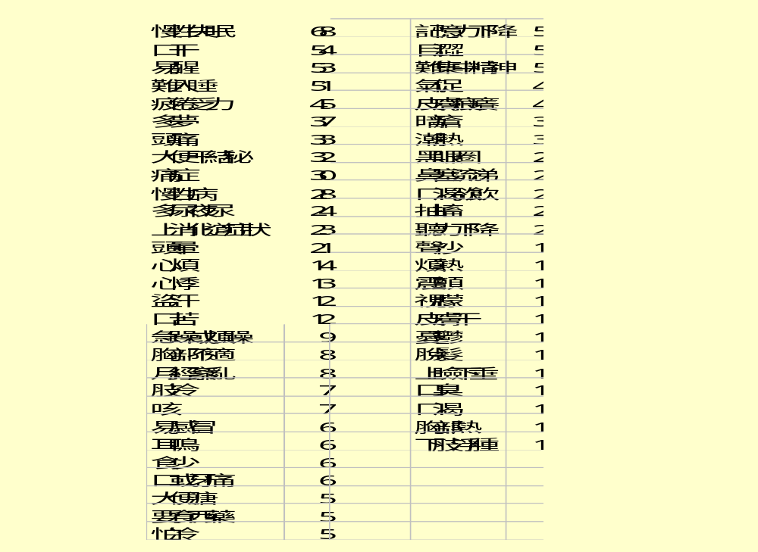
An Example of Clustering:
Analysis of Insomnia
From
Patient
History

Slide 39
Analysis of Insomnia (2)
Cluster 1:多夢易醒型
  多夢,易醒,難入睡,口干,大便干結或秘, 或有頭暈頭痛, 舌淡紅光滑苔薄白,脈弦或滑或弦滑.
Cluster 2: 口干易醒難睡型
Cluster 3: 難入睡型
Cluster 4: 多夢難睡型
Cluster 5: 口干型
Cluster 6: 頭痛型

Slide 40
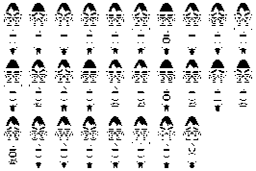


Classification ≠Clustering
Classification
Given: two or more classes
of data (VG, G, B, VB)
Find: the differences
among VG, G, B, VB
for prediction.
Good Customers
Bad Customers
Clustering
Given: one database of
customers without
class information (not
known)
Find: Groupings within the
database.

Slide 41
An Example of Clustering
Age group.
Tongue.
  color (紫,淡紅,鮮紅,淡白)
  appearance (光滑,裂紋,痿軟,瘦薄,芒刺,腫脹)
  Tongue coating color (黃,白,無)
  Tongue coating texture (薄,厚,潤,剝,膩,乾)
Pulse.
  脈細,脈弦,脈緩,脈滑,脈沈,脈數,脈濡,脈結,脈遲,脈速,脈弱
Illness.
  胸部不適,慢性失眠,黑眼圈,易感冒,鼻塞流涕,盜汗

Slide 42
Discovering Sequential Patterns
People who have purchased a VCR are three times more likely to purchase a camcorder two to four months after the purchase.
If the price of Stock A increases by more than 10% and the price of Stock B decreases by less than 2% today, then the price of Stock C will increase by 5% two days later.

Slide 43
An Example of Sequential Pattern Mining
Electricity consumption data:
  A set of time series each associated with an industrial user.
  Each time series represents an electricity load profile of a user at a certain premise.
  Reading of electricity load taken every 30 min.
The Goal
  Identify companies with similar electricity load profiles using data mining.

Slide 44
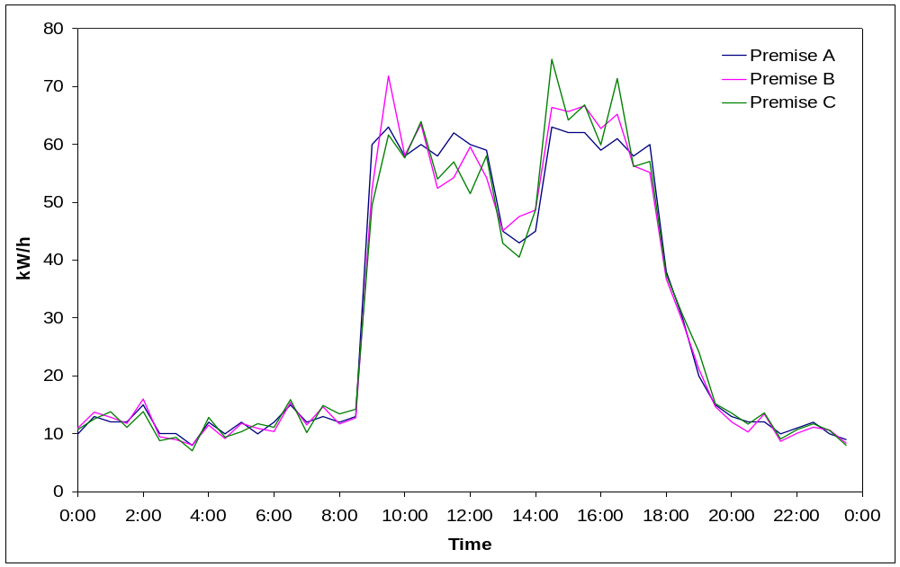
An Example of Sequential Pattern Mining (2)

Slide 45
Web Log Mining
Web Servers register a log entry for every single access they get.
A huge number of accesses (hits) are registered and collected in an ever-growing web log.
Web log mining:
  Understand general access patterns and trends.
  Better structure and grouping of resource providers.
  Adaptive Sites -- Web site restructures itself automatically.
  Personalization.
  Target customers for electronic commerce
  Identify potential prime advertisement locations

Slide 46
An Example of Web Log Mining
Given a web access log file
  Provided by an airline company.
The Goal
  Analysis user access pattern
  e.g. Page A --> Page B --> Page C --> …
  Which page the viewer will arrive after accessing certain URLs.
Results:
  IF Page = Destination Information & Next Page = Flight Schedules THEN Next Page = XxxAir Travel Packages
  IF Day of week = Wed. & Time = Non-office hour
  THEN duration = long
Actionable Items
  Golden time for advertisements is on Wed. during non-office hour.

Slide 47
Other Applications of Data Mining
Market analysis and management
  Target marketing, customer relation management, market basket analysis, cross selling, market segmentation.
Risk analysis and management
  Forecasting, customer retention, improved underwriting, quality control, competitive analysis.
Fraud detection and management

Slide 48
Data Mining Techniques
Confluence of Multiple Disciplines
  Database systems, data warehouse and OLAP.
  High performance computing.
  More traditionally:
    Probability & Statistics.
    Machine learning and Pattern Recognition.
  More recently:
    Fuzzy logic.
    Artificial neural networks.
    Genetic Algorithms and Evolutionary computations
  Visualization.

Slide 49
Statistical Software
SPSS
  Traditional statistics.
  Decision trees.
  Neural Networks.
  Data visualization.
  Database access and management.
  Multidimensional tables.
  Interactive graphics.
  Report generation and web distribution.
SAS
  Enterprise Miner.
  Statistical tools for clustering.
  Decision trees.
  Linear and logistic regression.
  Neural networks.
  Data preparations tools.
  Visualization tools.
  Multi-D tables.

Slide 50
Fuzzy Logic
Complexity in the world arises from uncertainty in the form of ambiguity.
Closed-form mathematical expressions provide precise descriptions of systems with little complexity and uncertainty.
Fuzzy reasoning for complex systems where:
  no numerical data exist, and
  only ambiguous or imprecise information is available.

Slide 51
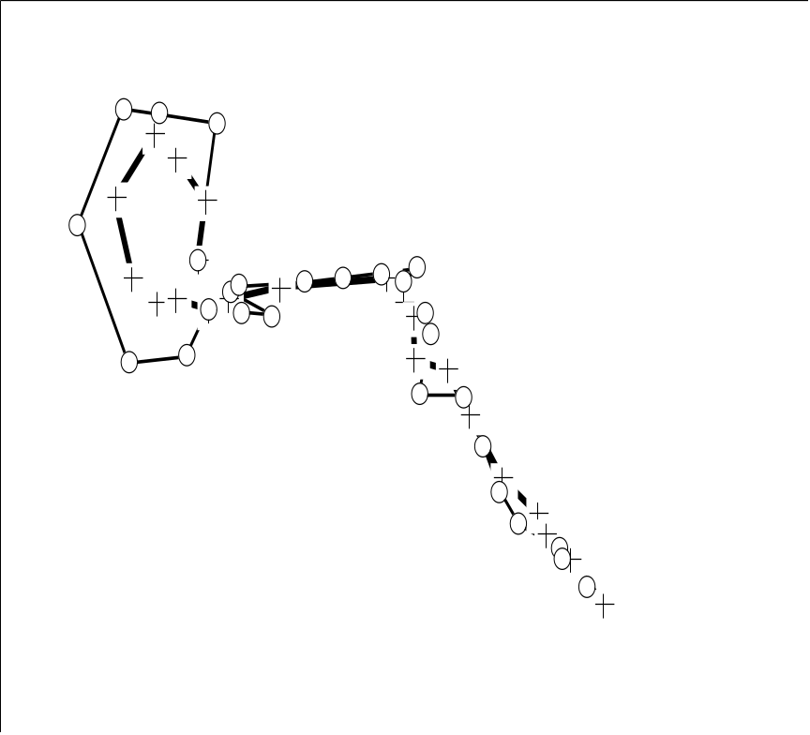
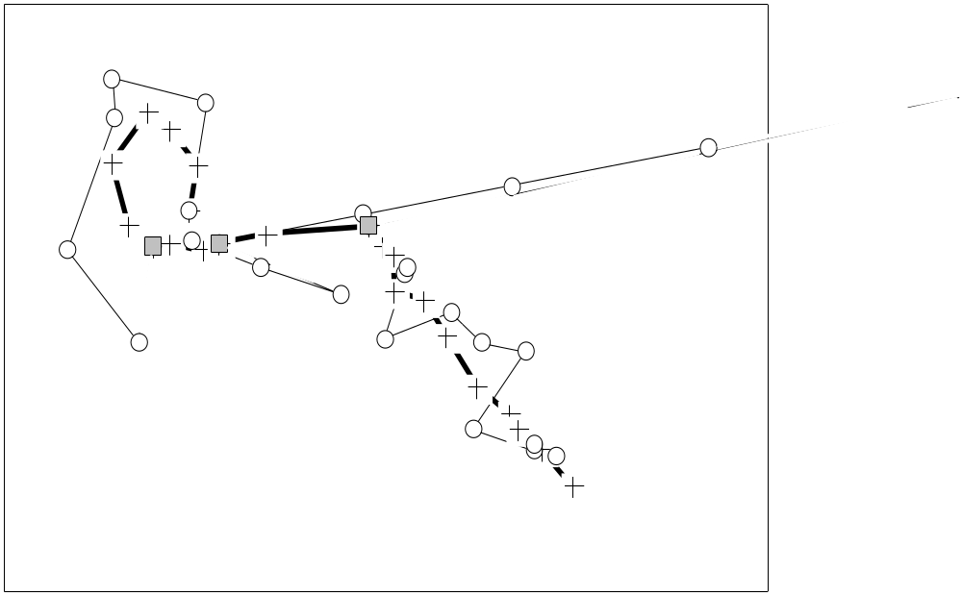
Fuzzy Logic: An Application
An Application in Radar Target Tracking

Slide 52
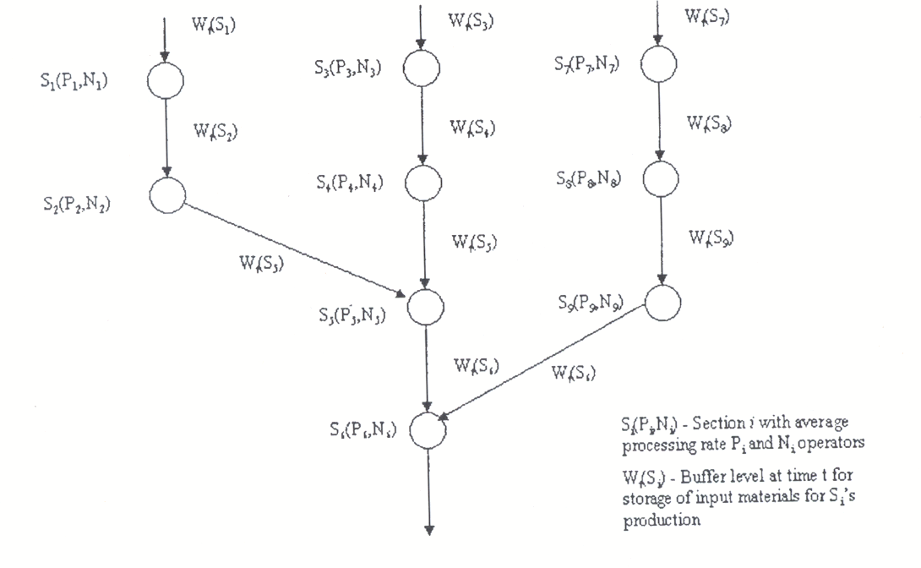
Fuzzy Logic: Another Application
Fuzzy operator allocation for balance control of assembly line in apparel manufacturing.
Reduction of production time by 30%.

Slide 53
Example Fuzzy Sets Defined by their Membership Functions
1.0
0.5
Medium water
melon
Large
water
melon
Small water
melon
0.0
3kg
5kg
8kg
9kg
10kg

Slide 54
An Example of Fuzzy Rules
87% of callers who called in the morning make long-duration calls.
90% of high-income customers are also large-spenders.
70% of property-owners in Tai Po who own expensive flats are active stock traders.

Slide 55
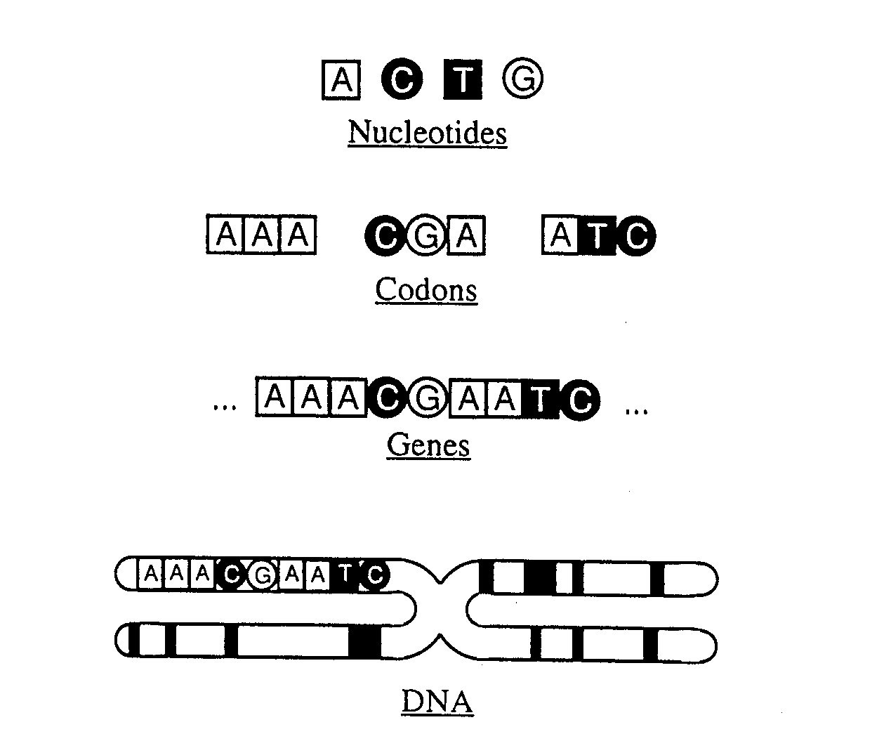
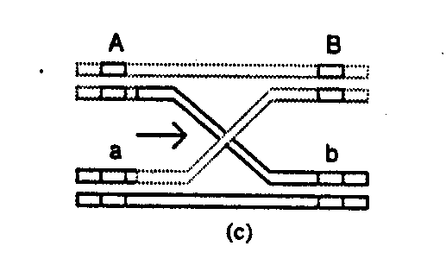
Genetic Algorithms
Survival of the fittest.
Concepts in Evolutionary Theory.
  Chromosomes.
  Crossover.
  Mutation.
  Selection.

Slide 56
Genetic Algorithm: An Example

Slide 57
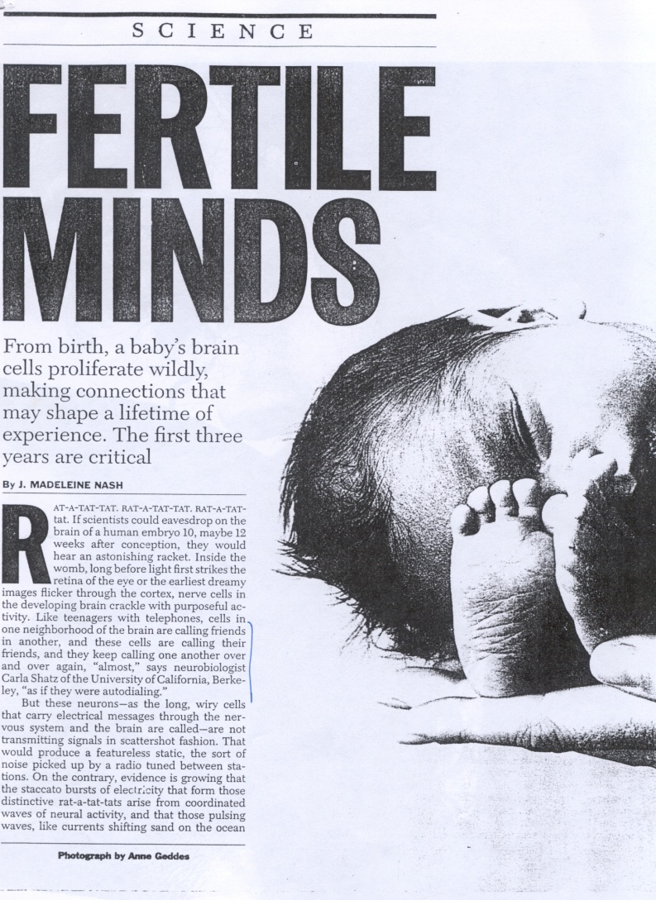
Artificial Neural Networks

Slide 58
Artificial Neural Networks
Computers process sequential instructions extremely rapidly.
Not good at vision or speech recognition.
Brain cells respond ~10 times/s (10 Hz).
Neural computing to capture principles underlying brain's solution.
x1
x2
x4
x5
x7
x8
x9

Slide 59
Requirements and Challenges
Variety of data types.
Noisy and incomplete data
The interestingness problem.
Different kinds of knowledge.
Different levels of abstraction.
Expression and visualization of data mining results.
Efficiency and scalability of data mining algorithms.

