Slide 1
Discovering Association Rules
Keith C.C. Chan
Department of Computing
The Hong Kong Polytechnic University

Slide 2
The AR Mining Problem
Given a database of transactions.
  Each transaction being a list of items.
  E.g. purchased by a customer in a visit.
Find all interesting rules that correlate the presence of one set of items with that of another set of items
  E.g., 30% of people who buy diapers also buy beer.

Slide 3
Motivation & Applications
If we can find such associations, we will be able to answer:
  ??? ⇒ beer (What should the company do to boost beer sales?).
  Diapers ⇒ ??? (What other products should the store stocks up?).
  Attached mailing in direct marketing.

Slide 4
Motivation & Applications (2)
Originally for marketing to understand purchasing trends.
  What products or services customers tend to purchase at the same time, or later on?
Use market basket analysis to plan:
  Couponing and discounting:
    Do not offer simultaneous discounts on beer and diapers if they tend to be bought together.
    Discount one to pull in sales of the other.
  Product placement.
    Place products that have a strong purchasing relationship close together.
    Place such products far apart to increase traffic past other items.

Slide 5
Measure of Interestingness
There can be many association rules:
  1% of the people who buy Noodles also buy Tooth Brush.
  13% of the people who buy Candies also buy Onion.
  30% of the people who buy diapers also buy beer.
How do you find these percentages?
  We find the percentages by finding the conditional probability.
  We call the conditional probability – confidence.
Which one is more interesting?
  The ones with larger confidence.
  How large is the minimum confidence for an association to be considered interesting?
  This is something subjective.

Slide 6
Measure of Interestingness (2)
We are only interested in the “interesting” association rules.
We need a measure of interestingness.
One popular interestingness measures have been proposed:
  The Support and Confidence measures.
What is the Confidence measure?
  The conditional probability.

Slide 7
Confidence Measure and Sample Size
Consider the association Diapers -> Beer.
A Confidence Measure can be very large if
  Only 10 out of 1,000,000 buy Diapers.
  Only 7 out of 1,000,000 buy both.
  Only 20 out of 1,000,000 buy Beer.
Very high confidence measure.
But small sample size.
Sample size need to be considered.

Slide 8
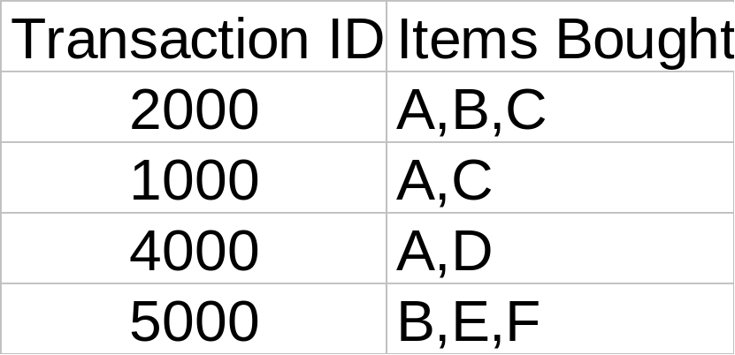
The Support and Confidence
Customer
buys both
Customer
buys diaper
Find all the rules X ⇒ Y with minimum confidence and support
  support, s, probability that a transaction contains X and Y.
  confidence, c, conditional probability that a transaction having X also contains Y
Customer
buys beer
Example
  A ⇒ C (50%, 66.6%)
  C ⇒ A (50%, 100%)
Which percentage is support and which is confidence?

Slide 9
Complexity of AR Mining Algorithms
An association algorithm is simply a counting algorithm.
Probabilities are computed by taking ratios among various counts.
If item hierarchies are in use, then some translation (or lookup) is needed.
One must carefully control the sizes of the item sets because of combinatorial explosion problem.

Slide 10
Complexity of AR Mining Algorithms (2/4)
Large grocery stores stock sell more than 100,000 different items.
There can be 5 billion possible item pairs, and 1.7 x 10¹⁴ sets of three items.
An item hierarchy can be used to reduce this number to a manageable size.
There is unlikely to be a specific relationship between Pampers in the 30-count box and Blue Ribbon in 12oz cans.

Slide 11
Complexity of AR Mining Algorithms (3/4)
If there is such a relationship, it is probably subsumed by the more general relationship between diapers and beer.
Using an item hierarchy reduces the number of combinations.
It also helps to find more general higher-level relationships such as those between any kind of diapers and any kind of beer.

Slide 12
Complexity of AR Mining Algorithms (4/4)
The combinatorial explosion problem:
  Even if you use an item hierarchy to group items together so that the average group size is 50.
  Reducing 100,000 items to 2,000 item groups.
  With 2,000 item groups there are still almost 2 million paired item sets.
  An algorithm might require up to 2 million counting registers.
  There are 1.3 billion three-item item sets!
  Many combinations will never occur.
  Some sort of dynamic memory or counter allocation and addressing scheme will be needed.

Slide 13
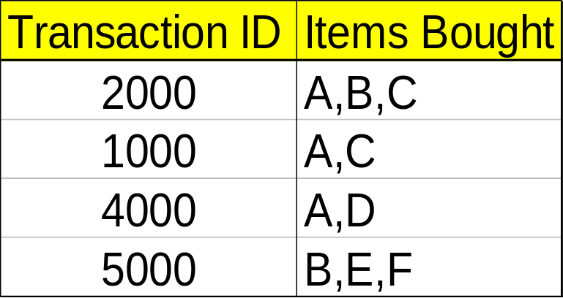
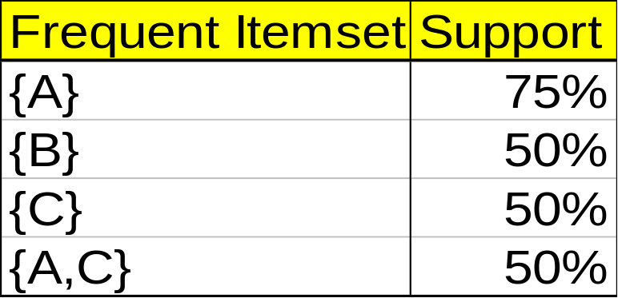
The Apriori Algorithm
Min. support 50%
Min. confidence 50%
For rule A ⇒ C:
  support = support(A and C) = 50%
  confidence = support(A and C})/support(A) = 66.6%
The Apriori principle:
  A frequent itemset is an itemset that is greater than the min_support.
  Any subset of a frequent itemset must be frequent.
  The superset of an “infrequent itemset” must be “infrequent”.

Slide 14








Applying Apriori Algorithm
Database D
L₁
C₁
Scan D
C₂
C₂
L₂
Scan D
{123}
{135}
{125}
{235}
C₃
Scan D
L₃

Slide 15
Is Apriori Fast Enough?
The core of the Apriori algorithm:
  Use frequent (k – 1)-itemsets to generate candidate frequent k-itemsets
  Use database scan and pattern matching to collect counts for the candidate itemsets
The bottleneck of Apriori: candidate generation
  Huge candidate sets:
    10⁴ frequent 1-itemset will generate 10⁷ candidate 2-itemsets
    To discover a frequent pattern of size 100, e.g., {a₁, a₂, …, a₁₀₀}, one needs to generate 2¹⁰⁰ ≈ 10³⁰ candidates.
  Multiple scans of database:
    Needs (n +1 ) scans, n is the length of the longest pattern

Slide 16
Improving Apriori’s Efficiency
Hash-based itemset counting: A k-itemset whose corresponding hashing bucket count is below the threshold cannot be frequent
Transaction reduction: A transaction that does not contain any frequent k-itemset is useless in subsequent scans
Partitioning: Any itemset that is potentially frequent in DB must be frequent in at least one of the partitions of DB
Sampling: mining on a subset of given data, lower support threshold + a method to determine the completeness
Dynamic itemset counting: add new candidate itemsets only when all of their subsets are estimated to be frequent.

Slide 17
What is A Lift Ratio?
Consider these rule:
  30% of the people who buy diapers they also buy beer.
  People who buy diapers are 10 times more likely to also buy beer (more likely than expected).
The first rule contains an explicit percentage.
  30% is the conditional probability, Pr(Beer | diapers).
  It is also called the “confidence” of the rule.
This measure alone may not be enough to allow one to decide if a rule is interesting.

Slide 18
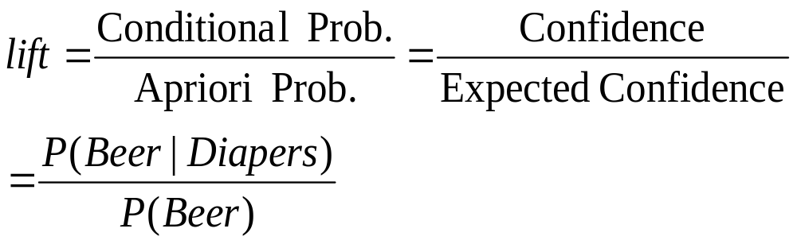
What is A Lift Ratio? (2)
Comparative phrase in 2nd rule “10 times more likely”.
Ratio of conditional (confidence) to apriori probability (expected confidence) can make a difference.
Apriori is probability of event occurring independently.
  E.g., if people normally buy beer 3% of the time, then the first rule could have said “10 times more likely.”
The ratio in this kind of comparison is called lift.
A key goal of an association rule mining exercise is to find rules that exceeds a minimum lift.

Slide 19
What is a Lift (3)
Measures difference between confidence and expected confidence of a rule.
Measure strength of an effect (interactions between diapers and beer).
If people who bought diapers also bought beer 8% of the time, then the effect is small when expected confidence is 6%.
If the confidence is 50%, and lift is more than 8 times (when measured as a ratio), then the effect is very strong.

Slide 20
Example of Lift Ratio
To understand what lift ratio is, consider the following:
  500,000 transactions
    20,000 transactions contain diapers (4 percent)
    30,000 transactions contain beer (6 percent)
    10,000 transactions contain both diapers and beer (2 percent)
  When people buy diapers, they also buy beer 50% of the time (10,000/20,000).
  The conditional probability or confidence for this rule is 50%.

Slide 21
Example of Lift Ratio (2)
In the absence of any knowledge about what else was bought, the following can be computed:
    People buy diapers 4 percent of the time.
    People buy beer 6 percent of the time.
4% and 6% are called the expected confidence (or Apriori Probability) of buying diapers or beer.

Slide 22
Three-Item Association
Consider item sets with three items:
  10,000 transactions contain wipes.
  8,000 transactions contain wipes and diapers (80%).
  220 transactions contain wipes and beer (2.2%).
  200 transactions contain wipes, diapers and beer (2%).
  The complete set of 12 rules is presented in a table along with their confidence, support and lift.

Slide 23
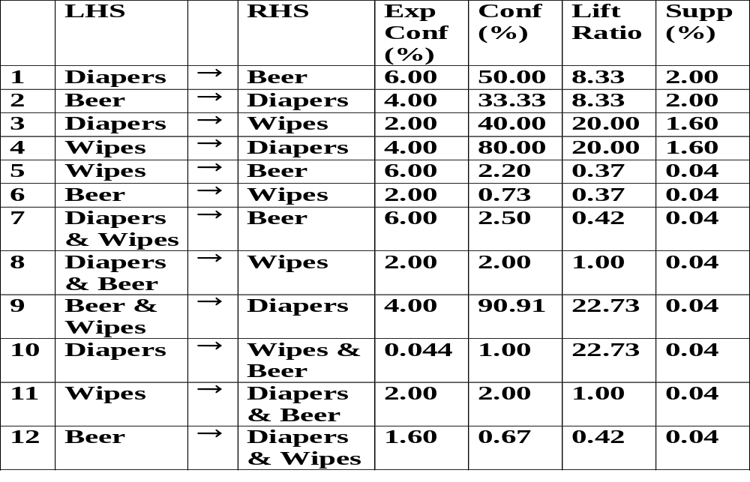
Three-Item Association (2)

Slide 24
Three-Item Association (3)
The greatest amount of lift, if measured as a ratio, is found in the 9th and 10th rules.
Both have a lift greater than 22, computed as 90.91÷4 and 1÷0.044.
For the 9th rule, the lift of 22 means:
  People who purchase wipes and beer are 22 times more likely to also purchase diapers than ordinary people.
Note the negative association (or negative lift) (i.e. lift ratio less than 1) in the 5th, 6th, 7th and last rules.
The latter two rules both have a lift ratio of approximately 0.42.

Slide 25
Three-Item Association (4)
Negative lift on the 7th rule means:
  People who buy diapers and wipes are less likely to buy beer than one would expect.
Rules with very high or very low confidence model an anomaly.
  If a rule says, with a confidence of 1 (100%), that whenever people bought pet food they also bought pet supplies.
  Further investigation show that was for one day only.
  There was a special giveaway.

Slide 26
Three-Item Association (5)
Most rules have dairy on the right hand side.
Milk or eggs are so commonly purchased, “dairy” is quite likely to show up in many rules.
Ability to exclude specific items is very useful.
Interesting rules are:
  Have a very high or very low lift.
  Do not involve items that appear on most transactions.
  Have sample size that exceeds a threshold.
    Small sample size might simply be due to a statistical anomaly.
  Rules that are more general are frequently desirable.
    People who buy 30pc-a-box of diapers also buy Tsingtao Beer.
    People who buy diaper also buy beer.
  Sometimes interesting to differentiate between diapers sold in boxes vs. diapers sold in bulk.

Slide 27
Lift Ratio and Sample Size
Consider the association Diapers -> Beer.
A lift ratio can be very large even if
  Only 10 out of 1,000,000 buy Diapers.
  Only 6 out of 1,000,000 buy both.
  Only 20 out of 1,000,000 buy Beer.
Sample size need to be considered.
A different interestingness measures using:
  support and confidence.

Slide 28
Multiple-Level ARs
Items often form hierarchy.
Items at the lower level are expected to have lower support.
Rules regarding itemsets at
appropriate levels could be quite useful.
Transaction database can be encoded based on dimensions and levels
It is smart to explore shared multi-level mining (Han & Fu,VLDB’95).

Slide 29
Mining Multi-Level Associations
A top_down, progressive deepening approach:
  First find high-level strong rules:
milk → bread [20%, 60%].
  Then find their lower-level “weaker” rules:
2% milk → wheat bread [6%, 50%].
Variations at mining multiple-level association rules.
  Level-crossed association rules:
2% milk → Wonder wheat bread
  Association rules with multiple, alternative hierarchies:
2% milk → Wonder breadg

Slide 30
Multi-level Association:
Uniform Support vs. Reduced Support
Uniform Support: the same minimum support for all levels
  + (Advantage) One minimum support threshold. No need to examine itemsets containing any item whose ancestors do not have minimum support.
  – (Disadvantage) Lower level items do not occur as frequently. If support threshold
      too high ⇒ miss low level associations.
      too low ⇒ generate too many high level associations.
Reduced Support: reduced minimum support at lower levels

Slide 31
Uniform Support
Multi-level mining with uniform support
Level 1
min_sup = 5%
Milk
[support = 10%]
Level 2
min_sup = 5%
2% Milk
[support = 6%]
Skim Milk
[support = 4%]

Slide 32
Reduced Support
Multi-level mining with reduced support
Level 1
min_sup = 5%
Milk
[support = 10%]
Level 2
min_sup = 3%
2% Milk
[support = 6%]
Skim Milk
[support = 4%]
Back

Slide 33
Multi-level Association:
Redundancy Filtering
Some rules may be redundant due to “ancestor” relationships between items.
Example
  milk ⇒ wheat bread, [support = 8%, confidence = 70%]
  2% milk ⇒ wheat bread, [support = 2%, confidence = 72%]
We say the first rule is an ancestor of the second rule.
A rule is redundant if its support is close to the “expected” value, based on the rule’s ancestor.

Slide 34
Multi-Level Mining:
Progressive Deepening
A top-down, progressive deepening approach:
  First mine high-level frequent items:
milk (15%), bread (10%)
  Then mine their lower-level “weaker” frequent itemsets:
2% milk (5%), wheat bread (4%)
Different min_support threshold across multi-levels lead to different algorithms:
  If adopting the same min_support across multi-levels
    then ignore a descendent if any of it’s ancestors is infrequent.
  If adopting reduced min_support at lower levels
    then examine only those descendents whose ancestor’s support is frequent/non-negligible.

Slide 35
AR Representation Scheme
In words:
  60% of people who buys diapers also buys beers and 0.5% buys both.
In first-order logic or PROLOG-like statement:
  buys(x, “diapers”) −> buys(x, “beers”) [0.5%, 60%].
Also representation as if-then rules.
  If diapers in Itemset THEN beers in Itemset [0.5%, 60%].
  If people buy diapers, they also buy beers 60% of the time, 0.5% of the people buy both.

Slide 36
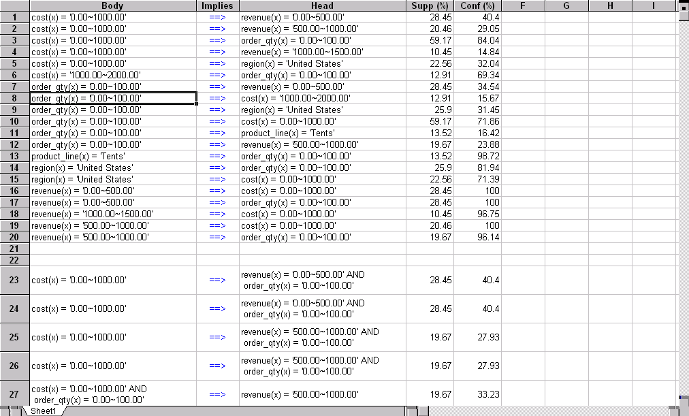
Presentation of Association Rules (Table Form )

Slide 37

Visualization of Association Rule Using Plane Graph

Slide 38

Visualization of Association Rule Using Rule Graph

