Slide 1
Discovering Classification Rules
Keith C.C. Chan
Department of Computing
The Hong Kong Polytechnic University

Slide 2
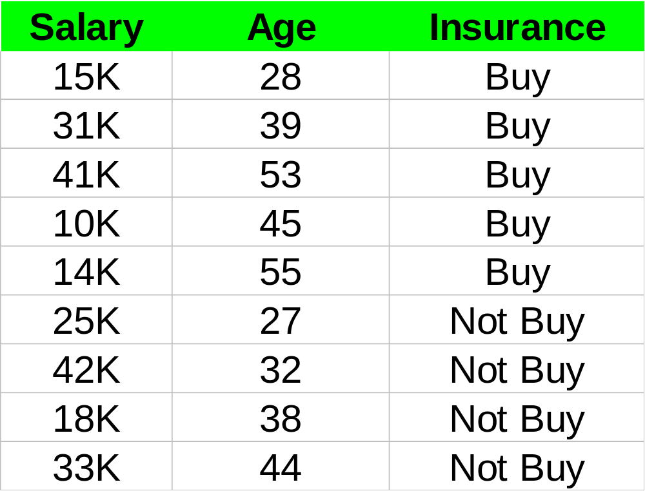
An Example Classification Problem
John earns 24K per month and is 42 years old.
Will he buy insurance?

Slide 3
An Example Classification Problem
Customer Records
Demographic data
Buy
Not Buy
Buy?
Not buy?

Slide 4


Discovering of Classification Rules
Mining
Classification
Rules
Training
Data
Classification
Rules
IF Salary >35K
AND Age < 40
THEN Buy
Based on the classification rule discovered, will John who
Earns 24K and is 42 years old, buy insurance from you?

Slide 5
The Classification Problem
Given:
  A database consisting of n records.
  Each record characterized by m attributes.
  Each record pre-classified into p different classes.
Find:
  A set of classification rules (that constitutes a classification model) that characterizes the different classes
  so that records not originally in the database can be accurately classified.
  I.e “predicting” class labels.

Slide 6
Typical Applications
Credit approval.
  Classes can be High Risk, Low Risk?
Target marketing.
  What are the classes?
Medical diagnosis
  Classes can be customers with different diseases.
Treatment effectiveness analysis.
  Classes can be patients with different degrees of recovery.

Slide 7
Techniques for Discovering of Classification Rules
The k-Nearest Neighbor Algorithm.
The Linear Discriminant Function.
The Bayesian Approach.
The Decision Tree approach.
The Neural Network approach.
The Genetic Algorithm approach.

Slide 8
Example Using The k-NN Algorithm
John earns 24K per month and is 42 years old.
Will he buy insurance?

Slide 9
The k-Nearest Neighbor Algorithm
All data records correspond to points in the n-Dimensional space.
Nearest neighbor defined in terms of Euclidean distance.
k-NN returns the most common class label among k training examples nearest to xq.
_
_
_
.
+
_
+
_
xq
+
_
+
.

Slide 10
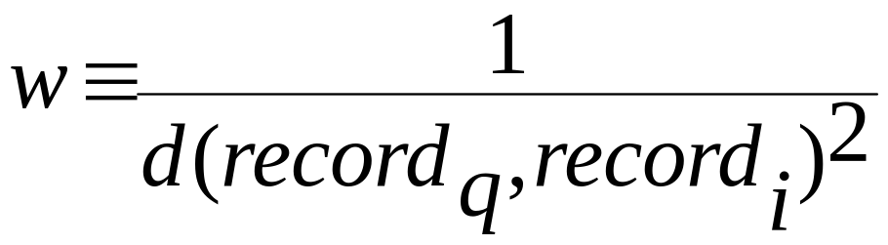
The k-NN Algorithm (2)
k-NN can be used to predict a number rather than a label.
  By calculating the average of its k nearest neighbors
Distance-weighted nearest neighbor algorithm
  Weight the contribution of each of the k neighbors according to their distance to the query point x_{q}
Advantage:
  Robust to noisy data by averaging k-nearest neighbors
Disadvantage:
  Distance between neighbors could be dominated by irrelevant attributes.

Slide 11
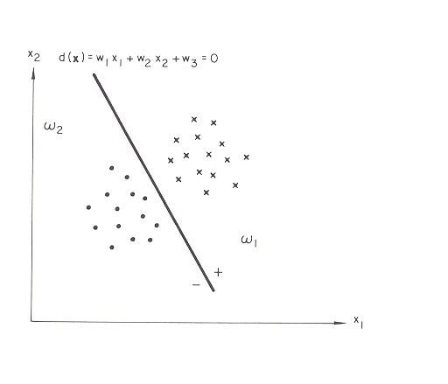
Linear Discriminant Function (LDF)
How should
we determine
the coefficients,
i.e. the w_{i}’s?

Slide 12
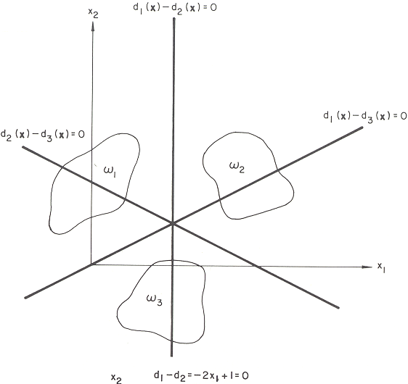
Linear Discriminant Function (2)
3 lines separating
3 classes

Slide 13
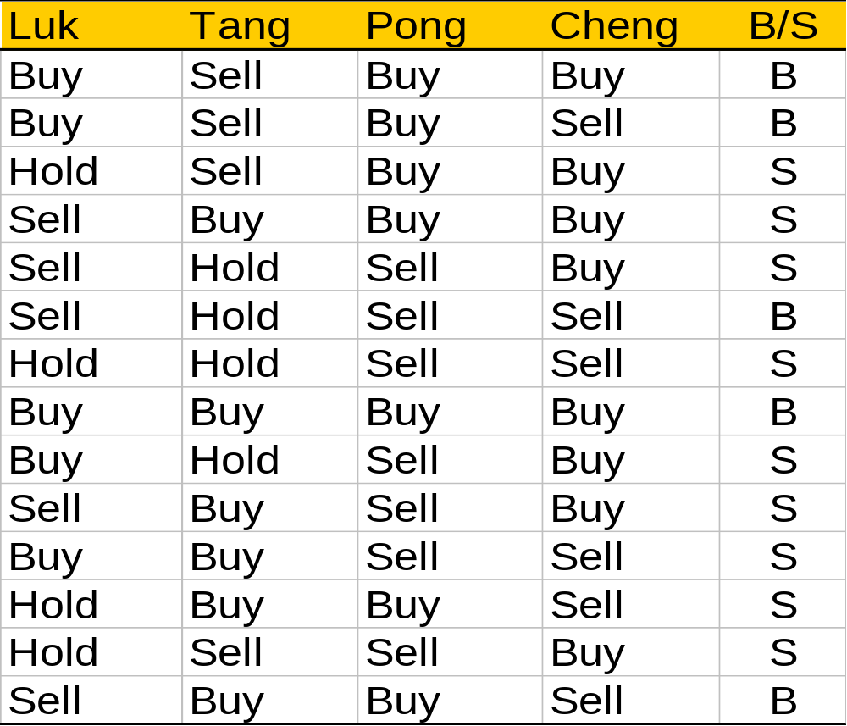
An Example Using The
Naïve Bayesian Approach

Slide 14
The Example Continued
On one particular day, if
  Luk recommends Sell
  Tang recommends Sell
  Pong recommends Buy, and
  Cheng recommends Buy.
If P(Buy | L=Sell, T=Sell, P=Buy, C=Buy)>
  P(Sell | L=Sell, T=Sell, P=Buy, C=Buy)
  Then BUY
  Else Sell
How do we compute the probabilities?

Slide 15
The Bayesian Approach
Given a record characterized by n attributes:
  X=<x₁,…,x_{n}>.
Calculate the probability for it to belong to a class C_{i}.
  P(C_{i}|X) = prob. that record X=<x₁,…,x_{k}> is of class C_{i}.
  I.e. P(C_{i}|X) = P(C_{i}|x₁,…,x_{k}).
  X is classified into C_{i} if P(C_{i}|X) is the greatest amongst all.

Slide 16
Estimating A-Posteriori Probabilities
How do we compute P(C|X).
Bayes theorem:
P(C|X) = P(X|C)·P(C) / P(X)
P(X) is constant for all classes.
P(C) = relative freq of class C samples
C such that P(C|X) is maximum =
C such that P(X|C)·P(C) is maximum
Problem: computing P(X|C) is not feasible!

Slide 17
The Naïve Bayesian Approach
Naïve assumption:
  All attributes are mutually conditionally independent
P(x₁,…,x_{k}|C) = P(x₁|C)·…·P(x_{k}|C)
If i-th attribute is categorical:
  P(x_{i}|C) is estimated as the relative freq of samples having value x_{i} as i-th attribute in class C
If i-th attribute is continuous:
  P(x_{i}|C) is estimated thru a Gaussian density function
Computationally easy in both cases

Slide 18
An Example Using The
Naïve Bayesian Approach

Slide 19
The Example Continued
On one particular day, X=<Sell,Sell,Buy,Buy>
  P(X|Sell)·P(Sell)=
  P(Sell|Sell)·P(Sell|Sell)·P(Buy|Sell)·P(Buy|Sell)·P(Sell) = 3/9·2/9·3/9·6/9·9/14 = 0.010582
  P(X|Buy)·P(Buy) = P(Sell|Buy)·P(Sell|Buy)·P(Buy|Buy)·P(Buy|Buy)·P(Buy) = 2/5·2/5·4/5·2/5·5/14 = 0.018286
You should Buy.

Slide 20
Advantages of The Bayesian Approach
Probabilistic.
  Calculate explicit probabilities (given the characteristics of the “unseen” record.
Incremental.
  Additional example can incrementally increase/decrease a class probability.
Probabilistic classification.
  Classify into multiple classes weighted by their probabilities.
Optimal.
  Though computationally intractable, the approach can provide a standard of optimal decision making.

Slide 21
The independence hypothesis…
… makes computation possible.
… yields optimal classifiers when satisfied.
… but is seldom satisfied in practice, as attributes (variables) are often correlated.
Attempts to overcome this limitation:
  Bayesian networks, that combine Bayesian reasoning with causal relationships between attributes
  Decision trees, that reason on one attribute at the time, considering most important attributes first

Slide 22
Bayesian belief networks (BBNs)
Find full joint probability using the product rule:
  Estimation of many parameters.
P(X₁,X₂,..,X_{n}) = P(X_{i} | X₁,X₂,..,X_{i-1})
e.g. P(X₁)P(X₂|X₁)…P(X₅| X₁,X₂, X₃,X₄)
Bayesian belief networks
  Represent full joint distribution more compactly with a smaller number of parameters.
  Take advantage of conditional and marginal independences among random variables.
  A and B are independent
      P(A,B) = P(A)P(B)
  A and B are conditionally independent given C
  P(A,B|C) = P(A|C)P(B|C)
      P(A|C,B) = P(A|C)
i = 1,..n

Slide 23
An Alarm system example.
Alarm system set off either because of burglary or earthquake.
If your two neighbors, Mary and John, hear the alarm they call you, but this is not guaranteed.
Represent the probability distribution of events:
  Burglary, Earthquake, Alarm, Mary calls and John calls
Burglary
Earthquake
Causal
Relationship
Alarm
JohnCalls
MaryCalls

Slide 24
Bayesian belief network.
Directed acyclic graph
  Nodes = random variables
  Burglary, Earthquake, Alarm, Mary calls and John calls
  Links = direct (casual) dependencies between variables.
  The chance of Alarm is influenced by Earthquake, The chance of John calling is affected by the Alarm.
Burglary
P(B)
Earthquake
P(E)
Alarm
P(A|B,E)
JohnCalls
P(J|A)
MaryCalls
P(M|A)

Slide 25
Bayesian belief network.
2. Local conditional distributions
  relate variables and their parents
Burglary
P(B)
Earthquake
P(E)
Alarm
P(A|B,E)
JohnCalls
P(J|A)
MaryCalls
P(M|A)

Slide 26
Bayesian belief network.
P(B)
P(E)
Burglary
Earthquake
T F
0.001 0.999
T F
0.002 0.998
P(A|B,E)
Alarm
B E | T F
T T T F F T F F | 0.95 0.05 0.94 0.06 0.29 0.71 0.001 0.999
P(J|A)
P(J|A)
P(M|A)
JohnCalls
A | T F
T F | 0.90 0.1 0.05 0.95
MaryCalls
A | T F
T F | 0.7 0.3 0.01 0.99

Slide 27
Bayesian belief networks (general)
Two components: B = (S, _{s})
Directed acyclic graph
  Nodes correspond to random variables
  (Missing) links encode independences
Parameters
  Local conditional probability distributions for every variable-parent configuration
  P(X_{i} | pa(X_{i}))
  Where:
  pa(X_{i}) – stand for parents of X_{i}
B
E
A
J
M
B E | T F
T T T F F T F F | 0.95 0.05 0.94 0.06 0.29 0.71 0.001 0.999

Slide 28
Full joint distribution in BBNs
Full Join distribution is defined in terms of local conditional distributions (obtained via the chain rule): P(X₁,X₂,..,X_{n}) = P(X_{i} | pa(X_{i}))
B
E
i = 1,..n
Example:
Assume the following assignment
of values to random variables
B = T, E=T, A=T, J=T, M=F
Then its probability is:
P(B=T, E=T, A=T, J=T, M=F) =
P(B=T)P(E=T|B=T)P(A=T|B=T, E=T)P(J=T|B=T,E=T,A=T)P(M=F|J=T,A=T,
E=T,B=T)
P(B=T)P(E=T)P(A=T|B=T,E=T)P(J=T|A=T)P(M=F|A=T)
A
J
M

Slide 29
Bayesian Belief Networks
Bayesian belief network allows a subset of the variables conditionally independent
A graphical model of causal relationships
Several cases of learning Bayesian belief networks
  Given both network structure and all the variables: easy
  Given network structure but only some variables
  When the network structure is not known in advance

Slide 30
Constructing A Decision Tree

Slide 31
A Decision Tree Example
Luk
Buy
Hold
Sell
Pong
Sell
Cheng
Buy
Sell
Buy
Sell
Buy
Sell
Sell
Buy

Slide 32
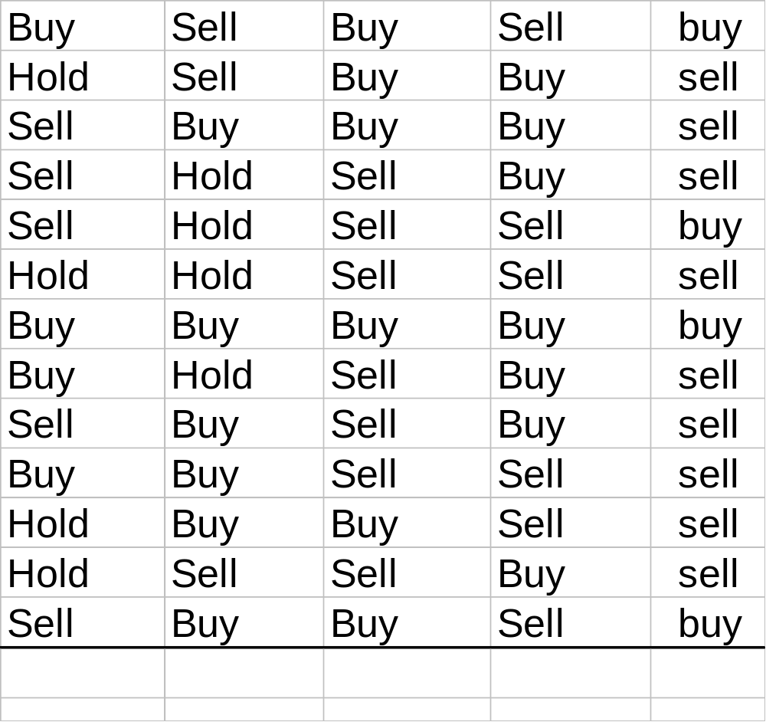
Constructing A Decision Tree

Slide 33
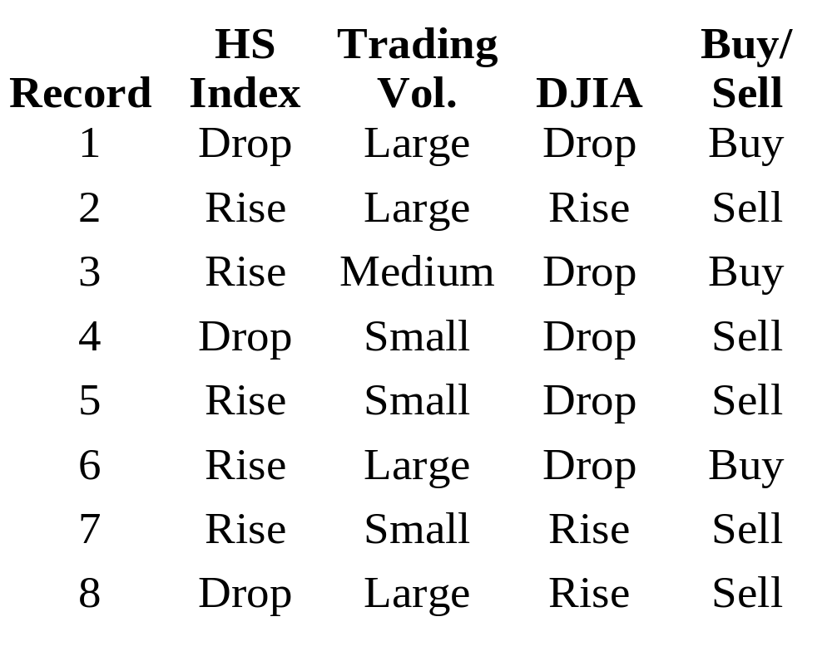
Constructing A Decision Tree

Slide 34
A Decision Tree Example
Trading Volume
Small
overcast
Large
Medium
Sell
Buy
DJIA
Drop
Rise
Sell
Buy

Slide 35
Example of constructing a DT

Slide 36
Tree Construction Algorithm
Basic algorithm (a greedy algorithm)
  At start, all the training examples are at the root
  Attributes are categorical
    if continuous-valued, they are discretized in advance
  Examples are partitioned recursively based on selected attributes
Conditions for stopping partitioning
  All examples for a given node belong to the same class
  There are no remaining attributes for further partitioning
  There are no samples left

Slide 37
Example of constructing a DT (2)
Each record is described in terms of three attributes:
  Hang Seng Index with values {rise, drop}
  Trading volume with values {small, medium, large}
  Dow Jones Industrial Average (DJIA) with values {rise, drop}
  Records contain Buy (B) or Sell (S) to indicate the correct decision.
  B or S can be considered a class label.

Slide 38
Example of constructing a DT (3)
If we select Trading Volume to form the root of the decision tree:
Trading Volume
Small
Medium
Large
{4, 5, 7}
{3}
{1, 2, 6, 8}

Slide 39
Example of constructing a DT (4)
The sub-collections corresponding to “Small” and “Medium” contain records of only a single class
Further partitioning unnecessary.
Select the DJIA attribute to test for the “Large” branch.
Now all sub-collections contain records of one decision (class).
We can replace each sub-collection by the decision/class name to obtain the decision tree.

Slide 40
Example of constructing a DT (5)
Trading Volume
Small
overcast
Large
Medium
Sell
Buy
DJIA
Drop
Rise
Sell
Buy

Slide 41
Example of constructing a DT (6)
A record can be classified by:
  Start at the root of the decision tree.
  Find value of attribute being tested in the given record.
  Taking the branch appropriate to that value.
  Continue in the same fashion until a leaf is reached.
  Two records having identical attribute values may belong to different classes.
  The leaves corresponding to an empty set of examples should be kept to a minimum.
Classifying a particular record may involve evaluating only a small number of the attributes depending on the length of the path.
  We never need to consider the HSI.

Slide 42
We want A Simple Decision Tree
The selection of each attribute in turn for different levels of the tree tend to lead to complex tree.
A simple tree is easier to understand.
Select attribute so as to make final tree as simple as possible.
Use the ID3 algorithm which makes use of an information measure.

Slide 43
A Measure of Information
Information theory proposed by Shannon in 1948.
Provides a useful theoretic basis for measuring the information content of a predicted outcome (a.k.a. a message).
An outcome from a universe of possible outcomes.
The information content of a predicted outcome is dependent on:
  Number of possible outcomes (size of the universe).
  Frequency each possible outcomes.

Slide 44
A Measure of Information (2)
The number of possible outcomes determines amount of information (e.g. gambling).
  Roulette has many outcomes.
  A prediction concerning its outcome is of more value.
The probability of each outcome determines the amount of information (e.g. a rigged coin).
  If one already know enough about the coin to wager correctly ¾ of the time, a message telling me the outcome of a given toss is worth less to me than it would be for an honest coin.
Such intuition formalized in Information Theory.
  Define the amount of information in a predicted outcome as a function of the probability of occurrence of each possible outcomes.

Slide 45
A Measure of Information (3)
Given a universe of outcomes:
  M={m₁, m₂, …, m_{n}}
  And suppose each outcome, m_{i} has probability p(m_{i}) of being received.
  The amount of information I(m_{i}) contained in the predicted outcome is defined as:
      I(m_{i})= −log₂ p(m_{i})
  The uncertainty of a prediction, U(M) is just the sum of the information in the several possible outcomes weighted by their probabilities:
      U(M) = − Σ_{i} p(m_{i}) log p(m_{i}), i=1 to n.
  That is, we compute the average information of the possible predicted outcomes that could be sent.
  If all outcomes in a set are equiprobable, then uncertainty is at a maximum.

Slide 46
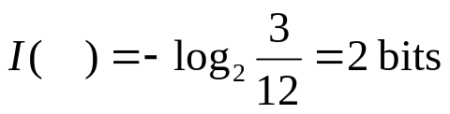


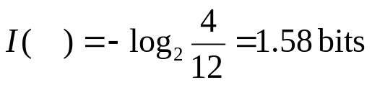

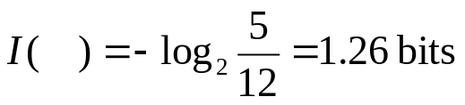
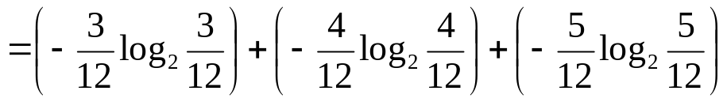
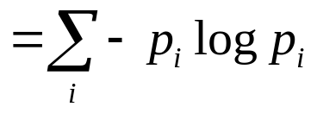
1
3
2
4
6
5
7
8
9
10
11
12
The equation represents a measure of the average information/uncertainty of
the messages/outcomes in the box.

Slide 47
Data Table
ID | Odd | Size | Color | shape
1 | Y | Large | Blue | Rect
2 | N | Small | Green | Circle
3 | Y | Small | Orang. | Circle
4 | N | Large | Yellow | Rect
5 | Y | Small | Red | Circle
6 | N | Large | Red | Rect
7 | Y | Med. | Orang. | Triang
8 | N | Med. | Green | Triang
9 | Y | Large | Orang. | Rect
10 | N | Large | Green | Rect
11 | Y | Med. | Red | Triang
12 | N | Med. | Blue | Circle
1
3
2
4
6
5
7
8
9
10
11
12

Slide 48
The ID3 Algorithm
Uses an information-theoretic approach for this.
A decision tree considered an information source that, given a record, generates a predicted outcome.
The predicted outcome is the classification of that record (say, Buy (B) or Sell (S)).
ID3 selects attributes by assuming that tree complexity is related to amount of information conveyed by this predicted outcome.

Slide 49
Information Theoretic Test Selection
Each attribute of a record contributes a certain amount of information to its classification.
E.g., if our goal is to determine the credit risk of a customer, the discovery that it has many late-payment records may contribute a certain amount of information to that goal.
ID3 measures the information gained (surprised reduced) by making each attribute the root of the current sub-tree.
It then picks the attribute that provides the greatest information gain (reduction in surprisal).

Slide 50
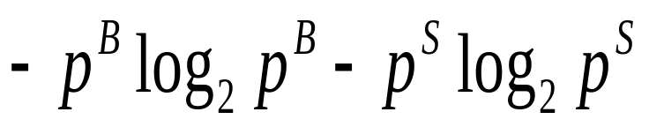
DT Construction Using ID3
If the probability of these outcomes is p^{B} and p^{S} respectively, the expected information content of the outcome is:
With a known set C of records we can approximate these probabilities by relative frequencies.
That is p^{B} becomes the proportion of records in C with class B.

Slide 51
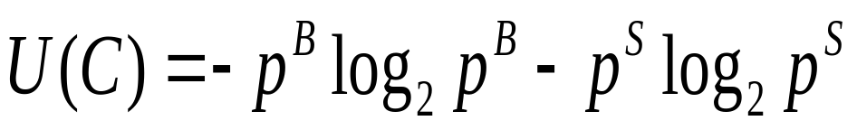
DT Construction Using ID3 (2)
Let U(C) denote this calculation of the expected information content of an outcome from a decision tree, i.e.,
And we define U({ })=0.
Now consider as before the possible choice of as the attribute to test next.
The partial decision tree is:

Slide 52
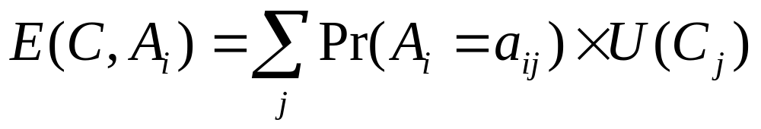
DT Construction Using ID3 (3)
A_{j}
a_{j1}
a_{jj}
a_{jmi}
c₁
...
c_{j}
...
c_{mi}
The values of attribute are mutually exclusive, so the new expected information content will be:

Slide 53
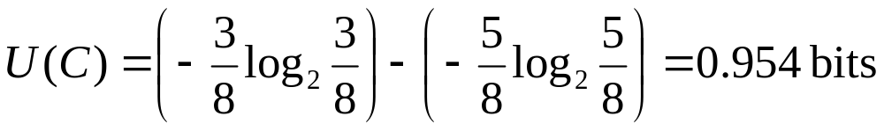
DT Construction Using ID3 (4)
Again we can replace the probabilities by relative frequencies.
The suggested choice of attribute to test next is that which gains the most information.
That is select for which is maximal.
For example: consider the choice of the first attribute to test, i.e., HIS
The collection of records contains 3 Buy signals (B) and 5 Sell signals (S), so:

Slide 54
DT Construction Using ID3 (5)
Testing the first attribute gives the results shown below.
Hang Seng Index
Rise
Drop
{2, 3, 5, 6, 7}
{1, 4, 8}

Slide 55
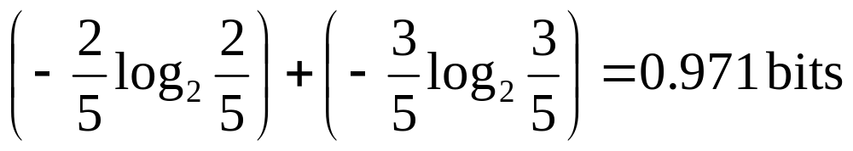
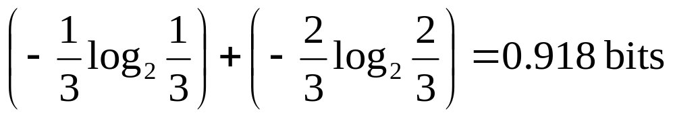
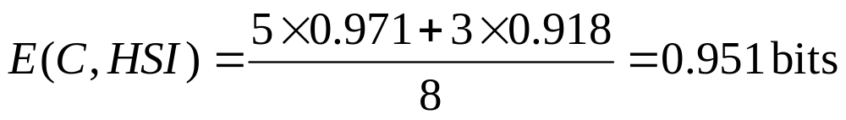
DT Construction Using ID3 (6)
The informaiton still needed for a rule for the “rise” branch is:
And for the “drop” branch
The expected information content is:

Slide 56
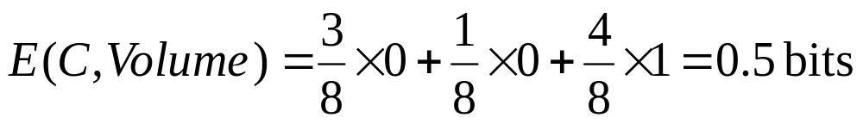
DT Construction Using ID3 (7)
The information gained by testing this attribute is 0.954 - 0.951 = 0.003 bits which is negligible.
The tree arising from testing the second attribute was given previously.
The branches for small (with 3 records) and medium (1 record) require no further information.
The branch for large contained 2 Buy and 2 Sell records and so requires 1 bit.

Slide 57
DT Construction Using ID3 (8)
The information gained by testing Trading Volume is 0.954 - 0.5 = 0.454 bits.
In a similar way the information gained by testing DJIA comes to 0.347 bits.
The principle of maximizing expected information gain would lead ID3 to select Trading Volume as the attribute to form the root of the decision tree.

Slide 58
How to use a tree?
Directly
  test the attribute value of unknown sample against the tree.
  A path is traced from root to a leaf which holds the label
Indirectly
  decision tree is converted to classification rules
  one rule is created for each path from the root to a leaf
  IF-THEN is easier for humans to understand

Slide 59
Extracting Classification Rules from Trees
Represent the knowledge in the form of IF-THEN rules
One rule is created for each path from the root to a leaf
Each attribute-value pair along a path forms a conjunction
The leaf node holds the class prediction
Rules are easier for humans to understand
Example
  IF Vol = “L” AND DJIA = “D” THEN Decision = “Sell”
  IF Vol = “L” AND DJIA = “R” THEN Decision = “Buy”
  IF Vol = “M” THEN Decision = “Buy”
  IF Vol = “S” THEN Decision = “Sell”

Slide 60
Avoid Overfitting in Classification
The generated tree may overfit the training data
  Too many branches, some may reflect anomalies due to noise or outliers
  Result is in poor accuracy for unseen samples
Two approaches to avoid overfitting
  Prepruning: Halt tree construction early—do not split a node if this would result in the goodness measure falling below a threshold
    Difficult to choose an appropriate threshold
  Postpruning: Remove branches from a “fully grown” tree—get a sequence of progressively pruned trees
    Use a set of data different from the training data to decide which is the “best pruned tree”

Slide 61
Improving the C4.5/ID3 Algorithm
Allow for continuous-valued attributes
  Dynamically define new discrete-valued attributes that partition the continuous attribute value into a discrete set of intervals
Handle missing attribute values
  Assign the most common value of the attribute
  Assign probability to each of the possible values
Attribute construction
  Create new attributes based on existing ones that are sparsely represented
  This reduces fragmentation, repetition, and replication

Slide 62
Classifying Large Datasets
Advantages of the decision-tree approach
  Computational efficient compared to other classification methods.
  Convertible into simple and easy to understand classification rules.
  Relatively good quality rules (comparable classification accuracy).

Slide 63

Presentation of Classification Results

Slide 64
Neural Networks
A Neuron
-
μ_{k}
x₀
w₀
x₁
w₁
∑
f
output y
x_{n}
w_{n}
Input
vector x
weight
vector w
weighted
sum
Activation
function

Slide 65
Neural Networks
Advantages
  prediction accuracy is generally high
  robust, works when training examples contain errors
  output may be discrete, real-valued, or a vector of several discrete or real-valued attributes
  fast evaluation of the learned target function
Criticism
  long training time
  difficult to understand the learned function (weights)
  not easy to incorporate domain knowledge

Slide 66
Genetic Algorithm (I)
GA: based on an analogy to biological evolution.
  A diverse population of competing hypotheses is maintained.
  At each iteration, the most fit members are selected to produce new offspring that replace the least fit ones.
  Hypotheses are encoded by strings that are combined by crossover operations, and subject to random mutation.
Learning is viewed as a special case of optimization.
  Finding optimal hypothesis according to the predefined fitness function.

Slide 67
Genetic Algorithm (II)
IF (level = doctor) and (GPA = 3.6)
  THEN result=approval
level GPA result
  001 111 10
00111110 10011110
  10001101 00101101

Slide 68

Fuzzy Set Approaches
Fuzzy logic uses truth values between 0.0 and 1.0 to represent the degree of membership (such as using fuzzy membership graph)
Attribute values are converted to fuzzy values
  e.g., income is mapped into the discrete categories {low, medium, high} with fuzzy values calculated
For a given new sample, more than one fuzzy value may apply
Each applicable rule contributes a vote for membership in the categories
Typically, the truth values for each predicted category are summed

Slide 69
Evaluating Classification Rules
Constructing a classification model.
  In form of mathematical equations?
  Neural networks.
  Classification rules.
  Requires training set of pre-classified records.
Evaluation of classification model.
  Estimate quality by testing classification model.
  Quality = accuracy of classification.
  Requires a testing set of records (known class labels).
  Accuracy is percentage of correctly classified test set.

Slide 70
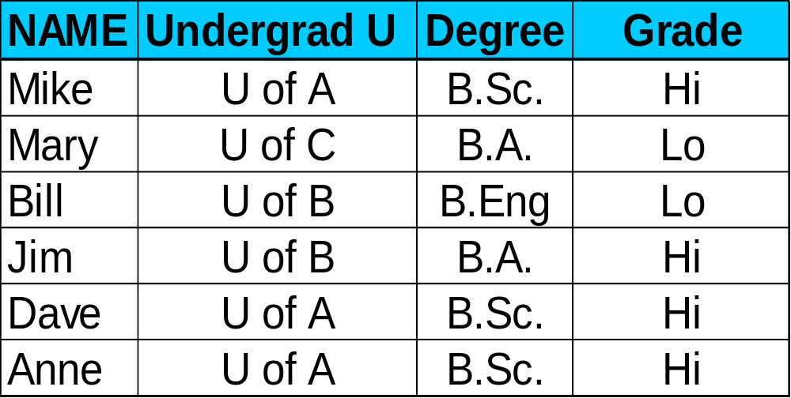
Construction of Classification Model
Classification
Algorithms
Training
Data
Classifier
(Model)
IF Undergrad U = ‘U of A’
OR Degree = B.Sc.
THEN Grade = ‘Hi’

Slide 71


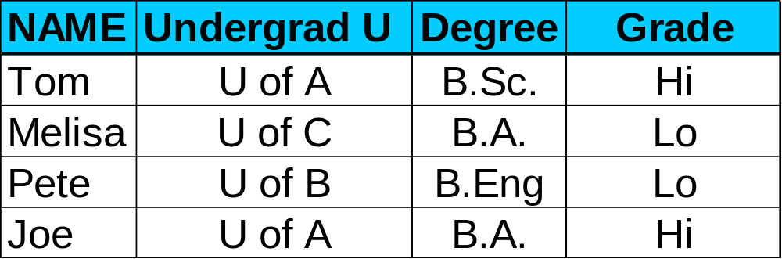

Evaluation of Classification Model
Classifier
Testing
Data
Unseen Data
(Jeff, U of A, B.Sc.)
Hi Grade?

Slide 72
Classification Accuracy: Estimating Error Rates
Partition: Training-and-testing
  use two independent data sets, e.g., training set (2/3), test set(1/3)
  used for data set with large number of samples
Cross-validation
  divide the data set into k subsamples
  use k-1 subsamples as training data and one sub-sample as test data --- k-fold cross-validation
  for data set with moderate size
Bootstrapping (leave-one-out)
  for small size data

Slide 73
Issues Regarding classification: Data Preparation
Data cleaning
  Preprocess data in order to reduce noise and handle missing values
Relevance analysis (feature selection)
  Remove the irrelevant or redundant attributes
Data transformation
  Generalize and/or normalize data

Slide 74
Issues regarding classification (2): Evaluating Classification Methods
Predictive accuracy
Speed and scalability
  time to construct the model
  time to use the model
Robustness
  handling noise and missing values
Scalability
  efficiency in disk-resident databases
Interpretability:
  understanding and insight provded by the model
Goodness of rules
  decision tree size
  compactness of classification rules

