Slide 1
Discovering Clusters in Databases
Keith C.C. Chan
Department of Computing
The Hong Kong Polytechnic University

Slide 2
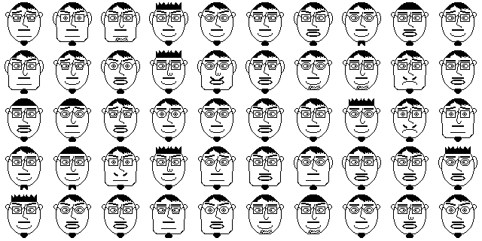
Discovering Clusters

Slide 3
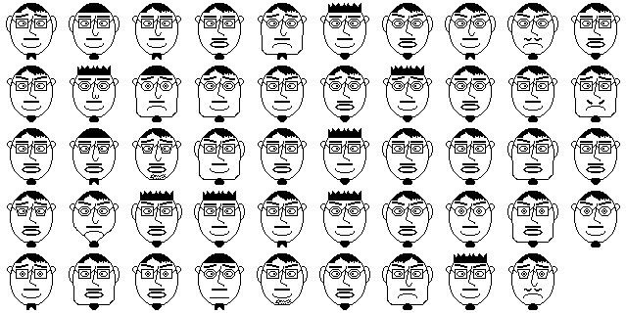

Slide 4
Introduction to Clustering
Problem:
  Given
    A database of records.
    Each characterized by a set of attributes.
  To
    Group similar records together based on their attributes.
Solution:
  Defines similarity/dissimilarity measure.
  Partition database into clusters according to similarity.

Slide 5
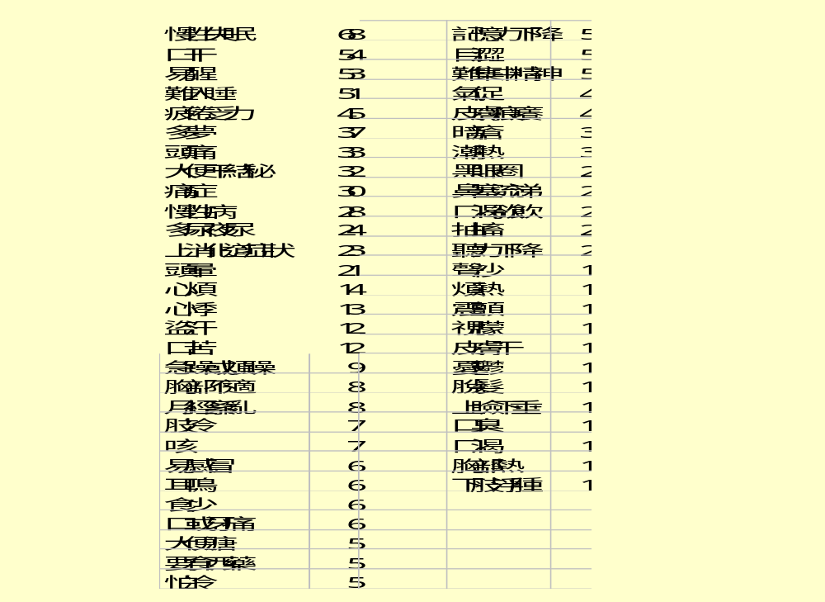
An Example of Clustering:
Analysis of Insomnia
From
Patient
History

Slide 6
Analysis of Insomnia (2)
Cluster 1:多夢易醒型
  多夢,易醒,難入睡,口干,大便干結或秘, 或有頭暈頭痛, 舌淡紅光滑苔薄白,脈弦或滑或弦滑.
Cluster 2: 口干易醒難睡型
Cluster 3: 難入睡型
Cluster 4: 多夢難睡型
Cluster 5: 口干型
Cluster 6: 頭痛型

Slide 7
Applications of clustering
Psychiatry
  To refine or even redefine current diagnostic categories.
Medicine
  Sub-classification of patients with a particular syndrome.
Social services
  To identify groups with particular requirements or which are particularly isolated.
  So that social services could be economically and effectively allocated.
Education
  Clustering teachers into distinct styles on the basis of teaching behaviour.

Slide 8
Similarity and Dissimilarity (1)
Many clustering techniques begin with a similarity matrix.
Numbers in matrix indicate degree of similarity between two records.
Similarity between two records r_{i} and r_{j} is some function of their attribute values, i.e. s_{ij} = f(r_{i}, r_{j})
Where r_{i} = [a_{i1}, a_{i2}, …, a_{ip}] and r_{j} = [a_{j1}, a_{j2}, …, a_{jp}] are the attributes values for r_{i} and r_{j}.

Slide 9
Similarity and Dissimilarity (2)
Most similarity measures are:
  Symmetric, i.e., s_{ij} = s_{ji.}
  Non negative.
  Scaled so as to have an upper limit of unity.
Dissimilarity measure can be:
  d_{ij} = 1 - s_{ij}
  Also symmetric and non negative.
  d_{ij} + d_{ik} ≥ d_{jk} for all i, j ,k.
  Also called distance measure.
The most commonly used distance measure is Euclidean distance.

Slide 10
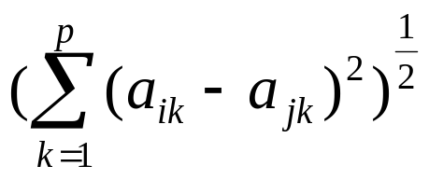
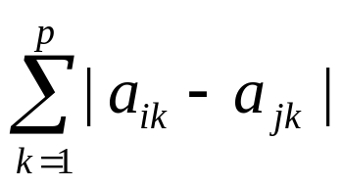
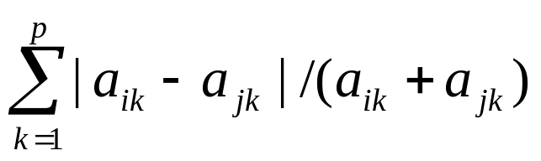
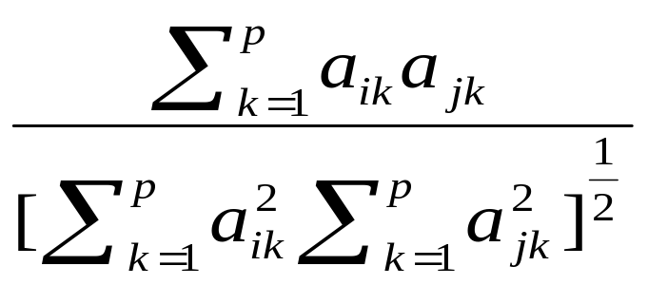
Some common dissimilarity measures
Euclidean distance:
City block:
‘Canberra’ metric:
Angular separation:

Slide 11
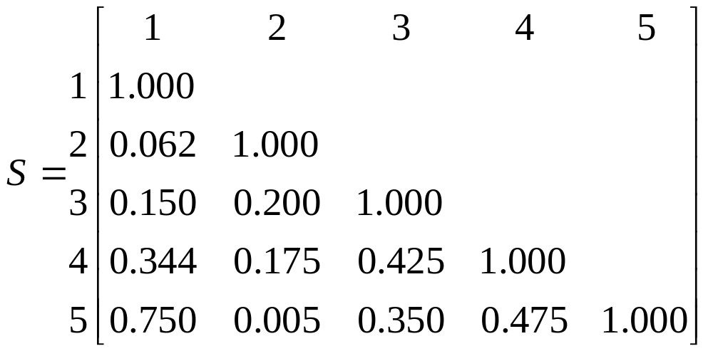
Examples of a similarity / dissimilarity matrix

Slide 12
Hierarchical clustering techniques
Clustering consists of a series of partitions/merging.
  May run from a single cluster containing all records to n clusters each containing a single record.
Two popular approaches.
  agglomerative & divisive methods
Results may be represented by a dendrogram
  Diagram illustrating the fusions or divisions made at each successive stage of the analysis.

Slide 13
Hierarchical-Agglomerative Clustering (1)
Proceed by a series of successive fusions of n records into groups.
Produces a series of partitions of the data, P_{n}, P_{n-1}, …, P₁.
The first partition P_{n}, consists of n single-member clusters.
The last partition P₁, consists of a single group containing all n records.

Slide 14
Hierarchical-Agglomerative Clustering (2)
Basic operations:
  START:
    Clusters C₁, C₂, …, C_{n} each containing a single individual.
  Step 1.
    Find nearest pair of distinct clusters, say, C_{i} and C_{j}.
    Merge C_{i} and C_{j}.
    Delete C_{j} and decrement number of cluster by one.
  Step 2.
    If number of cluster equal one then stop, else return to 1.

Slide 16
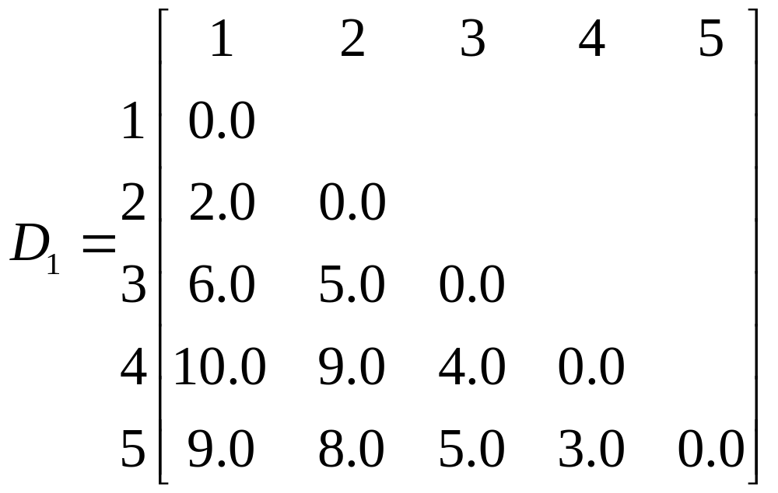
Example of single linkage clustering (1)
Given the following distance matrix.

Slide 17
Example of single linkage clustering (2)
The smallest entry is that for record 1 and 2.
They are joined to form a two-member cluster.
Distances between this cluster and the other three records are obtained as
  d(12)3 = min[d13,d23] = d23 = 5.0
  d(12)4 = min[d14,d24] = d24 = 9.0
  d(12)5 = min[d15,d25] = d25 = 8.0

Slide 18
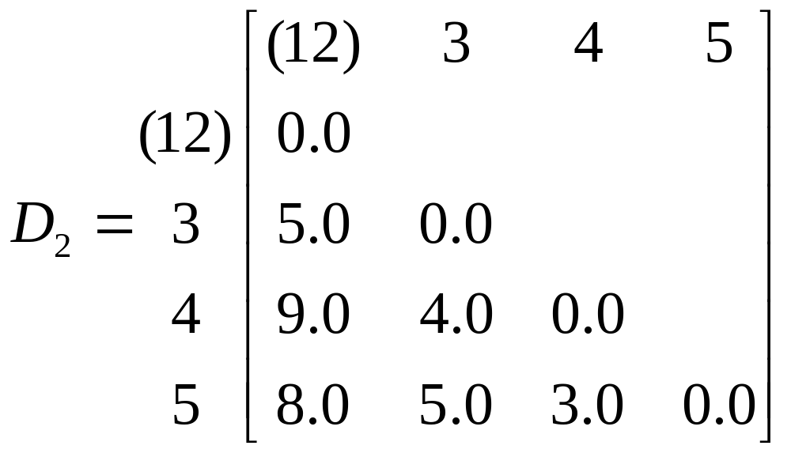
Example of single linkage clustering (3)
A new matrix may now be constructed whose entries are inter-individual distances and cluster-individual values.

Slide 19
Example of single linkage clustering (4)
The smallest entry in D₂ is that for individuals 4 and 5, so these now form a second two-member cluster, and a new set of distances found
  d(12)3 = 5.0 as before
  d(12)(45) = min[d14,d15,d25,d25] = d25 = 8.0
  d(45)3 = min[d34,d35] = d34 = 4.0

Slide 20
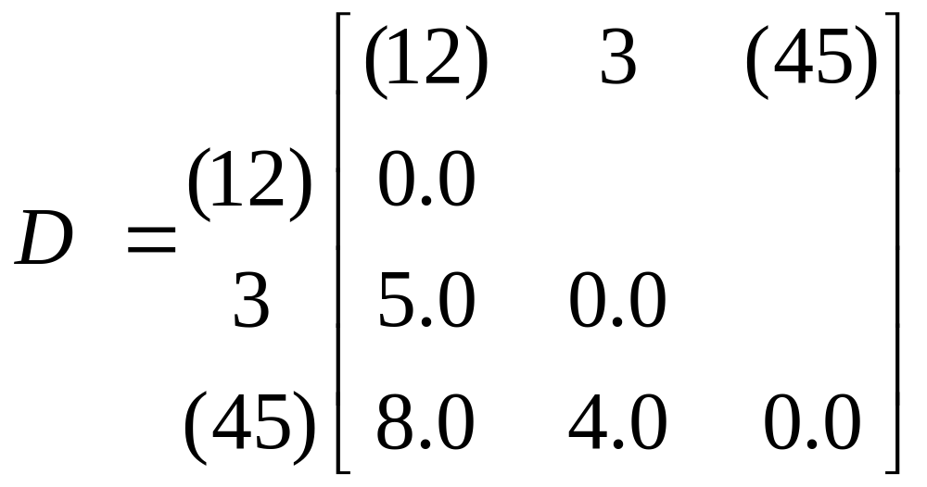
Example of single linkage clustering (5)
These may be arranged in a matrix D3:

Slide 21

Example of single linkage clustering (6)
The smallest entry is now d(45)3 and so individual 3 is added to the cluster containing individuals 4 and 5.
Finally the groups containing individuals 1, 2 and 3, 4, 5 are combined into a single cluster.
The partitions produced at each stage are as follows:

Slide 23
Multiple Linkage Clustering (1)
Complete linkage clustering
  Also known as furthest neighbour technique.
  Distance between groups is now defined as that of the most distant pair of individuals.
Group-average clustering
  Distance between two clusters is defined as the average of the distances between all pairs of individuals between the two clusters.

Slide 25
Weaknesses of Agglomerative
Hierarchical Clustering
The problem of Chaining
  A tendency to cluster together, at relatively low level, individuals linked by a series of intermediates.
  May cause the methods to fail to resolve relatively distinct clusters when there are a small number of individuals (noise points) lying between them.

Slide 26
Hierarchical - Divisive methods
Divide n records successively into finer groupings.
Approach 1: Monothetic
  Divide the data on the basis of the possession or otherwise of a single specified attribute.
  Generally used for data consisting binary variables.
Approach 2: Polythetic
  Divisions are based on the values taken by all attributes.
Less popular than agglomerative hierarchical techniques

Slide 27
Problems of hierarchical clustering
Biased towards finding ‘spherical’ clusters.
Deciding of appropriate number of clusters for the data is difficult.
Computational time is high due to requirement to calculate the similarity or dissimilarity of each pair of objects.

Slide 28
Optimization clustering techniques (1)
Form clusters by either minimizing or maximizing some numerical criterion.
Quality of clustering measured by within-group (W) and between-group dispersion (B).
W and B can also be interpreted as intra-class and inter-class distance respectively.
To cluster data, minimize W and maximize B.
The number of possible clustering partition is vast.
2,375,101 possible groupings for just 15 records to be clustered into 3 groups.

Slide 29
Optimization clustering techniques (2)
To find grouping to optimize clustering criterion, rearranging records and keep new one only if it provides an improvement.
This is a hill-climbing algorithm known as the k-means algorithm
  a) Generate p initial clusters.
  b) Calculate the change in clustering criterion produced by moving each record from its own to another cluster.
  c) Make the change which leads to the greatest improvement in the value of the clustering criterion.
  d) Repeat step (b) and (c) until no move of a single individual causes the clustering criterion to improve.

Slide 30
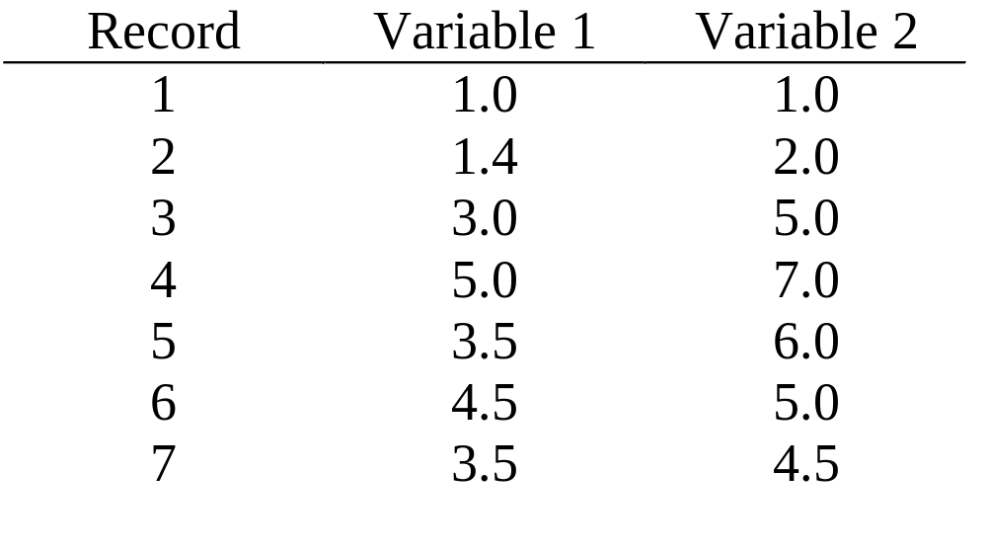
Optimization clustering techniques (3)
Numerical example

Slide 31
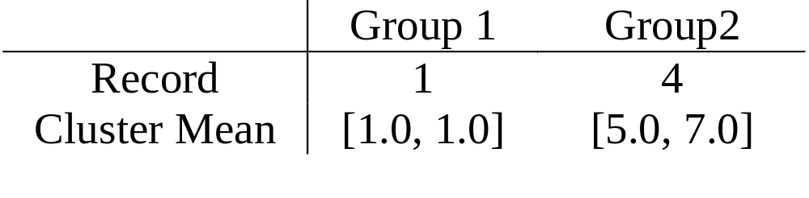
Optimization clustering techniques (4)
Take any two records as initial cluster means, say:
Remaining records examined in sequence.
They are allocated to the closest group based on their Euclidean distance to the cluster mean.

Slide 32
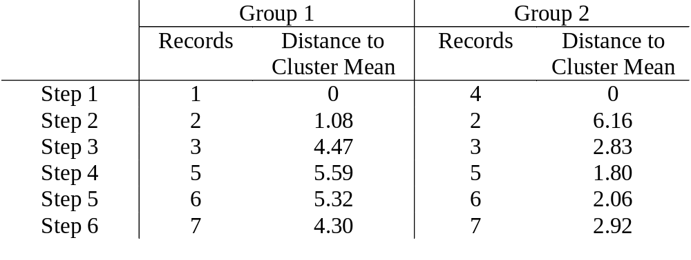
Optimization clustering techniques (5)
Compute distance to Cluster Mean leads to the following series of steps.
Cluster A={1, 2} Cluster B={3, 4, 5, 6, 7}
Compute new Cluster Means for A and B:
(1.2, 1.5) and (3.9, 5.5)
Repeat until there are no changes in the Cluster Means.

Slide 33
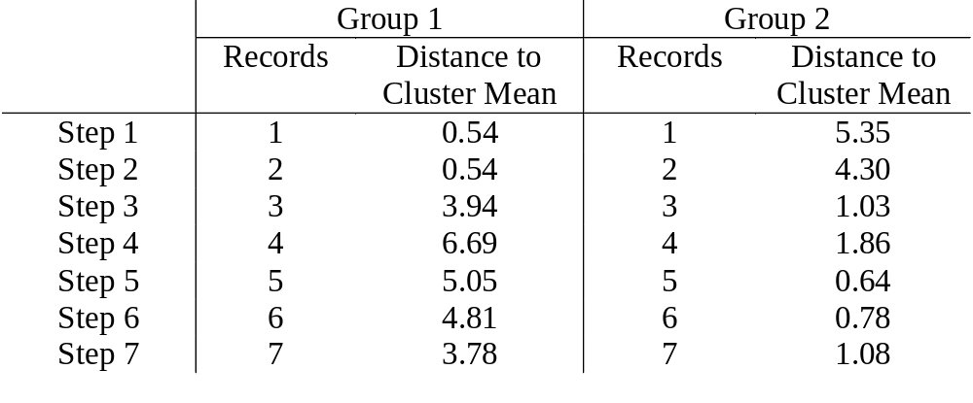
Optimization clustering techniques (6)
Second iteration.
Cluster A={1, 2} Cluster B={3, 4, 5, 6, 7}
Computer new Cluster Means for A and B:
(1.2, 1.5) and (3.9, 5.5)
STOP as there are no changes in the Cluster Means.

Slide 34
Properties and problems of optimization clustering techniques
The structure of cluster found is always ‘spherical’.
Users need to decide how many groups to be clustered.
The method is scale dependent.
Different solutions may be obtained from the raw data and from the data standardized in some particular way.

Slide 35
Clustering discrete-valued data (1)
  Basic concept
    Based on a simple voting principle called Condorset.
    Measure distance between input records and assign them to specific clusters.
    Pairs of records are compared by the values of the individual fields.
    No. of fields with same values determine the degree to which the records are similar.
    No. of fields with different values determine the degree to which the records are different.

Slide 36
Clustering discrete-valued data - (2)
Scoring mechanism
  When a pair of records has the same value for the same field, the field gets a vote of +1.
  When a pair of records does not have the same value for a field, the field gets a vote of -1.
  The overall score is calculated as the sum of scores for and against placing the record in a given cluster.

Slide 37
Clustering discrete-valued data - (3)
Assignment of record to a cluster
  A record is assigned to a cluster if the overall score of that cluster is the highest among all other clusters.
  A record is assigned to a new cluster if the overall scores of all clusters turn out to be negative.

Slide 38
Clustering discrete-valued data - (4)
There are a number of passes over the set with records, and therefore the cluster centers are reviewed for potential reassignment to a different cluster.
Termination criteria
  Maximum number of passes is achieved.
  Maximum number of clusters is reached.
  Cluster centers do not change significantly as measured by a user-determined margin.

Slide 39
An Example - (1)
Assume 5 records with 5 fields, each field takes on a value either 0, 1 or 2:
  record 1 : 0 1 0 2 1
  record 2 : 0 2 1 2 1
  record 3 : 1 2 2 1 1
  record 4 : 1 1 2 1 2
  record 5 : 1 1 2 0 1

Slide 40
An Example - (2)
Creation of first cluster:
  Since record 1 is the first record of the data set, it is assigned to cluster 1.
Addition of record 2:
  Comparison between record 1 and 2:
    Number of positive vote = 3
    Number of negative vote = 2
    Overall score = 3-2 = 1
    Since the overall score is positive, record 2 are assigned to cluster 1.

Slide 41
An Example - (3)
Addition of record 3:
  Score between record 1 and 3 = -3
  Score between record 2 and 3 = -1
  Overall score for cluster 1 = score between record 1,3 and 2,3 = -3 + -1 = -4
  Since the overall score is negative, record 3 is assigned to a new cluster (cluster 2).

Slide 42
An Example - (4)
Addition of record 4:
  Score between record 1 and 4 = -3
  Score between record 2 and 4 = -5
  Score between record 3 and 4 = 1
  Overall score for cluster 1 = -8
  Overall score for cluster 2 = 1
  Therefore, record 4 is assigned to cluster 2.

Slide 43
An Example - (5)
Addition of record 5:
  Score between record 1 and 5 = -1
  Score between record 2 and 5 = -3
  Score between record 3 and 5 = 1
  Score between record 4 and 5 = 1
  Overall score for cluster 1 = -4
  Overall score for cluster 2 = 2
  Therefore, record 5 is assigned to cluster 2.

Slide 44
An Example - (6)
Overall cluster distribution of 5 records after iteration 1:
  Cluster 1 : record 1 and 2
  Cluster 2 : record 3, 4 and 5

