Slide 1
Fuzzy Sets in Data Mining
Keith C.C. Chan
Department of Computing
The Hong Kong Polytechnic University

Slide 2
Fuzzy Data and Associations
Associations.
  People who buy large water melon also buy many oranges.
How do you know if it is interesting?
Determine support and confidence by defining
  Large water melon
  Many oranges

Slide 3
Classical Sets in Association Mining
How do you define the set of large water melons?
  Large Water Melons = {x | 5kg < weight(x) < 10kg}.
How do you define the set of very large water melons?
  Very Large Water Melons = {x | weight(x) > 10kg}.
What about a water melon that is exactly 9.9kg?
What about a water melon that is exactly 10.1kg?
The difference of 0.2kg makes one large and the other very large!

Slide 4
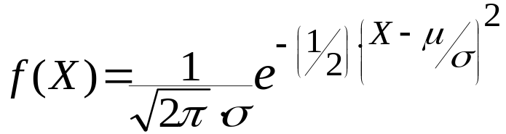
Fuzziness in The Real World
Human reason approximately about behavior of a very complex system.
Closed-form mathematical expressions, e.g.,
  Provide precise descriptions of systems
  But Little complexity and uncertainty.
Relating observed input and output approximately rather than exactly.
Fuzzy logic for reasoning with complex systems:
  When no numerical data exist.
  When only ambiguous or imprecise information is available.
  When behavior can only be described and understood by:

Slide 5
Uncertainty vs Imprecision
Probability theory:
  Modeling uncertainty arising from randomness.
  People communicate with computer with extreme precision.
  E.g. instructions in a software program.
Fuzzy set theory:
  Modeling uncertainty associated with vagueness, imprecision.
  People communicate with people in natural language (NL).
  NL is vague and imprecise but powerful.
  Uses linguistic variables not quantitative variables to represent imprecise concepts.

Slide 6
Fuzzy Logic Applications
Sanyo fuzzy logic camcorders.
  Fuzzy focusing and image stabilization.
Mitsubishi fuzzy air conditioner.
  Controls Tº changes according to human comfort indexes.
Matsushita fuzzy washing machine.
  Sensors detect color, kind of clothes, the quantity of grit.
  Select combinations of water temperature, detergent amount and wash and spin cycle time.
Sendai's 16-station subway system.
  Fuzzy controller makes 70% fewer judgment errors in acceleration and braking than human operators.
Nissan fuzzy auto-transmission & anti-skid braking.
Tokyo's stock market.
  At least one stock-trading portfolio based on fuzzy logic that outperformed the Nikkei Exchange average.
Fuzzy golf diagnostic systems, fuzzy toasters, fuzzy rice cookers, fuzzy vacuum cleaners, etc.

Slide 7
Classical Sets
X = universe of discourse = the set of all objects with the same characteristics.
Let n_{x} = cardinality = total number of elements in X.
For crisp sets A and B in X, we define:
  x ∈A → x belongs to A.
  x ∉ A → x does not belong to A.
For sets A and B on X:
  A ⊂ B → ∀x∈A, x∈B.
The null set, ∅, contains no elements.

Slide 8
Representing Classical Sets
Set of tall people:
  Tall={Peter, John, Mary}
Alternatively
  Tall={x | height(x) > 5’10”}

Slide 9
Operations on Classical Sets
Union:
  A∪B = {x | x ∈ A or x ∈ B}.
Intersection:
  A∩B = {x | x ∈ A and x ∈ B}.
Complement:
  A^{c} = {x | x ∉ A, x ∈ X}.

Slide 10
Fuzzy Sets
Transition between membership and non-membership can be gradual.
Fuzzy set contains elements which have varying degrees of membership.
Degree of membership measured by a function.
Function maps elements to a real numbered value on the interval 0 to 1, μ_{A}∈[0,1].
Elements in a fuzzy set can also be members of other fuzzy sets on the same universe.

Slide 11
A Fuzzy Set Example
Example:
  A water melon of exactly 9.9kg can belong to:
    The set “large water melon” with a degree of 0.1, and to
    The set of “very large water melon” with a degree of 0.9.
  But how do we determine the degree of membership?
    It can be found from a fuzzy membership function.

Slide 12
A Membership Function
1.0
0.5
Large water
melon
Very
Large
water
melon
0.0
3kg
5kg
8kg
9kg
10kg

Slide 13
Representing Degree of Membership
For a fuzzy set A, its membership function is represented as μ_{A.}
μ_{A}(x_{i}) is the degree of membership of x_{i} with respect to A.
For example,
  Let A = Large water melon
  Let x_{i} be a water melon of 9.9kg.
  From the membership function in the last slide, μ_{A}(x_{i}) = 0.1.

Slide 14
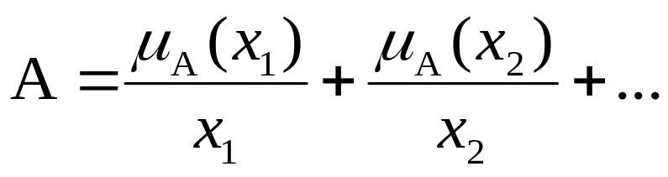
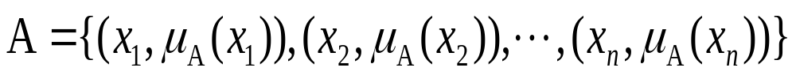
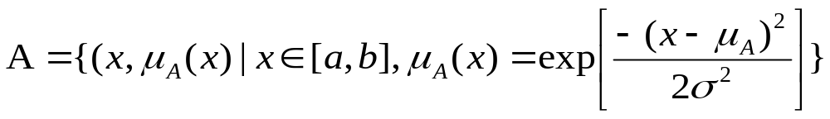
Representing Fuzzy Sets
A notation convention for fuzzy sets:
  Numerator is membership value, horizontal bar is delimiter, Plus sign denotes a function-theoretic union.
Alternatively,
In general, e.g.

Slide 15
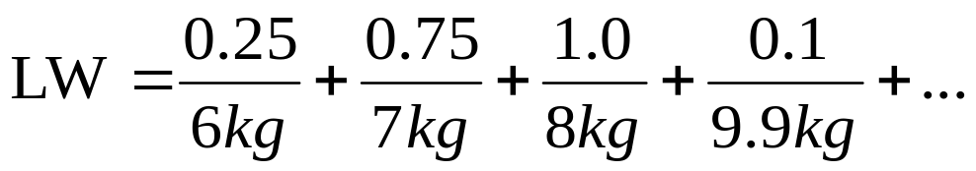
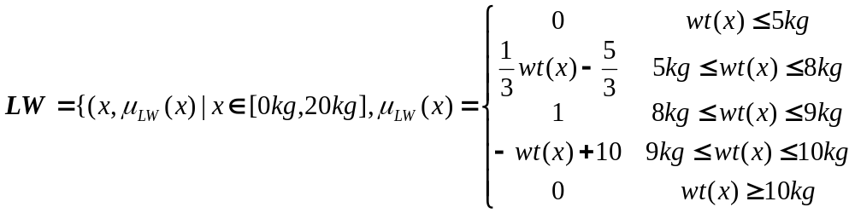
Example of A Fuzzy Set Representation
A definition of the fuzzy set LW=“Large Water Melon”.
Alternatively,
  LW = {(6kg, 0.25), (7kg, 0.75), (8kg, 1.0), (9.9kg, 0.1), …}
In general, e.g.

Slide 16
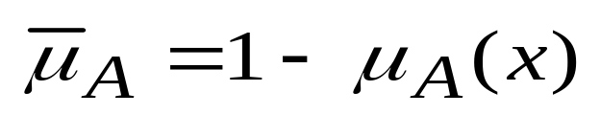
Fuzzy Set Operations
Union:
  μ_{A}∪_{B}(x) = max(μ_{A}(x), μ_{B}(x)).
Intersection:
  μ_{A}∩_{B}(x) = min(μ_{A}(x), μ_{B}(x)).
Complement:
Containment:
  If A ⊆ X → μ_{A}(x) ≤ μ_{X}(x).

Slide 17
Fuzzy Logic
A fuzzy logic proposition, P, involves some concept without clearly defined boundaries.
Most natural language is fuzzy and involves vague and imprecise terms.
Truth value assigned to P can be any value on the interval [0, 1].
The degree of truth for P: x∈A is equal to the membership grade of x∈A.
Negation, disjunction, conjunction, and implication are also defined for a fuzzy logic.

Slide 18
Fuzzy Set for Data Mining
How could fuzzy data be considered for association rule mining?
How could the concept of fuzzy set be used for classification involving fuzzy classes.
  E.g. Risk classification = {High, Medium, Low}
With fuzzy sets, how could clustering be performed to take into consideration:
  Overlapping of clusters, and
  To allow a record to belong to different clusters to different degrees.

Slide 19
Fuzzy Association
The interestingness measures: A→B
  Lift Ratio: Pr(B|A)/Pr(B).
  Support and Confidence: Pr(A,B) and Pr(B|A).
How much do you count?
 | Eggs | Cheese | Water Mellon
 | 2 boxes | Low Fat | {(Small, 0.35), (Medium, 0.65)}
 | 1 box | Hi Cal | {(Small, 0.5), (Medium, 0.5)}
 | 3 boxes | Regular | {(Medium, 0.75), (High, 0.25)}
 | 1 box | Low Fat | {(Medium, 0.3), (High, 0.7)}
 | 3 boxes | Hi Cal | {(Medium, 0.4), (High, 0.6)}

Slide 20

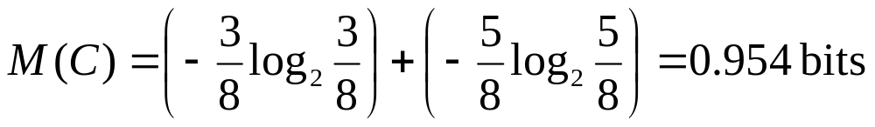
Fuzzy Classification
Information Gain
How again do you count if a customer belongs partially to both a “high risk” and “low risk” group?

Slide 21
Some Examples

Slide 22
Discovering Fuzzy Associations
Given a set of transaction data.
Is the association “Large Mellon → Small Milk” is interesting?
TID | Items
001 | 1.2 kg Water Mellon, 15 oz milk, …
002 | 1.6 kg Water Mellon, 23 oz milk, …
003 | 1.5 kg Water Mellon, 26 oz milk, …
004 | 1.4 kg Water Mellon, 12 oz milk, …
005 | 1.8 kg Water Mellon, 27 oz milk, …
006 | 1.9 kg Water Mellon, 6 oz milk, …

Slide 23
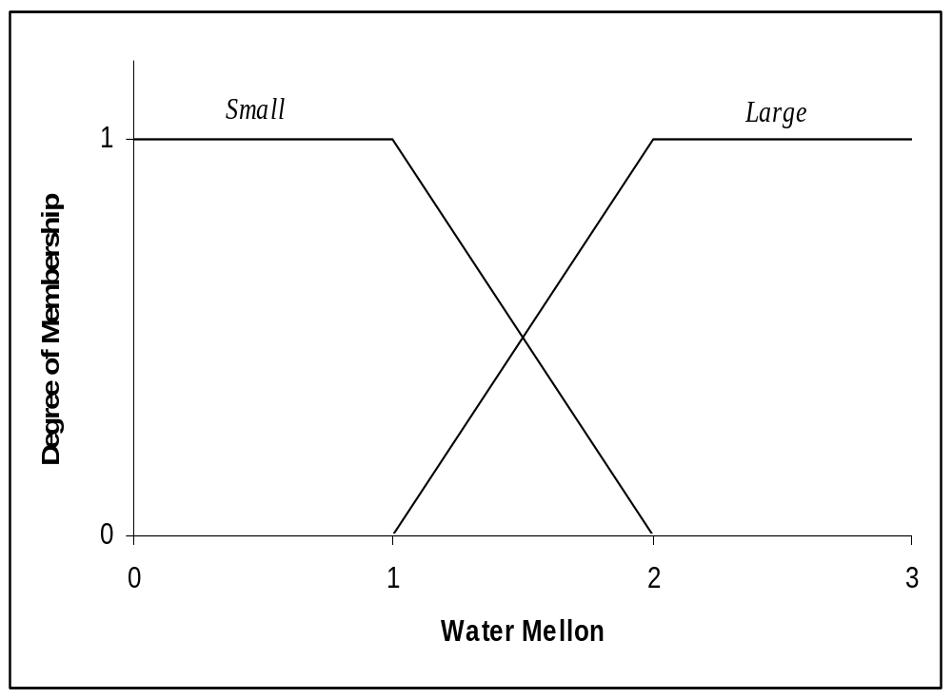
MF for Size of Water Mellon

Slide 24
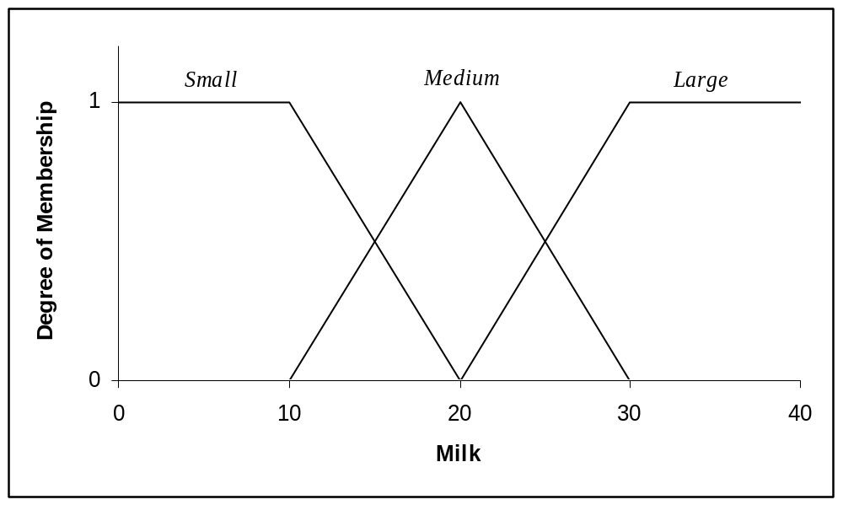
MF for Size of Milk

Slide 25
Transformed Data
TID | Items
001 | {μ_{LWM}(1.2 kg)=0.2, μ_{SWM}(1.2 kg)=0.8}, {μ_{MM}(15 oz)=0.5, μ_{SM}(15 oz)=0.5}, …
002 | {μ_{LWM}(1.6 kg)=0.6, μ_{SWM}(1.6 kg)=0.4}, {μ_{LM}(23 oz)=0.3, μ_{MM}(23 oz)=0.7}, …
003 | {μ_{LWM}(1.5 kg)=0.5, μ_{SWM}(1.5 kg)=0.5}, {μ_{LM}(26 oz)=0.6, μ_{MM}(26 oz)=0.4}, …
004 | {μ_{LWM}(1.4 kg)=0.4, μ_{SWM}(1.4 kg)=0.6}, {μ_{MM}(12 oz)=0.2, μ_{SM}(12 oz)=0.8}, …
005 | {μ_{LWM}(1.8 kg)=0.8, μ_{SWM}(1.8 kg)=0.2}, {μ_{LM}(27 oz)=0.7, μ_{MM}(27 oz)=0.3}, …
006 | {μ_{LWM}(1.9 kg)=0.9, μ_{SWM}(1.9 kg)=0.1}, {μ_{SM}(6 oz)=1.0}, …

Slide 26
Interesting?
 |  | Water Melon |  | Total
 |  | Small | Large
Milk | Small | 1.2 | 1.5 | 2.7
 | Medium | 1.7 | 1.7 | 3.4
 | Large | 1.0 | 1.5 | 2.5
Total |  | 3.9 | 4.7 | 8.6

Slide 27
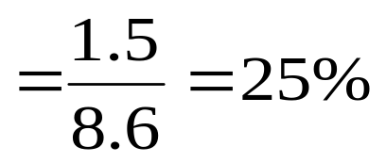
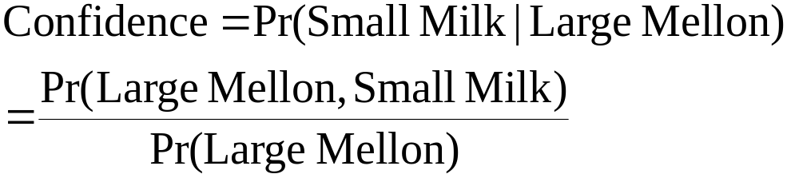
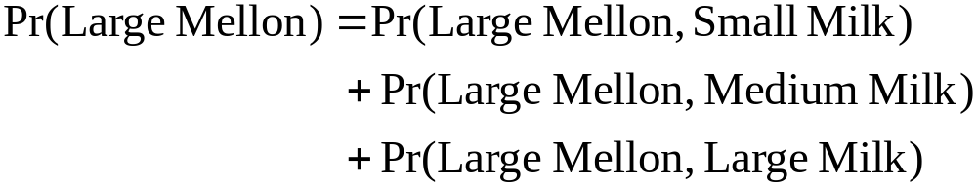
Interesting?
Support=Pr(Large Mellon, Small Milk)

Slide 28
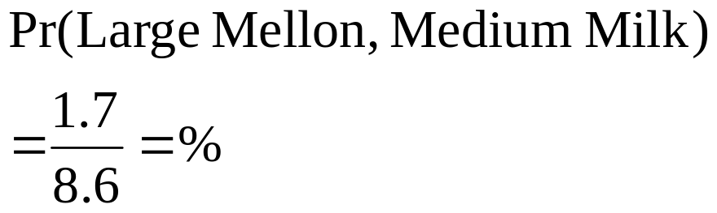
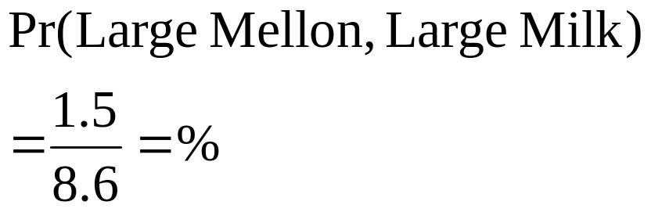
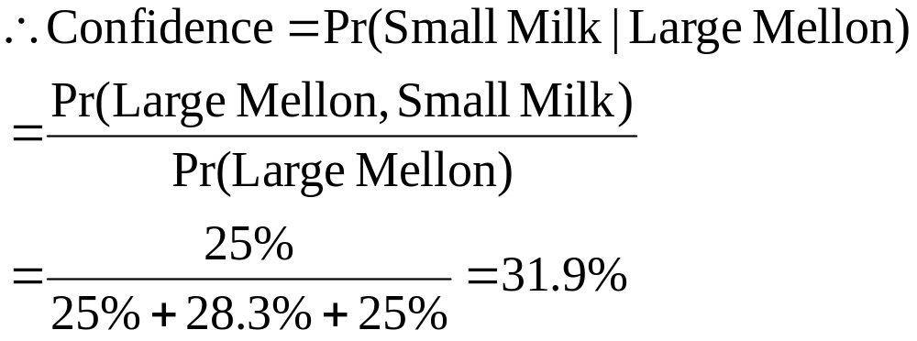
Interesting? (2)

Slide 29
Fuzzy Decision Tree
Construct a DT to classify customers into large and small-credit using ID3.
Record No. | Income Level | Frequency of Call | Credit Amount
1 | High | Frequent | 14,000
2 | Low | Frequent | 7,000
3 | High | Not Frequent | 19,000
4 | Low | Frequent | 11,000
5 | Medium | Not Frequent | 25,000
6 | Medium | Frequent | 14,000
7 | Low | Frequent | 11,000
8 | High | Not Frequent | 18,000
9 | High | Not Frequent | 17,000
10 | Medium | Frequent | 15,000

Slide 30
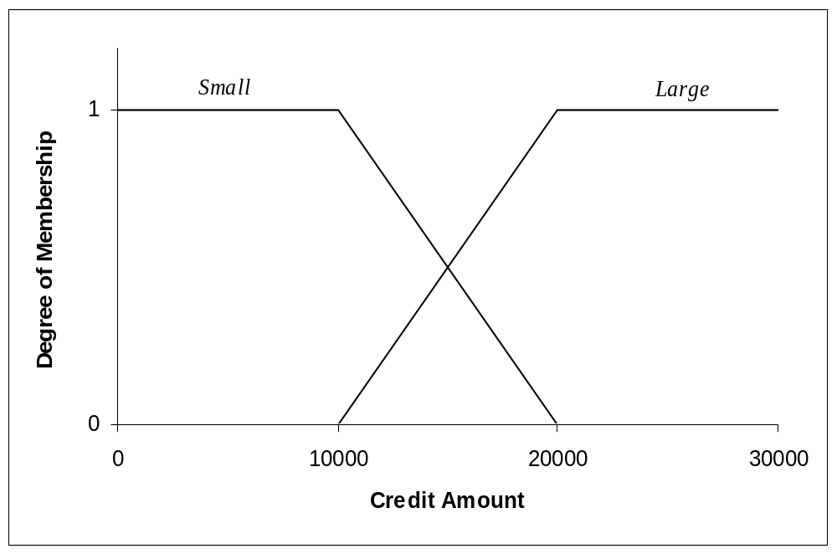
MFs for Large and Small Credit

Slide 31
Transformed Data
Record No. | Income Level | Frequency of Call | Credit Amount
1 | High | Frequent | {μ_{L}(14,000)=0.4, μ_{S}(14,000)=0.6}
2 | Low | Frequent | {μ_{S}(7,000)=1.0}
3 | High | Not Frequent | { μ_{L}(19,000)=0.9, μ_{S}(19,000)=0.1}
4 | Low | Frequent | {μ_{L}(11,000)=0.1, μ_{S}(11,000)=0.9}
5 | Medium | Not Frequent | {μ_{L}(25,000)=1.0}
6 | Medium | Frequent | {μ_{L}(14,000)=0.4, μ_{S}(14,000)=0.6}
7 | Low | Frequent | {μ_{L}(11,000)=0.1, μ_{S}(11,000)=0.9}
8 | High | Not Frequent | { μ_{L}(18,000)=0.8, μ_{S}(18,000)=0.2}
9 | High | Not Frequent | {μ_{L}(17,000)=0.7, μ_{S}(17,000)=0.3}
10 | Medium | Frequent | {μ_{L}(15,000)=0.5, μ_{S}(15,000)=0.5}

Slide 32
Detailed Calculations
Calculate H(Credit Amount)
Pr(Credit Amount = Large) = (0.4 + 0 + 0.9 + 0.1 + 1 + 0.4 + 0.1 + 0.8 + 0.7 + 0.5) / 10 = 0.49
Pr(Credit Amount = Small) = (0.6 + 1 +0.1 + 0.9 + 0 + 0.6 + 0.9 + 0.2 + 0.3 + 0.5) / 10 = 0.51
H(Credit Amount) = – 0.49 log(0.49) – 0.51 log(0.51) = 1.00

Slide 33
Calculate H(Credit Amount | Income Level)
Calculate H(Credit Amount | Income Level = High)
Pr(Credit Amount = Large | Income Level = High) = (0.4 + 0.9 + 0.8 + 0.7) / 4 = 0.7
Pr(Credit Amount = Small | Income Level = High) = (0.6 + 0.1 + 0.2 + 0.3) / 4 = 0.3
H(Credit Amount | Income Level = High) = – 0.7 log(0.7) – 0.3 log(0.3) = 0.88
Calculate H(Credit Amount | Income Level = Medium)
Pr(Credit Amount = Large | Income Level = Medium) = (1 + 0.4 + 0.5) / 3 = 0.63
Pr(Credit Amount = Small | Income Level = Medium) = (0 + 0.6 + 0.5) / 3 = 0.37
H(Credit Amount | Income Level = Medium) = – 0.63 log(0.63) – 0.37 log(0.37) = 0.95
Calculate H(Credit Amount | Income Level = Low)
Pr(Credit Amount = Large | Income Level = Low) = (0 + 0.1 + 0.1) / 3 = 0.07
Pr(Credit Amount = Small | Income Level = Low) = (1 + 0.9 + 0.9) / 3 = 0.93
H(Credit Amount | Income Level = Low) = – 0.07 log(0.07) – 0.93 log(0.93) = 0.35
H(Credit Amount | Income Level)
= Pr(Income Level = High) × H(Credit Amount | Income Level = High) + Pr(Income Level = Medium) × H(Credit Amount | Income Level = Medium) + Pr(Income Level = Low) × H(Credit Amount | Income Level = Low)
= 0.4 × 0.88 + 0.3 × 0.95 + 0.3 × 0.35
= 0.74
Calculate G(Income Level)
G(Income Level)
= H(Credit Amount) – H(Credit Amount | Income Level)
= 1.00 – 0.74
= 0.26

Slide 34
Calculate H(Credit Amount | Frequency of Call)
Calculate H(Credit Amount | Frequency of Call = Frequent)
Pr(Credit Amount = Large | Frequency of Call = Frequent) = (0.4 + 0 + 0.1 + 0.4 + 0.1 + 0.5) / 6 = 0.25
Pr(Credit Amount = Small | Frequency of Call = Frequent) = (0.6 + 1 + 0.9 + 0.6 + 0.9 + 0.5) / 6 = 0.75
H(Credit Amount | Frequency of Call = Frequent) = – 0.25 log(0.25) – 0.75 log(0.75) = 0.81
Calculate H(Credit Amount | Frequency of Call = Not Frequent)
Pr(Credit Amount = Large | Frequency of Call = Not Frequent) = (0.9 + 1 + 0.8 + 0.7) / 4 = 0.85
Pr(Credit Amount = Small | Frequency of Call = Not Frequent) = (0.1 + 0 + 0.2 + 0.3) / 4 = 0.15
H(Credit Amount | Frequency of Call = Not Frequent) = – 0.85 log(0.85) – 0.15 log(0.15) = 0.61
H(Credit Amount | Frequency of Call)
= Pr(Frequency of Call = Frequent) × H(Credit Amount | Frequency of Call = Frequent) + Pr(Frequency of Call = Not Frequent) × H(Credit Amount | Frequency of Call = Not Frequent)
= 0.6 × 0.81 + 0.4 × 0.61
= 0.73
Calculate G(Frequency of Call)
G(Frequency of Call)
= H(Credit Amount) – H(Credit Amount | Frequency of Call)
= 1.00 – 0.73
= 0.27
Since G(Frequency of Call) > G(Income Level), the node to split is “Frequency of Call”.

Slide 35
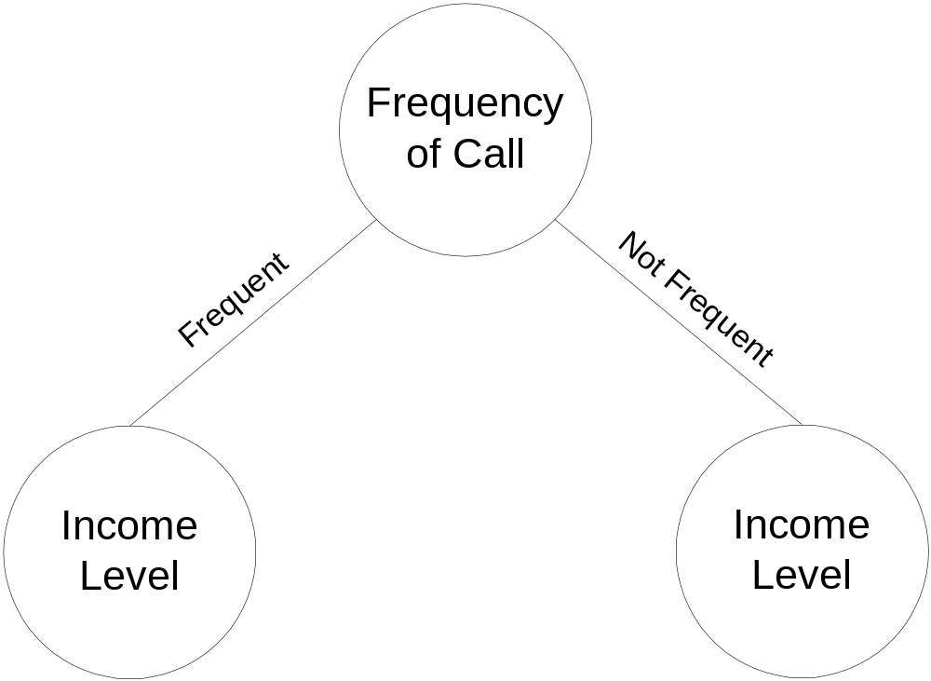

Slide 36
Selecting the Next Node to Split
Since only “Income Level” is left, the next node to split is “Income Level”. As there is no attribute left, the leaves are followed in the decision tree.
The Probabilities
Pr(Credit Amount = Large | Frequency of Call = Frequent ∧ Income Level = High)
= 0.4 / 1
= 0.4
Pr(Credit Amount = Small | Frequency of Call = Frequent ∧ Income Level = High)
= 0.6 / 1
= 0.6
Pr(Credit Amount = Large | Frequency of Call = Frequent ∧ Income Level = Medium)
= (0.4 + 0.5) / 2
= 0.45
Pr(Credit Amount = Small | Frequency of Call = Frequent ∧ Income Level = Medium)
= (0.6 + 0.5) / 2
= 0.55
Pr(Credit Amount = Large | Frequency of Call = Frequent ∧ Income Level = Low)
= (0 + 0.1 + 0.1) / 3
= 0.07
Pr(Credit Amount = Small | Frequency of Call = Frequent ∧ Income Level = Low)
= (1 + 0.9 + 0.9) / 3
= 0.93
Pr(Credit Amount = Large | Frequency of Call = Not Frequent ∧ Income Level = High)
= (0.9 + 0.8 + 0.7) / 3
= 0.8
Pr(Credit Amount = Small | Frequency of Call = Not Frequent ∧ Income Level = High)
= (0.1 + 0.2 + 0.3) / 3
= 0.2
Pr(Credit Amount = Large | Frequency of Call = Not Frequent ∧ Income Level = Medium)
= 1 / 1
= 1
Pr(Credit Amount = Small | Frequency of Call = Not Frequent ∧ Income Level = Medium)
= 0 / 1
= 0
Pr(Credit Amount = Large | Frequency of Call = Not Frequent ∧ Income Level = Low)
= N/A
Pr(Credit Amount = Small | Frequency of Call = Not Frequent ∧ Income Level = Low)
= N/A

Slide 37
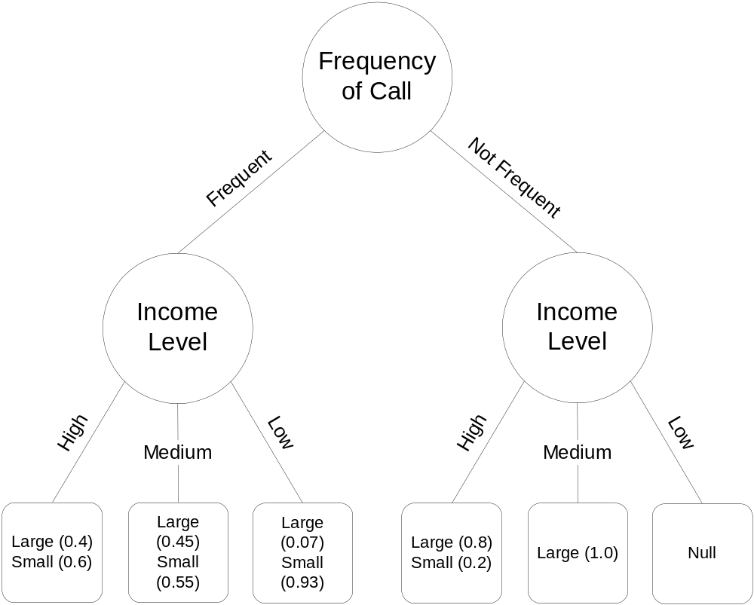

Slide 38
Fuzzy Decision Trees

Slide 39
Data Set 1
Class label
 | Income | Call_ Frequency | Credit_ Rating
1 | {(Low, 0), (Medium, 0.3), (High, 0.7)} | Frequent | Bad
2 | {(Low, 0.9), (Medium, 0.1), (High, 0)} | Frequent | Bad
3 | {(Low, 0), (Medium, 0.2), (High, 0.8)} | Not_Frequent | Good
4 | {(Low, 1), (Medium, 0), (High, 0)} | Frequent | Bad
5 | {(Low, 0), (Medium, 0.9), (High, 0.1)} | Not_Frequent | Good
6 | {(Low, 0.2), (Medium, 0.8), (High, 0)} | Frequent | Bad
7 | {(Low, 0.6), (Medium, 0.4), (High, 0)} | Frequent | Bad
8 | {(Low, 0), (Medium, 0), (High, 1)} | Not_Frequent | Good
9 | {(Low, 0), (Medium, 0.1), (High, 0.9)} | Not_Frequent | Good
10 | {(Low, 0), (Medium, 0.7), (High, 0.3)} | Frequent | Good

Slide 40
Selecting Node to Split (1)
Calculate H(Credit_Rating)
  P(Credit_Rating = Bad) = 5 / 10 = 0.5
  P(Credit_Rating = Good) = 5 / 10 = 0.5
  H(Credit_Rating)
  = – 0.5 log(0.5) – 0.5 log(0.5)
  = 1

Slide 41
Selecting Node to Split (2)
Calculate H(Credit_Rating | Call_Frequency)
  Calculate H(Credit_Rating | Call_Frequency = Not_Frequent)
    P(Credit_Rating = Good | Call_Frequency = Not_Frequent)
    = 4 / 4
    = 1
    P(Credit_Rating = Bad | Call_Frequency = Not_Frequent)
    = 0 / 4
    = 0
    H(Credit_Rating | Call_Frequency = Not_Frequent)
    = – 1 log(1) – 0 log(0)
    = 0

Slide 42
Selecting Node to Split (3)
Calculate H(Credit_Rating | Call_Frequency)
  Calculate H(Credit_Rating | Call_Frequency = Frequent)
    P(Credit_Rating = Good | Call_Frequency = Frequent)
    = 1 / 6
    = 0.17
    P(Credit_Rating = Bad | Call_Frequency = Not_Frequent)
    = 5 / 6
    = 0.83
    H(Credit_Rating | Call_Frequency = Not_Frequent)
    = – 0.17 log(0.17) – 0.83 log(0.83)
    = 0.65

Slide 43
Selecting Node to Split (4)
Calculate H(Credit_Rating | Call_Frequency)
  H(Credit_Rating | Call_Frequency)
  = P(Call_Frequency = Not_Frequent) * H(Credit_Rating | Call_Frequency = Not_Frequent) + P(Call_Frequency = Frequent) * H(Credit_Rating | Call_Frequency = Frequent)
  = 4 / 10 * 0 + 6 / 10 * 0.65
  = 0.39

Slide 44
Selecting Node to Split (5)
Calculate H(Credit_Rating | Income)
  Calculate H(Credit_Rating | Income = High)
    P(Credit_Rating = Good | Income = High)
    = 3.1 / 3.8
    = 0.82
    P(Credit_Rating = Bad | Income = High)
    = 0.7 / 3.8
    = 0.18
    H(Credit_Rating | Income = High)
    = – 0.82 log(0.82) – 0.18 log(0.18)
    = 0.69

Slide 45
Selecting Node to Split (6)
Calculate H(Credit_Rating | Income)
  Calculate H(Credit_Rating | Income = Medium)
    P(Credit_Rating = Good | Income = Medium)
    = 1.9 / 3.5
    = 0.54
    P(Credit_Rating = Bad | Income = Medium)
    = 1.6 / 3.5
    = 0.46
    H(Credit_Rating | Income = Medium)
    = – 0.54 log(0.54) – 0.46 log(0.46)
    = 0.99

Slide 46
Selecting Node to Split (7)
Calculate H(Credit_Rating | Income)
  Calculate H(Credit_Rating | Income = Low)
    P(Credit_Rating = Good | Income = Low)
    = 0 / 2.7
    = 0
    P(Credit_Rating = Bad | Income = Low)
    = 2.7 / 2.7
    = 1
    H(Credit_Rating | Income = Low)
    = – 0 log(0) – 1 log(1)
    = 0

Slide 47
Selecting Node to Split (8)
Calculate H(Credit_Rating | Income)
  H(Credit_Rating | Income)
  = P(Income = High) * H(Credit_Rating | Income = High) + P(Income = Medium) * H(Credit_Rating | Income = Medium) + P(Income = Low) * H(Credit_Rating | Income = Low)
  = 3.8 / 10 * 0.69 + 3.5 / 10 * 0.99 + 2.7 / 10 * 0
  = 0.61

Slide 48
Selecting Node to Split (9)
Calculate G(Call_Frequency)
  G(Call_Frequency)
  = H(Credit_Rating) – H(Credit_Rating | Call_Frequency)
  = 1 – 0.39
  = 0.61
Calculate G(Income)
  G(Income)
  = H(Credit_Rating) – H(Credit_Rating | Income)
  = 1 – 0.61
  = 0.39
Since G(Call_Frequency) > G(Income), the node to split is “Call_Frequency”.
Since all records with “Call_Frequency = Not_Frequency” have “Credit_Rating = Good”, it forms a leave.

Slide 49
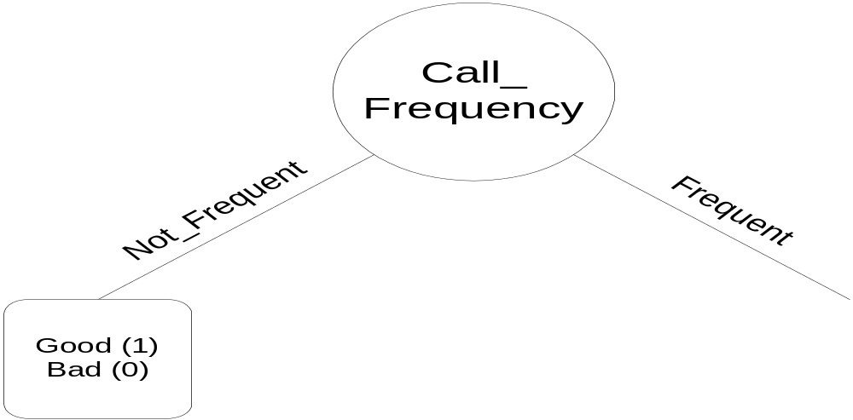
The Decision Tree Built …

Slide 50
Selecting the Next Node to Split
Since only “Income” is left, the next node to split is “Income”.
Since there is no attribute left, the leaves are followed in the decision tree.

Slide 51
The Probabilities
P(Credit_Rating = Good | Call_Frequency = Frequent and Income = High)
= 0.3 / 1 = 0.3
P(Credit_Rating = Bad | Call_Frequency = Frequent and Income = High)
= 0.7 / 1 = 0.7
P(Credit_Rating = Good | Call_Frequency = Frequent and Income = Medium)
= 0.7 / 2.3 = 0.3
P(Credit_Rating = Bad | Call_Frequency = Frequent and Income = Medium)
= 1.6 / 2.3 = 0.7
P(Credit_Rating = Good | Call_Frequency = Frequent and Income = Low)
= 0 / 2.7 = 0
P(Credit_Rating = Bad | Call_Frequency = Frequent and Income = Low)
= 2.7 / 2.7 = 1

Slide 52
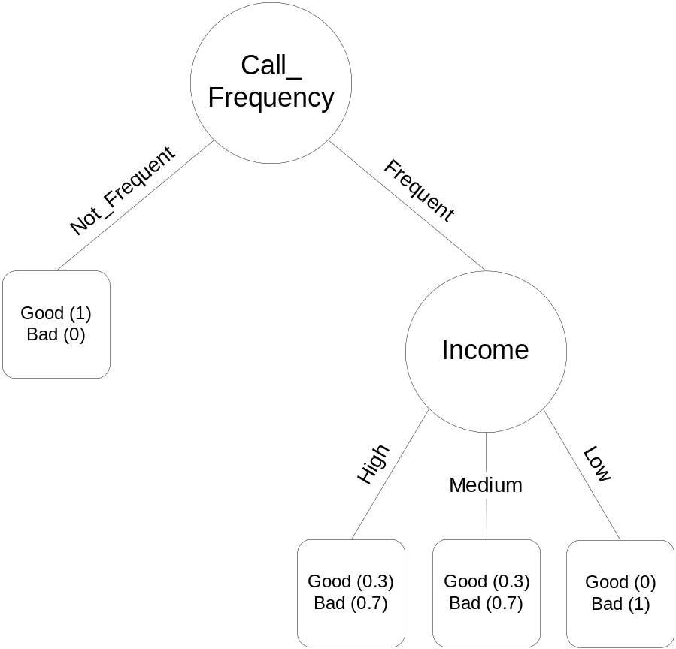
The Resultant Decision Tree

Slide 53
Data Set 2
Class label
 | Income | Call_ Frequency | Credit_ Rating
1 | {(Low, 0), (Medium, 0.3), (High, 0.7)} | Frequent | {(Good, 0.4), (Bad, 0.6)}
2 | {(Low, 0.9), (Medium, 0.1), (High, 0)} | Frequent | {(Good, 0), (Bad, 1)}
3 | {(Low, 0), (Medium, 0.2), (High, 0.8)} | Not_Frequent | {(Good, 0.9), (Bad, 0.1)}
4 | {(Low, 1), (Medium, 0), (High, 0)} | Frequent | {(Good, 0.1), (Bad, 0.9)}
5 | {(Low, 0), (Medium, 0.9), (High, 0.1)} | Not_Frequent | {(Good, 1), (Bad, 0)}
6 | {(Low, 0.2), (Medium, 0.8), (High, 0)} | Frequent | {(Good, 0.4), (Bad, 0.6)}
7 | {(Low, 0.6), (Medium, 0.4), (High, 0)} | Frequent | {(Good, 0.1), (Bad, 0.9)}
8 | {(Low, 0), (Medium, 0), (High, 1)} | Not_Frequent | {(Good, 0.8), (Bad, 0.2)}
9 | {(Low, 0), (Medium, 0.1), (High, 0.9)} | Not_Frequent | {(Good, 0.7), (Bad, 0.3)}
10 | {(Low, 0), (Medium, 0.7), (High, 0.3)} | Frequent | {(Good, 0.5), (Bad, 0.5)}

Slide 54
Selecting Node to Split (1)
Calculate H(Credit_Rating)
  P(Credit_Rating = Bad) = 4.9 / 10 = 0.49
  P(Credit_Rating = Good) = 5.1 / 10 = 0.51
  H(Credit_Rating)
  = – 0.49 log(0.49) – 0.51 log(0.51)
  = 1.00

Slide 55
Selecting Node to Split (2)
Calculate H(Credit_Rating | Call_Frequency)
  Calculate H(Credit_Rating | Call_Frequency = Not_Frequent)
    P(Credit_Rating = Good | Call_Frequency = Not_Frequent)
    = 3.4 / 4
    = 0.85
    P(Credit_Rating = Bad | Call_Frequency = Not_Frequent)
    = 0.6 / 4
    = 0.15
    H(Credit_Rating | Call_Frequency = Not_Frequent)
    = – 0.85 log(0.85) – 0.15 log(0.15)
    = 0.61

Slide 56
Selecting Node to Split (3)
Calculate H(Credit_Rating | Call_Frequency)
  Calculate H(Credit_Rating | Call_Frequency = Frequent)
    P(Credit_Rating = Good | Call_Frequency = Frequent)
    = 1.5 / 6
    = 0.25
    P(Credit_Rating = Bad | Call_Frequency = Not_Frequent)
    = 4.5 / 6
    = 0.75
    H(Credit_Rating | Call_Frequency = Not_Frequent)
    = – 0.25 log(0.25) – 0.75 log(0.75)
    = 0.81

Slide 57
Selecting Node to Split (4)
Calculate H(Credit_Rating | Call_Frequency)
  H(Credit_Rating | Call_Frequency)
  = P(Call_Frequency = Not_Frequent) * H(Credit_Rating | Call_Frequency = Not_Frequent) + P(Call_Frequency = Frequent) * H(Credit_Rating | Call_Frequency = Frequent)
  = 4 / 10 * 0.61 + 6 / 10 * 0.81
  = 0.73

Slide 58
Selecting Node to Split (5)
Calculate H(Credit_Rating | Income)
  Calculate H(Credit_Rating | Income = High)
    P(Credit_Rating = Good | Income = High)
    = 3.1 / 4.6
    = 0.67
    P(Credit_Rating = Bad | Income = High)
    = 1.5 / 4.6
    = 0.33
    H(Credit_Rating | Income = High)
    = – 0.67 log(0.67) – 0.33 log(0.33)
    = 0.91

Slide 59
Selecting Node to Split (6)
Calculate H(Credit_Rating | Income)
  Calculate H(Credit_Rating | Income = Medium)
    P(Credit_Rating = Good | Income = Medium)
    = 2.5 / 4.6
    = 0.54
    P(Credit_Rating = Bad | Income = Medium)
    = 2.1 / 4.6
    = 0.46
    H(Credit_Rating | Income = Medium)
    = – 0.54 log(0.54) – 0.46 log(0.46)
    = 0.99

Slide 60
Selecting Node to Split (7)
Calculate H(Credit_Rating | Income)
  Calculate H(Credit_Rating | Income = Low)
    P(Credit_Rating = Good | Income = Low)
    = 0.4 / 3
    = 0.13
    P(Credit_Rating = Bad | Income = Low)
    = 2.6 / 3
    = 0.87
    H(Credit_Rating | Income = Low)
    = – 0.13 log(0.13) – 0.87 log(0.87)
    = 0.18

Slide 61
Selecting Node to Split (8)
Calculate H(Credit_Rating | Income)
  H(Credit_Rating | Income)
  = P(Income = High) * H(Credit_Rating | Income = High) + P(Income = Medium) * H(Credit_Rating | Income = Medium) + P(Income = Low) * H(Credit_Rating | Income = Low)
  = 4.6 / 12.2 * 0.91 + 4.6 / 12.2 * 0.99 + 3 / 12.2 * 0.18
  = 0.76

Slide 62
Selecting Node to Split (9)
Calculate G(Call_Frequency)
  G(Call_Frequency)
  = H(Credit_Rating) – H(Credit_Rating | Call_Frequency)
  = 1 – 0.73
  = 0.27
Calculate G(Income)
  G(Income)
  = H(Credit_Rating) – H(Credit_Rating | Income)
  = 1 – 0.76
  = 0.24
Since G(Call_Frequency) > G(Income), the node to split is “Call_Frequency”.

Slide 63
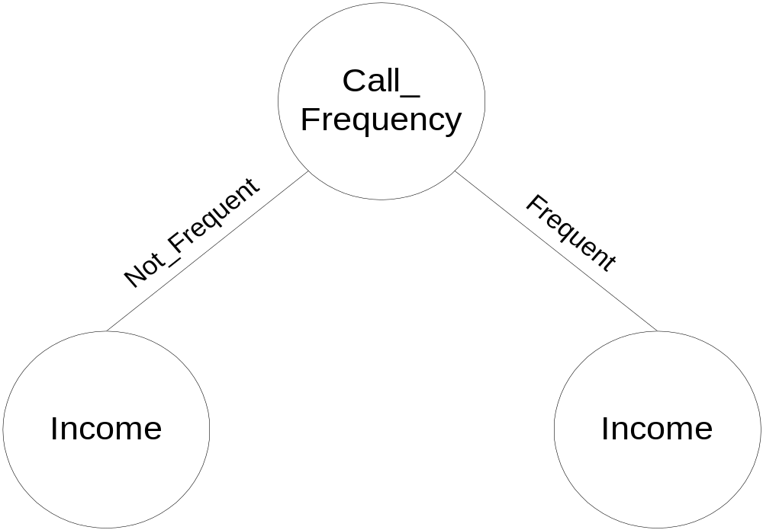
The Decision Tree Built …

Slide 64
Selecting the Next Node to Split
Since only “Income” is left, the next node to split is “Income”.
Since there is no attribute left, the leaves are followed in the decision tree.

Slide 65
The Probabilities (1)
P(Credit_Rating = Good | Call_Frequency = Not_Frequent and Income = High)
= 2.4 / 3.7 = 0.65
P(Credit_Rating = Bad | Call_Frequency = Not_Frequent and Income = High)
= 1.3 / 3.7 = 0.35
P(Credit_Rating = Good | Call_Frequency = Not_Frequent and Income = Medium)
= 1.2 / 1.5 = 0.8
P(Credit_Rating = Bad | Call_Frequency = Not_Frequent and Income = Medium)
= 0.3 / 1.5 = 0.2
P(Credit_Rating = Good | Call_Frequency = Not_Frequent and Income = Low)
= 0
P(Credit_Rating = Bad | Call_Frequency = Not_Frequent and Income = Low)
= 0

Slide 66
The Probabilities (2)
P(Credit_Rating = Good | Call_Frequency = Frequent and Income = High)
= 0.7 / 1.6 = 0.44
P(Credit_Rating = Bad | Call_Frequency = Frequent and Income = High)
= 0.9 / 1.6 = 0.56
P(Credit_Rating = Good | Call_Frequency = Frequent and Income = Medium)
= 1.3 / 3.2 = 0.41
P(Credit_Rating = Bad | Call_Frequency = Frequent and Income = Medium)
= 1.9 / 3.2 = 0.59
P(Credit_Rating = Good | Call_Frequency = Frequent and Income = Low)
= 0.4 / 3 = 0.13
P(Credit_Rating = Bad | Call_Frequency = Frequent and Income = Low)
= 2.6 / 3 = 0.87

Slide 67
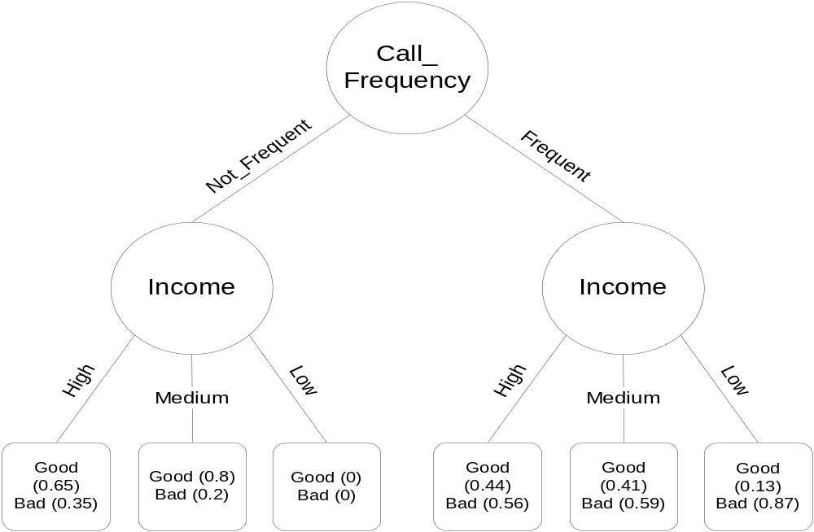
The Resultant Decision Tree

Slide 68
Fuzzy Clustering
The mean height value for cluster 2 (short) is 5’3” and cluster 3 (medium) is 5’7”.
You are just over 5'5” and are classified "medium".
Fuzzy k-means is an extension of k-means.
A membership value of each observation to each cluster is determined.
User specifies a fuzzy MF.
A height of 5'5'' may give you a membership value of 0.4 to cluster 1, 0.4 to cluster 2 and 0.1 to cluster 3.

Slide 69
Part II
Fuzzy Rule Inferences

Slide 70
Approximate Reasoning
Reasoning about imprecise propositions is referred to as approximate reasoning.
Given fuzzy rules: (1) If x is A Then y is B.
Induce a new antecedent, say A', find B' by fuzzy composition:
  B' = A' ο R
The idea of an inverse relationship between fuzzy antecedents and fuzzy consequences arises from the composition operation.
The inference represent an approximate linguistic characteristic of the relation between two universes of discourse, X and Y.

Slide 71
Graphical Techniques of Inference
Procedures (matrix operations) to conduct inference of IF-THEN rules illustrated.
Use graphical techniques to conduct the inference computation manually with a few rules to verify the inference operations.
The graphical procedures can be easily extended and will hold for fuzzy ESs with any number of antecedents (inputs) and consequent (outputs).

Slide 72
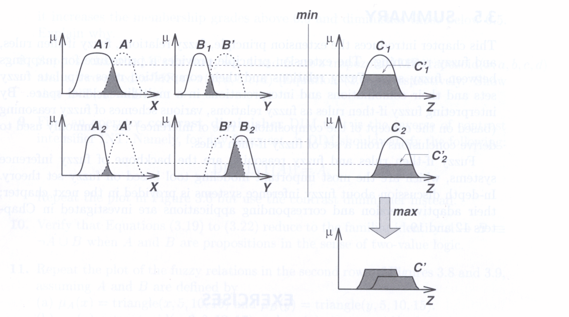
An Example
Conditions of two rules, R1 and R2, are both matched.

