Slide 1
Genetic Algorithms for Classification
Keith C.C. Chan
Department of Computing
The Hong Kong Polytechnic University

Slide 2
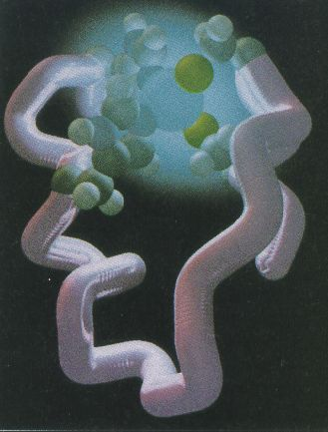
What is GA?
GA perform optimization based on ideas in biological evolution.
The idea is to simulate evolution (survival of the fittest) on populations of chromosomes
Protein Formed and Folded
Into Functional Units
Primary Structure of Protein
…
cys
gly
val
pro
ala
DNA sequence
Amino acid sequence
…
leu
ala
ala
asn

Slide 3
Overview of a GA
GA has started to be made available by commercial data mining tool. E.g., Genalytics.
To use GA, you need to begin with
  Encoding a solution in a chromosome.
  Deciding on a fitness function.
With these, a GA consists of the following steps:
  Initialize a population of chromosomes randomly.
  Evaluate each chromosome in the population according to the fitness function defined.
  Select two chromosomes using the roulette wheel scheme
  4 Perform reproduction with the selected chromosomes by:
    Crossover.
    Mutation.
  Insert the two children created into new population.
  Repeat Steps 3 to 5 until you have a full new population.
  Delete old population to make room for the new chromosomes.
  8 Evaluate the chromosomes in the new population.
  9 If time is up or maximum converges, stop and return the best chromosome; if not, go to 3.

Slide 4
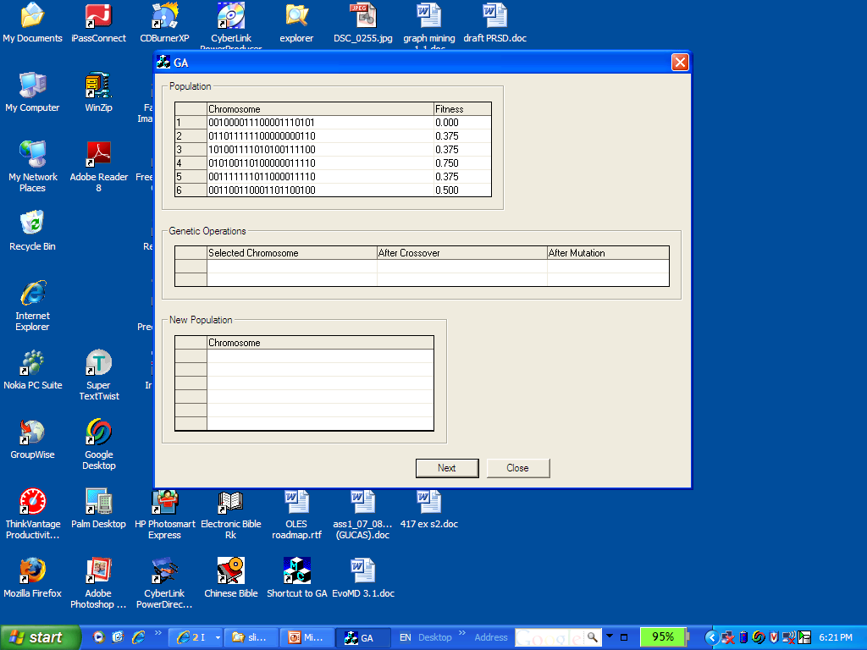
A GA Simulator

Slide 5
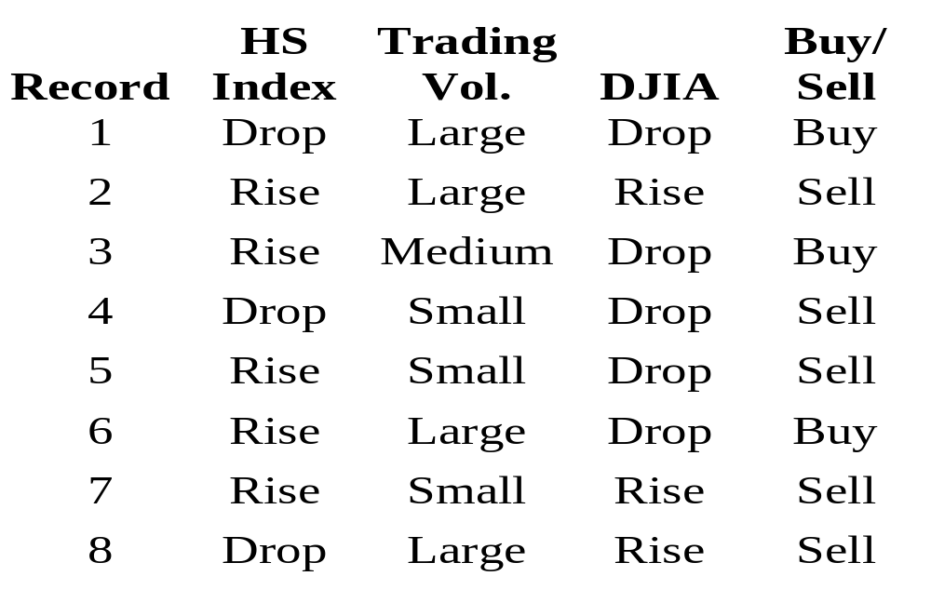
Using GA in Data Mining

Slide 6
Randomly generated rule sets
1
5
HSI=D→B
HSI=R&VOL=S→B
VOL=S/M&DJIA=R→B
HSI=D&VOL=S&DJIA=D→B
VOL=S/M&&DJIA=D→B
HSI=S&VOL=M→B
HSI=R&VOL=S→B
VOL=S/L→B
DJIA=R→B
3
HSI=D&VOL=S/L&DJIA=D→B
HSI=R&DJIA=R→B
HSI=D&VOL=S→B
HSI=D&VOL=S&DJIA=D→B
HSI=R&VOL=S/L&DJIA=D→B
HSI=D&VOL=S&DJIA=D→B
2
6
VOL=S&DJIA=D→B
VOL=S/L&DJIA=D→B
HSI=D&VOL=S&DJIA=D→B
4

Slide 7
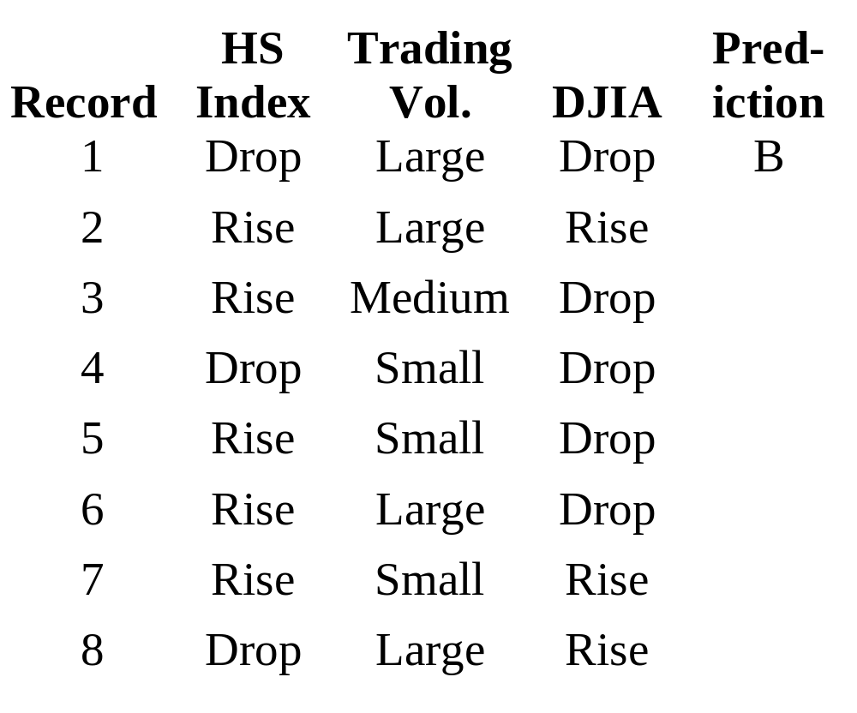
Computing Classification Accuracy
Record 1 matches “HSI = Drop → Buy”

Slide 8
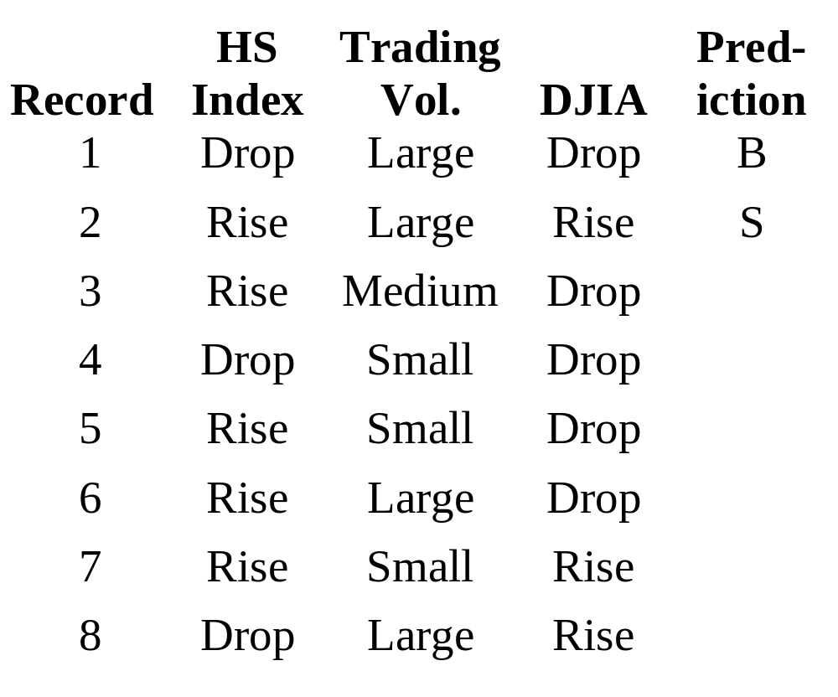
Computing Classification Accuracy
Record 2 does not match any rule → Sell.

Slide 9
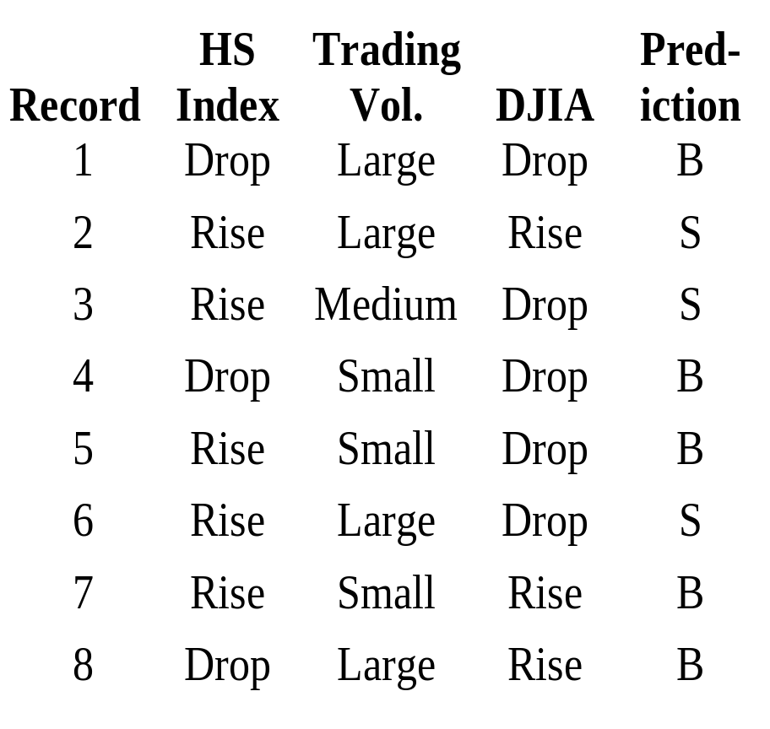
Computing Classification Accuracy
Record 3 does not match any rule → Sell.
Record 4 matches “HSI = Drop → Buy”
Record 5 matches “HSI = Rise & VOL = Small → Buy”
Record 6 does not match any rule → Sell
Record 7 matches “HSI = Rise & VOL = Small → Buy” and “(VOL= Small or Medium) ∧ DJIA = Rise → Buy”.
Record 8 matches “HSI = Drop → Buy”.

Slide 10
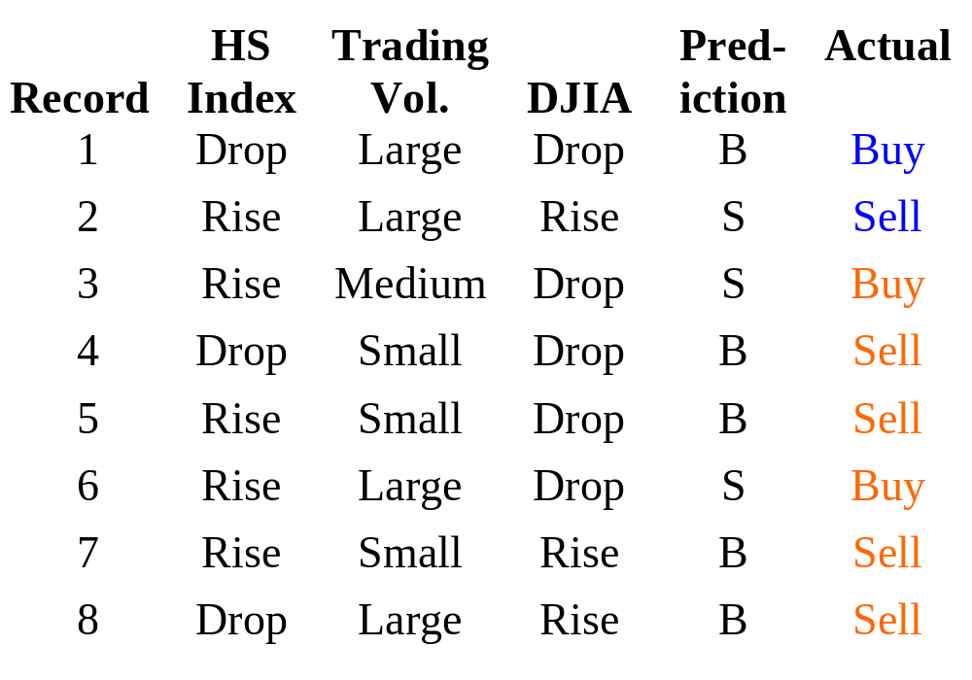
The Data Set

Slide 11
Computing Classification Accuracy
Record 1 matches “HSI = Drop → Buy” (Correct)
Record 2 does not match any rule → Sell. (Correct)
Record 3 does not match any rule → Sell. (Incorrect)
Record 4 matches “HSI = Drop → Buy” (Incorrect)
Record 5 matches “HSI = Rise & VOL = Small → Buy” (Incorrect)
Record 6 does not match any rule → Sell (Incorrect)
Record 7 matches “HSI = Rise & VOL = Small → Buy” and “(VOL= Small or Medium) ∧ DJIA = Rise → Buy”. (Incorrect)
Record 8 matches “HSI = Drop → Buy”. (Incorrect)
Fitness value = 2 / 8 = 0.25

Slide 12
Which Rule Set is The Best?
Apply each rule set to the data on Slide 2 and compute the classification accuracy.
The better rule sets are those with higher accuracy.
Rule Set | Classification Accuracy | Proportion | Watermark
1 | 25% | 0.25 / 2.75 = 0.09 | 0.09
2 | 50% | 0.5 / 2.75 = 0.18 | 0.09 + 0.18 = 0.27
3 | 37.5% | 0.375 / 2.75 = 0.14 | 0.27 + 0.14 = 0.41
4 | 62.5% | 0.625 / 2.75 = 0.23 | 0.41 + 0.23 = 0.64
5 | 50% | 0.5 / 2.75 = 0.18 | 0.64 + 0.18 = 0.82
6 | 50% | 0.5 / 2.75 = 0.18 | 1

Slide 13
Finding the Best Set of Classification Rules
Given what we have, how do we find the best set?
  Generate the next sets of rules randomly?
  Will the accuracy of the best set of rules improve?
How can we ensure a higher chance of generating better rule sets?
This problem can be solved by combining the better rule sets in the hope of finding better rules.

Slide 14
Selecting Rule Sets to Merge
Rule Set | Classification Accuracy | Proportion | Watermark
1 | 25% | 0.25 / 2.75 = 0.09 | 0.09
2 | 50% | 0.5 / 2.75 = 0.18 | 0.09 + 0.18 = 0.27
3 | 37.5% | 0.375 / 2.75 = 0.14 | 0.27 + 0.14 = 0.41
4 | 62.5% | 0.625 / 2.75 = 0.23 | 0.41 + 0.23 = 0.64
5 | 50% | 0.5 / 2.75 = 0.18 | 0.64 + 0.18 = 0.82
6 | 50% | 0.5 / 2.75 = 0.18 | 1

Slide 15
Selecting Rule Sets to Merge (2)
Generate a random number from 0 to 1.
E.g.,
  Random number = 0.73
    Since Rule Set 4’s watermark < 0.73 < Rule Set 5’s watermark, Rule Set 5 is selected.
  Random number = 0.38
    Since Rule Set 2’s watermark < 0.38 < Rule Set 3’s watermark, Rule Set 3 is selected.

Slide 16
Merging and Changing
Randomly select a portion of a rule for swapping.
HSI=R&VOL=S→B
VOL=S/L→B
DJIA=R→B
3
HSI=D&VOL=S&DJIA=D→B
VOL=S/M&&DJIA=D→B
HSI=R&VOL=M→B
5
HSI=D&VOL=S→B
VOL=S/L→B
DJIA=R→B
HSI=R&VOL=S&DJIA=D→B
VOL=S/M&&DJIA=D→B
HSI=R&VOL=M→B
HSI=D&VOL=S→B
VOL=S→B
DJIA=R→B
HSI=R&DJIA=D→B
VOL=M&&DJIA=D→B
HSI=R&VOL=M→B

Slide 17
Finding Best Rule Sets
The problem is a combinatorial optimization problem.
We would like to search a large rule space for the best set of rules.
Optimal solution for this kind of problem could best be found by Genetic Algorithms (GA).

Slide 18
What is GA?
GA perform optimization based on ideas in biological evolution.
The idea is to simulate evolution (survival of the fittest) on populations of chromosomes
Protein Formed and Folded
Into Functional Units
Primary Structure of Protein
…
cys
gly
val
pro
ala
DNA sequence
Amino acid sequence
…
leu
ala
ala
asn

Slide 19
Overview of a GA
GA has started to be made available by commercial data mining tool. E.g., Genalytics.
To use GA, you need to begin with
  Encoding a solution in a chromosome.
  Deciding on a fitness function.
With these, a GA consists of the following steps:
  Initialize a population of chromosomes randomly.
  Evaluate each chromosome in the population according to the fitness function defined.
  Select two chromosomes using the roulette wheel scheme
  4 Perform reproduction with the selected chromosomes by:
    Crossover.
    Mutation.
  Insert the two children created into new population.
  Repeat Steps 3 to 5 until you have a full new population.
  Delete old population to make room for the new chromosomes.
  8 Evaluate the chromosomes in the new population.
  9 If time is up or maximum converges, stop and return the best chromosome; if not, go to 3.

Slide 20
Encoding
Use 2 bits to represent HS_Index:
    Bit 1: HS_Index = Drop
    Bit 2: HS_Index = Rise
Use 3 bits to represent Trading_Vol
    Bit 3: Trading_Vol = Small
    Bit 4: Trading_Vol = Medium
    Bit 5: Trading_Vol = High
Use 2 bits to represent DJIA
    Bit 6: DJIA = Drop
    Bit 7: DJIA = Rise
Only rules for “Decisions = Buy” is encoded.
If a record fails to match any rule in the chromosome, it is classified as Sell.

Slide 21
Some Definitions
Each gene/allele represents a rule.
  E.g., “1011111” represents.
  “HS_Index = Drop ⇒ Decision = Buy”.
Each chromosome composed of 3 alleles (rules).
  E.g., 101111101100111111001 represents three rules:
    HS_Index = Drop ⇒ Decision = Buy
    HS_Index = Rise ∧ Trading_Vol = Small ⇒ Decision = Buy
    Trading_Vol = Small ∨ Trading_Vol = Medium) ∧ DJIA = Rise ⇒ Decision = Buy”
Each population consists of a number of chromosomes.
Fitness Value = Classification accuracy over the training data.

Slide 22
Initialization
Generate an initial population randomly, e.g.,
  Choose the no. of chromosomes in a population = 6
  Choose the no. of alleles in a chromosome = 3
  Choose a Crossover probability = 0.6
  Choose a Mutation probability = 0.1
  Initial population (see previous slides).
    101111101100111111001
    101011001000011010011
    011001100101110011101
    111001000101101010010
    101001000110100101011
    101001001101101010010

Slide 23
Reproduction
1. Evaluate the fitness of each chromosome.
2. Select a pair of chromosome in the current population, chrom1 and chrom2.
3. Reproduce two offsprings, nchrom1 and nchrom2, from chrom1 and chrom2 by crossover.
4. If necessary, mutate nchrom1 and nchrom2.
5. Place nchrom1 and nchrom2 into the next population.
6. Repeat from Step 1 – 5 until the next population is full.

Slide 24
Step 1. Evaluation (1)
Calculate the fitness values of the chromosomes in the population.
E.g., “101111101100111111001” represents rule set {“HS_Index = Drop ⇒ Buy_Sell = Buy”, “HS_Index = Rise ∧ Trading_Vol = Small ⇒ Buy_Sell = Buy”, “(Trading_Vol = Small ∨ Trading_Vol = Medium) ∧ DJIA = Rise ⇒ Buy_Sell = Buy”}.
  Record 1 matches “HS_Index = Drop ⇒ Buy_Sell = Buy”. Hence, Buy_Sell = Buy. (Correct)
  Record 2 does not match any rule. Hence, Buy_Sell = Sell. (Correct)
  Record 3 does not match any rule. Hence, Buy_Sell = Sell. (Incorrect)
  Record 4 matches “HS_Index = Drop ⇒ Buy_Sell = Buy”. Hence, Buy_Sell = Buy. (Incorrect)
  Record 5 matches “HS_Index = Rise ∧ Trading_Vol = Small ⇒ Buy_Sell = Buy”. Hence, Buy_Sell = Buy. (Incorrect)
  Record 6 does not match any rule. Hence, Buy_Sell = Sell. (Incorrect)
  Record 7 matches “HS_Index = Rise ∧ Trading_Vol = Small ⇒ Buy_Sell = Buy” and “(Trading_Vol = Small ∨ Trading_Vol = Medium) ∧ DJIA = Rise ⇒ Buy_Sell = Buy”. Hence Buy_Sell = Buy. (Incorrect)
  Record 8 matches “HS_Index = Drop ⇒ Buy_Sell = Buy”. Hence Buy_Sell = Buy. (Incorrect)
  Fitness value = 2 / 8 = 0.25

Slide 25
Step 1. Evaluation (2)
 | Chromosome | Fitness Value
1 | “101111101100111111001” | 0.25
2 | “101011001000011010011” | 0.5
3 | “011001100101110011101” | 0.375
4 | “111001000101101010010” | 0.625
5 | “101001000110100101011” | 0.5
6 | “101001001101101010010” | 0.5
Total |  | 2.75
Average |  | 0.46

Slide 26
Step 2. Selection (1)
The chromosome with higher fitness value has greater chance to survive in the next generation.
Hence, the next generation should have higher fitness value than the current generation.
 | Chromosome | Proportion | Watermark
1 | “101111101100111111001” | 0.25 / 2.75 = 0.09 | 0.09
2 | “101011001000011010011” | 0.5 / 2.75 = 0.18 | 0.09 + 0.18 = 0.27
3 | “011001100101110011101” | 0.375 / 2.75 = 0.14 | 0.27 + 0.14 = 0.41
4 | “111001000101101010010” | 0.625 / 2.75 = 0.23 | 0.41 + 0.23 = 0.64
5 | “101001000110100101011” | 0.5 / 2.75 = 0.18 | 0.64 + 0.18 = 0.82
6 | “101001001101101010010” | 0.5 / 2.75 = 0.18 | 1

Slide 27
Step 2. Selection (2)
Generate a random number from 0 to 1.
E.g.,
  Random number = 0.73
    Since Chromosome 4’s watermark < 0.73 < Chromosome 5’s watermark, Chromosome 5 is selected.
    chrom1 = “101001000110100101011”
  Random number = 0.38
    Since Chromosome 2’s watermark < 0.38 < Chromosome 3’s watermark, Chromosome 3 is selected.
    chrom2 = “011001100101110011101”

Slide 28
Step 3. Crossover (1)
Generate a random number from 0 to 1.
If the random number < crossover probability, reproduce two offsprings by crossover and proceed to Step 3.
Otherwise, set nchrom1 = chrom1 and nchrom2 = chrom2 and simply proceed to Step 3.
E.g., random number = 0.49
  Since 0.49 < 0.6 (crossover probability), crossover is in action.
  Generate a random number from 1 to 20 (Note: There are 21 bits in each chromosome).
  Random number = 3

Slide 29
Step 3. Crossover (2)
101001000110100101011
101001100101110011101
011001100101110011101
011001000110100101011
nchrom1 = 101001100101110011101
nchrom2 = 011001000110100101011

Slide 30
Step 4. Mutation
For each bit in a chromosome
  Generate a random number from 0 to 1.
  If the random number < mutation probability, change to bit from “0” to “1” or vice versa.
For ncrhom1 = “101001100101110011101”
  Random numbers = (0.23, 0.35, 0.24, 0.17, 0.98, 0.72, 0.53, 0.78, 0.46, 0.78, 0.64, 0.04, 0.48, 0.69, 0.19, 0.23, 0.42, 0.49, 0.89, 0.92, 0.65)
  Only the 12th bit is mutated.
  After mutation, nchrom1 = “101001100100110011101”
For ncrhom2 = “011001000110100101011”
  Random numbers = (0.32, 0.53, 0.04, 0.71, 0.89, 0.27, 0.38, 0.78, 0.66, 0.07, 0.4, 0.72, 0.86, 0.69, 0.31, 0.45, 0.87, 0.72, 0.98, 0.12, 0.19)
  Only the 3rd and 10th bits are mutated.
  After mutation, nchrom2 = “010001000010100101011”

Slide 31
Step 5. New Population
P1 = {“101001100100110011101”, “010001000010100101011”}

Slide 32
Step 6. Is Reproduction Complete?
If Number of chromosomes in P1 < Number of chromosomes in a population, Repeat Step 2 – 5.
Otherwise, reproduction is complete.
Repeat Step 1 – 6 until any of the termination criteria is met.

Slide 33
Step 2. Selection (One More)
Random number = 0.89
  Select Chromosome 6
  chrom1 = “101001001101101010010”
Random number = 0.56
  Select Chromosome 4
  chrom2 = “111001000101101010010”

Slide 34
Step 3. Crossover (One More)
Random number = 0.73
Since 0.73 > crossover probability (0.6), no crossover occur.
nchrom1 = chrom1 = “101001001101101010010”
nchrom2 = chrom2 = “111001000101101010010”

Slide 35
Step 4. Mutation (One More)
For ncrhom1 = “101001001101101010010”
  Random numbers = (0.19, 0.34, 0.54, 0.71, 0.91, 0.32, 0.33, 0.48, 0.46, 0.58, 0.74, 0.41, 0.32, 0.69, 0.19, 0.45, 0.65, 0.76, 0.92, 0.42, 0.32)
  No bit is mutated.
  nchrom1 = “101001001101101010010”
For ncrhom2 = “111001000101101010010”
  Random numbers = (0.32, 0.83, 0.14, 0.17, 0.81, 0.23, 0.78, 0.28, 0.6, 0.39, 0.04, 0.72, 0.86, 0.69, 0.31, 0.34, 0.57, 0.76, 0.63, 0.82, 0.32)
  Only the 11th bit is mutated.
  After mutation, nchrom2 = “111001000111101010010”

Slide 36
Step 5. New Population (One More)
P1 = {“101001100100110011101”, “010001000010100101011”, “101001001101101010010”, “111001000111101010010”}

Slide 37
Step 2. Selection (Two More)
Random number = 0.66
  Select Chromosome 5
  chrom1 = “101001000110100101011”
Random number = 0.39
  Select Chromosome 3
  chrom2 = “011001100101110011101”

Slide 38
Step 3. Crossover (Two More)
Random number = 0.63
Since 0.63 > crossover probability (0.6), no crossover occur.
nchrom1 = chrom1 = “101001000110100101011”
nchrom2 = chrom2 = “011001100101110011101”

Slide 39
Step 4. Mutation (Two More)
For ncrhom1 = “101001000110100101011”
  Random numbers = (0.29, 0.32, 0.54, 0.71, 0.91, 0.32, 0.33, 0.48, 0.46, 0.58, 0.74, 0.14, 0.32, 0.69, 0.19, 0.34, 0.25, 0.79, 0.21, 0.32, 0.87)
  No bit is mutated.
  nchrom1 = “101001000110100101011”
For ncrhom2 = “011001100101110011101”
  Random numbers = (0.32, 0.81, 0.14, 0.17, 0.81, 0.23, 0.78, 0.28, 0.6, 0.39, 0.24, 0.71, 0.86, 0.69, 0.31, 0.45, 0.78, 0.12, 0.45, 0.13, 0.89)
  No bit is mutated.
  After mutation, nchrom2 = “011001100101110011101”

Slide 40
Step 5. New Population (Two More)
P1 = {“101001100100110011101”, “010001000010100101011”, “101001001101101010010”, “111001000111101010010”, “101001000110100101011”, “011001100101110011101”}

Slide 41
Evaluation of New Population
 | Chromosome | Fitness Value
1 | “101001100100110011101” | 0
2 | “010001000010100101011” | 0.625
3 | “101001001101101010010” | 0.5
4 | “111001000111101010010” | 0.75
5 | “101001000110100101011” | 0.5
6 | “011001100101110011101” | 0.375
Total |  | 2.75
Average |  | 0.46

Slide 42
Termination Criteria
User-specified maximum number of generations.
The highest fitness value – The lowest fitness value < user-specified threshold.
The average fitness value of the next population – The average fitness value of the current population < user-specified threshold.

