Slide 1
Data Warehouse and Data Warehousing:
An Introduction
Keith C.C. Chan
Department of Computing
The Hong Kong Polytechnic University

Slide 2
What is A Data Warehouse?
A data warehouse is a subject-oriented, integrated, time-variant, and nonvolatile collection of data in support of management’s decision-making process.— W. H. Inmon
HRO
Health
Data
Warehouse
Student
ITs

Slide 3
Data Warehousing and Industry
One of the hottest topic in IS.
  Over 90% of larger companies either have a DW or are starting one.
Warehousing is big business
  Old statistics from Megroup.
    $3.5 billion in early 1997
    $8 billion in 1998 [Metagroup]
    over $200 billion over next 5 years.
  Latest by IDC on DW tools.
    $5 billion in 1999.
    $16 billion in 2004.
  Latest by IDC on CRM applications
    $61 billion in 2001
    $148 billion in 2005

Slide 4
Data Warehousing and Industry (2)
A 1996 study of 62 data warehousing projects showed an average return on investment of 321%, with an average payback period of 2.73 years.
In 2003, some people are skeptical.
WalMart has largest warehouse
  900-CPU, 2,700 disk, 23 TB Teradata system
  ~7TB in warehouse
  40-50GB per day

Slide 5
Why Data Warehouse?
Why The Hype?

Slide 6
The Information Gap
Fragmented way in which ISs and supporting DBs have been developed.
  One-thing-at-a-time due to constraints on time and resources.
  DBs on a variety of hardware and software platforms.
  Difficult to locate and use accurate information.
Most DB systems developed to support operational processing.
  Operational processing (a.k.a. TP) captures, stores and manipulates data to support daily operations.
  E.g. sales order processing, reservation systems, patient registration,
  Real time processing based on current data.
  Process large volumes of relatively simple read/write transactions, while providing fast response.
  Little thought given to the information or analytical tools needed for decision making.

Slide 7
DW Bridge Information Gap
Need a single, corporate view of data for decision making.
  Can consolidate and integrate information from many different sources.
  Can arrange it in a meaningful format for making accurate business decisions (Martin, 1997a).
  Can support complex business decisions through analysis of trends, target marketing, competitive analysis, and so on.
Meet these needs without disturbing existing operational processing.
Data Warehouse (DW) developed for these needs.

Slide 8
DW Bridge Information Gap (2)
Separate informational from operational processing.
A separate data warehouse eliminates much of the contention for resources that results when informational applications are cofounded with operational processing.
Different functions and different data:
  missing data: Decision support requires historical data which operational DBs do not typically maintain
  data consolidation: DS requires consolidation (aggregation, summarization) of data from heterogeneous sources
  data quality: different sources typically use inconsistent data representations, codes and formats which have to be reconciled.
High performance for both systems:
  DBMS — tuned for operational processing: access methods, indexing, concurrency control, recovery
  DW — tuned for OLAP: complex OLAP queries, multidimensional view, consolidation.
  A properly designed DW adds value to data by improving their quality and consistency.

Slide 9
The Terms &
The Definitions

Slide 10

What is a Data Warehouse
Multi-Dimensional Database
Data Rotation
O L A P
Middleware
M e t a D a t a
Data Scrubbers
Data Warehouse Manager
D S S
E I S
Data Mart
Dimensional Data Modeling
ESS
Data Mining
Star Schema
Data Propagation
Multi-relational tools
Notes:
Even the term Data Warehousing means different things to different people.
To some it is a database, to others a business decision support mechanism or
a means of centralizing or rehabilitating corporate data.
As usual in IT we further confuse the issue by providing numerous synonmys and homonyms for what we mean such as dimensional data modeling (also known as star schema), or data warehousing also known as information warehousing or the information factory.
So how do we make sense of it all?

Slide 11
What is a Data Warehouse?
A Practitioners Viewpoint
“A data warehouse is simply a single, complete, and consistent store of data obtained from a variety of sources and made available to end users in a way they can understand and use it in a business context.”
-- Barry Devlin, IBM Consultant

Slide 12
What is a Data Warehouse?
An Alternative Viewpoint
“A DW is a
  subject-oriented,
  integrated,
  time-varying,
  non-volatile
collection of data that is used primarily in organizational decision making.”
-- W.H. Inmon, Building the Data Warehouse, 1992

Slide 13

The Data Warehouse
Key characteristics
  Subject-oriented
  Integrated
  Time-variant
  Nonvolatile
Notes:
So what are its common characteristics?
Data Warehouses are data driven rather than application or procedural driven as in OLTP. Databases are maintained around common subjects of information of interest to decision makers such as customers and products
They are integrated in that the information they contain, is consistent across theorganization
They are time variant as they reflect data across time by including mulitple years of data
They are nonvolatile as they reflect a stable, consistent view of corporate information which is independent of the vagracies of day to day OLTP processing.

Slide 14
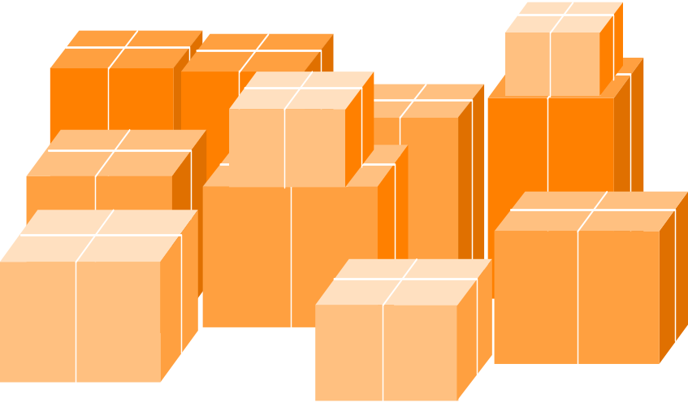
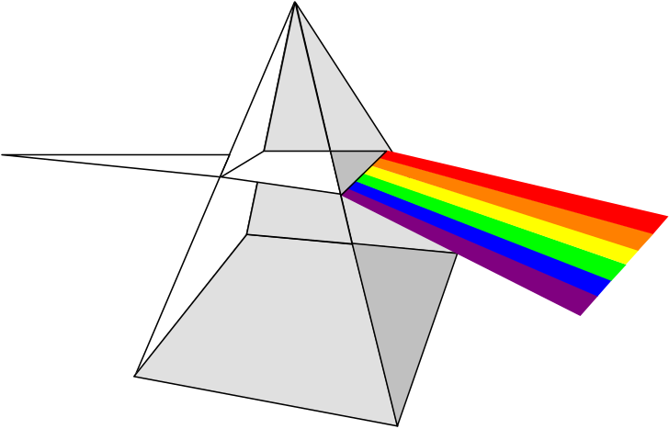
Subject Oriented
Operational Applications/
Databases
Data Warehouse Subjects
Data is stored by business subject rather than by application
Order Billing
Accounts Receivable
Accounts Payable
Loans
Savings
Life Insurance Claims Processing
Auto Insurance
Customer
Claims
Sales
Product

Slide 15

Integrated
Data is stored once in a single integrated location
Operational Environment
Decision Support Environment
Savings
Database
Savings
Application
Data Warehouse
Database
No
Application
Flavor
Customer data stored in several Databases
Current Accounts
Database
Current
Accounts
Application
Personal Loans
Database
Personal
Loans
Application
Subject = Customer

Slide 16

Time-variant
Data is stored as a series of snapshots or views which records data content and context across time.
Data Warehouse Data
{
Time
Data
Key, Version and Date timestamp
- Data is tagged with some element of time - creation date, as of date/to , etc.
- Data is available for long periods of time. For example, five or more years

Slide 17

Non-volatile
Existing data in the warehouse is not overwritten or updated.
External Source
Systems
Create
Update
Delete
Transactions
Internal Source
Systems
Data
Warehouse
READ-ONLY
Data Warehouse
Business Users & Applications

Slide 18
Data Warehousing
Definition 1:
  The process of constructing and using data warehouses
Definition 2:
  The process whereby organizations extract meaning from their informational assets through the use of data warehouses.

Slide 19
What Are The Issues?
Develop a profile for each student from:
  STUDENT_DATA, STUDENT-EMPLOYEE, STUDENT_HEALTH
Some issues to resolve:
  Inconsistent key structures: HKID and student name
  Synonyms: Student_No and Student_ID.
  Free-form vs. structured fields: Last name, first name.
  Inconsistent data values: different phone numbers.
  Missing data: how will the value for insurance be located?
How DW relates to existing operational systems.
Data architecture appropriate for most DW environments.
Extracting data from existing operational systems and loading them into a DW.
Interact with DW using OLAP, data mining and data visualization.

