Slide 1
Data Warehouse Architecture
And Design
Keith C.C. Chan
Department of Computing
The Hong Kong Polytechnic University

Slide 2
An Overview
The basic architectures used most often with data warehouses are:
  A generic two-level physical architecture for entry-level data warehouses;
  An expanded three-level architecture that is increasingly used in more complex environments
115/11/07
Data Warehouse Management Handbook

Slide 3
A Generic Two-Level Architecture
other
sources
Metadata
Operational
DBs
Extract
Transform
Load
End-Users’
Decision
Support
Applications
Data
Warehouse
Serve
115/11/07
Data Warehouse Management Handbook

Slide 4
A Generic Two-Level Architecture
4 basic steps to building this architecture:
  Data extracted from various system files and DB.
  Data are transformed and integrated before being loaded into the DW.
  DW contains both detailed and summary data and is read-only and for decision support.
  Users access DW by means of a variety of query languages and analytical tools.
115/11/07
Data Warehouse Management Handbook

Slide 5
A Generic Three-Level Architecture
OLAP Server
Monitor
&
Integrator
other
sources
Metadata
Operational
DBs
Extract
Transform
Load
Selection
&
Aggregation
Data
Warehouse
Data Marts
115/11/07
Data Warehouse Management Handbook

Slide 6
A Generic Three-Level Architecture
Two-layer architecture
  Represents earliest DW.
  Still widely used today.
  Works well in SMEs with limited HW and SW platforms and a relatively homogeneous computing environment.
  Problems in maintaining data quality and managing the data extraction process for larger companies.
Three-level architecture:
  Operational systems and data
  Enterprise data warehouse
  Data marts
115/11/07
Data Warehouse Management Handbook

Slide 7
Enterprise data warehouse
EDW is a centralized, integrated DW.
  It serves as a control point for assuring the quality and integrity of data before making it available.
  It provides a historical record of the business for time-sensitive data.
  It is the single source of all data but is not typically accessed directly by end users.
  It is too large and complex for users to navigate.
Users access data derived from the data warehouse and stored in data marts.
115/11/07
Data Warehouse Management Handbook

Slide 8
Data Mart
It is a DW that is limited in scope.
Its contents are obtained by selecting and summarizing data from the enterprise DW.
Each data mart is customized for the decision-support applications of a particular end-user group.
An organization may have a marketing data mart, a finance data mart, and so on.
115/11/07
Data Warehouse Management Handbook

Slide 9
A Three Layer Data Architecture
Operational data stored in various operational system throughout the organization.
Reconciled data:
  Detailed, historical data intended to be the single, authoritative source for all decision support applications.
  Not intended to be accessed directly by end users.
Derived data:
  Data that have been selected, formatted and aggregated for end user decision support applications
115/11/07
Data Warehouse Management Handbook

Slide 10
Data Characteristics

Slide 11
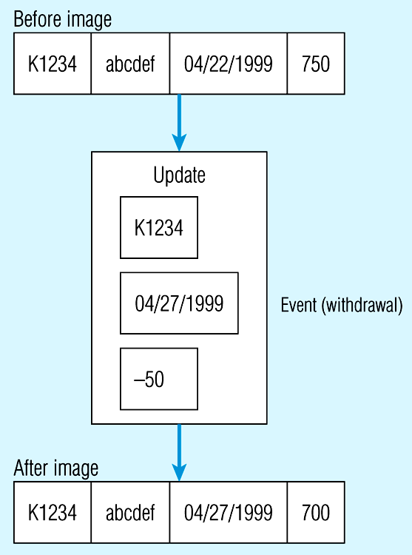
Example of DBMS Log Entry
115/11/07
Data Warehouse Management Handbook

Slide 12
Status vs. Event Data
Example of a log entry recorded by a DBMS when processing a business transaction for a banking application.
  The before image and after image represent the status of the bank account before and then after withdrawal.
  A transaction is a business activity that causes one or more business events to occur at a database level.
  An event is a database action (create, update or delete) that results from a transaction.
115/11/07
Data Warehouse Management Handbook

Slide 13
Status vs. Event Data (2)
Both type of data can be stored in a DB.
Most of the data stored in DW are status data.
Event data may be stored in DB for a short time but are then deleted or archived to save storage space.
Both status and event data are typically stored in database logs for backup and recovery.
The DB log plays an important role in filling the DW.
115/11/07
Data Warehouse Management Handbook

Slide 14
Transient vs. Periodic data
In DW, it is necessary to maintain a record of when events occurred in the past.
  To compare sales on a particular date or during a period on same date or during same period.
Most operational systems are based on the use of transient data.
Transient data are data in which changes to existing records are written over previous records.
115/11/07
Data Warehouse Management Handbook

Slide 15
Transient vs. Periodic data (2)
Records are deleted without preserving the previous contents of those records.
In a DB log both images are normally preserved.
Periodic data are data that are never physically altered or deleted once added to the store.
Each record contains a timestamp that indicates the date (and time if needed) when the most recent update event occurred.
115/11/07
Data Warehouse Management Handbook

Slide 16
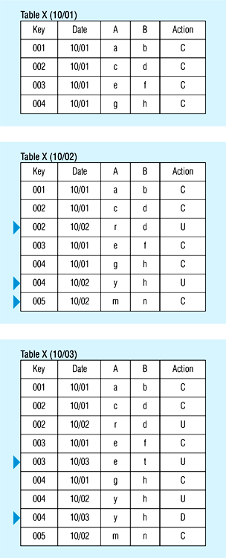
Transient Operational Data
115/11/07
Data Warehouse Management Handbook

Slide 17
The Reconciled Data Layer

Slide 18
An Overview
We use the term reconciled data to refer to the data layer associated with the EDW.
The term used by IBM in 1993 paper describing a DW architectures.
Describes the nature of data that should appear in the EDW and the way they are derived.
115/11/07
Data Warehouse Management Handbook

Slide 19
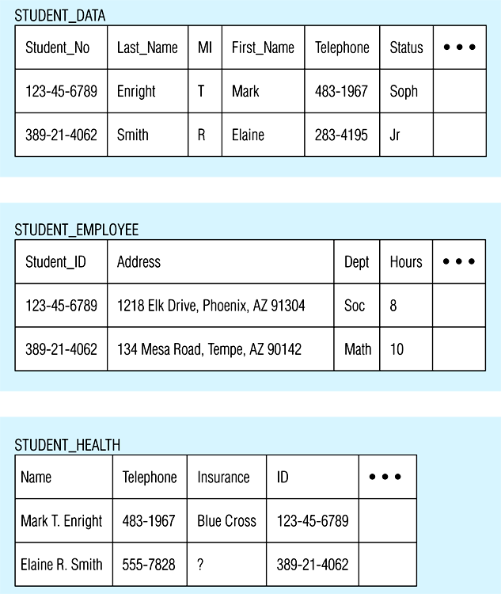
Examples of Heterogeneous Data
115/11/07
Data Warehouse Management Handbook

Slide 20
Characteristics of reconciled data
Intended to provide a single, authoritative source for data that support decision making.
Ideally normalized, this data layer is detailed, historical, comprehensive, and quality- controlled.
  Detailed.
    Rather than summarized.
    Providing maximum flexibility for various user communities to structure the data to best suit their needs.
  Historical.
    The data are periodic (or point-in-time) to provide a historical perspective.
115/11/07
Data Warehouse Management Handbook

Slide 21
Characteristics of reconciled data (2)
  Normalized.
    Third normal form or higher.
    Normalized data provide greater integrity and flexibility of use.
    De-normalization is not necessary to improve performance since reconciled data are usually assessed periodically using batch processes.
  Comprehensive.
    Reconciled data reflect an enterprise-wide perspective, whose design conforms to the enterprise data model.
  Quality controlled.
    Reconciled data must be of unquestioned quality and integrity, since they are summarized into the data marts and used for decision making
115/11/07
Data Warehouse Management Handbook

Slide 22
Characteristics of reconciled data (3)
Characteristics of reconciled data quite different from the typical operational data from which they are derived.
Operational data are typically detailed, but they differ strongly in the other four dimensions.
  Operational data are transient, rather than historical.
  Operational data may have never been normalized or may have been denormalized for performance reasons.
  Rather than being comprehensive, oeprational data are generally restricted in scope to a particular application.
  Operational data are often of poor quality with numerous types of inconsistencies and errors.
115/11/07
Data Warehouse Management Handbook

Slide 23
The Data Reconciliation Process
The process is responsible for transforming operational data to reconciled data.
Because of the sharp differences, the process is the most difficult and technically challenging part of building a DW.
Sophisticaed software products are required to assist with this activity.
115/11/07
Data Warehouse Management Handbook

Slide 24
The Data Reconciliation Process (2)
Data reconciliation occurs in two stages during the process of filling the EDW.
  An initial load when the EDW is first created.
  Subsequent updates to keep the EDW current and/or to expand it.
Data reconciliation can be visualized as a process consisting of four steps: capture, scrub, transform and load and index.
These steps can be combined.
115/11/07
Data Warehouse Management Handbook

Slide 25
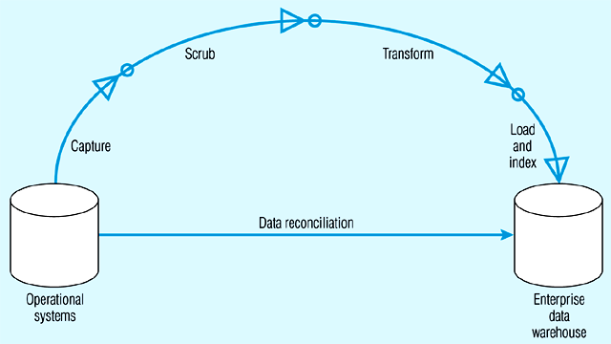
Steps in Data Reconciliation
Transform
(Clean data)
Transform
Extract
Load
115/11/07
Data Warehouse Management Handbook

Slide 26
Data Extraction
Extracting the relevant data from the source files and DBs to fill the EDW.
May extract only a subset of source data.
Best performed by a team directed by data administration and composed of both end users and DW professionals.
Two generic types of data extraction are static and incremental extraction.
115/11/07
Data Warehouse Management Handbook

Slide 27
Static & Incremental Extraction
Static extraction used to fill the DW initially.
  Extract a snapshot of the required source data at a point in time.
Incremental extraction used for ongoing warehouse maintenance.
  Extracts only the changes that have occurred in the source data since the last capture.
  The most common method is log extraction.
  DB log contains after images that record the most recent changes to database records.
  Only after images that are logged after the last extraction are selected from the log.
115/11/07
Data Warehouse Management Handbook

Slide 28
Transformation (Data Cleansing)
Data in operational systems are often of poor quality.
Typical errors and inconsistencies:
  Mis-spelled names and addresses.
  Impossible or erroneous dates of birth.
  Fields used for purposes for which they were never intended.
  Mismatched addresses and area codes.
  Missing data.
115/11/07
Data Warehouse Management Handbook

Slide 29
Transformation (Data Cleansing) (2)
Manual vs. automatic.
Data cleansing using pattern recognition and AI techniques to upgrade quality of raw data before transforming and moving the data to the data warehouse.
TQM focus on defect prevention, rather than defect correction.
115/11/07
Data Warehouse Management Handbook

Slide 30
Data Transformation
Most important in data reconciliation process.
Converts data from the format of the source operational systems to the format of the EDW.
Data transformation may range from a simple change in data format or representation to a highly complex exercise in data integration.
115/11/07
Data Warehouse Management Handbook

Slide 31
Data Transformation (2)
Three examples that illustrate this range:
  A salesperson requires a download of customer data from a mainframe DB to her laptop computer.
  A manufacturing company has product data stored in three different systems -- a manufacturing system, a marketing system and an engineering application.
  A large health care organization managed a geographically dispersed group of hospitals, clinics, and health care centers.
115/11/07
Data Warehouse Management Handbook

Slide 32
Data Transformation (3)
Case 1:
  Mapping data from EBCDIC to ASCII.
  Performed with commercial off-the-shelf software.
Case 2:
  The company needs to develop a consolidated view of these product data.
  Data transformation involves several different functions, including resolving different key structures, converting to a common set of codes, and integrating data from different sources.
  These functions are quite straight-forward, and most of the necessary software can be generated using a standard commercial software package with a graphical interface.
115/11/07
Data Warehouse Management Handbook

Slide 33
Data Transformation (4)
Case 3:
  Many units have been acquired through acquisition over time, the data are heterogeneous and un-coordinated.
  There are needs to develop a DW to provide a single corporate view of the enterprise.
  This effort will require full range of transformation functions including some customized software development.
115/11/07
Data Warehouse Management Handbook

Slide 34
Data transformation functions
Classified into two categories:
  Record-level functions
  Field-level functions.
Record-level functions operate on a set of records such as a file or table.
Most important are selection, joining, normalization and aggregation.
115/11/07
Data Warehouse Management Handbook

Slide 35
Field-level functions
Field-level functions are of two types: single-field and multi-field.
A single-field transformation converts data from a single source field to a single target field.
  E.g., Converting from imperial to metric representation.
A multi-field transformation converts data from one or more source fields to one or more target fields.
115/11/07
Data Warehouse Management Handbook

Slide 36
Multi-Field-level functions
Many-to-one transformation.
  Combination of employee name and telephone number is used as the primary key.
  In creating a target record, the combination is mapped to a unique employee identification (EMP_ID).
  A lookup table would be created to support this transformation.
One-to-many transformation.
  In the source record, a product code has been used to encode the combination of brand name and product name.
  In the target record, it is desired to display the full text describing product and brand names.
  A lookup table would be employed for this purpose.
115/11/07
Data Warehouse Management Handbook

Slide 37
Loading
The last step in filling the EDW is to load the selected data into the target data warehouse and to create the necessary indexes.
The two basic modes for loading data to the target EDW are refresh and update.
115/11/07
Data Warehouse Management Handbook

Slide 38
Loading in Refresh mode
Fill a DW by employing bulk rewriting of the target data at periodic intervals.
The target data are written initially to fill the warehouse.
Then at periodic intervals the warehouse is rewritten, replacing the previous contents.
Refresh model is generally used to fill the warehouse when it is first created.
Refresh mode is used in conkiunction with static data capture.
115/11/07
Data Warehouse Management Handbook

Slide 39
Loading in Update mode
Only changes in the source data are written to the data warehouse.
To support the periodic nature of warehouse data, these new records are usually written to the DW without overwriting or deleting previous records.
It is generally used for ongoing maintenance of the target warehouse.
It is used in conjunction with incremental data capture.
115/11/07
Data Warehouse Management Handbook

Slide 40
Loading (Indexing)
With both modes, it is necessary to create and maintain the indexes that are used to manage the warehouse data.
A type of indexing called bit-mapped indexing is often used in a data warehouse data.
115/11/07
Data Warehouse Management Handbook

Slide 41
Tools to Support Data Reconciliation
Data reconciliation is an extremely complex and challenging process.
A variety of closely integrated software applications must be developed (or acquired) to support this process.
A number of powerful software tools are available to assist organizations in developing these applications: data quality, data conversion, and data cleansing.
115/11/07
Data Warehouse Management Handbook

Slide 42
Data quality tools
Used to assess data quality in existing systems and compare them to DW requirements.
Used during early stage of DW development.
Examples:
  Analyse (QDB Solutions, Inc.)
    Assess data quality and related business rules.
    Make recommendations for cleansing and organizing data prior to extraction and transformation.
  WizRules (WizSoft, Inc.)
    Rules discovery tool that searches through records in existing tables and discovers the rules associated with the data.
    Product identifies records that deviate from the established rule.
115/11/07
Data Warehouse Management Handbook

Slide 43
Data conversion tools
Perform: extract, transform, load and index.
Examples:
  Extract (Evolutionary Technologies International).
  InfoSuite (Platinum Technology, Inc.)
  Passport (Carleton Corp.)
  Prism (Prism Solutions, Inc.)
These are program-generation tools.
  Accept as input schema of source and target files.
  Business rules used for data transformation (e.g. formulas, algorithms, and lookup tables).
  Tools generate program code necessary to perform the transformation functions on an ongoing basis.
115/11/07
Data Warehouse Management Handbook

Slide 44
Data cleansing tools
One tool: Integrity (Vality Technology Inc.).
Designed to perform:
  Data quality analysis.
  Data cleansing.
  Data reengineering.
    Discovering business rules and relationships among entities.
115/11/07
Data Warehouse Management Handbook

Slide 45
The Derived Data Layer
The data layer associated with data marts.
Users at this layer normally interact for their decision-support applications.
The issues:
  What characteristics of the derived data layer?
  How is it derived form the reconciled data layer?
  Introduce the star schema (or dimensional model)
    The data model most commonly used today to implement this data layer.
115/11/07
Data Warehouse Management Handbook

Slide 46
The Star Schema
A start schema is a simple database design:
  Particularly suited to ad-hoc queries.
  Dimensional data (describing how data are commonly aggregated).
  Fact or event data (describing individual business transactions).
  Another name used is the dimensional model.
  Not suited to on-line transaction processing and therefore not generally used in operational systems.
115/11/07
Data Warehouse Management Handbook

Slide 47
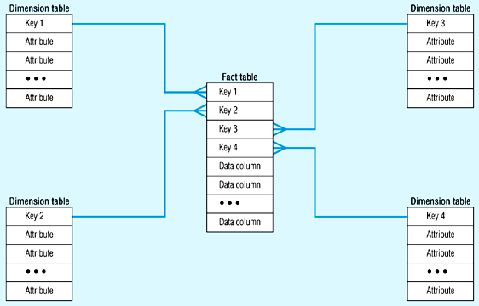
Components of The Star Schema
115/11/07
Data Warehouse Management Handbook

Slide 48
Fact Tables and Dimension Tables
A Star Schema consists of two types of tables:
  Fact Tables
    Contain factual or quantitative data about a business.
    E.g. units sold, orders booked and so on.
  Dimension tables
    Hold descriptive data about the business.
    E.g. Product, Customer, and Period.
  The simplest star schema consists of one fact table, surrounded by several dimension tables.
115/11/07
Data Warehouse Management Handbook

Slide 49
Fact Tables and Dimension Tables (2)
  Each dimension table has a one-to-many relationship to the central fact table.
  Each dimension table generally has a simple primary key, as well as several non-key attributes.
  The primary key is a foreign key in the fact table.
  Primary key of fact table is a composite key consisting of concatenation of all foreign keys.
  Relationship between each dimension table and the fact table:
    provides a join path that allows users to query the database easily.
    Queries in the form of SQL statements for either predefined or ad-hoc queries.
115/11/07
Data Warehouse Management Handbook

Slide 50
Fact Tables and Dimension Tables (3)
Star schema is not a new model.
It is a particular implementation of the relational data model.
The fact table plays the role of an associative entity that links the instances of the various dimensions.
115/11/07
Data Warehouse Management Handbook

Slide 51
Multiple Fact Tables
For performance or other reasons, define more than one fact table in a given star schema.
  E.g., various users require different levels of aggregation (i.e. a different table grain).
Performance can be improved by defining a different fact table for each level of aggregation.
Designers of data mart need decide whether increased storage requirements are justified by the prospective performance improvement.
115/11/07
Data Warehouse Management Handbook

Slide 52
Example of Star Schema
Date
Product
Day
Month
Year
ProductNo
ProdName
ProdDesc
Category
QOH
Sales Fact Table
Date
Product
Store
Store
StoreID
City
State
Country
Region
Cust
Customer
CustId
CustName
CustCity
CustCountry
unit_sales
dollar_sales
Yen_sales
Measurements
115/11/07
Data Warehouse Management Handbook

Slide 53
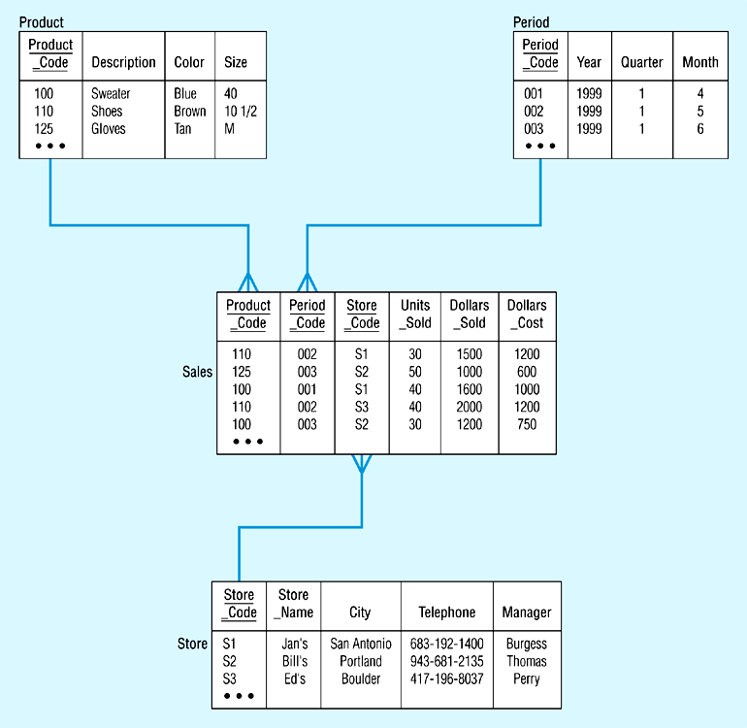
Example of Star Schema with Data
115/11/07
Data Warehouse Management Handbook

Slide 54
Example of Snowflake Schema
Year
Product
Year
Month
Date
ProductNo
ProdName
ProdDesc
Category
QOH
Month
Year
Sales Fact Table
Day
Month
Date
Product
Store
Store
Cust
City
StoreID
City
Customer
CustId
CustName
CustCity
CustCountry
City
State
unit_sales
State
State
Country
dollar_sales
Country
Yen_sales
Country
Region
Measurements
115/11/07
Data Warehouse Management Handbook

Slide 55
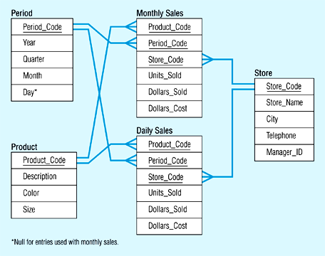
Star Schema with Two Fact Tables
115/11/07
Data Warehouse Management Handbook

Slide 56
Snowflake Schema
Sometimes a dimension in a star schema forms a natural hierarchy.
  E.g. a dimension named Market has geographic hierarchy:
    Several markets within a state.
    Several states within a region.
    Several regions within a country.
115/11/07
Data Warehouse Management Handbook

Slide 57
Snowflake Schema (2)
When a dimension participates in a hierarchy, the designer has two basic choices.
  Include all of the information for the hierarchy in a single table.
    I.e., table is de-normalized (not in 3rd normal form).
  Normalize the tables.
    This results in an expanded schema -- the snowflake schema.
A snowflake schema
  An expanded version of a star schema in which all of the tables are fully normalized.
115/11/07
Data Warehouse Management Handbook

Slide 58
Snowflake Schema (3)
Should dimensions with hierarchies be decomposed?
  The advantages are reduced storage space and improved flexibility.
  The major disadvantage is poor performance, particularly when browsing the database.
115/11/07
Data Warehouse Management Handbook

Slide 59
Proprietary Databases
A number of proprietary multidimensional databases.
  Data are first summarized or aggregated.
  Then stored in the multidimensional database for predetermined queries or other analytical operations.
  Multidimensional databases usually store data in some form of array, similar to that used in the star schema.
  The advantage is very fast performance if used for the type of queries for which it was optimized.
  Disadvantage is that it is limited in the size of the database it can accommodate.
  Also not as flexible as a star schema.
115/11/07
Data Warehouse Management Handbook

Slide 60
Characteristics of Derived Data
Source of derived data is reconciled data.
Selected, formatted and aggregated for end-user decision support applications.
Generally optimized for particular user groups
  E.g. departments, work groups or individuals.
A common mode of operation:
  Select relevant data from the enterprise DW on a daily basis.
  Format and aggregate those data as needed.
  Load and index those data in the target data marts.
115/11/07
Data Warehouse Management Handbook

Slide 61
Characteristics of Derived Data (2)
Objectives sought with derived data:
  Provide ease of use for decision support applications.
  Provide fast response for user queries.
  Customize data for particular target user groups.
  Support ad-hoc queries and data mining applications.
To satisfy these needs, we usually find the following characteristics in derived data:
  both detailed data and aggregate data are present.
    Detailed data are often (but not always) periodic -- that is, they provide a historical record.
    Aggregate data are formatted to respond quickly to pre-determined (or common) queries.
115/11/07
Data Warehouse Management Handbook

Slide 62
Characteristics of Derived Data (3)
  Data are distributed to departmental servers.
  The data model that is most commonly used is the a relational-like model, the Star Schema.
  Proprietary models are also sometimes used.
115/11/07
Data Warehouse Management Handbook

Slide 63
Independent vs. Dependent Data Marts
A dependent data mart is one filled exclusively from the EDW and its reconciled data layer.
Is it possible or desirable to build data marts independent of an enterprise DW?
An independent data mart is one filled with data extracted from the operational environment, without benefit of a reconciled data layer.
115/11/07
Data Warehouse Management Handbook

Slide 64
Independent vs. Dependent Data Marts (2)
Might have an initial appeal but suffer from:
  No assurance that data from different data marts are semantically consistent, since each set is derived from different sources.
  No capability to drill down to greater details in the EDW.
  Data redundancy increases because the same data are often stored in the various data marts.
  Lack of integration of data from an enterprise perspective, since that is the responsibility of the EDW.
  Creating an independent data mart may require cross-platform joins that are difficult to perform.
  Different users have different requirements for the currency of data in data marts, which might lower the quality of data that is made available.
115/11/07
Data Warehouse Management Handbook

