Slide 1
Data Warehousing And OLAP Technology
Keith C.C. Chan
Department of Computing
The Hong Kong Polytechnic University

Slide 2
A Generic Three-Level Architecture
OLAP Server
Monitor
&
Integrator
other
sources
Metadata
Operational
DBs
Extract
Transform
Load
Refresh
Selection
&
Aggregation
Data
Warehouse
Data Marts
115/11/08
Data Warehouse Management Handbook

Slide 3
The User Interface
Even a well-designed data mart used only when provided with powerful, intuitive interface for access and analysis of those data.
A variety of tools are available to query and analyze data stored in data warehouses and data marts.
These tools may be classified as follows:
  Traditional query and reporting tools.
  OLAP tools.
  Data mining tools.
  Data visualization tools.
115/11/08
Data Warehouse Management Handbook

Slide 4
Role of DM Metadata
To build a user-friendly interface requires:
  A set of metadata that describes the data in the data mart in business terms that users can easily understand.
  Metadata associated with data marts are “data catalog” or “ data directory” or similar term.
  Metadata serve as kind of a yellow pages directory to the data in the data marts.
The metadata should allow users to easily answer questions such as:
  what subjects are described in the data mart? (E.g. customers, patients, students, products, courses, etc.)
115/11/08
Data Warehouse Management Handbook

Slide 5
Role of DM Metadata (2)
  What dimensions and facts are included in the data mart? What is the grain of the fact table?
  How are the data in the data mart derived from the EDW? What rules are used in the derivation?
  How are the data in the EDW derived from operational data? What rules are used in this derivation?
  What reports and predefined queries are available to view the data?
  What drill-down and other data analysis techniques are available?
Who is responsible for the quality of data in the data marts, and to whom are requests for changes made?
115/11/08
Data Warehouse Management Handbook

Slide 6
OLAP Tools
On-line analytical processing (OLAP) to contrast with the more traditional term OLTP.
Also referred to as multidimensional analysis.
Concerns with use of a set of graphical tools for multidimensional views of data.
Allows users to analyze data using simple windowing techniques.
Data can be viewed as a simple 3-D cube.
115/11/08
Data Warehouse Management Handbook

Slide 7
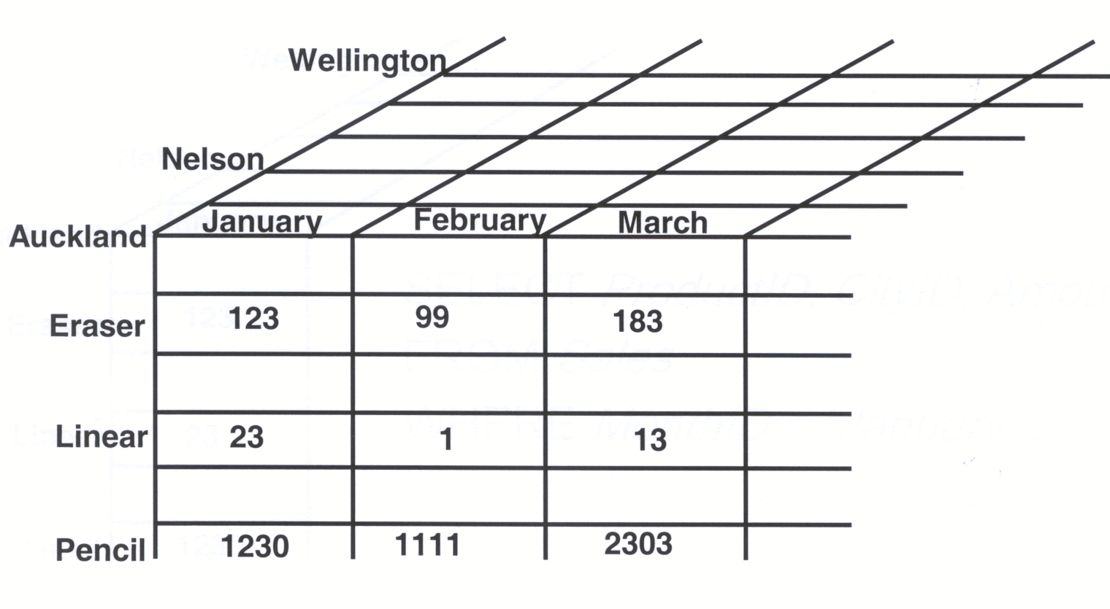
A Hypercube
115/11/08
Data Warehouse Management Handbook

Slide 8
OLAP Queries and SQL
A large number of OLAP queries can be expressed using traditional SQL.
This applies to simple operations as:
  Roll-up and drill-down operations.
  Slice_and_Dice operations
  Pivoting.
OLAP queries mainly use SQL aggregate functions and GROUP BY clause.
115/11/08
Data Warehouse Management Handbook

Slide 9
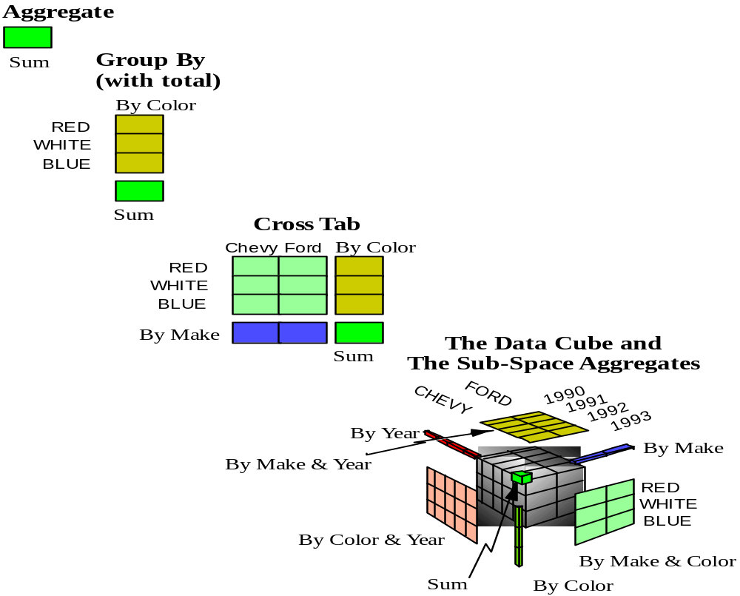
OLAP queries and SQL
115/11/08
Data Warehouse Management Handbook

Slide 10
Slicing a Cube
Slicing the data cube to produce a simple two-dimensional table or view.
  E.g. A slice is for the product named shoes.
  Other views developed by simple “drag and drop”.
  This type of operation is often called “slicing and dicing” the cube.
Closely related to slicing and dicing is data pivoting.
  This term refers to rotating the view for a particular data point, to obtain another perspective.
  The analyst could pivot this view to obtain the sales of shoes by store for the same month.
115/11/08
Data Warehouse Management Handbook

Slide 11
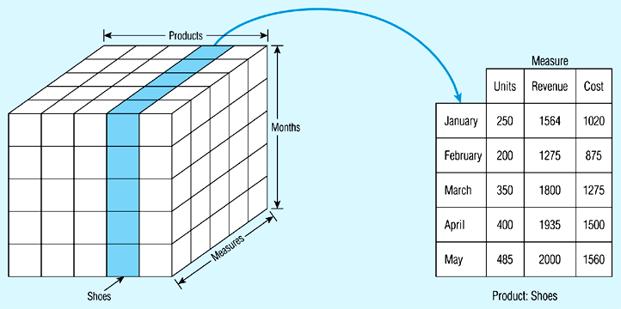
Example of Cube Slicing
115/11/08
Data Warehouse Management Handbook

Slide 12
Dice Operation
Slice_and_Dice operations reduce the number of dimensions by taking a projection of facts on a subset of dimensions and for some selected values of dimensions that are being dropped.
Dice operation amounts to range select conditions.
115/11/08
Data Warehouse Management Handbook

Slide 13
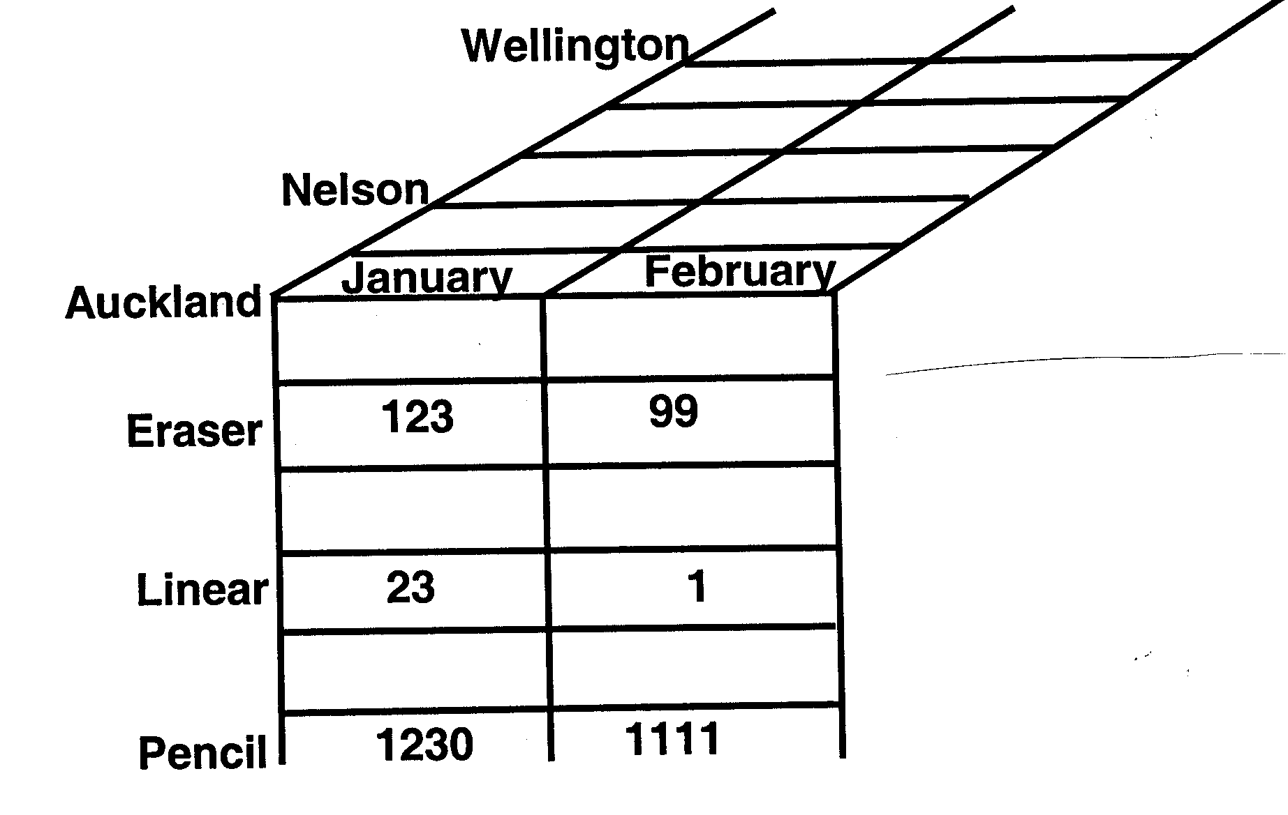
Dice Operation
115/11/08
Data Warehouse Management Handbook

Slide 14
Pivoting
In a fact that, each tuple corresponds to a measure value and there is one column for each of dimensions.
The simplest view of pivoting is that it selects two dimensions to aggregate the measure.
The aggregated values are often displayed in a grid where every point in the (x, y) coordinate system corresponds to an aggregated value of the measure.
The x and y coordinate values are the values of the selected two dimensions
The result of pivoting is called cross-tabulation.
115/11/08
Data Warehouse Management Handbook

Slide 15
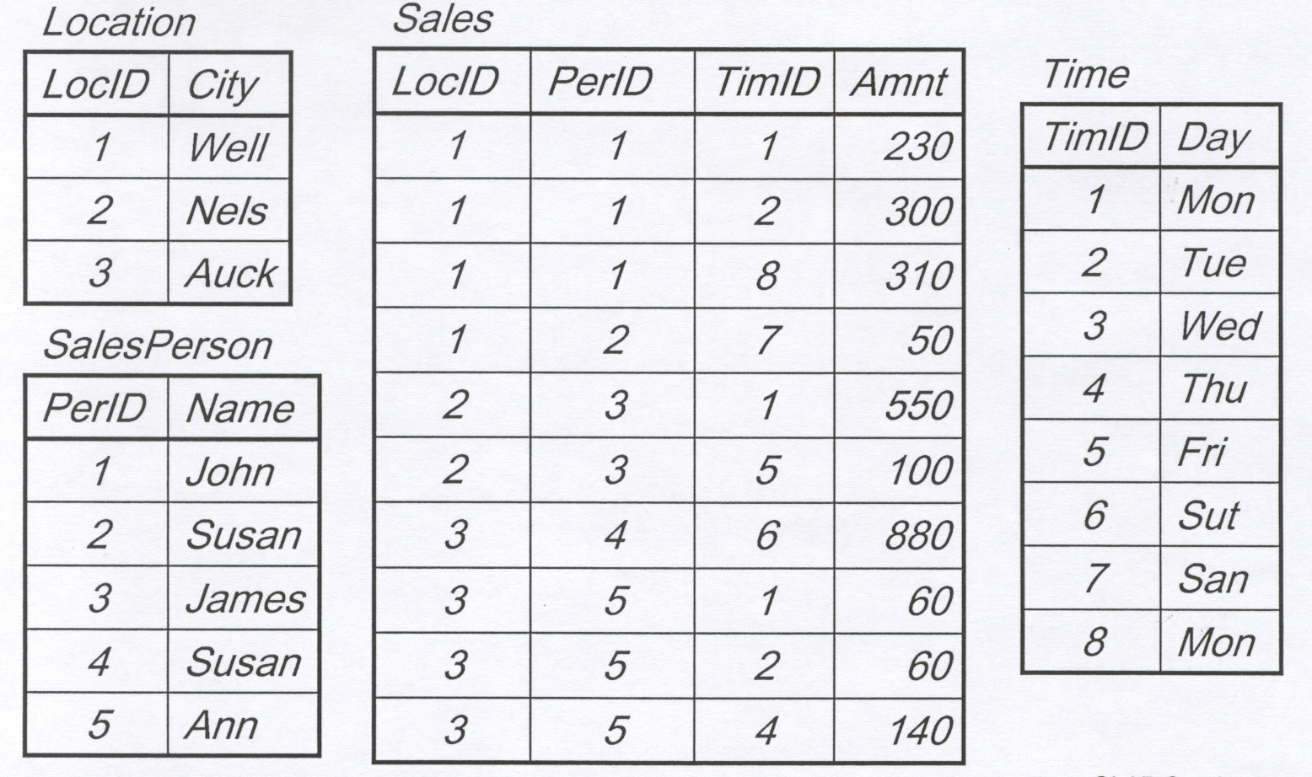
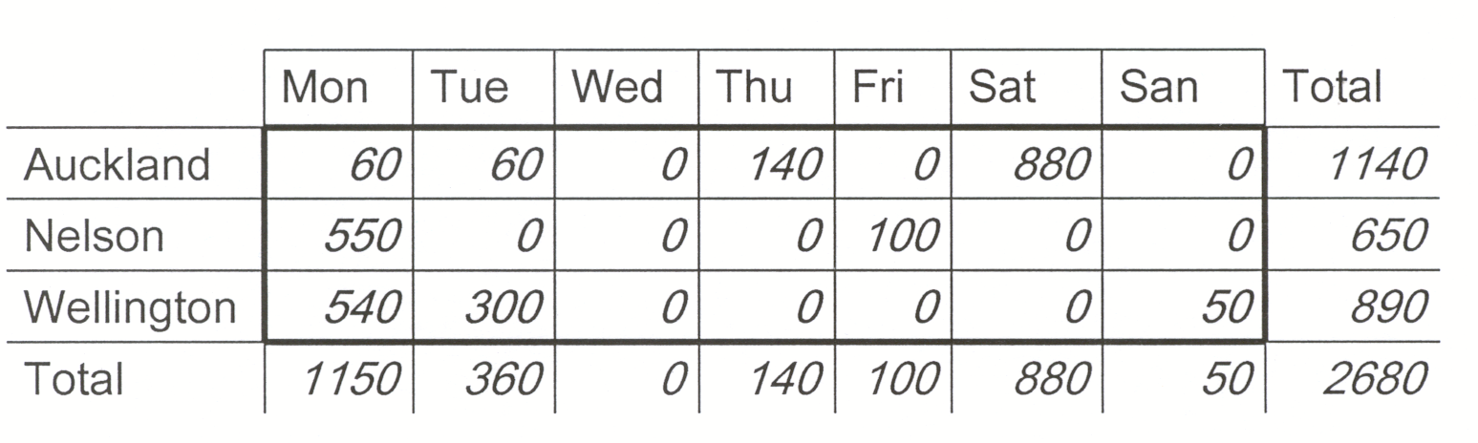
Pivoting on City & Day
115/11/08
Data Warehouse Management Handbook

Slide 16
Roll-up and Drill Down
Roll-up operation corresponds to taking the current aggregation level of fact values and doing a further aggregation on one (or more) of the dimensions.
That is equivalent to doing GROUP BY to this dimension(s) by using attribute hierarchy.
Roll-up operation can be understood as lowering the number of dimensions.
In this case, the measure is calculated without regard to dimensions to be omitted.
115/11/08
Data Warehouse Management Handbook

Slide 17
Drill-Down
Analyzing a set of data at a finer level of detail.
  E.g. A summary report for the total sales of three package sizes for a given brand of paper towels.
  Further breakdown of sales by color within each of these package sizes.
Breakdown obtained using a “point-and-click”.
A drill-down presentation is equivalent to adding another column to the original report (in this case, a column was added for the attribute “color”).
115/11/08
Data Warehouse Management Handbook

Slide 18
Drill-Down (2)
Executing a drill-down may require that the OLAP tool “reach back” to the DW to obtain the detailed data necessary for the drill-down.
This type of operation can be performed by an OLAP tool (without user participation) only if an integrated set of metadata is available to that tool.
Some tools even permit the OLAP tool to reach back to the operational data if necessary for a given query.
115/11/08
Data Warehouse Management Handbook

Slide 19
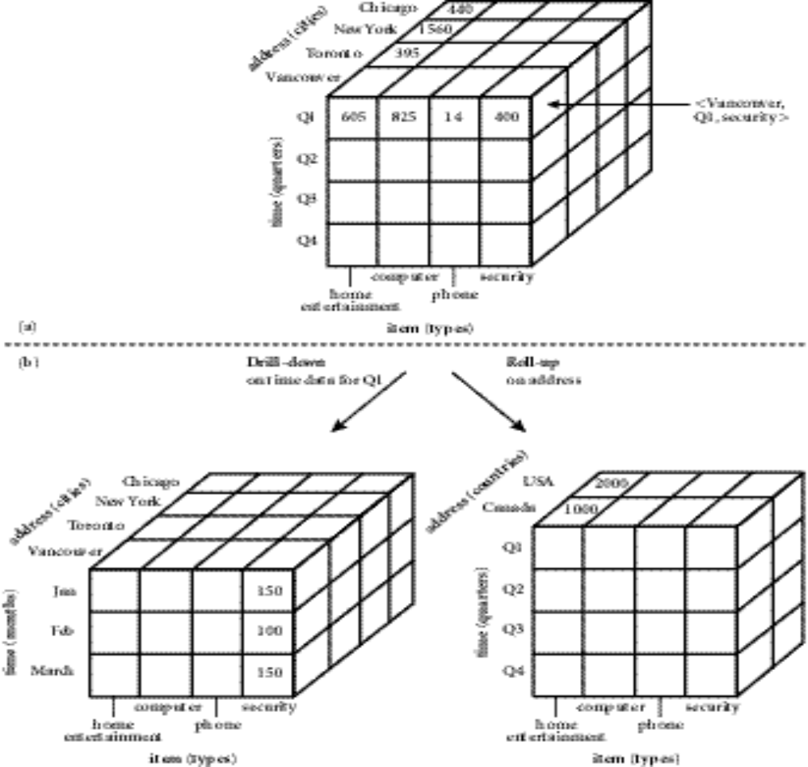
Example of OLAP Operations
115/11/08
Data Warehouse Management Handbook

Slide 20
Data Visualization
Human eye can best discern patterns when data are represented graphically.
Data visualization is the representation of data in graphical and multimedia formats for human analysis.
Benefits of data visualization include the ability to better observe trends and patterns, and to identify correlations and clusters.
Data visualization is often used in conjunction with data mining and other analytical techniques.
115/11/08
Data Warehouse Management Handbook

Slide 21

115/11/08
Data Warehouse Management Handbook

Slide 22

115/11/08
Data Warehouse Management Handbook

