Slide 1
Mining Sequential Patterns
Keith C.C. Chan
Department of Computing
The Hong Kong Polytechnic University

Slide 2
Discovering Sequential Patterns
People who have purchased a VCR are three times more likely to purchase a camcorder two to four months after the purchase.
If the price of Stock A increases by more than 10% and the price of Stock B decreases by less than 2% today, then the price of Stock C will increase by 5% two days later.

Slide 3
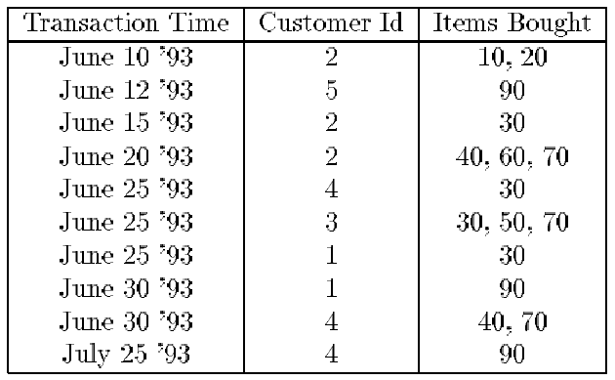
The Sequential Mining Problem
Given a DB of customer transactions consisting of
  A customer-id*, a transaction-time*, and the Items purchased.
The problem is to find sequential patterns.
Transaction
Item
Itemset

Slide 4
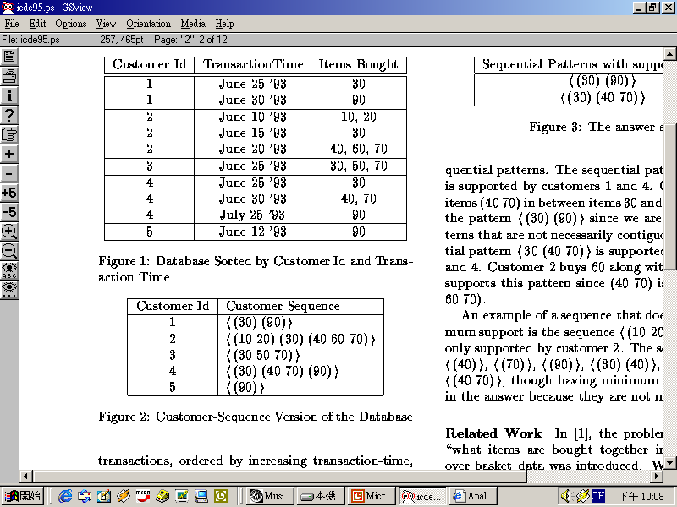
Terminologies (1)
Sequence
3-Sequence
<(30) (90)> is supported by customer 1 and 4
<30 (40 70)> is supported by customer 2 and 4
With minimum support of 2 customers:
The large itemset (litemset) (support>=min_support)
(30), (40), (70), (40 70), (90)

Slide 5
Terminologies (2)
  A Large sequence is a sequence with support greater than or equal to the minimum support
  <(30)>, <(40)>, <(70)>, <(90)>
    <(30) (40)>, <(30) (70)>, <(40 70)>
  Defn: A sequence s is maximal if s is not contained in any other sequences.
The maximal sequences
with minimum support of 2 customers is:
  - The answer set is:
  <(30) (90)>, <30 (40 70)>
Sequential Patterns

Slide 6
Defining Customer-Sequence
Given transactions of one particular customer:
  Transactions of a customer ordered by increasing transaction-time, T₁, …, T_{n}.
We define
  itemset(T_{i}) denote set of items purchased in T_{i}.
  customer-sequence for this customer is <itemset(T₁) … itemset(T_{n})>.
  A customer supports a sequence s if s is contained in the customer-sequence for this customer.
  The support for a sequence is defined as the fraction of total customers (i.e., the % of customers) who support this sequence.

Slide 7
The Problem Statement
Problem of mining sequential pattern mining
  Given a set of transaction data as above
  Find the maximal sequences among all sequences that have a certain user-specified minimum support.
Where
  A sequence s is maximal if s is not contained in any other sequences.
  A sequence satisfying the minimum support constraint is called a large sequence.
  Each such maximal sequence represents a sequential pattern.

Slide 8
The Solution
A 5-Phase Apriori Sequential Pattern Discovery Algorithm.
Phase 1: Sort phase
  Sort transaction DB by customer-id & trans-time.
Phase 2: Large itemset phase
  Find all large itemsets using, e.g., Apriori.
Phase 3: Transformation phase
  Transformation for easy comparison.
Phase 4: Sequence phase
  Find all large sequences.
Phase 5: Maximal phase
  Find maximal sequences among the set of large sequences.

Slide 9
Phase 1: Sort phase
Sort the database with customer-id as the major key and transaction-time as the minor key
customer-id | transaction-time | items
1 | June 25, 2003 | 30
1 | June 30, 2003 | 90
2 | June 10, 2003 | 10, 20
2 | June 15, 2003 | 30
2 | June 20, 2003 | 40, 60, 70
3 | June 25, 2003 | 30, 50, 70
4 | June 25, 2003 | 30
4 | June 30, 2003 | 40, 70
4 | July 25, 2003 | 90
5 | June 12, 2003 | 90

Slide 10
Phase 2: Large itemset phase
Find all large itemsets using, e.g., Apriori.
Large itemsets with min. support = 25% (Result of Step 2)
Itemset mapping
Identifier | Large itemset | support
1 | (30) | 80%
2 | (40) | 40%
3 | (70) | 60%
4 | (40 70) | 40%
5 | (90) | 60%

Slide 11
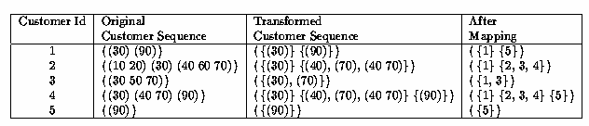
Phase 3: Transformation phase
Deleting non-large itemsets
Mapping large itemsets to integer identifiers.

Slide 12
Phase 4: Sequence phase
Use the set of litemsets to find the desired sequence.
Use an AprioriAll algorithm.
Find Large 1-sequences
Large 1-sequence | Support
<1> | 80%
<2> | 40%
<3> | 60%
<4> | 40%
<5> | 60%

Slide 13
Phase 4: (Cont’d)
Candidate 2-sequences
Candidate 2-sequence | Support
<1 2> | 40%
<1 3> | 40%
<1 4> | 40%
<1 5> | 40%
<2 3> | 0%
<2 4> | 0%
<2 5> | 20%
<3 4> | 0%
<3 5> | 20%
<4 5> | 20%

Slide 14
Phase 4 (Cont’d)
Large 2-sequences
Candidate 3-sequences = ∅
Large 2-sequence | Support
<1 2> | 40%
<1 3> | 40%
<1 4> | 40%
<1 5> | 40%

Slide 15
Phase 5: Maximal phase
Find the maximum sequences among the set of large sequences.
In some algorithms, this phase is combined with the sequence phase.
Maximal sequences / Sequential patterns (Result of Step 5)
  <1 2>
  <1 3>
  <1 4>
  <1 5>

Slide 16
Maximal phase
Algorithm:
  S the set of all litemsets
  n the length of the longest sequence
for (k = n; k > 1; k--) do
foreach k-sequence s_{k} do
Delete from S all subsequences of s_{k}

Slide 17
AprioriAll
The basic method to mine sequential patterns
Based on the Apriori algorithm.
Count all the large sequences, including non-maximal sequences.
Use Apriori-generate function to generate candidate sequence.

Slide 18
AprioriAll (cont.)
L₁ = {large 1-sequences}; // Result of the phase
for ( k=2; L_{k-1}≠Φ; k++) do
begin
C_{k} = New candidate generate from L_{k-1}
foreach customer-sequence c in the database do
Increment the count of all candidates in C_{k} that are contained in c
L_{k} = Candidates in C_{k} with minimum support.
End
Answer=Maximal Sequences in U_{k}L_{k};

Slide 19
Apriori Candidate Generation
generate candidates for pass using only the large sequences found in the previous pass and then makes a pass over the data to find their support.

Slide 20
Apriori Candidate Generation
Algorithm:
  L_{k} the set of all large k-sequences
  C_{k} the set of candidate k-sequences
insert into C_{k}
select p.litemset₁, p.litemset₂,…, p.litemset_{k-1}, q.litemset_{k-1}
from L_{k-1} p, L_{k-1} q
where p.litemset₁=q.litemset₁,…, p.litemset_{k-2}=q.litemset_{k-2};
forall sequences c∈C_{k} do
forall (k-1)-subsequences s of c do
if (s∉L_{k-1}) then
delete c from C_{k;}

Slide 21
An illustrative example:
Apriori Candidate Generation
Example: (Customer Sequences)
<{1 5}{2}{3}{4}>
<{1}{3}{4}{3 5}>
<{1}{2}{3}{4}>
<{1}{3}{5}>
<{4}{5}>
With minimum set to 25%
next step: find the large 1-sequences

Slide 22
Example
Large 1-Sequence
<{1 5}{2}{3}{4}>
<{1}{3}{4}{3 5}>
<{1}{2}{3}{4}>
<{1}{3}{5}>
<{4}{5}>
Sequence | Support
<1>
<2>
<3>
<4>
<5>
4
2
4
4
2
next step: find the large 2-sequences

Slide 23
Example
Large 2-Sequence
<{1 5}{2}{3}{4}>
<{1}{3}{4}{3 5}>
<{1}{2}{3}{4}>
<{1}{3}{5}>
<{4}{5}>
Sequence | Support
<1 2> | 2
<1 3> | 4
<1 4> | 3
<1 5> | 3
<2 3> | 2
<2 4> | 2
<3 4> | 3
<3 5> | 2
<4 5> | 2
next step:
find the large 3-sequences

Slide 24
Example
Large 3-Sequence
<{1 5}{2}{3}{4}>
<{1}{3}{4}{3 5}>
<{1}{2}{3}{4}>
<{1}{3}{5}>
<{4}{5}>
Sequence | Support
<1 2 3> | 2
<1 2 4> | 2
<1 3 4> | 3
<1 3 5> | 2
<2 3 4> | 2
next step: find the large 4-sequences

Slide 25
Example
Large 4-Sequence
<{1 5}{2}{3}{4}>
<{1}{3}{4}{3 5}>
<{1}{2}{3}{4}>
<{1}{3}{5}>
<{4}{5}>
Sequence | Support
<1 2 3 4> | 2
next step: find the sequential pattern

Slide 26
Example
Find the maximal large sequences
Sequence | Support
<1> | 4
<2> | 2
<3> | 4
<4> | 4
<5> | 2
Sequence | Support
<1 2> | 2
<1 3> | 4
<1 4> | 3
<1 5> | 3
<2 3> | 2
<2 4> | 2
<3 4> | 3
<3 5> | 2
<4 5> | 2
Sequence | Support
<1 2 3> | 2
<1 2 4> | 2
<1 3 4> | 3
<1 3 5> | 2
<2 3 4> | 2
Sequence | Support
<1 2 3 4> | 2

Slide 27


judgment
Waste too much time in counting
non-maximal sequence, which is
impossible to be a sequential pattern.

