Slide 1
Planning for A Data Warehouse Project
Case Study

Slide 2
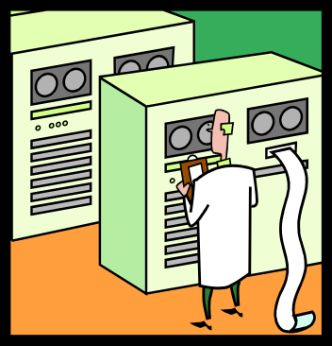


Legacy Systems
Payroll System
(IBM S/390, COBOL)
Inventory System
(SUN Enterprise 450, Oracle)
Point-of-Sales System
(PC, MS Access)

Slide 3
The Data Warehouse
Legacy Systems
Data Warehouse
Payroll System
(COBOL data file)
MS SQL Server
OLAP Service
Extract,
Transform,
Load
Inventory System
(Oracle database)
MS SQL Server
POS System
(MS Access Database)

Slide 4
Extract (1)
Payroll System (COBOL data file)
  Have programmers to write COBOL programs to extract the data
    Pros: Usually faster as programmers can tune the programs to obtain good performance
    Cons: May not be easy to maintain, especially when the programmers have not produced any documentation
  Use software tools (e.g., Prism Warehouse Executive) to generate COBOL programs to extract the data
    Pros: Easy to maintain as the tools will produce necessary documentation for you
    Cons: Usually slower as the program generated has not been tuned for good performance

Slide 5
Extract (2)
Inventory System (Oracle database)
  Have programmers to write programs to extract the data
  Use software tools (e.g., Ardent DataStage) to extract the data

Slide 6
Extract (3)
POS System (MS Access database)
  Have programmers to write programs to extract the data
  Use software tools (e.g., Ardent DataStage) to extract the data

Slide 7
Transform
Have programmers to write programs to do transformation
  Pros: Flexible and can support complicated transformation
  Cons: May not be easy to maintain, especially when the programmers have not produced any documentation
Use software tools to do transformation
  Pros: Easy to maintain as the tools will produce necessary documentation for you
  Cons: Support straight-forward transformations only

Slide 8
Load
Use software tools to load the transformed data to the data warehouse
  Ardent DataStage
  Some DBMSs (e.g., Oracle, MS SQL Server, etc.) provide their own tools to do so

Slide 9
Hints
The frequency of ETL is dependent on different business needs.
  It is usually performed once a day or once a week.
  Different data in the data warehouse may have different ETL cycles. E.g., POS data may be loaded daily whereas payroll data may be loaded monthly.
Spare enough time for the ETL. It may take days (!) to complete.
No one expects real-time update of the data from the data sources to the data warehouse because of the adverse degradation of the performance of the production systems.

Slide 10
Star Schema
A star schema consists of
  1 fact table
    Contains the aggregate of factors of interest.
    Indexed by the dimensions.
  N dimension tables
    Each dimension table represents a hierarchy for roll-up and drill-down.
From data warehouse to star schema
  Calculate the aggregates of factors with all the possible combination of dimensions.
  Populate the aggregates into the fact table.
  This requires programming efforts.

Slide 11
OLAP Data Cube
From star schema to OLAP data cube
  Use vendor-proprietary tool to retrieve the star schema and to produce the data cube.
OLAP data cube
  Logical
    The OLAP data cube contains the definition only and retrieve the relevant aggregates from the star schema when users access the data cube.
    The size of the data cube is small but the performance is poor.
  Physical
    The OLAP data cube contains the data in the star schema.
    The size of the data cube is usually huge (can be several GBs!) but the performance is good.
    It may take days (!) to build.

