Slide 1


Unit 01:
Introduction to
SE And ASD
eXtreme Programming and Agile Software Development
2011
Notes:
Note
http://www.fsktm.upm.edu.my/~rodziah/sak5108/p44-beck.pdf
Once upon a time, in the land of Metaphor, there lived a monkey and an elephant. They both lived on one side of a wide, swiftly flowing river. On both sides of the river there were many fruit trees. The monkey was very agile. He could climb to the top of the fruit trees and eat as much fruit as he needed. The elephant was very tall. He could reach up with his trunk and eat as much fruit as he needed.
But the trees grew taller. Soon the elephant could not reach enough fruit to eat. But he was strong and self-sufficient. He found that when he was hungry, he could just pull
down a tree and have fruit to eat. The monkey watched the elephant pull down most of the fruit trees. He was not happy.
He said to the elephant, “Don’t do that! I will climb up the trees and get fruit for you.” The elephant said, “ I am hungry. I am strong. I can do things for myself.” The monkey said, “You dumb elephant. Soon there will be no trees or fruit for you either.”

Slide 2

Doctrine of Fair Use
This PowerPoint is prepared for educational purpose and is strictly used in the classroom lecturing.
We have adopted the "Fair Use" doctrine in this PowerPoint which allows limited copying of copyrighted works for educational and research purposes.

Slide 3
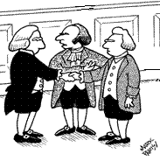
Mr. Traditional SE, who wants to discipline software developers, have realistic project plans, and make software processes efficient, I’d like you to meet Mr. Agile, who wants to let the developers, the plans, and the processes take care of themselves. I am sure you two will have a lot to talk about.

Slide 4

Learning Objectives
To review software engineering
To review software project management
To introduce agile software development

Slide 5

Review
What is agile software development?
Is it a branch of software engineering?
Is it about software project management?

Slide 6
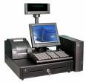

System Categories
Technical computer-based systems
Socio-technical systems
?
Notes:
Note
Before we try to explain or define what software engineering is, we should go back the definition of a system.
Technical computer-based systems
Systems that include hardware and software but where the operators and operational processes are not normally considered to be major part of the system. (Opposite to Socio-technical systems)
Socio-technical systems
Systems that include technical systems but also operational processes and people who use and interact with the technical system. Socio-technical systems are governed by organisational policies and rules.

Slide 7

Socio-Technical System Characteristics
Emergent properties
Non-deterministic
Complex relationships with organisational objectives
Notes:
Note
Emergent properties
Properties of the system of a whole that depend on the system components and their relationships.
Non-deterministic
They do not always produce the output as before when presented with the same input because the systems’s behaviour is partially dependent on human operators.
Complex relationships with organisational objectives
The extent to which the system supports organisational objectives does not just depend on the system itself.

Slide 8

What is Software Engineering
Software engineering is an engineering discipline that is concerned with all aspects of software production.
Software engineers should adopt a systematic and organised approach to their work and use appropriate tools and techniques depending on the problem to be solved, the development constraints and the resources available.
Notes:
Note
The term software engineering first appeared in the 1968 NATO Conference

Slide 9

Definition of
Software Engineering
IEEE defines that Software engineering is the application of a systematic, disciplined, quantifiable approach to the development, operation, and maintenance of software.
Notes:
Note
Source: http://en.wikipedia.org/wiki/Software_engineering

Slide 10

What is the difference between software engineering and computer science?
Computer science theories are still insufficient to act as a complete underpinning for software engineering (unlike e.g. physics and electrical engineering).
Difference or Same
Notes:
Note
Computer science is concerned with theory and fundamentals.
software engineering is concerned with the practicalities of developing and delivering useful software.
Therefore, computer science may not be considered as a superset of software engineering.

Slide 11
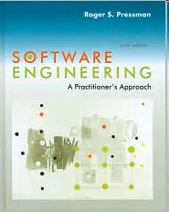
Topics in
Software Engineering
Managing Software Projects
Software Process and Project Metrics
Analysis Modeling
Design Methods
Software Testing Techniques
Software Quality Assurance
Software Configuration Management
Notes:
Note
Pressman, Software Engineering: A Practitioner's Approach
Topics included are:
The Product
The Process
Managing Software Projects
Project Management Concepts
Software Process and Project Metrics
Software Project Planning
Risk Management
Project Scheduling and Tracking
Software Quality Assurance
Software Configuration Management
Analysis Concepts and Principles
Analysis Modeling
Design Concepts and Principles
Design Methods
Design for Real-Time Systems
Software Testing Techniques
Software Testing Strategies
Technical Metrics for Software
Object-Oriented Concepts and Principles
Object-Oriented Analysis
Object-Oriented Design
Object-Oriented Testing
Technical Metrics for Object-Oriented Systems
Formal Methods
Cleanroom Software Engineering
Software Reuse
Reengineering
The Road Ahead

Slide 12

Software project management
Software project management is a sub-discipline of project management in which software projects are planned, monitored and controlled.
Notes:
Note
For those who have forgot the definition of software project management. Here are some explanations.
The purpose of project planning is to identify the scope of the project, estimate the work involved, and create a project schedule. Project planning begins with requirements that define the software to be developed. The project plan is then developed to describe the tasks that will lead to completion.
The purpose of project monitoring and control is to keep the team and management up to date on the project's progress. If the project deviates from the plan, then the project manager can take action to correct the problem. Project monitoring and control involves status meetings to gather status from the team. When changes need to be made, change control is used to keep the products up to date. (From Wiki)

Slide 13

Topics in SPM
Software project planning
Estimation
Project schedules
Reviews
Software requirements
Design and programming
Software testing
Understanding change
Management and leadership
Managing an outsourced project
Process improvement
Notes:
Note
Stellman, Applied Software Project Management

Slide 14
Project management
Project management is the discipline of planning, organizing, and managing resources to bring about the successful completion of specific project goals and objectives.

Slide 15
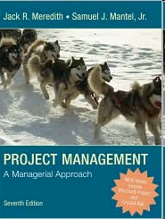
Topics in PM
Projects in Contemporary Organizations
Strategic Management and Project Selection
The Project Manager
Negotiation and the Management of Conflict
The Project in the Organizational Structure
Project Activity Planning
Budgeting and Cost Estimation
Scheduling
Resource Allocation
Monitoring and Information Systems
Project Control
Project Auditing
Project Termination
Notes:
Note
Meredith and Mantel / Project Management, Fourth Edition

Slide 16
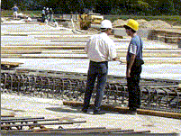
Engineering Projects
Notes:
Note
Some people argue that software development may seem to have a lot in common with construction or engineering projects, such as building a bridge and making a car.
A set of activities must be carried out in what seems to be a natural order: requirements gathering, design, building, testing, and finally putting the bridge into general service. From then on, the bridge goes into operation and maintenance. For software, the usual activities are recast as user requirements, architectural analysis, design, code and test.

Slide 17
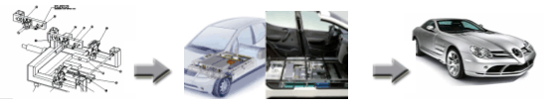
Making Cars
Notes:
Note
Tasks are serialized in construction projects. For example, you cannot lay the foundation for a building until the excavation is completed and approved. The flooring task must not begin until the joists are inspected and signed off. Early approaches to software development tried to follow the same discipline.
(1) The analysis team captured and documented the requirements.
(2) When the requirements were approved, the design started.
(3) When the design was approved, coding began.
(4) Each line of code was inspected. If it was approved, it was allowed to be integrated into the product

Slide 18
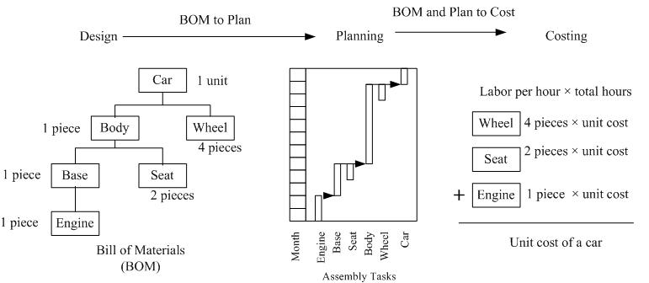
Example
Notes:
Note
If a product is considered to be made up of a number of components, sub-components and sub-sub-components, etc. then one can draw up a hierarchical architecture that consists of the complete product being at the top with a hierarchy of its sub-components, which in turn, are made up of sub-sub-components etc.
This structure is called a Bill of Materials and it is at the heart of operations in many assembly plants.
We then plan when, what types and what quantities of materials or sub-components are needed for production. The assembly task planning will allow costing to be determined

Slide 19
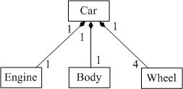
Simplified Class Diagram
Notes:
Note
Similar to engineering projects, software is often designed with the use of class diagrams
For those who have forgot the class diagram, please visit http://www.agilemodeling.com/artifacts/classDiagram.htm

Slide 20
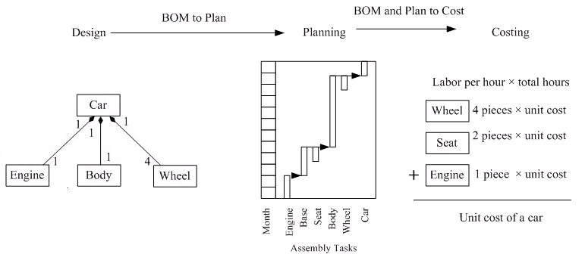
Can we do the same as …?

Slide 21
No Restrictions
There are virtually no restrictions on the ordering when we build with software components.
Notes:
Note
In software projects, products cannot be assembled with this kind of job sequence as defined with class diagrams the way Bills of Materials are, no matter how these are designed.
Programmers can work out login interfaces and main menu interfaces in an order that corresponds to how the users operate the system. But, they can also do these later on ?

Slide 22
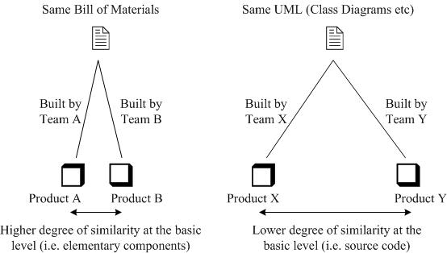
Degree of Difference
Degree of difference is a conceptual term which measures how two products can be built differently using the same design
Notes:
Note
In manufacturing, when two products, designed by two groups of engineers, eventually appear on the same Bill of Materials, we can almost speculate that these products should be built in similar ways.
Unlike bill-of-materials, class diagrams do not fully address code implementation. Given the same diagrams, implementation could be done in a variety of ways by different programmers.

Slide 23
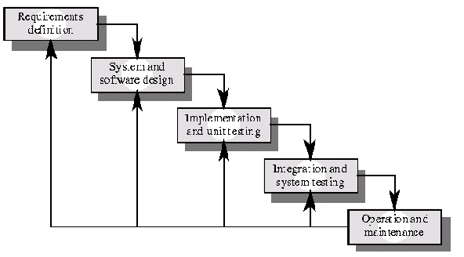
The Waterfall Model
Notes:
Note
The model was originally presented by Winston Royce in Managing Development of Large Scale Software Systems
The Waterfall Model is the earliest method of structured system development. It is the "traditional" model of software development lifecycle. Although it has come under attack in recent years for being too rigid and unrealistic when it comes to quickly meeting customer's needs, the Waterfall Model is still widely used.
It is attributed with providing the theoretical basis for other Process Models, because it most closely resembles a "generic" model for software development. It was originally presented by Winston Royce in Managing Development of Large Scale Software Systems in August 1970.

Slide 24
The Waterfall Model
Two essential steps to develop a program:
analysis and coding
Several other “overhead” steps
System Conceptualization.
Systems Analysis
System Design.
Coding
Testing
Notes:
Note
At that time, the model was actually made a lot of sense. Royce said that there were two essential steps to develop a program: analysis and coding; but precisely because you need to manage all the intellectual freedom associated with software development, you must introduce several other “overhead” steps, which for a large project can be.
The waterfall model has been under attack in recent years for being too rigid and unrealistic
It is still widely used

Slide 25
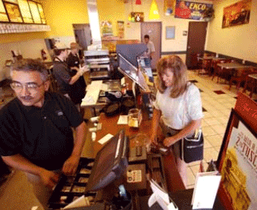

System Conceptualization
Notes:
Note
System Conceptualization refers to the consideration of all aspects of the targeted business function or process, with the goals of determining how each of those aspects relates with one another, and which aspects will be incorporated into the system.

Slide 26
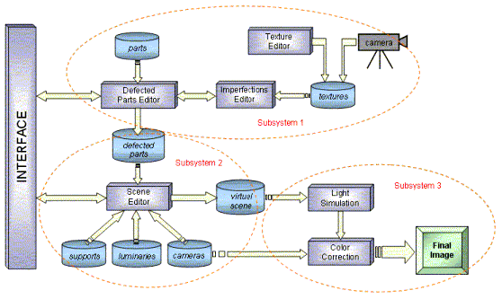
System Analysis
Notes:
Note
This step refers to the gathering of system requirements, with the goal of determining how these requirements will be accommodated in the system. Extensive communication between the customer and the developer is essential.

Slide 27
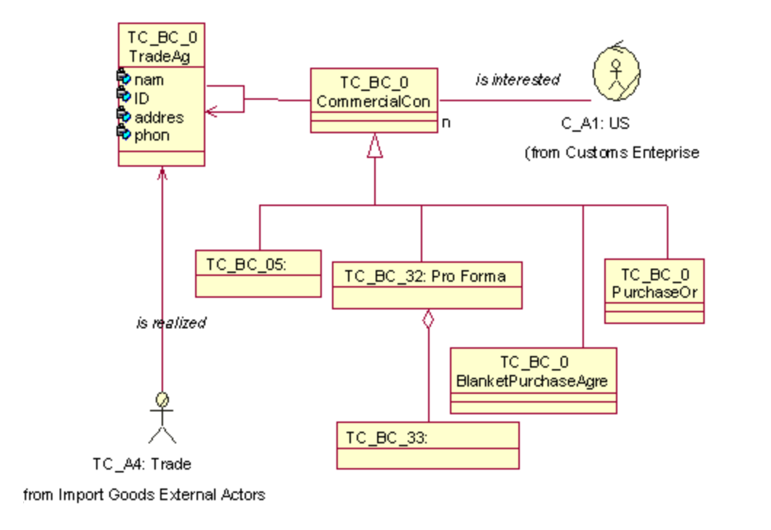
Design
Notes:
Note
Once the requirements have been collected and analyzed, it is necessary to identify in detail how the system will be constructed to perform necessary tasks. More specifically, the System Design phase is focused on the data requirements (what information will be processed in the system?), the software construction (how will the application be constructed?), and the interface construction (what will the system look like? What standards will be followed?).

Slide 28
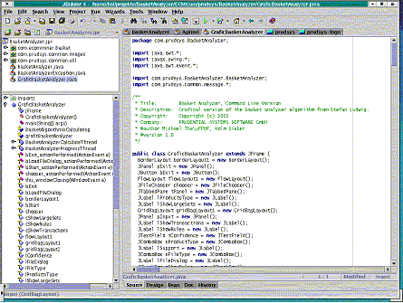
Coding
Notes:
Note
Also known as programming, this step involves the creation of the system software. Requirements and systems specifications from the System Design step are translated into machine readable computer code.

Slide 29
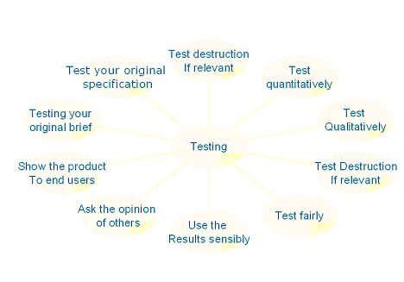
Testing
Notes:
Note
As the software is created and added to the developing system, testing is performed to ensure that it is working correctly and efficiently. Testing is generally focused on two areas: internal efficiency and external effectiveness.
The goal of external effectiveness testing is to verify that the software is functioning according to system design, and that it is performing all necessary functions or sub-functions.
The goal of internal testing is to make sure that the computer code is efficient, standardized, and well documented. Testing can be a labor-intensive process, due to its iterative nature.

Slide 30

What does “waterfall” imply?
No going back
Documentation driven
Notes:
Note
The name “waterfall model” suggests that there is no going back, once a phase is completed.
Also The documentation for that phase must not be altered.

Slide 31


Group Discussion
When should we use the Waterfall?
  Bad things?
  Good things?

Slide 32
Acceptable Fail
Succeeding when everyone else fails is nice
failing when everyone else succeeds is fatal
Notes:
Note
Waterfall is an acceptable fail. Succeeding when everyone else fails is nice, but failing when everyone else succeeds is fatal. When everyone is using technology X, it is ok to fail if you use technology X, but fatal if you had used technology Y instead. It's fatal to technology Y, so the answer is yes. This is a complicated issue.
Consider the following scenarios:
Scenario 1. Give someone $400. Then offer them a choice of gaining $100, no risk, or a 50/50 chance of gaining $90/$110. People nearly always take the $100. ''
Scenario 2. Give someone $600. Then tell them they have a choice between losing $100 or a 50/50 chance of losing $90/$110. People nearly always take the risk.
People don't really believe in change. You can tell them 50/50 but they mentally discount in favor of the status-quo. So a 50/50 gain is treated as a 40/60 gain while a 50/50 loss is treated as 60/40. So people take the certain $100 gain and prefer to punt for the $90 loss

Slide 33

Data and Space
Data expands to fill the space available for storage.
Notes:
Note
It is a corollary of "Parkinson's Law"

Slide 34

Parkinson's Law
Work expands to fill the time available for its completion.
Parkinson's Law published in The Economist in 1955
Notes:
Note
"Parkinson's Law" could be generalized further still as:
The demand upon a resource tends to expand to match the supply of the resource.
An extension is often added to this, stating that:
the reverse is not true.

Slide 35
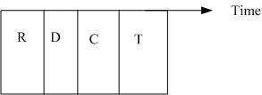
Chance of completing the project on time
Notes:
Note
According to Parkinson's Law, it is rare for a software team to complete its tasks on time.
Assuming that the probability of delay in project schedule be 1/2, for four stages, we can be very pessimistic about the chance of completing the project on time as (1/2)×(1/2)×(1/2)×(1/2)=1/16.

Slide 36
Agile Software Development
Agile software development refers to a group of software development methodologies based on iterative development, where requirements and solutions evolve through collaboration between self-organizing cross-functional teams.

Slide 37
Contrasted with other iterative development methods
Most agile methods share other iterative and incremental development methods' emphasis on building releasable software in short time periods.
Notes:
Note
Agile development differs from other development models: in this model time periods are measured in weeks rather than months and work is performed in a highly collaborative manner.
Agile development has little in common with the waterfall model.
As of 2004, the waterfall model is still in common use. The waterfall model is the most structured of the methods, stepping through requirements-capture, analysis, design, coding, and testing in a strict, pre-planned sequence.

Slide 38
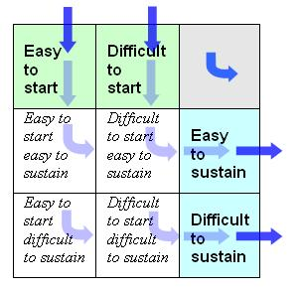
Thinking Tool: IN-OUT Diagram

Slide 39
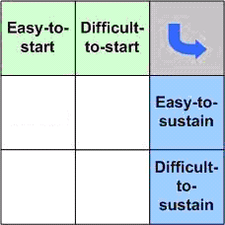
Group Discussion
Adopting a waterfall model in a project in which requirements keep changing

Slide 40
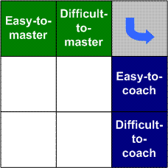
Thinking Tool: Master-Coach Diagram

Slide 41
Question…
Can you give your own case in which both IN-OUT diagram and Master-Coach diagram can be useful as a thinking tool?

