Slide 1

Unit 02: Process and people
eXtreme Programming and Agile Software Development
2011

Slide 2

Doctrine of Fair Use
This PowerPoint is prepared for educational purpose and is strictly used in the classroom lecturing.
We have adopted the "Fair Use" doctrine in this PowerPoint which allows limited copying of copyrighted works for educational and research purposes.

Slide 3
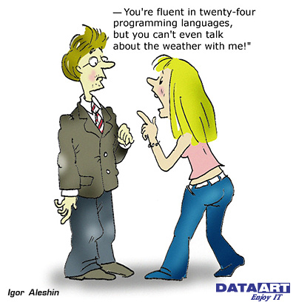
Languages and Communications

Slide 4
The SEI’s Mission
Mission: to provide leadership in advancing the state of the practice of software engineering to improve the quality of systems that depends on software
Problems: (1) cost rising by million dollars,
(2) schedule delays of not months but years
(3)multi-billion-dollar systems that don’t
perform as envisioned
Notes:
Note
The Carnegie Mellon Software Engineering Institute (SEI) found in 1984 is a federally funded research and development center headquartered on the campus of Carnegie Mellon University in Pittsburgh,

Slide 5
Maturity and Quality
Quality
Maturity
Capability
Work Product
Software
Organization
Software
Project
works on
delivers

Slide 6
What is the CMM
A staged software model
A framework for organizing these evolutionary steps into five maturity levels that lay successive foundations for continuous process improvement
Guidance of an organization to prioritize improvement efforts
Notes:
Note
The Capability Maturity Model (CMM) was originally developed as a tool for objectively assessing the ability of government contractors' processes to perform a contracted software project.
The CMM is based on the Process Maturity Framework first described in the 1989 book "Managing the Software Process" by Watts Humphrey. It was later published in a report in 1993 (Technical Report CMU/SEI-93-TR-024 ESC-TR-93-177 February 1993, Capability Maturity Model SM for Software, Version 1.1) and as a book by the same authors in 1995. (From Wiki)

Slide 7
The Evolution of the CMM
1986
1987
1991
1993
1997
SEI, with help from MITRE, began developing a process maturity framework
SEI released a brief description of the S/W process maturity framework
CMM
v1.0
CMM
v1.1
CMM
v2.0

Slide 8

Making Dynamite
Two Worst Issues You Do Not Want To See:
  It should blast but it doesn’t.
  It blasts but it shouldn’t.
Notes:
Note
Product Quality Problem:
The dynamite should blast but it doesn’t.
Process Quality Problem:
The semi-finished dynamite blast unexpectedly in the production line.
Reference: Page 4 of Textbook

Slide 9
Process: holding the pieces together
Procedures and methods defining the relationship of tasks


People with skills, training, and motivation
Tools and equipment

Slide 10
Software Engineering Process
It is a set of sequential practice that are functionally coherent and reusable for software engineering organization, implementation, an management.
Notes:
Note
Software engineering process is usually referred to as the software process, or simply process.

Slide 11

Software Process Capability
It describes the range of expected results that can be achieved by following a software process.
The software process capability of an organization provides one means of predicting the most likely outcomes to be expected from the next software project the organization undertakes.

Slide 12

Software Process Performance
It represents the actual results achieved by following a software process.
Notes:
Note
Thus, software process performance focuses on the results achieved, while software process capability focuses on results expected.

Slide 13
Software Process Maturity
Maturity implies a potential for growth in capability and indicates both the richness of an organization's software process and the consistency with which it is applied in projects throughout the organization.
Notes:
Note
It is the extent to which a specific process is explicitly defined, managed, measured, controlled, and effective.

Slide 14
Immature Versus Mature Software Organization
Immature
  SPs being improvised by practitioners
  managers being forced on solving immediate crises (fire fighting)
  Being no objective basis for judging quality
Mature
  Processes mandated being documented, usable, and consistent with the way the work actually done
→ • • → • • • → • • →

Slide 15
Software Process Improvement
Technique
Management
Organization

Slide 16
CMM’s Maturity Level
A maturity level is a well-defined evolutionary plateau toward achieving a mature software process.
Each maturity level provides a layer in the foundation for continuous process improvement.

Slide 17

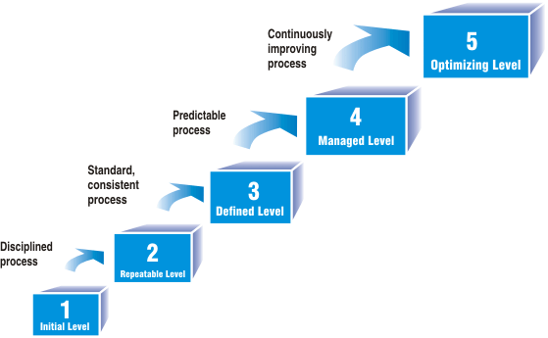
CMM
Notes:
Note
(From Wiki)
Level 1 - Ad hoc (Chaotic)
It is characteristic of processes at this level that they are (typically) undocumented and in a state of dynamic change, tending to be driven in an ad hoc, uncontrolled and reactive manner by users or events. This provides a chaotic or unstable environment for the processes.
Level 2 - Repeatable
It is characteristic of processes at this level that some processes are repeatable, possibly with consistent results. Process discipline is unlikely to be rigorous, but where it exists it may help to ensure that existing processes are maintained during times of stress.
Level 3 - Defined
It is characteristic of processes at this level that there are sets of defined and documented standard processes established and subject to some degree of improvement over time. These standard processes are in place (i.e., they are the AS-IS processes) and used to establish consistency of process performance across the organization.
Level 4 - Managed
It is characteristic of processes at this level that, using process metrics, management can effectively control the AS-IS process (e.g., for software development ). In particular, management can identify ways to adjust and adapt the process to particular projects without measurable losses of quality or deviations from specifications. Process Capability is established from this level.
Level 5 - Optimized
It is a characteristic of processes at this level that the focus is on continually improving process performance through both incremental and innovative technological changes/improvements.
Short Reference: Section 8.3.1 of Textbook

Slide 18
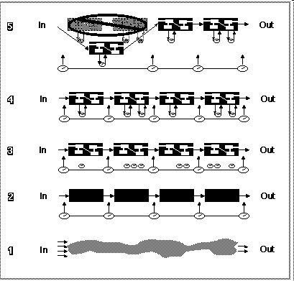
Visibility into the S/W Process
Notes:
Note
At Level 1, the software process is an amorphous entity -- a black box -- and visibility into the project's processes is limited. Since the staging of activities is poorly defined, managers have an extremely difficult time establishing the status of the project's progress and activities.
At Level 2, the customer requirements and work products are controlled, and basic project management practices have been established. These management controls allow visibility into the project on defined occasions. The process of building the software can be viewed as a succession of black boxes that allows management visibility at transition points as activity flows between boxes (project milestones). Even though management may not know the details of what is happening in the box, the products of the process and checkpoints for confirming that the process is working are identified and known. Management reacts to problems as they occur.
At Level 3, the internal structure of the boxes, i.e., the tasks in the project's defined software process, is visible. The internal structure represents the way the organization's standard software process has been applied to specific projects. Both managers and engineers understand their roles and responsibilities within the process and how their activities interact at the appropriate level of detail.
At Level 4, the defined software processes are instrumented and controlled quantitatively. Managers are able to measure progress and problems. They have an objective, quantitative basis for making decisions.
At Level 5, new and improved ways of building the software are continually tried, in a controlled manner, to improve productivity and quality.
Reference: http://www2.umassd.edu/SWPI/sei/tr24f/tr24_c2.html

Slide 19

Skipping Maturity Level
Each maturity level in the CMM forms a necessary foundation on which to build the next level.
Trying to skip level is almost always counterproductive

Slide 20
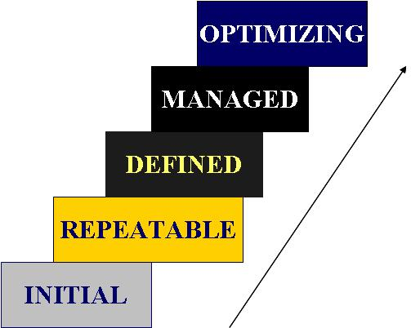
Key Process Areas
____ Requirements Management RM
_5__ Process Change Management PCM
____ Software Project Planning SPP
_5__ Technology Change Management TCM
_5__ Defect Prevention DP
____ Software Project Tracking & Oversight SPTO
____ Software Subcontract Management SSM
____ Peer Reviews PR
____ Software Quality Assurance SQA
____ Software Configuration Management SCM
____ Quantitative Process Management QPM
____ Software Quality Management SQM
____ Organization Process Definition OPD
____ Organization Process Focus OPF
_3__ Training Program TP
_3__ Integrated Software Management ISM
_3__ Software Product Engineering SPE
_3__ Integrated Coordination IC
Notes:
Note
Please fill in the blank.

Slide 21
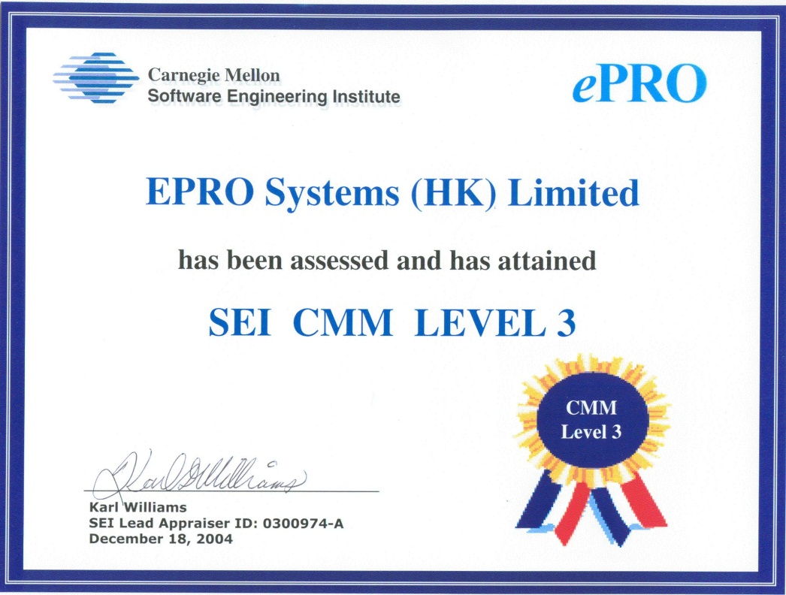
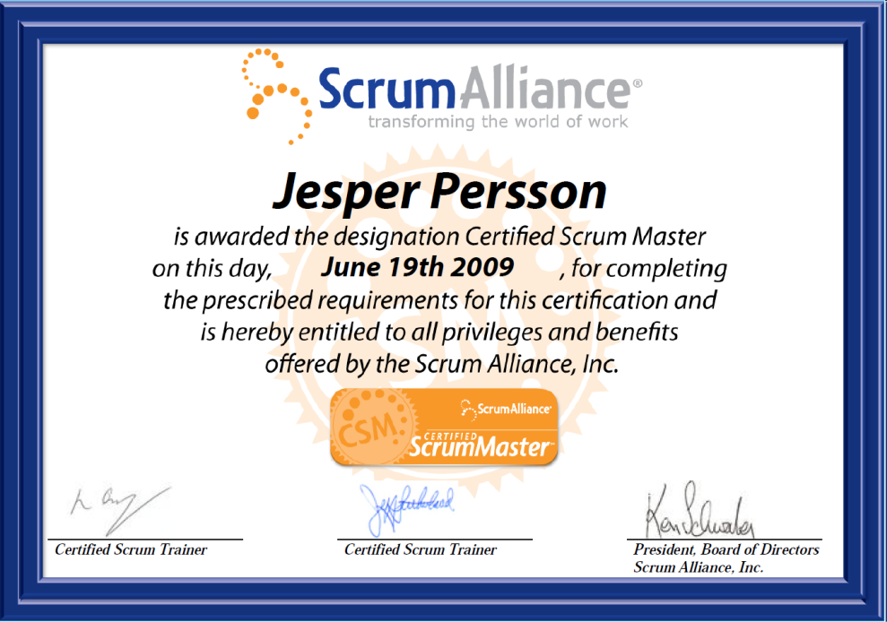
CMM
Certification

Slide 22

Group Discussion
What are the similarities between the Waterfall and the CMM in terms of structure?
If we have a team of ten developers, will it be costly to adopt CMM to develop software products?
Notes:
Note
Like ISO9000, CMM requires heavy documentation for communications.
A design diagram is taken 10 hours to complete. Consider the following two cases:
The document might be read by ten people in a team of hundred developers for communications.
(2) Or by two people in a team of ten developers.

Slide 23

Time to market
We need programmers for many 21st century electronic products.
Embedded control software is so complex that it usually takes longer to develop the software than the hardware.
The constraint is that the software cannot be effectively debugged until the hardware is ready.
Notes:
Note
Many 21st century electronic products are run by control programs that consist of hundreds of thousands or millions of lines of software. These programs require development teams of dozens or hundreds of programmers. Programming teams are often much larger than the teams developing the hardware for an electronic product.
This makes software development the largest development cost. Embedded control software is so complex that it usually takes longer to develop the software than the hardware. Since the software cannot be effectively debugged until the hardware is working, software is inevitably the gating item for product shipment.

Slide 24
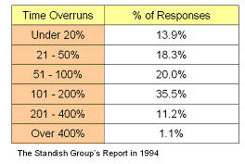
Behind Schedule
over one-third experienced time overruns of 200 to 300%.
Notes:
Note
Software schedules are notoriously unreliable. The product is far more likely to be delayed because of software bugs, or crashes than any hardware problem. In electronic product development, the main challenge is getting the software debugged.
The Standish Group reported their survey in 1994. It was found that over one-third experienced time overruns of 200 to 300%. The average overrun is 222% of the original time estimate

Slide 25
Possible Ways of achieving time-to-market
Around the clock develop
Talented People
More People
Notes:
Note
It seems that the most important factor in time to market is programmer productivity. The greater the productivity of programmers, the sooner they can finish their work, and the sooner they can get their product to market. Productivity can be in terms of an individual and a team.
Around the clock develop
Talented People
More People

Slide 26
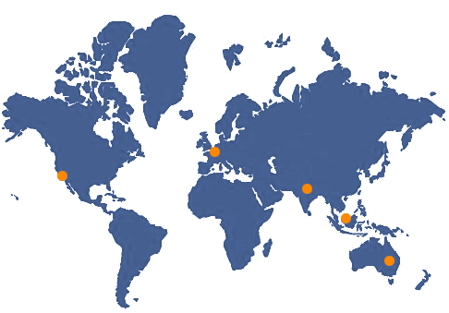
Around-the-clock development
Notes:
Note
Given time zone differences, the ideal dispersed project can be productive around-the-clock, following the sun as the earth rotates. Around-the-clock development has the potential to collapse time-to-market for project completion. Just as factory can increase production speed by running the factory in 24-hour shifts, so can dispersed software teams.
The concept of around-the-clock works as follows: when the team in the States finishes its work for the day, it sends its work, such as design modules or source code, to its sister team in China. The members read through the questions, summaries, and instructions written by their American colleagues and proceed to continue their work. As the sets in China, the local team finishes its day’s task, reversing the information flow, together with its day’s worth of added value

Slide 27
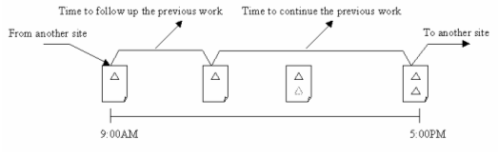
Challenge of around-the-clock working
Notes:
Note
The basic challenge of around-the-clock working here would be the time needed to follow up in order to continue the task delivered electronically from another site, and the remaining time for working and then to relay to another site at sunset, depicted in the following figure. There are two unconventional issues. The sub-process in a site must be non-interrupted or non-stopped; otherwise, the whole process will then be suspended. So is the progress. In addition, the sum of the working hours to follow up and to continue is just a day.
Anatomy of the Process of Around-the-clock Developmen

Slide 28
Group Discussion
What is the difference between on shift development and around-the-clock development ?

Slide 29

Good Enough Software

Slide 30

Good Enough Software
The term good enough software is subjective.
It totally depends on if users could not afford anything going wrong in software.
Notes:
Note
Example: In life safety systems and mission-critical systems, users could not afford anything going wrong in software.
We look at a word processor, we might find another story. Suppose that a word processor be malfunctioning once per two hours but it would not corrupt any working file. What users need to do is restart the machine when the word processor is malfunctioning.

Slide 31
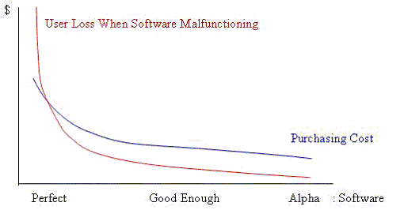
Good Enough Software
Notes:
Note
As in software, the relationships between the cost at which a user purchases software and the cost that a user bears when the software malfunctions, drive how users select either close-to-perfect software, good enough software or even bad software. Consider two systems.
A user purchases software ABC at 50 dollars, each month its quality problem causes him 1 dollar loss; and software XYZ at 200 dollars and 2 dollar loss. In this sense, software ABC is good enough.
However when the quality of software ABC may accidentally cause us 100 dollars loss, it may be rational that software XYZ is good enough. The above diagram illustrates the relationships.

Slide 32

Programmer and Programmer Capability

Slide 33

Personality and
Intelligence
People are more sensitive to the issues of intelligence than personality.
  This programmer is stubborn
  This developer is not smart enough.
Notes:
Note
People are more sensitive to the issues of intelligence than personality.
For example, how would you feel if your team leader said you weren’t intellectually up to the job?
In contrast, how would you feel if he said you were stubborn? It is probably worse to be told you are not smart enough. We are generally pretty tolerant of our human failings or we are willing to concede that we have flaws or just have different personalities. But we don’t like to think we aren’t as smart as our peers. You have to wonder if we put too much emphasis on this slippery concept we call “intelligence”.
Reference: Section 2.1 of Textbook

Slide 34

Personality
Subordinates, who have similar personality as their superiors, will be slightly more satisfied with the job instructed by their superiors
Notes:
Note
Shell and Duncan (2000) say that subordinates, who have similar personality as their superiors, will be slightly more satisfied with the job instructed by their superiors. Happy programmers work harder. They bring some sort of positive attitude into a workplace. As a consequence, problems seem easier to handle.

Slide 35
Group Discussion
Do you agree on that the success of a software project is about not only technical stuff but also lots of human factors?
If so, should a software methodology cope with both aspects equally?

Slide 36
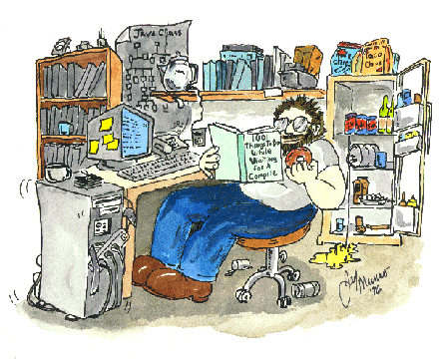
Fast and Slow
Programmer
programming is a kind of mental activity
People originate the ideas, solve the problems, and produce the products.
Therefore, talented people are the important elements in software organization.
Notes:
Note
Talented people are the most important elements in software organization because programming is a kind of mental activity.
They originate the creative ideas, solve the key problems, and produce the successful products.
Thus, it will be interesting to learn that the difference between talented people and average people in writing programs.

Slide 37
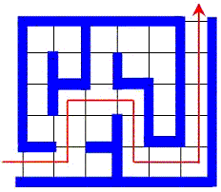
Sackman’s Study
Twelve subjects were divided into two groups solving algebraic problems and maze problems
Notes:
Note
In 1968, Sackman already conducted experiments accessing the programmer performance.
Twelve subjects were divided into two groups solving algebraic problems and maze problems, respectively. The algebraic problem was to interpret algebraic equations (Samelson 1960).
And the maze problem was to find an only path through a 20x20 cell maze (see the slide). The algebra task was harder problem than the Maze tasks.

Slide 38
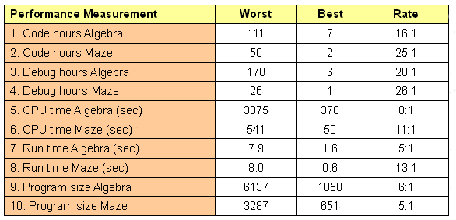
Result
Notes:
Note
The researchers measured programmer’s performance by coding time and debugging time. Man hours spent on each program until a successful pass was made through the compiler. This is called coding time.
The debugging time was considered to begin when the programmer had coded and compiled a program with no serious format errors detected by the compiler. Debugging was considered finished when the subject’s program was able to process a standard set of test inputs without errors.
The software quality was measured by (1) CPU time, (2) run time and (3) program size when the programs successful passed through the test data.
As computer power grows and computer hardware costs go down, the software quality will not be measured in terms of run time and so on. But in 1968, the software quality was judged by its performance, which has been very different from today’s criteria of software quality such as maintainability or readability. The results of the experiment are shown below.

Slide 39
Experiment
104 engineers were all given the same specifications for 10 programs and they tracked their development time, program size and defect levels for each programs.

Slide 40
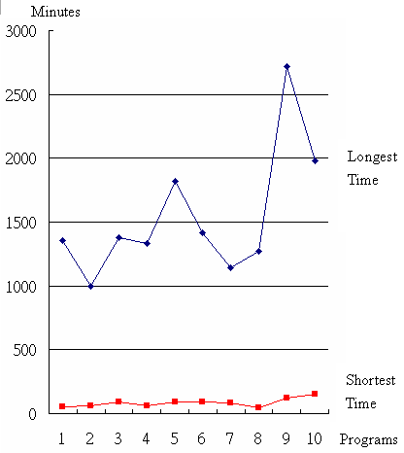
Result

Slide 41

Exercise
Use paper and pencil and draw four circles, each of which represents their view of four basic programming concepts:
    user requirements,
    system design,
    programming, and
    testing.
You may just draw however many you want on the paper.
Notes:
Note
Use paper and pencil and draw four circles, each of which represents their view of four basic programming concepts: (1) user requirements, (2) system design, (3) programming, and (4) testing. You may just draw however many you want on the paper.
This little exercise is a good starting point to show everyone that software practices matter, and that in fact they are at the heart of software design and quality.

Slide 42


Not learning from experience
Notes:
Note
Reference: Section 2.3 of Textbook

Slide 43

Perception
The same events are perceived differently by different people.
Notes:
Note
Plous shows that what we perceive is heavily influenced by what we expect and want to find.
Brehmer reports a disappointingly low correlation between length of experience and the quality of professional’s judgments.

Slide 44

Improper Learning
Model
We prefer deterministic rules
(IF <a> THEN <b>).
If no such rule is found, we start guessing
Notes:
Note
We tend to prefer deterministic rules (IF <a> THEN <b> - type of rules) even if the relationship between variables is probabilistic (IF <a> THEN 20% probability of <b> - type of rules).
If we find no deterministic rules, we tend to assume that there is no rule at all and start guessing.
Applied on software projects this means that we tend to prefer rules where the same software project characteristics lead to the same project outcomes each time.

Slide 45

Learning correctly from experience is difficult
Much of the learning may be incorrect,
Experience databases and “post mortem reviews” may include much incorrect information, and
Invalid conclusions about causal relationships may be drawn.

Slide 46

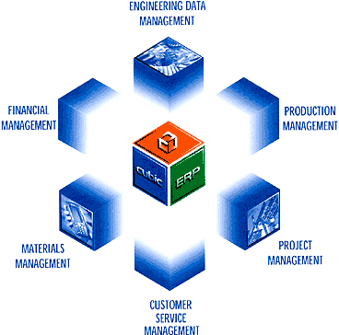
Group Discussion
Are these the same:
1 Learning from Engineering Projects
2 Learning from Software Projects

Slide 47

Experience
Change of conditions makes history invalid.
The change of conditions is frequent in a software development context
Notes:
Note
Change of conditions makes history invalid. Sometimes the experience itself changes the conditions so much that the experience is invalid. The change of conditions is particularly frequent in a software development context.
It is difficult (if not impossible) to compare what actual happened with what had happened if the actual actions were not taken. A cause effect is, therefore, very difficult in one of a kind development projects.
Experience is context dependent and much of the context is hard (impossible?) to describe.

Slide 48
