Slide 1
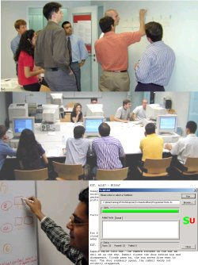
Unit 03 eXtreme Programming
eXtreme Programming and Agile Software Development
2011

Slide 2

Doctrine of Fair Use
This PowerPoint is prepared for educational purpose and is strictly used in the classroom lecturing.
We have adopted the "Fair Use" doctrine in this PowerPoint which allows limited copying of copyrighted works for educational and research purposes.

Slide 3
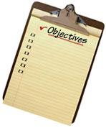
Learning Objectives
To review a software project in which the adopted methodology was later known as extreme programming
To introduce eXtreme Programming
To discuss how we may adopt eXtreme programming

Slide 4
Question for software requirements
The fact is that many programmers write software requirements in many software project
  We should not spend time on writing user requirements because they are not my requirements.
  We are not selling user requirements! We are selling software?!
  Do you think those who raise their requirements write for themselves!
Notes:
Note
Remember. There is no straightforward solution here.
One may say that users write requirements and the requirements are then converted to specifications for system design.

Slide 5
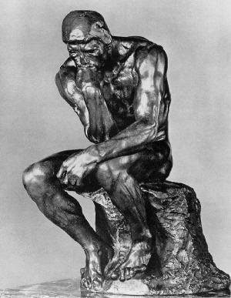
Question for design
Have you ever wondered :
  Since it is possible to write code without design, shouldn’t we set this as our new goal in software engineering?
  Many programmers do not understand formal notations. If so why don’t we take specification by code (or design by code)?!

Slide 6

Question for testing
Good quality but bad design
We have been taught to believe that the best practice is design before code!
If good software quality is the goal, it should be test before code!?
Notes:
Note
There are some controversial arguments here.

Slide 7

Replacing a legacy system
Chrysler decided to replace their twenty years old payroll system
Notes:
Note
In the early 1990s, the Payroll Services Department and the Information Services group at Chrysler Corporation decided to replace their twenty years old system.
The company first tried a pay-roll package from a leading vendor. But, it could not handle the complexities of Chrysler’s pay rules, and further analysis showed that no package could. The only option was to design and write a new payroll system

Slide 8
A Troubled Project
In 1995, Chrysler Comprehensive Compensation System, C3 in short, was launched under a fixed price contract with a joint Chrysler and contractor team。
The project was in a mess

Slide 9
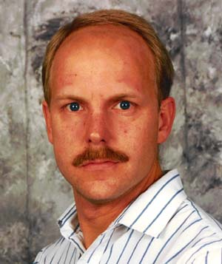
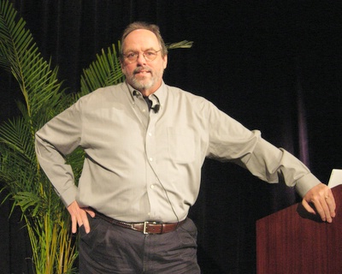

eXtreme Programming
In 1996, Chrysler called in Kent Beck to help with their struggling C3 project as an external consultant.
During 96-99, Beck, Cunningham, Jeffries and others assembled the essential elements of what we now know as eXtreme Programming.

Slide 10

Success
The XP team at Chrysler was able to deliver their first working system within one year, and
In May 1997 the first 10,000 executive employees were paid from the new C3 system.

Slide 11

End of the first XP Project
C3 project was cancelled in Feb 2000
a system with 2,000 classes and 30,000 methods was built
The methodology to build that system was documented and was called as eXtreme Programming
Notes:
Note
In February 2000, the project was cancelled because the prime contractor changed and the focus of Chrysler shifted away from C3.
When the dust settled, eight-member development had built a system with 2,000 classes and 30,000 methods.
XP had been refined and tested and was now ready for the wider development community.

Slide 12

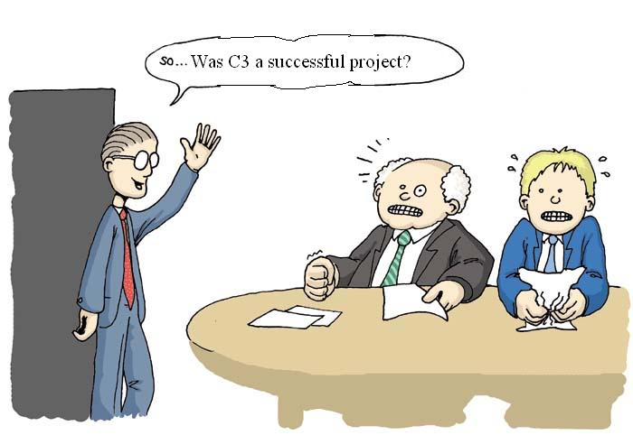
Group Discussion
Notes:
Note
One simple question: Was C3 a successful project?

Slide 13
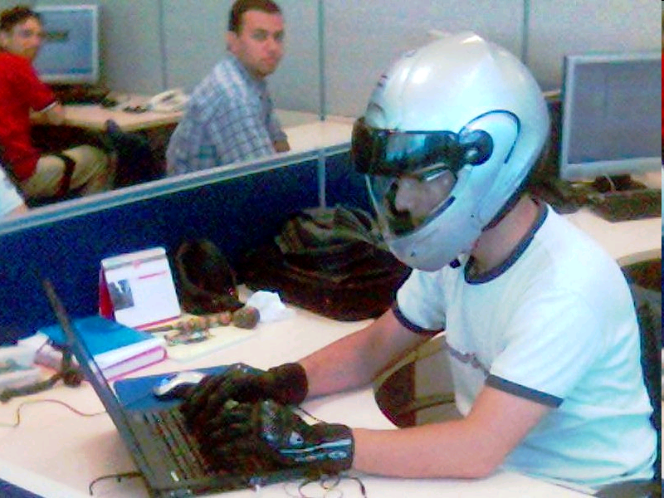
Extreme
Programming (XP)
The most widely used agile process, originally proposed by Kent Beck
XP Planning
  Begins with the creation of “user stories”
  Agile team assesses each story and assigns a cost
  Stories are grouped to for a deliverable increment
  A commitment is made on delivery date
  After the first increment “project velocity” is used to help define subsequent delivery dates for other increments

Slide 14
Extreme Programming (XP)
XP Design
  Encourage simple design
  Encourages “refactoring”—an iterative refinement of the internal program design
XP Coding
  Recommends the construction of a unit test for a store before coding commences
  Encourages “pair programming”
XP Testing
  All unit tests are executed daily
  “Acceptance tests” are defined by the customer and excuted to assess customer visible functionality

Slide 15
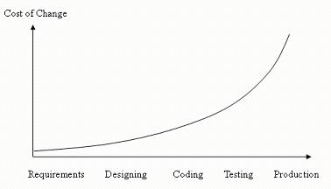
Cost of Change (Waterfall)
Notes:
Note
For example, if you make an requirements error and find it during the requirements phase it is inexpensive to fix. However, if you do not find it until the design stage, it is more expensive to fix. Similarly, if you do not find it until the coding stage, it is more expensive to fix than before.

Slide 16
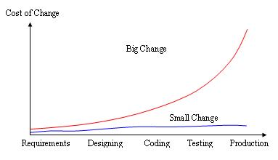
Two types of Cost of Change
Notes:
Note
The cost of change diagram has been questioned as it is not from any experiment, which was based on anecdotal evidence and initially presented as a metaphor to help people to rethink the things that they have believed for years. From a wider perspective, there can be many changes from small to big. Thus the cost of a small change will be different from big a change

Slide 17
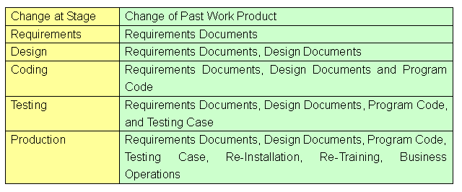
Changes in the Waterfall Model
Notes:
Note
Let us examine what we need to be changed at each stage. If any change happens at requirements stage, we need to revise the related requirements document. But if the change happens at design stage, we need to revise not only the requirements document but also design document. Thus the latter phase we change, the more work we change
But why do we have to revise the document in the previous stage? The reason is that in the waterfall different people are responsible for different stages and their communications between stages (or between people) are through documents, even though in many cases some people will be involved in more than one stage. Thus document functions as both the input and output. Following illustrates impact of changes in different stages in the waterfall.

Slide 18
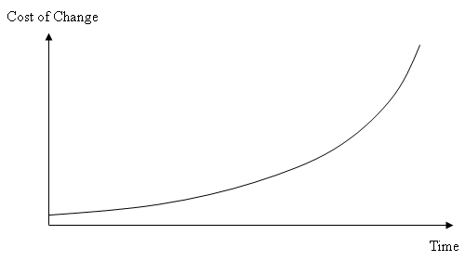
Cost of Change (Along the time)
Notes:
Note
We view different stages in terms of time. We can have a general diagram. It generalizes the meaning of cost of change. Given a software project, the cost of changing requirements and fixing errors will increases exponentially along the time

Slide 19
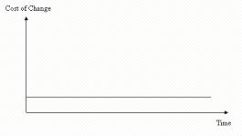
Invariant along the time
Notes:
Note
We of course expect the cost of change is invariant along the time (i.e. a flat line), which will look like the cost of small changes. This is an ideal case and cannot be easily achieved in theory and in practice. Before production, i.e. while we are developing system, it is getting bigger; we have a bigger graph diagram. Thus cost of change will increase even though we are assumed of knowing where to modify the code and how to modify the code and to forget updating documents. The cost of change still increases along time. After production, the program of the system does not change. Thus it seems that the cost of change is invariant. However, while the system is in production, the system will have more data along the time. And any big change of the program of system is often associated with data. In this case, we need to ensure data integrity and even fix bad original data as well. Thus the cost of change will also increase along time. Thus, the cost of change must increase along the whole life time of the system.

Slide 20
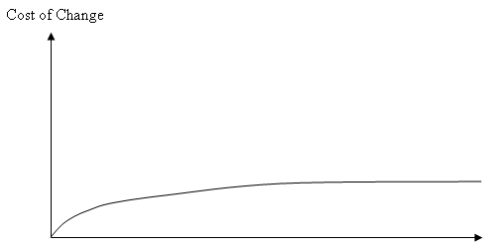
Extreme Programming: Cost of Change
Notes:
Note
To obtain such cost of change, we need a highly iterative process, which constantly get some feedback. A typical iterative process will look as follows. And eXtreme programming, on an outset, can be viewed as a highly iterative process. Note that many iterative process introduced in software management has a longer duration in each iteration than XP.

Slide 21
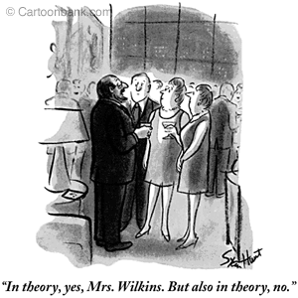
Group Discussion
Do you agree on the analysis of Cost of Change?
Notes:
Note
The cartoon is by Stan Hunt from www.cantonbank.com

Slide 22
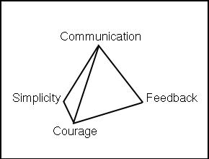
Four Values
Notes:
Note
Respect has been added recently.

Slide 23
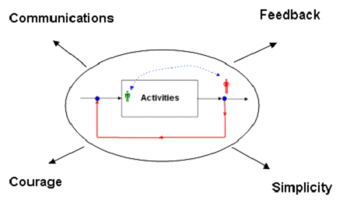
Four Values
Notes:
Note
Communications is beyond that customers and developers talk to each other. For example, the programmers ask the customers questions, but they don’t ask the customers the right question, so a critical domain decision is blown. Surely talking to each other is the fist step toward communications. Therefore, a highly iterative process cannot be established without communicating.
Simplicity: If the process is highly iterative, we only need to care “what is the simplest thing that could possibly work.” An iterative process has many repeated phase. The philosophy is that it is better to do a simple thing this phase and pay a little more to change it next phase if it needs it, than to do a more complicated thing this phase that may never be used in the subsequent phases.
Feedback works together with communications and simplicity. The more feedback we have, the easier it is to communicate.
Courage is needed for expecting changes. It is possible that we find previous fault or we need to overthrow our earlier work during iterative phases. We need courage to face it. If we always accept that there is nothing wrong previous, there is no point to have a highly iterative process.

Slide 24
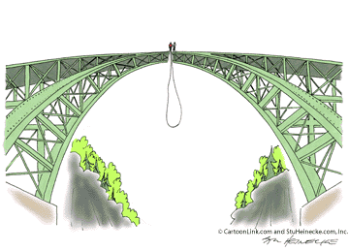
Principles
The principles that form the basis of XP are based on the values just described and are intended to foster decisions in a system development project.
The principles are intended to be more concrete than the values and more easily translated to guidance in a practical situation.
Notes:
Note
Source：http://en.wikipedia.org/wiki/Extreme_Programming#Principles

Slide 25
Four Activities
XP describes four basic activities that are performed within the software development process.
  Coding
  Testing
  Listening
  Designing

Slide 26
Listening
less reliance on written formal documentation
quality verbal communication
Notes:
Note
XP is grounded in communication and has practices that require active listening. With less reliance on written formal documentation there needs to be quality verbal communication. Beyond simply saying that developers should listen to customers, XP has practices that direct and guide toward better communication. Without the reliance on documentation, a XP team is forced to learn and mature in the form of verbal communication

Slide 27
Testing
developers write tests before they develop code
quality built-in rather than waiting to catch bugs later
Notes:
Note
Testing in XP is not an afterthought to be done before delivery to the customer, but an interval step throughout the process. In fact, XP put emphasis on that developers write tests before they develop code (We will discuss more in XP practices). This requires a shift in thinking for developers. The result is code that has quality built-in rather than waiting to catch bugs later in the development cycle where costs are usually higher

Slide 28
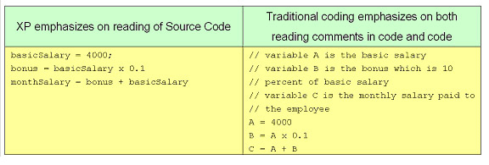
Coding
Notes:
Note
XP is about programming after all, and writing code is a craft that is refined through practices such as Refactoring, pair programming, and code review. With a little design, XP developers write code that intentionally expresses their meaning. By the mere reading of source code, other team member can understand logic, algorithms, and flow. It must be understood here that we are not talking about comments in code, but the code itself as a form of communication.

Slide 29
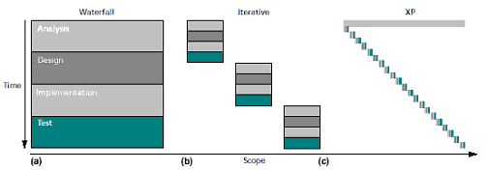
Designing
Notes:
Note
One of XP’s radical ideas it that design should evolve and grow through the project. Design is not stationary or assigned to one role, but is both team-based and dynamic. In one sense, software is always in a state of being designed. Instead of ignoring this fact by limiting design activities, XP accepts the natural evolution of the system.
All the above can be summarized in a well-known diagram depicting the evolution from the waterfall to XP presented by Kent. So far we have explained what XP is and how XP is different from the traditional method.

Slide 30
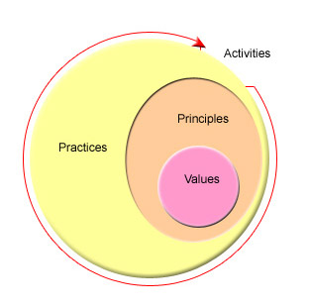
Summary

Slide 31
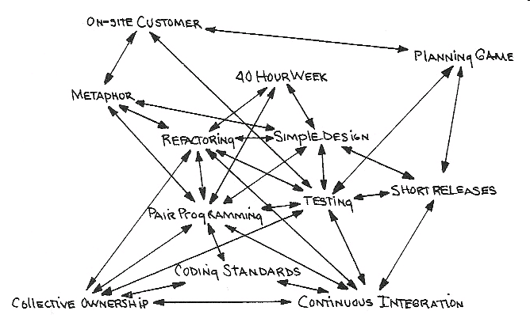
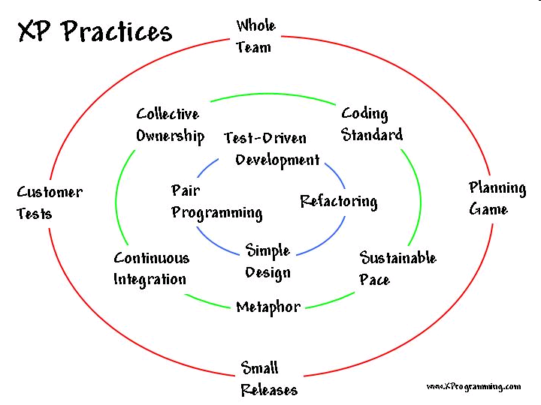
12 Practices
Notes:
Note
http://ullizee.wordpress.com/2009/11/page/2/

Slide 32
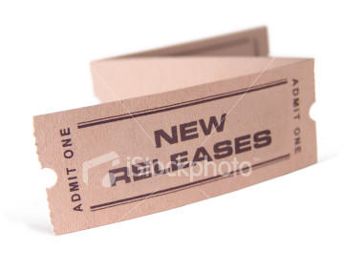
[1] Small Releases
We want to have a highly iterative process. After one or a few iterative cycles, we may release a small product to customers.
Notes:
Note
By keeping releases small and frequent, we therefore get more feedback from them.
This feedback makes several things possible. It allows the programmers to accurately predict, within a few weeks of project start, how much work will be done by the project deadline.

Slide 33
[2] Planning Game
Customers decide the scope and schedule of releases based on estimates provided by programmers
Programmers implement only the functionality demanded by the stories in this iteration.

Slide 34
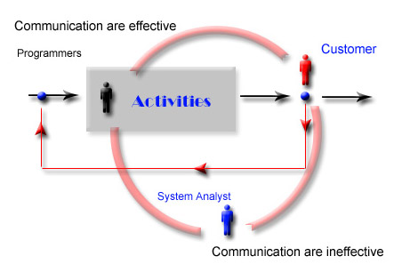
Traditional Approach
Notes:
Note
In traditional approach, we do probably have people such as called system analyst to communicate between customers and programmers by developing heavy documents.
This way however will only make the whole iterative less efficiently and less speedy. Thus, for this reason, in XP, programmers and customers work closely together and talk to each other directly. The obvious advantage is that the number of interactions is reduced and decision-making is simplified.

Slide 35
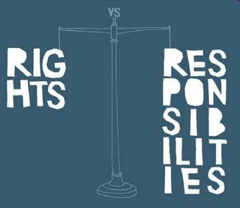
Bill of Rights for
Customers
Providing overall plan
valuing out of every programming week
passing repeatable tests
changing their minds
reducing scope to restore the original date
Notes:
Note
Customers have:
1.the right to an overall plan, and to know what can be accomplished, when, and at what cost.
2.the right get the most value out of every programming week.
3.the right to see the progress in a running system, proven to work by passing repeatable tests that they specify.
4.the right to change their minds, to substitute functionality, and to change priorities without paying much too high costs
5.the right to be informed of schedule changes in time to choose how to reduce scope to restore the original date. They can cancel at any time and be left with a useful working system that reflects investment to date.

Slide 36
Bill of Rights for
Programmers
knowing what is need (priority)
producing quality work
receiving help from peers
updating their own estimates
accepting your responsibilities
Notes:
Note
1 The right to know what is need, with clear declarations of priority.
2.the right to produce quality work at all times
3.the right to ask for and receive help from peers, superiors, from other experts and customers.
4.the right to make and update their own estimates
5.the right to accept your responsibilities instead of having them assigned to them

Slide 37

Bill of Responsibilities for Customers
define user stories
decide what business value
decide what stories to build in the next release
demonstrate courage
Notes:
Note
the responsibility to define user stories, which is pieces of requirements written on a index card.
the responsibility to decide what business value the stories have
the responsibility to decide what stories to build in the release the responsibility to write user acceptance tests
the responsibility to demonstrate courage.
XP is a way from where they are today to where they want to be. The team can help them find it if the customers will help the team find it

Slide 38
Bill of Responsibilities for Programmers
estimate how long to build
warn the customers of technical risks
measure the development progress
demonstrate courage
Notes:
Note
the responsibility to estimate how long each story will take to build
the responsibility to warn the customers of technical risks
the responsibility to measure the development team’s progress.
the responsibility to demonstrate courage as well.

Slide 39
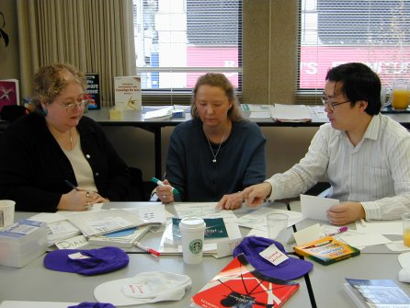
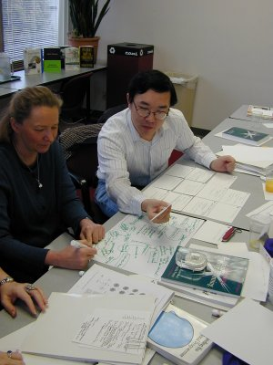
Planning Game
http://industriallogic.com/training/xp0101/planning.html

Slide 40
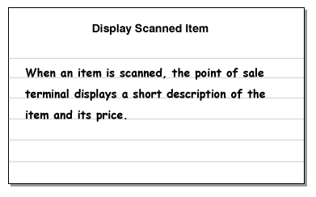
User Story
User Stories are simple descriptions of a single aspect of our system.
A user story must to be small enough for the team to develop within an iteration
Notes:
Note
For your reference, Ward Cunningham and Kent Beck proposed Class Responsibility Collaboration (CRC cards) in 1989, a brainstorming tool used in the design of object-oriented software.
In addition, Ward Cunningham was the founder of the first wiki.

Slide 41
Example of User Story
001 User Registration
When the user selects to register, they should be taken to the registration page, which prompts the user for an email address, first name, last name, affiliation, and whether or not they want to be notified of changes to the site. Upon submit, the system generates a password and e-mails it to the user.
Ideal Days=Two days

Slide 42
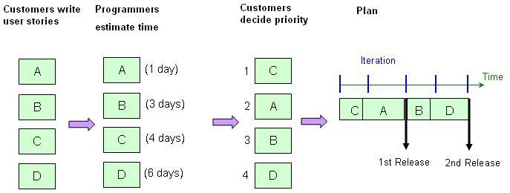
Prioritized Stories

Slide 43

[3] On-site Customer
A customer sits with the team (full-time, part-time).

Slide 44
User Story and On-site Customer
User stories lack detail and need for explantion
Mandate that the customer be on the project full-time
Notes:
Note
Unlike traditional requirement documents, user stories lack detail and call for clarifies; programmers will have to speak to the customer.
To support the fast iteration development, we have to reduce the amount of documents and even sign-off procedures.
With XP, we get extreme about customer involvement, we’ll mandate that the customer be on the project full-time for the duration and be located on-site with the team.

Slide 45

[4] Metaphor
What is Spinning
The shape of the system is defined by a metaphor or set of metaphors shared between the customer and programmers.
Example : The user interface is like a spreadsheet. It displays all of the results of query in tabular format.

Slide 46
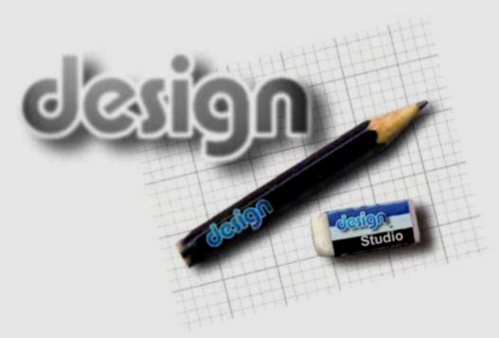
[5] Simple Design
Simple design means coding for today's specified requirements, and no more.
It expressly suggests not coding for extensions or changes programmers think might be required later. everything once and only once.”
Notes:
Note
Simple means enough to allow you to keep moving.
Don't design for something that isn't needed today.
A program built with XP should be the simplest program that meets the current requirements.
There is not much building for the future.
Instead, the focus is on providing business value. Of course it is necessary to ensure that a good design is used, and in XP this is brought about through Refactoring.

Slide 47

Critics
Weak in design
No big design up-front
Notes:
Note
Critics claim that XP is weak in design as it lacks a design phase.
The difference between XP and waterfall is that with XP there is no big design up-front.
The thinking in XP is that design is a continuous process that happens at both the conceptual and physical levels.
This makes sense when we consider the change is given in XP and we’re never quite sure what is around the corner.

Slide 48
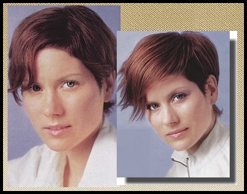
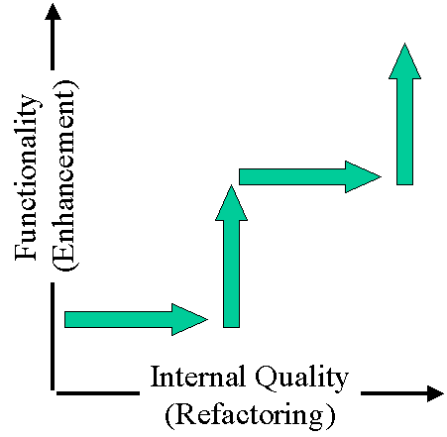
[6] Refactoring
Refactoring is the process of clarifying and simplifying the design of (existing, new) code, without changing its behavior.
x ² – 1 can be refactored
as (x -1) (x + 1).

Slide 49

Code Smells
Example by Martin Fowler
After
void f() {
…..
computeScore();
}
void computeScore() {
score = a * b + c;
score -= discount;
}
Before
// Assume all are instance
// variables
void f() {
…..
// Compute Score
score = a* b + c;
score -= discount;
}

