Slide 1
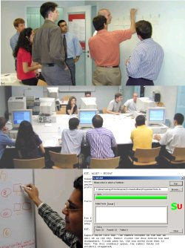
Unit 03 eXtreme Programming
eXtreme Programming and Agile Software Development
2011

Slide 2

Doctrine of Fair Use
This PowerPoint is prepared for educational purpose and is strictly used in the classroom lecturing.
We have adopted the "Fair Use" doctrine in this PowerPoint which allows limited copying of copyrighted works for educational and research purposes.

Slide 3
[7] Testing (Test First)
Programmers write unit tests minute by minute.
These tests are collected and they must all run correctly.

Slide 4
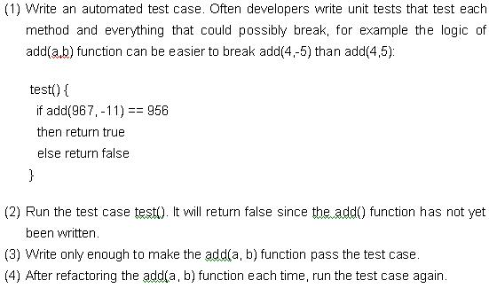
The Test/Code Cycle in XP

Slide 5

[8] Continuous Integration
New code is integrated with the current system after no more than a few (hours, days).
When integrating, the system is built from scratch and all tests must pass or the changes are discarded.

Slide 6

[9] Pair Programming
All production code is written by two people at one screen/keyboard/mouse.
Driver: writing the design and code
Observer: actively examines the work of the driver
Notes:
Note
Pair Programming is a significant focal point of XP
One person is the “driver” and has control of the pencil/keyboard/mouse and is writing the design and code
The other person, the “observer,” continuously and actively examines the work of the driver – watching for defects, thinking of alternatives, looking up resources, and considering strategic implications of the work at hand

Slide 7
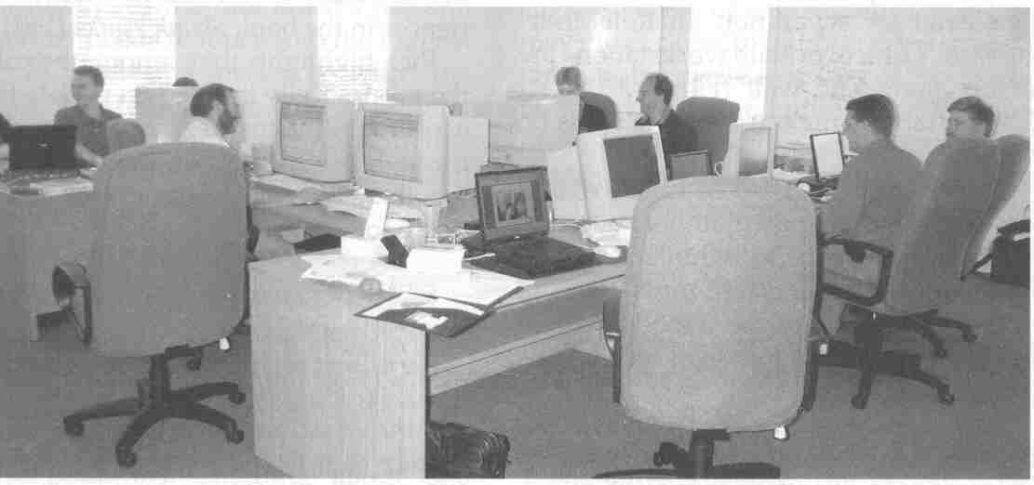
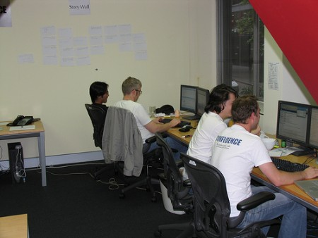
Pair Programming

Slide 8
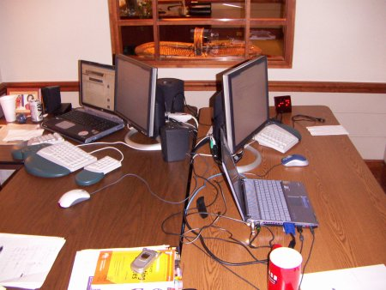
Things we do while pair programming
Making design decisions
Implementing code (test and production)
Reviewing code (test and production)
Testing code
Refactoring code (test and production)
Communicating, with your partner and indirectly with the whole team
Educating each other and, again, indirectly the whole team

Slide 9

[10] Collective Code
Ownership
Collective Code Ownership means that any pair of programmers can make any change to any part of the source code at any time.
No one person "owns" any part of the code.
Notes:
Note
Collective Code Ownership encourages everyone to contribute new ideas to all segments of the project. Any developer can change any line of code to add functionality, fix bugs, or refactor.
No one person becomes a bottle neck for changes.

Slide 10
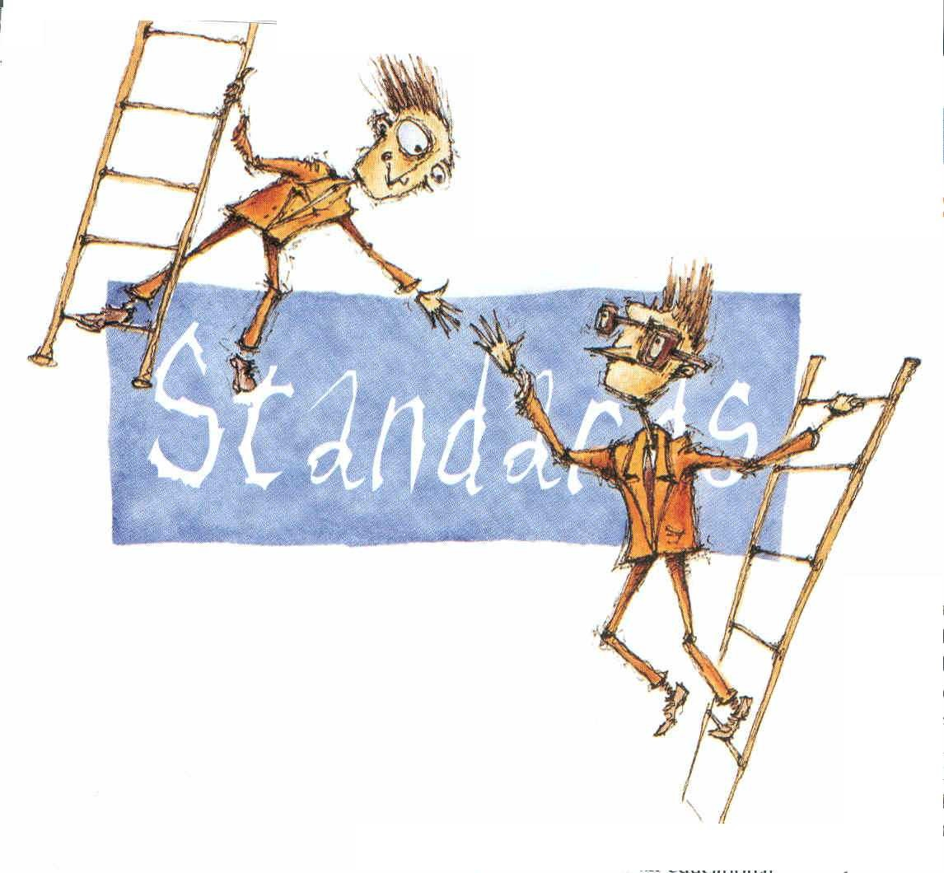
[11] Coding Standards
The purpose of coding standards
is to produce software that has a
consistent style, independent of
the author.
Notes:
Note
In XP, code is collectively owned by all XP developers, not any individual. In order for the team to share all of the code, there must be a single coding standard to which everyone adheres.
This allows the XP team to be comfortable working on any of the code, since it all looks the same.

Slide 11
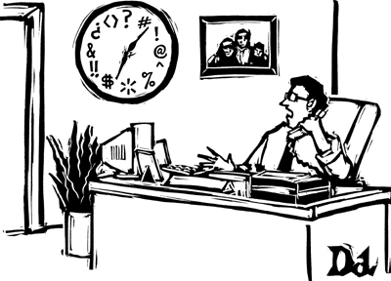

[12] Sustainable Pace
No one can work a second consecutive week of overtime.
Even isolated overtime used too frequently is a sign of deeper problems that must be addressed.
Notes:
Note
The practice was originally called 40-hour Week.
Tired programmers make more mistakes.
Extreme Programming advocates only working overtime if it is effective, and certainly not for an extended period of time.
Even isolated overtime used too frequently is a sign of deeper problems that must be addressed.

Slide 12

Workplace
All furniture against the walls is removed.
Tables for computers are placed near the center.
The walls are covered in giant whiteboards, and whiteboard-like static-cling sheets are used as wallpaper elsewhere.

Slide 13
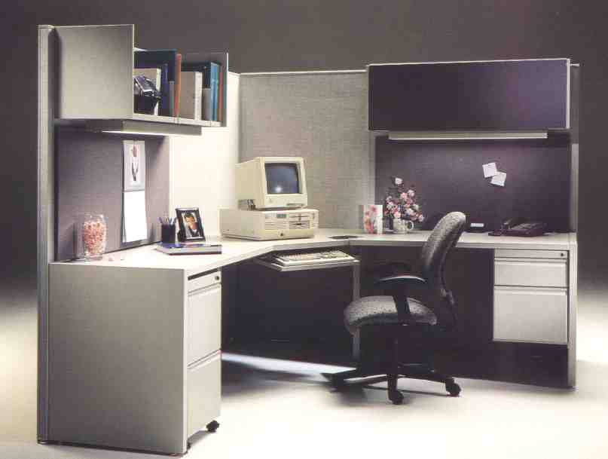
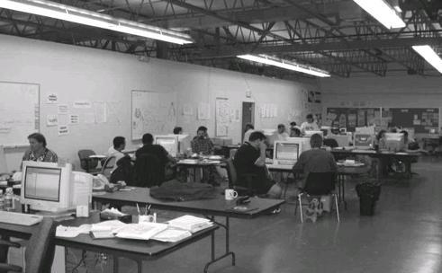
Workplace

Slide 14

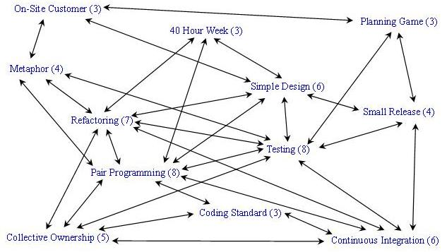
Group Discussion
Which practices are controversial?
Why?
Which are “must practices” in programming?
Why?

Slide 15

XP Adoption

Slide 16
Questions
How do you start XP?
Should we adopt all XP practices over a night?

Slide 17
Group Discussion
Phase I ________
Phase II ________
Phase III ________
Phase IV ________

