Slide 1
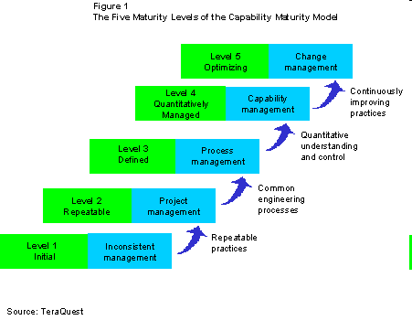
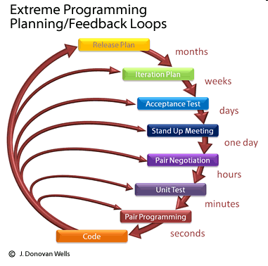
Unit 04 XP vs. CMM
eXtreme Programming and Agile Software Development
2011

Slide 2

Doctrine of Fair Use
This PowerPoint is prepared for educational purpose and is strictly used in the classroom lecturing.
We have adopted the "Fair Use" doctrine in this PowerPoint which allows limited copying of copyrighted works for educational and research purposes.

Slide 3
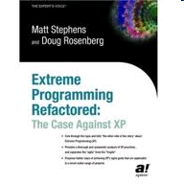


XP Books

Slide 4
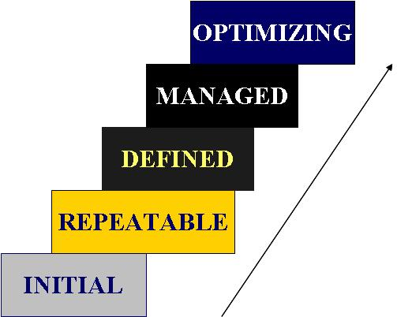
Key Process Areas (Unit 2)
____ Requirements Management RM
_5__ Process Change Management PCM
____ Software Project Planning SPP
_5__ Technology Change Management TCM
_5__ Defect Prevention DP
____ Software Project Tracking & Oversight SPTO
____ Software Subcontract Management SSM
____ Peer Reviews PR
____ Software Quality Assurance SQA
____ Software Configuration Management SCM
____ Quantitative Process Management QPM
____ Software Quality Management SQM
____ Organization Process Definition OPD
____ Organization Process Focus OPF
_3__ Training Program TP
_3__ Integrated Software Management ISM
_3__ Software Product Engineering SPE
_3__ Integrated Coordination IC
Notes:
Note
Please fill in the blank.

Slide 5
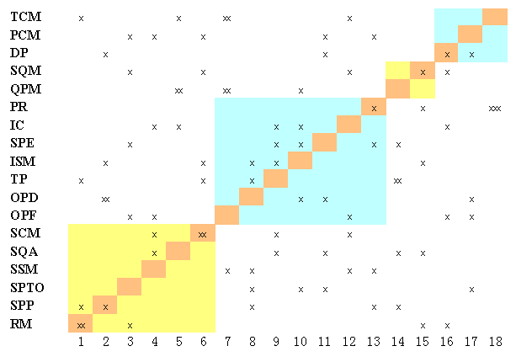
Review

Slide 6
TSP
Team Software Process (TSP) guides engineering teams that are developing software-intensive products.
Using TSP helps organizations establish a mature and disciplined engineering practice that produces secure, reliable software in less time and at lower costs.

Slide 7
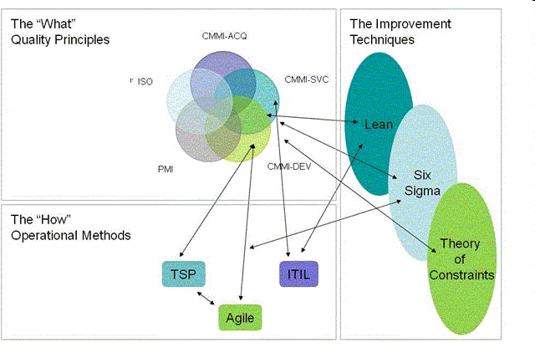
Reference
Notes:
Note
http://www.scrumalliance.org/articles/100

Slide 8
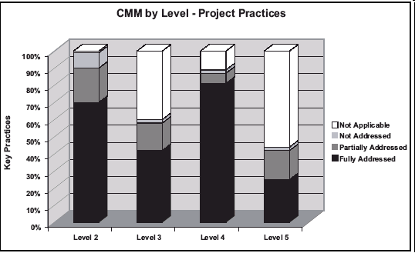
TSP and CMM
Notes:
Note
http://www.stsc.hill.af.mil/crosstalk/2005/03/0503koch.html
CMM Reference http://www.dfas.mil/technology/pal/cmm/index.htm

Slide 9
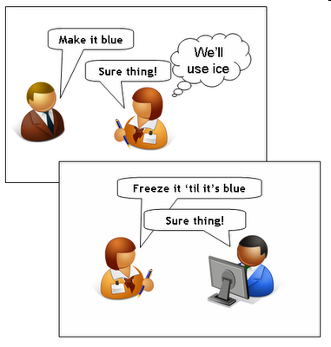
2.1 Requirements Management
The purpose of Requirements Management is to establish a common understanding between the customer and the software project of the customer's requirements that will be addressed by the software project.

Slide 10

2.2 Software Project Planning
The purpose of Software Project Planning is to establish reasonable plans for performing the software engineering and for managing the software project

Slide 11

2.3 Software Project Tracking and Oversight
The purpose of Software Project Tracking and Oversight is to establish adequate visibility into actual progress so that management can take effective actions when the software project's performance deviates significantly from the software plans.

Slide 12

2.4 Software Subcontract Management
The purpose of Software subcontract Management is to select qualified software subcontractors and manage them effectively.

Slide 13

2.5 Software Quality Assurance
The purpose of Software Quality Assurance is to provide management with appropriate visibility into the process being used by the software project and of the products being built. Software Quality Assurance is an integral part of most software engineering and management processes.

Slide 14
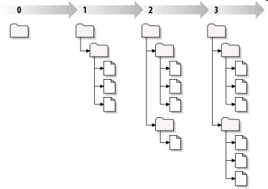
2.6 Software Configuration Management
The purpose of Software configuration management is to establish and maintain the integrity of the products of the software project throughout the project's software life cycle.

Slide 15
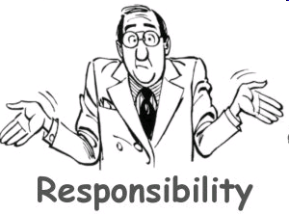
3.1 Organization Process Focus
The purpose of Organization Process Focus is to establish the organizational responsibility for software process activities that improve the organization's overall software process capability.

Slide 16

3.2 Organization Process Definition
The purpose of Organization Process Definition is to develop and maintain a usable set of software process assets that improve process performance across the projects and provide a basis for cumulative, long-term benefits to the organization.

Slide 17
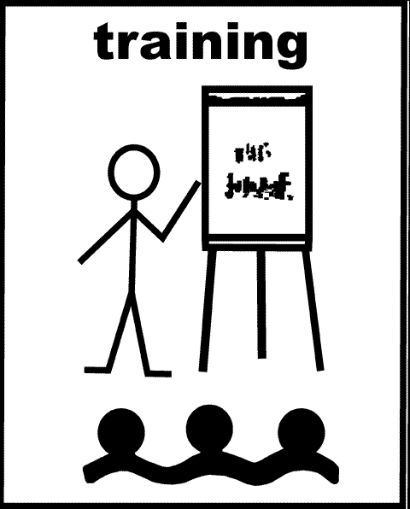
3.3 Training Program
The purpose of Training Program is to develop the skills and knowledge of individuals so they can perform their roles effectively and efficiently.

Slide 18
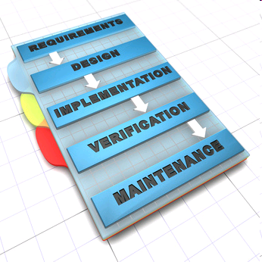
3.4 Integrated Software Management
The purpose of Integrated Software Management is to integrate the software engineering and management activities into a coherent, defined software process that is tailored from the organization's standard software process and related process assets, which are described in Organization Process Definition.

Slide 19
3.5 Software Product Engineering
The purpose of Software Product Engineering is to consistently perform a well-defined engineering process that integrates all the software engineering activities to produce correct, consistent software products effectively and efficiently.

Slide 20

3.6 Intergroup Coordination Level
The purpose of Intergroup Coordination is to establish a means for the software engineering group to participate actively with the other engineering groups so the project is better able to satisfy the customer's needs effectively and efficiently.

Slide 21

3.7 Peer Review
   The purpose of Peer Reviews is to remove defects from the software work products early and efficiently. An important corollary effect is to develop a better understanding of the software work products and of the defects that can be prevented.

Slide 22

4.1 Quantitative Process Management
The purpose of Quantitative Process Management is to control the process performance of the software project quantitatively.

Slide 23

4.2 Software Quality Management
The purpose of Software Quality Management is to develop a
quantitative understanding of the quality of the project's software
products and achieve specific quality goals.

Slide 24
5.1 Defect Prevention
The purpose of Defect Prevention is to identify the causes of defects and prevent them from recurring.

Slide 25
5.2 Technology Change Management
The purpose of Technology Change Management is to identify beneficial new technologies (i.e., tools, methods, and processes) and transfer them into the organization in an orderly manner, as is described in Process Change Management.

Slide 26
5.3 Process Change Management
The purpose of Process Change Management is to continually improve the software processes used in the organization with the intent of improving software quality, increasing productivity, and decreasing the cycle time for product development.

Slide 27
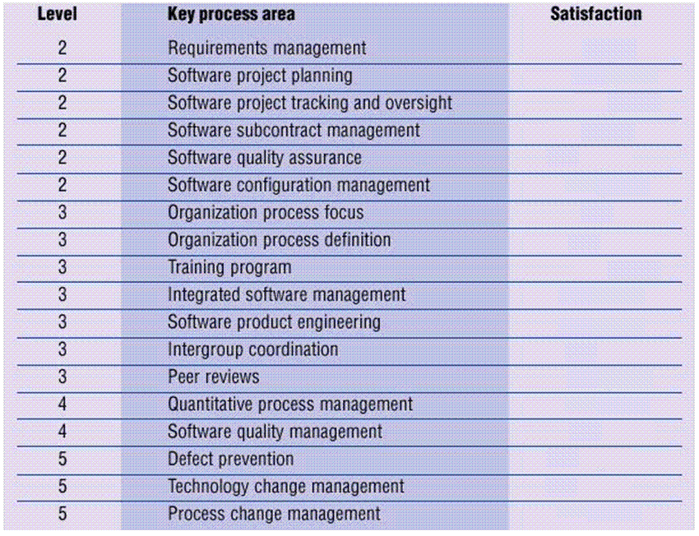

Slide 28
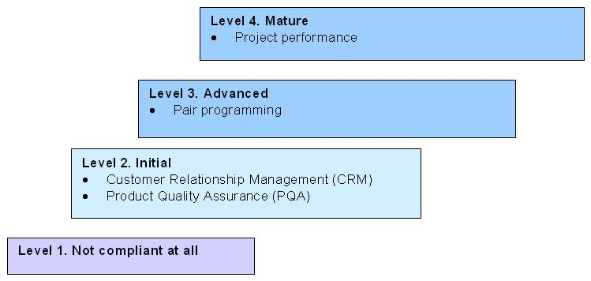
Maturity Level
Notes:
Note
http://ieeexplore.ieee.org/xpl/freeabs_all.jsp?arnumber=952459

Slide 29
Discussion
How do we implement twelve XP practices?
How do we start XP?
Should we switch to adopting all twelve XP practices over night?

Slide 30
Discussion
Phase I ________
Phase II ________
Phase III ________
Phase IV ________

Slide 31
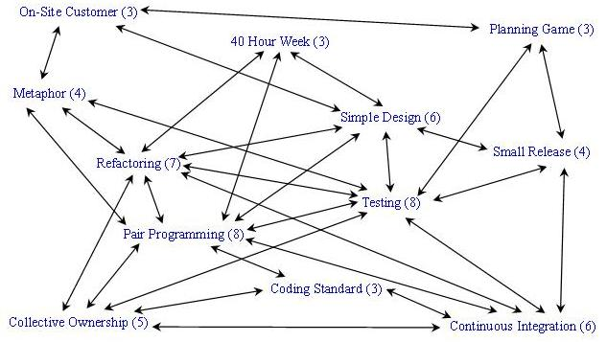
XP Practices

Slide 32
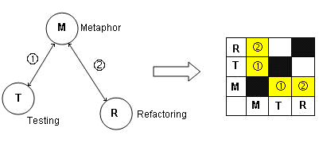
Representation

Slide 33
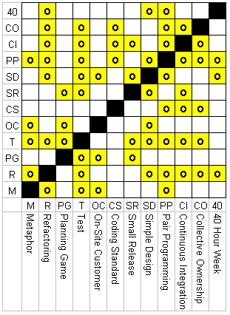
Matrix

Slide 34
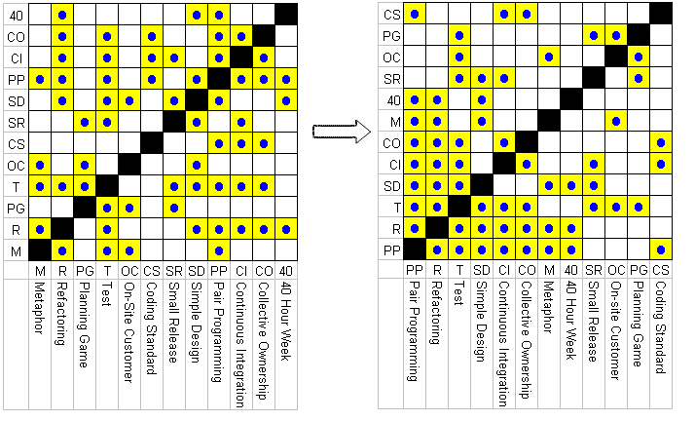
Swap Rows and Columns

Slide 35
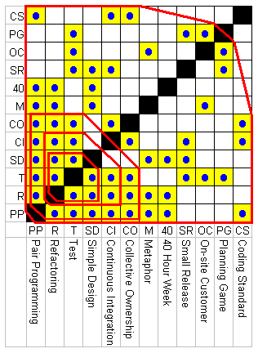
Implementation

Slide 36
Reference
Paulk, Mark C., "Extreme Programmming From a CMM Perspective", XP Universe Conference Papers, Raleigh, NC, 23-25 July 2001.
http://www.sei.cmu.edu/cmm/papers/xp-cmm-paper.pdf
XP and the CMM ftp://www.ufv.br/dpi/mestrado/XP/XP%20and%20the%20CMM.pdf
Are CMM and Agile Methods Really Compatible? http://www.soberit.hut.fi/T-76.5650/Spring_2004/Papers/P.Laurila_76650_final.pdf
Comparison of CMM Level 2 and eXtreme Programming http://info.iet.unipi.it/~vaglini/GQ/Articoli/CMMIeXtreme.pdf

