Slide 1

Unit 05
eXtreme Programming and Agile Software Development
2010
Notes:
Note
See Agility through Discipline: A Debate
http://www2.computer.org/portal/web/csdl/doi/10.1109/MC.2003.1204374

Slide 2

Doctrine of Fair Use
This PowerPoint is prepared for educational purpose and is strictly used in the classroom lecturing.
We have adopted the "Fair Use" doctrine in this PowerPoint which allows limited copying of copyrighted works for educational and research purposes.

Slide 3
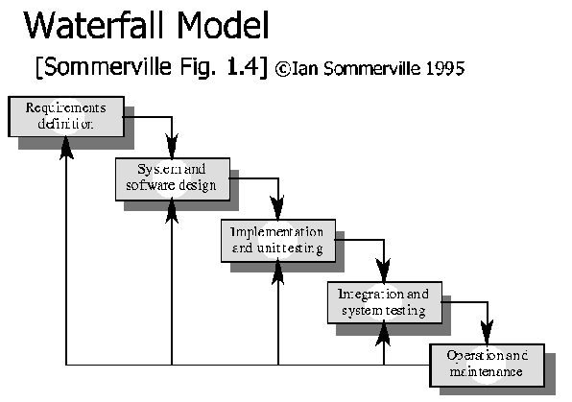
The Waterfall Model

Slide 4
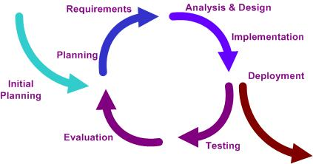
The Iterative Model

Slide 5
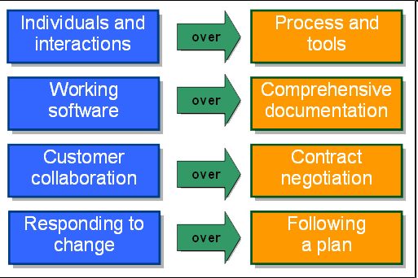
Agile Manifesto
Originally called lightweight development methods
  Methods are different from conventional methods
  software quickly deal with uncertainties
Notes:
Note
Originally, XP, Scrum and other methods were called “lightweight” or “light” development methods.
Each method was finding similar ways of building software quickly and dealing with uncertain of changing requirements.
They differ in execution or approach but there is a fundamental values and principle alignment.
This alignment was underlined when the Agile Manifesto was written and signed during the Snowbird gathering.

Slide 6
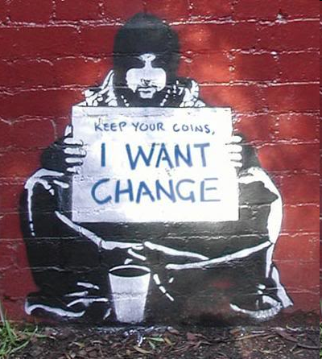
What is “Agility”?
Effective (rapid and adaptive) response to change
Effective communication among all stakeholders
Drawing the customer onto the team
Organizing a team so that it is in control of the work performed
Yielding …
Rapid, incremental delivery of software

Slide 7
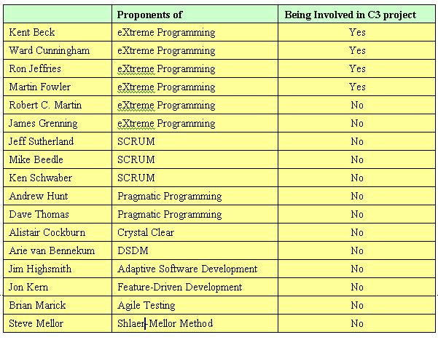
Agile Software Development
Notes:
Note
The Agile Manifesto is a statement of the principles that underpin agile software development. It was drafted from 11 to 13 February 2001, at The Lodge at the Snowbird ski resort in the Wasatch Range of mountains in Utah[2], where representatives of various new methodologies (From Wiki)
Pragmatic Programming
All programming is maintenance programming, because you are rarely writing original code. If you look at the actual time you spend programming, you write a bit here and then you go back and make a change. Or you go back and fix a bug. Or you rip it out altogether and replace it with something else. But you are very quickly maintaining code even if it's a brand new project with a fresh source file. You spend most of your time in maintenance mode. So you may as well just bite the bullet and say, "I'm maintaining from day one." The disciplines that apply to maintenance should apply globally. It's only the first 10 minutes that the code's original, when you type it in the first time. That's it.
Don't Repeat Yourself (or DRY). DRY says that every piece of system knowledge should have one authoritative, unambiguous representation. Every piece of knowledge in the development of something should have a single representation. A system's knowledge is far broader than just its code. It refers to database schemas, test plans, the build system, even documentation.
Be Orthogonal: The basic idea of orthogonality is that things that are not related conceptually should not be related in the system. Parts of the architecture that really have nothing to do with the other, such as the database and the UI, should not need to be changed together. A change to one should not cause a change to the other. Unfortunately, we've seen systems throughout our careers where that's not the case.
DSDM Dynamic Systems Development Method
ASD replaces the traditional waterfall cycle with a repeating series of speculate, collaborate, and learn cycles.
Agile testing is a software testing practice that follows the principles of the agile manifesto, emphasizing testing from the perspective of customers who will utilize the system. Agile testing does not emphasize rigidly defined testing procedures, but rather focuses on testing iteratively against newly developed code until quality is achieved from an end customer's perspective. In other words, the emphasis is shifted from "testers as quality police" to something more like "entire project team working toward demonstrable quality."
The Shlaer-Mellor method, developed by Sally Shlaer and Stephen Mellor, is one of a number of object-oriented analysis (OOA) / object-oriented design (OOD) methods which arrived in the late 1980s in response to established weaknesses in the existing structured analysis and structured design (SASD) techniques in use by (primarily) software engineers.

Slide 8
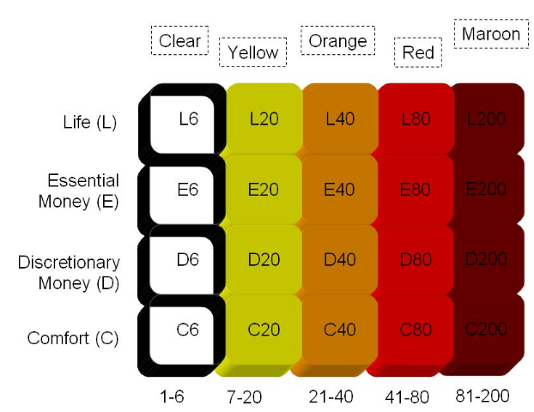

Crystal Clear
Notes:
Note
Crystal is not actually a methodology itself, but a family of methodologies that vary based on the size and complexity of the project.
If a project starts as a Crystal Clear project it should not expect to transition to a Crystal Maroon project. The founder implies that should the project turn into a Maroon project, the project should adopt the characteristics and practices of a Maroon project, and not expect to "grow" the prior Crystal Clear practices over time.
Regardless of which Crystal implementation you choose, you will find seven key principles at the heart of each:
Frequent Delivery: Project owners/customers can expect deliverables from the team(s) every couple of months. On larger or more critical projects the deliverables may not go into production but stakeholders will see intermediate versions and be able to provide feedback.
Continual Feedback: The entire project team meets on a regular basis to discuss project activities. The team also meets with stakeholders regularly to make sure the project is heading in the expected direction and to communicate any new discoveries that may impact the project.
Constant Communication: Small projects expect the entire team to be in the same room, while larger projects are expected to be co-located in the same facility. All projects expect to have frequent access to the person(s) defining the requirements.
Safety: Crystal is somewhat unique in its focus on the safety aspect of software development. This comes in two forms. One is the safe zone that team members must have to be effective and to communicate truth during the project without fear of reprisal; this is true of most Agile methodologies. The other form of safety that only Crystal recognizes is that the purpose of each software project is not the same and that some software projects are affect the safety of their end-users. For example, a space shuttle system is much more critical than a recipe organizer.
Focus: Team members are expected to know the top two or three priority items each member should be working on and should be given time to complete them without interruption.
Access to Users: As with most Agile methods, Crystal expects that the project team will have access to one or more users of the system being built.
Automated Tests and Integration: Crystal has various capacities for verification of project functionality. Controls must be put in place to support versioning, automated testing, and frequent integration of system components.

Slide 9
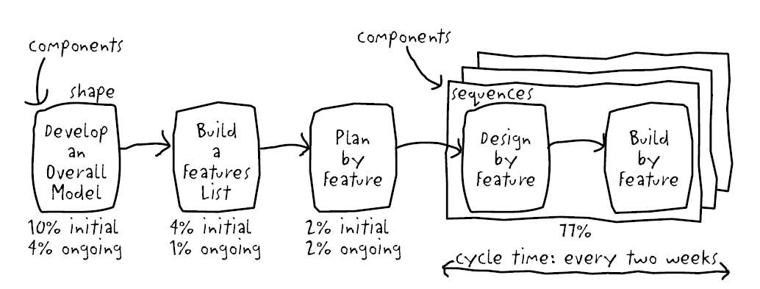
FFD
Notes:
Note
Now that the feature list is complete, the next step is to produce the development plan. Class ownership is done by ordering and assigning features (or feature sets) as classes to chief programmers.
<action> <result> <object>
For example, calculate the total of a sale, calculate the total quantity sold by a retail outlet for an item description

Slide 10

Agile Manifesto
“We are uncovering better ways of developing software by doing it and helping others do it. Through this work we have come to value:
  Individuals and interactions over processes and tools
  Working software over comprehensive documentation
  Customer collaboration over contract negotiation
  Responding to change over following a plan
That is, while there is value in the items on the right, we value the items on the left more.”
Kent Beck et al
Notes:
Note
Picture is from http://www.jan-erik.com/2008_04_01_archive.html

Slide 11
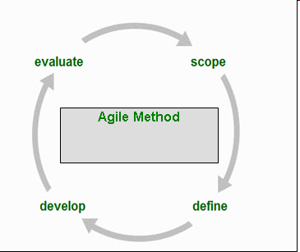
Agile Process
Is driven by customer descriptions of what is required (scenarios)
Recognizes that plans are short-lived
Develops software iteratively with a heavy emphasis on construction activities
Delivers multiple ‘software increments’
Adapts as changes occur

Slide 12

Agile Principle
The 12 principles were documented during the February 2001 meeting during which the Agile Manifesto was written.

Slide 13
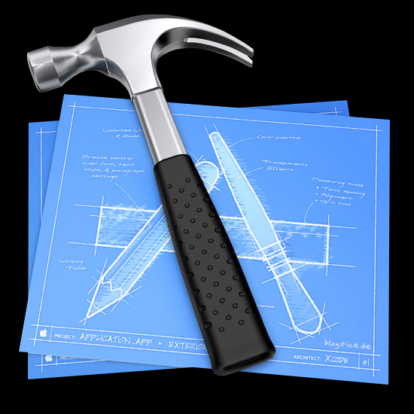
12 Agile Principles
Our highest priority is to satisfy the customer through early and continuous delivery of valuable software.
Welcome changing requirements, even late in development. Agile processes harness change for the customer's competitive advantage.
Deliver working software frequently, from a couple of weeks to a cou­ple of months, with a preference to the shorter time scale.

Slide 14

12 Agile Principles
Business people and developers must work together daily throughout the project.
Build projects around motivated individuals. Give them the environment and support they need, and trust them to get the job done.
The most efficient and effective method of conveying information to and within a development team is face-to-face conversation.

Slide 15
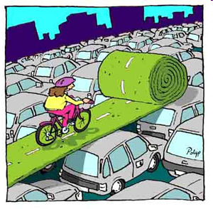
12 Agile Principles
Working software is the primary measure of progress.
Agile processes promote sustainable development. The sponsors, developers, and users should be able to maintain a constant pace indefinitely.
Continuous attention to technical excellence and good design enhances agility.

Slide 16
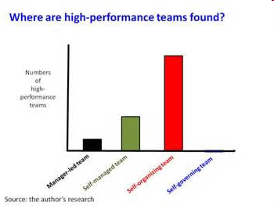
12 Agile Principles
Simplicity - the art of maximizing the amount of work not done - is essential.
The best architectures, requirements, and designs emerge from self-organizing teams.
At regular intervals, the team reflects on how to become more effective, then tunes and adjusts its behavior accordingly.
Notes:
Note
The picture is from http://www.stevedenning.com/High-Performance-Teams/most-high-performance-teams-are-self-organizing.aspx explaining as below:
“However most of the high-performance teams were not manager-led teams. They were teams where the management had deliberately stepped back, or was inattentive or where one reason or another was totally absent, thus enabling the team to self-organize. It’s as though there was a tear in the fabric of the universe, an open space that was created, and lo and behold, the self-organizing team emerged.”

Slide 17
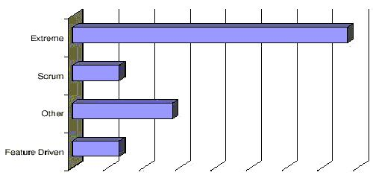
Statistics
Notes:
Note
Scrum and XP are widely applied agile methods—the two most common, according to at least one survey

Slide 18
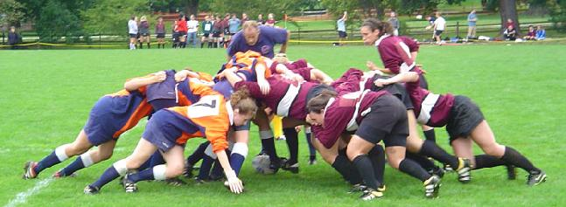
Scrum
Notes:
Note
If engineering practices are candy bars, then scrum is a candy bar wrapper. Scrum is superimposed on and encapsulates whatever engineering practices already exist. The ease of implementing Scrum is superimposed on and encapsulates whatever engineering practices already exist. The ease of implementing Scrum often comes as a surprise. Implementing new practices, cultures, and methodologies is usually difficult, and can even be painful, but implementing Scrum is not. Also because of this, Scrum doesn’t seem to be a complete software model or methodology. Anyway, what is Scrum? Let us look at the game of rugby where the term Scrum was actually taken from
The roots of Scrum are found in a well-known article summarizing common best practices in 10 innovative Japanese companies. It firstly introduced the term Scrum for the adaptive and self-directed team practices as Scrum in rugby is a adaptive team behavior moving a ball up the field.

Slide 19
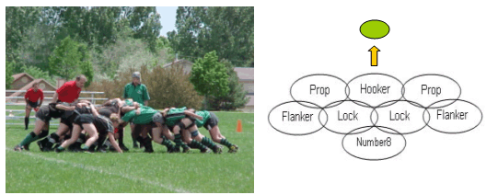
Rugby
Notes:
Note
A scrum is a team of eight individuals in Rugby. Everyone in the pack acts together with everyone else to move the ball down the field.
Teams work as tight, integrated units with each team member playing a well-defined role and the whole team focusing on a single goal. In software development teams, each team member must understand his or her role and the tasks for each increment. The entire team must have a single focus. The priorities must be clear. Thus, we would like software team as a scrum working in a highly integrated manner; in addition the team is self-directed team.

Slide 20
Scrum
Originally proposed by Schwaber and Beedle
Scrum—distinguishing features
  Development work is partitioned into “packets”
  Testing and documentation are on-going as the product is constructed
  Work occurs in “sprints” and is derived from a “backlog” of existing requirements
  Meetings are very short and sometimes conducted without chairs
  “demos” are delivered to the customer with the time-box allocated

Slide 21
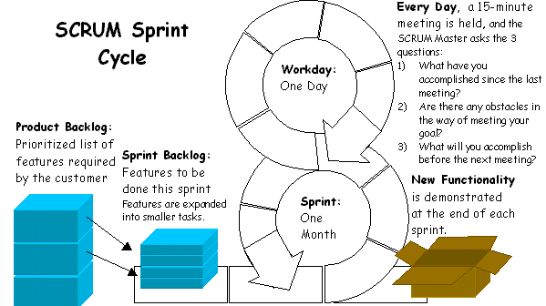
Scrum

Slide 22

Scrum Master
The Scrum Master can’t make a decision during the Daily Scrum Meeting, a short daily morning meeting (15 minutes).
He or she is responsible for making a decision and communicating it to the whole team within one hour after the end of the Scrum.

Slide 23
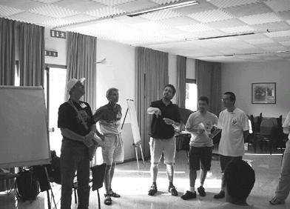
Stand-up Scrum Meeting
Each workday at the same time and place, hold a meeting with the team members standing in a circle, at which time the same special questions are answered by each member:
  What have you done
  What will you do
  What is getting in the way (blocks) of meeting the iteration goals?
Notes:
Note
Each Scrum Team meets daily for a 15-minute status meeting called the Daily Scrum. During the meeting, the team explains what it has accomplished since the last meeting, what is going to do before the next meeting, and what obstacles are in its way.
Daily Scurms improve communications, eliminate other meetings, identify and remove impediments to development, highlight and promote quick decision-making, and improve everyone’s level of project knowledge

Slide 24
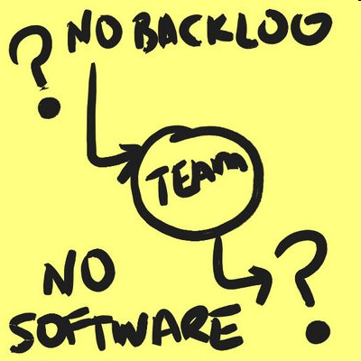
Product Backlog
The Product Backlog represents everything that anyone interested in the product or process has thought is needed or would be a good idea in the product.

Slide 25
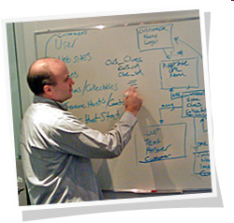
Product Owner
As backlog is created, the product owner works with others to estimate how long it will take to develop.

Slide 26
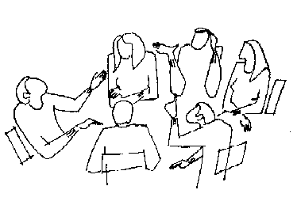
Sprinting Planning
Meeting
Sprint planning meeting has two meetings.
(External Meeting) to figure out what functionality to build during the next Sprint.
(Internal Meeting) to build this functionality into a product increment during the Sprint.
Input to this meeting is the Product Backlog, and past performance of the team.
Notes:
Note
The Sprint planning meeting actually consists of two consecutive meetings.
At the first meeting, the team meets with the Product Owner, management, and users to figure out what functionality to build during the next Sprint.
At the second meeting, the team works by itself to figure out how it is going to build this functionality into a product increment during the Sprint.
Input to this meeting is the Product Backlog, the latest increment of product, and the capabilities and past performance of the team.

Slide 27
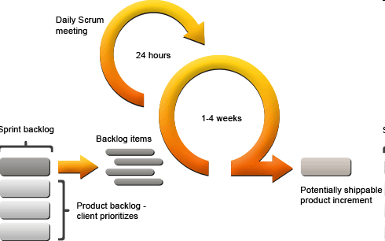
Sprint
The team works for a fixed period of time called a Sprint.
Notes:
Note
The team works for a fixed period of time called a Sprint.
Each Sprint has a goal called Sprint Goal, which is to give the team what should be reached. For example, a Sprint goal can be: “Automate the client account modification functionality through a secure, recoverable transaction middleware capability.” As the team works, it keeps this goal in mind.
The team compiles a list of tasks it has to complete to meet the Sprint goal. These tasks are the detailed pieces of work needed to convert the Product Backlog into working software. Tasks should have enough detail so that each task takes roughly four to sixteen hours to finish. This task list is called the Sprint Backlog.
The team has complete authority during the Sprint. It can work as many hours or as few hours as it wants. It can hold meetings whenever it wants. It can hold design sessions from 6 am to 10 pm. I can spend days interviewing vendors and consultants, or surfing the web for information. The team has absolute authority, because management has given the tem free reign for thirty days. The team is a self-directed or self-organizing

Slide 28
Sprint Backlog
The team compiles a list of tasks it has to complete to meet the Sprint goal.
These tasks are the detailed pieces of work needed to convert the Product Backlog into working software.
Tasks should have enough detail so that each task takes roughly four to sixteen hours to finish.
This task list is called the Sprint Backlog.

Slide 29
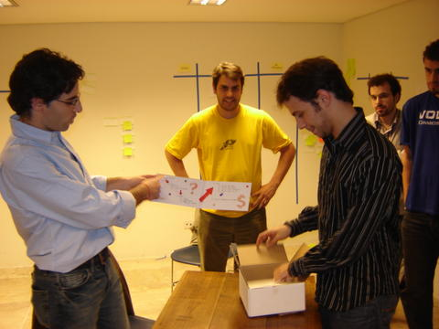
Sprint Review
The Scrum Master is responsible for coordinating and conducting the Sprint Review meeting.
The Scrum Master meets with the team to establish the agenda and discuss how the Sprint results will be presented and by whom.
The best presentations usually start with the Scrum Master giving a concise overview of the Sprint.
The Sprint goal and Product Backlog are compared to the actual results of the Sprint, and reasons for any discrepancies are discussed.

Slide 30
Summary of key Scrum practices
Self-organizing team
No changed work to an iteration
Daily standup meeting
30 calendar day iterations
Demo to stakeholders
Client-driven adaptive planning
Notes:
Note
We summarize key scrum practices as follows:
Self-directed and self-organizing team
No external addition of work to an iteration, once chosen
Daily 15-minute meeting with special questions
Usually 30 calendar day iterations
Demo to external stakeholders at end of each iteration
Each iteration, client-driven adaptive planning

Slide 31
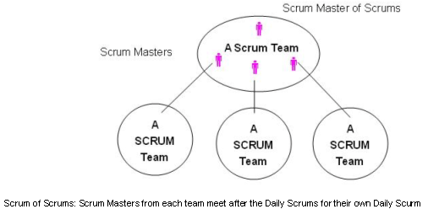
Scrum of Scrums

Slide 32
Ceremony and cycles
degree of ceremony—the amount of method weight in terms of documentation, formal steps, review, and so forth.
Another classification is their cycles—the number and length of iterations. For example, single-pass waterfall has no iterations; at the other end, an Evo project could have very many—one iteration per week.

Slide 33
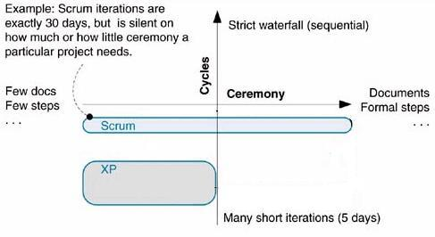
Ceremony and cycles

Slide 34
What is a Process?
Define Who is doing What, When to do it, and how to reach a certain goal.
User’s requirements Software system
Software Development Process
Notes:
Note
Simply put, a software process is a collection of activities performed to achieve given goals. Therefore, a software process is a way of describing how work should be done. The definition is given by Sommerville, 1999.

Slide 35
Process and Practice
A process is made up of one or two activities and a process may be considered as a practice
The reverse may not be true. A number of practices together may not be regarded as a process if there is no well-defined goal.
Notes:
Note
When a process is made up of one or two activities, it may be considered a practice.
Some practices are just more pragmatic and culture-oriented than they are goal-specific.
For example, the practices, energized work and shared code (Beck and Andres, 2005) do not together explicitly indicate any objective. Along with other practices, energized work and shared code can be used to achieve certain things or they alone are just organizational norms.

Slide 36
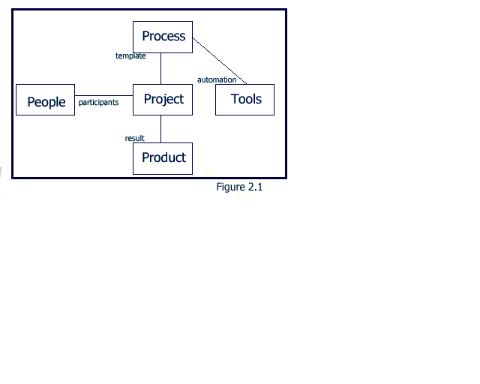
4 P’s
Notes:
Note
The Unified Process recognized four aspects of software development as being equally important
People Project Product Process (Tools)
See Jacobson, Booch, and Rumbaugh. The Unified Software Development Process. Addison-Wesley. Boston, MA. 1999.

Slide 37
4 P’s (cont.)
People are crucial
Projects make the product
Product is not just the code
Process directs Projects
Tools are integral to the process

Slide 38
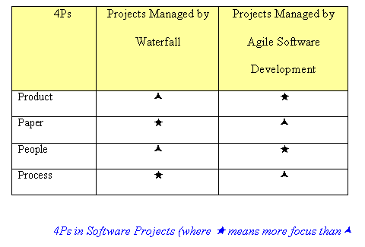
4P

