Slide 1

Unit 07 Agile Teaming
eXtreme Programming and Agile Software Development
2011

Slide 2

Doctrine of Fair Use
This PowerPoint is prepared for educational purpose and is strictly used in the classroom lecturing.
We have adopted the "Fair Use" doctrine in this PowerPoint which allows limited copying of copyrighted works for educational and research purposes.

Slide 3
Learning Objective
To understand the team structure
To link a team structure with agile software development
To learn Tuckman model and pair jelling

Slide 4

Two Questions for Agile Manifesto
people over process vs. process over people
  when either of one works better?
  when either can be better used?
Notes:
Note
traditional software development is more on tasks coordination for each developer being allocated the right amount of tasks while agile software development is on people collaboration for completing tasks.
Now that people over process (i.e., focus for how people collaborate) or process over people (i.e., focus for how tasks assigned to people are better coordinated) are different approaches, two thorny questions are arising: when either of one works better and when either can be better used.

Slide 5

Definitely before deadline
If we are running a project which can be completed definitely much earlier before deadline
Will it make any difference between people over process or process over people?
Notes:
Note
Assume that you are running a project which can definitely be completed much earlier before deadline.
In this case, process over people or people over process does not matter. You have plenty of time to manage any inaccuracy and risk that may materialise.

Slide 6

Deadline brought forward
Now consider another situation in which the deadline is suddenly brought forward
Will it make any difference between people over process or process over people?
Notes:
Many software projects that have been changing from promising to failing always happen unexpectedly.
When the deadline is suddenly brought forward, how do people react? Process over people is inflexible, as the order among processes or activities is established under an assumption of no change.
It is people over process that could handle the problem of this kind.

Slide 7
People-over-process approach.
Teaming is a difficult topic
There are two team structures
  Flat
  Layered
Notes:
Note
Unfortunately, teaming is a difficult topic and it is hard to put its theories into action.

Slide 8
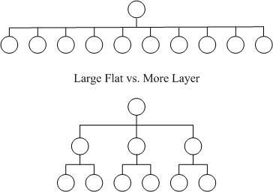
Flat organisation
Notes:
Note
A flat organisation allows for more talented subordinates to be directly involved in decision making.

Slide 9
Project Manager’s Difficulties
A project team can be temporarily established
  To exercise more personal power than positional power
  No power to take disciplinary action against problematic members
Notes:
When members are in a permanent team according to an organisational chart, its manager (e.g., Department Head) has absolute power and can manipulate rewards and penalties in the work environment.
A project team can be temporarily established to achieve specific goals and teammates are often selected from different departments within an organisation, or from two or three software vendors. With that kind of project team, there are two problems. First, the project manager is expected to exercise more personal power than positional power because he/she is often regarded as one highly competitive guy and should provide a good role model for his/her team members. Second, the project manager may not have much power to take disciplinary action against problematic members from other departments or companies. Such differences between managing permanent teams and running project teams are where conflicts come from.

Slide 10
Permanent teams
Teams that are more permanent such as departmental teams are
  easier to control
  longer timelines
  greater team stability
  team development not necessarily in conflict with work progress.
Notes:
Note
While we may want to educate a project development team and establish some sort of team culture, we must consider the project schedule.
Teams that are more permanent such as departmental teams are easier to control, and longer timelines and greater team stability mean so that team development is not necessarily in conflict with work progress.

Slide 11
Project teams in a software company
When the company is sizable, team members may not know each other well.
In a worst case scenario, some expert programmers may just show up in a project meeting to report their work progress.
Notes:
Note
When the company is sizable, team members may not know each other well. It takes time for us to understand them.
Some programmers, particularly experts, are often involved in many projects rather than just one. In a worst case scenario, they may just show up in a project meeting to report their work progress. For sure, the team members hardly establish a close rapport with one another and they become more and more coordinated to achieve their assigned tasks. In the end, the team becomes practicing process over people.

Slide 12
Partnership
Project team members may be drawn from two companies
  be cautious about cultural differences between the two organisations
  people from different areas should take the time to agree with practices
Notes:
Note
In a project that involves partnership, it is not unusual that project team members may be drawn from two companies. In this case we should be cautious about cultural differences between the two organisations. Potential team members should not assume that the way things are done in their organisation must be the way things are done in the combined team. In particular, people from different areas should take the time to agree with practices that should be adopted before tasks are undertaken.

Slide 13
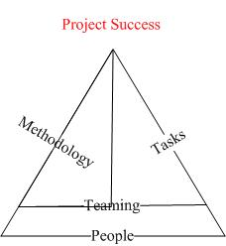

Fundamental Layer
Notes:
Note
Project teams have their own dynamics and life cycles.
People are the most fundamental layer of program tasks and programming paradigms.

Slide 14
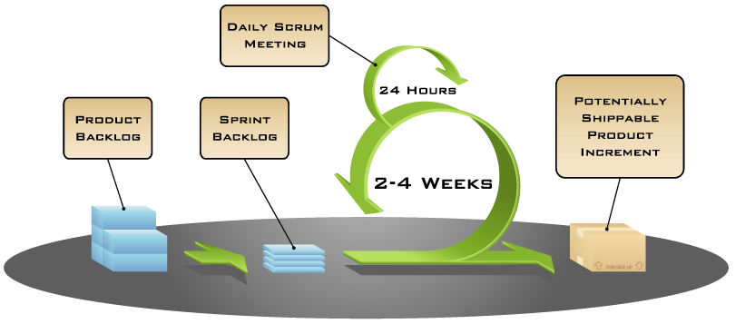
Scrum (Review)
Notes:
Note
The Scrum methodology adopts a self-organizing team.
The diagram is from http://www.mountaingoatsoftware.com/scrum-figures

Slide 15
Self-organizing teams
Self-organizing teams can be a risky practice if people do not know how to organise themselves
To play it safe, there should be a coacher to guide the self organizing teams.
Notes:
Note
Self-organizing teams can be a risky practice if the team members do not know how to organise themselves to maximise productivity. Team decisions as to how to combine their efforts to solve a problem are a discretionary task. To play it safe, there should be a coacher to guide the self organizing teams.
Such a self-organising team is normally small, which fits well with agile teaming.

Slide 16
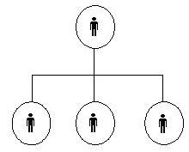
Traditional team structure
Notes:
Note
A traditional team structure is like a tree diagram.
Team members often possess complementary skills. Mutual education and skill-sharing is a possible outcome. In many real situations, to make a team productive by skill-sharing is challenging. For example, one is in finding ways to promote the sharing of knowledge and experience. Sharing experience that does not help meet a project’s deadline around the corner can be time wasting. Another problem is in ensuring that theoretically complementary do in fact work together in a complementary way. Complementary skills are not freebies. There are associated communication overheads as team members need to understand each other.

Slide 17
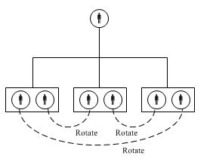
Teams in Team
Notes:
Note
This is a team-in–team approach, which is different from arrangements where a team is composed of sub-teams.
Each team in a team-in-team approach exists for just a short period and exchanges its partners with other teams.
Teams can organise their own partner rotations, but this doesn’t always produce ideal outcomes.

Slide 18
Project Team Composition
Functional diversity
Positional diversity
Notes:
Note
Any project must start with the establishment of a project team in which the members are selected from different positions in major functional units of the company. Such heterogeneity in a team will, on the one hand, contribute to a staff member’s functional expertise in re-engineering a business process and designing an integrated system, and, on the other hand, will cause conflicts of interest among different functional departments which to some extent may lead to scheduling slipping, failure to keep to the budget, and low morale among team members

Slide 19
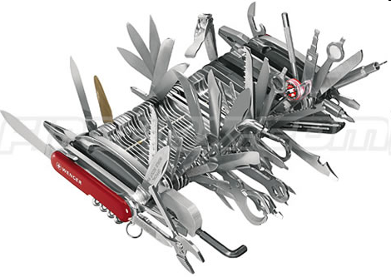
Functional diversity
Team members are selected from different functional areas
Functional diversity has been negatively associated with team performance. Why?
Notes:
Note
Functional diversity is when team members are selected from different functional areas (e.g., sales and marketing, finance, distribution, information systems, etc). Functional diversity has been negatively associated with team performance because people from different backgrounds may bring irresolvable viewpoints to a team and a project manager will have to manage their conflicts.

Slide 20

Positional diversity
Team members are selected from different ranks of an organisation
Positional diversity has a positive influence on team performance. Why?
Notes:
Note
Positional diversity is when team members are selected from different ranks of an organisation. Positional diversity has a positive influence on team performance because people at the junior level appreciate the opportunity to engage at the level of strategy and planning with more experienced staff, while senior staff are exposed to issues related to more operational problems. This way may lead to lower levels of conflict within a team and greater effectiveness

Slide 21
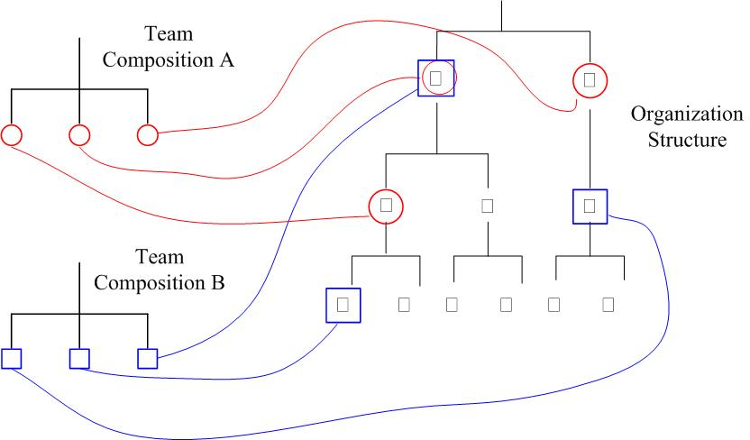
Discussion:
Is Team B better than Team A?

Slide 22
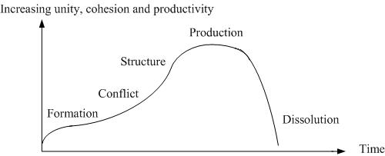
Tuckman model
Notes:
Note
Once a project team has been established, it moves through four stages to reach its optimal level of productivity (Figure). In the formation phase, group members start to orient toward one another. Then conflict emerges. It subsides when the group becomes more structured. Norms and cultures emerge in the structure phase. Finally, in the production phase, the group moves beyond disagreement and concentrates on the work to be done.

Slide 23
Agile Development: Pair Jelling
Expecting two people to sit down and straightaway make pair programming productive is unrealistic
The learning period to become productivity pair is called the “Pair Jelling” time
Notes:
Note
expecting two people to sit down and straightaway make pair programming productive is unrealistic. Even a team of two requires time to communicate on how to collaborate. As in pair programming, this period is referred to as the “Pair Jelling” time

Slide 24
Discussion
Consider two situations:
  A project’s life cycle is much shorter than the time to reach the team’s production stage?
  A project’s life cycle is much longer than the time to reach the team’s production stage?

Slide 25
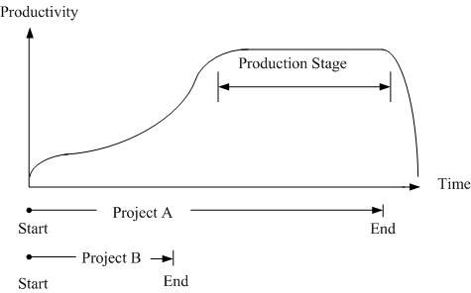
Application of Tuckman model
Notes:
Note
When the project life cycle is shorter than the time that a project team requires to reach its optimum productivity (i.e., the production phase of the Tuckman model), the project manager will have to deal with more teaming problems than project issues. This is not good at all (see Figure 7.11). It is preferable to select the right members so that the team will reach their productivity in the fastest possible time. In addition, we should also try some warm-up exercises and cooperative games to facilitate team building.

Slide 26
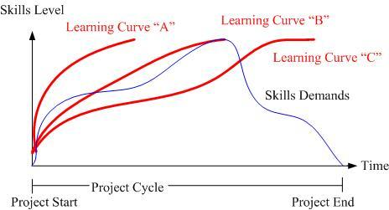
Learning Curve
Notes:
Note
In many software projects, a newly established team needs to learn new skills; for example, software tools, development languages, and domain knowledge. Depending on the team experience, its learning curve can vary. Suppose that a learning curve over project time for a team can have three situations in Figure 7.12

Slide 27
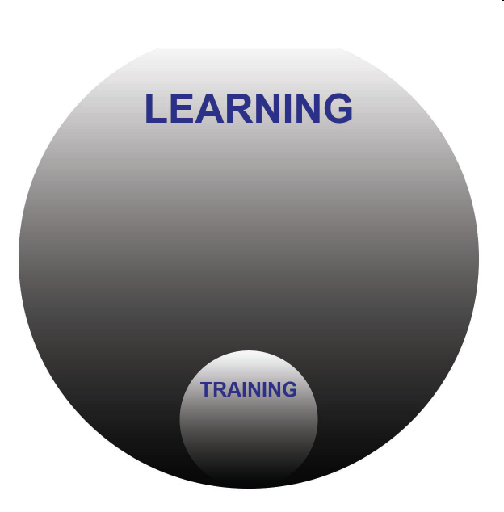
Training vs. learning
Training ≠ Learning
Extensive training to our team is provided
But when or whether they acquire the skills and knowledge to contribute to a project is another story
Notes:
Note
Training is not the same as learning. We can provide extensive training to our team but when or whether they acquire the skills and knowledge to contribute to a project is another story. For this reason, teams should start with enough experience rather than trying to train everybody on the job. Reliance on the learning curve should be avoided.

Slide 28

Team productivity
Team productivity in software development is about how a team makes use of their intelligence and experience so as to produce high quality products with less rework effort.
Notes:
Note
Team productivity in software development is about how a team makes use of their intelligence and experience so as to produce high quality products with less rework effort. A team’s organisation definitely affects productivity. Although it is hard to tell how to reach the maximum productivity of a software team, we surely know of some teaming issues that will hurt a software team’s productivity.

Slide 29
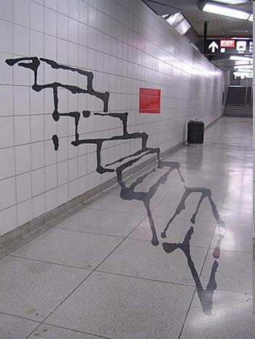
Illusion of Productivity
Members of teams working on collective tasks generally think that their team is more productive than other teams.
people performing simple tasks often work harder over any period when they are being watched
Notes:
Note
Members of teams working on collective tasks generally think that their team is more productive than other teams. Team members also feel that they are doing more than their fair share – even those who are loafers. These two individual illusions produce the group illusion of team productivity. At the same time, people performing simple tasks often work harder over any period when they are being watched and evaluated and do less when they are not being evaluated.

Slide 30
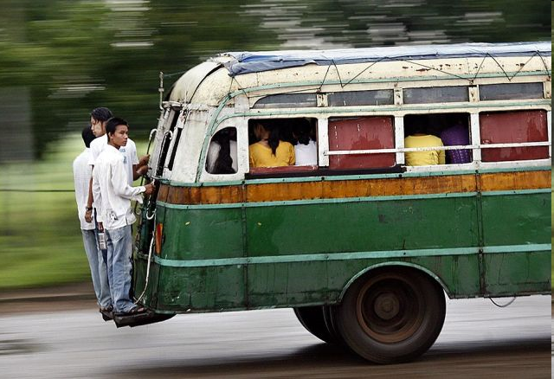
Free-ride
Team members can do less than their share of the work yet still share equally in the team's rewards
Notes:
Note
Team members can do less than their share of the work yet still share equally in the team's rewards. When people’s contributions are combined into a single work product and it is difficult to measure individual contributions, some will try to “free-ride.” And the more free riders there are perceived to be, the more other team members will hold back, for fear of being “suckers
They will only get the average team reward, so why should they make more than the average team effort?

Slide 31
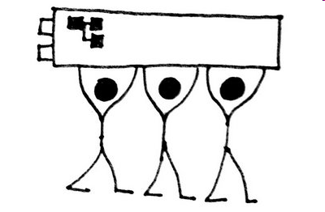
Collective Code Ownership
We should be able to identify who has fixed bugs and updated the system.
If this is difficult in small software teams, have a day-end meeting to let team members claim credit for their work.
Notes:
Note
It is important to be able to identify contributions to collaborative work. Therefore, collective code ownership, in which any programmers can make any change to any part of the source code at any time, should not be anonymous. We should be able to identify who has fixed bugs and updated the system. If this is difficult in small software teams, have a day-end meeting to let team members claim credit for their work.

Slide 32

Pair Programming
Williams and Kessler (2003) suggested peer appraisal so that there exists a better idea of whom to reward.
This can provide valuable feedback, although peer appraisal doesn’t always work well
Notes:
Note
It is somewhat difficult to quantify individual contributions in pair programming as two programmers sit side-by-side and collaborate on the same task. Williams and Kessler (2003) suggested peer appraisal so that there exists a better idea of whom to reward. This can provide valuable feedback, although peer appraisal doesn’t always work well

Slide 33

Kent Beck’s Teaming
Kent Beck said that we should keep a team workload constant but gradually reduce the team size until there is no more wasted effort.
Notes:
Note
Kent Beck (2005) said that we should keep a team workload constant but gradually reduce the team size until there is no more wasted effort. What Beck advised was actually about agile teaming adopted for a self-organising team, so that it may reach an optimum structure and size that can lead to a highly productive team.
The importance of root-cause analysis has been addressed in Agile Software Development Management

Slide 34
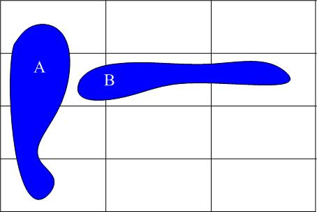
Problems and Problem Owners
Notes:
Note
It is hard to generalise about the root causes of many problems in software projects. What appear to be causes of one problem may simply be the symptoms of another. However, it is relatively easy to group an event or a problem by type rather than to identify its cause. In this way, we can identify a problem by its type and as having two dimensions: a process area dimension and a functional module dimension

Slide 35

Teaming Principles
Agile teaming involves changing team structures in troubled projects, is not without costs, and is best reserved for serious problems.
Notes:
Note
Agile teaming involves changing team structures in troubled projects, is not without costs, and is best reserved for serious problems. The following are some principles for executing agile teaming.

Slide 36
Principle 1:
Exploratory action over heavy analysis
  Executives who have stronger programming backgrounds tend to prefer determining causality in a troubled software project rather than to immediately take remedial actions to rescue the project.
Notes:
Note
Most management does not know much about technical implications. Drawing incorrect conclusions about problems in IT projects can be dangerous. Executives who have stronger programming backgrounds tend to prefer determining causality in a troubled software project rather than to immediately take remedial actions to rescue the project.

Slide 37
Principle 2:
Problem owners over problems
  The project structure has gone wrong when many project issues have no real owner or more than one owner. It is therefore important to fix the project structure in order to rescue a troubled software project
Notes:
Note
We should get to understand who owns a problem rather what the problem could be. It makes sense that the project structure has gone wrong when many project issues have no owner or more than one owner. It is therefore important to fix the project structure in order to rescue a troubled software project

Slide 38
Principle 3:
Change people responsibilities in need over their titles responsibilities as planned
Notes:
Note
Rather than asking a team leader to leave a software project, management should continuously motivate the project manager but, meanwhile, narrow his/her responsibilities to a few particular areas.

Slide 39
Principle 4:
Collaboration over organisation hierarchy
Notes:
Note
To deal with a troubled project, it is advisable for management to sit in on all regular meetings. This has three major benefits: it re-builds team spirit, resolves any politics among team members, and improves team effectiveness by providing positional diversity

Slide 40
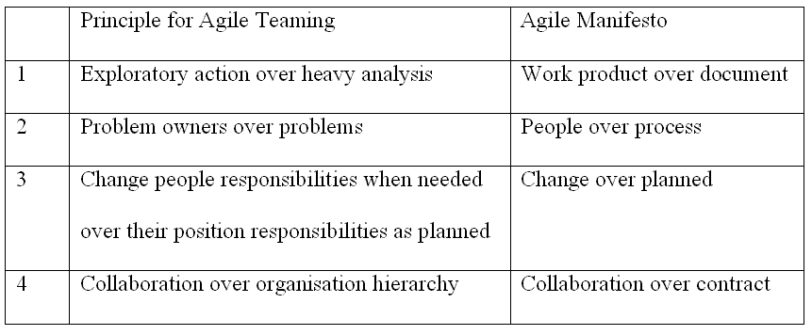
Principles Related to the Agile Manifesto

