Slide 1
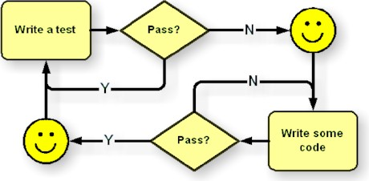
Unit 08: TDD
eXtreme Programming and Agile Software Development
2011

Slide 2

Doctrine of Fair Use
This PowerPoint is prepared for educational purpose and is strictly used in the classroom lecturing.
We have adopted the "Fair Use" doctrine in this PowerPoint which allows limited copying of copyrighted works for educational and research purposes.

Slide 3
Learning Objective
To understand the nature of testing and two kinds of testing
To learn the framework of TDD
To know tools and their applications
To learn Testing Data
To identify relationships between TDD and Software Process Improvement
To learn how to adopt XP

Slide 4

The cost of software development
More than 50% of the cost
percentage of testing cost being increased significantly in future
Notes:
Note
Studies indicate that testing consumes more than 50% of the cost of software development.
Unless we can find more efficient ways to perform effective testing, the percentage of development costs devoted to testing will increase significantly.

Slide 5
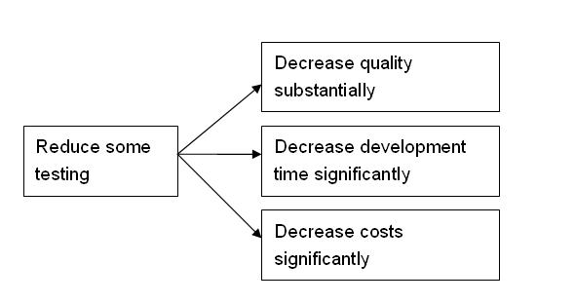

Reduce Testing
Notes:
Note
When reducing some testing on software products, we will normally shorten development time and decrease development costs; however, the quality of software also decreases substantially.

Slide 6

Test Cases
The more the number of test cases, the higher quality ???
What is the challenge here?
Notes:
Note
When users tell us that their business cannot afford to have an application down, we become more serious about software quality.
Our team extensively devises user test cases and testing data. When the team has accumulated lots of test cases, we have another problem.
It is hard to judge which cases are redundant.

Slide 7
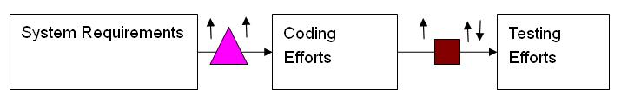
Testing Efforts and Coding Efforts

Slide 8
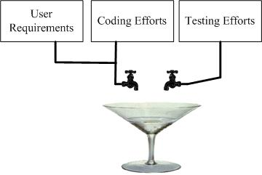
Testing decoupled
Notes:
Note
Testing decoupled from other activities. No matter how much you add or change, testing efforts remain constant.
This happens in so many software development projects because software requirements are coupled with coding but both are decoupled from testing

Slide 9
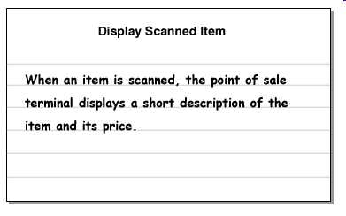
Simple Agile Solution
At least write two user test cases:
  testing true and
  testing false
True
False
Notes:
Note
Suppose an application has ten story cards. We should at least write twenty user test cases, with each pair of testing true and testing false being mapped to one a story card.

Slide 10
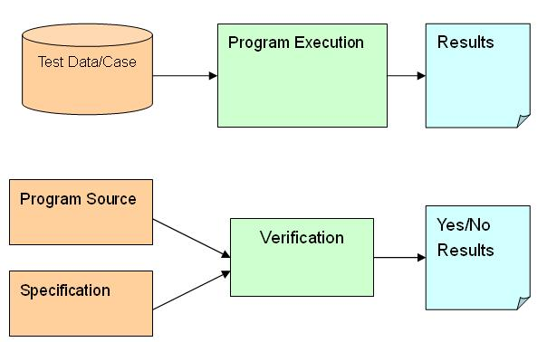
Testing and Verification
Notes:
Note
Testing is a means of improving our understanding of the software we are building, not just a way of assessing its quality. Testing requires the execution of the software, often referred to as dynamic analysis. It often involves three steps: testing cases with data, program execution, and results generated. The opposite form of testing, a form of verification that does not require execution of the software, such as mathematically proving properties about a given source, is referred to as static analysis.

Slide 11
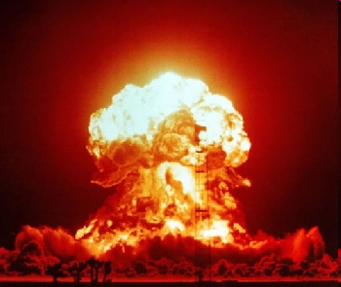
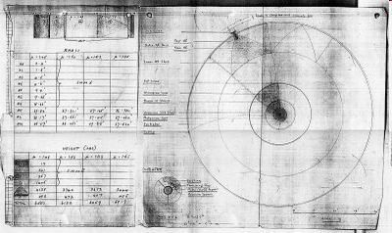
Testing and Verification
Testing
  execution of the software
  Testing data
  Results
Verification
  model checking
Notes:
Note
Testing requires the execution of the software. It is often called dynamic analysis. It normally involves testing data, program execution and results generated by the program.
A form of verification that does not require execution of the software, such as model checking, is called static analysis.

Slide 12

Advantages of Testing
Ease to conduct
Provide confidence
Automate a testing process
Notes:
Note
Testing is the relative ease with which many of the testing activities can be performed. The software being developed can be executed in its expected environment. The results of these executions with the test cases provide confidence that the software will perform as intended.
Much of the process can be automated.
With this automation, the test cases can be reused for testing as the software evolves

Slide 13

Limitations of Testing
Absence of faults
Test testing results cannot usually be generalized.
Testing widely used in practice
Notes:
Note
Testing cannot show the absence of faults.
test execution results for specific test cases cannot usually be generalized. For example a test case such as f(1, 2) and its result may not be the same case as the ones of f(2, 3).
Despite these limitations, testing is widely used in practice to provide confidence in the quality of software.

Slide 14

Unit Tests
Unit tests differ from user acceptance tests
Unit tests are written in the same language
Notes:
Note
A key element of testing is unit tests. Unit tests differ from user acceptance tests (UAT) in that they do not involve programming. Crispin (2003) explains that unit tests are written in the same language as is used to directly interact with programming modules.
Thus, unit testing, as the name implies, examines a piece of code or a unit of functionality.

Slide 15
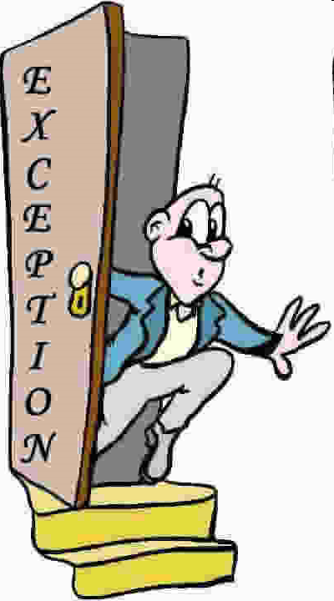
Exception Handling
Unit tests covering
  Valid parameter
  Invalid values
    Boundary values
    Rounding Numbers
    Negative values
    Null
    Date
Notes:
Note
We may write unit tests covering (1) valid parameter values which return correctly, for example -5 / 2 == -2.50 and 10/3 != 3.34 and
(2) invalid values which cause appropriate exception such as 5 / 0. Boundary values, rounding numbers, negative values, null and 29th of February are often selected as test data.

Slide 16

Testing Data
Simplicity
Heterogeneity
Realistic Data
Evident Data
Notes:
Note
Simplicity: To make tests readable, test data should be simple. From a testing point of view, if there is no difference between “24.54” and “1”, then we use 1 for human reading.
Heterogeneity: To handle multiple inputs, use different values for each input. For example, p (2, 3) is better than p (2, 2), for p (3, 2) is order irreversible, i.e. p (2, 3) ≠ p (3, 2).
Realistic Data: Try to use realistic data which simulates how the system will be used.
Evident Data: The variance between expected and actual results, if any, should be apparent when a program runs the unit test.

Slide 17
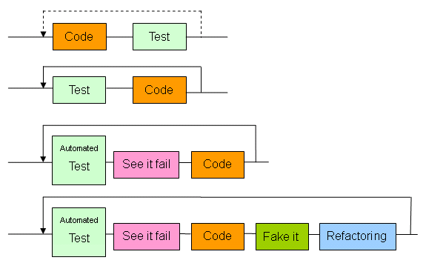
TDD
Convention
Evolution
TDD

Slide 18
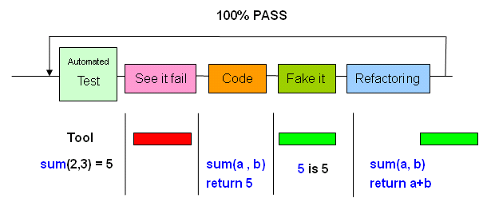
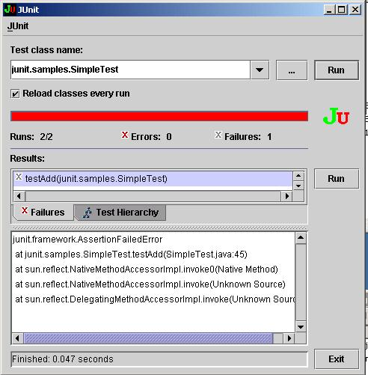
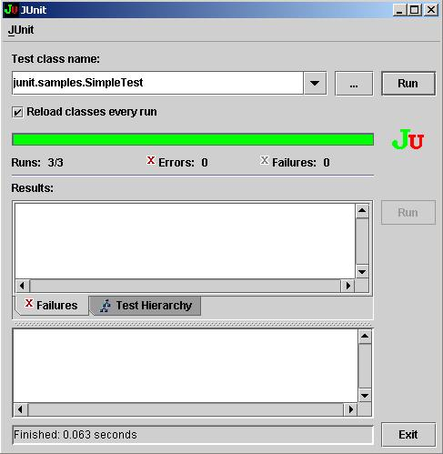
TDD Flowchart
Red Bar
Red Bar
Green Bar
Green Bar
Green Bar

Slide 19

TDD Python Example (1/4)
implement a function sum(x,y)
assert( sum(2 , 3) is 5 )
Notes:
We would like to implement a function sum(x,y), which returns the total of x and y.
The unit test can be sum(2,3)= 5.
Written in Python, the statement is as:
assert( sum(2,3) is 5 )

Slide 20

TDD Example (2/4)
Fake it by returning 5 irrespective of the operands, i.e. 2 and 3.
def sum(arg1 , arg2):
return 5
Notes:
Note
Suppose that we do not figure out how to implement sum(2,3) in the beginning or how to code sum(2,3) in a simple way, then we fake it by returning 5 irrespective of the operands, i.e. 2 and 3.
def sum(arg1 , arg2):
return 5
Clearly, return 5 does not implement sum(2,3) at all. However it passes the unit test. Starting from this point, we proceed to implement sum(2,3) gradually.

Slide 21

TDD Example (3/4)
Fake it: anticipate the expected result and roll back to the last point.
def sum(arg1 , arg2):
# return 5
return arg1 * arg2
Notes:
Note
The value of “fake it” is that programmers can anticipate the expected result and roll back to the last point at which all tests ran with a 100% pass rate.
For example, programmers might write incorrect logic for sum(2,3) as 2×3.
Thus, the function returns the value of 6 rather than of 5; however, such mistakes never cause backsliding as the programmers can go back to the previous point.
def sum(arg1 , arg2):
# return 5
return arg1 * arg2

Slide 22
TDD Example (4/4)
do not have to fake everything when the implementation is obvious
def sum(arg1 , arg2):
return arg1 + arg2
Notes:
Note
Programmers do not have to fake everything.
When the implementation is obvious, they can go ahead and write the code.
def sum(arg1 , arg2):
return arg1 + arg2

Slide 23
TDD and XP
A customer writes stories
The developers estimate the time
The estimates help the customer to prioritize the stories
Acceptance tests are developed by customers
Stories may be exploratory
Notes:
Note
A customer writes stories that will lead to the development of the system.
The developers estimate the cost of developing the stories (which may require that a story is broken down into smaller, more manageable stories).
The estimates help the customer to prioritize the stories, in order to choose which will fit into the next iteration.
Acceptance tests are developed by customers for the stories chosen for an iteration. They are used to determine whether a story is complete.
Stories may be exploratory because no-one is yet clear as to what the system should do.

Slide 24
TDD and XP
Choose an area of the design or task requirements
Design a concrete test that is as simple as possible
Alter the system to satisfy the test
Refactor the system
Notes:
Note
Choose an area of the design or task requirements to best drive the development.
Design a concrete test that is as simple as possible while driving the development as required, and check that the test fails.
Alter the system to satisfy the test and all other tests.
Possibly refactor the system to remove redundancy, without breaking any tests.

Slide 25
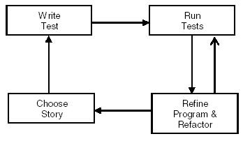
TDD and XP

Slide 26
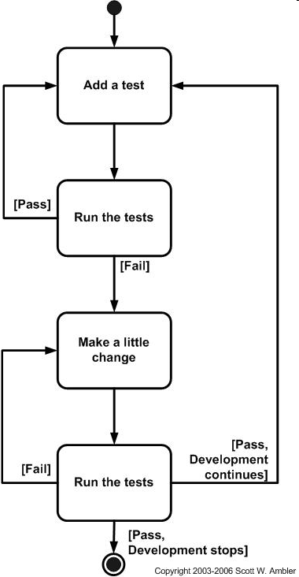
TDD and XP
Notes:
Note
The diagram is from the website : http://www.agiledata.org/essays/tdd.html

Slide 27
TDD Tools
TDD could be impossible to use in practice
If there is no an automated repetitive testing tool.
Notes:
Note
The TDD unit testing pass rate is 100%.
Any new modification of a program must pass both the new unit tests for that modification and the old unit tests.
As a result, in TDD, programmers always repeat unit tests and achieve a 100% pass rate.
TDD could be impossible to use in practice if it were not bundled with an automated repetitive testing tool.

Slide 28
xUnit
Written in Java by Kent Beck and Erich Gamma
But, xUnit is a unit testing framework that has been ported to many languages.
Notes:
Note
Most tools for facilitating TDD are available in Java development.
xUnit is an exception to this. Originally inspired by the JUnit framework written in Java by Kent Beck and Erich Gamma, since 2000 it has been extensively developed in more than thirty computer languages.
xUnit is a unit testing framework that has been ported to many languages.

Slide 29
Reference (Not IN EXAM)
More tools are Code Coverage and Jester
These tools however are not as popular as Junit

Slide 30
Code Coverage
the degree to which the program code has been tested
Condition Coverage
Path Coverage
IF A=B
THEN
ELSE
Notes:
Note
Finding areas of a program not exercised by a set of test cases,
Creating additional test cases to increase coverage, and
Determining a quantitative measure of code coverage, which is an indirect measure of quality.
Identifying redundant test cases that do not increase coverage.

Slide 31
Path coverage
When having 10 if-statements, there are 1024 paths to test!!!
How many paths? _____
  if (success) statement1;
  statement2;
  if (success) statement3;
How many feasible path? _____
Notes:
Note
Path coverage has the advantage of requiring very thorough testing. Path coverage has two severe disadvantages. The first is that the number of paths is exponential to the number of branches. For example, a function containing 10 if-statements has 1024 paths to test. Adding just one more if-statement doubles the count to 2048. The second disadvantage is that many paths are impossible to exercise due to relationships of data.

Slide 32
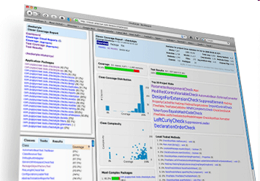
Code Coverage Download
To download a coverage analyzer for Java programs, go http://www.thecortex.net/clover/

Slide 33
Mutation testing (1980)
Given a program P, we generate lot of mutants by modifying program's source code in small way
Notes:
Note
The first implementation of a mutation testing tool was by Timothy Budd as part of his PhD work (titled Mutation Analysis) in 1980 from Yale University.
Mutation testing is used to test the effectiveness of your test set. Given a program P, we generate lot of mutants. We then test the P-mutant by the test set T, if a mutant generates different results, the mutant will be killed (removed), or it will be alive. We then add test cases to the alive test cases until all mutants are killed.
Mutation testing is a kind of fault-based testing, a technique that we use to find test set with a high ability to detect faults.

Slide 34
Algorithm
t1(P1a, P1b)
  t1(P1) <> t1(P1a), kill P1a
  t1(P1) = t1(P1b), P1b alive
add new test case to kill P1b
If the new test case is t2 and t2(P1) fail, revise the program P1 to P2
Notes:
Note
P1 is the program, one defect inside, t1 is the test case which can not find the bug
testing P1 by t1, denoted by t1(P1), assume the result is pass
generate two mutant of P1, said P1a and P1b
t1(P1a, P1b)
t1(P1) <> t1(P1a), kill P1a
t1(P1) = t1(P1b), P1b alive
we need to add new test case to kill P1b, the new test case is t2
t2(P1) fail, we find the defect
revise the program P1 to P2
testing P2 by t1 and t2, denoted as (t1,t2)(P2), assume the result is pass
generate two mutant of P2, said P2a and P2b
(t1, t2)(P2a, P2b)
assume P2a and P2b are killed since the results are all equal to (t1,t2)(P2), respectively
stop the process

Slide 35
Example and Question
P(x,y) { if (x>1 or y>1) z=2 else z=1 }
t1 = <1,0>
P1a { if (x<=1 or y>1) z=2 else z=1 }
P1b { if (x>1 and y>1) z=2 else z=1 }
What is the mutation score (killed mutants)/(all mutants) in this example = ________
Notes:
Note
the mutation score = (killed mutants)/(all mutants) = 1/2 = 50%

Slide 36
Jester
Jester is a test tester for JUnit tests; it modifies the source in a variety of ways, and checks whether the tests fail for each modification.
Jester indicates code changes that can be made that do not cause the tests to fail. If code can be modified without the tests failing, it either indicates that there is a test missing or that the code is redundant.
Jester can be used to gain confidence that the existing tests are adequate, or give clues about the tests that are missing.
Notes:
Note
Jester is a test tester for JUnit tests; it modifies the source in a variety of ways, and checks whether the tests fail for each modification.
Jester indicates code changes that can be made that do not cause the tests to fail. If code can be modified without the tests failing, it either indicates that there is a test missing or that the code is redundant.
Jester can be used to gain confidence that the existing tests are adequate, or give clues about the tests that are missing.

Slide 37
Jester vs. Code Coverage
Jester is different than code coverage tools
it can find code that is executed by the running of tests but not actually tested
Notes:
Note
Jester is different than code coverage tools, because it can find code that is executed by the running of tests but not actually tested.
Code coverage tools indicate which code is not executed by the test suites.
Jester is not meant as a replacement for code coverage tools, merely as a complementary approach.

Slide 38
Jester
Modifications:
Changing literal numbers; e.g. 0 is changed to 1
changing true to false and vice-versa
changing if( expression) to if(true || expression)
changing if( expression) to if(false && expression)
Notes:
Note
Jester modifies Java source code in very simple ways, which do not require parsing or changes to more than one source file at a time. The modifications are:
modifying literal numbers; e.g. 0 is changed to 1
changing true to false and vice-versa
changing if( expression) to if(true || expression)
changing if( expression) to if(false && expression)

Slide 39

Jester Download
To download Jester, go http://jester.sourceforge.net/

