Slide 1
Sedna
XML Database System:
Internal Representation
Leonid Novak
Ph.D., Software developer
novak@ispras.ru
Institute for System Programming
Russian Academy of Sciences

Slide 2
Agenda
Data structures
Descriptive schema of XML documents
XPATH execution modes
Labeling scheme
Strings and serialization
Indexes
Microoperations
Update statements

Slide 3
Sedna Database objects
Database
Collection and Stand-alone document
Document in Collection
Schema, Index, Trigger, Module
Node
Atomic Value (utf-8)
Statement-level
Context
Sequence
Tuple…

Slide 4
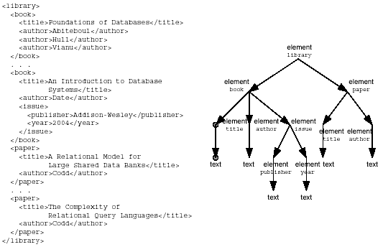
Internal Data Representation:
Descriptive Schema
Notes:
Descriptive schema (data guide):
for each path in the document there is only one path in the schema and for each path in the schema there is at least one path in the document

Slide 5
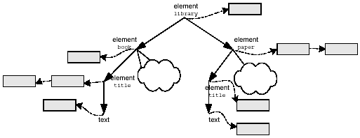
Internal Data Representation:
Descriptive Schema Driven Storage

Slide 6
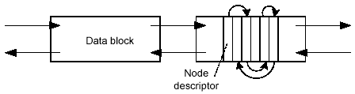
Internal Data Representation:
Storing data in blocks
Blocks are chained into bidirectional lists
Node descriptors are ordered across blocks according to document order
Bi-directional references from the descriptive schema node to/from the block

Slide 7
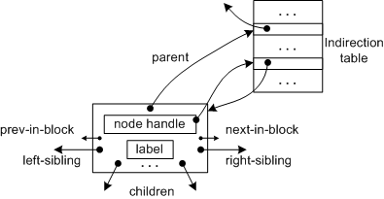
Internal Data Representation:
Node Descriptor Structure
Fixed-size descriptor inside block
All pointers are direct except parent
Long and short pointers are used
Label – numbering scheme number
Indirection record - OID

Slide 8
Labeling Scheme
Prefix-based (Dewey encoding) labeling (easy updates);
Label: [a1…an], where ai∈[0..255]
Document order: A [a1..an]<B[b1..bm] iff: ∃i ∀j<i aj=bj and ai<bi
Ancestor: A [a1..an] is ancestor Of B[b1..bm] iff: n<m and ∀j<=n aj=bj and bn+1≠255
255 is used as delimeter in generic prefix encoding. In contrast to generic approach: we don’t use it per depth level per label

Slide 9
XPath Evaluation Scenarios
Simple absolute XPath: /library/book/title (descriptive schema evaluation only)
Absolute XPath with descendant axes: /library//title (descriptive schema with merge by labeling schema)
XPath with predicates: /library/book[title=“XQuery”]/author
following,sibling,parent,…: /library//author[text()=“Tolstoy”]/..

Slide 10
Various features
Persistent and Temporary (constructed) nodes have identical presentation.
Namespace nodes: explicit and implicit declaration.
Strings: short and long strings. Random access for long strings.
System documents.
Serialization parameters: indent, character maps
Notes:
Virtual root is used as common ancestor for all temporary nodes.
We use permitted way of sharing namespace nodes between elements (see XDM).
Explicit declaration means that we store namespace node in blocks. We use explicit declaration only iff namespace declaration attribute is written in original XML-document. Otherwise namespace is not stored, and in order to serialize correctly we have to infer the list of namespaces in scope.
As far as string values have arbitrary size we store them in separate blocks with sorted heap control for free space. Long string (more than one block) are stored separately with random access feature support.

Slide 11
Internal Data Representation:
Conclusion
Fast execution of XPath expressions
  Descriptive schema as structural index
  Clustering – avoid reading needless data
Support for updates
  Node descriptors have a fixed size within a block
  Node descriptors are partly ordered
  The parent pointer of node descriptor is indirect
  Indirection record is OID
Numbering scheme based algorithms are used
Disadvantages:
  Data serialization is not very fast
  Space expenditure in case of very unstable structures

Slide 12
Indexes.
Create Index title ON path1 BY path2 as type
  path1 – nodes to be indexed
  path2 – these node’ values are used as keys
  type – an atomic type the keys are casted to
index-scan(title,value,mode)
  value – key value (type promotion)
  mode – one of (EQ,LT,GT,GE,LE)
Drop index title
Notes:
Path1- expression without predicates which is evaluated on schema of some document.
Path2 – is evaluated on nodes returned by Path1
Type- is an atomic type for the key values

Slide 13
XML VS. SQL indexes
Dynamic type casting
Ununiqueness of (key,value) pair
Support of dynamic structure changes
Support for XQuery updates

Slide 14
Index Implementation details & tradeoffs
B+-tree
Clusterization
Error counters
Pre-sorting during create
Markers on Schema
Index update is part of micro-operation
Long keys are not supported (>PAGE_SIZE/2)
Physical optimization is not supported (yet)

Slide 15
Full-text indices and IR
Integration with external engine: dtSearch
CREATE FULL_TEXT INDEX title ON path TYPE type (“XML”,”stringvalue”,”delimited”, ”customized”)
ftscan based on IR-oriented language
  and,or,near,contains,wildcards…
  Stemming and morphology
  Higlightning in results
ACID support and lazy evaluation

Slide 16
Microoperations
An atomic unbreakable piece of work with DB
Minimal logical unit for logical undo-redo
Insert_node (left_sibling,right_sibling,parent…)
  Inserts new node to descriptive schema (if needed)
  Inserts new node to blocks (or appends existing text node)
  Index updates, logs, locks…
  Checks well-formedness (attribute duplicates)
  Optimized for Bulk-loading
Delete (node)
  Deletes leaf node (i.e. node w/o children and attributes)
  Merges text nodes (if needed)
  Index updates, logs, locks…

Slide 17
Sedna updates
UPDATE insert SourceExpr1 (into|preceding|following) TargetExpr2
UPDATE delete Expr
UPDATE delete_undeep Expr
UPDATE rename Expr on QName
UPDATE replace $var [as type] in Expr1
with Expr2($var)

Slide 18
XQUery vs. Sedna updates
Same expressive power
No detachments in Sedna (XqueryP issue)
All updates are top-level in Sedna
Avoid intermediate copying of nodes of SourceExpression
Straitforward Mappings: insert, delete, rename, replace(->)
Artificial mapping: replace value(->), delete undeep(<-),replace(<-)
Transform: straightforward (with copying) artif. (on versions)
To extent existing expressions in Sedna (FLWR,Comma…): pending update list must be implemented

Slide 19
Future modifications
To speed up performance:
  Physical optimization with indexes and statistics
  Indirection records inside data blocks
  Index support for fast serialization (region indexes e.t.c)
To decrease XML data size:
  Unfixed size for node descriptors
  Prefix numbering scheme optimization
Additional functionality:
  XQuery update facility
  XQueryP support

