Slide 1

Sedna: Memory Management
Nickolay Zavaritsky mejedi@gmail.com
Software Developer
Sedna Team

Slide 2
Background
Huge database address space (64 bits enough?)
Dedicated memory region – buffer memory
DBMS decides when to swap particular buffer, not the OS!
Internal structures in DB are interconnected with database address space pointers
XML specifics – DAS pointers everywhere!
Notes:
I am going to talk a bit about memory management in databases in general and then I will focus on Sedna-specific details.
It is convenient to introduce a ‘Database Address Space’ concept when talking about memory management. Basicly all database objects – I mean low level objects like individual records – must be somehow uniquely identified. Each low level object is given a address – a unique integral number used to locate the object. The most basic design is to store DB as a single file. In this case we can use an offset of the object in the database file as it’s address.
DAS is the set of all valid database objects addresses.
Huge datasets are stored in databases – need large enough DAS.
We can not work with data on HDD directly. We have to upload data in the main memory first. The common design is to allocate a dedicated chunk of memory for this purpose (so-called ‘buffer memory’). A data block is loaded from HDD in the buffer. DBMS works with the data. When DBMS is running low on buffer memory it starts swapping blocks back to disk. Generally buffer memory is locked so that OS can not swap it. DBMS has a better knowledge of the data-access pattern and hence can manage swap process more efficiently. (Swapping is not nessesary tied to low memory condition. For instance a background flusher can be implemented.)
DAS pointer is passed to the buffer manager when asking for data. The manager either find the requested data in buffers or not. In the latter case the data location on disk is computed and IO occurs. If DAS pointers are followed infrequently the performance of the pointer dereference operation isn’t critical.
However if DAS pointers are followed frequently and the referenced data is nearly always availible from buffers we have to optimize the DAS pointer dereference operation. This is the Sedna case – we are using internal XML representation with a large amount of interconnecting pointers.

Slide 3
Challenge
XML nodes are interconnected with DAS pointers
DAS pointers followed very often
Traditionally pointer swizzling is used
Swizzling is not for free
  Have to analyze data in buffers substituting DAS pointers
  When swapping a block complex processing is required to fix all pointers referencing the swapped block
  Complex auxilary structures
Custom method developed – fast DAS pointers dereference without pointer swizzling.

Slide 4
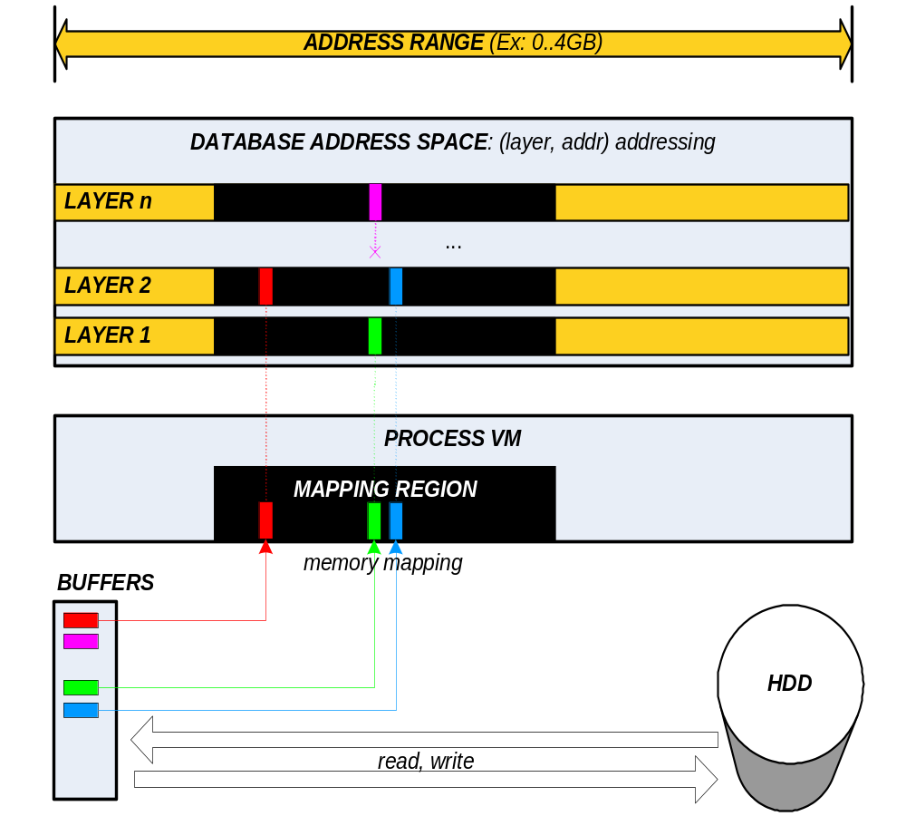

Slide 5
Dereferencing DAS pointer
Extract addr – this is the in-memory address of where the data can be
Go to block header and check layer
  If layer is correct we are done
  If it is not, map the block from correct layer
  (probably we will have to put the block in buffer first)
Example follows…

Slide 6
Example
Pointer – (layer:7, addr:1020)
Block – (layer:7, addr:1000)
The block can be mapped in VM at 1000 only!
Have to check the block header (at 1000) and ensure that layer is 7.
The final result is 1020: the in-memory address of the object we are interested in.

Slide 7
Performance Estimation
Experiment details:
Loading 113Mb XML (xmark, generated)
Huge buffer memory – no swapping
Avg. 60M DAS pointers dereferenced
Machine: 1.5GHz P4, 2GB RAM, Red Hat Linux 9.0
Normal Sedna | Sedna with light DAS pointers
63.5 sec | 62.1 sec
Following DAS pointer is nearly as fast as following a plain C pointer! (1% overhead)

Slide 8
Conclusion
64-bit address space on 32-bit architecture
Fast pointer dereferencing (no pointer swizzling)
Control over buffer management strategy

Slide 9
Questions?

Slide 10
