Slide 1
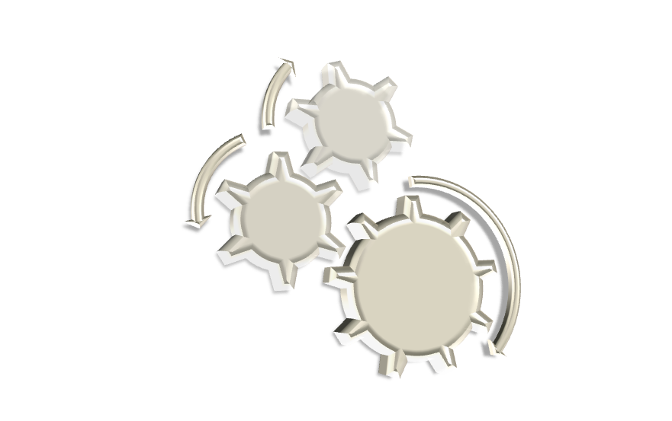
Sedna XML Database:
Query Executor
Ivan Shcheklein
shcheklein@ispras.ru
Software Developer
Sedna Team

Slide 2
Agenda
Architecture overview
Basic design concepts
Physical operations
Two-phase sorting
External connections
Benchmarks

Slide 3
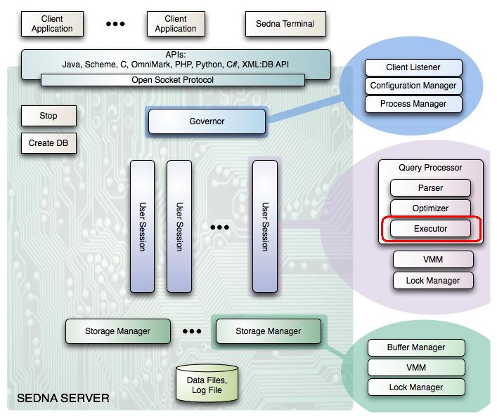
Sedna Architecture

Slide 4
Executor: Architecture Overview
QEP tree construction module
  provides high level API for the User Session Process
  manages in-memory QEP representation, context structures
Physical operations set
XDM support system
  built-in atomic data types support – casting, arithmetic …
  nodes - dm accessors, atomization …
Two-phase sorting
External connections
  SQL connection interface
  foreign function interface

Slide 5
Executor: Basic Features
Pipelined Query Execution:
  unnecessary computation are not performed
  low memory consumption
  obtaining first results before query execution is completed
External Memory Management: unlimited size of intermediate sequences and external sort
Optimizations:
  embedded constructors
  use of the descriptive schema in structured XPath evaluation
  store intermediate results where appropriate to avoid recomputing
  etc …

Slide 6
Query Execution Plan
Tree of the physical operations
Example:
fn:count(
for $x in fn:doc(“auction”)//person/name
where $x = “John”
return $x)
continues …

Slide 7
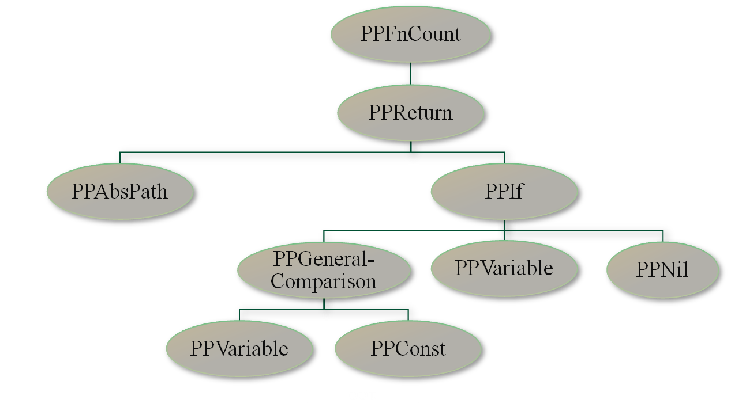
Query Execution Plan
Tree of the physical operations
Example:
fn:doc(“auction”)//person/name
$x
$x
“John”

Slide 8
Physical Operations
XPath:
  structured XPath – efficient evaluation using descriptive schema (PPAbsPath)
  general XPath – tree of the connected operations (PPAxisChild, PPAxisAncestor, etc)
XQuery Expressions:
  FLOWR: PPReturn, PPLet, PPOrderBy, PPIf …
Functions:
  have prefix PPFn, e.g. PPFnCount
  implement W3C FO spec.
+ implementations of DDL, Updates, Indexes …

Slide 9
Physical Operations: Basic Interface
Each operation implements iterator with an open-next-close interface
class PPIterator
{
protected:
dynamic_context *cxt; /// variable bindings context, static context
...
public:
virtual void open () = 0; /// initializes state
virtual void next (tuple &t) = 0; /// stores next tuple in t
virtual void close () = 0; /// drops state of the operation
virtual void reopen () = 0; /// fast implementation of close-open
… };
+ reopen() – faster than “close()-open()”

Slide 10
Physical Operations: Tuple
“tuple” – unit of interaction between physical operations
  consists of one or more “tuple cells”
  allocated in dynamic memory
  passed by reference – next(tuple& t) – to avoid redundant memory allocations
“tuple cell” – encapsulates item of XDM:
  atomic – stores value, in memory pointer or DAS pointer, nodes – DAS pointer
  small size (20 bytes structure)

Slide 11
Physical Operations: Extended Interface
Some XQuery expressions require an additional interface
  Solution: consumer-producer interface
class PPVarIterator : public PPIterator
{
public:
/// register consumer of the variable dsc
virtual var_c_id register_consumer(var_dsc dsc) = 0;
/// get next value of the variable by id
virtual void next(tuple &t, var_dsc dsc, var_c_id id) = 0;
…
};
Used for variables values and context information passing
example …

Slide 12
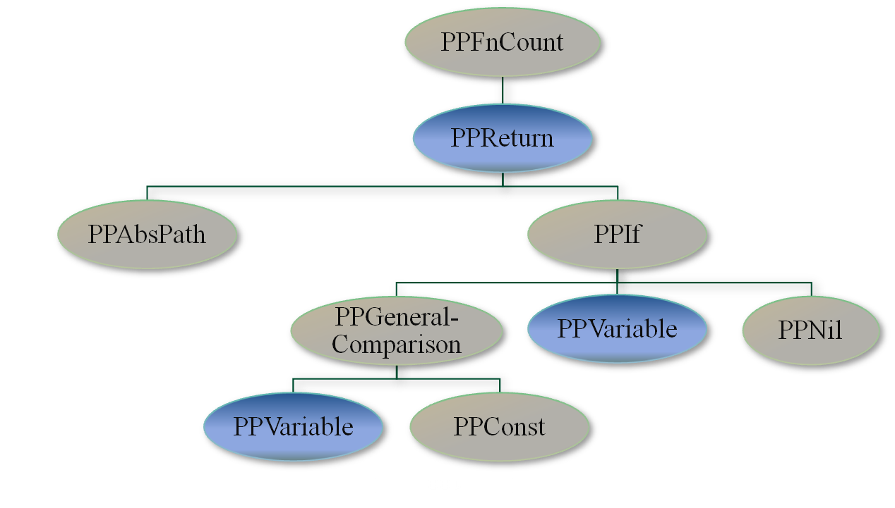
Example
fn:count(
for $x in fn:doc(“auction”)//person/name
where $x = “John”
return $x)
$x
fn:doc(“auction”)//person/name
$x
$x
“John”

Slide 13
Two-phase Sorting
External memory sorting using two phase sort-merge algorithm
Provides low-level high efficient interface: serialize-compare-deserialize:
  used in document order maintenance and duplicate elimination, order by, indexes creation
Optimizations:
  perform merge phase as later as possible
  use exclusive mode of Sedna’s buffer manager

Slide 14
SQL Connection
Allows querying and updating relational databases
Uses well known ODBC interface
Query results are presented as a sequence of XML elements:
<tuple column1=“value1” … columnN=“valueN”/>
Example:
declare namespace sql="http://modis.ispras.ru/Sedna/SQL";
let $connection := sql:connect("odbc:driver://localhost/somedb”)
return
sql:execute($connection,
"SELECT * FROM people WHERE name = ’Peter’")

Slide 15
Foreign Functions Interface
External functions in C
  allows implementing functions which are hard to express in XQuery
  can usually provide faster implementation
Restrictions:
  only atomic values can be passed as parameters
  eager evaluation strategy
Example:
declare function log($a as xs:double) as xs:double external;
log(10)

Slide 16
Sedna
Benchmarks
Data Size (MB): |  | 50 | 100 | 500
XPath |  | 0.5 | 0.8 | 3.1
XPath, pos, trans |  | 1.5 | 1.7 | 13.3
Complex XPath |  | 1.1 | 2.2 | 9.9
Id comparison |  | 1.0 | 2.3 | 10.9
XPath, count |  | 0.2 | 0.4 | 1.4
FLWR |  | 0.3 | 0.5 | 1.8
FLWR, count |  | 0.4 | 0.8 | 3.0
Join(1,2) |  | 263 | 1046 | */154
Join(1,2,3) |  | 340 | 1350 | *
Group by |  | 40 | 81 | 237
Semijoin |  | 423 | 1664 | */173
Complex semijoin |  | 97 | 373 | *
Struct. XPath + trans |  | 0.9 | 1.3 | 6.1
Contains substring |  | 5.9 | 8.4 | 54.6
Long XPath |  | 0.07 | 0.1 | 0.2
Nested Long XPath |  | 0.45 | 0.7 | 3.2
Empty |  | 1.9 | 2.1 | 11
Function Calls |  | 0.5 | 1.0 | 6.2
Sorting |  | 1.9 | 3.5 | 29.4
Trans(nested XPaths) |  | 0.5 | 2.5 | 4.5
50 - 500 MB XMark Benchmark
AMD Athlon 64 2.00 GHz, 1 GB of RAM
Timeout: 2000

Slide 17
Summary
Fast && Efficient
  pipelined execution + optimizations
Complete
  W3C conformant implementation of XQuery 1.0
  powerful DDL and update language
Extensible && Reliable
  clean and well known iterator based interface

Slide 18
Questions
?

Slide 19
Sedna vs. X-Hive
 | X-Hive | Sedna
XPath | 1.2 | 0.8
XPath, pos, trans | 4.0 | 1.7
Complex XPath | 6.8 | 2.2
Id comparison | 3.7 | 2.3
XPath, count | 3.0 | 0.4
FLWR | 4.6 | 0.5
FLWR, count | 16.1 | 0.8
Join(1,2) | * | 1046
Join(1,2,3) | * | 1350
Group by | 34.8 | 81
Semijoin | * | 1664
Complex semijoin | * | 373
Struct. XPath + trans | 3.3 | 1.3
Contains substring | 10.4 | 8.4
Long XPath | 1.8 | 0.1
Nested Long XPath | 2.3 | 0.7
Empty | 3.1 | 2.1
Function Calls | 2.6 | 1.0
Sorting | 24.3 | 3.5
Trans(nested XPaths) | 3.3 | 2.5
100 MB XMark Benchmark
AMD Athlon 64 2.00 GHz, 1 GB of RAM.
Timeout: 2000

Slide 20
Sedna vs.
Berkeley XML DB
 |  | BDB node | Sedna
XPath |  | 0.172 | 0.109
XPath, pos, trans |  | 0.421 | 0.188
Complex XPath |  | 0.625 | 0.141
Id comparison |  | 0.969 | 0.250
XPath, count |  | 0.188 | 0.094
FLWR |  | 1.297 | 0.109
FLWR, count |  | 7.016 | 0.172
Join(1,2) |  | 263.219 | 11.109
Join(1,2,3) |  | 428.453 | 14.125
Group by |  | 42.250 | 2.219
Semijoin |  | 281.781 | 34.625
Complex semijoin |  | 81.453 | 10.969
Struct. XPath, trans |  | 0.109 | 0.454
Contains substring |  | 3.797 | 2.485
Long XPath |  | 0.219 | 0.047
Nested Long XPath |  | 0.234 | 0.156
Empty |  | 0.312 | 0.125
Function Calls |  | * | 0.062
Sorting |  | * | 0.43
Trans(nested XPathes) |  | 1.016 | 0.156
12MB XMark benchmark
AMD Athlon 64 2.00 GHz, 1 GB of RAM.
Timeout: 2000

