Slide 1
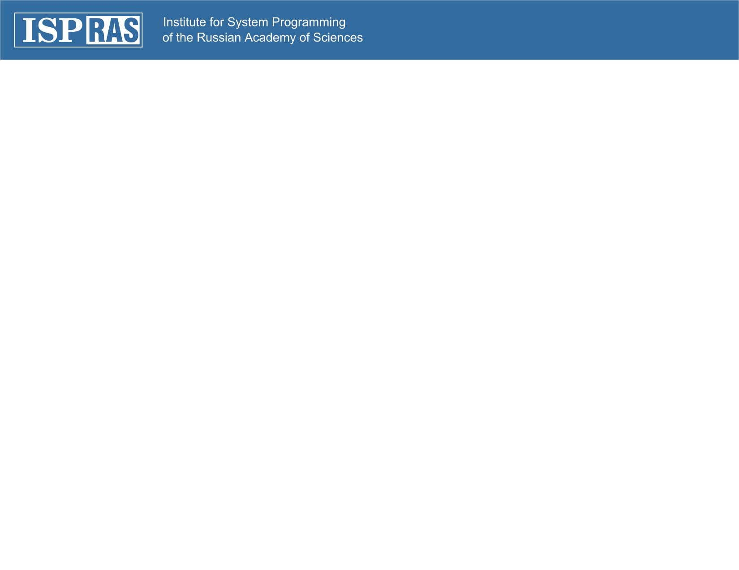
Sedna Architecture
Maria Grineva
upa@grinev.net
PhD, Software Developer
Sedna Team

Slide 2
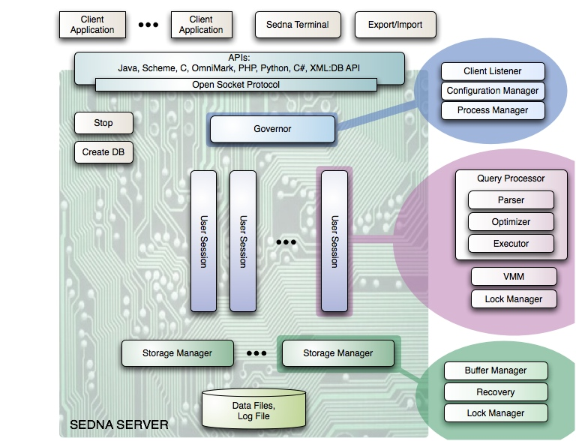
Sedna Architecture Overview
Notes:
First let me introduce you Sedna architecture from the global point of view.
Sedna presents simple “process per user” client-server model. In this model there is one client process connected to exactly one server process.
Governor process serves as a control center in the system. To run Sedna you must first start Governor process. Then Governor controls all Sedna server components. Governor is responsible for the following functions:
Serves as a Client listener. Sedna Client applications connect to the approriate socket port that Governor listens to. And then Governor organizes all the job to process Client application request.
When started Governor process the system configuration files and initializes corresponding structures that later used by other Sedna components.
Governor registers all User sessions and Databases that have been started. Governor uses special socket based mechanism to watch that all registered Sedna components are still alive. Governor also organizes the job to stop all Sedna components correctly.
For every Client application Governor spawns User Session process. This process is responsible to execute User query. It contains: query processor, Lock Manager and Virtual Memory Manager. Query processor fully belongs to the User session process, while Lock Manager is shared between Storage manager and User Session Process
Query Processor constsis of the Parser, Optimizer and Executor. Parser – checks the syntax of query transmitted by the application, and creates a query tree. Optimizer process optimiization and creates a query plan. This query plan then passed to the Executor. Executor recursively steps through the plan tree, retrieves XML nodes and sends the result data to the Client Application.
Query processor will be discussed later and in deep detail in a separate presentation that will be given by Ivan Shchklein.
One instance of a Storage Manager is started for each Sedna database. It is responsible for database buffer management, database recovery support. It also contains a part of Lock manager. Storage manager reads and writes pages from database files on the disk.
Sedna contains utilities to Create/Drop Databases, to Stop Sedna server and to Export/Import data from and to the database. The work of these utilities I will describe shortly on my next slide.
Client applications work with Sedna through various APIs. There is also Interactive Terminal that provides an easy way to run queries through command line. I will provide more details on Sedna APIs later in my presentation.
Concerning this picture I am responsible for the two aspects. First - is a part upon the Query Processor. Generally speaking this part contains all the stuff needed for a Client application to process its command on Server. The second aspect - is the interaction among processes on Server. So now I will dive into these two aspects: process interactions and Sedna APIs.

Slide 3
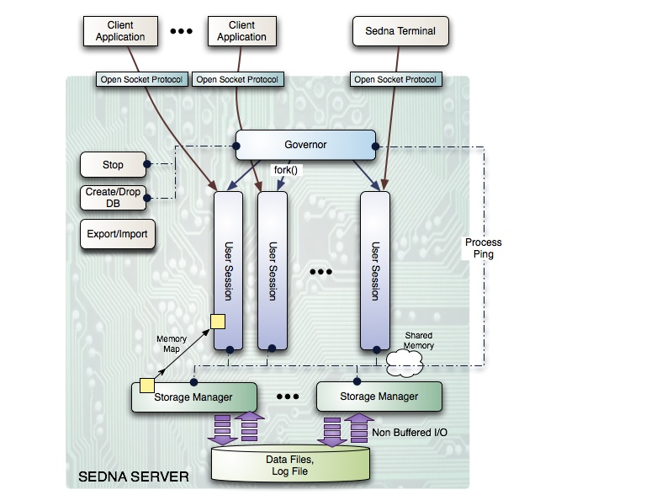
Sedna Architecture: interactions between processes
Notes:
So let us consider the interaction between processes on Server.
Governor is bound to the socket port where it listens to the Client connections. When Client application connects to the Governor, it spawns a new User Session process and passes a socket descriptor to this new user process through an environment variable. So that User Session is connected with Client application directly.
Client interact with User session through a socket using an Open Socket Protocol. This Open Socket Protocol describes the set of messages that are possible in communication between Sedna Client Application and Sedna Server. This protocol is well-documented. Using this protocol it is easy to build a driver for any programming language. In Sedna distributive package we provide drivers for a different popular programming languages such as C, Java, Python and others.
While executing User Query, User session maps blocks from Storage Manager buffers on to its own Virtual memory. Storage Manager reads and writes blocks from database files on the disk.
This memory management mechanism will be later presented in a separate presentation by Nickolay Zavaritskiy. Two parts of the Lock Manager module that is shared between the two processes communicate with each other through a shared memory. Details on Transactions support will be later provided by Alexander Kalinin in his presentation.
There is a special mechanism “Process Ping” that is used by Governor to watch all the processes on Server. Every Sedna process connected to the Governor via socket. Governor uses a separate socket port where all processes are connected to. Governor pings every process periodically and if the connection is broken, it understands that this process failed due to some system error, and Sedna server cannot guarantee it behaves correctly, thus Governor sends appropriate message to other processes and asks them to shut down.
To Stop the Sedna server, a special utility is used. It connects to Governor and sends an appropriated message. Governor shut down all the components.
Database creation consists of creating files on disk. Then create-db utility spawns Storage Manager for these files and runs a special system session that initializes all the necessary metadata structures into this database.
Export/Import utility works with the Sedna server through C API. It allows to export all the data from database and to store it locally on the File System as XML documents. And to import XML documents into the database. Our open source users use this utility in particular to migrate between Sedna releases (In the case when database internal representation have changed in new Sedna release).

Slide 4
Sedna API overview
APIs developed by our team:
  C
  Java
  Scheme
  OmniMark (Stilo’s streaming programming language used for content engineering tasks)
APIs contributed by Sedna open source users:
  Python
  PHP
  .Net
  XML:DB API (standard API for XML databases, supported by other products also)
Notes:
Now let me give a short overview of APIs that Senda currently provides.
Together with Sedna in its distributive package we provide C API, Java API and Scheme API.
The most frequently used Sedna APIs are Java API ,C API and Python. Python API was used for our encyclopedia project that was demostrated yesterday by Alexander.
C API is a lightweight set of functions. C API is a basic one. Some other drivers were implemented upon this C API using foreign function interface in its programming languages.
Java API was design to be similar to the JDBC API.
We also provide API for the Scheme programming language. Scheme is a functional programming language, a popular Lisp dialect.
Together with Canadian content management company Stilo we have implemented Sedna API for their language OmniMark. OmniMark driver is implemented upon the C API by means of foreign function calls mechanism of OmniMark. OmniMark is a streaming programming language used for content engineering tasks. Now Sedna API for OmniMark is included into the OmniMark distributive packaged provided by Stilo.
Our open source users have implemented drivers for a variety of programming languages they used in their projects. These are Python, PHP, .Net, and XML:DB API. Python and PHP are based on our basic C API.

Slide 5
Basic Sedna C API
C API – lightweight set of functions for:
Managing sessions:
  SEconnect, SEclose;
Managing transactions:
  SEbegin, SEcommit, SErollback;
Executing queries:
  SEexecute, SEgetData, SEnext;
  Query result can be presented as a DOM tree, or processed as a stream of SAX events
Load data:
  SEloadData
more…
DDL statements are incorporated into Sedna language:
for example: CREATE COLLECTION, LOAD “xmark.xml” “xmark”, CREATE INDEX …, CREATE TRIGGER … and more.
Notes:
On this slide I will describe the typical set of functions in Sedna API by example of basic C API.
Sedna C API provides a lightweight set of functions that allow to process commands for Sedna.
SEconnect and SEclose functions serves to open and close User session.
Once a session is open, Client application can start, commit or rollback transactions using appropriate functions.
To execute a query SEexecute function is provided. In Sedna we have made a decision to incorporate Data Definition commands into the Database Language. That is, to create a new collection in database, you have to execute a corresponding statement CREATE COLLECTION through the common SEexecute function in the API. On the contrary, in some XML database products (for example XHive and eXists) management of database logical structure such as creating collections and so on, is incorporated into the API as a functions call. For example XHive provides only Java API, and the only way to create a collection and to load data into it is to write and appropriate Java application.
Turning back to the query execution. If the statement passed to the SEexecute function was a query (not an Update) – a programmer can retrieve a result of this query in a serialized form (as a string). In this aspect C API reflects the Sedna Executor model. In Sedna we have pipelined Executor implemented via Iterators. That is to iterate over the items of XQuery query result SEnext function must be used. To retrieve the next item data SEgetData function is provided. SEgetData provides an interface similar to fread function for reading from Files. That is you provide a buffer and specify the number of bytes to be read into this buffer. XML data fetched from the database can be manifested as a DOM object or processed as a stream of SAX events.

Slide 6
Sedna API Extensibility
Sedna Open Socket Protocol
  message-based protocol for communicating between Sedna server and Client application over TCP/IP sockets
  easy to create a new API upon Open Socket Protocol
  similar to Frontend/Backend Protocol in PostgreSQL
Creating new API upon Basic C API using foreign function interface
  PHP, Python, OmniMark
Notes:
It is easy to create a new API for Sedna because Sedna provides Open Socket Protocol.
Open Socket Protocol is a message-based protocol for communicating between Sedna server and Client applications over TCP/IP sockets.
This protocol describes a set of commands that are used for Sedna server while communicating with Client applications. Thus – any API driver constitutes a library that connects to the Sedna Governor and then sends and receives these commands over socket connection.
This protocol is well-documented and put on Sedna site. So our open source users are free to implement their own drivers. You can also see Open Socket Protocol documentation in the printed Sedna documentation set
When designing our Open Socket Protocol we considered analogous Frontend/Backend Protocol in PostgreSQL – an open source relational database system.
Another easy way to implement a driver for Sedna is to build it upon the C API calling C functiuons via foreign function interface of the new programming language. In this way we have implemented OmniMark driver and Sedna users have contributed PHP and Python drivers in a similar way.

Slide 7
Your Questions

