Slide 1
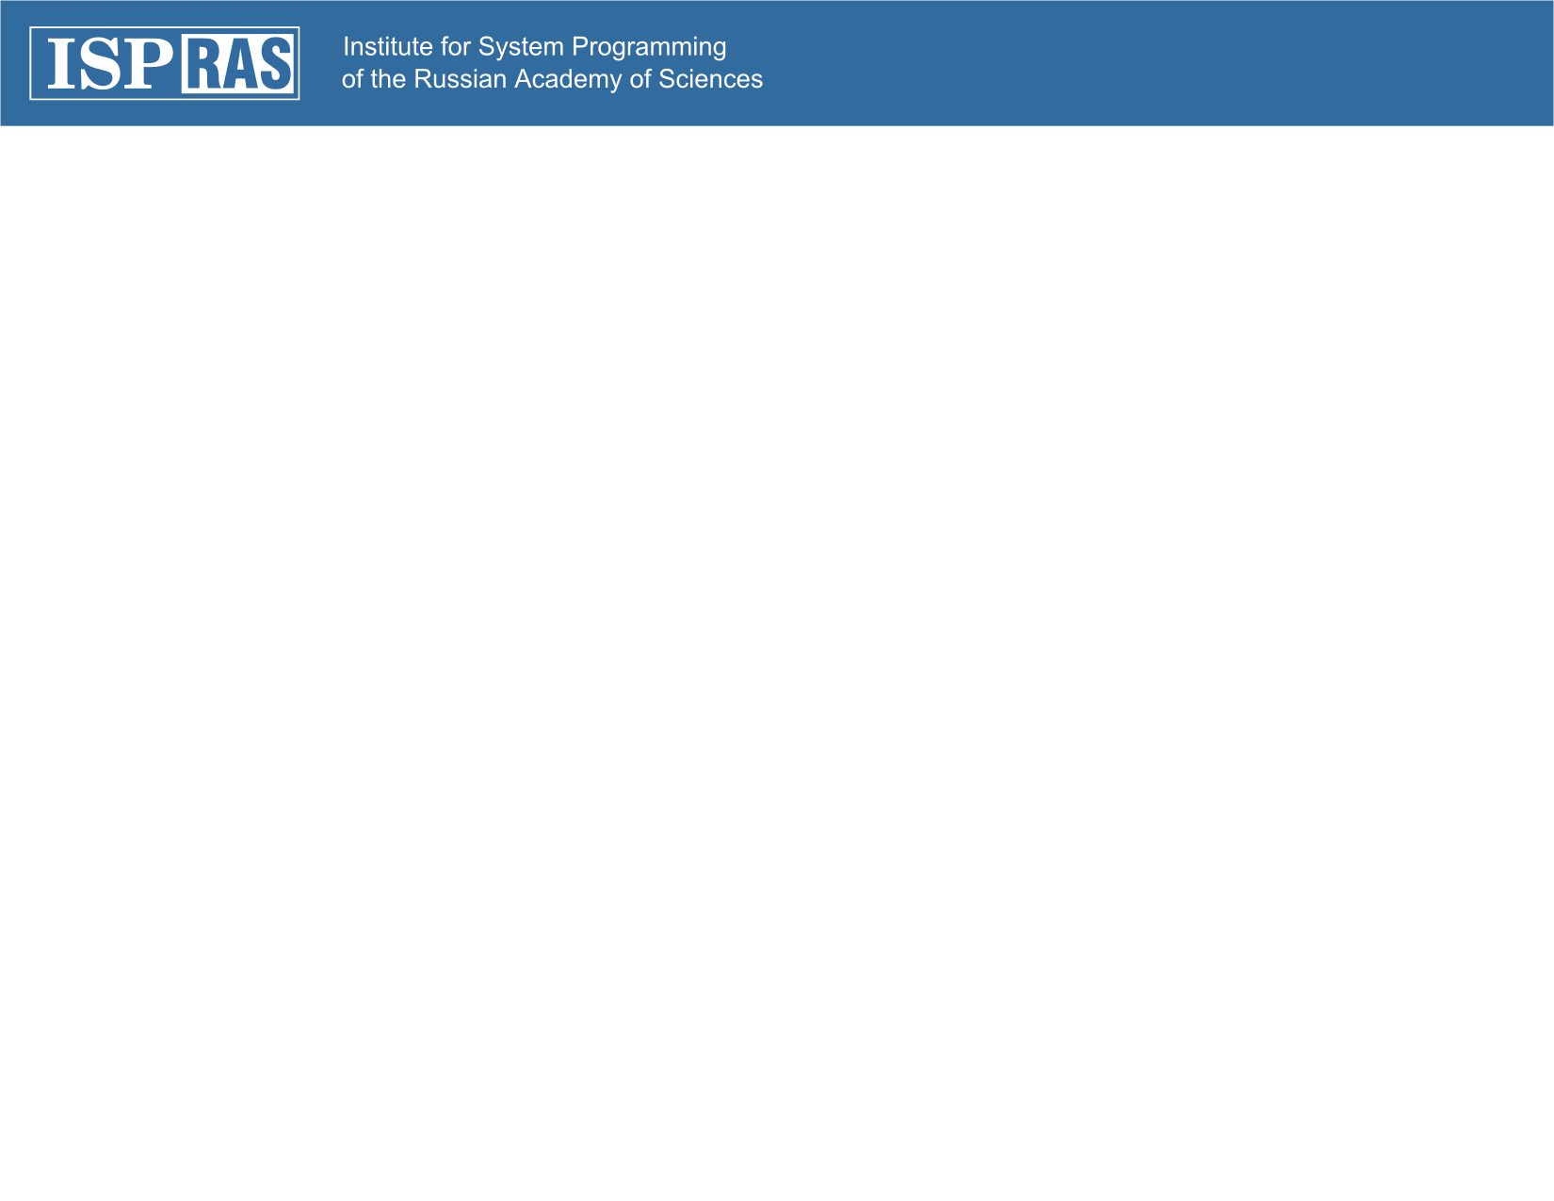
XQuery Triggers in Sedna
Maria Grineva
upa@grinev.net
PhD, Software Developer
Sedna Team
Nov, 26, 2007

Slide 2
XQuery Triggers
Triggers designed specifically for XML data
Natively based on XQuery, XPath and Sedna XML update language
Triggers granularity is the same as update language granularity: triggers fire on nodes
Triggers take into account XML data hierarchy
Can be used for similar purposes as relational database triggers: integrity constraints, event-based applications, statistics gathering, monitoring specific data changes…
Notes:
Sedna supports triggers specifically designed to be suitable for XML data. Sedna triggers are based on XQuery, XPath and Sedna update language.
Triggers in Sedna provide fine-grained processing. Processing granularity of triggers are the same as update language granularity. That is a trigger can be set on a particular nodes of XML-document in database and fire when these nodes are updated.
One of the important trigger features is that they take into account XML data hierarchy. I will explain this aspect further more in detail.
In general Sedna triggers provide wide range of possible applications that can be build upon them. These applications are analogous to those of Relational database applications that work using triggers. These are for example: different types of integrity constraints checking, event-based applications, statistics gathering, monitoring of events related to specific data changes.

Slide 3
XQuery Triggers
CREATE TRIGGER “trigger-name”
(BEFORE | AFTER) (INSERT | DELETE | REPLACE)
ON <XPath-expression> (,<XPath-expression>)*
( FOR EACH NODE | FOR EACH STATEMENT )
DO
{
(<XUpdate-expression($NEW, $OLD, $WHERE)>;)*
<XQuery-expression($NEW, $OLD, $WHERE)>
}
DROP TRIGGER “trigger_name”
Notes:
So lets consider trigger in more detail.
CREATE TRIGGER statement is incorporated into the Sedna Data Definition Language. With this statement a new trigger with trigger_name is created into the database.
Triggers can be deﬁned to execute either before or after any INSERT, DELETE or REPLACE operation, either once per modiﬁed node (node-level triggers), or once per the whole update statement (statement-level triggers). If a trigger event occurs, the trigger’s action is called at the appropriate time to handle the event.
ON path is XPath expression identiﬁes the nodes on which the trigger is set. That means that the trigger ﬁres when corresponding modiﬁcation (insertion, deletion or replacement) of those nodes occurs. Currently trigger implementation in Sedna that I will explain further in this presentation restricts these XPath expression to have predicates and parent axes.
Trigger action is speciﬁed in braces {} after the DO key word. Action contains zero or more update statements and an XQuery query.
Transition variables $NEW, $OLD and $WHERE are deﬁned for each node-level trigger ﬁring and can be used in each statement of the trigger action. These tree variables deﬁne the node subject to modification
For example, for Insert-trigger: $NEW is the node being inserted; for delete-trigger $OLD is the node being deleted; $WHERE is the parent node of the inserted or deleted nodes. For triggers on REPLACE operation, both $OLD and $NEW variables are defined
You cannot use transition variables in statement-level triggers.
Before-node-level-triggers are worth to mention, as they provide special flexible functionality. They can cancel the update operation for the current node if Xquery expression in the trigger body returns an empty sequence. And for INSERT and REPLACE triggers they can modify the inserted node. This modification is described in the trigger body by means of XQuery-expression, thus a new node that will be inserted can be built upon the existing node by means of XQuery constructors.
Typically, node-level-before triggers are used for checking or modifying the data that will be inserted or updated. For example, a before trigger might be used to insert the current time node as a child of the inserting node. Node-level-after triggers are used to propagate the updates to other documents, or make consistency checks against other documents. The reason is that an after-trigger can be certain it is seeing the ﬁnal value of the node, while a before-trigger cannot; there might be other before triggers ﬁring after it. A Programmer designing his application that uses triggers must know that node-level triggers are typically cheaper then statement-level ones.

Slide 4
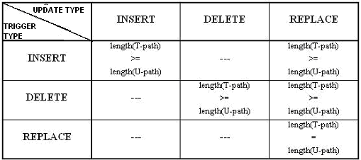
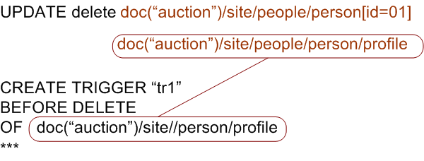
XML specific execution semantics
Notes:
XML data hierarchy must be considered by triggers. For example, when a node is deleted all its descendants are also deleted. Thus, a trigger that is set on the descendant of the deleted node must be fired by this update.

Slide 5
Trigger Example I
CREATE TRIGGER "tr1"
BEFORE INSERT
ON doc("auction")/site//person
FOR EACH NODE
DO
{ if($NEW/age < 14)
then
<person>{attribute id {$NEW/@id}}
{$NEW/*}
<age-group>young</age-group>
</person>
else
<person>{attribute id {$NEW/@id}}
{$NEW/*}
<age-group>adult</age-group>
</person>; }
Node-level before-trigger: analysis and enrichment of the inserted node
Notes:
The following trigger is set on insertion of person nodes. When some person node is inserted, the trigger analyzes its content and modiﬁes it in the following way. If the person is under 14 years old, the trigger inserts additional child node age-group with the text value ’young’: if the person is older than 14 years old - the trigger inserts age-group node with value ’adult’.

Slide 6
Trigger Example II
CREATE TRIGGER "tr3"
BEFORE DELETE
ON doc("auction")/site//person
FOR EACH NODE
DO
{
if(exists($WHERE//open_auction/bidder/personref/@person
= $OLD/@id))
then ( )
else $OLD;
}
Referential integrity support
(trigger prohibits person deletion if the person has any open auctions)
Notes:
The following trigger tr3 cancels person node deletion if there are any open auctions referenced by this person:

Slide 7
Trigger Example III
CREATE TRIGGER "tr4"
AFTER DELETE
ON doc("auction")//*
FOR EACH STATEMENT
DO
{ UPDATE replace $b in doc("stat")/stat with
<stat>
<open_auctions>{count(doc("auction")//open_auction)}
</open_auctions>
<closed_auctions>{{count(doc("auction")//closed_auction)}}
</closed_auctions>
<persons>{count(doc("auction")//person)}</persons>
</stat>;
UPDATE insert
if(count(doc("auction")//person) < 10)
then
<warning>Critical number of person left in the auction</warning>
else ( )
into doc("stat")/stat; }
Statement-level after-trigger: (1) maintains statistics about open/close auctions; (2) provides warnings when constraint is close to violation
Notes:
The next statement-level trigger tr4 maintains statistics in document stat. When this trigger is ﬁred, the update operation is completed that gives the possibility to make aggregative checks on the updated data. After deletion of any node in auction document, the trigger refreshes statistics in stat and provides warning if there are less then 10 persons left.

Slide 8
Implementation aspects
XQuery trigger support on static analysis phase is impossible due to XQuery specifics
In Sedna triggers incorporated deep into executor to achieve better performance
Notes:
While designing the subsystem of triggers support in Sedna, we considered different approaches. First, if to look at the relational database approaches, it is quite often that triggers are processed at the static analysis phase of the update execution. That is, when the update statement is passed for the execution, after the parser phase, it is analized by the optimizer, and the optimizer can understand which tables are accessed by the update statement, then optimizer checks the database metadata to see if there are triggers set on that table. And if there are, the update operation is rewritten in a way that it includes all the trigger processing. That is, trigger actions are put into the update statement at such an early phase.
But applied to XQuery and XML data this approach opens a bunch of new problems. These problems conserned with the fact that triggers are set on nodes (not on the whole table). With XQuery Updates it is impossible to understand which nodes will be actually updated by the current update statement on the static analysis phase. And so, at this early phase we cannot know which triggers will be fired by this update.
So, in Sedna we have decided to incorporate triggers support deep into the executor. Triggers are processed as update operation modifies node by node. This tight integration between trigger subsystem and the executor results in minimal overhead charges on trigger support. Now lets see what exactly method we use to support triggers.

Slide 9
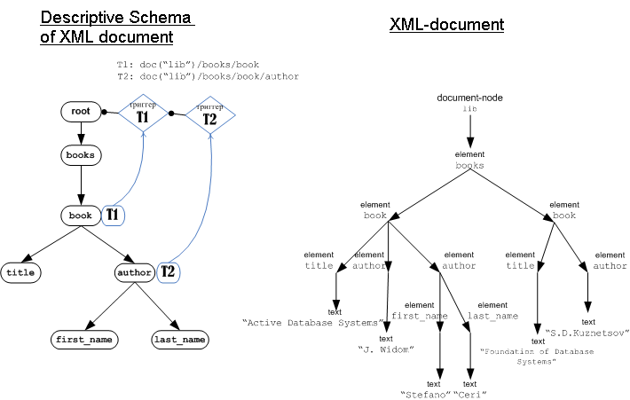
Implementation Aspects: efficient detection of fired triggers using fixators on descriptive schema
Notes:
The main idea of our method is to maintain special marks (that we call fixators) on the nodes of the descriptive schema of document.
As Leonid described in his presentation in Sedna descriptive schema is a part of the storage. There are pointers from the data blocks onto the corresponding node of the descriptive schema.
Lets follow how do we process a trigger. When the trigger is created for the database, the corresponding fixators are set on the nodes of the descriptive schema. Fixator are a small objects that contain trigger ID. Trigger action is stored as a set of precompiled statements in database metadata.
Then when any update operation is executed for a node, we just follow the reference from the node to its corresponding node of the descriptive schema and check if there are any triggers set for this node. Then if there is a trigger fixator, this trigger action is executed either before or after this node modification.
So, according to our method – all the overhead charges for the trigger support, consist in following one pointer and check the fixator presence.

Slide 10
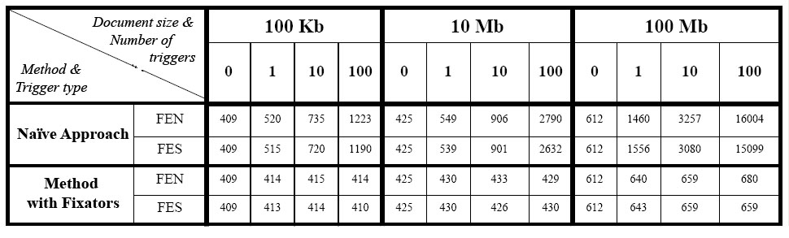
Triggers Experimental Study
Time of update operation execution in milliseconds
(Naïve approach compared to the method with fixators
implemented in Sedna)
Notes:
I have done a set of experiments for the triggers in Sedna.
This table contains the time of update statement execution in milliseconds when there are triggers set on the document that is modified.
I compared our method with a naïve approach. By naïve approach I meant the approach when we do not use any special techniques and discover the fired triggers in a straightforward way - just by executing their XPath-expressions. So, when the update statement is passed to the Query Processor, we execute all trigger’s XPath expressions and thus determining which triggers on which nodes must be fired.

Slide 11
Database Users and Privileges
Maria Grineva
upa@grinev.net
PhD, Software Developer
Sedna Team

Slide 12
Database Users
Database users interact with database objects:
  standalone document
  collection
  index
  module
  trigger
Two types of database users:
  Sedna database administrator (DBA user)
  ordinary user
DDL statements to manage users:
  CREATE USER ”user-name” WITH PASSWORD ”user-password”
  DROP USER ”user-name”
  ALTER USER ”user-name” WITH PASSWORD ”new-password”
Notes:
In Sedna Database Users and Privileges concept is similar to the one provided for SQL with some simplifications.
The granularity of privileges is the whole document or collection thus this subsystem does not have any XML specifics.
Here in my presentation I will not describe all the details about privileges, roles but just give an overview of them, and describe how this subsystem is implemented in Sedna.
Every Sedna database contains a set of database users. Those users are separate from the users managed by the operating system on which Sedna runs. Users own database object (for examples, documents) and can assign privileges on those objects to other users to control who has access to that object.
Database user names are global across a database (and not per all Sedna databases).
There are following kinds of Sedna database objects:
standalone document
collection
index
Module
Trigger
There are two types of Sedna database users:
Sedna database administrator (DBA user)
ordinary user (below we call ”user”)
There are corresponding statements in Database language for managing users.
When the database is created, it always contains one predeﬁned DBA user with name "SYSTEM" and password "MANAGER".

Slide 13
User Privileges and Roles
Possible privileges:
  CREATE-USER
  CREATE-DOCUMENT
  CREATE-COLLECTION
  CREATE-INDEX
  CREATE-TRIGGER
  LOAD-MODULE
  LOAD
  DROP
  QUERY
  INSERT
  DELETE
  RENAME
  RETRIEVE-METADATA
Role is a named group of related privileges.
DDL statements:
  CREATE ROLE "role-name"
  GRANT "privilege" | ALL ON [DOCUMENT|COLLECTION] "database-object-name"
  TO "user-name|role-name" | PUBLIC
  GRANT "privilege" | ALL ON DATABASE TO "user-name|role-name" | PUBLIC
  GRANT "role-name"
  TO "user-name|role_name" | PUBLIC
Notes:
There are the following possible privileges.
Some are them can be grated to the document or collection (for example CREATE-INDEX, QUERY, INSERT, DELETE) and some of them for the whole database like LOAD, RETRIEVE-METEDATA, CREATE-USER…
Role is a named group of related privileges. Roles provide an easy and controlled way to manage privileges. To create role the corresponding statement CREATE ROLE is used.
There are the following corresponding statements in Sedna DDL language. These statement again are identical to the SQL one.

Slide 14
The Privilege-Checking Process
DBUP metadata are stored in the database as a normal document
Privilege-checking process:
  At query compile phase: data definition statements are enriched with DBUP-checking on the static analysis phase
  At query execution phase: DBUP-checking for documents/collections are processed on the fly (when the document/collection root is accessed by the query executor)
Notes:
So how does the privileges checking is processed in Sedna. When the database is created the default metadata document with first default database user is created inside the database.
Then for each statement that is passed for the execution, the privileges-checking process is started that checks if the user that is running the session has all the needed privileges to execute current statement.
This privileges-checking module in Sedna is divided into two part. One part is a part of the Query Optimizer. And another part is incorporated into the executor. The reason for this devision is following.
For Data definition statement, such as CREATE COLLECTION for example, it is possible to know does the user have a necessary privilege. So, in the static analysis phase the optimizator creates an additional statement that is executed before the DDL statement.
But for XQuery and Update statements at the static analysis phase we cannot know which documents will be finally accessed – and thus we need to check the privileges at the query riun time. So, when the document/collection root is accessed by the executor, it executes an additional precompiled statement to check the necessary privileges.

Slide 15
Your Questions?

