Slide 1
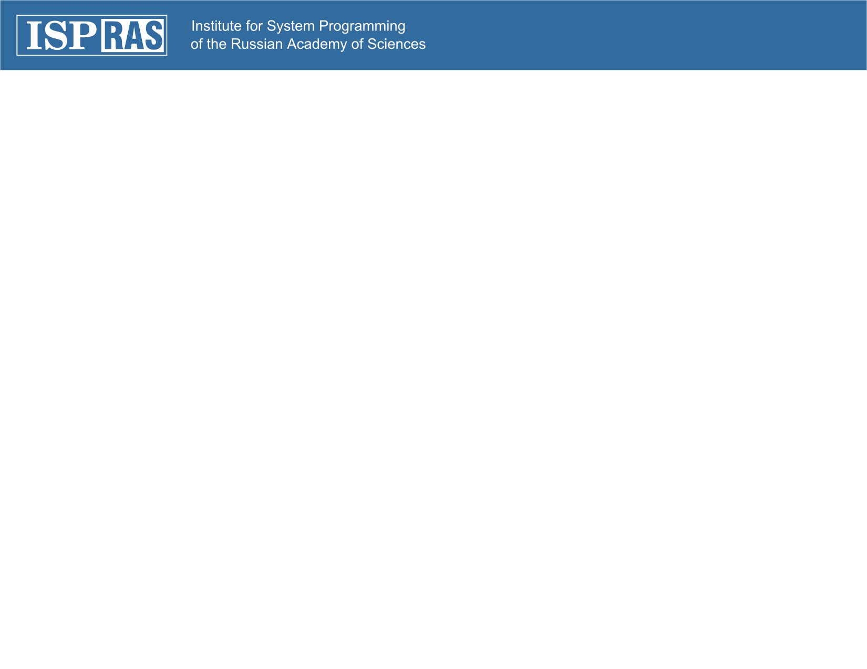
Sedna XML DBMS:
Transactions and Recovery
Alexander Kalinin kalinin@ispras.ru
Nickolay Zavaritsky mejedi@gmail.com
Sedna Team

Slide 2
General principles
ACID transactions
    Atomicity – rollback procedure
    Consistency – by design
    Isolation – S2PL and snapshots
    Durability – two-level recovery scheme
Versioning environment
    Support for Read-Only transactions
    Physical recovery using persistent snapshot
Logical recovery using log of microoperations

Slide 3
Versioning Scheme
Page-level versioning
    Consistent with internal representation (e.g. following the pointers)
    Transaction-transparent solution
    All logic is encapsulated in a separate module on SM
Limited number of versions for each page
    More effective maintenance and garbage collecting (4 versions on 2 snapshots)
Support for snapshots to process read-only transactions
    No isolation is required
    Long-running read-only transactions cannot be rolled back due to the lack of versions

Slide 4
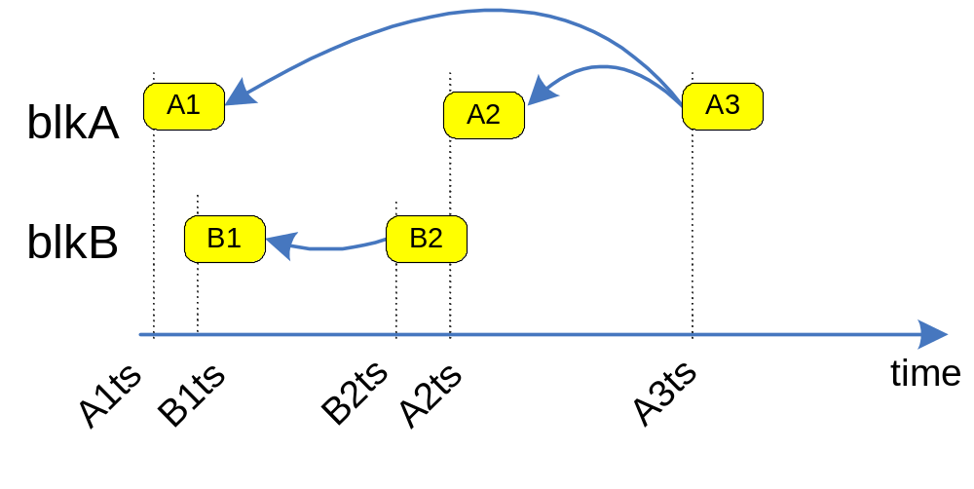

Slide 5
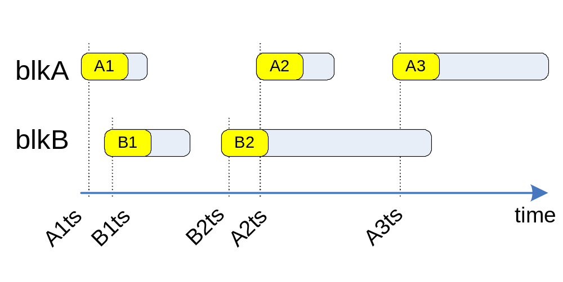

Slide 6
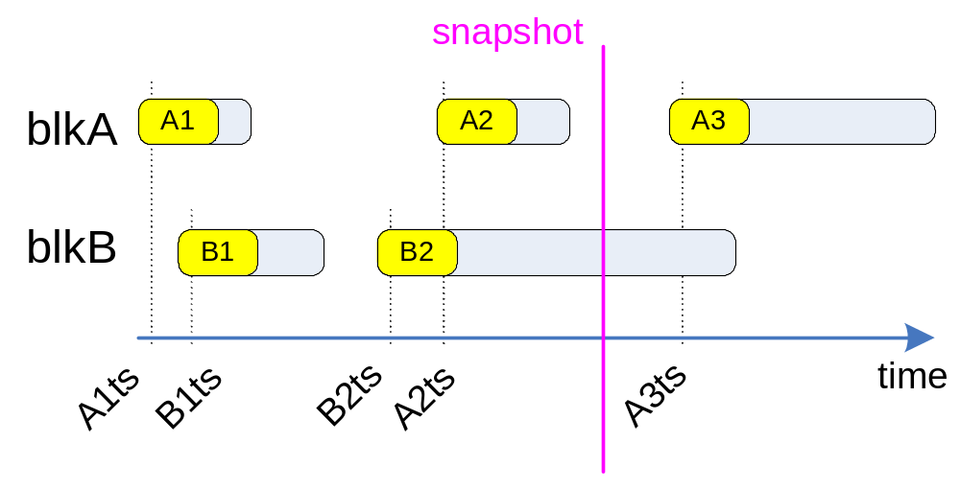

Slide 7
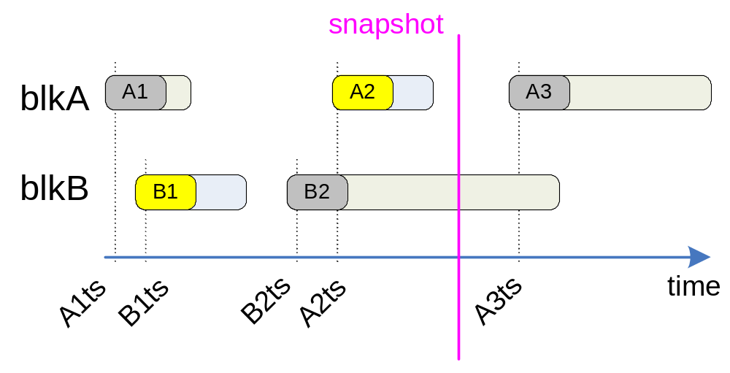

Slide 8
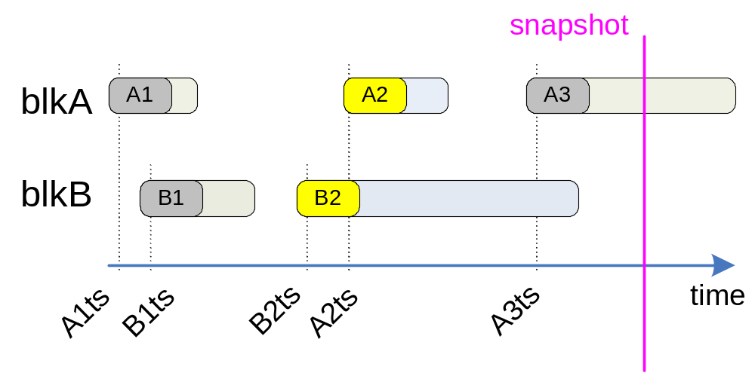

Slide 9
Rollback and Recovery scheme
Normal processing:
    Logical logging of all microoperations (1 record per microoperation + 1 record per changed persistent version)
    Transaction-consistent snapshots on checkpoints
Rollback processing:
    Undo microoperations using logical log records
Two-level recovery process:
    Restore transaction-consistent state using persistent snapshot
    Redo the necessary microoperations using logical log

Slide 10
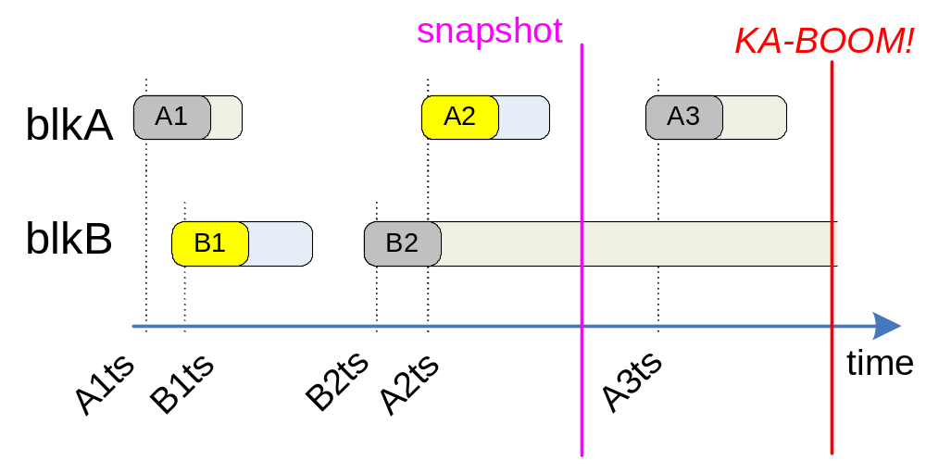
Recovery process

Slide 11
Isolation
Usual transactions
    S2PL protocol
    Document-level granularity
Read-only transactions
    No isolation is required since they use transaction-consistent snapshots

Slide 12
Thank you for your attention!

