Slide 1
COMP 5353 – Internet Security: Principles and Practice
Lecture 0: Subject Overview
Dr. Zili Shao
Department of Computing
The Hong Kong Polytechnic Univ.

Slide 2
Information security is needed
Physical and administrative means before the widespread use of computers and other data processing equipments
Computer security with the introduction of computers to store data
internet security with the introduction of distributed systems/networks/communications facilities
(internet here means any interconnected collection of networks)

Slide 3
Computer Security and internet security
Computer security is the generic name for the collection of tools designed to protect data and to thwart hackers
internet security measures are needed to protect data during their transmission (the focus of this subject)
No clear boundaries between them (we will talk about some common attack and computer virus as well)

Slide 4
The Internet is inherently insecure.
Internet backbone infrastructure: DoS, worm
Routing protocols: route hijacking
DNS: DoS
Core Internet protocols (e.g., IP, TCP/UDP, HTTP): eavesdropping, modification, authentication
LAN security: eavesdropping, modification, authentication
Host security (e.g., Web servers, database): DoS, authentication, phishing, malicious software implant, identity and data theft, etc.

Slide 5
Internet security is inherently complex.
A packet goes through many hops and links.
Involve from the physical layer and up.
  Physical layer security
  Network security
  System security
  Application security
Complexity in software and protocols
  Software ages
  Some protocol fields are never tested.
The weakest link
The human factor
The success of Internet makes things worse.
Security verses privacy (anonymity)
How to measure security?

Slide 6
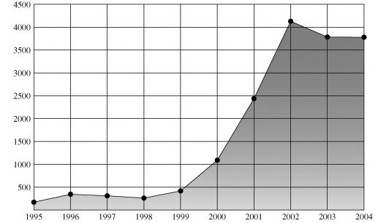
Security trends – Vulnerabilities reported
Source: CERT/CC:
the Computer Emergency Response Team (CERT) Coordination Center (CERT/CC).

Slide 7
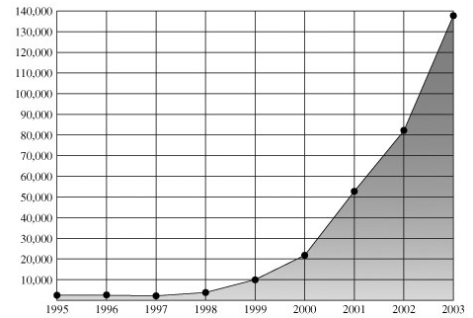
Security trends – Incidents reported
Source: CERT/CC

Slide 8
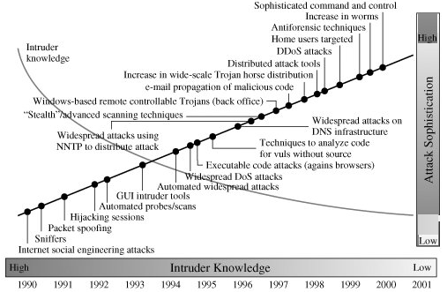
Security trends – Sophistication and Knowledge
Source: CERT

Slide 9
This course is about
Understand the fundamental cryptographic functions used in network security.
Understand the issues involved when applying the cryptographic functions to the network protocols.
Understand the main elements in securing today’s Internet infrastructure.
Exposed to some current Internet/system security problems.

Slide 10
The Course Organization
Network security applications: Authentication, Email, IP, Web, and system
Symmetric Cipher
Block cipher and DES/AES (Data Encryption Standard/ Advanced
Encryption Standard)
Public-key
cryptography
and RSA
Hash function and message authentication
Classical Encryption
Introduction to internet security/cryptography

Slide 11
Introduction to internet security
Security architecture
Security attacks
Security services
Security mechanisms
The model of network security
Cryptography
  Symmetric ciphers
  Public-key ciphers
  Hash functions

Slide 12
Symmetric Ciphers
Classical encryption techniques
  Some classical techniques and their problems
Block ciphers
  Principles
  DES (Data Encryption Standard)
  AES (Advanced Encryption Standard)

Slide 13
Public-key Ciphers
Introduction to number theory
Design principles
The RSA algorithm
Key management

Slide 14
Hash functions
Mathematical foundation of hash functions
Hash functions
Message authentication
MAC (Message Authentication Code)
  SHA (Secure Hash Algorithm)

Slide 15
Network Security Applications
Authentication applications
E-mail
IP Security (IPSec)
Web Security
  Secure Socket Layer (SSL)
  Transport Layer Security (TLS)
Buffer overflow vulnerability
Internet worm and virus

Slide 16
Textbook and Reference Books
Textbook:
William Stallings, Cryptography and Network Security Principles and Practices, Fourth Edition, Prentice Hall, 2005 (Required).
Reference books:
  R. Anderson. Security Engineering, Second Edition, Wiley, 2008.
  M. Bishop. Introduction to Computer Security, Addison Wesley, 2005.
Handout: Handouts will be provided and can be downloaded from the course website.

Slide 17
The Course Website
Everything will be put on the webct:
http://webct2.polyu.edu.hk/webct/public/home.pl

Slide 18
The Grading
Components:
  Continuous Assessment 30%
    3 Assignments (each 10%)
  Final Exam 35%
  Practicum 35%
    One programming mini-project related to Buffer Overflow Attacks (Program Language: C) 15%
    One project related to internet security 20%

Slide 19
What I expect of students?
Class participation
  Believe me, you will learn more quickly and easily when attending the classes
Start to do your homework early and finish them in time
  20% deduction each day for late homework
  Do not try for any excuse (Trip in Mainland, China; Too busy recently) – We need to be fair to everyone
No cheating in any exam and homework.
I am very serious in teaching and I am a good teacher. So please do your part and be a good student.

Slide 20
Office Hour
Welcome to come to my office during the office hours:
Office: PQ 721 Tel: 2766-7287
Office hours: Friday 3-5pm

