Slide 1
COMP 5353 – Internet Security: Principles and Practice
Lecture 1: Introduction to internet security
Dr. Zili Shao
Department of Computing
The Hong Kong Polytechnic Univ.

Slide 2
Outline
Security trends
The OSI security architecture
  Security attacks
  Security services
  Security mechanisms
Network security models
Introduction to cryptosystems
  Terminologies: Plaintext, ciphertext, encryption, decryption, Cryptology: cryptography/cryptanalysis
  Basic methods: symmetric cipher, public-key cipher and hash functions

Slide 3
Part I: Security trends

Slide 4
Computer Security and internet security
Computer security is the generic name for the collection of tools designed to protect data and to thwart hackers
internet security measures are needed to protect data during their transmission (the focus of this subject)
No clear boundaries between them (we will talk about computer virus as well)

Slide 5
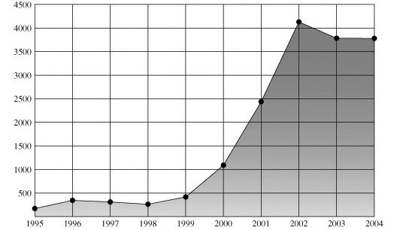
Security trends – Vulnerabilities reported
Source: CERT/CC:
the Computer Emergency Response Team (CERT) Coordination Center (CERT/CC).

Slide 6
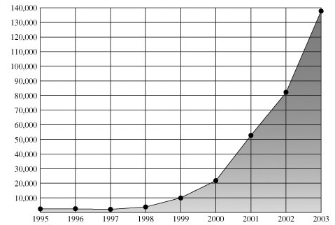
Security trends – Incidents reported
Source: CERT/CC

Slide 7
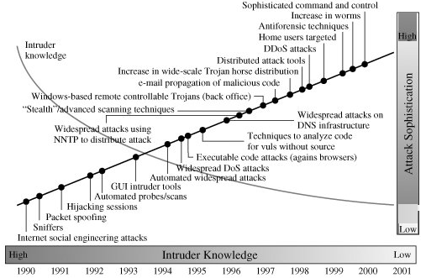
Security trends – Sophistication and Knowledge
Source: CERT

Slide 8
Part II: Security Architecture

Slide 9
The OSI Security Architecture
How to define the requirements for security and characterize approaches to satisfying requirements
ITU-T Recommendation X.800, Security Architecture for OSI (Open Systems Interconnection Model), defines such a systematic approach
The OSI security architecture focuses on security attacks, mechanisms, and services

Slide 10
Security attacks (X.800)
A passive attack attempts to learn or make use of information from the system but does not affect system resources.
An active attack attempts to alter system resources or affect their operation.

Slide 11
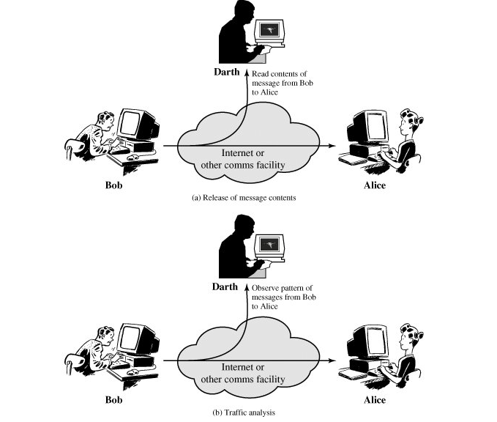
Passive attacks
Two types: release of message contents and traffic analysis.
Difficult to detect but
feasible to prevent
(encryption)
The emphasis is on
Prevention rather than
detection.

Slide 12
Active Attacks
Active attacks involve some modification of the data stream or the creation of a false stream
Four categories
  Masquerade
  Replay
  Modification of messages, and
  Denial of service

Slide 13
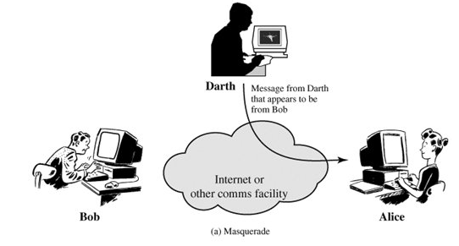
Active attack: Masquerade
One entity pretends to be a different entity

Slide 14
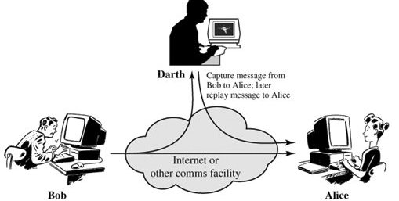
Active attack: Replay
The passive capture of a data unit and its subsequent retransmission to produce an unauthorized effect

Slide 15
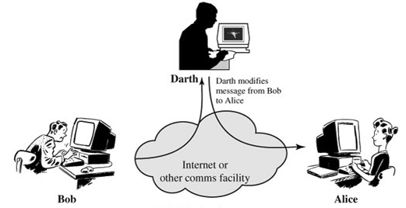
Active attack: Modification of messages
Some portion of a legitimate message is altered, or that messages are delayed or reordered, to produce an unauthorized effect

Slide 16
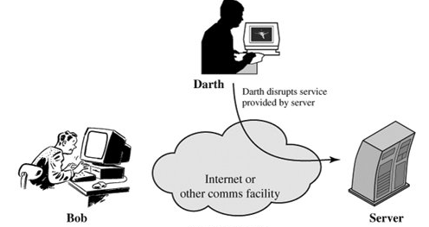
Active attack: Denial of service
Prevents or inhibits the normal use or management of communications facilities

Slide 17
Active Attacks
Easy to detect but hard to prevent
  The wide variety of potential physical hardware, software, and network vulnerabilities
The goal is to detect active attacks and to recover from any disruption or delays caused by them

Slide 18
Security Services (X.800)
Authentication – assure that the communicating entity is the one that it claims to be.
Access Control – the prevention of unauthorized use of a resource.
Data Confidentiality – the protection of data from unauthorized disclosure.
Data Integrity – data received are exactly as sent by an authorized entity.
Nonrepudiation – protection against denial by one of the entities involved in a communication of having participated in all or part of the communication.

Slide 19
Security Mechanisms (X.800)
Specific Security Mechanisms (to a protocol layer)
  Encipherment
  Digital Signature
  Access Control
  Data Integrity
  Authentication Exchange
  Traffic Padding
  Routing Control
  Notarization
Pervasive Security Mechanisms
  Trusted Functionality
  Security Label
  Event Detection
  Security Audit Trail
  Security Recovery

Slide 20
Encipherment/Digital Signature
Encipherment
  The use of mathematical algorithms to transform data into a form that is not readily intelligible.
  The transformation and subsequent recovery of the data depend on an algorithm and zero or more encryption keys.
Digital signature
  Data appended to, or a cryptographic transformation of, a data unit that allows a recipient of the data unit to prove the source and integrity of the data unit and protect against forgery (e.g., by the recipient).

Slide 21
Access Control/Data Integrity/Authentication Exchange
Access Control
  A variety of mechanisms that enforce access rights to resources.
Data Integrity
  A variety of mechanisms used to assure the integrity of a data unit or stream of data units.
Authentication Exchange
  A mechanism intended to ensure the identity of an entity by means of information exchange.

Slide 22
Traffic Padding/Routing Control/Notarization
Traffic Padding
  The insertion of bits into gaps in a data stream to frustrate traffic analysis attempts.
Routing Control
  Enables selection of particular physically secure routes for certain data and allows routing changes, especially when a breach of security is suspected.
Notarization
  The use of a trusted third party to assure certain properties of a data exchange.

Slide 23
Pervasive Security Mechanisms
Trusted Functionality – That which is perceived to be correct with respect to some criteria (e.g., as established by a security policy).
Security Label – The marking bound to a resource (which may be a data unit) that names or designates the security attributes of that resource.
Event Detection – Detection of security-relevant events.
Security Audit Trail – Data collected and potentially used to facilitate a security audit, which is an independent review and examination of system records and activities.
Security Recovery – Deals with requests from mechanisms, such as event handling and management functions, and takes recovery actions.

Slide 24
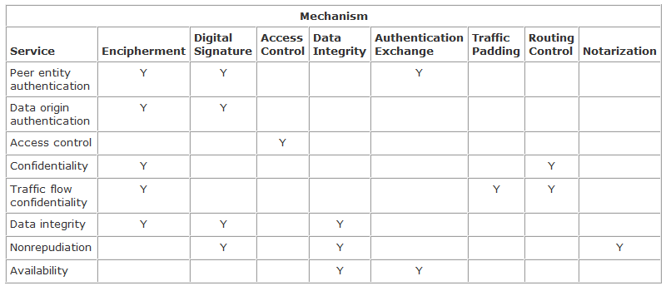
Relationship between Security Services/Mechanisms

Slide 25
Part III: Network Security Models

Slide 26

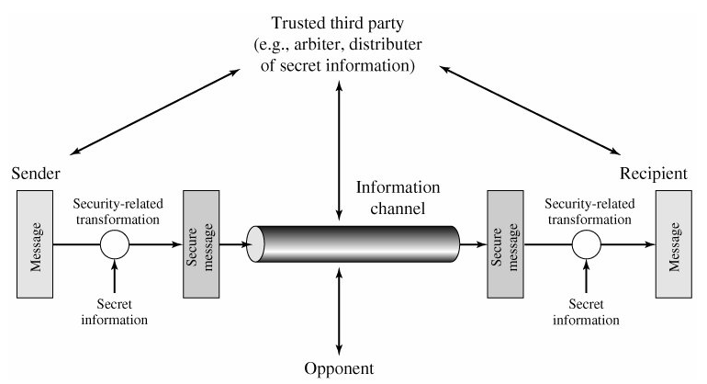
Model for Network Security

Slide 27
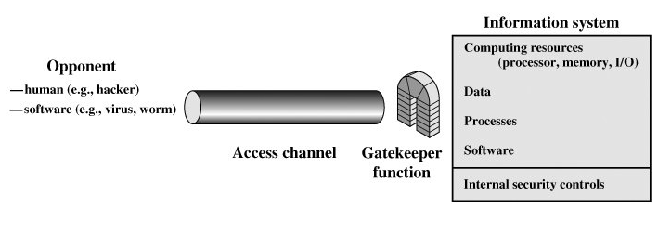
Network Access Security Model

Slide 28
Part IV: Introduction to Cryptography

Slide 29
Terms
Plaintext – An original message
Ciphertext – The coded message
Encryption (enciphering) – The process of converting from plaintext to ciphertext
Decryption (deciphering) – The process of restoring the plaintext from the ciphertext
The many schemes used for encryption constitute the area of study known as cryptography. Such a scheme is known as a cryptographic system or a cipher.
Cryptanalysis – Techniques used for deciphering a message without any knowledge of the enciphering details
Cryptology – The areas of cryptography and cryptanalysis together

Slide 30
Symmetric Ciphers
Given:
  Alice and Bob agree on a secret key cryptosystem.
  Alice and Bob agree on a key (secret) K.
Encryption and decryption using the key.
  Alice encrypts M with K: C = E(M, K)
  Bob decrypts C with K: M = D(C, K)
Algorithms are based on substitution and permutation
Problems:
  Keys must be distributed in secret.
  Compromising keys means compromising all aspects of security.
  The number of keys is not scalable to the user population size.

Slide 31
Public-Key Ciphers
Given:
  Alice and Bob agree on a public key cryptosystem.
  Alice owns a pair of public key and private key, and Bob knows Alice’s public key, which is not a secret.
Encryption using the public key and decryption using the private key.
  Alice encrypts M with Bob’s public key (Pub_{Bob}):
  C= E(M, Pub_{Bob})
  Bob decrypts C with his private key (Pri_{Bob})
  M=D (C, Pri_{Bob})

Slide 32
Public-Key Ciphers
Also, M=D (E(M, Pri_{Bob}), Pub_{Bob}) authentication
Public-key ciphers are very slow (100-1000 times slower than symmetric ciphers)
  They are used to encrypt “Keys”
  Many protocols such as SSL use it.
Algorithms are based on simple mathematical functions that are computationally infeasible:
Given a large n, find two primes p and q such that n = p*q.

Slide 33
Signature using public-key ciphers
Utilize M=D (E(M, Pri_{Bob}), Pub_{Bob}) for signature
Bob: S=E(M, Pri_{Bob}), C = E( M||S, Pub_{Alice})
Send C
Alice: M||S = D(C, Pri_{Alice})
M’ = D(S, Pub_{Bob})
Compare M and M’.
The problem: the message to be encrypted and decrypted is too long.

Slide 34
Hash functions
A hash (message digest or one-way function) produces a short, fixed-sized output h(m) for a message m.
Properties:
  One-way functions are relatively easy to compute, i.e., given x and compute h(x).
  However, given h(x), it is significantly harder to compute x.
  It is computationally infeasible to find two inputs that hash to the same value.

Slide 35
Summary
We introduced:
security trends
the OSI security architecture.
network security models
cryptology

