Slide 1
Vanguard Influx Documentation
Problem Statement | Requirement(s) | Design & Definition(s)

Slide 2
Problem Statement
To onboard new users into Vanguard’s Analytical Framework, several Citi marketplace orders are required. Currently, these orders are submitted manually; consuming many people-hours and is extremely repetitive.

Slide 3
Current Process Diagram
4. The handler updates periodically via E-mail
regarding the statuses of
the submitted marketplace
order(s)
E-mail Response
3. The handler submits the order(s) via Citi’s online marketplace
Task Handler
Citi Marketplace
E-mail Request
1. A requester sends out a E-mail Request
2. The task is assigned
to a handler i.e. Person

Slide 4
Requirement(s)
Automate the submission process of commonly used Citi marketplace orders
Automate marketplace order tracking
Is extendable i.e. without much coding, one can easily add an additional Citi marketplace order if required
Operated via a graphical user interface
(Optional) Dockerized webapp solution via OpenShift
(Optional) Incorporate stateful operations

Slide 5
Design & Definition(s)
The solution/technology to each requirement:
Use Selenium to develop an automation script
See above
Implement a Finite State Machine with extendibility; utilize JSON or XML format for State IO and transitions
Use Kivy or PyQT5
(Optional) Use Django or Flask
(Optional) Use PostgreSQL

Slide 6
Design & Definition(s)
Iteration #1: A Localized Executable
3. The handler submits the order(s) via a simplified GUI
6. The handler copies and pastes the lookups returned from the machine and updates the requester of the statuses of their order(s)
5. The machine returns a list of order numbers; given this list, it can lookup the statuses of these marketplace order(s) at any time
E-mail Response
Task Handler
Finite State Machine GUI (Exe)
Citi Marketplace
E-mail Request
1. A requester sends out a E-mail Request
2. The task is assigned
to a handler i.e. Person
4. The machine submits the order(s) automatically via the online marketplace

Slide 7
Iteration #1: A Localized Executable
Provide an extendible list of Actions for which when combined, any order is possible:
Default Actions : IDLE, OPEN, CLOSE, GET, CLICK, WRITE, WAIT
A JSON file to represent a Finite State Machine : {
“name”: “Name of Citi Marketplace Order”
“environment”: “Environment (if applicable)”
“graph”: [
[“labelA”, “stateA”, “nextState”, [“list of arguments (if applicable)”]],
[“labelB”, “stateB”, “nextState”, [“list of arguments (if applicable)”]],
…
]
}
Note. Knowledge on XPATH is required.

Slide 8
Iteration #1: A Localized Executable
Make bulk-ordering possible via CSV files:
SOEID
SOEID
… is for making specific marketplace orders (to be selected via the Graphical User Interface)
Or
SOEID,“Name of Citi Marketplace Order”[,“Name of Citi Marketplace Order”…]
SOEID,“Name of Citi Marketplace Order”[,“Name of Citi Marketplace Order”…]
… is for making customized marketplace orders for each SOEID

Slide 9
Iteration #1: A Localized Executable
Make bulk-lookup possible via CSV files:
“Order Number”
“Order Number”
… is for searching the exact marketplace order statuses
Or
SOEID,“Name of Citi Marketplace Order”[,“Name of Citi Marketplace Order”…]
SOEID,“Name of Citi Marketplace Order”[,“Name of Citi Marketplace Order”…]
… is for searching the most recent order of “Name of Citi Marketplace Order” for SOEID

Slide 10

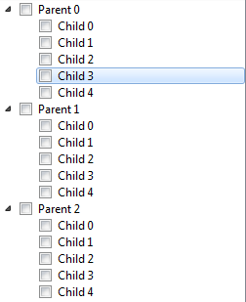
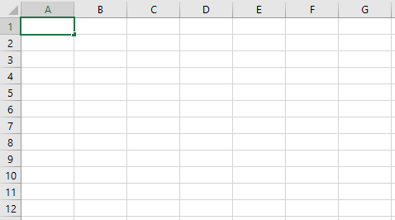
Iteration #1: A Localized Executable
Graphical User Interface Design [Draft]:
Vanguard Influx Tool
LOAD CSV
CLEAR CSV
SAVE CSV
ADD ORDER
REMOVE ORDER
Terminal for Standard Out &
Standard Error
Validate
Order
Tmp
Loaded
Order Results
DEV
UAT
PROD

Slide 11
Design & Definition(s)
Iteration #2: A Dockerized WebApp
3. The handler submits the order(s) via a simplified GUI
6. The handler copies and pastes the lookups returned from the machine and updates the requester of the statuses of their order(s)
5. The machine returns a list of order numbers; given this list, it can lookup the statuses of these marketplace order(s) at any time
E-mail Response
Task Handler
Finite State Machine (WebApp)
Citi Marketplace
E-mail Request
1. A requester sends out a E-mail Request
2. The task is assigned
to a handler i.e. Person
4. The machine submits the order(s) automatically via the online marketplace

Slide 12
Design & Definition(s)
Iteration #3: A Stateful WebApp
E-mail Response
5. The machine periodically updates, via E-mail,
each marketplace order’s statuses
3. The handler submits the order(s) via a simplified GUI
E-mail Request
Task Handler
Finite State Machine (WebApp)
Citi Marketplace
1. A requester sends out a E-mail Request
2. The task is assigned
to a handler i.e. Person
4. The machine submits the order(s) automatically via the online marketplace

