Slide 1
Perl and the Secrets of Life
By Paul Mooney
(Sorry about the title)
Notes:
I’ve been working in bioinformatics for about 8 years which is when I started using Perl.
I’m keen to know what other fields use Perl…
I’ll talk about my field and why Perl is used.
It is the primary language.

Slide 2
Some Background
The human genome contains >3 billion chemical nucleotide bases
A base is an A, C, G or T. To software it really is just a letter!
99.9% of all bases are the same between you and me.
If you stretched out the human genome it would be 2m long
Notes:
I work at The Sanger Institute which is based in Cambridge.
It was the largest single contributor to the human genome project and some of my software helped to do it.

Slide 3
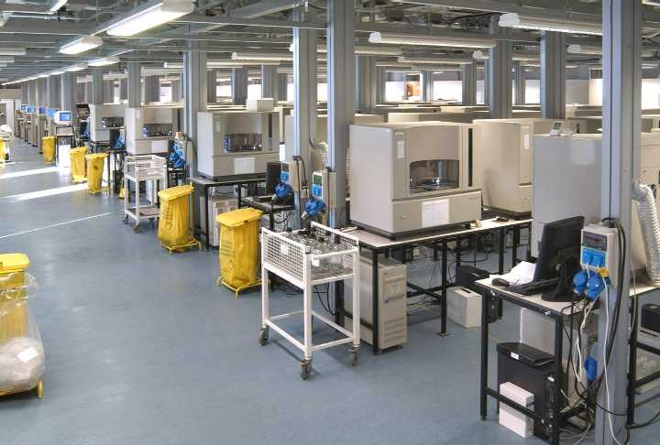
Producing DNA Sequence
Notes:
Unlike the Hollywood movies we can’t create huge chucks of DNA in seconds.
Small fragments of DNA are taken from a genome and broken into smaller pieces.
The smaller pieces are grown inside E. coli which replicate and produce many more copies.
After many steps and many people the fragments end up on these machines.
Perl is used in the labs to collect the data and control the work flow.

Slide 4
DNA
1 tcctggcatc agttactgtg ttgactcact cagtgttggg atcactcact ttccccctac
61 aggactcaga tctgggaggc aattaccttc ggagaaaaac gaataggaaa aactgaagtg
121 ttactttttt taaagctgct gaagtttgtt ggtttctcat tgtttttaag cctactggag
181 caataaagtt tgaagaactt ttaccaggtt ttttttatcg ctgccttgat atacactttt
241 caaaatgctt tggtgggaag aagtagagga ctgttatgaa agagaagatg ttcaaaagaa
301 aacattcaca aaatgggtaa atgcacaatt ttctaagttt gggaagcagc atattgagaa
361 cctcttcagt gacctacagg atgggaggcg cctcctagac ctcctcgaag gcctgacagg
421 gcaaaaactg ccaaaagaaa aaggatccac aagagttcat gccctgaaca atgtcaacaa
481 ggcactgcgg gttttgcaga acaataatgt tgatttagtg aatattggaa gtactgacat
541 cgtagatgga aatcataaac tgactcttgg tttgatttgg aatataatcc tccactggca
Notes:
Now we have lots of tiny bits of DNA everything is done in a computer, no lab work.
The tiny fragments are accessed for quality and prepare for “assembly” using Perl.
The fragments are joined together in a giant linear jigsaw.

Slide 5
Perl is the Infrastructure
The software the people in the labs use is all written in Perl Tk or Perl CGI.
All background processes and glue is written in Perl taking to a single Oracle DB.
The fragments of DNA from the machines are cleaned and organised by Perl.
From then on its all virtual…
Notes:
The lab scientists get there work from Perl/Tk applications and enter the data from their experiments.
Managers track work through the pipeline and control it.
Data on and off the sequencing machines is handled by Perl
Once we have a rough draft of the sequence we can predict where the genes are, compare to other sequences, find interesting stuff automatically. Yipp, Perl controls it.

Slide 6
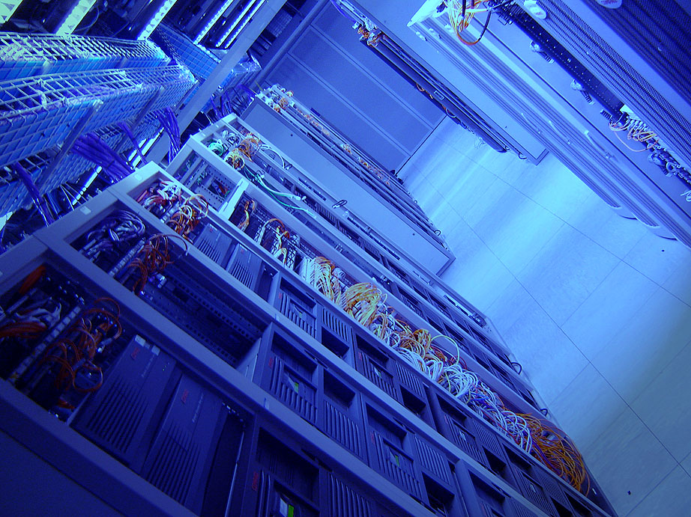
Processing the Sequence
Notes:
Stupid picture on its side :)
Doing auto gene predictions and searching against databases for known similar sequences takes a lot of horse power. Luckily it is embarrassing parallel as it can be broken up into smaller tasks so we can have lots of machines in racks to chug away.

Slide 7
An explosion in genomic information
1997
2005
72 million bases of DNA
Two genomes had been finished
Data on 1000 CDs
20,00 web hits
1000Mb download each week
Almost 3000 million bases
More than 50 genomes finished
Data on 440,000 CDs
5,000,000 web hits
130,000 each week
Notes:
A rapid increase in sequencing required software developed quickly… Perl.

Slide 8
Perl Based Projects
www.bioperl.org - on CPAN
www.EnsEML.org - has its own public CVS
www.gmod.org - on sourceforge
Other languages are used (Java, C) but Perl is the
language you learn first. Scientists can learn a
little and do a lot with their data.
Notes:
Perl is the language of choice for scientists as they can do a lot with only a small amount of knowledge.
These scientists have created several major projects in Perl that are in very active use around the world.
Bioperl : on CPAN, very active.
EnsEMBL is the easy way to get hold of Human DNA. It also controls a lot of ‘back end’ stuff, like predicting where the genes are etc
GMOD: Confederation of smaller projects nearly all Perl based.

Slide 9
Pathogens
Strains of Bird Flu virus H5N1 to be sequenced at Sanger, pipeline all Perl
Malaria parasite and its friends being analyzed with Perl, results displayed using Perl
MRSA sequenced (Staphylococcus aureus MRSA476)
Notes:
I currently work in the Pathogens dept.
A pathogen is a “nasty” like bacteria or virus that can make you ill.
We also do yeast as a model organism which is incredibly useful for understanding genetics.

Slide 10
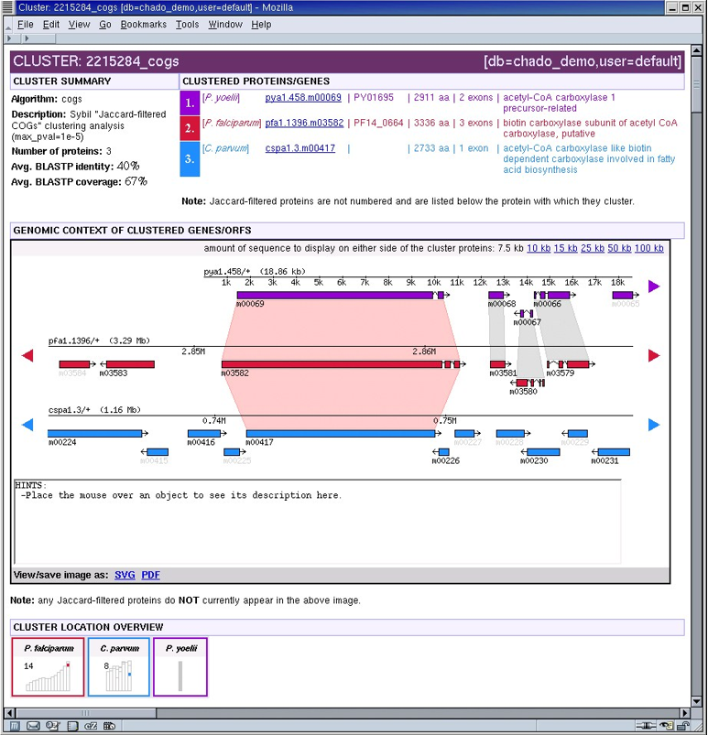
Comparitive Genomics
Notes:
Comparison genomics is the next big thing.
This web page is produced by Perl and the data prepared before hand by Perl to show how similar genes look in related organisms.
If you know what one does you can transfer that knowledge.

Slide 11
Summary
Perl used extensively in bioinformatics
Scientists learn it because it gets the job done with minimum effort, many resources to draw upon
Java has made some inroads but nothing out there to replace it
Notes:
Perl was the first choice for bioinformatics and will be for some time to come.

