Slide 1


Introduction to R and RStudio
Session 2: Projectsa

Slide 2
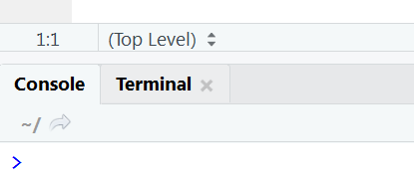
Working Directory
If you tell R to look for a file, or save a plot, it will (by default) look in a place called the working directory (wd).
You can (usually) see your wd path at the top of the console panel
…but right now it’s probably defaulted to “Documents” or similar.

Slide 3
Organisation
Sooner or later (but probably sooner) you will wish to change where files are saved (and loaded from).
Being organised is key:
Reduces cognitive load (and frustration).

Slide 4
RStudio Projects
make it far easier for you to:
Organise files and workflow
Switch between projects
Share scripts / projects with others
(when collaborating or getting assistance)
Recommended for all tasks (large or small).

Slide 5
Create a project
File → New Project → New Directory → New Project
Name the directory “workshop-r”
Create as a subdirectory somewhere useful for you
Create project!

Slide 6
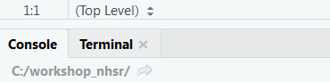
RStudio Projects
Now your working directory is your project directory:
R will save and load files from here (by default).
If starting another project, repeat this process.

Slide 7
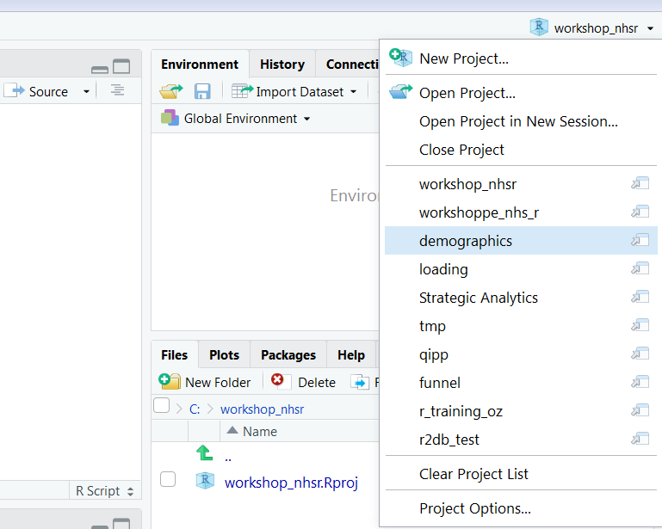
RStudio Projects
Switching between projects is simple

Slide 8
This material was created for the NHS-R community by:
Andrew Jones @The Strategy Unit
The work is licenced under:
Creative Commons
Attribution-ShareAlike 4.0
International
To view a copy of this license, visit
https://creativecommons.org/licenses/by-sa/4.0/

Slide 9
End

Slide 10
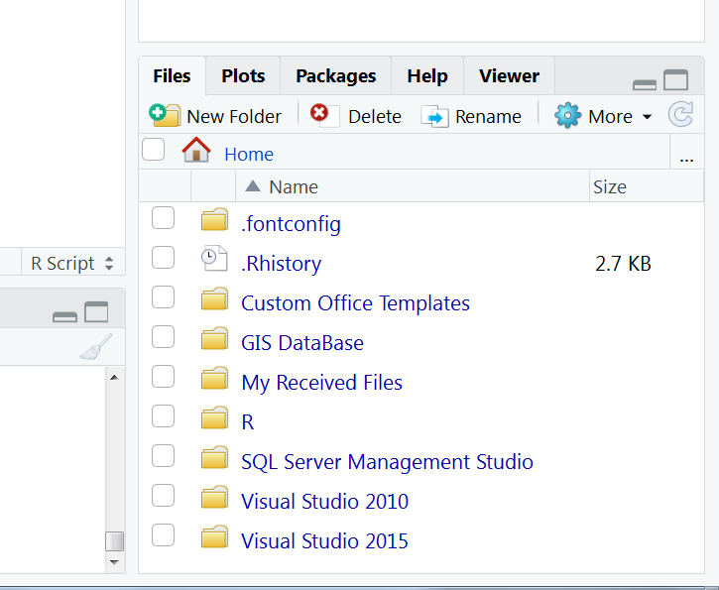
Addendum: Browsing in RStudio
Click here […] if you wish to browse further
Click this button to see contents of the current wd
in the files tab

