Slide 1
Session 8: R Markdown
NHS-R Community

Slide 2
What is R Markdown?
R Markdown allows you to combine:
Code
Results
Prose
in a fully reproducible document.
Supports Word, PDF, Slide outputs

Slide 3
Why use R Markdown?
To communicate to decision makers.
To collaborate with other analysts.
To capture what you were thinking as well as what you did.

Slide 4
When use R Markdown?
As a rough guide:
When more code than text: R script
When more text than code: R Markdown

Slide 5
Overview
Metadata (heading)
Text
Code (R, SQL, Python …)

Slide 6
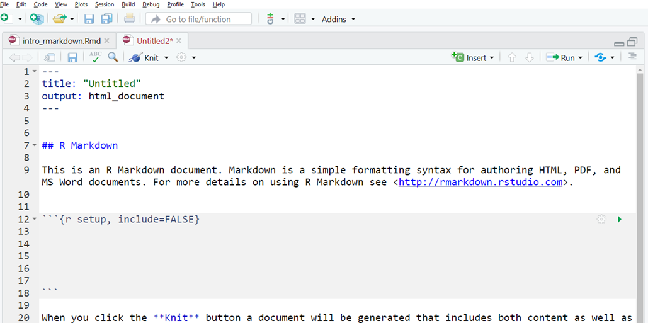
It looks like this:

Slide 7
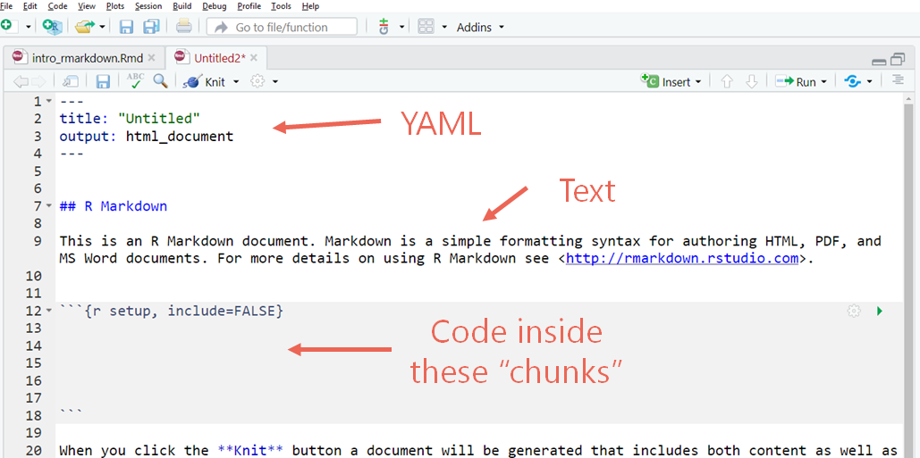
It looks like this:

Slide 8
YAML (Metadata or header)
Controls document settings
Not important for now.
Title, author, date

Slide 9
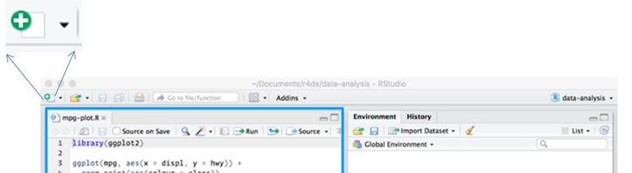
Start a new R Markdown document (or R Notebook) | …but…

Slide 10
Please open the tutorial:
intro_rmarkdown.rmd

Slide 11
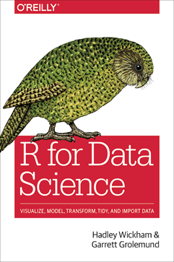
More in your new bible | http://r4ds.had.co.nz

Slide 12
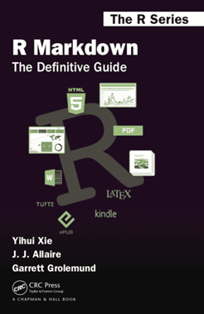
Even more in the R Markdown book | http://bookdown.org/yihui/rmarkdown

Slide 13
Licence
This material was created for the NHS-R community by: Andrew Jones at The Strategy Unit
The work is licenced under: Creative Commons Attribution-ShareAlike 4.0 International
To view a copy of this license, visit https://creativecommons.org/licenses/by-sa/4.0/

