Slide 1
Garden science Sounds, sensors, and network
Ed Baker
Acoustic Biology Researcher Natural History Museum, London

Slide 2
The Museum’s approach
BIOACOUSTICS
ECOACOUSTICS
Single species
Ecosystems
Single microphone devices
Connected sensor networks
Soundscape collections
Curated reference sound collections
Statistical analyses
Machine Learning
Species descriptions
Behavioural studies

Slide 3
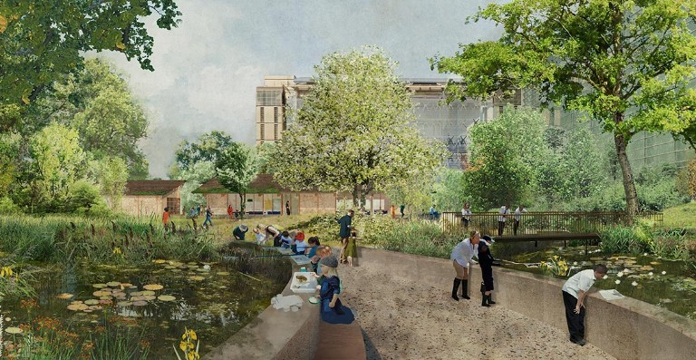
A Living Laboratory
Our gardens are a hub for urban nature identification and field survey skills

Slide 4
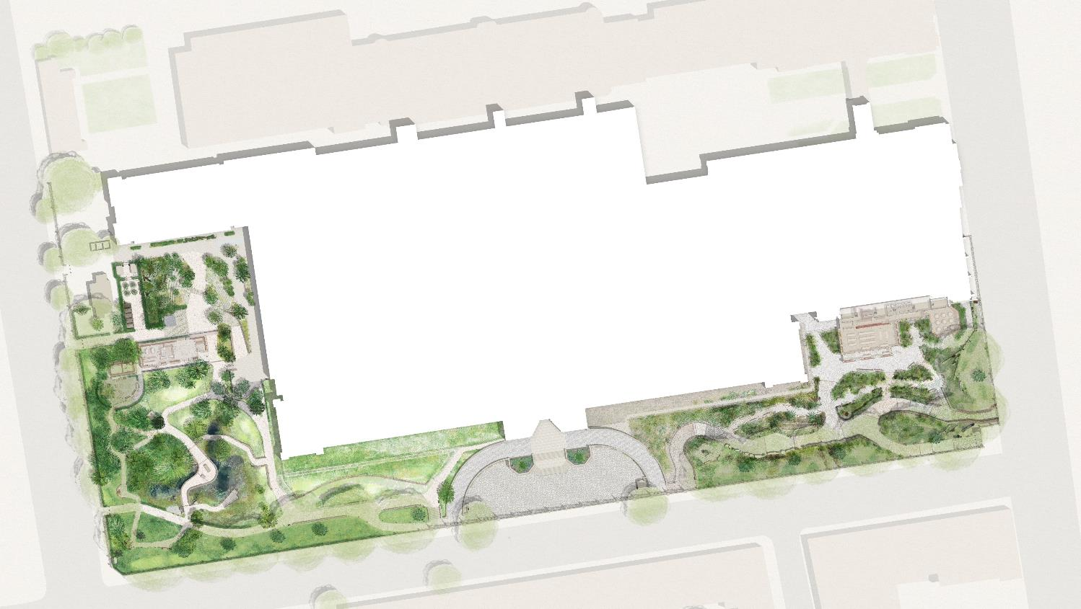
A Living Laboratory
Power-over-Ethernet locations
Long-term (intense, untargeted) monitoring plus detailed case studies of how habitat translocation, creation and restoration actions impact biodiversity
Over-specified (plenty of excess compute, transfer) – capacity to double number of devices. Testing arena for more targeted, less power hungry devices.
Background data:
One of the most intensively studied urban sites for 25 years

Slide 5
Acoustics and environmental sensors in the Urban Nature Project
Comprehensive survey of acoustic environments of the site
Airborne; freshwater; soil; timber
Nocturnal migration (roof)
First year: complete dataset
Look at sampling in some subsequent years
Some ultrasound, some arrays
Environmental sensors
Temperature
Humidity
Light levels

Slide 6
Research Agenda
Comprehensive baseline at the opening of grounds
Prior work before and during lockdowns
Sound in urban environments
Effects on wildlife
Effects on methods
Noise transfer between environments
Noise mitigation vs biodiversity gain
Some species-related work (with AI Team)
Focus on collection strengths (e.g. European Orthoptera)
Focus on hard groups with institutional knowledge (e.g. pollinators; mosquitoes) – from library creation

Slide 7
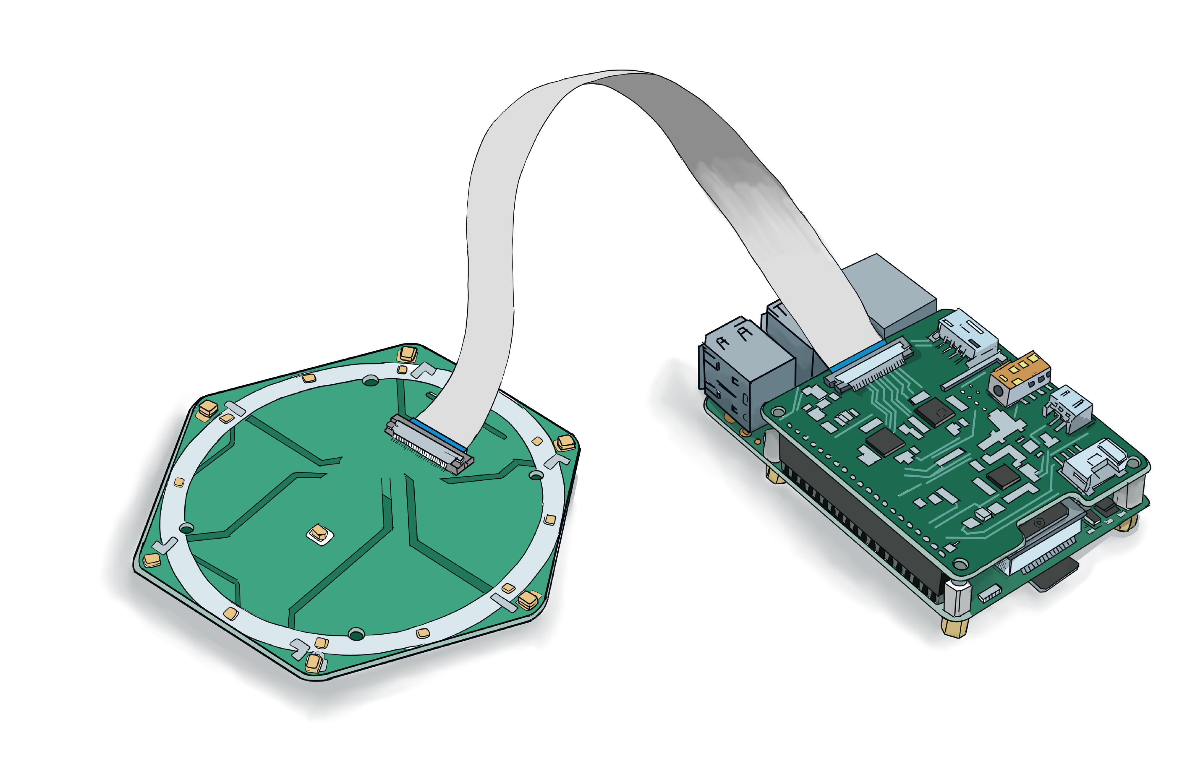
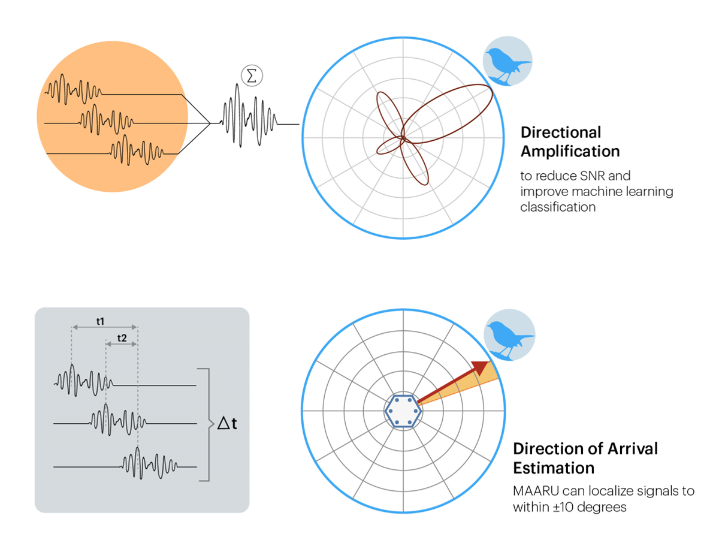
Microphone arrays

Slide 8
Outstanding questions
More directed strategy (e.g. transect) within broad overall strategy?
Research questions for environmental sensors (heat islands? Urban thermal complexity?)
Photo/video

