Slide 1
Sounds, sensors, specimens
Ed Baker
Acoustic Biology Researcher Natural History Museum, London

Slide 2
The Museum’s approach to sound
BIOACOUSTICS
ECOACOUSTICS
Single species
Ecosystems
Single microphone devices
Connected sensor networks
Soundscape collections
Curated reference sound collections
Statistical analyses
Machine Learning
Species descriptions
Behavioural studies

Slide 3
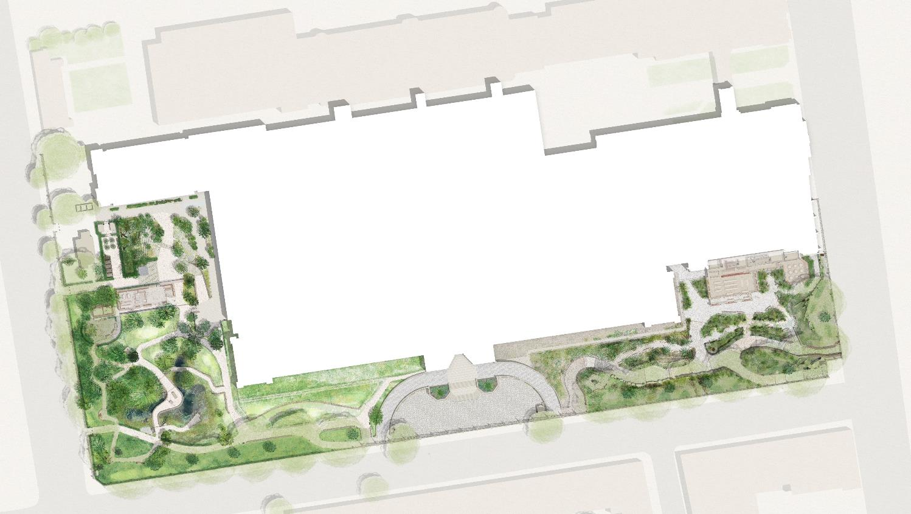
A Living Laboratory
Power-over-Ethernet locations
Long-term (intense, untargeted) monitoring plus detailed case studies of how habitat translocation, creation and restoration actions impact biodiversity
Over-specified (plenty of excess compute, transfer) – capacity to double number of devices. Testing arena for more targeted, less power-hungry devices.
Background data:
One of the most intensively studied urban sites for 25 years

Slide 4
Acoustics and environmental sensors in the Urban Nature Project
Comprehensive survey of acoustic environments of the site
Airborne; freshwater; soil; timber
Nocturnal migration (roof)
First year: complete dataset
Look at sampling in some subsequent years
Some ultrasound, some arrays
Environmental sensors
Temperature
Humidity
Light levels

Slide 5
Acoustics and environmental sensors in the Urban Nature Project
Comprehensive survey of acoustic environments of the site
Airborne; freshwater; soil; timber
Nocturnal migration (roof)
First year: complete dataset
Look at sampling in some subsequent years
Some ultrasound, some arrays
Environmental sensors
Temperature
Humidity
Light levels
Provides a large dataset to inform how we expand these monitoring techniques

Slide 6
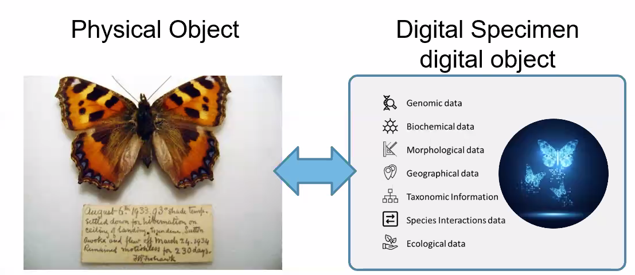
Why NHM? – Extended Specimen Concept
Credit DiSSCo

Slide 7
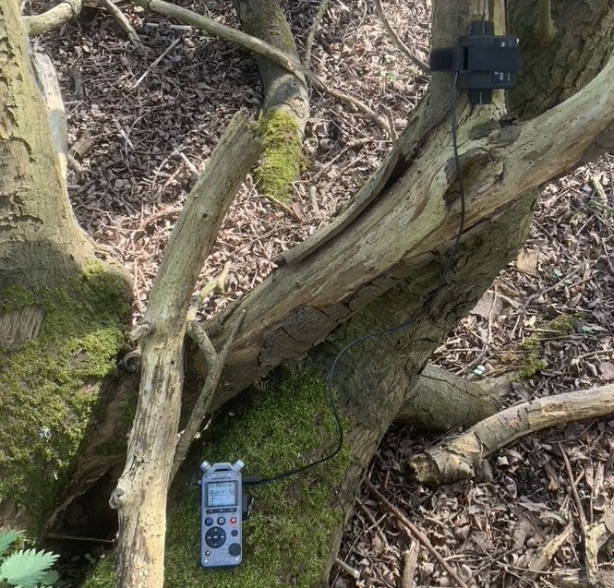
Why NHM? - borne-digital vs born-digital

Slide 8
Why NHM? - borne-digital vs born-digital
What is the preservable unit?

