Slide 1
Lipid-lator Code Architecture
By: Team Triple J³
Jessica Sok, Joseph Tsegaye, Jose Moreno

Slide 2
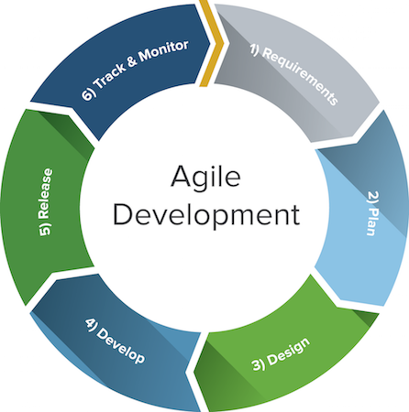


Justification & rationale
Platform → Android Studio
Language → Java
Framework → Agile

Slide 3



Justification & rationale
Code Management → GitHub
Issue tracking → JIRA
Storage Control → SQLite
Notes:
Github = web-based Git or version control repository and Internet hosting service
Agile software development describes a set of values and principles which requirements and solutions evolve through the collaborative effort of self-organizing cross-functional teams.^{[1]} It advocates adaptive planning, evolutionary development, early delivery, and continuous improvement, and it encourages rapid and flexible response to change.
SQL database engine

Slide 4
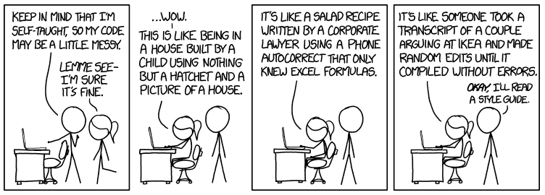
Coding Style
DOCUMENTATION!

Slide 5


Lipid-lator different components
Lipid-lator
Notes:
HomePage → (Selection → ←Database) → Calculation Screen

Slide 6
Lipid-lator different components
Lipid-lator
Home Screen
Selection Screen
Calculation
Screen
Notes:
HomePage → (Selection → ←Database) → Calculation Screen

Slide 7
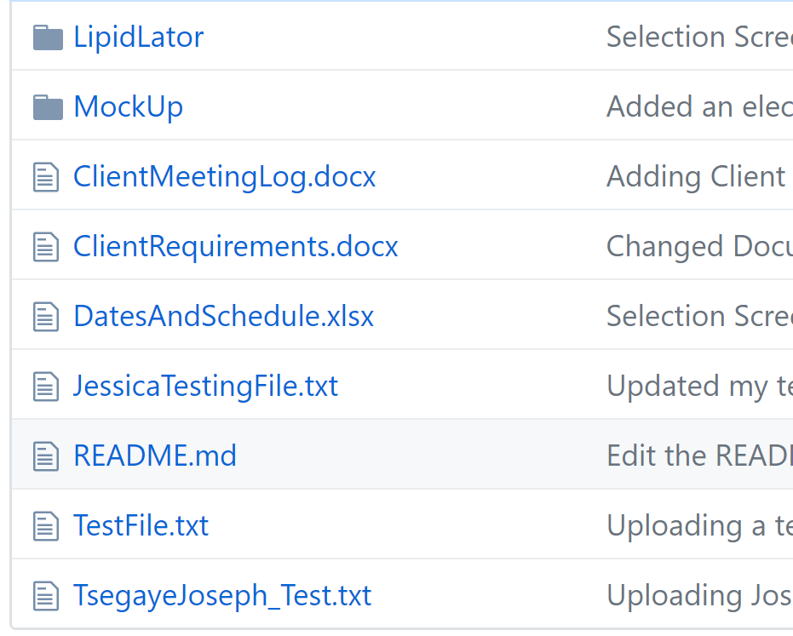
Folder structure
Main Folder
Design Folder
Additional Files:
Log Sheet
README
Etc.
Notes:
GitHub File Structure

Slide 8
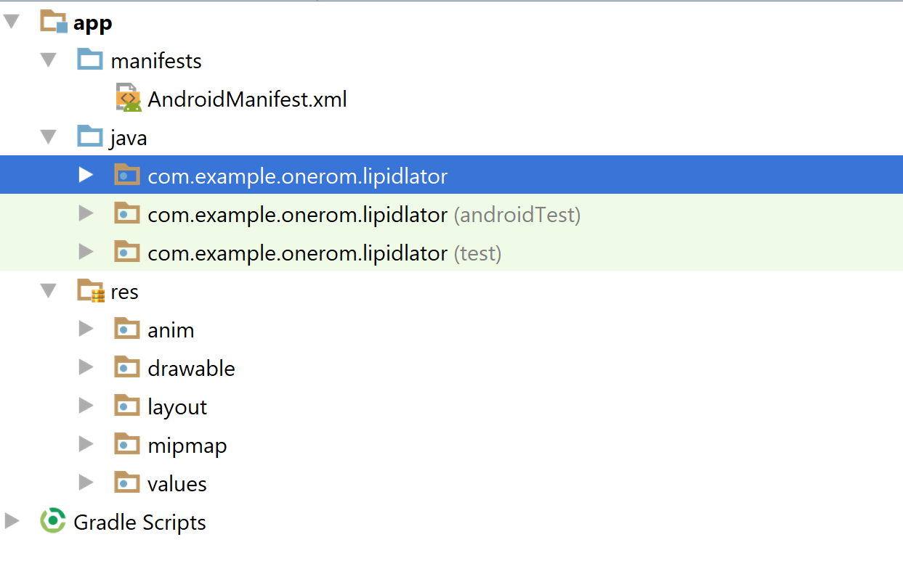
Major code components
Notes:
Android Studio In-depth Structure
BACK END CODE

Slide 9
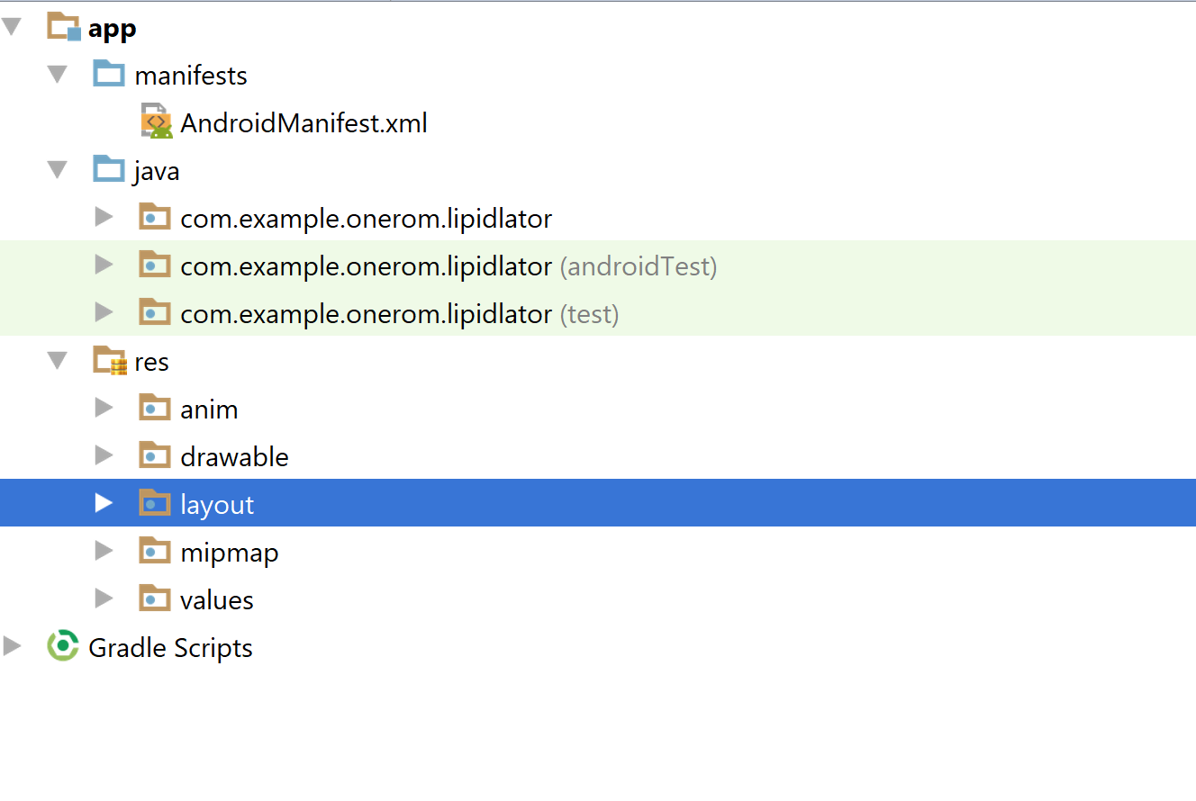
Major code components
Notes:
Android Studio In-depth Structure
FRONT END CODE

Slide 10
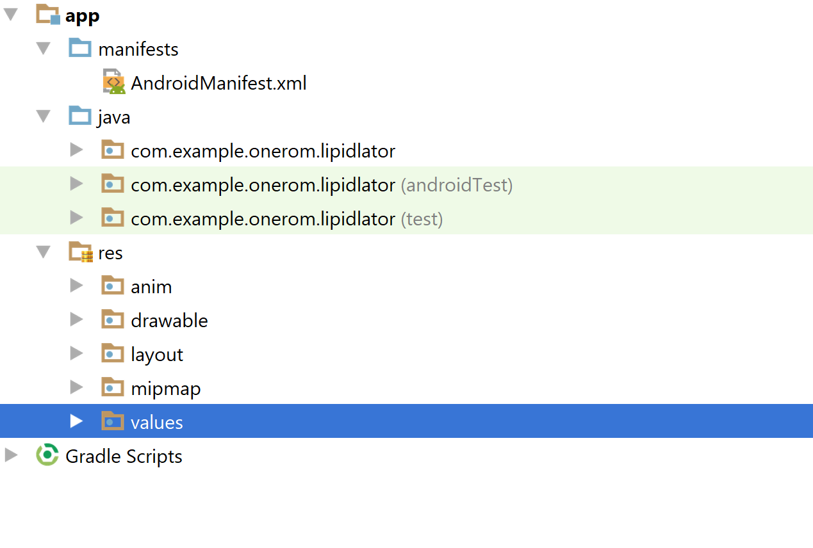
Major code components
Notes:
Android Studio In-depth Structure
STRINGS, ARRAYS, SIGNIFICANT VALUES

Slide 11
Recap
IDE choice?
Code style?
Any other relevant information?
Notes:
Candy Time!

