Slide 1
Testing: Lipid-Lator
By: Joseph Tsegaye

Slide 2
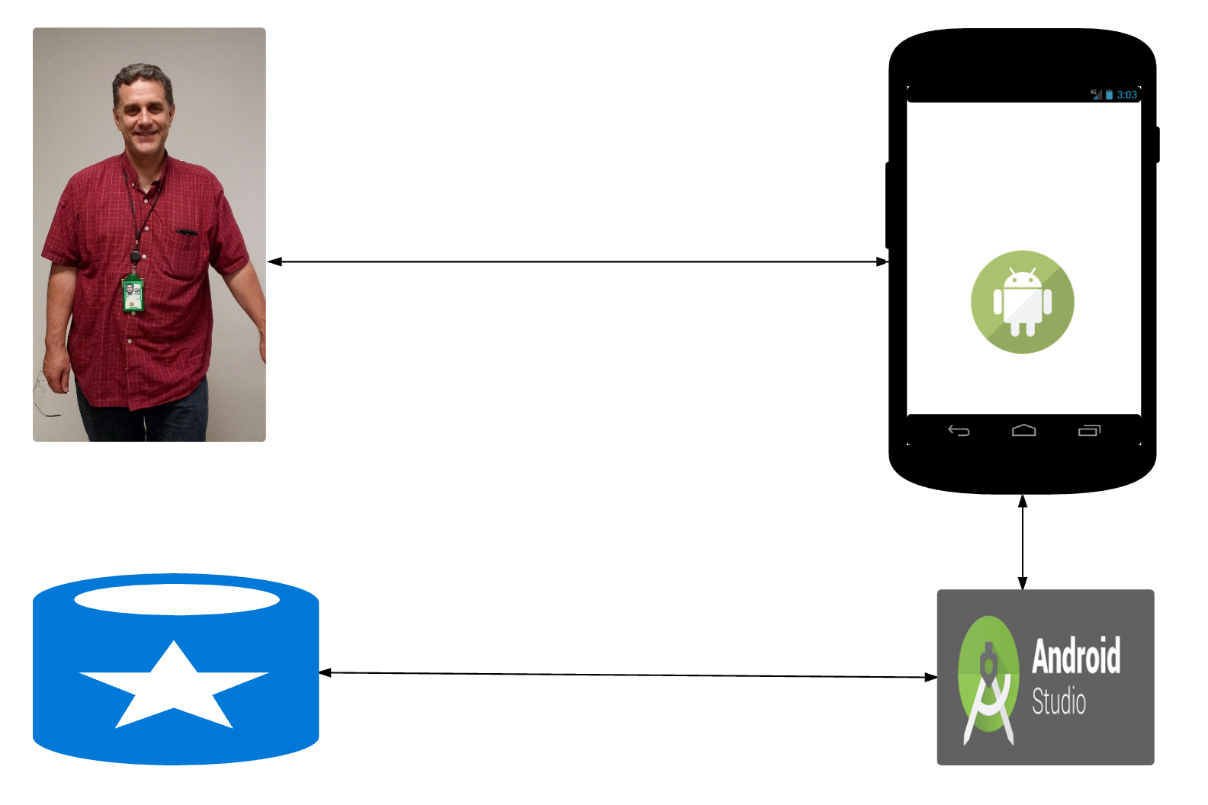
Lipid-lator Structure
LIPID-LATOR
Dr. Jon Rees
Built-in Database
IDE

Slide 3
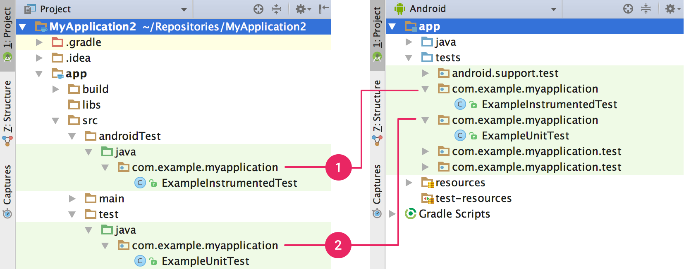


Framework & Starting Point

Slide 4
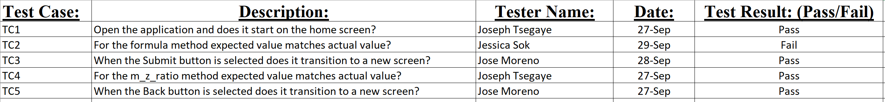
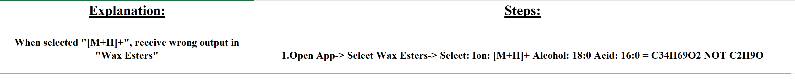
Test Scripts?
Notes:
Professional Standard of Running Tests
Early detection of failures in the development cycle.
Faster to Find Bugs
Easier to Replicate the Bugs

Slide 5
Plan of Action:
Documentation
1
Control
Testing Sessions
2
Replicate Failures
3
Understand the Bugs
4
Sophisticated Application
5

Slide 6
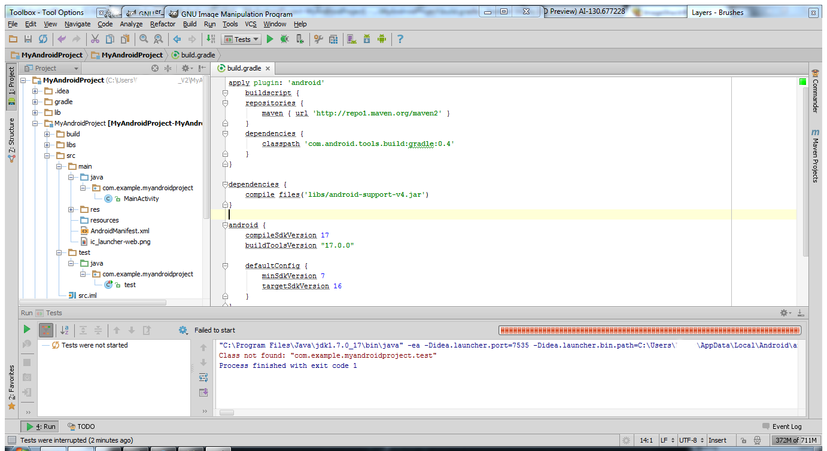
Unit Testing
White Box Testing:
Testing the functionality of the application through its source code.

Slide 7
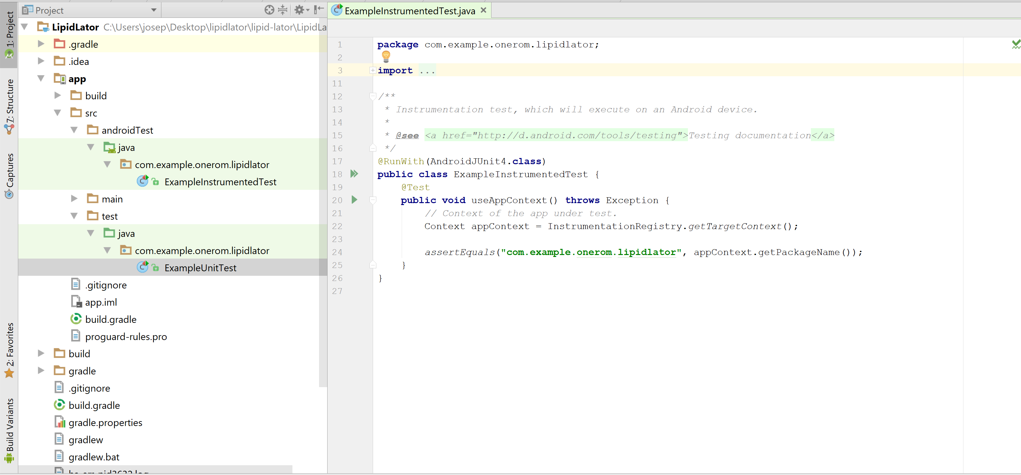
Unit Testing

Slide 8
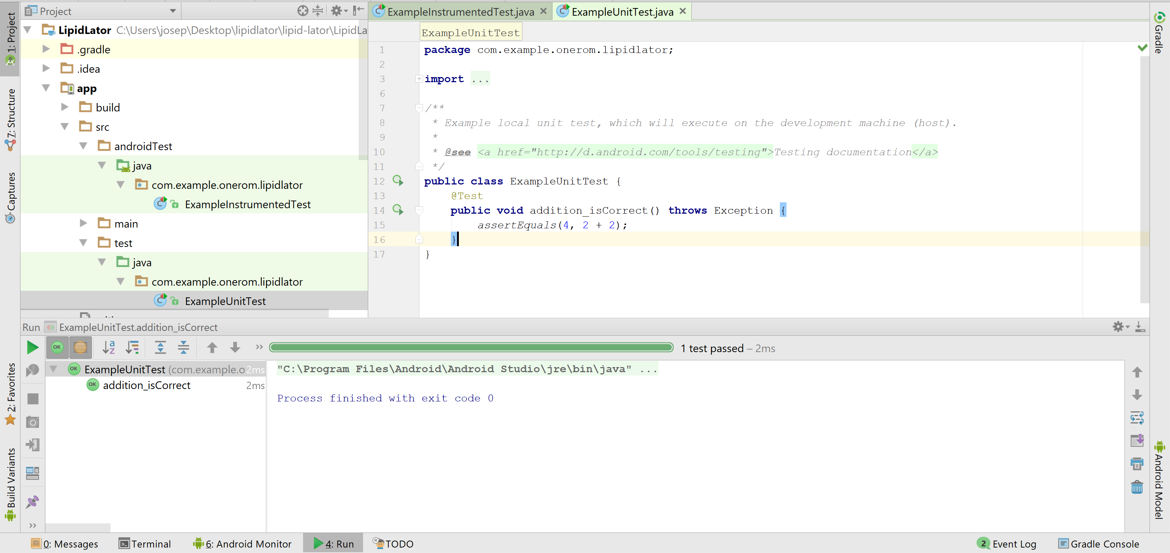

Slide 9
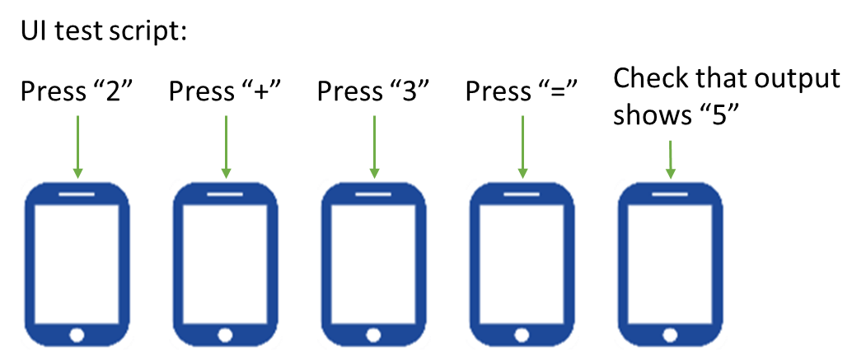

System Testing
Black Box Testing

Slide 10
Usability Testing:
Testing Session will consists of:
- 3 Different Technical Users
Testing session will be controlled
User Feedback will be collected by a survey
- 3 Different Non-Technical Users
Notes:
3 Different Non-technical users

Slide 11
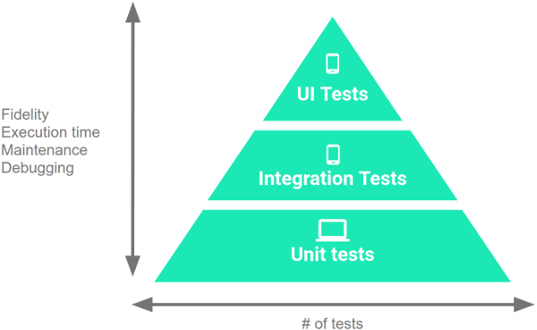
Testing Review:
Our Unit Test will confirm the major components of the application.
The Integration test will run on emulators or real devices to verify the application functionality is working together.
The UI Test will assure the team that the application is working as expected for the end-user!
Notes:
Also insure the quality and all requirements are upheld!

Slide 12
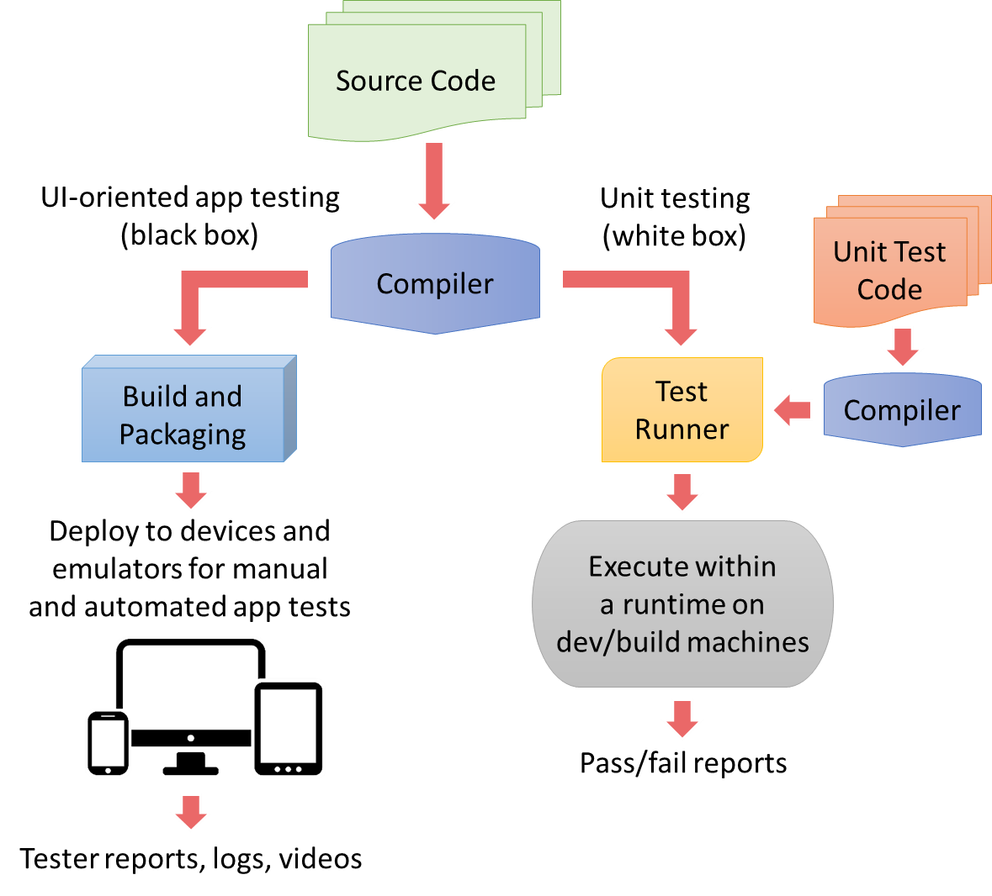
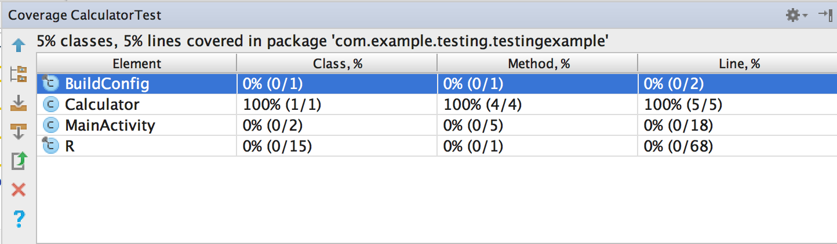
Notes:
RECAP of Testing Scenario!

Slide 13
Usability & Acceptance Testing Sessions
Unit Testing Sessions: (Nov. 3)
Does the application’s results matches the actual results?
System Testing Sessions: (Nov.11)
Record non-technical users feedback.
Record technical users feedback.
Client Testing: (Nov. 17)
Did the application meet or exceeds expectation?
Did the application fulfill all the user’s requirements?
CREATE Testing: (Nov. 23)
Is the application ready for the public to view?

Slide 14
Test Plan
Unit Testing Complete
Among all team members
Nov. 18
System Testing Complete
Among all members and non-technical users
Nov. 22
Client Acceptance Testing Complete
Nov. 25
CREATE Usability Testing Complete
Nov. 11

