Slide 1
Lipid-lator
Team Triple J
Jessica Sok, Jose Moreno, Joseph Tsegaye

Slide 2
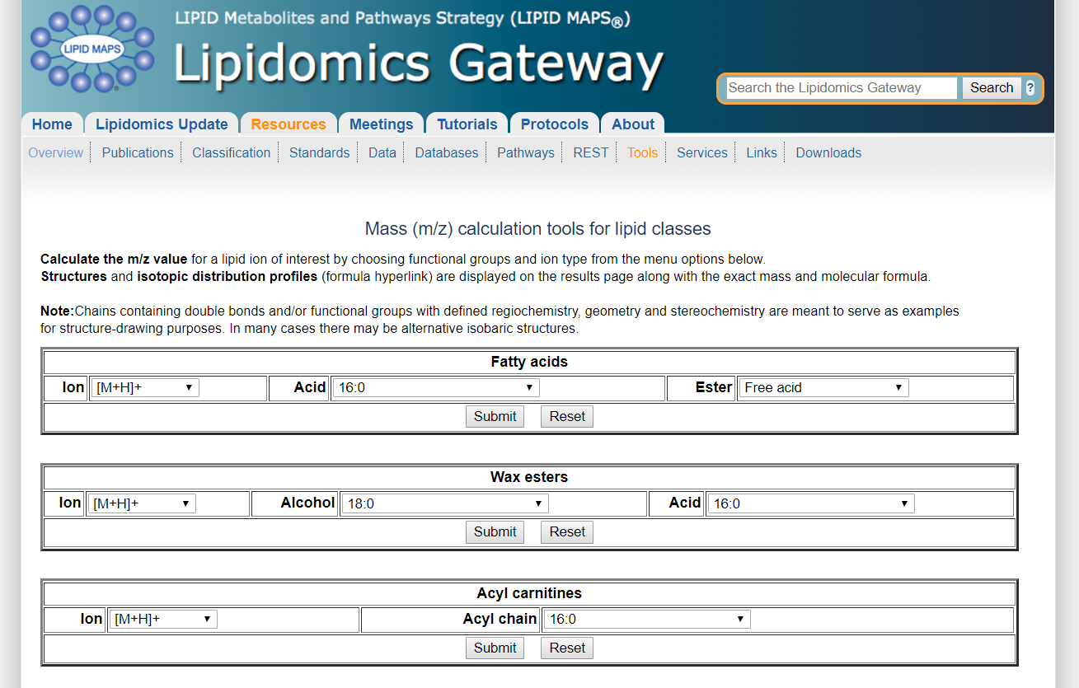
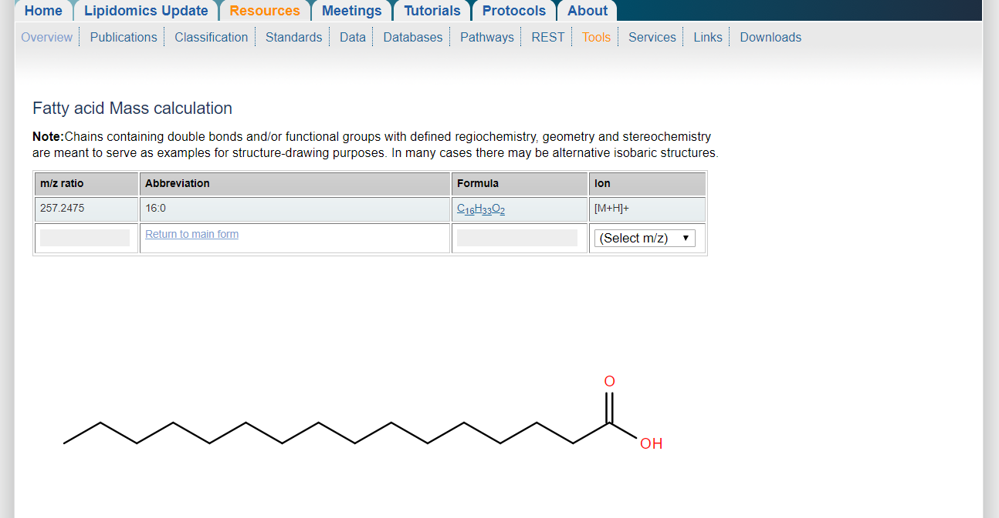
Client and Vision
Dr. Jon Rees
Part-Time Chemistry Professor at GGC
A smartphone application with an embedded database to be able to perform various calculations in order to facilitate his work.

Slide 3



Slide 4


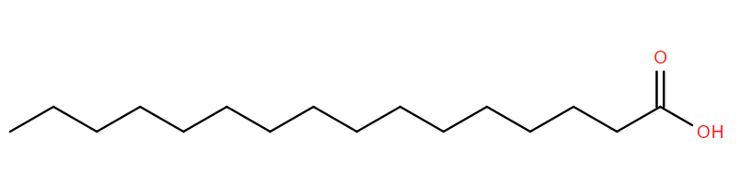
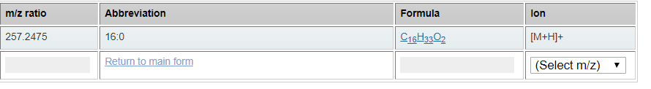
Requirements
Android Application
Embedded Database to work offline
Ease of use
Accurate information to mimic site
Backward compatibility
Images
All results present

Slide 5


What we will be using
Platform: Android Devices
Languages Used: Java, SQLite
Framework: Android Studio
Team Skills: Java Programming, Database Management, Graphic Design

Slide 6
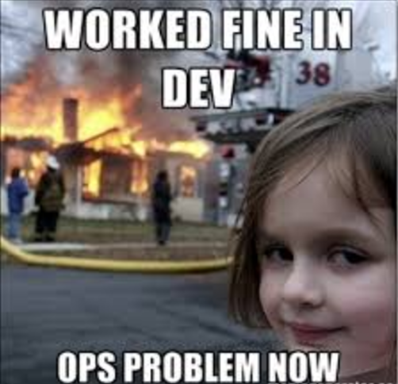
Timeline
Sprint 1
Week 1: Focusing a lot on the Database and flow of how things will go from screen to screen
Week 2: Final touches on the flow and database creation
Week 3: Begin to create the calculations needed to acquire desired results for at least 1 of the classes
Week 4: Test, Test, Test and Present

Slide 7
User story Example
As a: User
I need: to be able to calculate my solution
Because: I need it in my day to day tasks.
Subtask: Create a application which will facilitate this.
As a: User
I need: to be able to navigate easily throughout the app
Because: I need my results quickly and easy to read.
Subtask: Create a nice UI for the user to use and navigate through.

Slide 8
Ultimate semester long goals
Have a functioning app
Accurate calculations
Continue to develop to perfection (adding images, look appealing, deploy into play store)

Slide 9
Thank you for your time!

