Slide 1
Lipid-lator
By: Team Triple J³
Jessica Sok, Joseph Tsegaye, Jose Moreno

Slide 2
UI DESIGN/UX

Slide 3
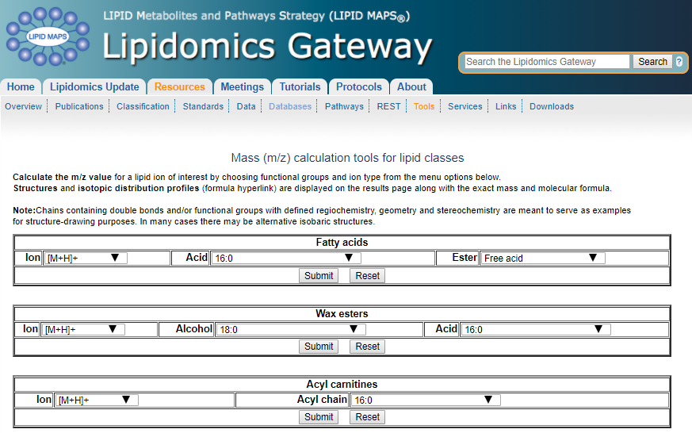
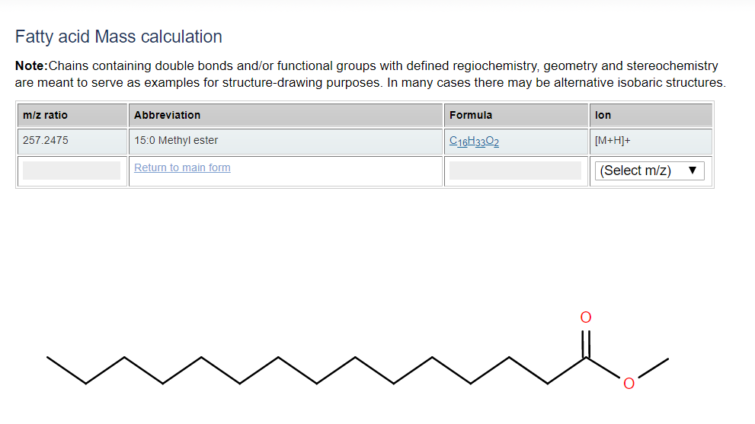
Existing Interface
Notes:
Lipids or “Fats”
Web interface existing

Slide 4
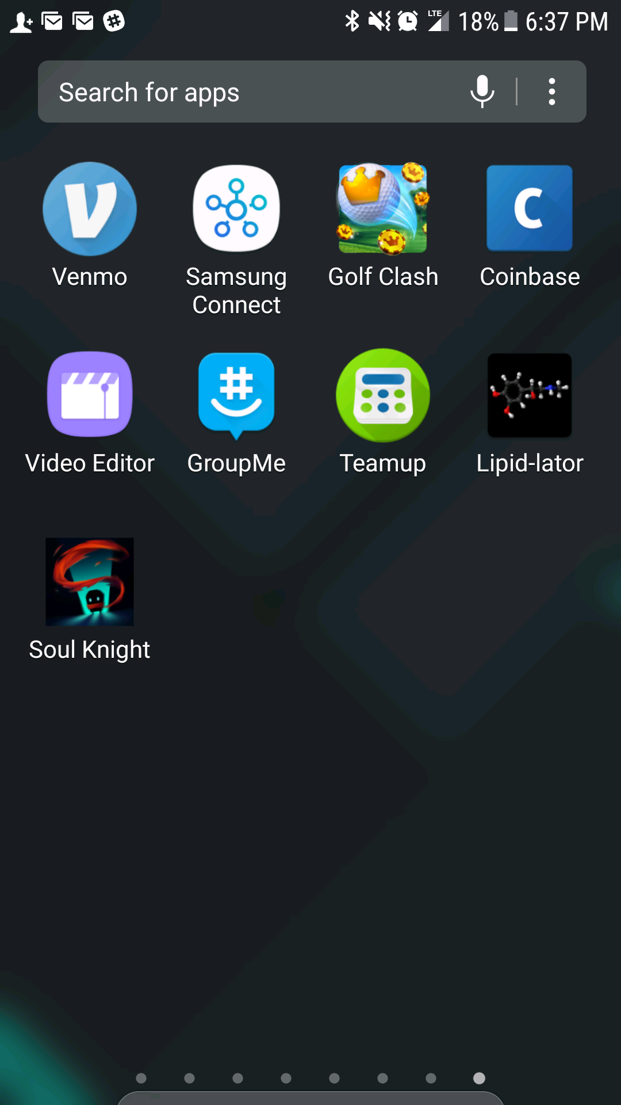
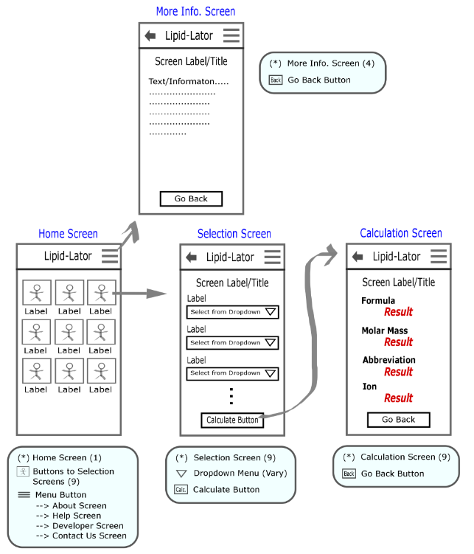
New Design
Android application
Multiple Screens
Buttons
Notes:
* Web interface → Android application

Slide 5
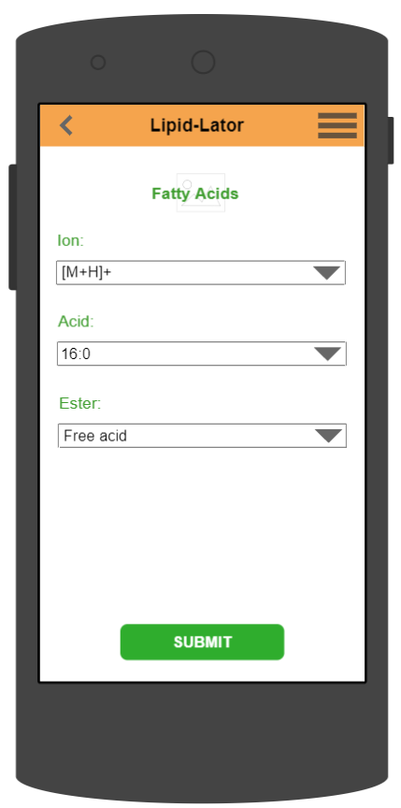
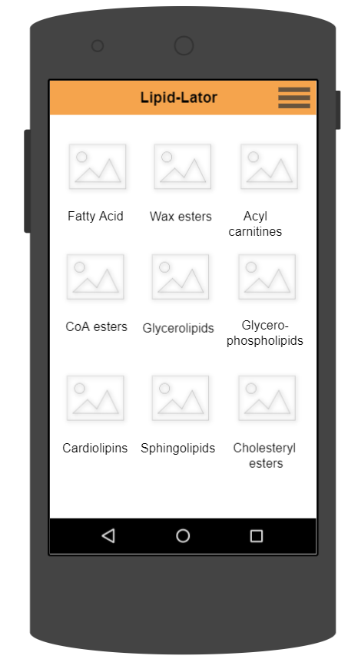
User Interface/user experience
User Interface:
Home Screen
Selection Screen
Calculation Screen
Menu Button
Color Coded, Images
User Experience
1 Click on Home Screen
Dropdown menu
Submit button
Back button
Home
Selection
Notes:
Our graphical representation/mock up
* Each picture and screen has a colored theme

Slide 6
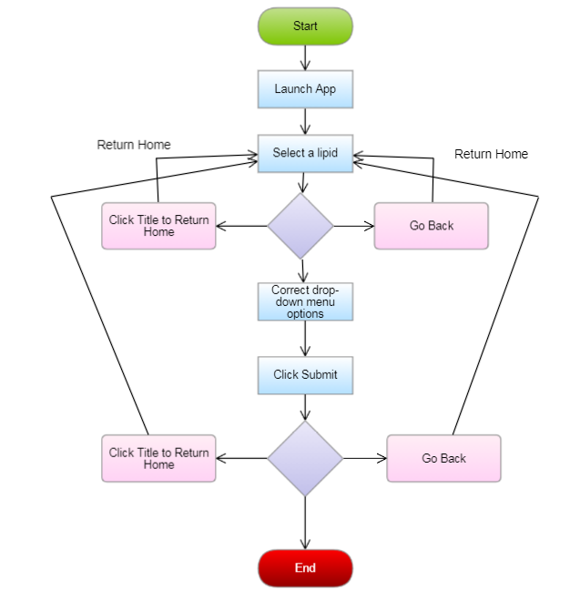
Activity Diagram

Slide 7
Principles of Organization
Follow the mock-up skeleton structure
Use default button
Use drop down menus (spinners)
Use text views for texts and labels
For now, theme the screens in black and white

Slide 8
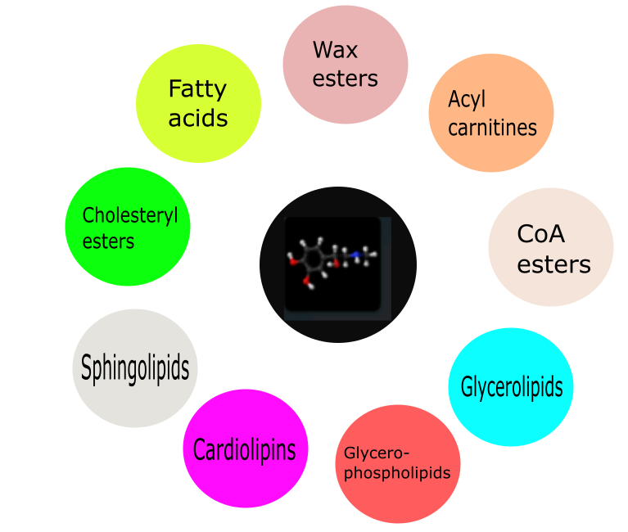
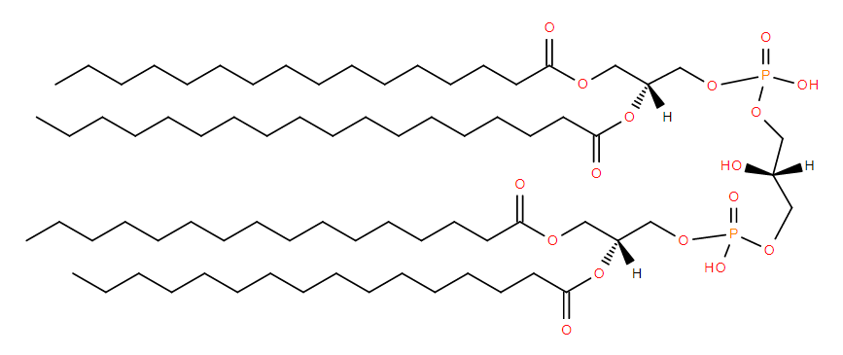
Future Direction
Customizing each lipid icon
Customized background
Adding molecular structure to result screen
Circle launcher for home screen

Slide 9
Questions?

Slide 10
THANK YOU! - Team triple j³ ^{Project: Lipid-Lator}

